Slide 1
A new grouping genetic algorithm for clustering problems
L.E. Agustı´n-Blas, S. Salcedo-Sanz, , S. Jiménez-Fernández,
L. Carro-Calvo, J. Del Ser,J.A. Portilla-Figueras
Department of Signal Theory and Communications, Universidad de Alcalá, Madrid, Spain
Expert Systems with Applications 39 (2012) 9695–9703
Presenter: 方鈞毅
Date: Feb. 25, 2013

Slide 2
Abstract
In this paper we present a novel grouping genetic algorithm for clustering problems. Though there have been different approaches that have analyzed the performance of several genetic and evolutionary algorithms in clustering, the grouping-based approach has not been, to our knowledge, tested in this problem yet.
In this paper we fully describe the grouping genetic algorithm for clustering, starting with the proposed encoding, different modiﬁcations of crossover and mutation operators, and also the description of a local search and an island model included in the algorithm, to improve the algorithm’s performance in the problem.

Slide 3
Abstract
We test the proposed grouping genetic algorithm in several experiments in synthetic and real data from public repositories, and compare its results with that of classical clustering approaches, such as K-means and DBSCAN algorithms, obtaining excellent results that conﬁrm the goodness of the proposed grouping-based methodology.

Slide 4
基因演算法流程
開始
亂數產生第0代群體
評估個體的適應值
產生第k代的群體
突變機制根據機率rm
終止條件
否
挑選機制
交配機制根據機率rc
是
結束

Slide 5
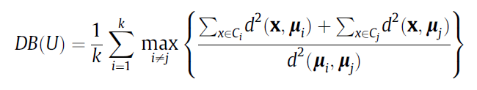
Clustering Evaluation
Davis–Bouldin Index (DB):minimize the intra-cluster distances, and at the same time, maximize the distances among the different clusters.
small values of the DB index correspond to compact and well separated clusters

Slide 6

Rand index (R):
Silhouette coefficient(S): where TP and FP are the number of correct and incorrect assignments, respectively, when the decision consists of assigning two elements to the same cluster, and TN and FN are the number of correct and incorrect assignments, respectively, when the decision consists of assigning two elements to different clusters. Note that R is in the interval [0, 1], and values of R closer to 1 indicate a better quality of the solution tested.

Slide 7
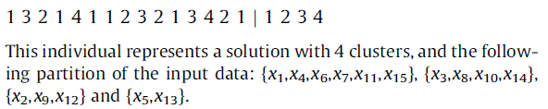
Encoding
把每個個體分成兩個部分，即element section 和 group section

Slide 8

挑選機制
Rank-based wheel selection mechanism
the individuals are sorted in a list based on their quality, the position of it in the list is called rank of the individual
A fitness function is defined
Example(具五個個體)則R1 = 5, R2=4,….R5=1
帶入上式可得{0.33,0.26,0.2,0.13,0.06}
則其roulette wheel 為
{0-0.33, 0.34-0.6, 0.61-0.8, 0.81-0.93, 0.94-1}.

Slide 9
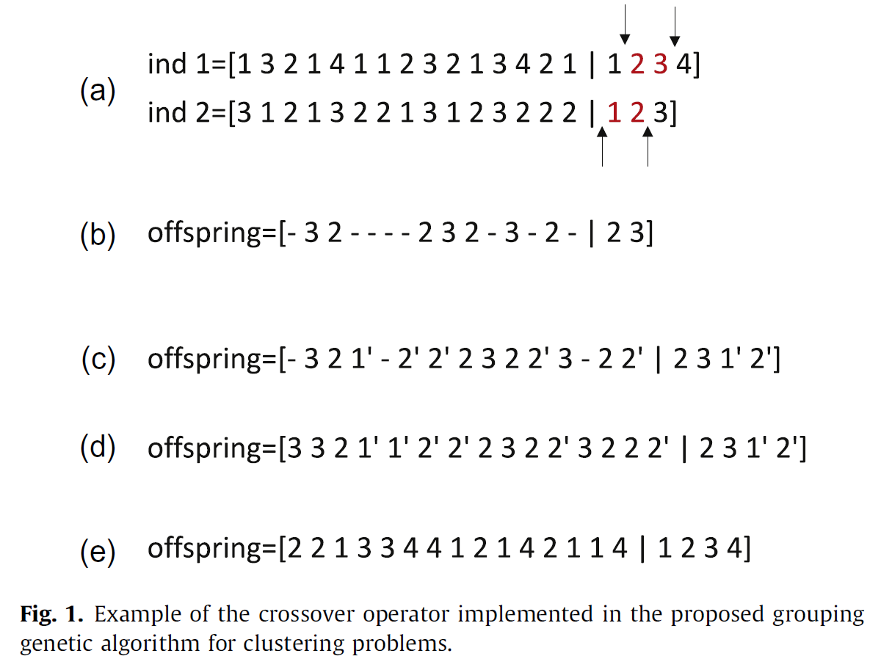
Crossover Operator

Slide 10
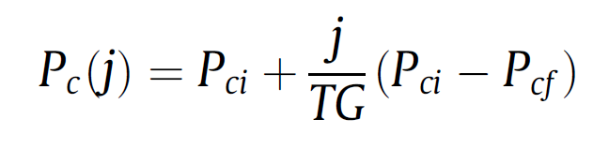
Crossover Probability
The probability of crossover must be high in the first stages of the algorithm, and moderate in the last ones in order to properly explore the search space.
in a given generation j,
TG stands for the total number of generations of the algorithm
Pci and Pcf are the initial and final values of probability

Slide 11
Mutation Operator
Mutation by cluster splitting: it consists of splitting a selected cluster into two different ones. one of the new generated clusters will keep its label in the group section of the individual, whereas the other will be assigned a new label (k + 1).
2 2 1 3 3 4 4 5 2 1 4 2 5 1 4 |1 2 3 4 5

Slide 12
Mutation Operator
Mutation by clusters merging: it consists of merging two existing clusters, randomly selected, into just one.
2 2 1 3 3 2 2 1 2 1 2 2 1 1 2 | 1 2 3

Slide 13
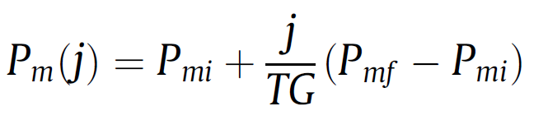
Probability of Mutation
probability of mutation is smaller in the first generations of the algorithm and larger in the last ones, in order to have more opportunities to scape from local minimums in the last stages of the evolution
TG - the total number of generations
Pmf and Pmi are the final and initial values of probability

Slide 14
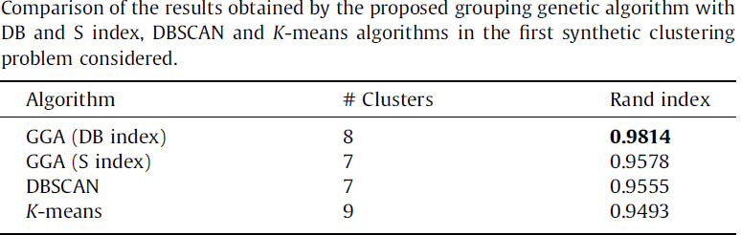
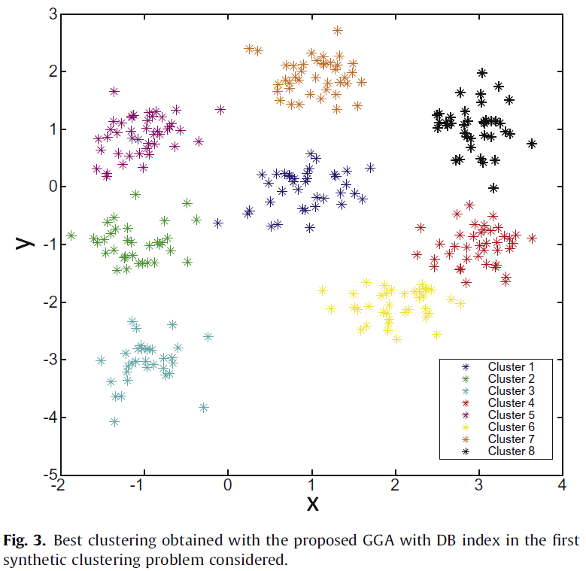
Experiments and results

Slide 15
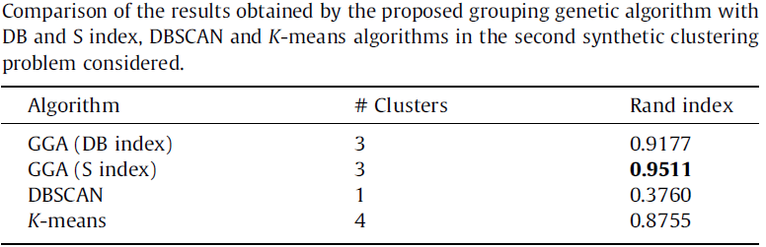
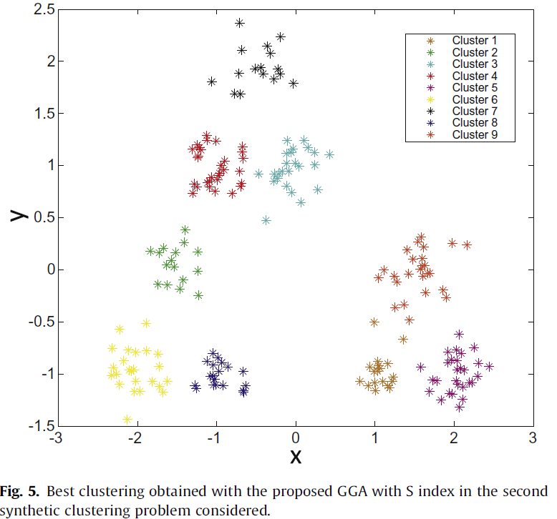

Slide 16
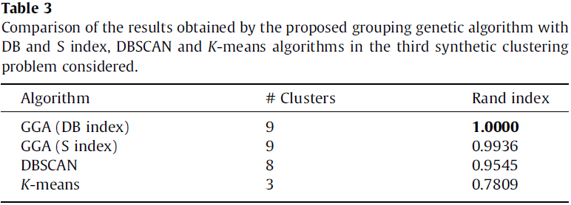
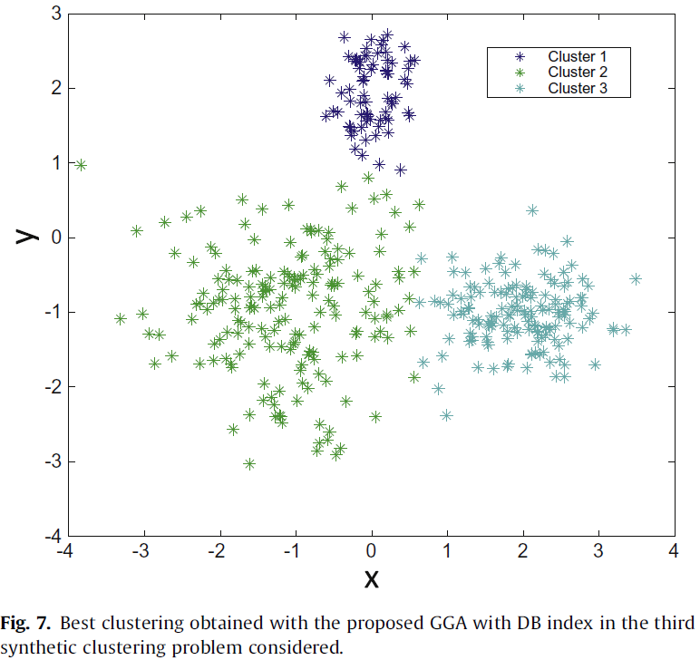

Slide 17
