Slide 1
A Fast Multiple Longest Common Subsequence (MLCS) Algorithm
Qingguo Wang, Dmitry Korkin, and Yi Shang
IEEE Transactions on Knowledge and Data Engineering, Vol. 23, No. 3, March 2011
Presenter: Che-Jui Hsu(許哲睿)
Date: 2013/2/25

Slide 2
Abstract (1/2)
Finding the longest common subsequence (LCS) of multiple strings is an NP-hard problem, with many applications in the areas of bioinformatics and computational genomics. Although significant efforts have been made to address the problem and its special cases, the increasing complexity and size of biological data require more efficient methods applicable to an arbitrary number of strings. In this paper, we present a new algorithm for the general case of multiple LCS (or MLCS) problem, i.e., finding an LCS of any number of strings, and its parallel realization. The algorithm is based on the dominant point approach and employs a fast divide-and-conquer technique to compute the dominant points.

Slide 3
Abstract (2/2)
When applied to a case of three strings, our algorithm demonstrates the same performance as the fastest existing MLCS algorithm designed for that specific case. When applied to more than three strings, our algorithm is significantly faster than the best existing sequential methods, reaching up to 2-3 orders of magnitude faster speed on large-size problems. Finally, we present an efficient parallel implementation of the algorithm. Evaluating the parallel algorithm on a benchmark set of both random and biological sequences reveals a near-linear speedup with respect to the sequential algorithm.

Slide 4
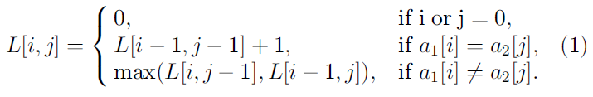
Dynamic Programming
 |  |  | 1 | 2 | 3 | 4 | 5 | 6 | 7 | 8 | 9 | 10
 |  |  | G | T | A | A | T | C | T | A | A | C
 |  | 0 | 0 | 0 | 0 | 0 | 0 | 0 | 0 | 0 | 0 | 0
1 | G | 0 | 1 | 1 | 1 | 1 | 1 | 1 | 1 | 1 | 1 | 1
2 | A | 0 | 1 | 1 | 2 | 2 | 2 | 2 | 2 | 2 | 2 | 2
3 | T | 0 | 1 | 2 | 2 | 2 | 3 | 3 | 3 | 3 | 3 | 3
4 | T | 0 | 1 | 2 | 2 | 2 | 3 | 3 | 4 | 4 | 4 | 4
5 | A | 0 | 1 | 2 | 3 | 3 | 3 | 3 | 4 | 5 | 5 | 5
6 | C | 0 | 1 | 2 | 3 | 3 | 3 | 4 | 4 | 5 | 5 | 6
7 | A | 0 | 1 | 2 | 3 | 4 | 4 | 4 | 4 | 5 | 6 | 6

Slide 5
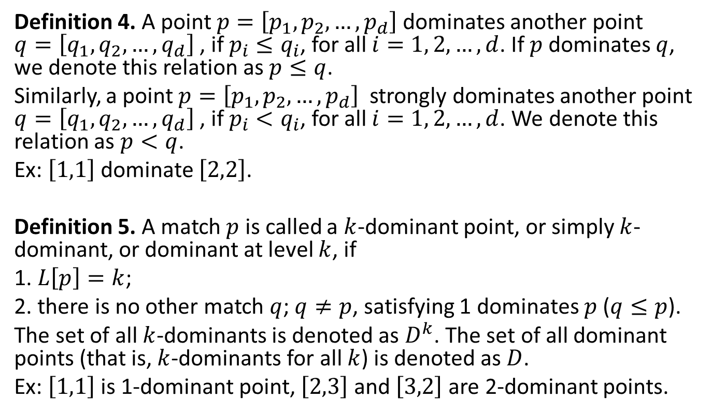
Dominant Point (1/2)
Definition 4. A point $p=\left[p_{1},p_{2},…,p_{d}\right]$ dominates another point $q=\left[q_{1},q_{2},…,q_{d}\right]$, if $p_{i}≤q_{i}$, for all $i=1, 2, …, d$. If $p$dominates $q$, we denote this relation as $p≤q$.
Similarly, a point $p=\left[p_{1},p_{2},…,p_{d}\right]$ strongly dominates another point $q=\left[q_{1},q_{2},…,q_{d}\right]$, if $p_{i}<q_{i}$, for all $i=1, 2, …, d$. We denote this relation as $p<q$.
Ex: $\left[1,1\right]$ dominate $\left[2,2\right]$.
Definition 5. A match $p$ is called a $k$-dominant point, or simply $k$-dominant, or dominant at level $k$, if
1. $L\left[p\right]=k$;
2. there is no other match $q$; $q≠p$, satisfying 1 dominates $p$ ($q≤p$).
The set of all $k$-dominants is denoted as $D^{k}$. The set of all dominant points (that is, $k$-dominants for all $k$) is denoted as $D$.
Ex: $\left[1,1\right]$ is 1-dominant point, $\left[2,3\right]$ and $\left[3,2\right]$ are 2-dominant points.

Slide 6
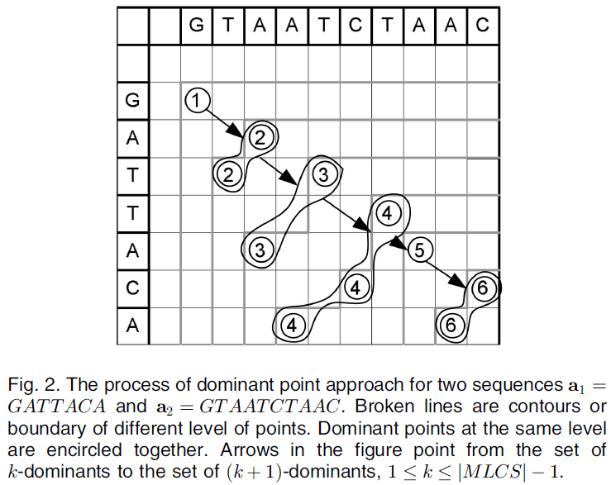
Dominant Point (2/2)

Slide 7
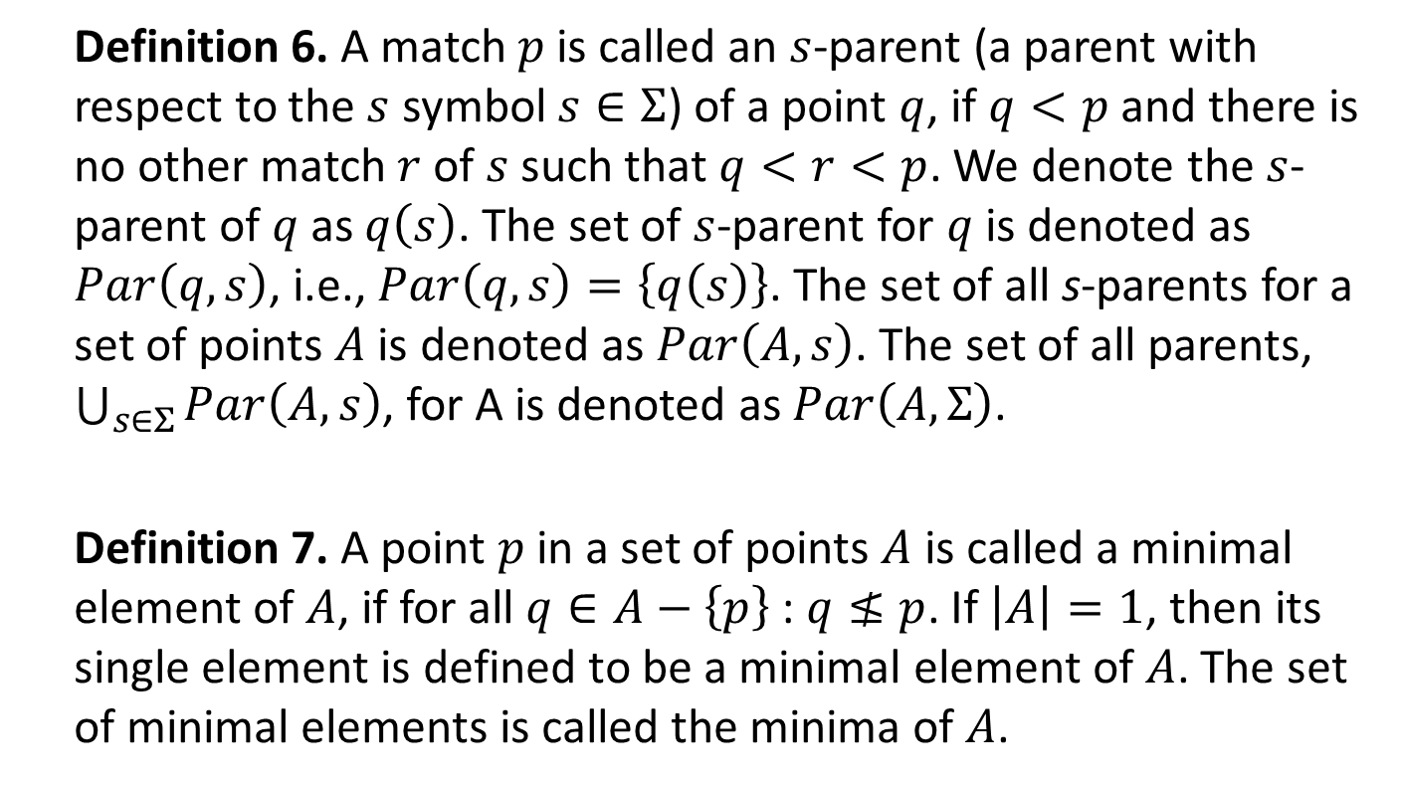
Quick-DP (1/4)
Definition 6. A match $p$ is called an $s$-parent (a parent with respect to the $s$ symbol $s∈Σ$) of a point $q$, if $q<p$and there is no other match $r$ of $s$ such that $q<r<p$. We denote the $s$-parent of $q$ as $q\left(s\right)$. The set of $s$-parent for $q$ is denoted as $Par\left(q, s\right)$, i.e., $Par\left(q, s\right)=\left\{q\left(s\right)\right\}$. The set of all s-parents for a set of points $A$ is denoted as $Par\left(A, s\right)$. The set of all parents, $\bigcup_{s∈Σ}{Par\left(A, s\right)}$, for A is denoted as $Par\left(A,Σ\right)$.
Definition 7. A point $p$ in a set of points $A$ is called a minimal element of $A$, if for all $q∈A−\left\{p\right\}$ : $q≰p$. If $\left|A\right|=1$, then its single element is defined to be a minimal element of $A$. The set of minimal elements is called the minima of $A$.

Slide 8
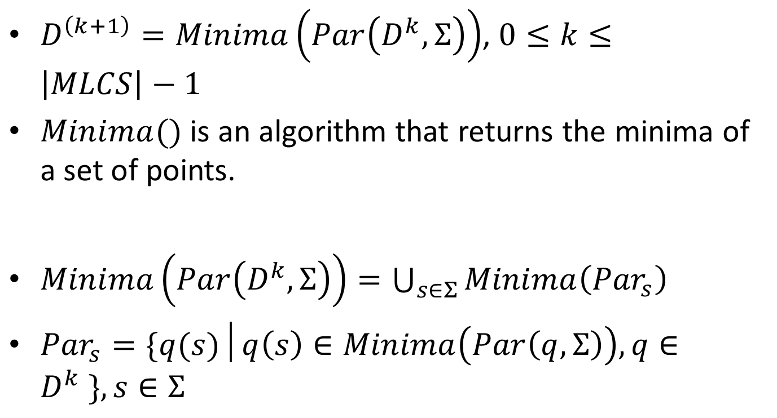
Quick-DP (2/4)
$D^{\left(k+1\right)}=Minima\left(Par\left(D^{k},Σ\right)\right)$, $0≤k≤\left|MLCS\right|−1$
$Minima()$ is an algorithm that returns the minima of a set of points.
$Minima\left(Par\left(D^{k},Σ\right)\right)=\bigcup_{s∈Σ}{Minima\left({Par}_{s}\right)}$
${Par}_{s}=\{q(s)│q\left(s\right)∈Minima\left(Par\left(q, Σ\right)\right), q∈D^{k} \}, s∈Σ$

Slide 9
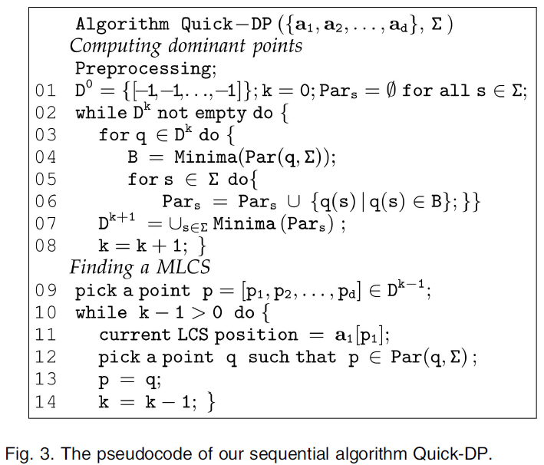
Quick-DP (3/4)

Slide 10
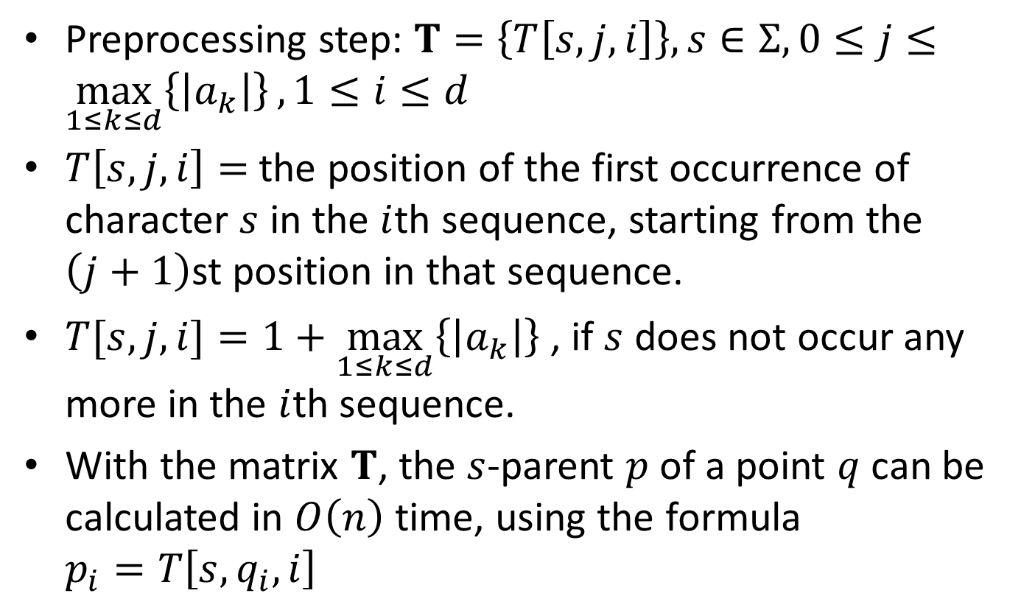
Quick-DP (4/4)
Preprocessing step: $T=\left\{T\left[s, j, i\right]\right\}, s∈Σ, 0≤j≤\max_{1≤k≤d}\left\{\left|a_{k}\right|\right\}, 1≤i≤d$
$T\left[s, j, i\right]=$ the position of the first occurrence of character $s$ in the $i$th sequence, starting from the $\left(j+1\right)$st position in that sequence.
$T[s, j, i]=1+\max_{1≤k≤d}\left\{\left|a_{k}\right|\right\}$ , if $s$ does not occur any more in the $i$th sequence.
With the matrix $T$, the $s$-parent $p$ of a point $q$ can be calculated in $O\left(n\right)$ time, using the formula $p_{i}=T\left[s, q_{i}, i\right]$

Slide 11
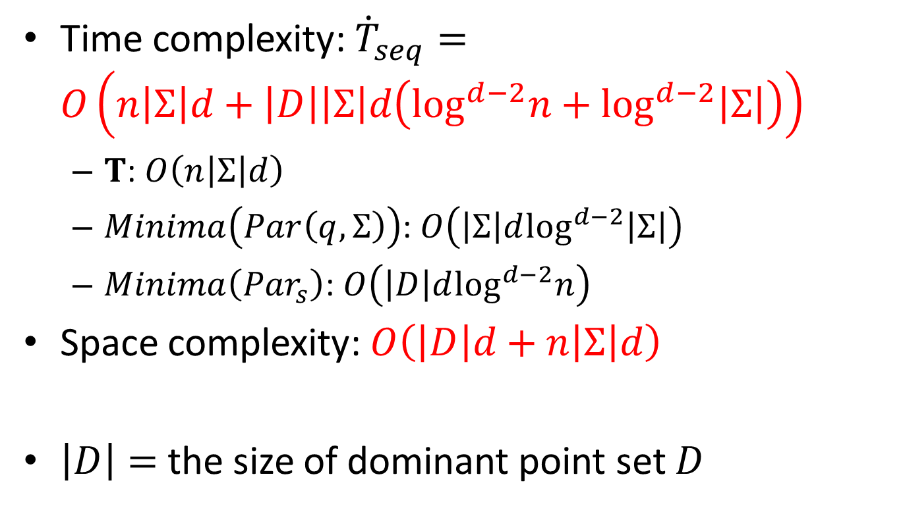
Complexity
Time complexity: ${\dot{T}}_{seq}=$ $O\left(n\left|Σ\right|d+\left|D\right|\left|Σ\right|d\left(\log^{d−2}n+\log^{d−2}\left|Σ\right|\right)\right)$
$T$: $O\left(n\left|Σ\right|d\right)$
$Minima\left(Par\left(q, Σ\right)\right)$: $O\left(\left|Σ\right|d\log^{d−2}\left|Σ\right|\right)$
$Minima\left({Par}_{s}\right)$: $O\left(\left|D\right|d\log^{d−2}n\right)$
Space complexity: $O\left(\left|D\right|d+n\left|Σ\right|d\right)$
$\left|D\right|=$ the size of dominant point set $D$

Slide 12
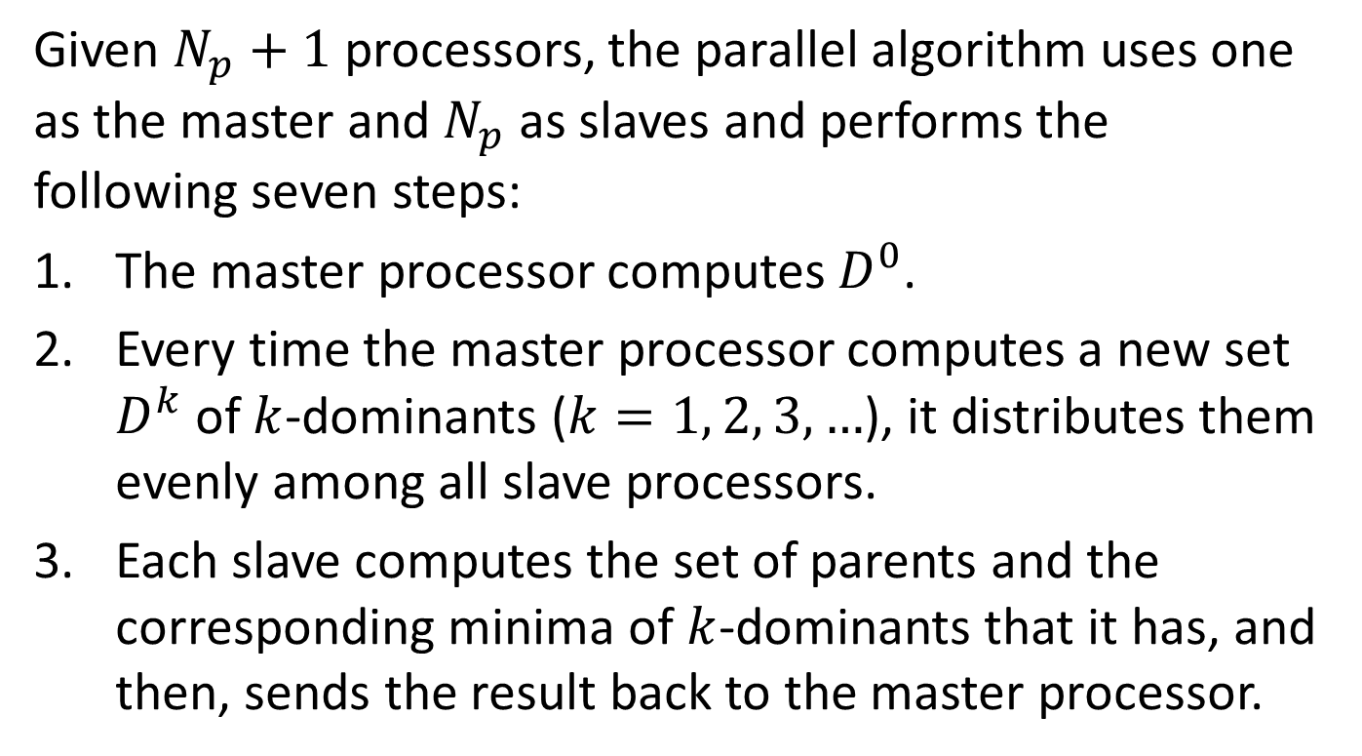
Quick-DPPAR (1/2)
Given $N_{p}+1$processors, the parallel algorithm uses one as the master and $N_{p}$ as slaves and performs the following seven steps:
The master processor computes $D^{0}$.
Every time the master processor computes a new set $D^{k}$ of $k$-dominants ($k=1, 2, 3, …$), it distributes them evenly among all slave processors.
Each slave computes the set of parents and the corresponding minima of $k$-dominants that it has, and then, sends the result back to the master processor.

Slide 13
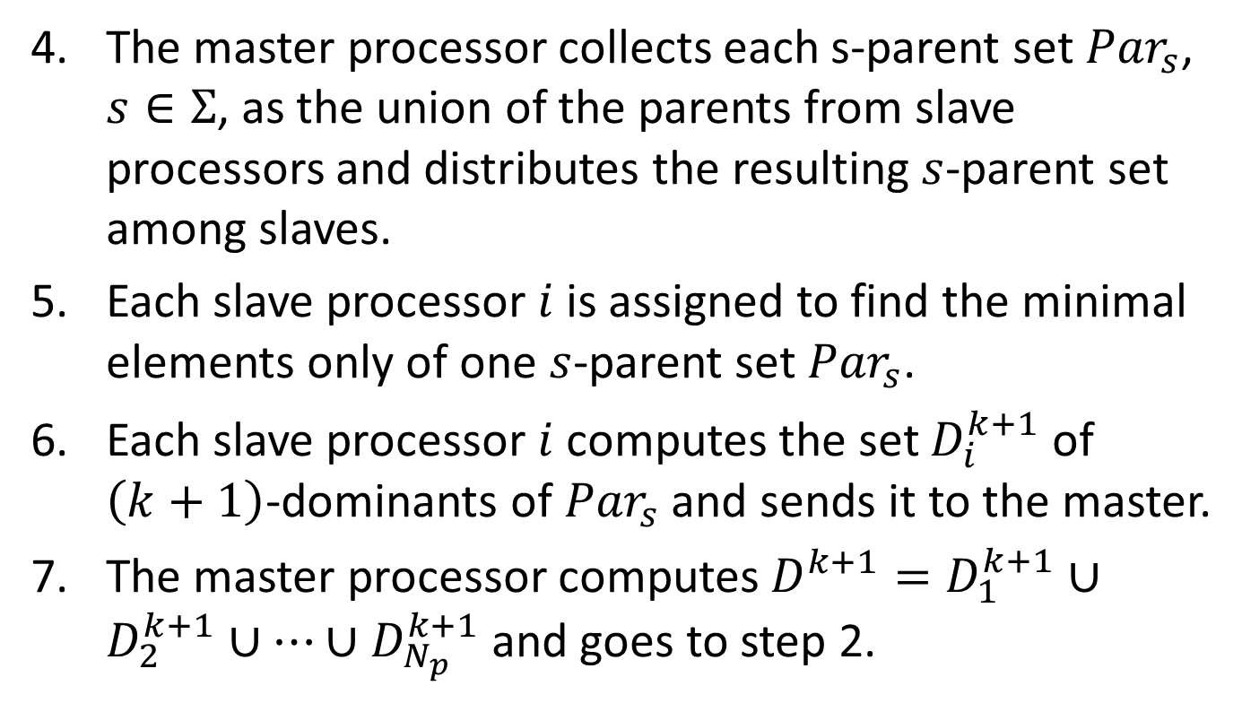
Quick-DPPAR (2/2)
The master processor collects each s-parent set ${Par}_{s}$, $s∈Σ$, as the union of the parents from slave processors and distributes the resulting $s$-parent set among slaves.
Each slave processor $i$ is assigned to find the minimal elements only of one $s$-parent set ${Par}_{s}$.
Each slave processor $i$ computes the set $D_{i}^{k+1}$ of $\left(k+1\right)$-dominants of ${Par}_{s}$ and sends it to the master.
The master processor computes $D^{k+1}=D_{1}^{k+1}∪D_{2}^{k+1}∪…∪D_{N_{p}}^{k+1}$ and goes to step 2.

Slide 14
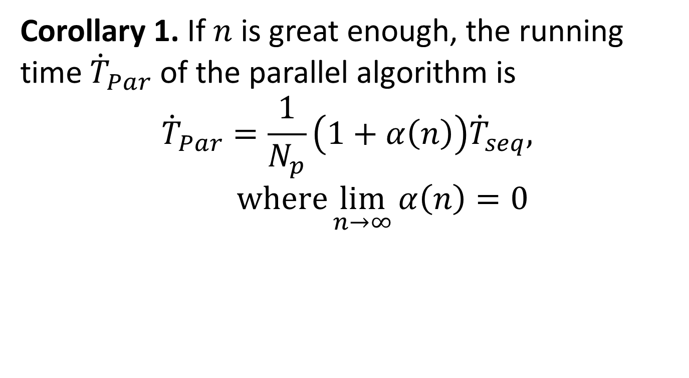
Complexity
Corollary 1. If $n$ is great enough, the running time ${\dot{T}}_{Par}$ of the parallel algorithm is
$${\dot{T}}_{Par}=\frac{1}{N_{p}}\left(1+α\left(n\right)\right){\dot{T}}_{seq}\text{, }\text{where}\lim_{n→∞}{α\left(n\right)=0}$$

Slide 15
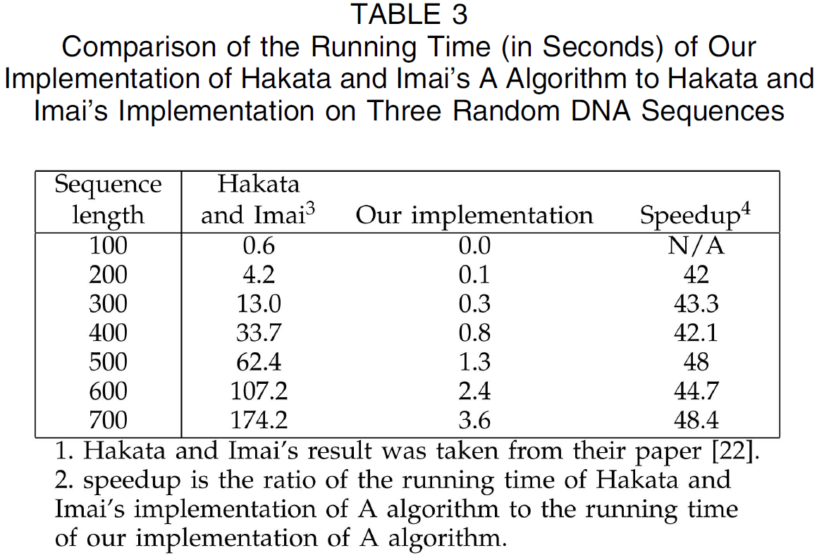
Experimental Results of Quick-DP (1/6)

Slide 16
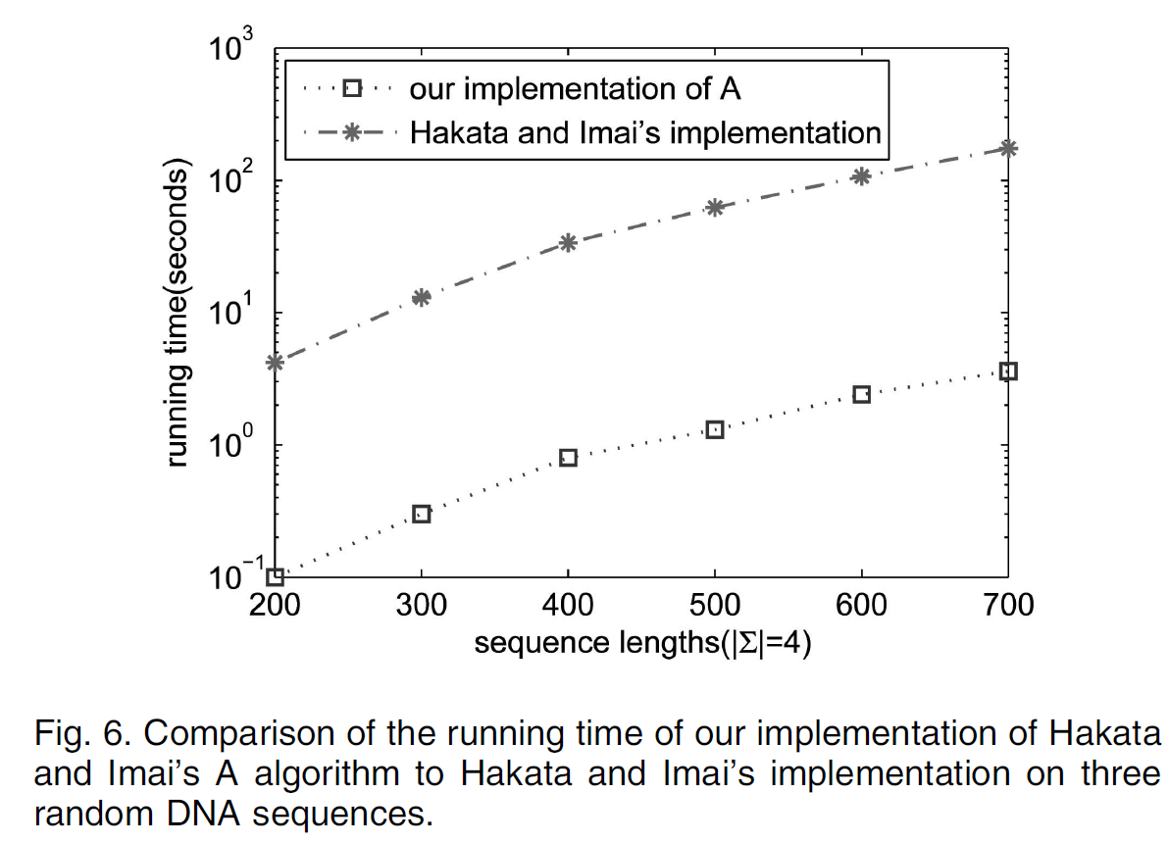
Experimental Results of Quick-DP (2/6)

Slide 17
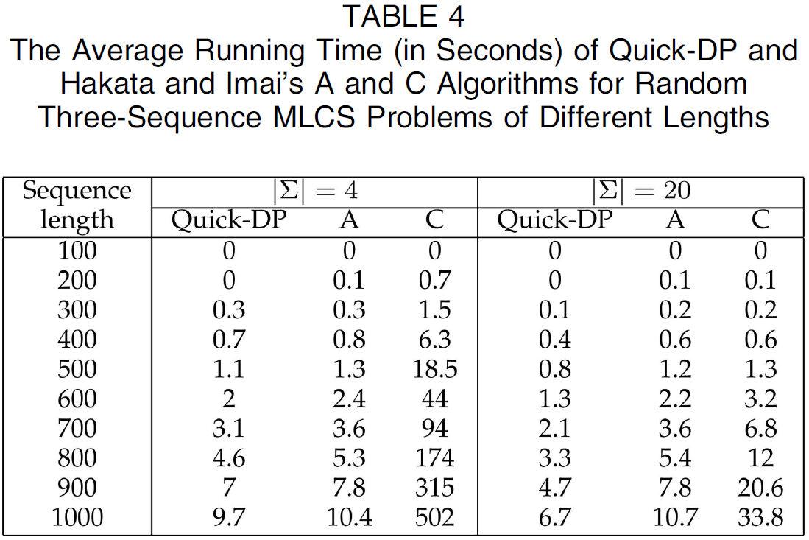
Experimental Results of Quick-DP (3/6)

Slide 18
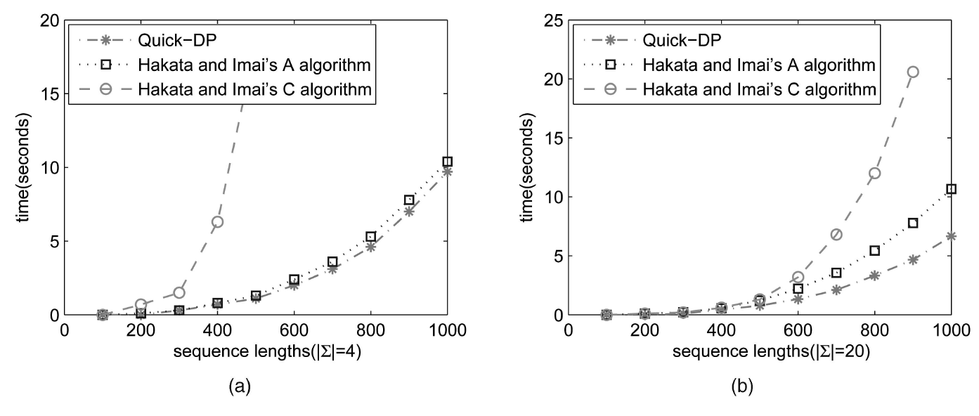
Experimental Results of Quick-DP (4/6)

Slide 19
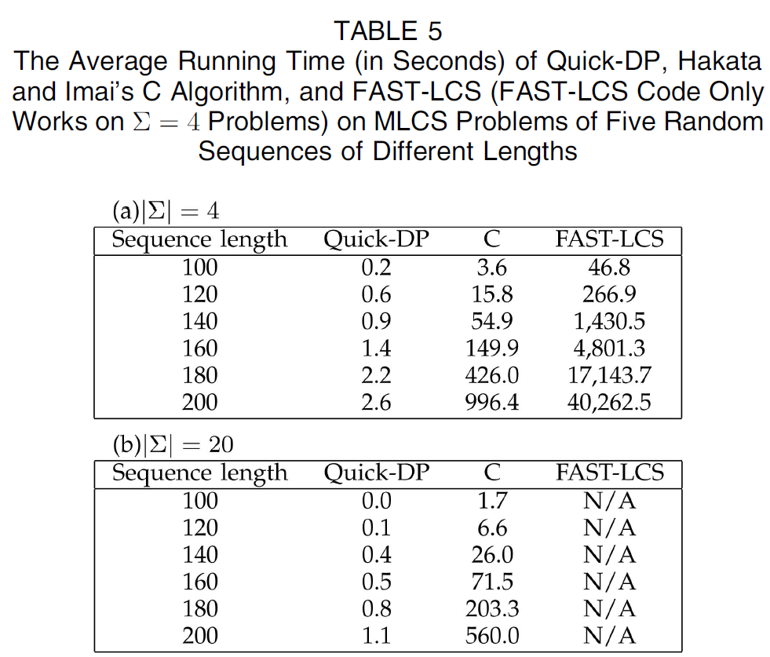
Experimental Results of Quick-DP (5/6)

Slide 20
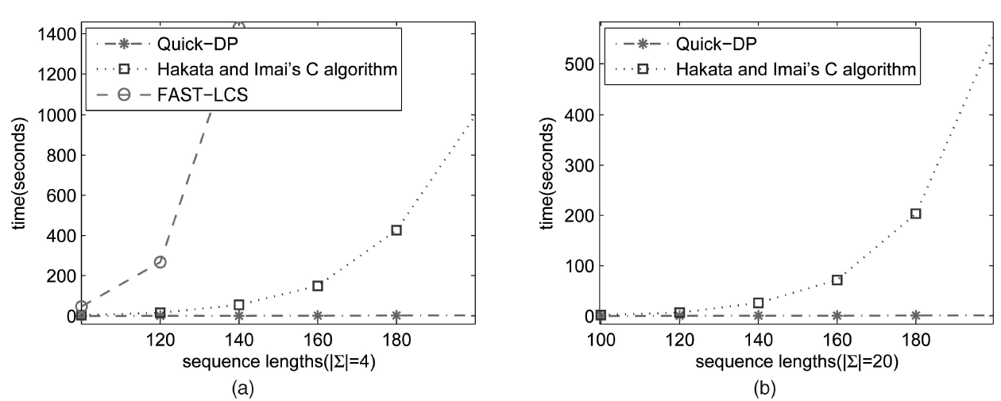
Experimental Results of Quick-DP (6/6)

Slide 21
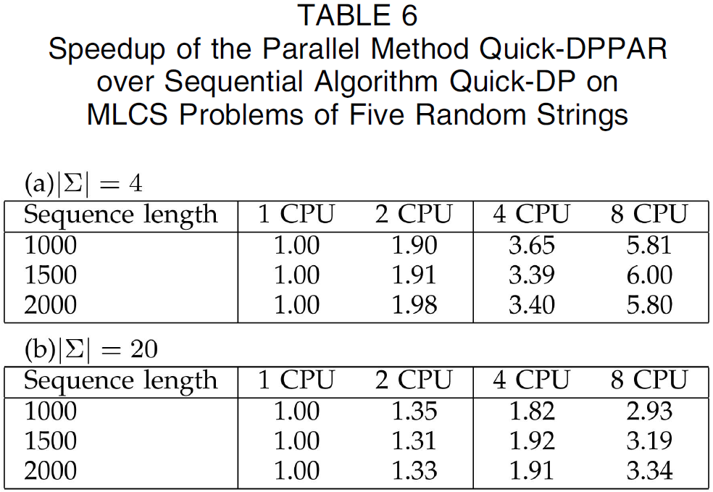
Experimental Results of Quick-DPPAR (1/6)

Slide 22
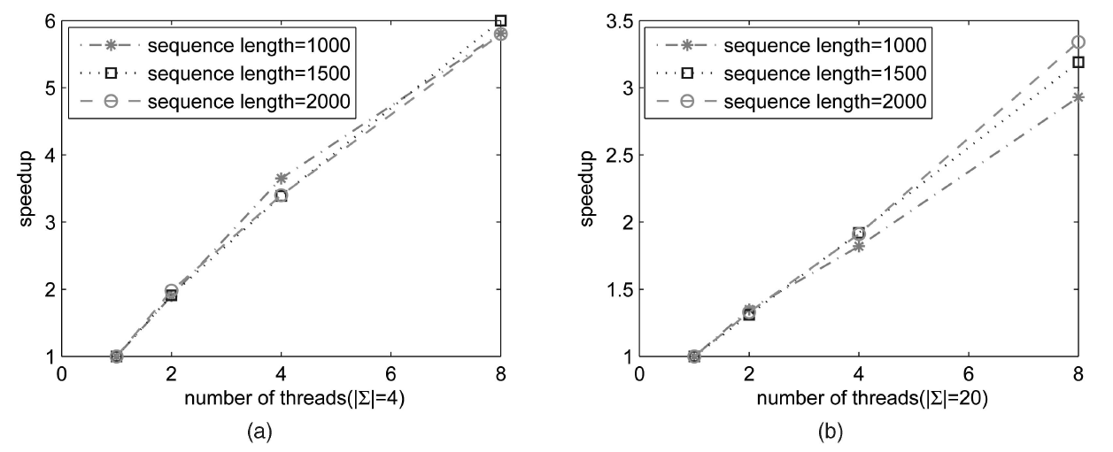
Experimental Results of Quick-DPPAR (2/6)

Slide 23
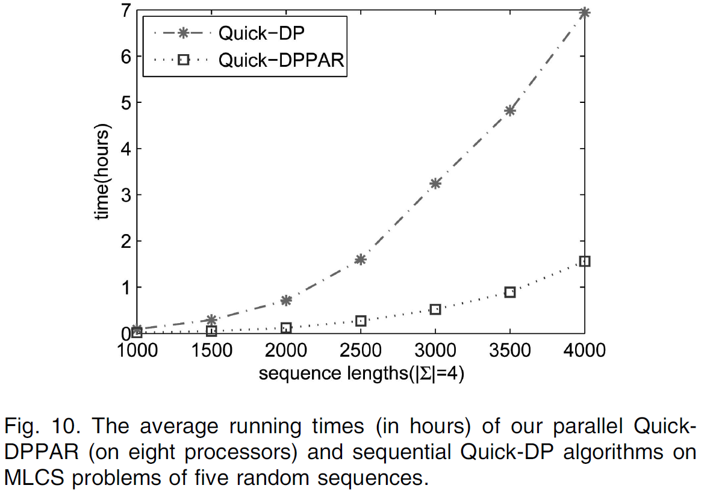
Experimental Results of Quick-DPPAR (3/6)

Slide 24
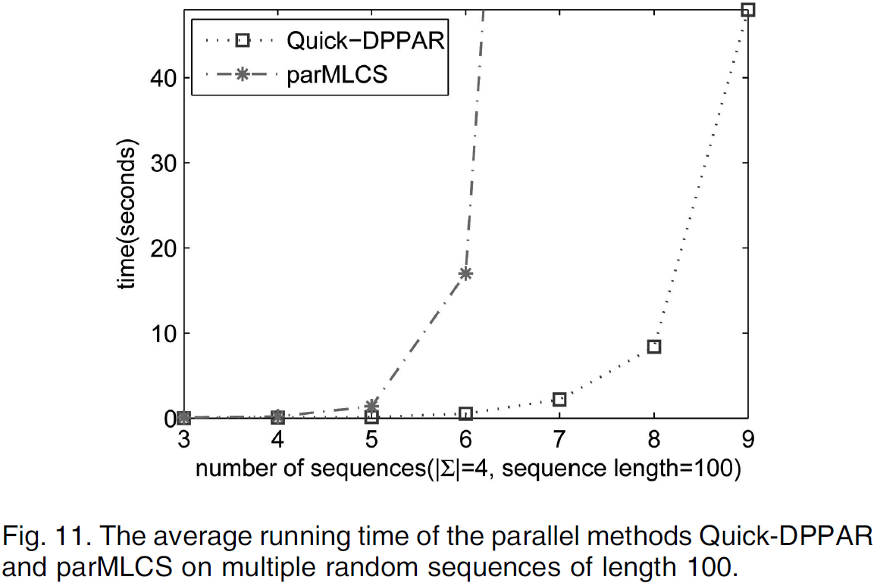
Experimental Results of Quick-DPPAR (4/6)

Slide 25
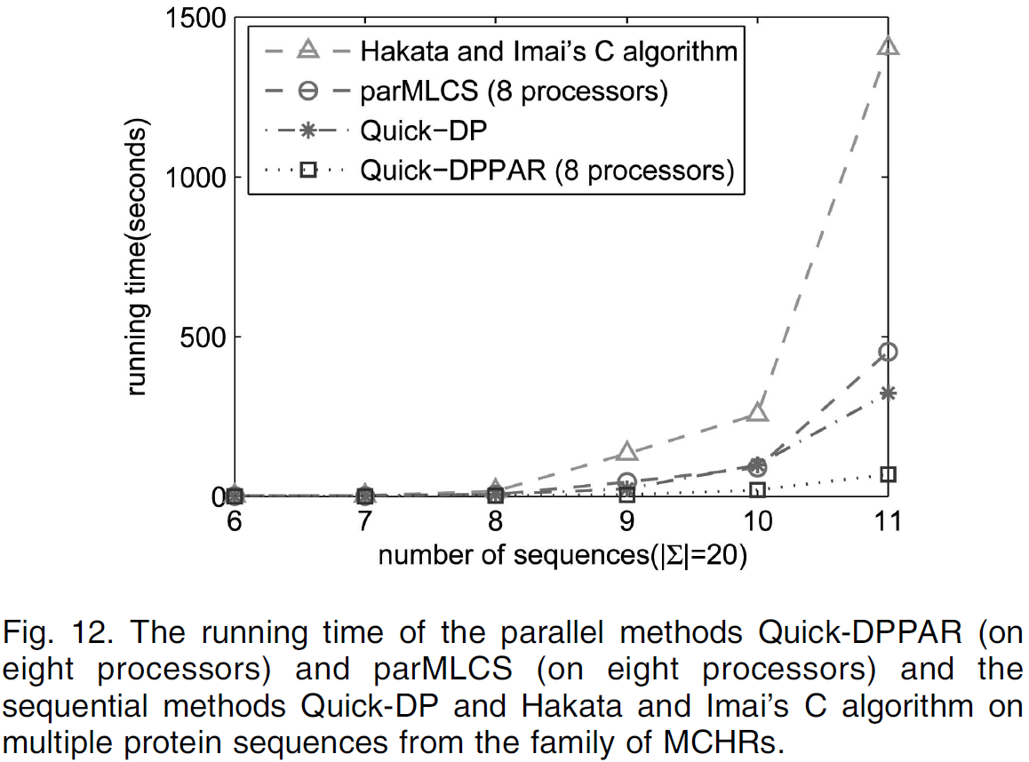
Experimental Results of Quick-DPPAR (5/6)

Slide 26
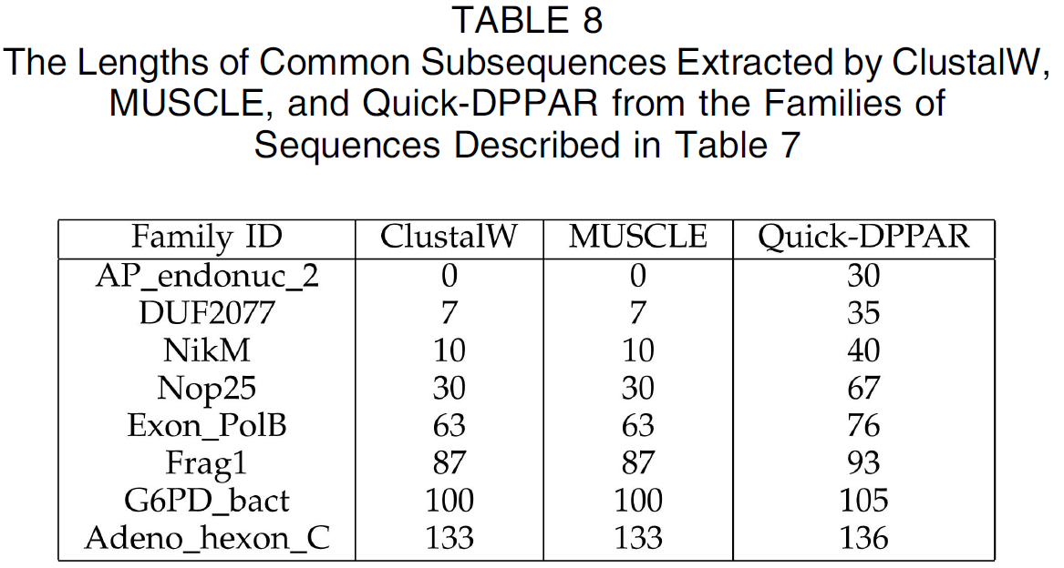
Experimental Results of Quick-DPPAR (6/6)

