Slide 1
The Complexity of Multiway Cuts
E. Dahlhausl, D. S. Johnson2, C, H. Papadimitriou3
P. D. Seymour4, and M. Yannakal&2
Presenter: 許竣傑
2013/2/19

Slide 2
Abstract
In the Multiway Cut problem we are given an edge-weighted graph and a subset of the vertices called terminals, and asked for a minimum weight set of edges that separates each terminal from all the others. When the number k of terminals is two, this is simply the min-cut, max-flow problem, and can be solved in polynomial time. We show that the problem becomes NP-hard as soon as k = 3, but can be solved in polynomial time for planar graphs for any fixed k. The planar problem is NP-hard, however, if k is not fixed. We also describe a simple approximation algorithm for arbitrary graphs that is guaranteed to come within a factor of 2– 2/k of the optimal cut weight.

Slide 3
Multiway Cuts Problem
A planar graph G(V,E)
A set S = {s₁,s₂,s₃,…,s_{k}} of k terminals
A positive weight w(e) for each edge e ∈ E
Find minimum weight set of edges E’ ⊆ E such that the removal of E’ from E disconnects each terminal form all the others

Slide 4
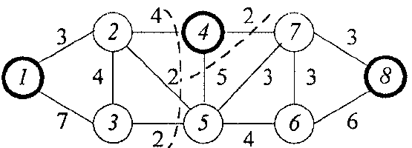
Multiway Cuts Problem
K = 3
C = {e₂₄,e₂₅,e₃₅,e₄₅,e₄₇}
2
4
7
1
β
8
3
5
6
α
γ

Slide 5
Multiway Cuts Problem
G^{D} is the dual graph of G
C is a multiway cut separating the graph into k components
C^{D} ⊆ G^{D} is the dual multiway cut of C

Slide 6
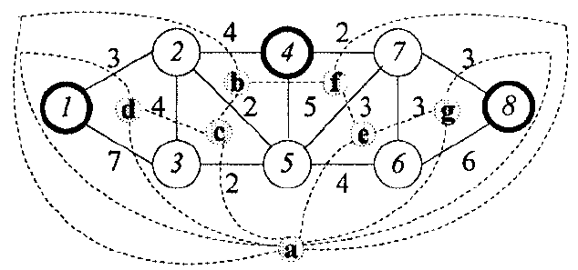
Multiway Cuts Problem
G^{D}
2
4
7
d
f
C^{D}
1
b
8
g
c
e
3
5
6
a

Slide 7
Isolating Cut
Definition. For a given terminal s_{i}, an isolating cut for s_{i} is any set of edges that cuts all paths between s_{i} and all the other terminals.

Slide 8
Minimum Weight Isolating Cut
Minimum weight isolating cut for s_{i} can be constructed by merging all the terminals other than s_{i} into a special vertex s_{o}, and the finding a minimum s_{i} - s_{o} cut in the resulting graph by a standard 2-terminal minimum cut algorithm.

Slide 9
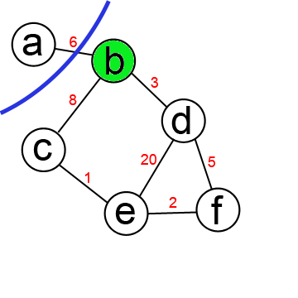
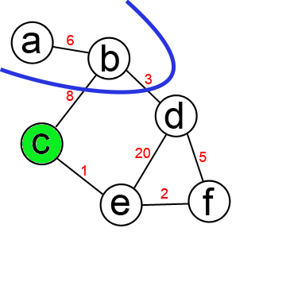
Example
A: (a)
A: (a,b)

Slide 10
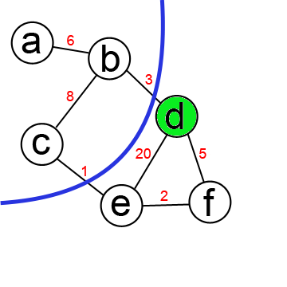
Example
A: (a,b)
A: (a,b,c)

Slide 11
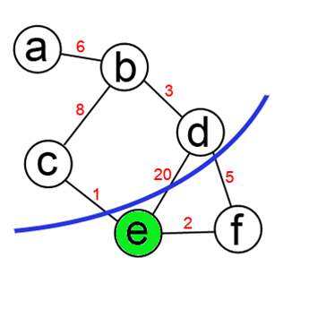
Example
A: (a,b,c)
A: (a,b,c,d)

Slide 12
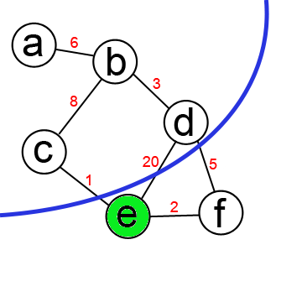
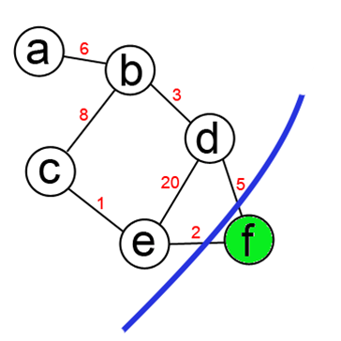
Example
A: (a,b,c,d)
A: (a,b,c,d,e)

Slide 13
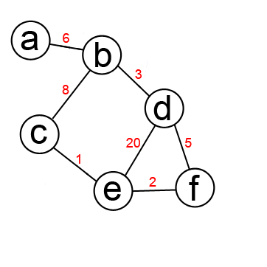
Example
A: (a,b,c,d,e)
A: (a,b,c,d,e,f)

Slide 14
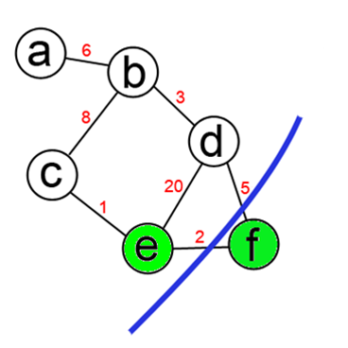
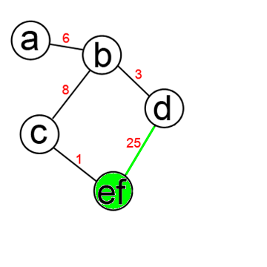
Example
Merge(G,e,f): G ← G\{e,f} U {ef}
For v ∈ V, v ≠ {ef}
w(ef, v) is sum of w(e,v) and w(f,v) in orig. graph

Slide 15
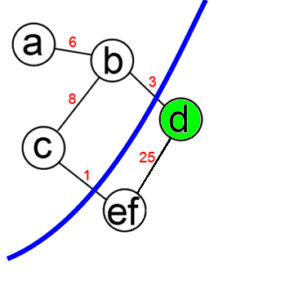
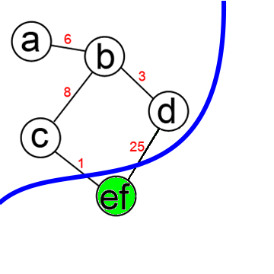
Example
A: (a,b,c)
A: (a,b,c,d)

Slide 16
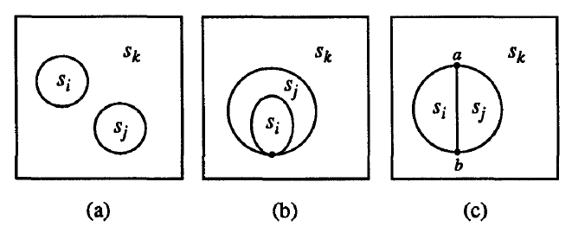
3-way Cut

Slide 17
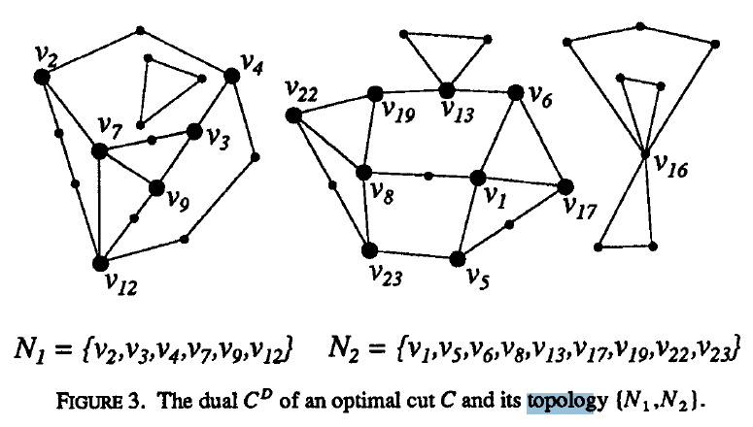
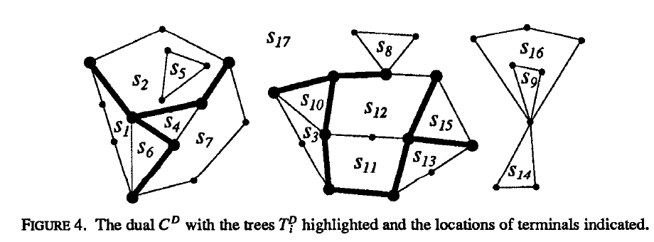
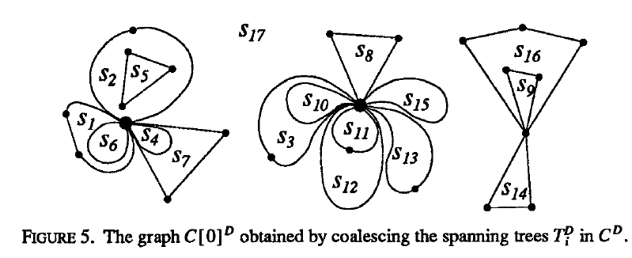
K-way Cut For Planar Graphs

Slide 18
K-way Cut For Planar Graphs
2
4
7
d
f
1
b
g
8
c
e
3
5
6
a
2
4
7
d
f
1
b
g
8
c
e
3
5
6
a

Slide 19
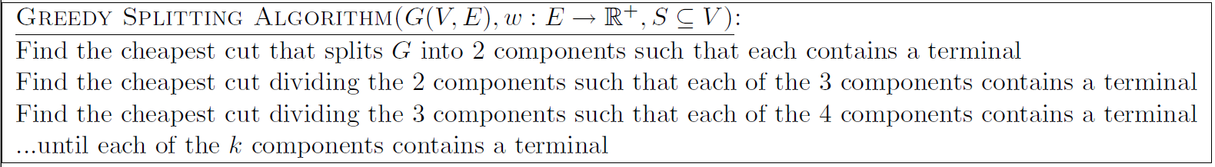
K-way Cut For Arbitrary Graphs
Isolating Cut Heuristic
Greedy Splitting Algorithm
Approximation ratio of 2 − 2/k .

Slide 20
Thank You!

