Slide 1
A Novel Instantaneous Frequency Algorithm and Its Application in Stock Index Movement Prediction
IEEE JOURNAL OF SELECTED TOPICS IN SIGNAL PROCESSING, VOL. 6, NO. 4, AUGUST 2012
Liming Zhang, Na Liu, Pengyi Yu
Presenter: Cheng-Han Lee Date:2013/3/5

Slide 2
Abstract
There are different approaches in deﬁning instantaneous frequency in the literature; however, with a great variety of practical problems a speciﬁc approach is not always applicable. This paper proposes a new type instantaneous frequency suitable for a large class of signals called simple wave. The new instantaneous frequency is called alpha-counting instantaneous frequency (IF) that should have independent interest. A stock index movement prediction approach is proposed in this paper based on the newly deﬁned instantaneous frequency and signal decomposition. An experiment is provided based on the stock market data of Hong Kong Hang Seng Index. Effectiveness of the proposed approach is assessed through the comparison with BP neural network prediction method, and is proved to be promising.

Slide 3
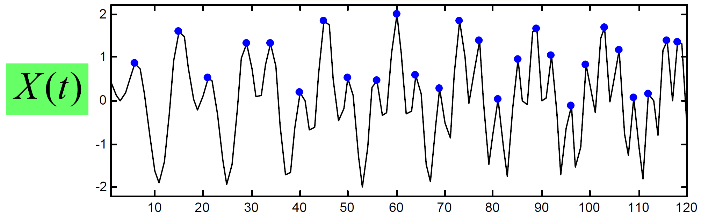
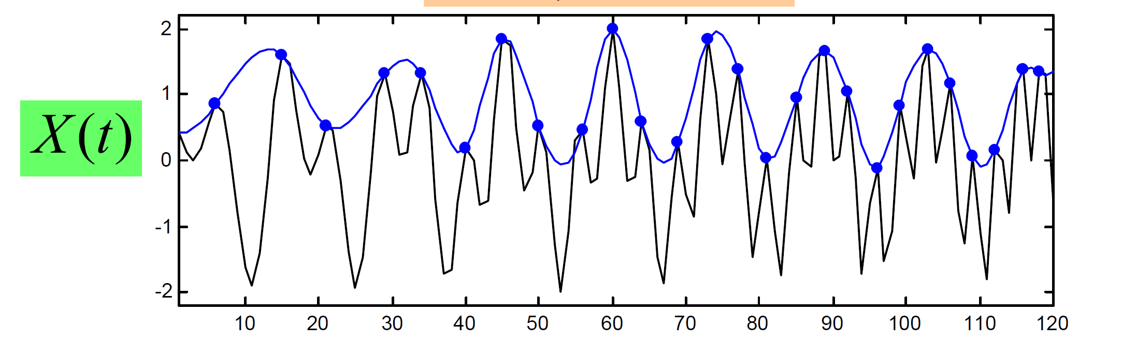
Empirical mode decomposition (EMD) (2)
IMF₁ iteration 0, step1: 找出 local maximum
IMF₁ iteration 0, step2: 找出 local maximum的 envelope (cubic function)

Slide 4
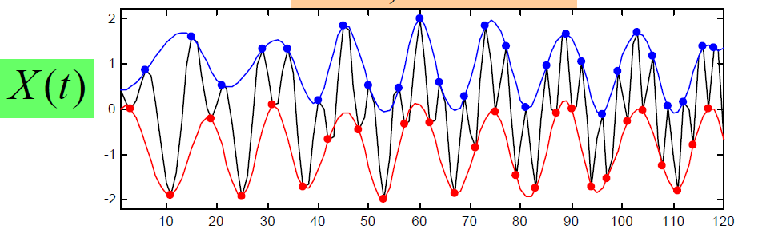
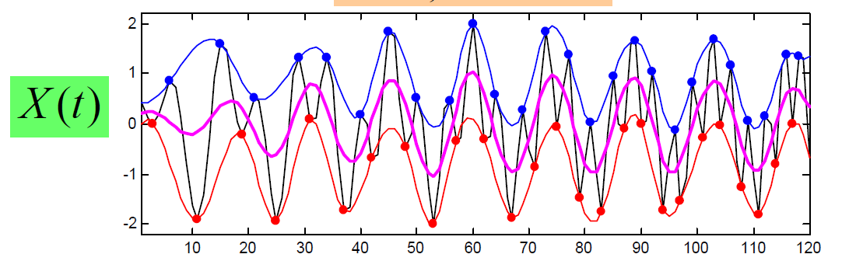
Empirical mode decomposition (EMD) (3)
IMF₁ iteration 0, step3, 4: 找出 local miniimum的 envelope (cubic function)
IMF₁ iteration 0, step 5: 找出upper & lower envelope的mean envelope m₁

Slide 5
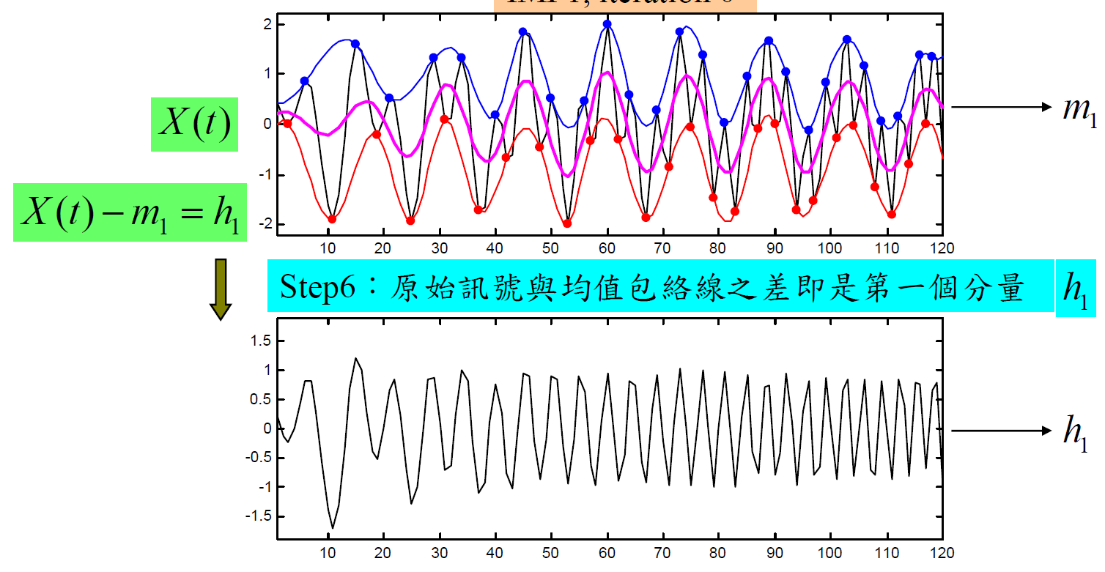
Empirical mode decomposition (EMD) (4)
篩檢過程有兩個目的
1.可消除載波
2.使得波形更對稱

Slide 6
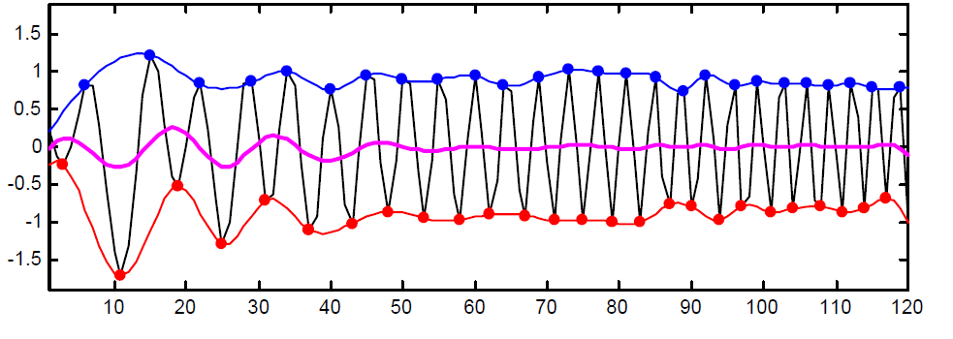
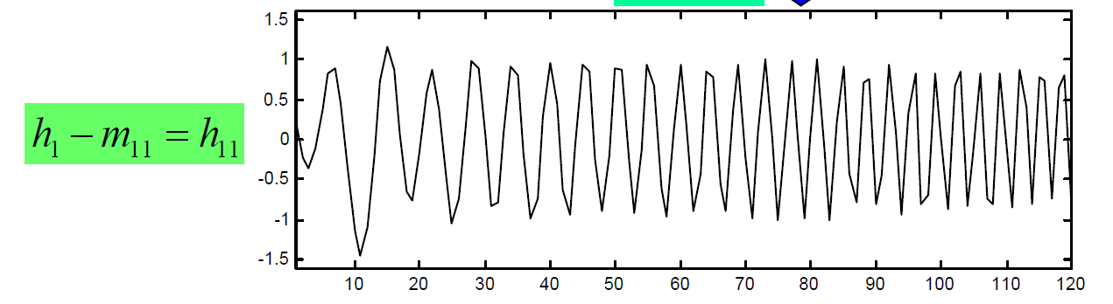
Empirical mode decomposition (EMD)(4)
IMF₁ iteration 1, 重複上述step得到h1的mean envelope m₁₁
h₁

Slide 7
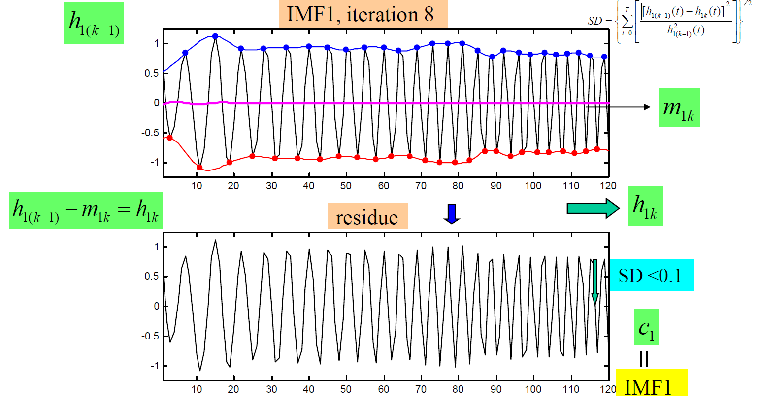
Empirical mode decomposition (EMD)(5)
IMF₁ iteration k, 重複上述步驟直到h_{1k}與h_{1(k-1)}的SD之值小於0.1(自訂，建議為0.2~0.3)，得到原始訊號的IMF₁ c₁

Slide 8
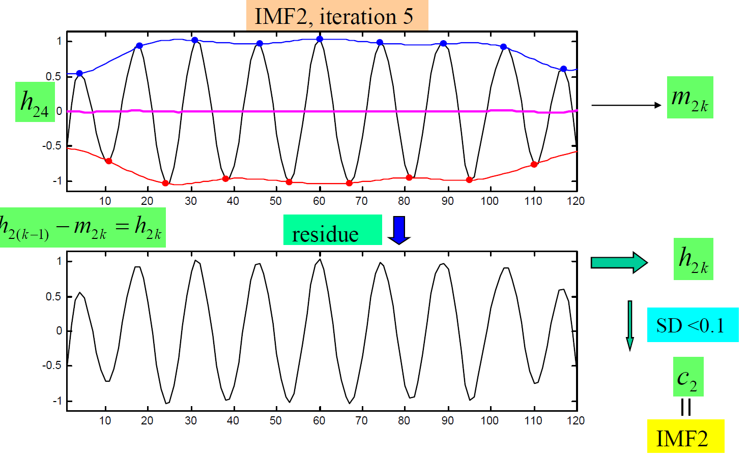
Empirical mode decomposition (EMD)(6)
將x(t)-c₁之後，繼續上述的分解得到IMF₂ c₂

Slide 9
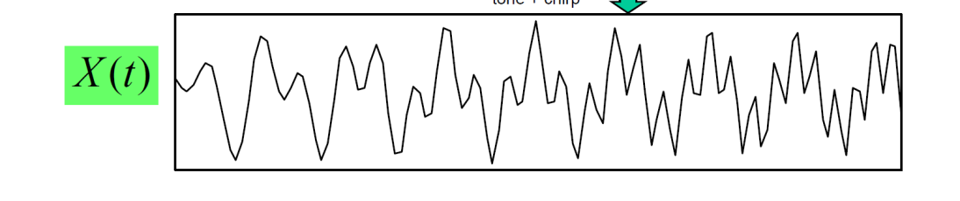
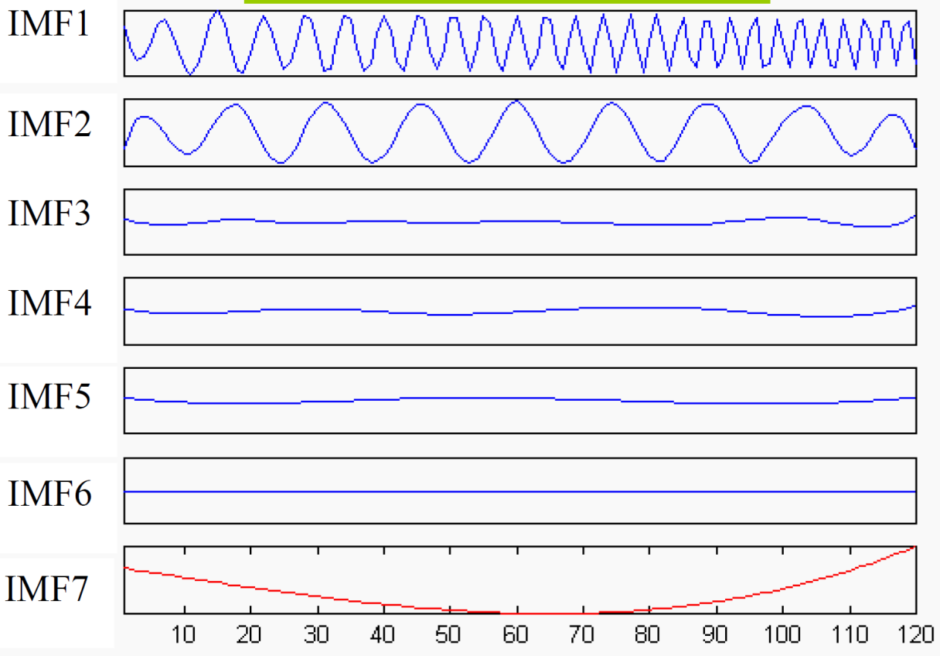
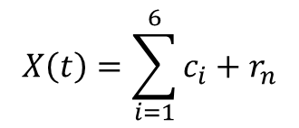
Empirical mode decomposition (EMD)(8)
當訊號之極值數目小於2，或是訊號能量已經小於設定的門檻值（例如原始訊號1%），整個篩檢過程即停止。
$$X\left(t\right)=\sum_{i=1}^{6}{c_{i}+r_{n}}$$
即可由IMF訊號疊加後復原到原始訊號X(t)
IMF訊號之間接近正交!!
殘餘序列，非IMF

Slide 10
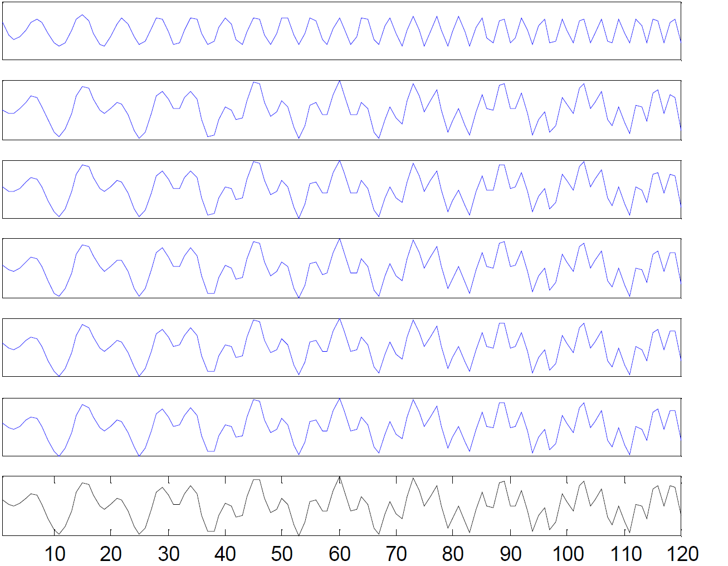
Reconstruction
c₁
c₁+c₂
c₁+c₂+c₃
…
X(t)

Slide 11
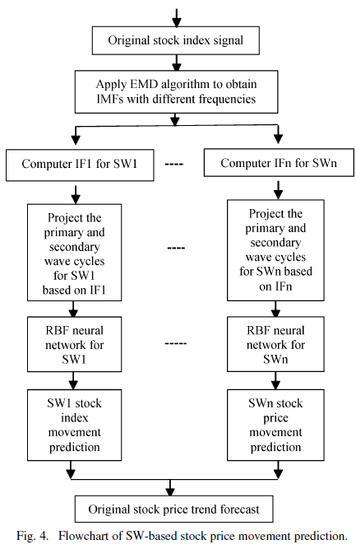
Experiment Design

Slide 12
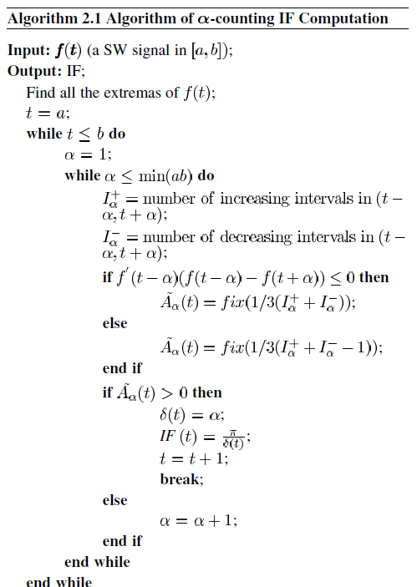

Slide 13
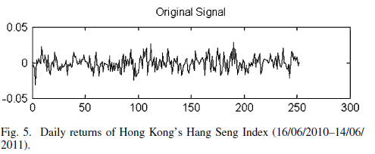
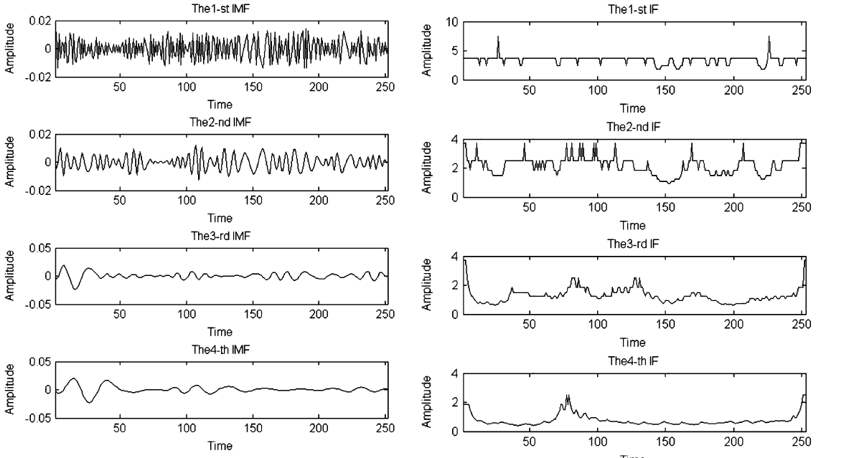

Slide 14
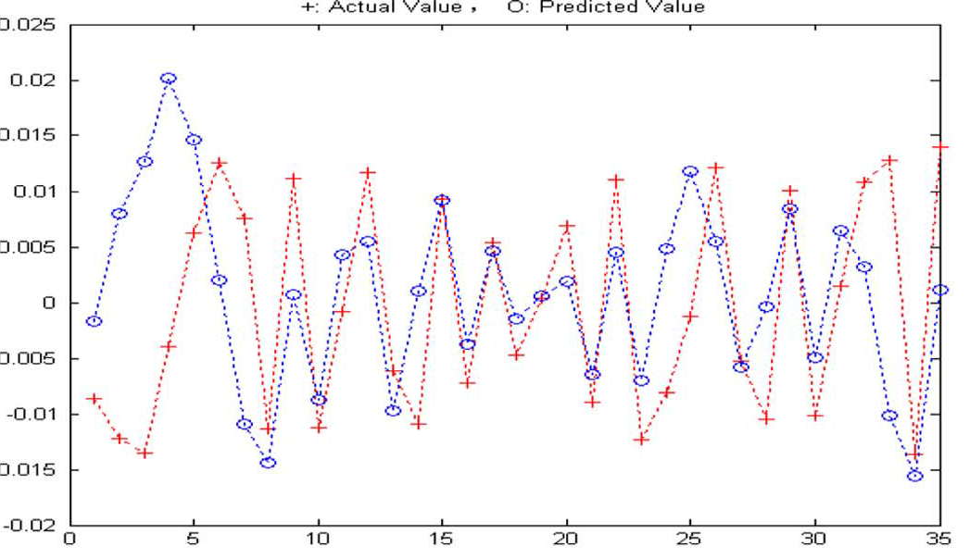
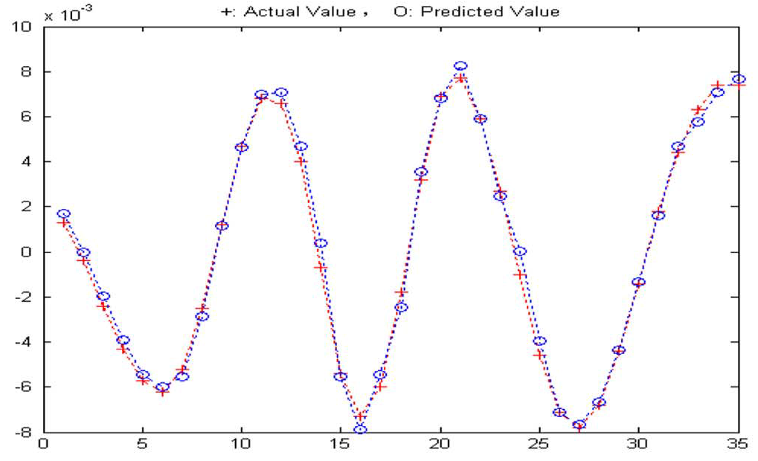
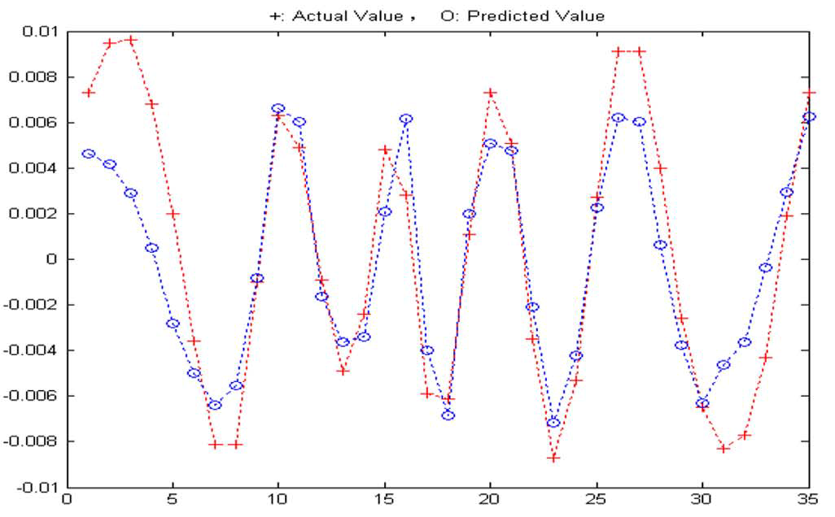
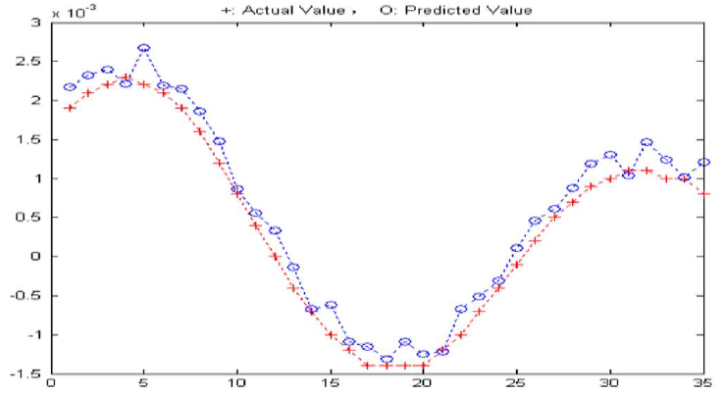
Experiment Results

Slide 15
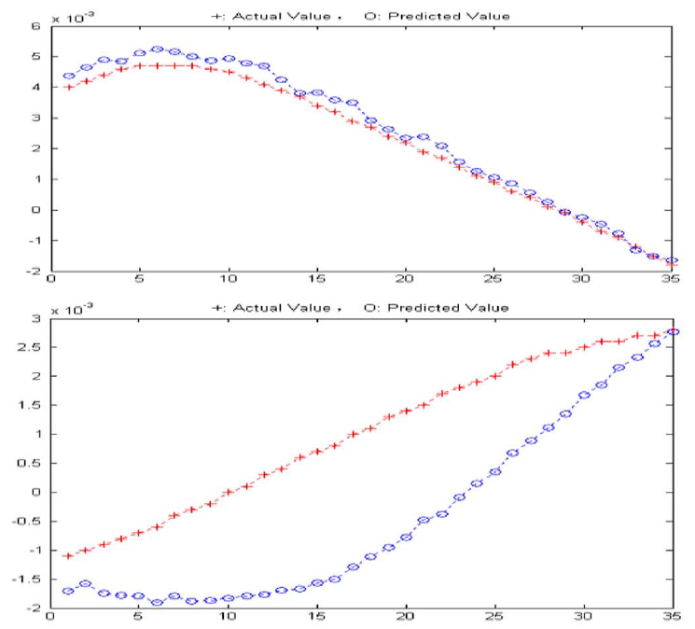
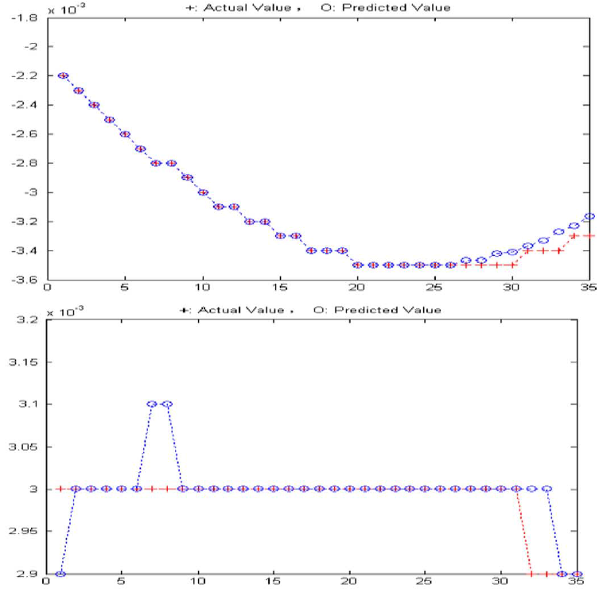

Slide 16
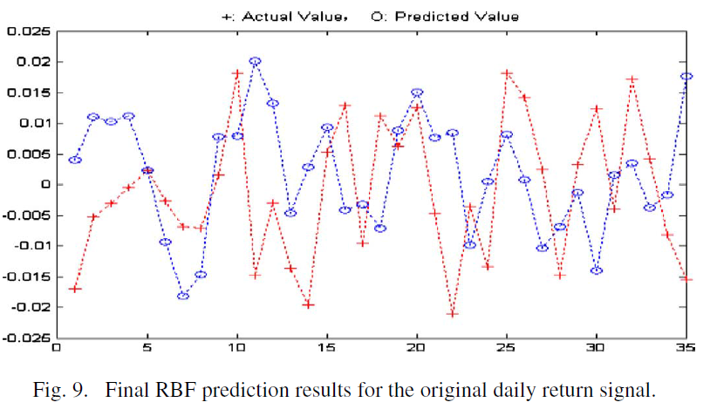
The error sum of squares = 0.0087

Slide 17
THE END

