Slide 1
Dynamic Ordered Sets with Exponential Search Trees
Arne Andersson and Mikkel Thorup
Journal of the ACM, Vol. 54, No. 3, Article 13, 2007
Presenter: Chiou-Ting Tseng
Date: Jan. 15, 2013

Slide 2
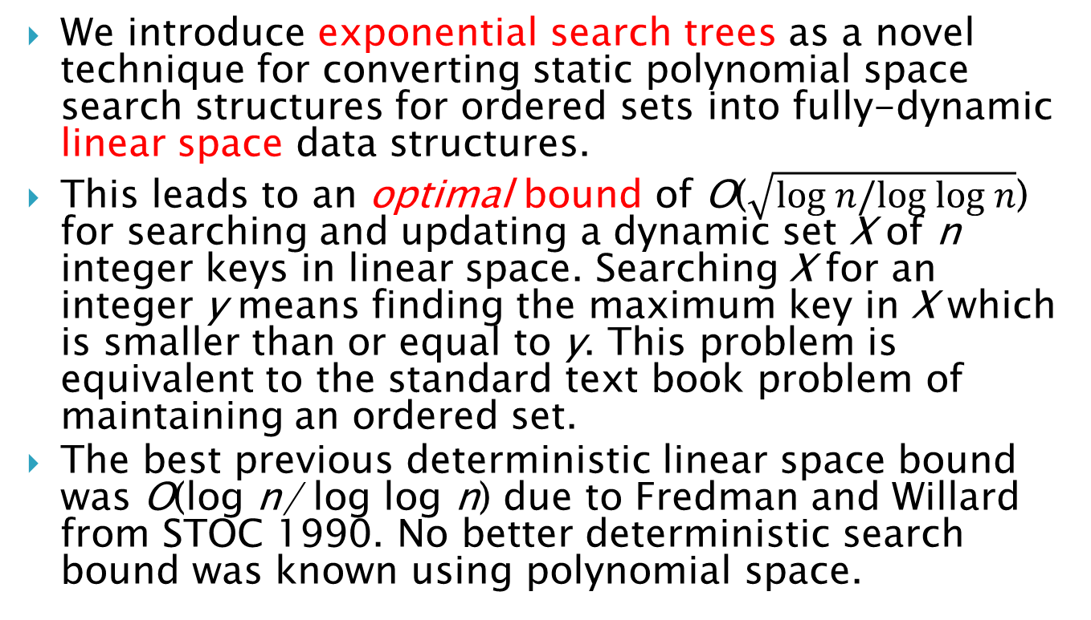
Abstract
We introduce exponential search trees as a novel technique for converting static polynomial space search structures for ordered sets into fully-dynamic linear space data structures.
This leads to an optimal bound of O($\sqrt{\text{log} n/\text{log} \text{log} n}$) for searching and updating a dynamic set X of n integer keys in linear space. Searching X for an integer y means finding the maximum key in X which is smaller than or equal to y. This problem is equivalent to the standard text book problem of maintaining an ordered set.
The best previous deterministic linear space bound was O(log n/ log log n) due to Fredman and Willard from STOC 1990. No better deterministic search bound was known using polynomial space.

Slide 3
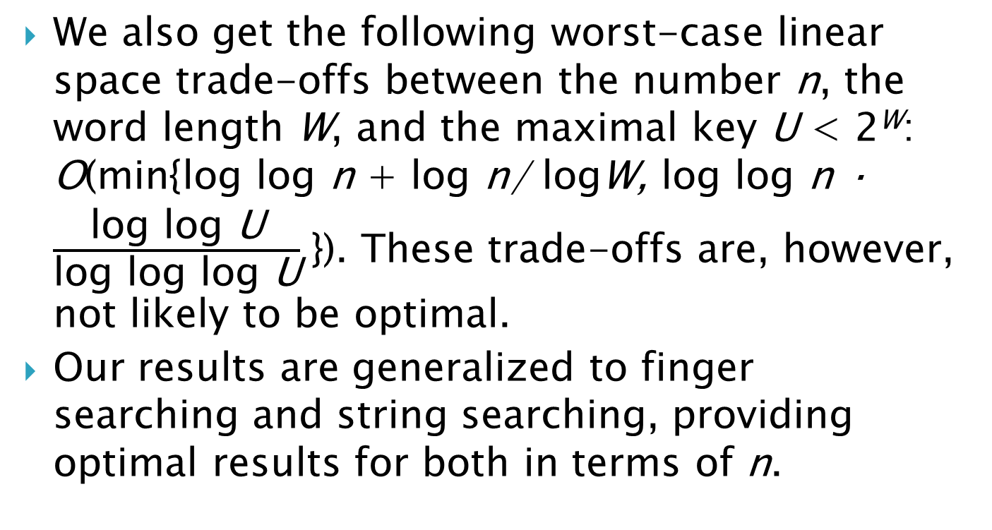
Abstract
We also get the following worst-case linear space trade-offs between the number n, the word length W, and the maximal key U < 2^{W}: O(min{log log n + log n/ logW, log log n · $\frac{\text{log} \text{log} \text{U}}{\text{log} \text{log} \text{log} \text{U}}$}). These trade-offs are, however, not likely to be optimal.
Our results are generalized to finger searching and string searching, providing optimal results for both in terms of n.

Slide 4
1st Symposium on Breakthroughs in Advanced Data Structures
http://algo2.iti.kit.edu/2109.php
space efficient hash tables
order maintenance problem
skip lists
exponential search trees
orthogonal 2d range searching
range successor queries
range median queries
range mode queries

Slide 5
space efficient construction of compressed suffix arrays
dynamic succinct trees
practical solutions for rank/select
alphabet partitioning for rank/select
persistent data structures
dynamic graphs (dynamic connectivity)
link-cut trees
lowest common ancestors in directed acyclic graphs (DAGs)

Slide 6
Outline
Introduction
Amortized exponential search tree
Worst case efficient exponential search tree
Static search structures
Finger Update
Finger Search
String Search

Slide 7
Basic Operations
Insert (X, x) Add x to X where x is a pointer to a key.
Delete (X, x) Remove x from X, here x is a pointer to a key in X.
Lookup(X, y) Returns a pointer to a key in X with the same value as y, or return a null pointer if there is no such key in X.
Search (X, y) Returns a pointer to the largest key in X which is smaller than or equal to y, or null if y is smaller than any key in X.
Predecessor/Successor (X, x) Given that x points at a key in X, return a pointer to the next smaller/larger key in X (or a null pointer if no such key exists).
Minimum/Maximum (X) Return a pointer to the smallest/largest key in X (or a null pointer if X is empty).
For keys that can only be accessed via comparisons, all of the above operations can be supported in O(log n) time, which is best possible.

Slide 8
Finger Search
By finger search we mean that we can have a “finger” pointing at a stored key x when searching for a key y.
Here a finger is just a reference returned to the user when x is inserted or searched for.
The goal is to do better if the number q of stored keys between x and y is small.

Slide 9
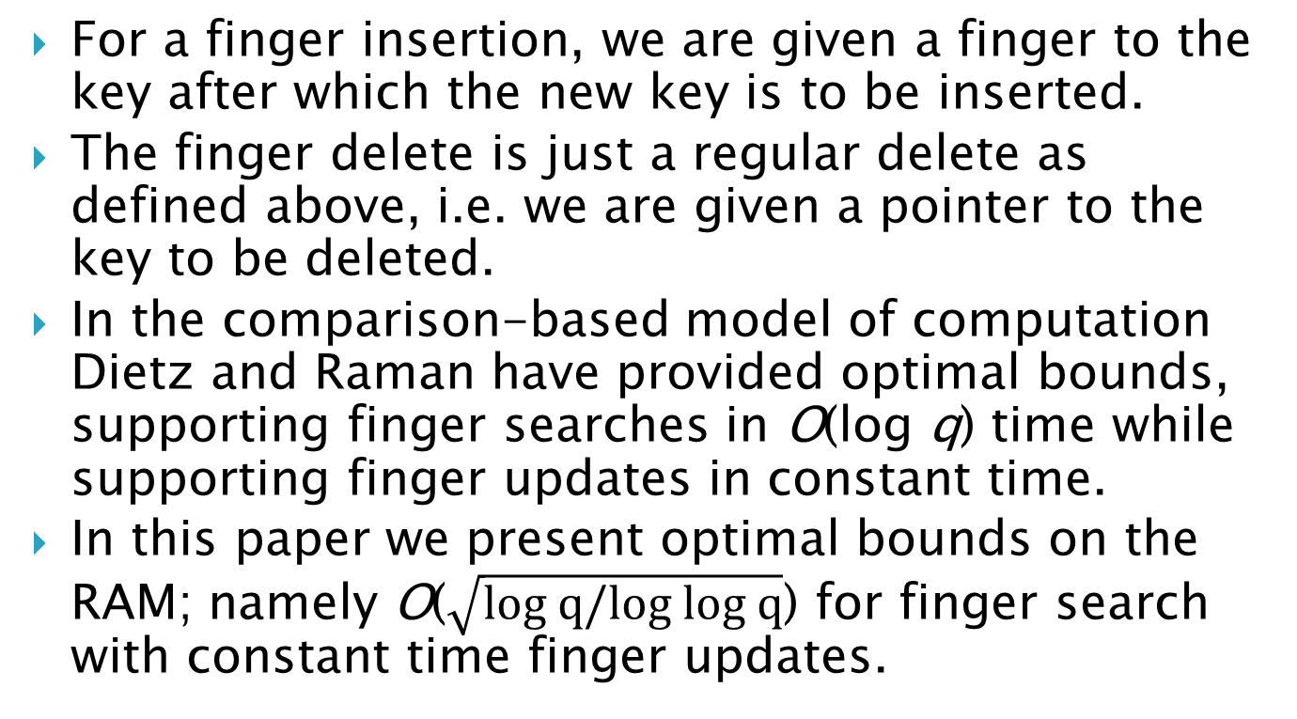
Finger Update
For a finger insertion, we are given a finger to the key after which the new key is to be inserted.
The finger delete is just a regular delete as defined above, i.e. we are given a pointer to the key to be deleted.
In the comparison-based model of computation Dietz and Raman have provided optimal bounds, supporting finger searches in O(log q) time while supporting finger updates in constant time.
In this paper we present optimal bounds on the RAM; namely O($\sqrt{\text{log} q/\text{log} \text{log} q}$) for finger search with constant time finger updates.

Slide 10
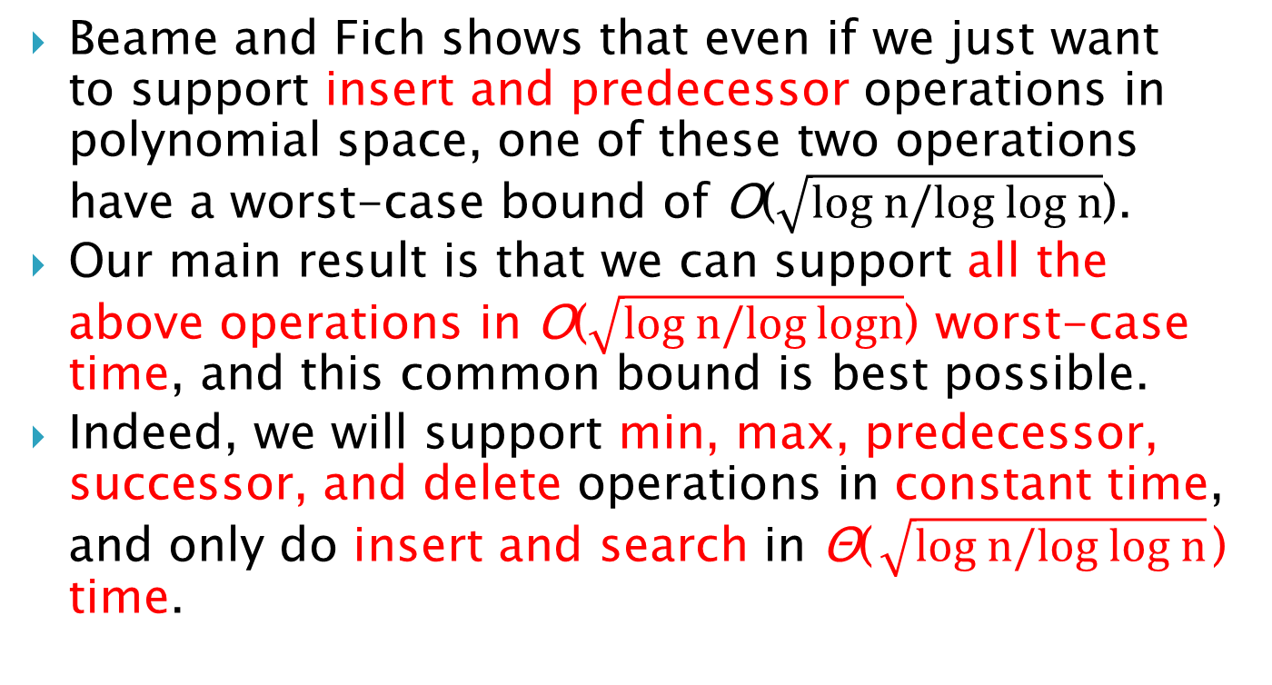
Optimality
Beame and Fich shows that even if we just want to support insert and predecessor operations in polynomial space, one of these two operations have a worst-case bound of O($\sqrt{\text{log} n/\text{log} \text{log} n}$).
Our main result is that we can support all the above operations in O($\sqrt{\text{log} n/\text{log} \text{log}n}$) worst-case time, and this common bound is best possible.
Indeed, we will support min, max, predecessor, successor, and delete operations in constant time, and only do insert and search in Θ($\sqrt{\text{log} n/\text{log} \text{log} n}$) time.

Slide 11
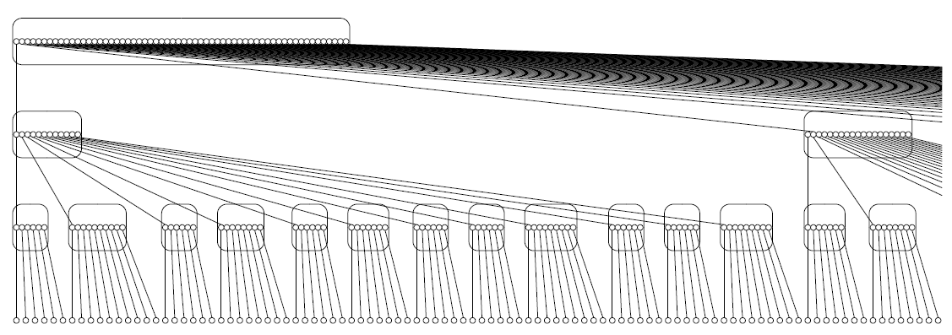

Exponential Search Tree
An exponential search tree on n keys is a search tree data structure where the root has Θ($n^{\frac{1}{c}}$) children, for a constant c > 1, and each child subtree is an exponential search tree on Θ($n^{1−\frac{1}{c}}$) keys.

Slide 12
Exponential Search Tree
The actual data is stored at the leaves.
Internal nodes store splitters for each child that is less than or equal to all nodes in the child subtree, and greater than all nodes in its left sibling subtree.
We require that the splitter of an internal node equals the splitter of its leftmost child.

Slide 13
Example
k₁, k_{2, …,} k₁₆，from small to large，c=2
k_{1,} k_{5,} k_{9,} k₁₃
k_{1,} k₃
k_{5,} k₇
k_{9,} k₁₁
k_{13,} k₁₅
k₁
k₂
k₃
k₄
k₅
k₆
k₇
k₈
k₉
k₁₀
k₁₁
k₁₂
k₁₃
k₁₄
k₁₅
k₁₆

Slide 14
Example2
k₁, k_{2, …,} k₅₁₂，c=3， 512=2⁹ so root has 2³=8 childes each for 2⁶=64 data
k_{1,} k_{65,} k_{129,} k_{193,} k_{193,} k_{257,} k_{321,} k_{385,}
5 more
……
k_{1,} k_{17,} k_{33,} k₄₉
k_{65,} k_{81,} k_{97,} k₁₁₃
k_{385,} k_{401,} k_{417,} k₄₃₃
k₁-k₁₆
k₁₇-k₃₂
k₃₃-k₄₈
k₄₉-k₆₄

Slide 15
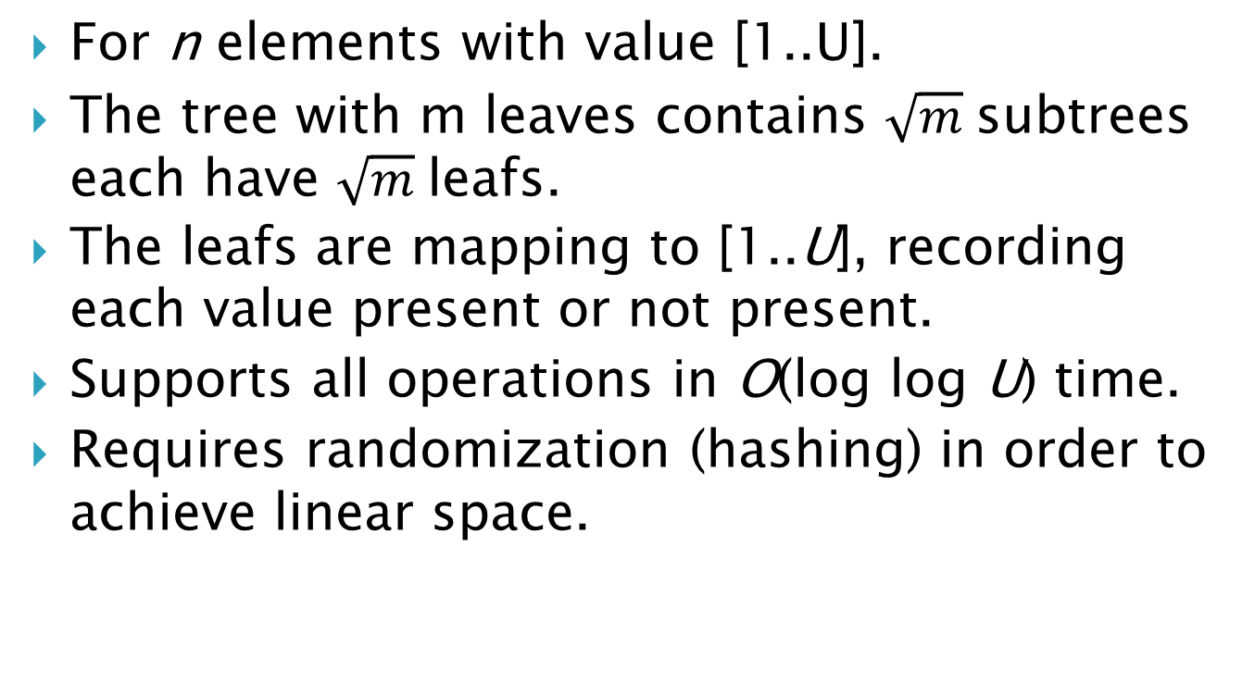
van Emde Boas Priority Queue
For n elements with value [1..U].
The tree with m leaves contains $\sqrt{m}$subtrees each have $\sqrt{m}$leafs.
The leafs are mapping to [1..U], recording each value present or not present.
Supports all operations in O(log log U) time.
Requires randomization (hashing) in order to achieve linear space.

Slide 16
Implementation
We will always maintain a sorted doubly-linked list with the stored keys and a distinguished head and tail.
With this list we support successor, predecessor, min, and max operations in constant time.
Then insertion subsumes a search identifying the key after which the new key is to be inserted.
Similarly, if we want to delete a key by value, rather than by a pointer to a key, a search, or look-up, identifies the key to be deleted, if any.

Slide 17
Outline
Introduction
Amortized exponential search tree
Worst case efficient exponential search tree
Static search structures
Finger Update
Finger Search
String Search

Slide 18
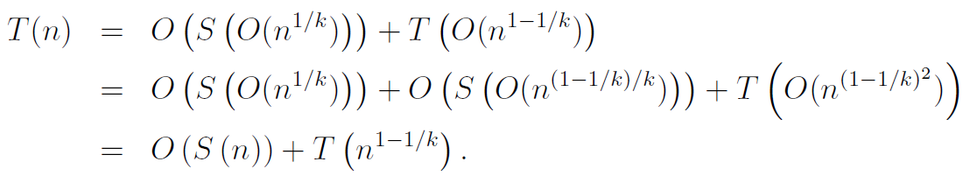
Implementation
In our exponential search trees, the local search at each internal node is performed using a static local search structure, called an S-structure.
We assume that an S-structure over d keys can be built in O(d^{k−1}) time and space and that it supports searches in S(d) time. The total search time T(n) is

Slide 19


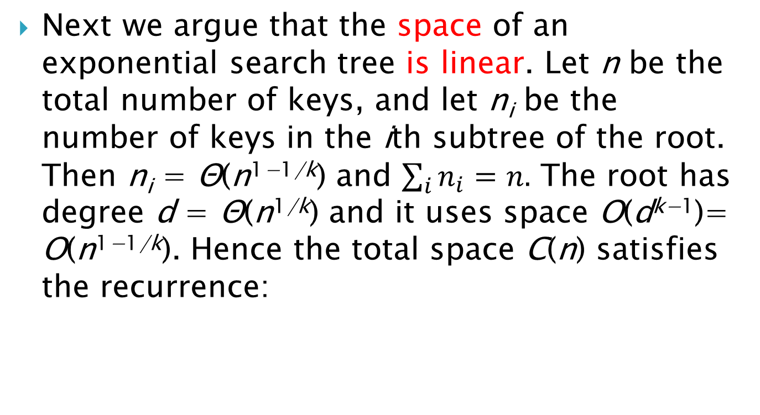
S-structure
Next we argue that the space of an exponential search tree is linear. Let n be the total number of keys, and let n_{i} be the number of keys in the ith subtree of the root. Then n_{i} = Θ(n^{1−1/k}) and $\sum_{i}{n_{i}}=n.$ The root has degree d = Θ(n^{1/k}) and it uses space O(d^{k−1})= O(n^{1−1/k}). Hence the total space C(n) satisfies the recurrence:

Slide 20
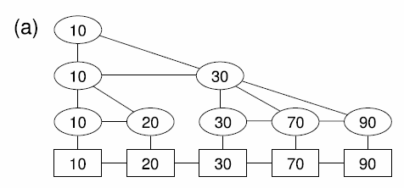
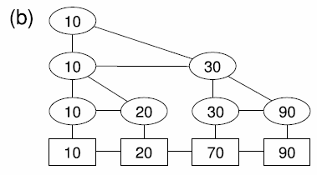
Finger Delete
A finger delete essentially just removes a leaf.
However, if the leaf was the first child of its parent, its splitter has to be transferred to the new first child.

Slide 21
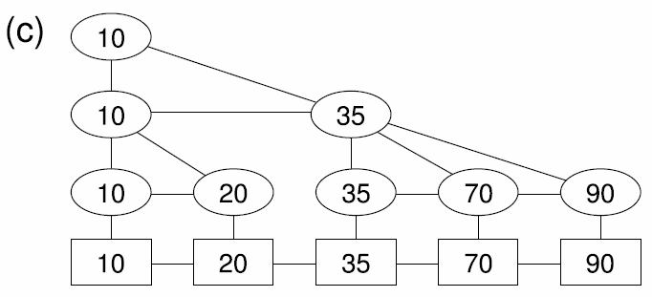
Finger Insert
For a finger insert of a key y, we get a reference (finger) to the key x after which y is to be inserted.
We then also have to consider the successor z of x. Let s be the splitter of z. If y < s, we place y after x under the parent of x, and let y be its own splitter. If y ≥ s, we place y before z under the parent of z, and give y splitter s and make z its own splitter.
s
x
z
y
25

Slide 22
Balance
When a subtree gets too heavy, by a factor of 2, we split it in two, and if it gets too light, by a factor of 2, we join it with its neighbor.
We can reconstruct the subtrees and update the parent’s S-structure in time linear in the weight of the subtrees.
Exceeding the weight constraints requires that a constant fraction of the keys in a subtree have been inserted and deleted since the subtree was constructed with proper weight. Thus, the reconstruction cost is an amortized constant per key inserted or deleted from a tree.

Slide 23
Since the depth of an exponential search tree is O(log log n), the update cost, excluding the search cost for finding out were to update, is O(log log n) amortized.

Slide 24
Outline
Introduction
Amortized exponential search tree
Worst case efficient exponential search tree
Static search structures
Finger Update
Finger Search
String Search

Slide 25
Main Change
In order to get from the amortized bounds above to worst-case bounds, we need a new type of data structure.
Instead of a data structure where we occasionally rebuild entire subtrees, we need a multiway tree which is something more in the style of a standard B-tree, where balance is maintained by locally joining and splitting nodes.
By locally we mean that the joining and splitting is done just by joining and splitting the children sequences.

Slide 26
Theorem 1
Suppose a static search structure on d integer keys can be constructed in O(d^{k−1}), k ≥ 2, time and space so that it supports searches in S(d) time. We can then construct a dynamic linear space search structure that with n integer keys supports insert, delete, and searches in time T(n) where T(n) ≤ T(n^{1−1/k})+O(S(n)). The reduction itself uses only standard AC⁰ operations.

Slide 27
Problem with the Previous Definition
The criteria when subtrees are too large or too small depend on their parents.
If two subtrees are joined, the resulting subtree is larger, and according to our recursive definition, this may imply that all of the children simultaneously become too small, so they have to be joined, etc.

Slide 28
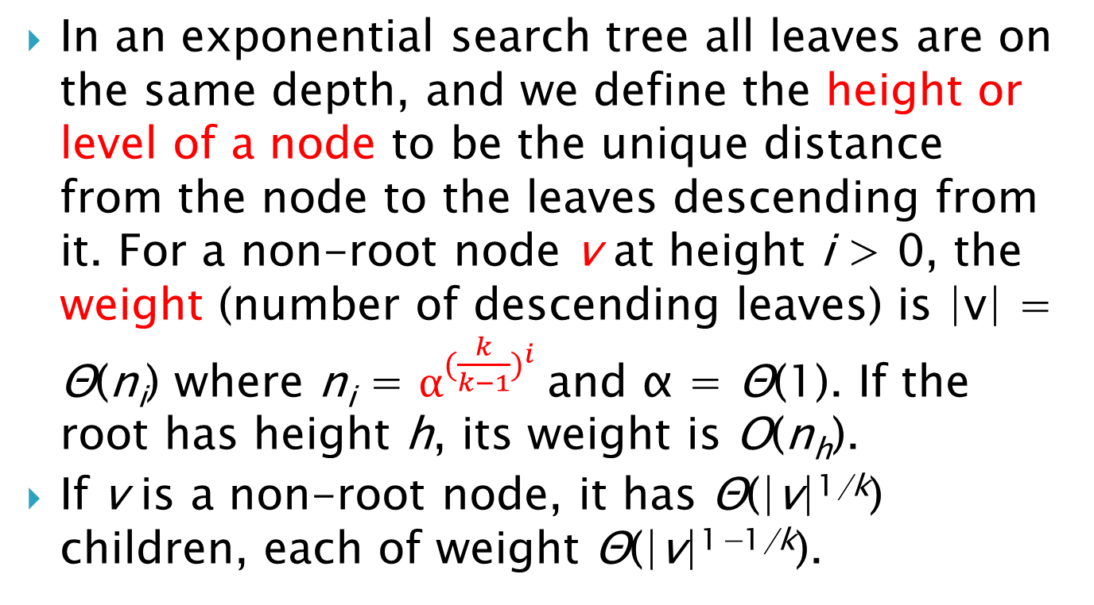
New Definition
In an exponential search tree all leaves are on the same depth, and we define the height or level of a node to be the unique distance from the node to the leaves descending from it. For a non-root node v at height i > 0, the weight (number of descending leaves) is |v| = Θ(n_{i}) where n_{i} = $α^{{(\frac{k}{k−1})}^{i}}$and α = Θ(1). If the root has height h, its weight is O(n_{h}).
If v is a non-root node, it has Θ(|v|^{1/k}) children, each of weight Θ(|v|^{1−1/k}).

Slide 29
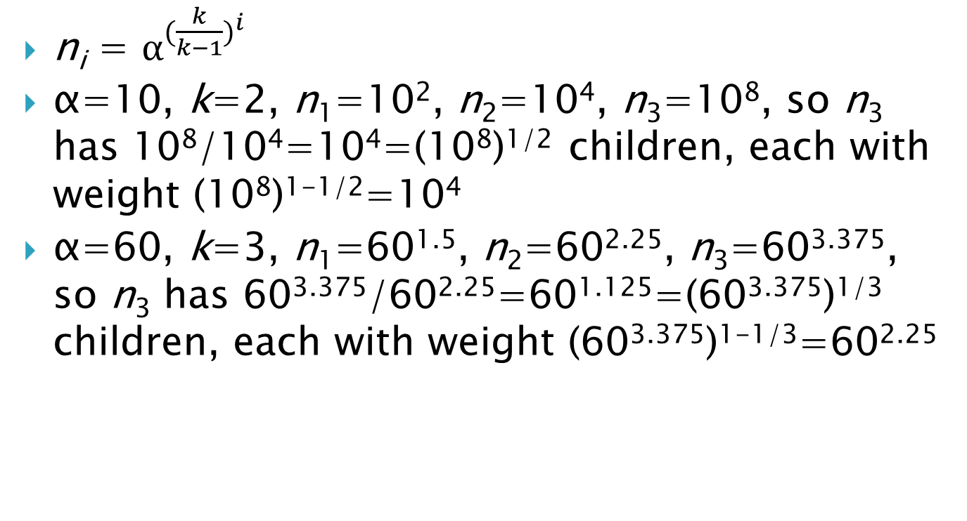
Example
n_{i} = $α^{{(\frac{k}{k−1})}^{i}}$
α=10, k=2, n₁=10², n₂=10⁴, n₃=10⁸, so n₃ has 10⁸/10⁴=10⁴=(10⁸)^{1/2} children, each with weight (10⁸)^{1-1/2}=10⁴
α=60, k=3, n₁=60^{1.5}, n₂=60^{2.25}, n₃=60^{3.375}, so n₃ has 60^{3.375}/60^{2.25}=60^{1.125}=(60^{3.375})^{1/3} children, each with weight (60^{3.375})^{1-1/3}=60^{2.25}

Slide 30
Compensation
Consider a process A that traverses a list. When A begins, the length of the list is m and A is given m steps to traverse the list, one element per step.
Now, assume that between two steps of A, another process B adds a new element to the list. Then, in order to ensure that A will not need any extra step, we let B compensate A by progressing A by one step.

Slide 31
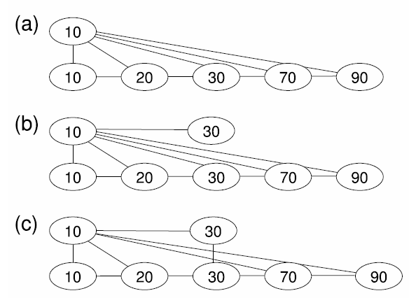
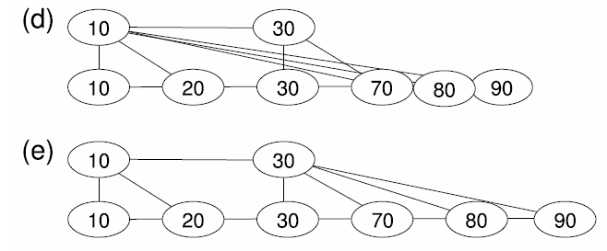
Example

Slide 32
Postprocessing
After each join or split, we want to allow for some unspecified postprocessing before the involved nodes can participate in new joins and splits.
This postprocessing time will, for example, be used to update parent pointers and S-structures.
If a data structure is changed by some other operation before the postprocessing is finished, the postprocessing will be compensated, and therefore it will always finish within the number of steps allocated.

Slide 33
Join & Split
Let u be the predecessor of v in their parent’s children list C.
A join of u and v
append the children list of v to that of u so that u adopts all these children from v.
delete v from C.
A split of a node u at its child w
add a new node v after u in the children list C of u’s parent
cut the children list of u just before w
make the last part the children list of v.

Slide 34
Join & Split
In the postprocessing of a join, the resulting node is not allowed to participate in any joins or splits.
In the postprocessing of a split, the resulting nodes are neither allowed to participate directly in a join or split, nor is the parent allowed to split between them.
Each round of postprocessing change 84 pointers.

Slide 35
Theorem 8
Given a number series n₁, n₂, . . ., with n₁ ≥ 84, n_{i+1} > 19n_{i}, we can schedule split and joins to maintain a multiway tree where each non-root node v on height i > 0 has weight between n_{i}/4 and n_{i}. A root node on height h > 0 has weight at most n_{h} and at least 2 children, so the root has weight at least n_{h−1}/2. The schedule gives the following properties:
When a leaf v is inserted or deleted, for each node u on the path from v to the root the schedule uses one local update step contributing to the postprocessing of at most one join or split involving either u or a neighbor of u. In addition to the local updates, the schedule spends constant time on each level.
For each split or join at level i the schedule ensures that we have n_{i}/84 local update steps available for postprocessing, including one at the time of the split or join.

Slide 36

Lemma 11
With α = max{84^{(k−1)/k}, ${19}^{{(k−1)}^{2}/k}$} and n_{i} = $α^{{(\frac{k}{k−1})}^{i}}$as in Definition 7, then n₁ ≥ 84 and n_{i+1}/n_{i} ≥ 19 for i ≥ 1.

Slide 37
Balance Game
Initial: Given a constant b and a list of weight between 24b and 58b
Balance: All weights are between 21b and 84b.
Destroyer
In each round, increase or decrease one of the weights by 1.
Cannot decrease the sum of all weights down below 24b.
Decide the two weights when splitting with the constraint that the difference is at most 7b

Slide 38
Balance Game
Keeper:
Join two neighboring weights or split one weights into two.
Each split or join is followed by a postprocessing requiring b steps during which the involved weights may not participate in any other split or join.
When it is our turn, we get to perform one such step.
Moreover, the step may only be performed locally in the sense of being on a postprocessing involving the weight last changed by the adversary, or a neighboring weight.

Slide 39
Let the Magic Start
We say a weight is involved if it is involved in a split or sum postprocessing; otherwise it is free.
If a weight gets up to 58b, we start splitting it.
If a weight v gets down to 24b and has a free neighbor w, we join v and w, untying w from any other neighbor.

Slide 40
If a free weight v gets down to 24b and has no free neighbors, we tie it to any one of its neighbors. If v later gets back up above 24b, it is untied again.
When we finish a join postprocessing
if the resulting weight is ≥ 58b, we immediately start splitting it. If a neighbor was tied to the joined weight, the tie is transferred to the nearest weight resulting from the split.
If the weight v resulting from the join is < 58b and v is tied by a neighbor, we join with the neighbor that tied v first.

Slide 41
At the end of a split postprocessing, if any of the resulting weights are tied by a neighbor, it joins with that neighbor. Note here that since resulting weights are not tied to each other, there cannot be a conflict.

Slide 42
Lemma 16
Each free weight is between 21b and 58b.
The weight in a join postprocessing is between 44b and 83b
In a split postprocessing, the total weight is at most 84b and the split weights are between 24.5b > 24b and 46b < 58b.
maximum uncuttable segment is of size at most 132b.
21, 24, 58, 84, 7

Slide 43
Applying the Protocol
For each level i < h, b_{i} = n_{i}/84 so 21b_{i} = n_{i}/4 and 84b_{i} = n_{i}
We can cut the list on level i with a difference of 132b_{i−1}. However, b_{i} ≥ 19b_{i−1}, so 132b_{i−1} < 7b_{i}
Three unresolved problems remain:
To implement splits in constant time, how do we find a good place to cut the children list?
How does the protocol apply as the height of the tree changes?
How do we actually find the nodes on the path from the leaf v to the root?

Slide 44
Cut Child
For each node v on level i, our goal is to maintain a good cut child in the sense that when cutting at that child, the lists will not differ by more than 7b_{i}.
We will always maintain the sum of the weights of the children preceding the cut child, and comparing that with the weight of v tells us if it is at good balance.
Move accordingly, a possible cut is always at most 4 children away.
If the cut child stops being cutable, we move in the direction that gives us the best balance

Slide 45
Cut Child
When a new list is created by a join or a split, we need to find a new good cut child.
We have at least b_{i} =n_{i}/84 update steps before the cut child is needed.
We can therefore start by making the cut child the leftmost child, and every time we receive an update step for the join, we move to the right, stopping when we are in balance.
Since the children list is of length O(n_{i}/n_{i−1}), we only need to move a constant number of children to the right in each update step in order to ensure balance before the postprocessing is ended.

Slide 46
Changing the Height
If the root is on height h, we only apply the protocol when it has weight at least 21b_{h}.
Before the split, the root has weight at most 84b_{h}, and this is the weight of the new root at height h + 1. However b_{h} ≤ b_{h+1}/19, so it will take many updates before the new root reaches the weight 21b_{h+1}.
At the join, the new root starts with weight at least 21b_{h}, so it has at least 21b_{h}/84b_{h−1}≥ 19/4 > 4 children. Hence it will survive long enough to pay for its construction.

Slide 47

Corollary 10
Suppose an S-structure for a node on height i can be built in O(n_{i−1}t_{i}) time. We can then maintain S-structures for the whole tree supporting a finger update in O(h+ $\sum_{i=1}^{h}{t_{i}}$) time where h is the current height of the tree.

Slide 48
Algorithm
An periodic rebuilding of the S-structure at each node v.
Starts by scanning the splitter list of the children of v in O(n_{i}/n_{i−1}) time.
Create a new S-structure in O(n_{i−1}t_{i}) time
In constant time, it replaces the old S-structure with the new S-structure.
The whole rebuilding is divided into n_{i−1}/160 steps, each taking O(t_{i}) time.

Slide 49
Algorithm
Every time an update contributes to a join or split postprocessing on level i − 1, we perform one step in the rebuilding of the S-structure of the parent p, which is on level i.
When two neighboring nodes u and v on level i−1 join to u
the next rebuilding of S(u) will automatically include the old children of v.
The maintenance of the disappearing node v, including rebuilding of S(v) when needed, is continued for all updates belonging under the old v; this maintenance is ended when the creation of S(u) for the joined node u is completed.
Furthermore, each step of rebuilding S(v) for the old v will also compensate the rebuilding of S(u)

Slide 50
Example
p
u
v
w
x
v join to u
rebuild take time p=16, u=8, v=8, w=4, x=4
Rebuild start time p=1, u=5, v=3, w=8, x=11
多(幾?)個工作同時執行的時間計算?
t | 1 | 2 | 3 | 4 | 5 | 6 | 7 | 8 | 9 | 10 | 11 | 12 | 13 | 14 | 15
Job | p1 | p2 | p3 v1 | p4 v2 | p5 u1 | p6 u2 | p7 u3 | p8 u4 w1 | p9 u5 w2 | p10 u6 w3 | p11 u7 w4 x1 | p12 u8 x2 | p13 x3 | p14 x4 | p15
v compensate
w point to u
v removed
x point to u

Slide 51
During the postprocessing of the join, we may, internally, have to forward keys between u and v.
If a key arrives at v from the S-structure of the parent and S(u) has been updated to take over S(v), the key is transferred to S(u).
Conversely, S(v) is still in use; if a key arriving at u is larger than or equal to the splitter of v it is transferred to S(v).
The split is implemented using the same ideas

Slide 52
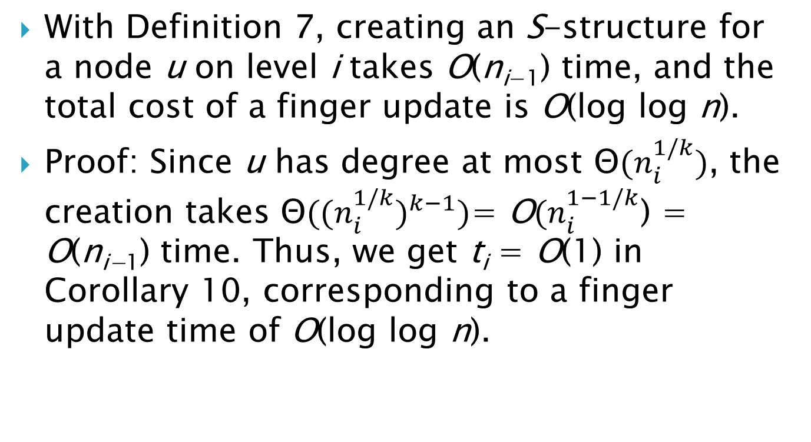
Lemma 12
With Definition 7, creating an S-structure for a node u on level i takes O(n_{i−1}) time, and the total cost of a finger update is O(log log n).
Proof: Since u has degree at most Θ${(n}_{i}^{1/k})$, the creation takes Θ${{((n}_{i}^{1/k})}^{k−1})$= O${(n}_{i}^{1−1/k}$) = O(n_{i−1}) time. Thus, we get t_{i} = O(1) in Corollary 10, corresponding to a finger update time of O(log log n).

Slide 53
Outline
Introduction
Amortized exponential search tree
Worst case efficient exponential search tree
Static search structures
Finger Update
Finger Search
String Search

Slide 54
RAM model
The memory is divided into addressable words of length W.
Addresses are themselves contained in words, so W ≥ log n.
Moreover, we have a constant number of registers, each with capacity for one word.
The basic instructions are: conditional jumps, direct and indirect addressing for loading and storing words in registers, comparisons, addition, and multiplication.

Slide 55
AC⁰ Operation
A computational instruction is an AC⁰ operation if it is computable by an W^{O(1)}-sized constant depth circuit with O(W) input and output bits.
In the circuit we may have negation, and-gates, and or-gates with unbounded fan-in.
Addition, shift, and bit-wise Boolean operations are all AC⁰ operations. On the other hand, multiplication is not.
In this paper, we will present a linear space worst-case time bound of O((log n)^{3/4+o(1)}) using only standard AC⁰ operations.

Slide 56
Outline
Introduction
Amortized exponential search tree
Worst case efficient exponential search tree
Static search structures
Finger Update
Finger Search
String Search

Slide 57
Finger Search
By finger search we mean that we can have a “finger” pointing at a stored key x when searching for a key y.
Here a finger is just a reference returned to the user when x is inserted or searched for.
The goal is to do better if the number q of stored keys between x and y is small.

Slide 58
Finger Update
For a finger insertion, we are given a finger to the key after which the new key is to be inserted.
The finger delete is just a regular delete as defined above, i.e. we are given a pointer to the key to be deleted.
In the comparison-based model of computation Dietz and Raman have provided optimal bounds, supporting finger searches in O(log q) time while supporting finger updates in constant time.
In this paper we present optimal bounds on the RAM; namely O($\sqrt{\text{log} q/\text{log} \text{log} q}$) for finger search with constant time finger updates.

Slide 59
Constant Time Finger Updates
The O(log log n) bound stems from the fact that when we insert or delete a leaf, we use a local update step for each level above the leaf.
Now, however, we only want to use a constant number of local update steps in connection with each leaf update.
The price is that we have less local update steps available for the postprocessing of joins and splits.

Slide 60
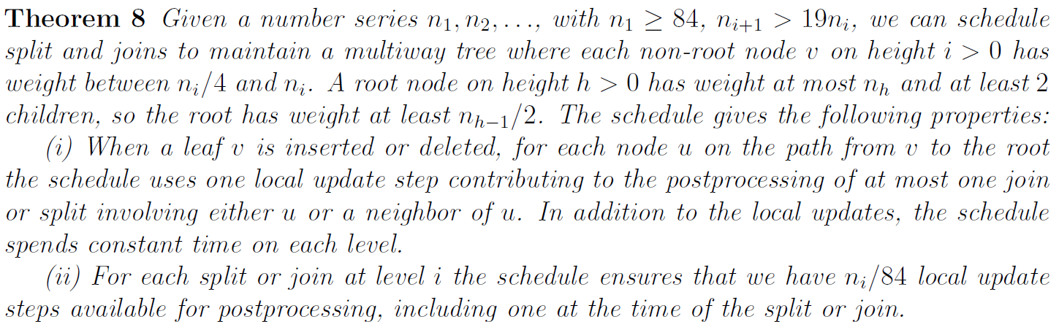
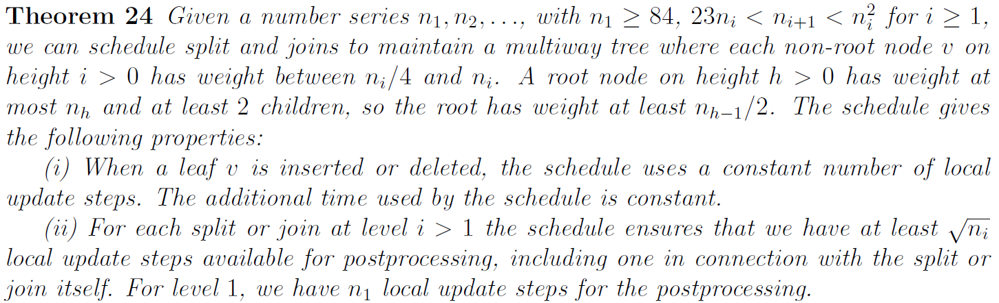

Slide 61
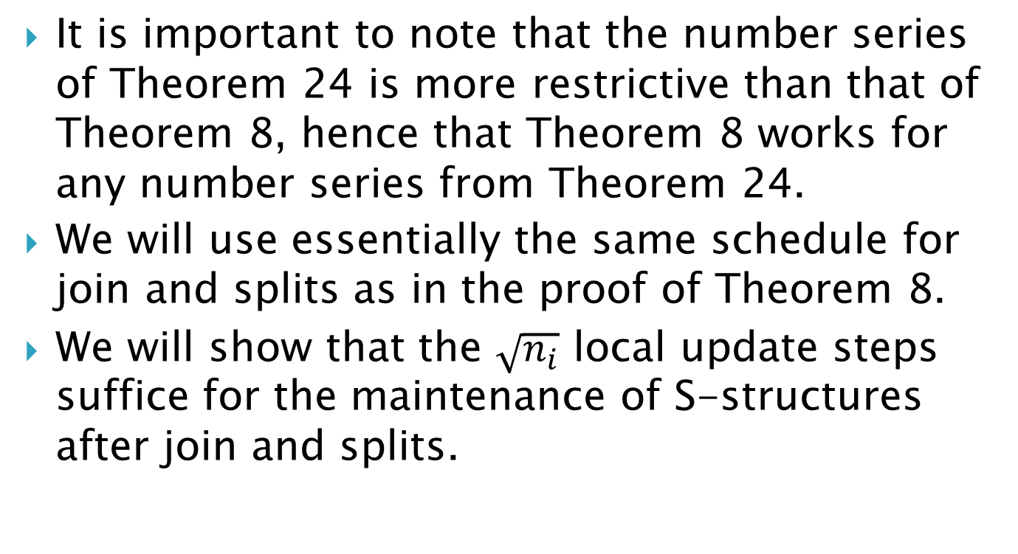
Constant Time Finger Updates
It is important to note that the number series of Theorem 24 is more restrictive than that of Theorem 8, hence that Theorem 8 works for any number series from Theorem 24.
We will use essentially the same schedule for join and splits as in the proof of Theorem 8.
We will show that the $\sqrt{n_{i}}$ local update steps suffice for the maintenance of S-structures after join and splits.

Slide 62
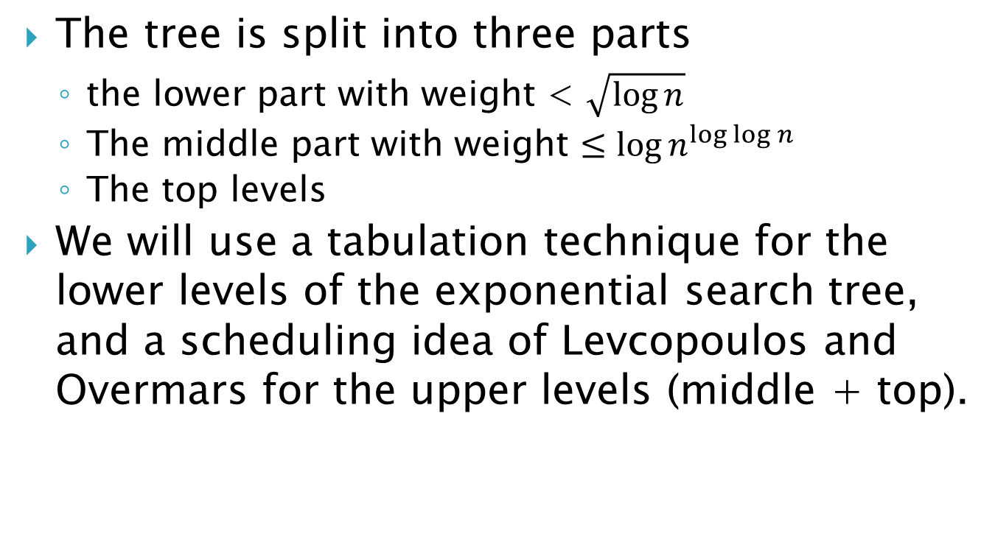
Constant Time Finger Updates
The tree is split into three parts
the lower part with weight < $\sqrt{\log{n}}$
The middle part with weight $≤{\log{n}}^{\log{\log{n}}}$
The top levels
We will use a tabulation technique for the lower levels of the exponential search tree, and a scheduling idea of Levcopoulos and Overmars for the upper levels (middle + top).

Slide 63
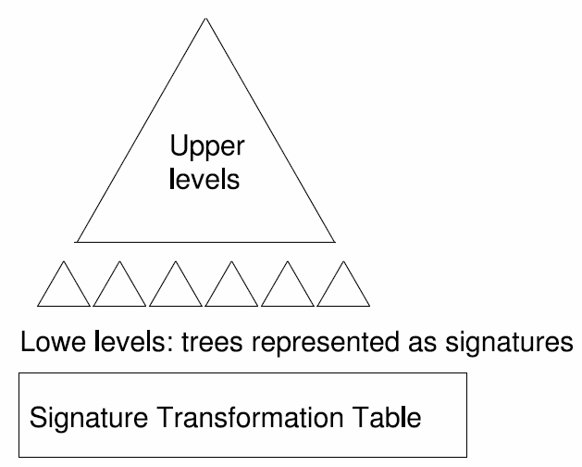
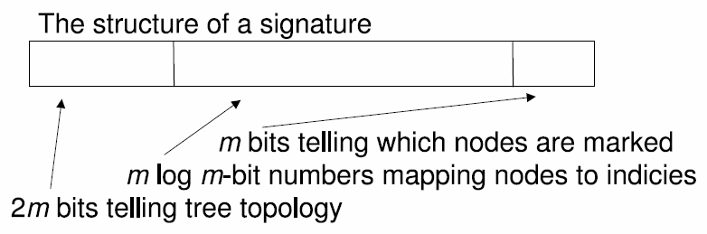

Slide 64
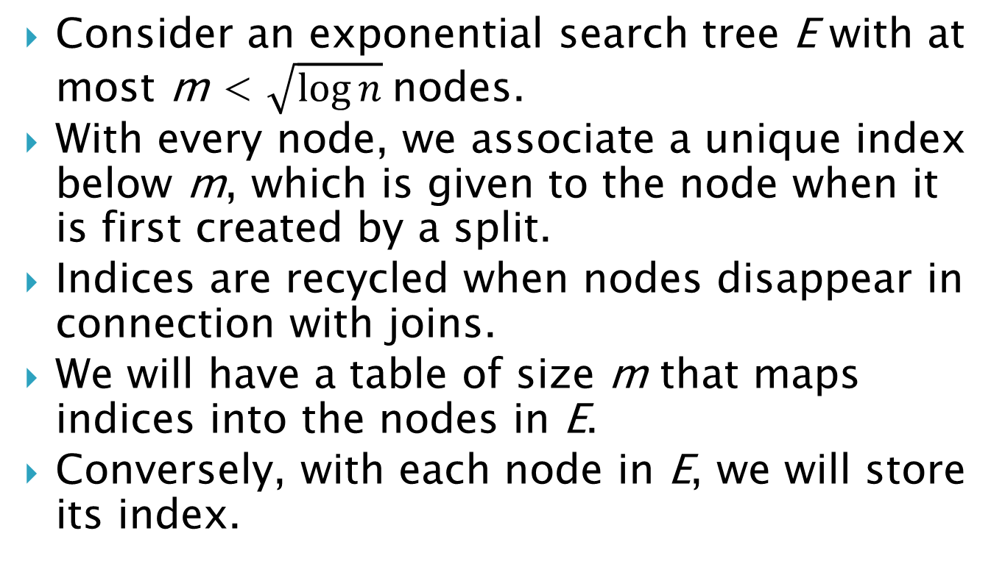
Lower-Level Trees
Consider an exponential search tree E with at most m < $\sqrt{\log{n}}$nodes.
With every node, we associate a unique index below m, which is given to the node when it is first created by a split.
Indices are recycled when nodes disappear in connection with joins.
We will have a table of size m that maps indices into the nodes in E.
Conversely, with each node in E, we will store its index.

Slide 65
Example
依序加入10, 5, 30, 15, 20, 50
1
10
3
30
15
5
2
4
20
5
6
50
10和30合併
加入45
10
10
1
n₁
1
n₆
n₄
n₅
2
4
5
6
n₂
2
n₃
4
3
5
6
5
15
20
50
5
15
45
20
50
1 | 2 | 3 | 4 | 5 | 6
n₁ | n₂ | n₄ | n₃ | n₅ | n₆

Slide 66
Signature
We call α_{E} = (τ_{E}, μ_{E}, γ_{E}) the signature of E.
τ_{E} representing the topology of E. More precisely, τ_{E} represents the depth first search traversal of E where 1 means go down and 0 means go up. Hence, τ_{E} has length 2m − 2.
μ_{E} maps depth first search numbers of nodes into indices.
γ_{E} for every node tells if it is marked.
Note that we have ≤ 2^{2m} × m^{m} × 2^{m} × O(m) = m^{O(m)} different signatures.

Slide 67
Example
7
0
1
0
1
1
3
0
1
0
1
0
1
0
1
0
1
2
4
5
6
8
τ_{E}=11010011010100
μ_{E}=71243568

Slide 68
Marking and Unmarking
When we insert or delete a leaf u, we will do 600 local update steps.
The place for these local update steps is determined based on a system of marking and unmarking nodes.
To place a local update step from a leaf u, we find its nearest unmarked ancestor v.
We then unmark all nodes on the path from u to v and mark v.
被mark的node可以做一次local update.

Slide 69
Lemma 26
Let v be a level i node. If there are s markings from leaves below v, then v gets marked at least (s − 2n_{i} )/2^{i+1} times.
這是非常低估的
以i=2, n₁=84, n₂=84*23+1=1933為例，level2的node至少有1933/4=484個leaf，只要把leaf node通通標一次, 再把每一個level 1 subtree選一個leaf delete再insert，則所有leaf+level 1 internal node都會被mark, 共執行了n₂+2*n₁<(25/23)n₂個步驟，之後的任何動作都會導致第2層的node被mark
84
84

Slide 70
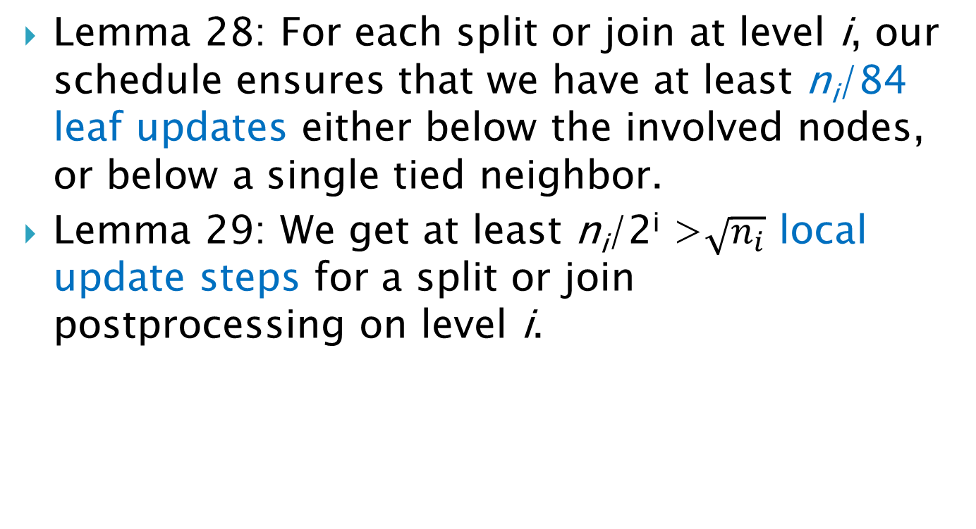
Lemma 28 & 29
Lemma 28: For each split or join at level i, our schedule ensures that we have at least n_{i}/84 leaf updates either below the involved nodes, or below a single tied neighbor.
Lemma 29: We get at least n_{i}/2^{i} >$\sqrt{n_{i}}$ local update steps for a split or join postprocessing on level i.

Slide 71
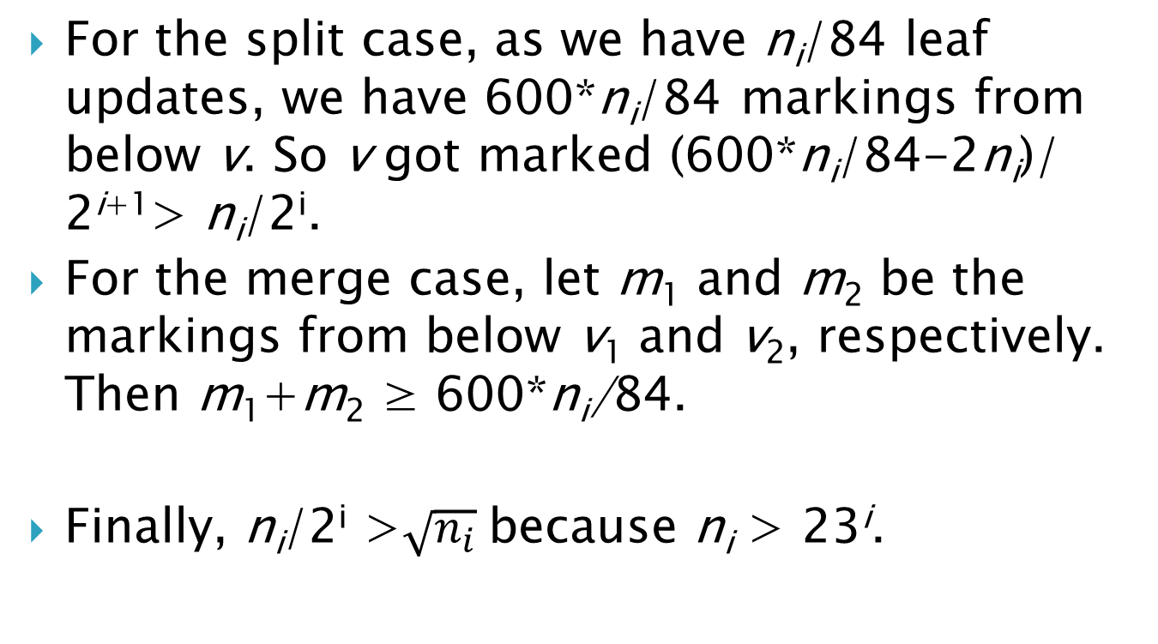
Proof of Lemma 29
For the split case, as we have n_{i}/84 leaf updates, we have 600*n_{i}/84 markings from below v. So v got marked (600*n_{i}/84-2n_{i})/ 2^{i+1}> n_{i}/2^{i}.
For the merge case, let m₁ and m₂ be the markings from below v₁ and v₂, respectively. Then m₁+m₂ ≥ 600*n_{i}/84.
Finally, n_{i}/2^{i} >$\sqrt{n_{i}}$because n_{i} > 23^{i}.

Slide 72
Tabulation Based Implementation
For each of the signatures, we tabulate what to do in connection with each possible leaf update.
For leaf insert or delete, the table gives the next signature.
For the local updates, the table produces the index of the node to be marked, hence at which to do a local update.
If a split or join is to be done, the transformation table produces the signature of the resulting tree.

Slide 73
Example – Leaf Delete
7
7
1
3
1
3
2
4
5
6
8
2
4
5
8
τ_{E}=11010011010100
μ_{E}=71243568
γ_{E}=01101111
τ_{E}=110100110100
μ_{E}=7124358
γ_{E}=0110111

Slide 74
Example – Local Update
7
0
7
1
3
0
0
1
3
1
2
4
5
6
8
2
4
5
6
8
τ_{E}=11010011010100
μ_{E}=71243568
γ_{E}=01101111
τ_{E}=110100110100
μ_{E}=71243568
γ_{E}=11100101

Slide 75
Example – Split
7
7
1
3
1
3
9
2
4
5
6
8
2
4
5
6
8
τ_{E}=11010011010100
μ_{E}=71243568
γ_{E}=01101111
τ_{E}=1101001101001100
μ_{E}=712435698
γ_{E}=011011101

Slide 76
Tabulation Based Implementation
The entire transformation table can easily be constructed in m^{O(m)} = o(n) time and space.
Furthermore, each signature occupies O(log n) bits, so we can update the signature of a tree in constant time.

Slide 77
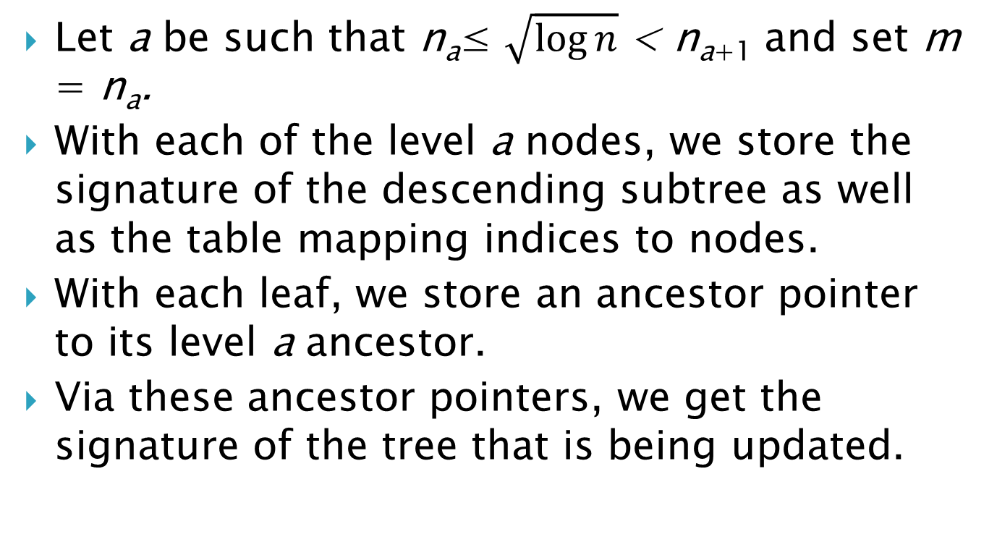
Tabulation Based Implementation
Let a be such that n_{a}≤ $\sqrt{\log{n}}$< n_{a+1} and set m = n_{a}.
With each of the level a nodes, we store the signature of the descending subtree as well as the table mapping indices to nodes.
With each leaf, we store an ancestor pointer to its level a ancestor.
Via these ancestor pointers, we get the signature of the tree that is being updated.

Slide 78
Joining at Level a
When level a nodes u and v get joined into u, we temporarily allow indices up to 2m− 1, and add m to the indices of nodes descending from v.
A table takes the signatures of the subtrees of u and v and produce the signature for the joined tree with these new indices.
Also, we place a forward pointer from v to u, so that nodes below v can find their new ancestor in constant time.
To get the index of a node, we take its current ancestor pointer. If it points to a node with a forward pointer, we add m to the stored index.
Conversely, given an index, if it is not less than m, this tells us that we should use the old table from v, though subtracting m from the index.

Slide 79
Joining at Level a
m=6
1
2
1
2
1
2
4
1
2
4
7
2
4
3
τ_{E}=1010
μ_{E}=124
γ_{E}=111
τ_{E}=10
μ_{E}=21
γ_{E}=11
τ_{E}=1010
μ_{E}=124
γ_{E}=111
τ_{E}=10
μ_{E}=27
γ_{E}=11
τ_{E}=101010
μ_{E}=1243
γ_{E}=1111

Slide 80
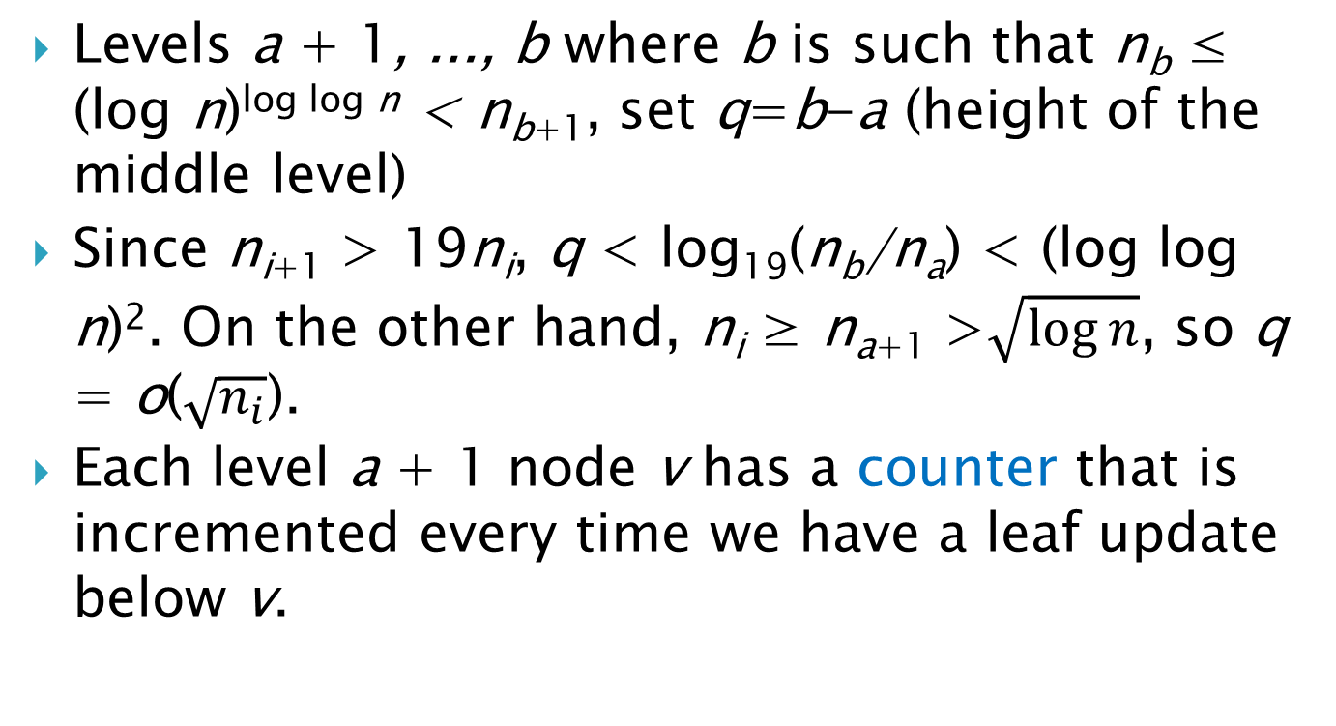
Middle Level Updates
Levels a + 1, ..., b where b is such that n_{b} ≤ (log n)^{log log n} < n_{b+1}, set q=b-a (height of the middle level)
Since n_{i+1} > 19n_{i}, q < log₁₉(n_{b}/n_{a}) < (log log n)². On the other hand, n_{i} ≥ n_{a+1} >$\sqrt{\log{n}}$, so q = o($\sqrt{n_{i}}$).
Each level a + 1 node v has a counter that is incremented every time we have a leaf update below v.

Slide 81
Counter Game
Lemma 30
Given p counters, all starting at zero, and an adversary incrementing these counters arbitrarily.
Every time the adversary has made q increments, the increments being by one at the time, we subtract q from some largest counter, or set it to zero if it is below q.
Then the largest possible counter value is Θ(q log p).

Slide 82
Lemma 31
Spending constant time per counter increment, the largest counter to be reduced can be found in constant time.
We simply maintain a doubly linked sorted list of counter values, and with each value we have a bucket containing the counters with that value.

Slide 83
Middle-Level Updates
We make an independent schedule for the subtree descending from each level b node u.
Once for every q updates below u, we pick a descending level i node with the largest counter, do a local update at v, and subtract q from the counter.
During the next q −1 leaf updates below u, we follow the path up from v to u, doing a local update at each node on the way.

Slide 84
Middle-Level Updates
A largest counter below u is maintained as described in Lemma 31.
The number of counters below u is at most p = n_{b}/(n_{a}/4), so by Lemma 30, the maximal counter value is O(q log p) = O((log n_{b})²) = O((log log n)⁴).
Consider a level i node w. The maximal number of counters below w is n_{i}/(4n_{a+1}), so their total value is at most

Slide 85
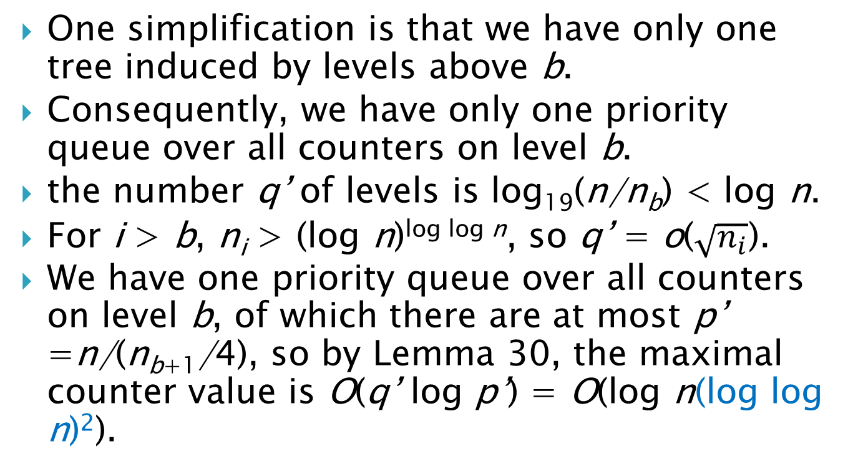
Top-Level Updates
One simplification is that we have only one tree induced by levels above b.
Consequently, we have only one priority queue over all counters on level b.
the number q’ of levels is log₁₉(n/n_{b}) < log n.
For i > b, n_{i} > (log n)^{log log n}, so q’ = o($\sqrt{n_{i}}$).
We have one priority queue over all counters on level b, of which there are at most p’ =n/(n_{b+1}/4), so by Lemma 30, the maximal counter value is O(q’ log p’) = O(log n(log log n)²).

Slide 86
Top-Level Updates
Now, for i > b, consider a level i node w. The maximal number of counters below w is n_{i}/(4n_{b+1}), so their total value is at most

Slide 87
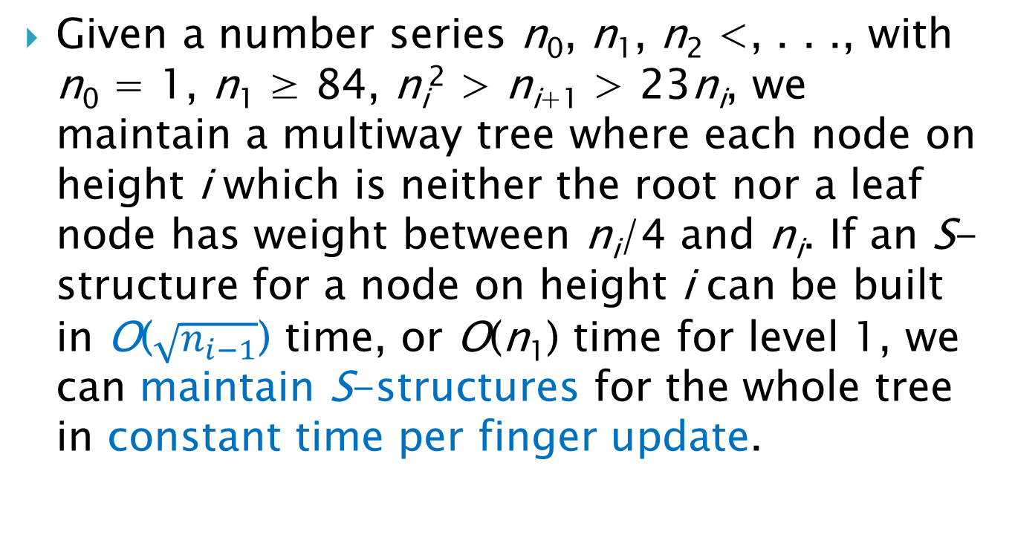
Corollary 32
Given a number series n₀, n₁, n₂ <, . . ., with n₀ = 1, n₁ ≥ 84, n_{i}² > n_{i+1} > 23n_{i}, we maintain a multiway tree where each node on height i which is neither the root nor a leaf node has weight between n_{i}/4 and n_{i}. If an S-structure for a node on height i can be built in O($\sqrt{n_{i−1}}$) time, or O(n₁) time for level 1, we can maintain S-structures for the whole tree in constant time per finger update.

Slide 88
Outline
Introduction
Amortized exponential search tree
Worst case efficient exponential search tree
Static search structures
Finger Update
Finger Search
String Search

Slide 89
Finger Search
For finger searching we have a finger pointing at a key x while searching for another key y.
Let q be the number of keys between x and y.
The idea of finger search is that we should be able to find y quickly if q is small.
Here, we also consider another possibility: the search should be fast if y − x is small.

Slide 90
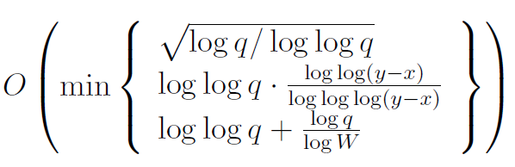
Finger Search
There is a fully-dynamic deterministic linear space search structure that supports finger updates in constant time, and given a finger to a stored key x, searches a key y > x in time
where q is the number of stored keys between x and y.

Slide 91
Theorem 33
Suppose a static search structure on d integer keys can be constructed in O(d^{(k−1)/2}), k ≥ 2, time and space so given a finger to a stored key x, we can search a key y > x in time S(d, y − x).
We can then construct a dynamic linear space search structure that with n integer keys supports finger updates in time constant time and finger searches in time T(q, y − x) where q is the number of stored keys between x and y and T(n, y − x) ≤ T(n^{1−1/k}, y − x) + O(S(n, y − x)). Here S is supposed to be non-decreasing in both arguments. The reduction itself uses only standard AC⁰ operations.

Slide 92
Finger Search
We use an exponential search tree where on each level we have horizontal links between neighboring nodes.
To search for y > x, given a finger to x, we first traverse the path up the tree from the leaf containing x.
At each level, we examine the current node and its right neighbor until a node v is found that contains y.
Here the right neighbor is found in constant time using the horizontal links between neighbors.

Slide 93
Finger Search
By definition of v, y does not belong to u’, and hence all keys below u’ are between x and y. It follows that q ≥n(u’ ) ≥ n_{i−1}/10.
v (…, x’, …)
u
u'
w
x
y

Slide 94
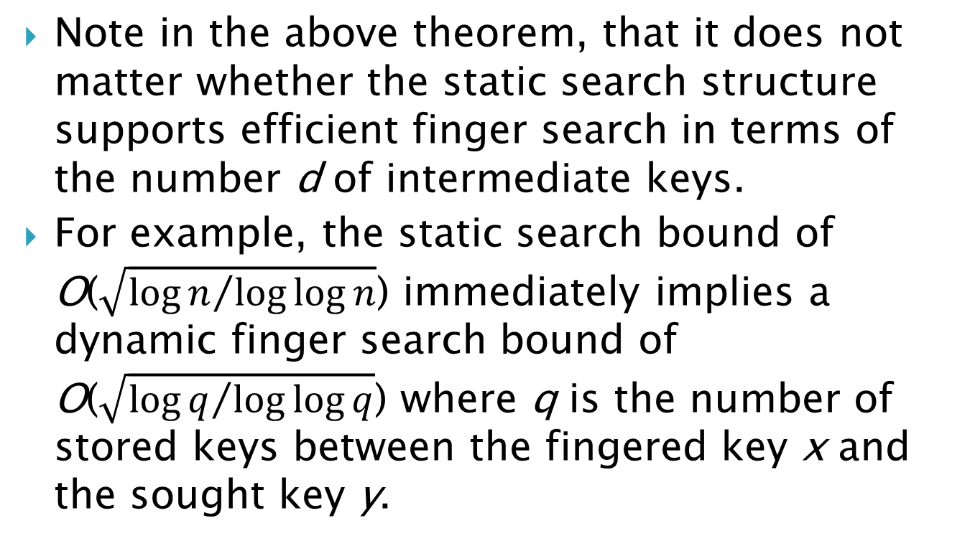
First Complexity
Note in the above theorem, that it does not matter whether the static search structure supports efficient finger search in terms of the number d of intermediate keys.
For example, the static search bound of O($\sqrt{{\log{n}}/{\log{\log{n}}}}$) immediately implies a dynamic finger search bound of O($\sqrt{{\log{q}}/{\log{\log{q}}}}$) where q is the number of stored keys between the fingered key x and the sought key y.

Slide 95
Lemma 34
A data structure storing a set X of d keys from a universe of size U can be constructed in d^{O(1)} time and space such that given a finger to stored key x ∈ X, we search a key y > x in time O(log log(y − x)/ log log log(y − x)).

Slide 96
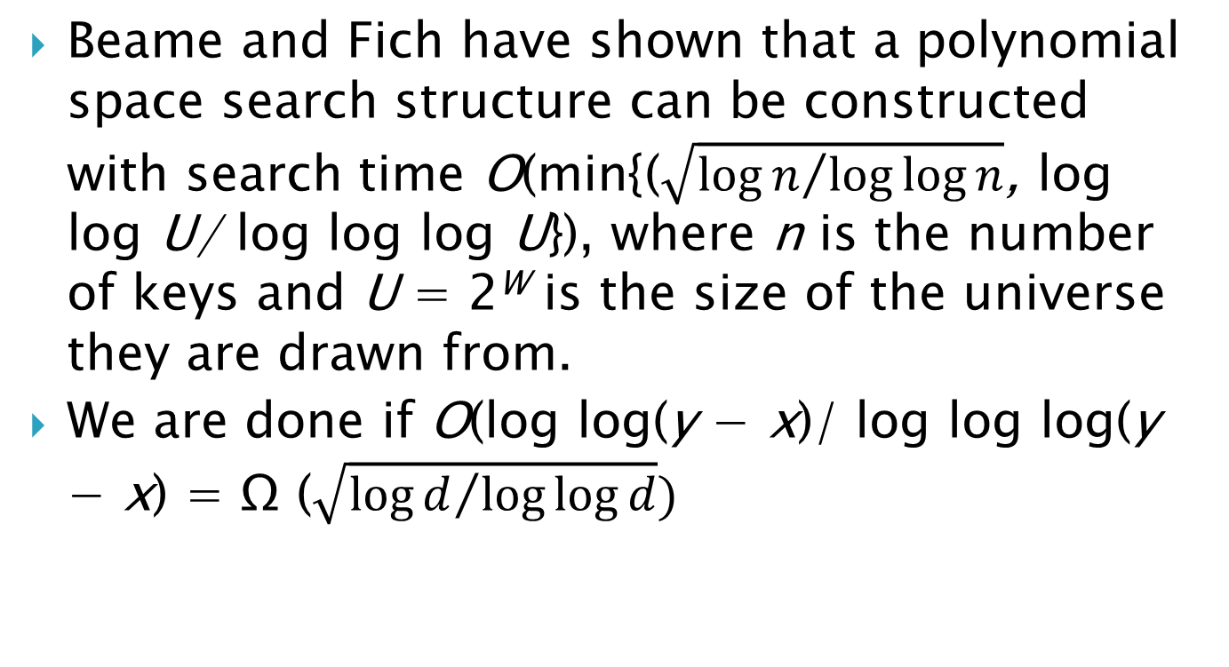
Case 1: y − x ≥ 2^{d}
Beame and Fich have shown that a polynomial space search structure can be constructed with search time O(min{($\sqrt{{\log{n}}/{\log{\log{n}}}}$, log log U/ log log log U}), where n is the number of keys and U = 2^{W} is the size of the universe they are drawn from.
We are done if O(log log(y − x)/ log log log(y − x) = Ω ($\sqrt{{\log{d}}/{\log{\log{d}}}})$

Slide 97
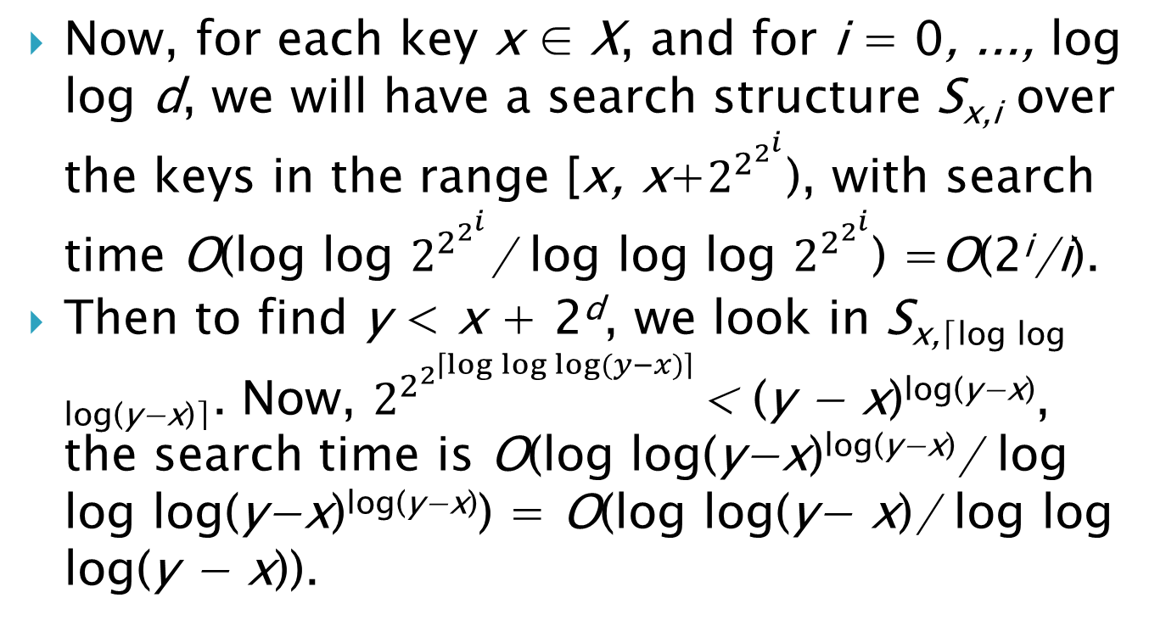
Case 2: y − x < 2^{d}
Now, for each key x ∈ X, and for i = 0, ..., log log d, we will have a search structure S_{x,i} over the keys in the range [x, x+$2^{2^{2^{i}}}$), with search time O(log log $2^{2^{2^{i}}}$/ log log log $2^{2^{2^{i}}}$) =O(2^{i}/i).
Then to find y < x + 2^{d}, we look in S_{x,⌈log log log(y−x)⌉}. Now, $2^{2^{2^{\left\lceil \log{\log{\log{(y−x)}}}\right\rceil }}}$< (y − x)^{log(y−x)}, the search time is O(log log(y−x)^{log(y−x)}/ log log log(y−x)^{log(y−x)}) = O(log log(y− x)/ log log log(y − x)).

Slide 98
Outline
Introduction
Amortized optimal exponential search tree
Worst case optimal exponential search tree
Static search structures
Finger Search
String Search

Slide 99
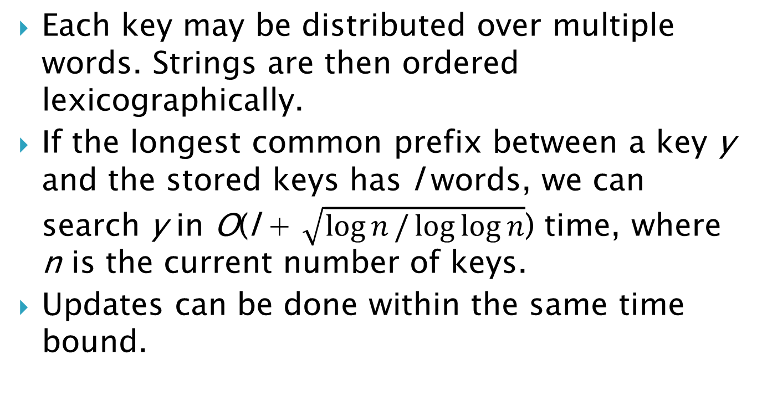
String Searching
Each key may be distributed over multiple words. Strings are then ordered lexicographically.
If the longest common prefix between a key y and the stored keys has l words, we can search y in O(l + $\sqrt{\log{n}/\log{\log{n}}}$) time, where n is the current number of keys.
Updates can be done within the same time bound.

Slide 100
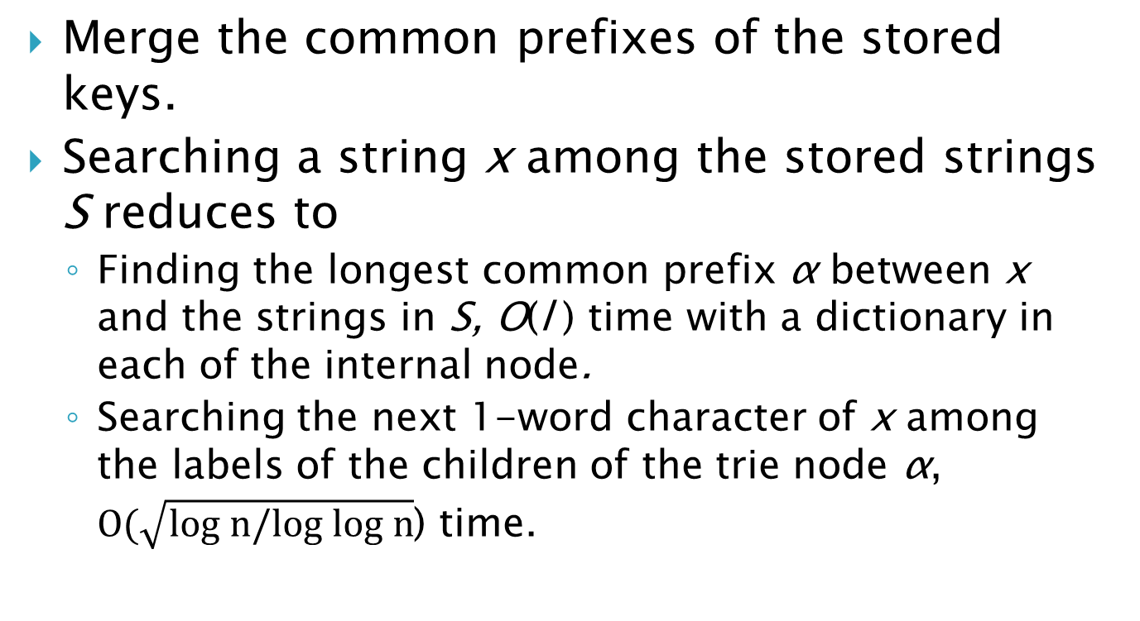
Static Trie
Merge the common prefixes of the stored keys.
Searching a string x among the stored strings S reduces to
Finding the longest common prefix α between x and the strings in S, O(l ) time with a dictionary in each of the internal node.
Searching the next 1-word character of x among the labels of the children of the trie node α, $O(\sqrt{\text{log} n/\text{log} \text{log} n}$) time.

Slide 101
Dynamic Trie
Our new idea is to only use the constant time dictionaries for some of the children of a node, called the dictionary children.
The dictionary children for a node α with m descending leaves will have more than m^{1−1/k} leaf descendants so they are guaranteed to remain for a long time.
We can therefore afford to store them in a constant time dictionary which is rebuilt slowly in the background.

Slide 102
Main Ideas
We construct the dictionary over the dictionary children using linear space and is constructed in O(n^{k−1}) time for any fixed k > 3.
Now suppose a search arrives at α and the next character is a
If a is in the dictionary, we get to the child labeled a in constant time (case 1)
If a is not in the dictionary, we use the search structure at α.
If the label a is found by the search structure, it brings us to the child labeled a. (case 2a)
Otherwise there was no child of α labeled a. (case 2b)

Slide 103
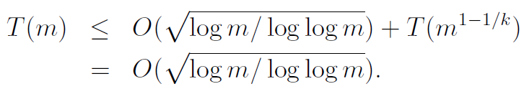
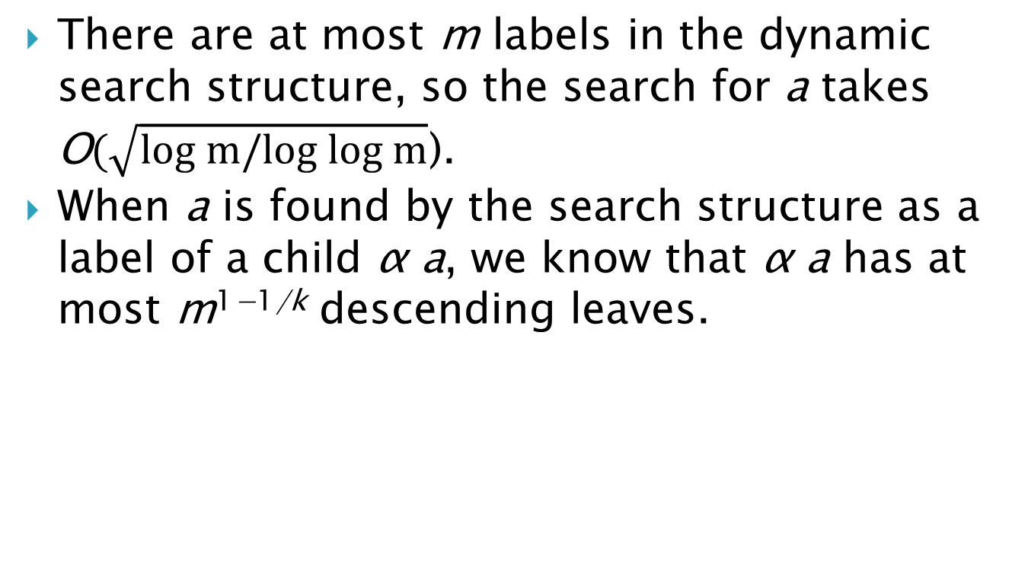
Case 2a
There are at most m labels in the dynamic search structure, so the search for a takes O$(\sqrt{\text{log} m/\text{log} \text{log} m}$).
When a is found by the search structure as a label of a child α a, we know that α a has at most m^{1−1/k} descending leaves.

Slide 104
Trie Update
Suppose the node α has m leaf descendants. Our challenge is to make sure that its dictionary contains the label of any child β with more than m^{1−1/k} leaf descendants.
The period of α spans m^{1−1/k}/4 leaf updates below α.
To keep track of the dictionary children of α, we maintain an unordered doubly-linked “heavy” list of all children with more than m^{1−1/k}/2 descending leaves.

Slide 105
Trie Update
In a period, we first scan the heavy list, and then build a dictionary over the labels of the scanned children.
When the new dictionary is completed, it replaces the previous one in constant time.
A scanned heavy child will continue to have at least m^{1−1/k}/4 descending leaves, so we collect at most m/(m^{1−1/k}/4) = O(m^{1/k}) children.
Constructing a dictionary over the labels takes O(m^{1/k*(k−1)}) = O(m^{1−1/k}) time.

Slide 106
Trie Update
The whole scan and rebuild can thus be completed spending only constant time during each of the m^{1−1/k}/4 updates below α during a period.
Then no child can have more than m^{1−1/k} descending leaves without having its label in the current heavy dictionary; for to get m^{1−1/k} descending leaves, it must have had m^{1−1/k}/2 descending leaves for at least m^{1−1/k}/2 updates. This must include one full period where it got scanned in the heavy list and placed in the new dictionary.

