Slide 1
Predicting residue–residue contacts using random forest models
Yunqi Li, Yaping Fang and Jianwen Fang
Bioinformatics,
Vol. 27, No. 24, pp. 3379–3384, 2011
2013-03-12
Presented by Chiou-Yi Hor

Slide 2
Abstract
Motivation: Protein residue–residue contact prediction can be useful in predicting protein 3D structures. Current algorithms for such a purpose leave room for improvement.
Availability: http://www.abl.ku.edu/proc/proc_s3.html.
Contact: jwfang@ku.edu
Supplementary Information: Supplementary data are available at Bioinformatics online.

Slide 3
Abstract
Results: We develop ProC_S3, a set of Random Forest algorithm-based models, for predicting residue–residue contact maps. The models are constructed based on a collection of 1490 non– redundant, high-resolution protein structures using >1280 sequence-based features. A new amino acid residue contact propensity matrix and a new set of seven amino acid groups based on contact preference are developed and used in ProC_S3. ProC_S3 delivers a 3-fold cross-validated accuracy of 26.9% with coverage of 4.7% for top L/5 predictions (L is the number of residues in a protein) of long-range contacts (sequence separation≥24). Further benchmark tests deliver an accuracy of 29.7% and coverage of 5.6% for an independent set of 329 proteins. In the recently completed Ninth Community Wide Experiment on the Critical Assessment of Techniques for Protein Structure Prediction (CASP9), ProC_S3 is ranked as No. 1, No. 3, and No. 2 accuracies in the top L/5, L/10 and best 5 predictions of long-range contacts, respectively, among 18 automatic prediction servers.

Slide 4
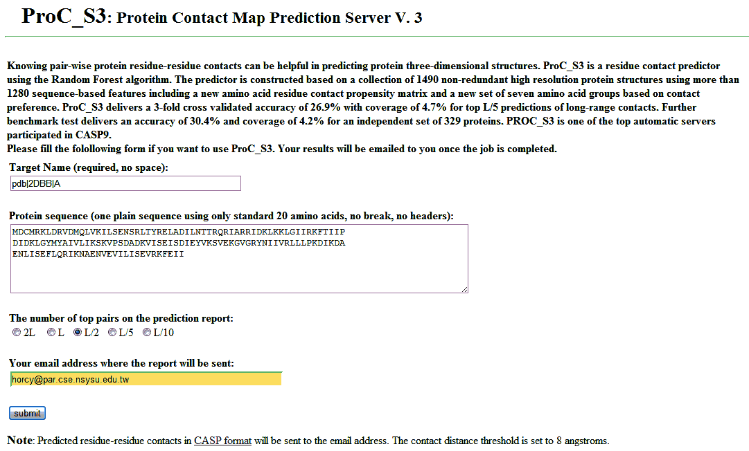
Predicting residue–residue contacts using random forest models
http://www.abl.ku.edu/proc/proc_s3.html

Slide 5

ProC_S3 output (submitted after 2 days)
PFRMAT RR
TARGET pdb_2DBBA
AUTHOR ProC_S3
METHOD RR contact predictor ProC_S3, Applied Bioinformatics Laboratory, University of Kansas
MODEL 1
MDCMRKLDRVDMQLVKILSENSRLTYRELADILNTTRQRIARRIDKLKKLGIIRKFTIIP
DIDKLGYMYAIVLIKSKVPSDADKVISEISDIEYVKSVEKGVGRYNIIVRLLLPKDIKDA
ENLISEFLQRIKNAENVEVILISEVRKFEII
30 36 0 8 0.90000
30 37 0 8 0.85300
18 24 0 8 0.83900
47 53 0 8 0.83100
128 134 0 8 0.76300
30 40 0 8 0.75900
114 120 0 8 0.75800
89 95 0 8 0.74700
48 54 0 8 0.73500
18 25 0 8 0.68500
27 37 0 8 0.67900
76 82 0 8 0.66700
99 105 0 8 0.66400
113 120 0 8 0.66400
19 25 0 8 0.66300
26 37 0 8 0.63500
47 54 0 8 0.63400
62 68 0 8 0.63100
62 69 0 8 0.62800
128 137 0 8 0.62300
75 82 0 8 0.62100
74 82 0 8 0.61900
100 106 0 8 0.60900
99 107 0 8 0.60600
31 37 0 8 0.60100
18 29 0 8 0.59800
99 106 0 8 0.59600
99 108 0 8 0.59600
18 26 0 8 0.59600
100 107 0 8 0.59400
44 53 0 8 0.59300
102 108 0 8 0.59200
19 26 0 8 0.58300
15 26 0 8 0.56600
52 58 0 8 0.56300
44 54 0 8 0.56000
129 135 0 8 0.55900
101 107 0 8 0.55400
112 120 0 8 0.54600
129 136 0 8 0.54100
100 108 0 8 0.53900
90 96 0 8 0.53800
75 81 0 8 0.53600
29 40 0 8 0.53600
59 69 0 8 0.53200
59 70 0 8 0.52700
29 35 0 8 0.52700
15 25 0 8 0.52500
58 69 0 8 0.52100
98 108 0 8 0.51700
74 85 0 8 0.51400
1 7 0 8 0.51400
89 96 0 8 0.51400
101 108 0 8 0.51100
33 40 0 8 0.50700
63 69 0 8 0.50500
48 55 0 8 0.50300
51 58 0 8 0.50000
47 58 0 8 0.50000
30 39 0 8 0.49600
15 24 0 8 0.49400
17 24 0 8 0.49300
89 98 0 8 0.49300
17 23 0 8 0.49200
60 69 0 8 0.49000
34 40 0 8 0.48800
61 69 0 8 0.48700
128 135 0 8 0.48600
30 38 0 8 0.48300
48 58 0 8 0.48000
128 139 0 8 0.48000
131 137 0 8 0.47700
99 109 0 8 0.47400
17 26 0 8 0.47000
60 70 0 8 0.47000
14 29 0 8 0.67500
14 33 0 8 0.64000
15 29 0 8 0.63500
58 71 0 8 0.58600
17 29 0 8 0.58400
57 74 0 8 0.57400
58 70 0 8 0.57200
58 72 0 8 0.57200
57 72 0 8 0.57200
56 73 0 8 0.57100
57 71 0 8 0.57000
15 30 0 8 0.56900
26 40 0 8 0.56400
56 74 0 8 0.56300
57 73 0 8 0.55900
59 71 0 8 0.55400
18 40 0 8 0.55300
56 72 0 8 0.54100
15 33 0 8 0.53600
55 73 0 8 0.53200
58 73 0 8 0.52800
56 75 0 8 0.52600
56 71 0 8 0.51900
58 74 0 8 0.51800
55 74 0 8 0.51500
72 85 0 8 0.51400
72 95 0 8 0.51400
57 70 0 8 0.51200
57 69 0 8 0.51000
26 41 0 8 0.51000
44 58 0 8 0.50800
10 33 0 8 0.50800
55 75 0 8 0.50600
44 56 0 8 0.50500
59 73 0 8 0.50400
18 30 0 8 0.50200
85 98 0 8 0.50000
14 30 0 8 0.49900
95 109 0 8 0.49800
59 72 0 8 0.49500
26 44 0 8 0.49000
15 35 0 8 0.48900
60 72 0 8 0.48900
29 44 0 8 0.48800
74 95 0 8 0.48700
109 131 0 8 0.48700
55 72 0 8 0.48400
86 98 0 8 0.48300
57 75 0 8 0.48300
55 77 0 8 0.47800
44 57 0 8 0.47600
40 58 0 8 0.47400
56 70 0 8 0.47400
89 109 0 8 0.47400
59 74 0 8 0.47200
96 109 0 8 0.47100
124 139 0 8 0.47100
56 76 0 8 0.47100
14 35 0 8 0.47100
18 33 0 8 0.46900
53 72 0 8 0.46700
14 26 0 8 0.46700
53 71 0 8 0.46700
55 76 0 8 0.46500
18 41 0 8 0.46500
124 137 0 8 0.46400
52 72 0 8 0.46100
95 111 0 8 0.46100
109 124 0 8 0.45800
111 134 0 8 0.45600
117 139 0 8 0.45500
37 60 0 8 0.45200
44 60 0 8 0.45100
15 38 0 8 0.45000
41 58 0 8 0.44900
72 109 0 8 0.77600
108 140 0 8 0.74600
111 137 0 8 0.74600
111 142 0 8 0.74400
72 107 0 8 0.73800
109 140 0 8 0.73600
111 141 0 8 0.73600
109 141 0 8 0.73400
70 109 0 8 0.73200
71 109 0 8 0.73000
112 139 0 8 0.72800
109 137 0 8 0.72600
72 111 0 8 0.72400
110 139 0 8 0.72200
109 139 0 8 0.72000
69 108 0 8 0.71400
71 111 0 8 0.71400
69 109 0 8 0.70800
108 141 0 8 0.70800
111 140 0 8 0.70800
69 111 0 8 0.70800
74 109 0 8 0.70600
111 139 0 8 0.70600
70 111 0 8 0.70400
72 110 0 8 0.70000
70 108 0 8 0.69800
112 141 0 8 0.69800
71 107 0 8 0.69600
73 109 0 8 0.69200
71 110 0 8 0.69200
110 141 0 8 0.69000
109 142 0 8 0.69000
110 140 0 8 0.68800
108 139 0 8 0.68800
74 108 0 8 0.68600
70 110 0 8 0.68600
72 108 0 8 0.68400
73 111 0 8 0.68200
72 112 0 8 0.68200
108 142 0 8 0.68000
107 140 0 8 0.67800
71 108 0 8 0.67800
112 142 0 8 0.67600
113 142 0 8 0.67400
69 107 0 8 0.67400
73 110 0 8 0.67400
70 141 0 8 0.67200
72 141 0 8 0.66400
110 137 0 8 0.66400
70 107 0 8 0.66200
109 138 0 8 0.66200
108 137 0 8 0.66200
74 110 0 8 0.66200
113 137 0 8 0.66000
69 141 0 8 0.65600
112 140 0 8 0.65600
69 110 0 8 0.65400
112 137 0 8 0.65400
110 142 0 8 0.65400
70 142 0 8 0.65200
107 141 0 8 0.65200
74 111 0 8 0.65200
73 108 0 8 0.65000
111 143 0 8 0.64800
70 112 0 8 0.64400
107 137 0 8 0.64400
71 140 0 8 0.64200
73 112 0 8 0.64200
109 143 0 8 0.64000
71 141 0 8 0.63800
58 107 0 8 0.63800
107 139 0 8 0.63800
107 142 0 8 0.63800
113 139 0 8 0.63800
114 142 0 8 0.63600
END
Notes:
PFRMAT RR
TARGET pdb_2DBBA
AUTHOR ProC_S3
METHOD RR contact predictor ProC_S3, Applied Bioinformatics Laboratory, University of Kansas
MODEL 1
MDCMRKLDRVDMQLVKILSENSRLTYRELADILNTTRQRIARRIDKLKKLGIIRKFTIIP
DIDKLGYMYAIVLIKSKVPSDADKVISEISDIEYVKSVEKGVGRYNIIVRLLLPKDIKDA
ENLISEFLQRIKNAENVEVILISEVRKFEII
30 36 0 8 0.90000
30 37 0 8 0.85300
18 24 0 8 0.83900
47 53 0 8 0.83100
128 134 0 8 0.76300
30 40 0 8 0.75900
114 120 0 8 0.75800
89 95 0 8 0.74700
48 54 0 8 0.73500
18 25 0 8 0.68500
27 37 0 8 0.67900
76 82 0 8 0.66700
99 105 0 8 0.66400
113 120 0 8 0.66400
19 25 0 8 0.66300
26 37 0 8 0.63500
47 54 0 8 0.63400
62 68 0 8 0.63100
62 69 0 8 0.62800
128 137 0 8 0.62300
75 82 0 8 0.62100
74 82 0 8 0.61900
100 106 0 8 0.60900
99 107 0 8 0.60600
31 37 0 8 0.60100
18 29 0 8 0.59800
99 106 0 8 0.59600
99 108 0 8 0.59600
18 26 0 8 0.59600
100 107 0 8 0.59400
44 53 0 8 0.59300
102 108 0 8 0.59200
19 26 0 8 0.58300
15 26 0 8 0.56600
52 58 0 8 0.56300
44 54 0 8 0.56000
129 135 0 8 0.55900
101 107 0 8 0.55400
112 120 0 8 0.54600
129 136 0 8 0.54100
100 108 0 8 0.53900
90 96 0 8 0.53800
75 81 0 8 0.53600
29 40 0 8 0.53600
59 69 0 8 0.53200
59 70 0 8 0.52700
29 35 0 8 0.52700
15 25 0 8 0.52500
58 69 0 8 0.52100
98 108 0 8 0.51700
74 85 0 8 0.51400
1 7 0 8 0.51400
89 96 0 8 0.51400
101 108 0 8 0.51100
33 40 0 8 0.50700
63 69 0 8 0.50500
48 55 0 8 0.50300
51 58 0 8 0.50000
47 58 0 8 0.50000
30 39 0 8 0.49600
15 24 0 8 0.49400
17 24 0 8 0.49300
89 98 0 8 0.49300
17 23 0 8 0.49200
60 69 0 8 0.49000
34 40 0 8 0.48800
61 69 0 8 0.48700
128 135 0 8 0.48600
30 38 0 8 0.48300
48 58 0 8 0.48000
128 139 0 8 0.48000
131 137 0 8 0.47700
99 109 0 8 0.47400
17 26 0 8 0.47000
60 70 0 8 0.47000
14 29 0 8 0.67500
14 33 0 8 0.64000
15 29 0 8 0.63500
58 71 0 8 0.58600
17 29 0 8 0.58400
57 74 0 8 0.57400
58 70 0 8 0.57200
58 72 0 8 0.57200
57 72 0 8 0.57200
56 73 0 8 0.57100
57 71 0 8 0.57000
15 30 0 8 0.56900
26 40 0 8 0.56400
56 74 0 8 0.56300
57 73 0 8 0.55900
59 71 0 8 0.55400
18 40 0 8 0.55300
56 72 0 8 0.54100
15 33 0 8 0.53600
55 73 0 8 0.53200
58 73 0 8 0.52800
56 75 0 8 0.52600
56 71 0 8 0.51900
58 74 0 8 0.51800
55 74 0 8 0.51500
72 85 0 8 0.51400
72 95 0 8 0.51400
57 70 0 8 0.51200
57 69 0 8 0.51000
26 41 0 8 0.51000
44 58 0 8 0.50800
10 33 0 8 0.50800
55 75 0 8 0.50600
44 56 0 8 0.50500
59 73 0 8 0.50400
18 30 0 8 0.50200
85 98 0 8 0.50000
14 30 0 8 0.49900
95 109 0 8 0.49800
59 72 0 8 0.49500
26 44 0 8 0.49000
15 35 0 8 0.48900
60 72 0 8 0.48900
29 44 0 8 0.48800
74 95 0 8 0.48700
109 131 0 8 0.48700
55 72 0 8 0.48400
86 98 0 8 0.48300
57 75 0 8 0.48300
55 77 0 8 0.47800
44 57 0 8 0.47600
40 58 0 8 0.47400
56 70 0 8 0.47400
89 109 0 8 0.47400
59 74 0 8 0.47200
96 109 0 8 0.47100
124 139 0 8 0.47100
56 76 0 8 0.47100
14 35 0 8 0.47100
18 33 0 8 0.46900
53 72 0 8 0.46700
14 26 0 8 0.46700
53 71 0 8 0.46700
55 76 0 8 0.46500
18 41 0 8 0.46500
124 137 0 8 0.46400
52 72 0 8 0.46100
95 111 0 8 0.46100
109 124 0 8 0.45800
111 134 0 8 0.45600
117 139 0 8 0.45500
37 60 0 8 0.45200
44 60 0 8 0.45100
15 38 0 8 0.45000
41 58 0 8 0.44900
72 109 0 8 0.77600
108 140 0 8 0.74600
111 137 0 8 0.74600
111 142 0 8 0.74400
72 107 0 8 0.73800
109 140 0 8 0.73600
111 141 0 8 0.73600
109 141 0 8 0.73400
70 109 0 8 0.73200
71 109 0 8 0.73000
112 139 0 8 0.72800
109 137 0 8 0.72600
72 111 0 8 0.72400
110 139 0 8 0.72200
109 139 0 8 0.72000
69 108 0 8 0.71400
71 111 0 8 0.71400
69 109 0 8 0.70800
108 141 0 8 0.70800
111 140 0 8 0.70800
69 111 0 8 0.70800
74 109 0 8 0.70600
111 139 0 8 0.70600
70 111 0 8 0.70400
72 110 0 8 0.70000
70 108 0 8 0.69800
112 141 0 8 0.69800
71 107 0 8 0.69600
73 109 0 8 0.69200
71 110 0 8 0.69200
110 141 0 8 0.69000
109 142 0 8 0.69000
110 140 0 8 0.68800
108 139 0 8 0.68800
74 108 0 8 0.68600
70 110 0 8 0.68600
72 108 0 8 0.68400
73 111 0 8 0.68200
72 112 0 8 0.68200
108 142 0 8 0.68000
107 140 0 8 0.67800
71 108 0 8 0.67800
112 142 0 8 0.67600
113 142 0 8 0.67400
69 107 0 8 0.67400
73 110 0 8 0.67400
70 141 0 8 0.67200
72 141 0 8 0.66400
110 137 0 8 0.66400
70 107 0 8 0.66200
109 138 0 8 0.66200
108 137 0 8 0.66200
74 110 0 8 0.66200
113 137 0 8 0.66000
69 141 0 8 0.65600
112 140 0 8 0.65600
69 110 0 8 0.65400
112 137 0 8 0.65400
110 142 0 8 0.65400
70 142 0 8 0.65200
107 141 0 8 0.65200
74 111 0 8 0.65200
73 108 0 8 0.65000
111 143 0 8 0.64800
70 112 0 8 0.64400
107 137 0 8 0.64400
71 140 0 8 0.64200
73 112 0 8 0.64200
109 143 0 8 0.64000
71 141 0 8 0.63800
58 107 0 8 0.63800
107 139 0 8 0.63800
107 142 0 8 0.63800
113 139 0 8 0.63800
114 142 0 8 0.63600
END

Slide 6
Datasets
D1490/D329: training/testing
CASP8/CASP9: resting

Slide 7
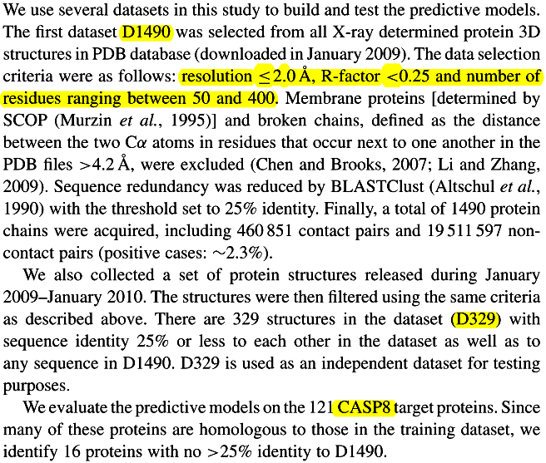
Datasets

Slide 8
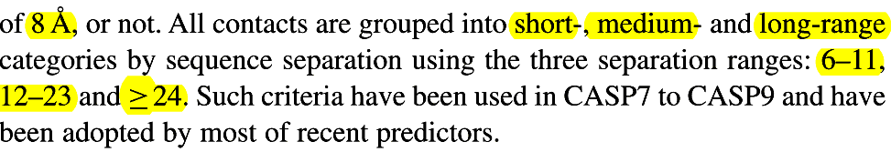
Definition of RR contact

Slide 9
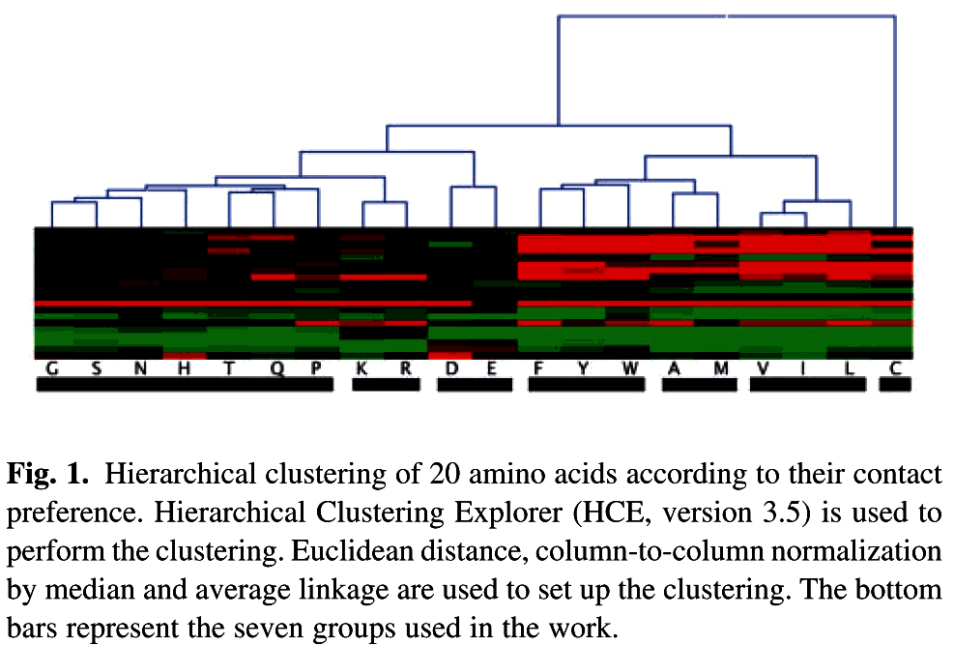
The seven amino acid groups

Slide 10
The seven amino acid groups
Weak hydrophobic (Ala and Met)
Hydrophobic (Val, Ile and Leu)
Aromatic (Phe, Tyr and Trp)
Positively charged (Arg and Lys)
Negatively charged (Asp and Glu)
Cysteine
All others (Gly, Ser, Asn, His, Pro, Thr and Gln)

Slide 11

Local window features (810+4)
15-residue sliding windows
  PSSM (20 log-odds, gap, score)
  helix: 100, sheet: 010, coil: 001
  four secondary structure predicted by PSIPRED (McGufﬁn et al., 2000)
  two binary coding features (exposed: 10, buried: 01, using 25% relative accessible area as threshold) for solvent accessibility predicted by SSpro
  The averages of maximum accessible surface areas (Frank Eisenhaber, 1993) and the isoelectric points of the amino acids in two local windows (four features)

Slide 12


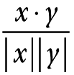
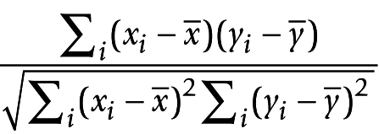
Residue pair features (49 + 4 + 4 + 4)
Seven amino acid groups for both residue i and j (7x7)
PSSM
  Joint entropy
  Mutual information
  Correlation
  Cosine
Contact matrix
maximum accessible surface area and the isoelectric point of the amino acids for residue i and j are considered

Slide 13
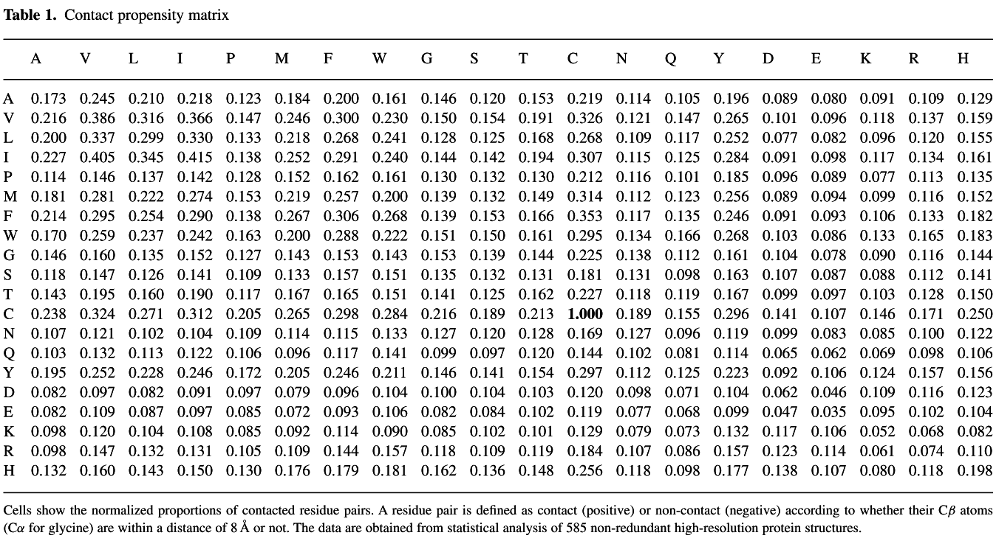
Contact propensity matrix
Notes:
a =
c(0.173,0.216,0.2,0.227,0.114,0.181,0.214,0.17,0.146,0.118,0.143,0.238,0.107,0.103,0.195,0.082,0.082,0.098,0.098,0.132,0.245,
0.386,0.337,0.405,0.146,0.281,0.295,0.259,0.16,0.147,0.195,0.324,0.121,0.132,0.252,0.097,0.109,0.12,0.147,0.16,0.21,0.316,
0.299,0.345,0.137,0.222,0.254,0.237,0.135,0.126,0.16,0.271,0.102,0.113,0.228,0.082,0.087,0.104,0.132,0.143,0.218,0.366,0.33,
0.415,0.142,0.274,0.29,0.242,0.152,0.141,0.19,0.312,0.104,0.122,0.246,0.091,0.097,0.108,0.131,0.15,0.123,0.147,0.133,0.138,
0.128,0.153,0.138,0.163,0.127,0.109,0.117,0.205,0.109,0.106,0.172,0.097,0.085,0.085,0.105,0.13,0.184,0.246,0.218,0.252,0.152,
0.219,0.267,0.2,0.143,0.133,0.167,0.265,0.114,0.096,0.205,0.079,0.072,0.092,0.109,0.176,0.2,0.3,0.268,0.291,0.162,0.257,
0.306,0.288,0.153,0.157,0.165,0.298,0.115,0.117,0.246,0.096,0.093,0.114,0.144,0.179,0.161,0.23,0.241,0.24,0.161,0.2,0.268,
0.222,0.143,0.151,0.151,0.284,0.133,0.141,0.211,0.104,0.106,0.09,0.157,0.181,0.146,0.15,0.128,0.144,0.13,0.139,0.139,0.151,
0.153,0.135,0.141,0.216,0.127,0.099,0.146,0.1,0.082,0.085,0.118,0.162,0.12,0.154,0.125,0.142,0.132,0.132,0.153,0.15,0.139,
0.132,0.125,0.189,0.12,0.097,0.141,0.104,0.084,0.102,0.109,0.136,0.153,0.191,0.168,0.194,0.13,0.149,0.166,0.161,0.144,0.131,
0.162,0.213,0.128,0.12,0.154,0.103,0.102,0.101,0.119,0.148,0.219,0.326,0.268,0.307,0.212,0.314,0.353,0.295,0.225,0.181,0.227,
1,0.169,0.144,0.297,0.12,0.119,0.129,0.184,0.256,0.114,0.121,0.109,0.115,0.116,0.112,0.117,0.134,0.138,0.131,0.118,0.189,
0.127,0.102,0.112,0.098,0.077,0.079,0.107,0.118,0.105,0.147,0.117,0.125,0.101,0.123,0.135,0.166,0.112,0.098,0.119,0.155,
0.096,0.081,0.125,0.071,0.068,0.073,0.086,0.098,0.196,0.265,0.252,0.284,0.185,0.256,0.246,0.268,0.161,0.163,0.167,0.296,
0.119,0.114,0.223,0.104,0.099,0.132,0.157,0.177,0.089,0.101,0.077,0.091,0.096,0.089,0.091,0.103,0.104,0.107,0.099,0.141,
0.099,0.065,0.092,0.062,0.047,0.117,0.123,0.138,0.08,0.096,0.082,0.098,0.089,0.094,0.093,0.086,0.078,0.087,0.097,0.107,
0.083,0.062,0.106,0.046,0.035,0.106,0.114,0.107,0.091,0.118,0.096,0.117,0.077,0.099,0.106,0.133,0.09,0.088,0.103,0.146,
0.085,0.069,0.124,0.109,0.095,0.052,0.061,0.08,0.109,0.137,0.12,0.134,0.113,0.116,0.133,0.165,0.116,0.112,0.128,0.171,0.1,
0.098,0.157,0.116,0.102,0.068,0.074,0.118,0.129,0.159,0.155,0.161,0.135,0.152,0.182,0.183,0.144,0.141,0.15,0.25,0.122,0.106,
0.156,0.123,0.104,0.082,0.11,0.198)
ti=c('A','V','L','I','P','M','F','W','G','S','T','C','N','Q','Y','D','E','K','R','H')
m=matrix(a,20)
colnames(m)=rownames(m)=ti

Slide 14

Levitt's contact potential
G A V L I P D E N Q K R S T M C Y W H F
G 0.1 0.7 0.1 0.1 0.0 0.5 0.4 0.6 0.1 0.0 0.4 -0.1 0.4 0.2 -0.1 -0.1 -0.4 -0.7 0.0 -0.3
A 0.7 0.5 -0.3 -0.4 -0.4 0.6 0.3 0.6 0.3 0.0 1.0 0.2 0.5 0.0 -0.5 0.3 -0.7 -0.8 0.0 -0.8
V 0.1 -0.3 -1.1 -1.2 -1.2 0.0 0.4 0.0 0.0 -0.4 0.1 -0.5 0.0 -0.3 -1.0 -0.5 -1.2 -1.6 -0.5 -1.5
L 0.1 -0.4 -1.2 -1.4 -1.4 -0.1 0.0 -0.1 -0.1 -0.6 0.1 -0.6 0.0 -0.3 -1.3 -0.8 -1.4 -1.7 -0.7 -1.6
I 0.0 -0.4 -1.2 -1.4 -1.5 -0.1 0.0 -0.2 -0.1 -0.4 0.0 -0.7 -0.1 -0.6 -1.4 -0.8 -1.4 -1.8 -0.8 -1.7
P 0.5 0.6 0.0 -0.1 -0.1 0.1 0.1 0.1 -0.1 -0.3 0.6 -0.2 0.2 0.0 -0.5 0.0 -1.0 -1.3 -0.4 -0.7
D 0.4 0.3 0.4 0.0 0.0 0.1 0.0 0.0 -0.6 -0.3 -1.0 -1.4 -0.3 -0.3 0.1 0.0 -1.0 -0.6 -1.1 -0.3
E 0.6 0.6 0.0 -0.1 -0.2 0.1 0.0 0.1 -0.6 -0.4 -1.1 -1.5 -0.2 -0.3 -0.3 0.1 -1.0 -0.8 -1.0 -0.5
N 0.1 0.3 0.0 -0.1 -0.1 -0.1 -0.6 -0.6 -0.7 -0.7 -0.3 -0.8 -0.1 -0.4 -0.3 0.0 -0.8 -0.8 -0.8 -0.6
Q 0.0 0.0 -0.4 -0.6 -0.4 -0.3 -0.3 -0.4 -0.7 -0.5 -0.4 -0.9 0.0 -0.5 -0.6 -0.2 -1.1 -1.0 -0.5 -0.8
K 0.4 1.0 0.1 0.1 0.0 0.6 -1.0 -1.1 -0.3 -0.4 0.7 0.1 0.1 0.0 -0.1 0.5 -1.0 -0.8 0.0 -0.4
R -0.1 0.2 -0.5 -0.6 -0.7 -0.2 -1.4 -1.5 -0.8 -0.9 0.1 -0.9 -0.4 -0.6 -0.5 0.0 -1.4 -1.3 -1.0 -0.9
S 0.4 0.5 0.0 0.0 -0.1 0.2 -0.3 -0.2 -0.1 0.0 0.1 -0.4 0.0 -0.2 -0.1 -0.1 -0.6 -0.6 -0.6 -0.4
T 0.2 0.0 -0.3 -0.3 -0.6 0.0 -0.3 -0.3 -0.4 -0.5 0.0 -0.6 -0.2 -0.5 -0.6 -0.3 -0.8 -0.9 -0.7 -0.7
M -0.1 -0.5 -1.0 -1.3 -1.4 -0.5 0.1 -0.3 -0.3 -0.6 -0.1 -0.5 -0.1 -0.6 -1.5 -0.8 -1.5 -2.0 -0.9 -1.9
C -0.1 0.3 -0.5 -0.8 -0.8 0.0 0.0 0.1 0.0 -0.2 0.5 0.0 -0.1 -0.3 -0.8 -2.7 -0.8 -1.3 -0.6 -1.2
Y -0.4 -0.7 -1.2 -1.4 -1.4 -1.0 -1.0 -1.0 -0.8 -1.1 -1.0 -1.4 -0.6 -0.8 -1.5 -0.8 -1.6 -1.8 -1.5 -1.7
W -0.7 -0.8 -1.6 -1.7 -1.8 -1.3 -0.6 -0.8 -0.8 -1.0 -0.8 -1.3 -0.6 -0.9 -2.0 -1.3 -1.8 -2.2 -1.5 -2.0
H 0.0 0.0 -0.5 -0.7 -0.8 -0.4 -1.1 -1.0 -0.8 -0.5 0.0 -1.0 -0.6 -0.7 -0.9 -0.6 -1.5 -1.5 -1.6 -1.2
F -0.3 -0.8 -1.5 -1.6 -1.7 -0.7 -0.3 -0.5 -0.6 -0.8 -0.4 -0.9 -0.4 -0.7 -1.9 -1.2 -1.7 -2.0 -1.2 -2.0
Cheng,J. and Baldi,P. (2007) Improved residue contact prediction using support vector machines and a large feature set. BMC Bioinformatics, 8, 113.
Allison N. Tegge et al., “NNcon: improved protein contact map prediction using 2D-recursive neural networks”
Notes:
Levitt <- function(){
# G A V L I P D E N Q K R S T M C Y W H F
# G 0.1 0.7 0.1 0.1 0.0 0.5 0.4 0.6 0.1 0.0 0.4 -0.1 0.4 0.2 -0.1 -0.1 -0.4 -0.7 0.0 -0.3
# A 0.7 0.5 -0.3 -0.4 -0.4 0.6 0.3 0.6 0.3 0.0 1.0 0.2 0.5 0.0 -0.5 0.3 -0.7 -0.8 0.0 -0.8
# V 0.1 -0.3 -1.1 -1.2 -1.2 0.0 0.4 0.0 0.0 -0.4 0.1 -0.5 0.0 -0.3 -1.0 -0.5 -1.2 -1.6 -0.5 -1.5
# L 0.1 -0.4 -1.2 -1.4 -1.4 -0.1 0.0 -0.1 -0.1 -0.6 0.1 -0.6 0.0 -0.3 -1.3 -0.8 -1.4 -1.7 -0.7 -1.6
# I 0.0 -0.4 -1.2 -1.4 -1.5 -0.1 0.0 -0.2 -0.1 -0.4 0.0 -0.7 -0.1 -0.6 -1.4 -0.8 -1.4 -1.8 -0.8 -1.7
# P 0.5 0.6 0.0 -0.1 -0.1 0.1 0.1 0.1 -0.1 -0.3 0.6 -0.2 0.2 0.0 -0.5 0.0 -1.0 -1.3 -0.4 -0.7
# D 0.4 0.3 0.4 0.0 0.0 0.1 0.0 0.0 -0.6 -0.3 -1.0 -1.4 -0.3 -0.3 0.1 0.0 -1.0 -0.6 -1.1 -0.3
# E 0.6 0.6 0.0 -0.1 -0.2 0.1 0.0 0.1 -0.6 -0.4 -1.1 -1.5 -0.2 -0.3 -0.3 0.1 -1.0 -0.8 -1.0 -0.5
# N 0.1 0.3 0.0 -0.1 -0.1 -0.1 -0.6 -0.6 -0.7 -0.7 -0.3 -0.8 -0.1 -0.4 -0.3 0.0 -0.8 -0.8 -0.8 -0.6
# Q 0.0 0.0 -0.4 -0.6 -0.4 -0.3 -0.3 -0.4 -0.7 -0.5 -0.4 -0.9 0.0 -0.5 -0.6 -0.2 -1.1 -1.0 -0.5 -0.8
# K 0.4 1.0 0.1 0.1 0.0 0.6 -1.0 -1.1 -0.3 -0.4 0.7 0.1 0.1 0.0 -0.1 0.5 -1.0 -0.8 0.0 -0.4
# R -0.1 0.2 -0.5 -0.6 -0.7 -0.2 -1.4 -1.5 -0.8 -0.9 0.1 -0.9 -0.4 -0.6 -0.5 0.0 -1.4 -1.3 -1.0 -0.9
# S 0.4 0.5 0.0 0.0 -0.1 0.2 -0.3 -0.2 -0.1 0.0 0.1 -0.4 0.0 -0.2 -0.1 -0.1 -0.6 -0.6 -0.6 -0.4
# T 0.2 0.0 -0.3 -0.3 -0.6 0.0 -0.3 -0.3 -0.4 -0.5 0.0 -0.6 -0.2 -0.5 -0.6 -0.3 -0.8 -0.9 -0.7 -0.7
# M -0.1 -0.5 -1.0 -1.3 -1.4 -0.5 0.1 -0.3 -0.3 -0.6 -0.1 -0.5 -0.1 -0.6 -1.5 -0.8 -1.5 -2.0 -0.9 -1.9
# C -0.1 0.3 -0.5 -0.8 -0.8 0.0 0.0 0.1 0.0 -0.2 0.5 0.0 -0.1 -0.3 -0.8 -2.7 -0.8 -1.3 -0.6 -1.2
# Y -0.4 -0.7 -1.2 -1.4 -1.4 -1.0 -1.0 -1.0 -0.8 -1.1 -1.0 -1.4 -0.6 -0.8 -1.5 -0.8 -1.6 -1.8 -1.5 -1.7
# W -0.7 -0.8 -1.6 -1.7 -1.8 -1.3 -0.6 -0.8 -0.8 -1.0 -0.8 -1.3 -0.6 -0.9 -2.0 -1.3 -1.8 -2.2 -1.5 -2.0
# H 0.0 0.0 -0.5 -0.7 -0.8 -0.4 -1.1 -1.0 -0.8 -0.5 0.0 -1.0 -0.6 -0.7 -0.9 -0.6 -1.5 -1.5 -1.6 -1.2
# F -0.3 -0.8 -1.5 -1.6 -1.7 -0.7 -0.3 -0.5 -0.6 -0.8 -0.4 -0.9 -0.4 -0.7 -1.9 -1.2 -1.7 -2.0 -1.2 -2.0
#Author: Jianlin Cheng
aa_levitt = "GAVLIPDENQKRSTMCYWHF"
a = c(.1,.7,.1,.1,0,.5,.4,.6,.1,0,.4,-0.1,.4,.2,-0.1,-0.1,-0.4,-0.7,0,-0.3,.5,-0.3,-0.4,-0.4,.6,.3,.6,.3,0,1.0,.2,.5,0,
-0.5,.3,-0.7,-0.8,0,-0.8,-1.1,-1.2,-1.2,0,.4,0,0,-0.4,0.1,-0.5,0,-0.3,-1.0,-0.5,-1.2,-1.6,-0.5,-1.5,-1.4,-1.4,-0.1,
0,-0.1,-0.1,-0.6,0.1,-0.6,0,-0.3,-1.3,-0.8,-1.4,-1.7,-0.7,-1.6,-1.5,-0.1,0,-0.2,-0.1,-0.4,0,-0.7,-0.1,-0.6,-1.4,
-0.8,-1.4,-1.8,-0.8,-1.7,.1,.1,.1,-0.1,-0.3,.6,-0.2,.2,0,-0.5,0,-1.0,-1.3,-0.4,-0.7,0,0,-0.6,-0.3,-1.0,-1.4,-0.3,
-0.3,0.1,0,-1.0,-0.6,-1.1,-0.3,0.1,-0.6,-0.4,-1.1,-1.5,-0.2,-0.3,-0.3,0.1,-1.0,-0.8,-1.0,-0.5,-0.7,-0.7,-0.3,-0.8,
-0.1,-0.4,-0.3,0,-0.8,-0.8,-0.8,-0.6,-0.5,-0.4,-0.9,0,-0.5,-0.6,-0.2,-1.1,-1.0,-0.5,-0.8,.7,.1,.1,0,-0.1,.5,-1.0,
-0.8,0,-0.4,-0.9,-0.4,-0.6,-0.5,0,-1.4,-1.3,-1.0,-0.9,0,-0.2,-0.1,-0.1,-0.6,-0.6,-0.6,-0.4,-0.5,-0.6,-0.3,-0.8,-0.9,
-0.7,-0.7,-1.5,-0.8,-1.5,-2.0,-0.9,-1.9,-2.7,-0.8,-1.3,-0.6,-1.2,-1.6,-1.8,-1.5,-1.7,-2.2,-1.5,-2.0,-1.6,-1.2,-2.0)
m = matrix(0,nchar(aa_levitt),nchar(aa_levitt))
m[lower.tri(m,diag=T)] <- a
m[upper.tri(m)] <- t(m)[upper.tri(m)]
colnames(m) = strsplit(aa_levitt,'')[[1]]
rownames(m) = strsplit(aa_levitt,'')[[1]]
m
}

Slide 15

Jernigan's pairwise potential
Gly Ala Val Leu Ile Pro Asp Glu Asn Gln Lys Arg Ser Thr Met Cys Tyr Trp His Phe
Gly -2.1 -2.2 -3.0 -2.5 -2.7 -1.8 -1.9 -1.3 -2.4 -2.0 -1.9 -2.2 -1.9 -2.4 -2.8 -3.0 -2.8 -3.1 -2.1 -2.6
Ala -2.9 -4.1 -3.7 -3.9 -2.3 -2.6 -1.9 -2.8 -2.7 -1.9 -2.4 -2.4 -3.2 -3.8 -3.1 -3.7 -3.8 -2.6 -3.7
Val -5.1 -4.7 -5.0 -3.2 -2.8 -2.8 -3.5 -3.4 -3.1 -3.5 -3.1 -3.9 -4.7 -4.3 -4.5 -4.8 -3.5 -4.6
Leu -4.3 -4.6 -2.8 -2.7 -2.4 -3.0 -3.1 -2.5 -3.0 -2.6 -3.3 -4.4 -4.0 -4.1 -4.4 -3.1 -4.2
Ile -4.9 -3.0 -2.9 -2.7 -3.2 -3.2 -2.9 -3.3 -3.0 -3.8 -4.7 -4.2 -4.4 -4.7 -3.4 -4.5
Pro -2.2 -2.3 -1.8 -2.7 -2.5 -1.8 -2.4 -2.2 -2.8 -3.4 -2.8 -3.5 -3.7 -2.6 -3.1
Asp -2.6 -2.0 -3.3 -2.7 -3.5 -3.7 -2.8 -3.2 -2.7 -2.9 -3.5 -3.2 -3.3 -2.7
Glu -1.5 -2.8 -2.2 -3.2 -3.2 -2.3 -2.7 -2.7 -2.4 -3.0 -2.8 -2.8 -2.4
Asn -3.6 -3.2 -3.0 -3.2 -2.8 -3.4 -3.3 -3.2 -3.5 -3.5 -3.2 -3.2
Gln -2.6 -2.7 -2.9 -2.3 -3.1 -3.3 -2.9 -3.4 -3.3 -2.5 -3.0
Lys -1.7 -2.0 -2.3 -2.8 -2.9 -2.4 -3.5 -3.3 -2.2 -2.8
Arg -2.9 -2.6 -3.1 -3.1 -2.6 -3.6 -3.5 -2.9 -3.0
Ser -2.4 -2.9 -3.0 -3.0 -3.1 -3.1 -2.7 -2.8
Thr -3.5 -3.8 -3.5 -3.6 -3.7 -3.2 -3.4
Met -4.8 -4.2 -4.4 -4.8 -3.5 -4.6
Cys -6.1 -3.8 -4.3 -3.3 -4.1
Tyr -4.1 -4.3 -3.7 -4.1
Trp -4.7 -3.6 -4.4
His -3.5 -3.3
Phe -4.3
Cheng,J. and Baldi,P. (2007) Improved residue contact prediction using support vector machines and a large feature set. BMC Bioinformatics, 8, 113.
Allison N. Tegge et al., “NNcon: improved protein contact map prediction using 2D-recursive neural networks”
Notes:
JerniganCP <- function(aa1,aa2){
#Author: Jianlin Cheng
#Jernigan contact potential
#Miyazawa & Jernigan
# Gly Ala Val Leu Ile Pro Asp Glu Asn Gln Lys Arg Ser Thr Met Cys Tyr Trp His Phe
#Gly -2.1 -2.2 -3.0 -2.5 -2.7 -1.8 -1.9 -1.3 -2.4 -2.0 -1.9 -2.2 -1.9 -2.4 -2.8 -3.0 -2.8 -3.1 -2.1 -2.6
#Ala -2.9 -4.1 -3.7 -3.9 -2.3 -2.6 -1.9 -2.8 -2.7 -1.9 -2.4 -2.4 -3.2 -3.8 -3.1 -3.7 -3.8 -2.6 -3.7
#Val -5.1 -4.7 -5.0 -3.2 -2.8 -2.8 -3.5 -3.4 -3.1 -3.5 -3.1 -3.9 -4.7 -4.3 -4.5 -4.8 -3.5 -4.6
#Leu -4.3 -4.6 -2.8 -2.7 -2.4 -3.0 -3.1 -2.5 -3.0 -2.6 -3.3 -4.4 -4.0 -4.1 -4.4 -3.1 -4.2
#Ile -4.9 -3.0 -2.9 -2.7 -3.2 -3.2 -2.9 -3.3 -3.0 -3.8 -4.7 -4.2 -4.4 -4.7 -3.4 -4.5
#Pro -2.2 -2.3 -1.8 -2.7 -2.5 -1.8 -2.4 -2.2 -2.8 -3.4 -2.8 -3.5 -3.7 -2.6 -3.1
#Asp -2.6 -2.0 -3.3 -2.7 -3.5 -3.7 -2.8 -3.2 -2.7 -2.9 -3.5 -3.2 -3.3 -2.7
#Glu -1.5 -2.8 -2.2 -3.2 -3.2 -2.3 -2.7 -2.7 -2.4 -3.0 -2.8 -2.8 -2.4
#Asn -3.6 -3.2 -3.0 -3.2 -2.8 -3.4 -3.3 -3.2 -3.5 -3.5 -3.2 -3.2
#Gln -2.6 -2.7 -2.9 -2.3 -3.1 -3.3 -2.9 -3.4 -3.3 -2.5 -3.0
#Lys -1.7 -2.0 -2.3 -2.8 -2.9 -2.4 -3.5 -3.3 -2.2 -2.8
#Arg -2.9 -2.6 -3.1 -3.1 -2.6 -3.6 -3.5 -2.9 -3.0
#Ser -2.4 -2.9 -3.0 -3.0 -3.1 -3.1 -2.7 -2.8
#Thr -3.5 -3.8 -3.5 -3.6 -3.7 -3.2 -3.4
#Met -4.8 -4.2 -4.4 -4.8 -3.5 -4.6
#Cys -6.1 -3.8 -4.3 -3.3 -4.1
#Tyr -4.1 -4.3 -3.7 -4.1
#Trp -4.7 -3.6 -4.4
#His -3.5 -3.3
#Phe -4.3
##################################################################################################################
aa_levitt = "GAVLIPDENQKRSTMCYWHF"
a = list(
c(-2.1,-2.2,-3.0,-2.5,-2.7,-1.8,-1.9,-1.3,-2.4,-2.0,-1.9,-2.2,-1.9,-2.4,-2.8,-3.0,-2.8,-3.1,-2.1,-2.6),
c(-2.9,-4.1,-3.7,-3.9,-2.3,-2.6,-1.9,-2.8,-2.7,-1.9,-2.4,-2.4,-3.2,-3.8,-3.1,-3.7,-3.8,-2.6,-3.7),
c(-5.1,-4.7,-5.0,-3.2,-2.8,-2.8,-3.5,-3.4,-3.1,-3.5,-3.1,-3.9,-4.7,-4.3,-4.5,-4.8,-3.5,-4.6),
c(-4.3,-4.6,-2.8,-2.7,-2.4,-3.0,-3.1,-2.5,-3.0,-2.6,-3.3,-4.4,-4.0,-4.1,-4.4,-3.1,-4.2),
c(-4.9,-3.0,-2.9,-2.7,-3.2,-3.2,-2.9,-3.3,-3.0,-3.8,-4.7,-4.2,-4.4,-4.7,-3.4,-4.5),
c(-2.2,-2.3,-1.8,-2.7,-2.5,-1.8,-2.4,-2.2,-2.8,-3.4,-2.8,-3.5,-3.7,-2.6,-3.1),
c(-2.6,-2.0,-3.3,-2.7,-3.5,-3.7,-2.8,-3.2,-2.7,-2.9,-3.5,-3.2,-3.3,-2.7),
c(-1.5,-2.8,-2.2,-3.2,-3.2,-2.3,-2.7,-2.7,-2.4,-3.0,-2.8,-2.8,-2.4),
c(-3.6,-3.2,-3.0,-3.2,-2.8,-3.4,-3.3,-3.2,-3.5,-3.5,-3.2,-3.2),
c(-2.6,-2.7,-2.9,-2.3,-3.1,-3.3,-2.9,-3.4,-3.3,-2.5,-3.0),
c(-1.7,-2.0,-2.3,-2.8,-2.9,-2.4,-3.5,-3.3,-2.2,-2.8),
c(-2.9,-2.6,-3.1,-3.1,-2.6,-3.6,-3.5,-2.9,-3.0),
c(-2.4,-2.9,-3.0,-3.0,-3.1,-3.1,-2.7,-2.8),
c(-3.5,-3.8,-3.5,-3.6,-3.7,-3.2,-3.4),
c(-4.8,-4.2,-4.4,-4.8,-3.5,-4.6),
c(-6.1,-3.8,-4.3,-3.3,-4.1),
c(-4.1,-4.3,-3.7,-4.1),
c(-4.7,-3.6,-4.4),
c(-3.5,-3.3),
c(-4.3))
aas = strsplit(aa_levitt,'')[[1]]
wh1 = which(aas==aa1)
wh2 = which(aas==aa2)
if(wh1>wh2){tmp=wh2;wh2=wh1;wh1=tmp}
a[[wh1]][wh2-wh1+1]
}

Slide 16

Braun's pairwise potential
G A V L I F Y W M C P S T N Q H K R D E
G -0.29 -0.14 -0.10 -0.04 0.27 -0.09 -0.21 -0.34 0.25 -0.42 0.06 0.04 0.28 0.49 0.54 -0.09 0.56 0.40 -0.26 0.21
A -0.14 -0.18 -0.15 -0.24 -0.25 -0.16 -0.18 -0.01 -0.02 0.08 0.28 0.38 0.06 -0.04 0.35 0.44 0.28 0.59 0.24 0.53
V -0.10 -0.15 -0.48 -0.29 -0.31 -0.31 0.00 0.18 -0.02 0.08 0.76 0.18 0.19 0.48 0.41 0.37 0.53 0.43 0.51 0.37
L -0.04 -0.24 -0.29 -0.43 -0.45 -0.28 -0.10 -0.18 -0.32 0.36 0.30 0.30 0.57 0.25 0.35 0.10 0.37 0.37 0.80 0.51
I 0.27 -0.25 -0.31 -0.45 -0.48 -0.05 -0.34 -0.28 0.21 -0.16 0.99 0.57 0.34 1.45 0.44 0.24 0.00 0.05 0.26 0.53
F -0.09 -0.16 -0.31 -0.28 -0.05 -0.50 -0.27 0.16 -0.36 -0.28 0.65 0.15 0.25 0.12 -0.04 0.25 0.75 0.31 0.33 0.38
Y -0.21 -0.18 0.00 -0.10 -0.34 -0.27 -0.11 -0.30 0.01 0.69 -0.02 -0.03 0.23 -0.14 -0.06 0.33 0.00 0.03 0.61 0.25
W -0.34 -0.01 0.18 -0.18 -0.28 0.16 -0.30 -0.53 -0.73 -0.74 0.70 0.44 0.74 0.46 -0.09 -0.34 0.02 -0.20 0.74 1.37
M 0.25 -0.02 -0.02 -0.32 0.21 -0.36 0.01 -0.73 -0.75 0.27 -0.78 0.00 0.43 -0.52 0.07 1.07 0.44 0.53 0.21 0.44
C -0.42 0.08 0.08 0.36 -0.16 -0.28 0.69 -0.74 0.27 -1.77 0.31 0.12 0.28 0.07 0.39 -0.45 0.68 0.92 0.53 0.17
P 0.06 0.28 0.76 0.30 0.99 0.65 -0.02 0.70 -0.78 0.31 -0.78 0.21 0.04 0.59 0.73 -0.21 0.26 0.34 0.87 0.41
S 0.04 0.38 0.18 0.30 0.57 0.15 -0.03 0.44 0.00 0.12 0.21 -0.68 -0.23 -0.21 0.19 -0.13 -0.05 0.24 -0.03 0.10
T 0.28 0.06 0.19 0.57 0.34 0.25 0.23 0.74 0.43 0.28 0.04 -0.23 -0.58 -0.06 -0.31 -0.22 -0.26 -0.31 0.32 -0.27
N 0.49 -0.04 0.48 0.25 1.45 0.12 -0.14 0.46 -0.52 0.07 0.59 -0.21 -0.06 -0.45 0.20 -0.56 -0.27 0.00 -0.43 0.76
Q 0.54 0.35 0.41 0.35 0.44 -0.04 -0.06 -0.09 0.07 0.39 0.73 0.19 -0.31 0.20 -0.17 0.28 0.05 0.56 -0.03 -0.20
H -0.09 0.44 0.37 0.10 0.24 0.25 0.33 -0.34 1.07 -0.45 -0.21 -0.13 -0.22 -0.56 0.28 -0.15 0.57 -0.11 -0.61 -0.14
K 0.56 0.28 0.53 0.37 0.00 0.75 0.00 0.02 0.44 0.68 0.26 -0.05 -0.26 -0.27 0.05 0.57 0.21 0.58 -0.43 -1.12
R 0.40 0.59 0.43 0.37 0.05 0.31 0.03 -0.20 0.53 0.92 0.34 0.24 -0.31 0.00 0.56 -0.11 0.58 -0.03 -0.79 -0.85
D -0.26 0.24 0.51 0.80 0.26 0.33 0.61 0.74 0.21 0.53 0.87 -0.03 0.32 -0.43 -0.03 -0.61 -0.43 -0.79 0.11 0.86
E 0.21 0.53 0.37 0.51 0.53 0.38 0.25 1.37 0.44 0.17 0.41 0.10 -0.27 0.76 -0.20 -0.14 -1.12 -0.85 0.86 0.58
Cheng,J. and Baldi,P. (2007) Improved residue contact prediction using support vector machines and a large feature set. BMC Bioinformatics, 8, 113.
Allison N. Tegge et al., “NNcon: improved protein contact map prediction using 2D-recursive neural networks”
Notes:
BraunCP <- function(){
#Author: Jianlin Cheng
#Zhu-Braun
#G -0.29
#A -0.14 -0.18
#V -0.10 -0.15 -0.48
#L -0.04 -0.24 -0.29 -0.43
#I 0.27 -0.25 -0.31 -0.45 -0.48
#F -0.09 -0.16 -0.31 -0.28 -0.05 -0.50
#Y -0.21 -0.18 0.00 -0.10 -0.34 -0.27 -0.11
#W -0.34 -0.01 0.18 -0.18 -0.28 0.16 -0.30 -0.53
#M 0.25 -0.02 -0.02 -0.32 0.21 -0.36 0.01 -0.73 -0.75
#C -0.42 0.08 0.08 0.36 -0.16 -0.28 0.69 -0.74 0.27 -1.77
#P 0.06 0.28 0.76 0.30 0.99 0.65 -0.02 0.70 -0.78 0.31 -0.78
#S 0.04 0.38 0.18 0.30 0.57 0.15 -0.03 0.44 0.00 0.12 0.21 -0.68
#T 0.28 0.06 0.19 0.57 0.34 0.25 0.23 0.74 0.43 0.28 0.04 -0.23 -0.58
#N 0.49 -0.04 0.48 0.25 1.45 0.12 -0.14 0.46 -0.52 0.07 0.59 -0.21 -0.06 -0.45
#Q 0.54 0.35 0.41 0.35 0.44 -0.04 -0.06 -0.09 0.07 0.39 0.73 0.19 -0.31 0.20 -0.17
#H -0.09 0.44 0.37 0.10 0.24 0.25 0.33 -0.34 1.07 -0.45 -0.21 -0.13 -0.22 -0.56 0.28 -0.15
#K 0.56 0.28 0.53 0.37 -0.00 0.75 -0.00 0.02 0.44 0.68 0.26 -0.05 -0.26 -0.27 0.05 0.57 0.21
#R 0.40 0.59 0.43 0.37 0.05 0.31 0.03 -0.20 0.53 0.92 0.34 0.24 -0.31 -0.00 0.56 -0.11 0.58 -0.03
#D -0.26 0.24 0.51 0.80 0.26 0.33 0.61 0.74 0.21 0.53 0.87 -0.03 0.32 -0.43 -0.03 -0.61 -0.43 -0.79 0.11
#E 0.21 0.53 0.37 0.51 0.53 0.38 0.25 1.37 0.44 0.17 0.41 0.10 -0.27 0.76 -0.20 -0.14 -1.12 -0.85 0.86 0.58
aa_braun = "GAVLIFYWMCPSTNQHKRDE"; #aa order used in Braun contact potential map
a =
c(
-0.29,
-0.14,-0.18,
-0.10,-0.15,-0.48,
-0.04,-0.24,-0.29,-0.43,
0.27,-0.25,-0.31,-0.45,-0.48,
-0.09,-0.16,-0.31,-0.28,-0.05,-0.50,
-0.21,-0.18,0.00,-0.10,-0.34,-0.27,-0.11,
-0.34,-0.01,0.18,-0.18,-0.28,0.16,-0.30,-0.53,
0.25,-0.02,-0.02,-0.32,0.21,-0.36,0.01,-0.73,-0.75,
-0.42,0.08,0.08,0.36,-0.16,-0.28,0.69,-0.74,0.27,-1.77,
0.06,0.28,0.76,0.30,0.99,0.65,-0.02,0.70,-0.78,0.31,-0.78,
0.04,0.38,0.18,0.30,0.57,0.15,-0.03,0.44,0.00,0.12,0.21,-0.68,
0.28,0.06,0.19,0.57,0.34,0.25,0.23,0.74,0.43,0.28,0.04,-0.23,-0.58,
0.49,-0.04,0.48,0.25,1.45,0.12,-0.14,0.46,-0.52,0.07,0.59,-0.21,-0.06,-0.45,
0.54,0.35,0.41,0.35,0.44,-0.04,-0.06,-0.09,0.07,0.39,0.73,0.19,-0.31,0.20,-0.17,
-0.09,0.44,0.37,0.10,0.24,0.25,0.33,-0.34,1.07,-0.45,-0.21,-0.13,-0.22,-0.56,0.28,-0.15,
0.56,0.28,0.53,0.37,-0.00,0.75,-0.00,0.02,0.44,0.68,0.26,-0.05,-0.26,-0.27,0.05,0.57,0.21,
0.40,0.59,0.43,0.37,0.05,0.31,0.03,-0.20,0.53,0.92,0.34,0.24,-0.31,-0.00,0.56,-0.11,0.58,-0.03,
-0.26,0.24,0.51,0.80,0.26,0.33,0.61,0.74,0.21,0.53,0.87,-0.03,0.32,-0.43,-0.03,-0.61,-0.43,-0.79,0.11,
0.21,0.53,0.37,0.51,0.53,0.38,0.25,1.37,0.44,0.17,0.41,0.10,-0.27,0.76,-0.20,-0.14,-1.12,-0.85,0.86,0.58)
m = matrix(0,nchar(aa_braun),nchar(aa_braun))
m[upper.tri(m,diag=T)] <- a
m = t(m)
m[upper.tri(m)] <- t(m)[upper.tri(m)]
colnames(m) = strsplit(aa_braun,'')[[1]]
rownames(m) = strsplit(aa_braun,'')[[1]]
m
}

Slide 17
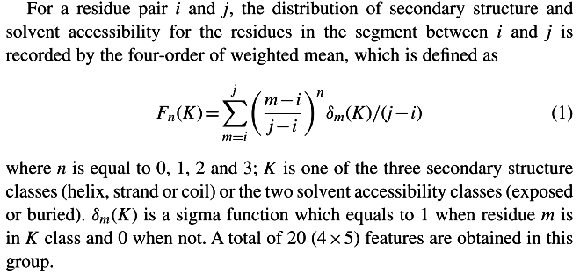
Separation segment features
(6/11 + 20)
The lengths of the separation segments
  Short: 6,7, 8, 9, 10, 11
  Medium: 12–13, 14–15, 16–17, 18–19, 20–21, 22–23
  Long: 24–28, 29–32, 33–36, 37–40, 41–44, 45–48, 49–52, 53–57, 58–62, 63–67, ≥ 68

Slide 18
Segment features (7x7x7 + 12 + 2)
The occurrence of all types of tripeptides in the separation segment
  Seven amino acid groups for each residue
12 features of the central residue in the separation segment
  The secondary structure (three features),
  Solvent accessibility (two features)
  Residue category (seven features)
2 Features
  Max. accessible surface area and the isoelectric point of the amino acids in the separation segment

Slide 19
Whole protein information (4 + 20)
Length
  ≤ 50, 51–100, 101–150 and > 150
The composition of 20 types of residues

Slide 20
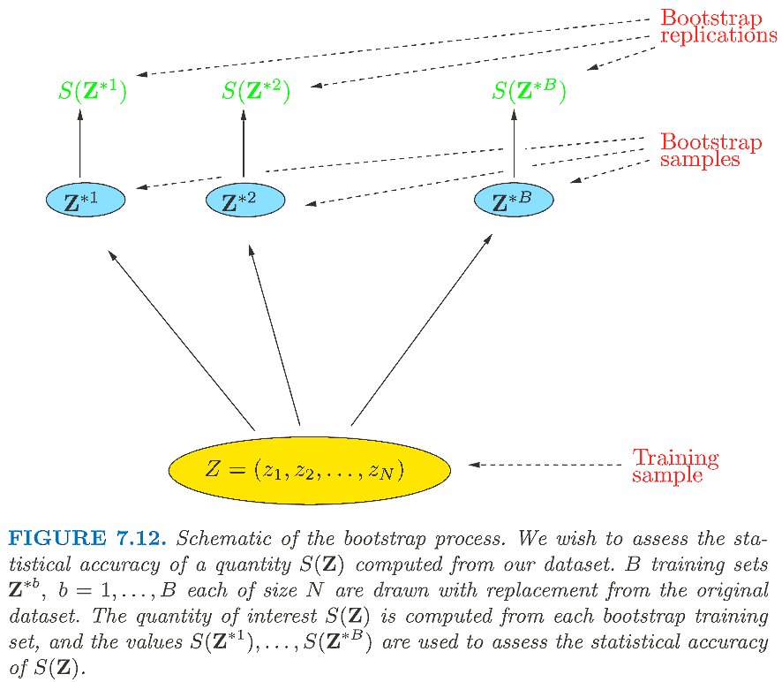
Bootstrap methods
Trevor Hastie et al., “The elements of statistical learning"

Slide 21
Generate random samples(打亂資料)
#sample without re-placement (conventional cross-validation)
N=15;x=range(N);random.shuffle(x);x
#output: [7, 11, 5, 12, 2, 0, 3, 8, 6, 9, 1, 13, 10, 14, 4]
#sample with re-placement (bootstrap cross-validation)
N=15;[random.choice(range(N)) for gene in range(N)]
#output: [13, 1, 13, 7, 2, 14, 2, 0, 7, 8, 0, 9, 8, 8, 1]

Slide 22
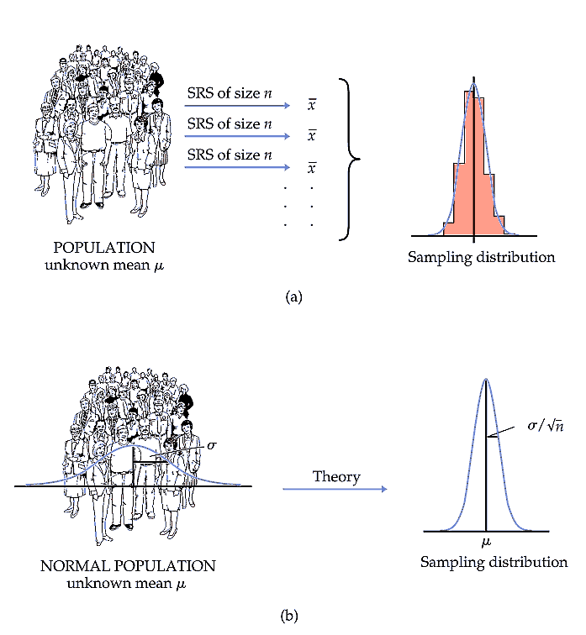
Moore et al., “The practice of business statistics"

Slide 23
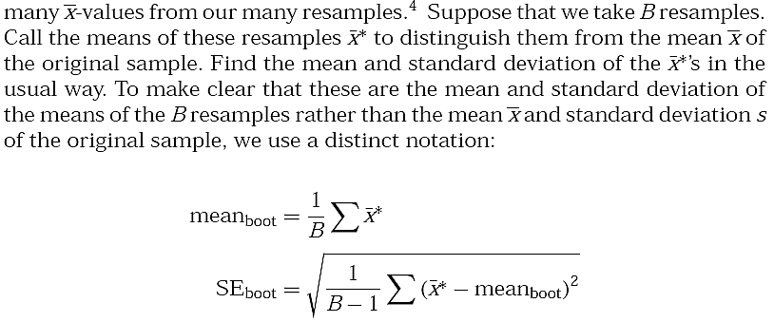
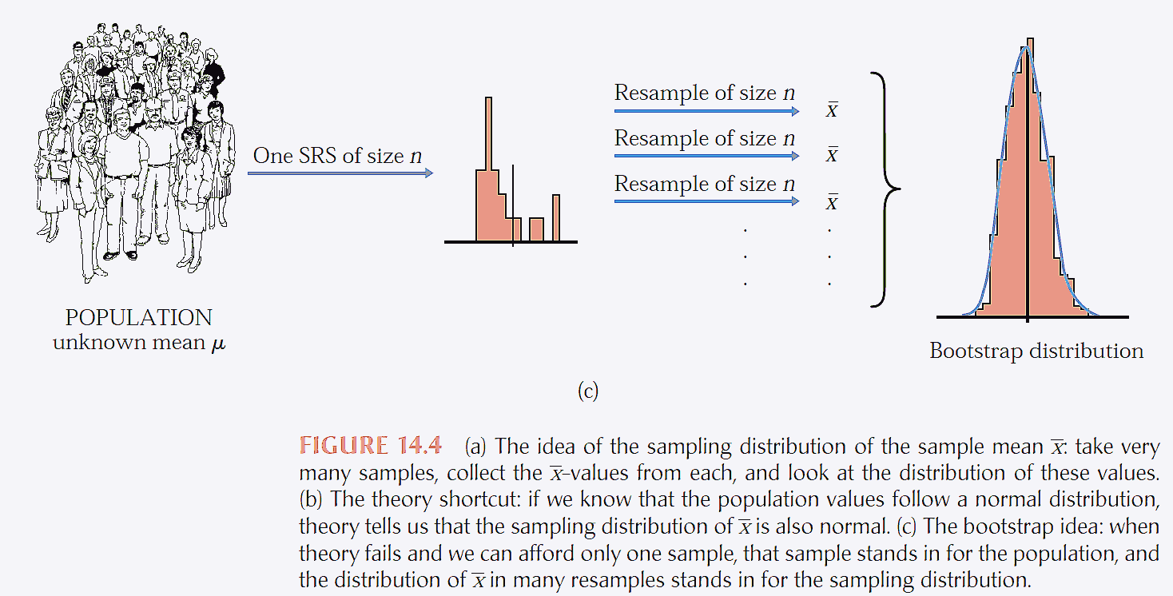
Moore et al., “The practice of business statistics"

Slide 24
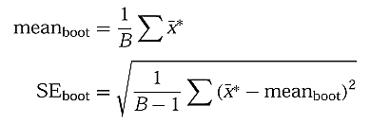
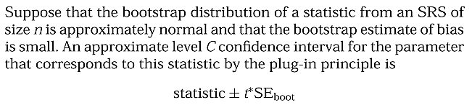

Bootstrap t confidence intervals
Moore et al., “The practice of business statistics"

Slide 25
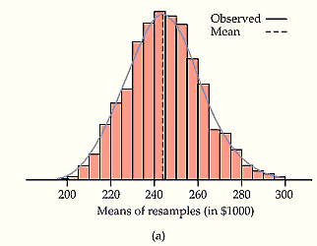
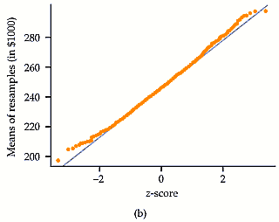
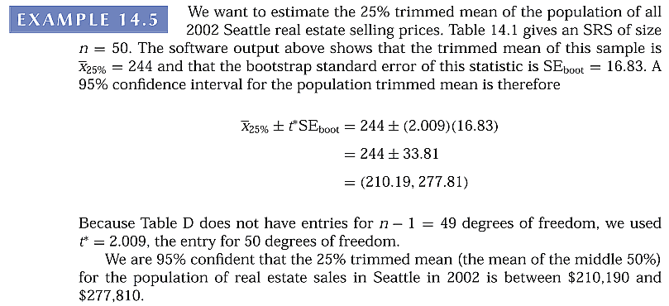

Bootstrap t confidence intervals
Moore et al., “The practice of business statistics"

Slide 26
n
0.25
0.2
0.15
0.1
0.05
0.025
0.01
0.005
0.0025
0.001
0.0005
1
1.000
1.376
1.963
3.078
6.314
12.71
31.82
63.66
127.3
318.3
636.6
2
0.816
1.061
1.386
1.886
2.920
4.303
6.965
9.925
14.09
22.33
31.60
3
0.765
0.978
1.250
1.638
2.353
3.182
4.541
5.841
7.453
10.21
12.92
4
0.741
0.941
1.190
1.533
2.132
2.776
3.747
4.604
5.598
7.173
8.610
5
0.727
0.920
1.156
1.476
2.015
2.571
3.365
4.032
4.773
5.893
6.869
6
0.718
0.906
1.134
1.440
1.943
2.447
3.143
3.707
4.317
5.208
5.959
7
0.711
0.896
1.119
1.415
1.895
2.365
2.998
3.499
4.029
4.785
5.408
8
0.706
0.889
1.108
1.397
1.860
2.306
2.896
3.355
3.833
4.501
5.041
9
0.703
0.883
1.100
1.383
1.833
2.262
2.821
3.250
3.690
4.297
4.781
10
0.700
0.879
1.093
1.372
1.812
2.228
2.764
3.169
3.581
4.144
4.587
11
0.697
0.876
1.088
1.363
1.796
2.201
2.718
3.106
3.497
4.025
4.437
12
0.695
0.873
1.083
1.356
1.782
2.179
2.681
3.055
3.428
3.930
4.318
13
0.694
0.870
1.079
1.350
1.771
2.160
2.650
3.012
3.372
3.852
4.221
14
0.692
0.868
1.076
1.345
1.761
2.145
2.624
2.977
3.326
3.787
4.140
15
0.691
0.866
1.074
1.341
1.753
2.131
2.602
2.947
3.286
3.733
4.073
16
0.690
0.865
1.071
1.337
1.746
2.120
2.583
2.921
3.252
3.686
4.015
17
0.689
0.863
1.069
1.333
1.740
2.110
2.567
2.898
3.222
3.646
3.965
18
0.688
0.862
1.067
1.330
1.734
2.101
2.552
2.878
3.197
3.610
3.922
19
0.688
0.861
1.066
1.328
1.729
2.093
2.539
2.861
3.174
3.579
3.883
20
0.687
0.860
1.064
1.325
1.725
2.086
2.528
2.845
3.153
3.552
3.850
21
0.686
0.859
1.063
1.323
1.721
2.080
2.518
2.831
3.135
3.527
3.819
22
0.686
0.858
1.061
1.321
1.717
2.074
2.508
2.819
3.119
3.505
3.792
23
0.685
0.858
1.060
1.319
1.714
2.069
2.500
2.807
3.104
3.485
3.767
24
0.685
0.857
1.059
1.318
1.711
2.064
2.492
2.797
3.091
3.467
3.745
25
0.684
0.856
1.058
1.316
1.708
2.060
2.485
2.787
3.078
3.450
3.725
26
0.684
0.856
1.058
1.315
1.706
2.056
2.479
2.779
3.067
3.435
3.707
27
0.684
0.855
1.057
1.314
1.703
2.052
2.473
2.771
3.057
3.421
3.690
28
0.683
0.855
1.056
1.313
1.701
2.048
2.467
2.763
3.047
3.408
3.674
29
0.683
0.854
1.055
1.311
1.699
2.045
2.462
2.756
3.038
3.396
3.659
30
0.683
0.854
1.055
1.310
1.697
2.042
2.457
2.750
3.030
3.385
3.646
40
0.681
0.851
1.050
1.303
1.684
2.021
2.423
2.704
2.971
3.307
3.551
50
0.679
0.849
1.047
1.299
1.676
2.009
2.403
2.678
2.937
3.261
3.496
60
0.679
0.848
1.045
1.296
1.671
2.000
2.390
2.660
2.915
3.232
3.460
80
0.678
0.846
1.043
1.292
1.664
1.990
2.374
2.639
2.887
3.195
3.416
100
0.677
0.845
1.042
1.290
1.660
1.984
2.364
2.626
2.871
3.174
3.390
http://fysh.blog.sohu.com/137331912.html
120
0.677
0.845
1.041
1.289
1.658
1.980
2.358
2.617
2.860
3.160
3.373
infty
0.674
0.842
1.036
1.282
1.645
1.960
2.326
2.576
2.807
3.090
3.291

Slide 27
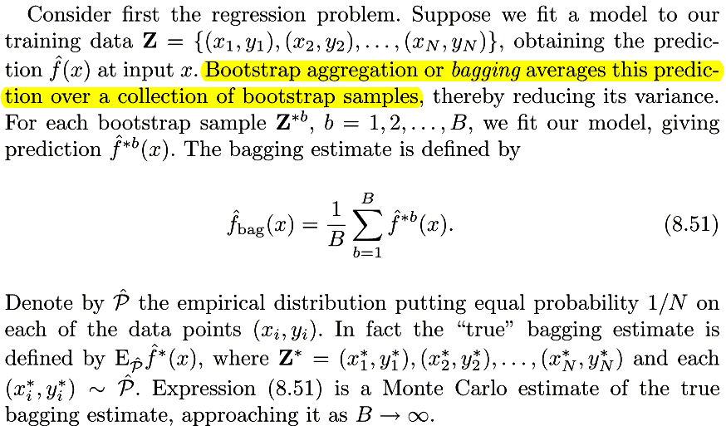
Bagging
Trevor Hastie et al., "The Elements of Statistical Learning"

Slide 28
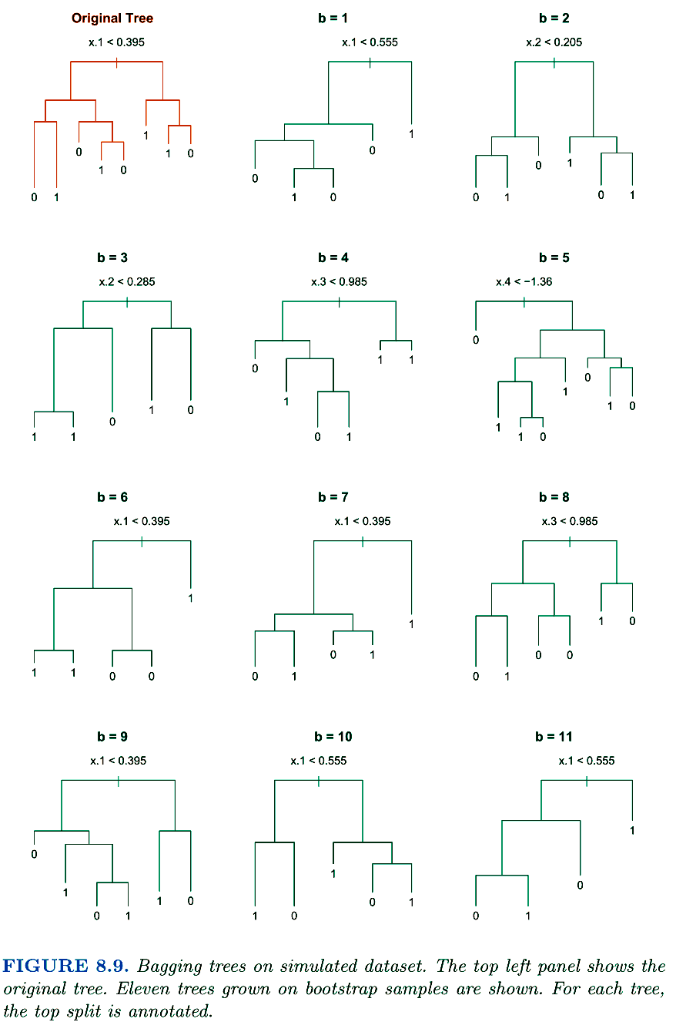
Bagging
Trevor Hastie et al., "The Elements of Statistical Learning"

Slide 29
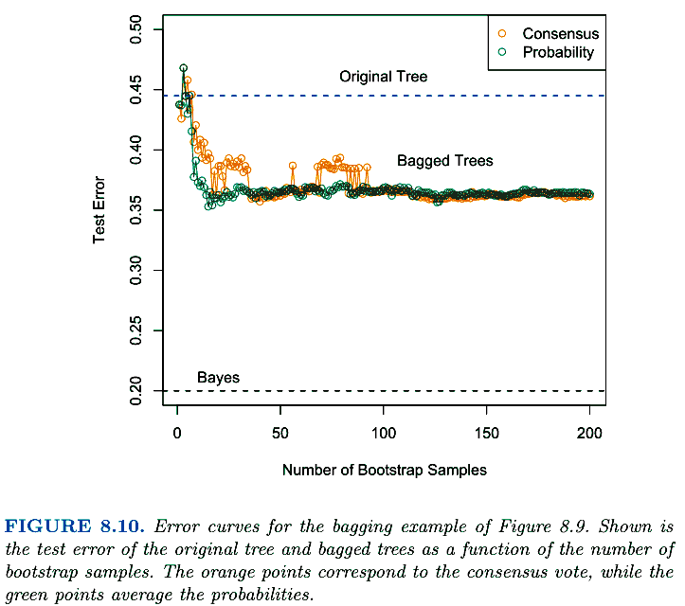
Bagging
Trevor Hastie et al., "The Elements of Statistical Learning"

Slide 30
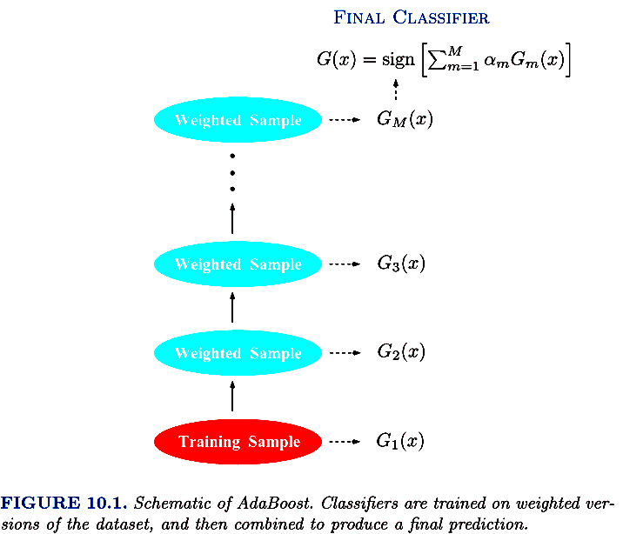
Boosting
Trevor Hastie et al., "The Elements of Statistical Learning"

Slide 31
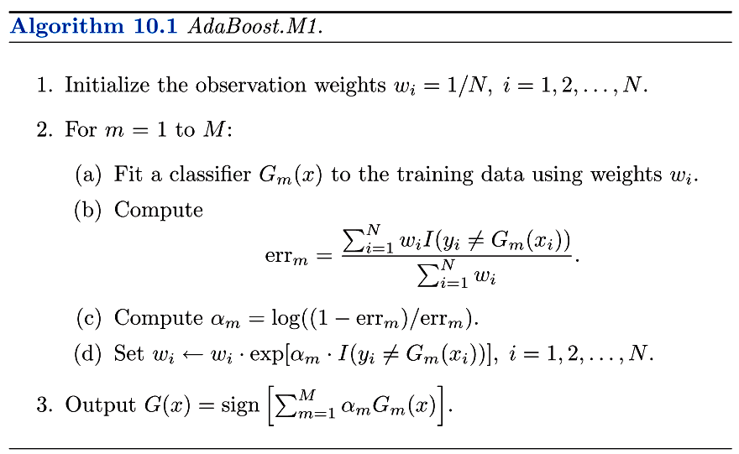
Boosting
Trevor Hastie et al., "The Elements of Statistical Learning"

Slide 32
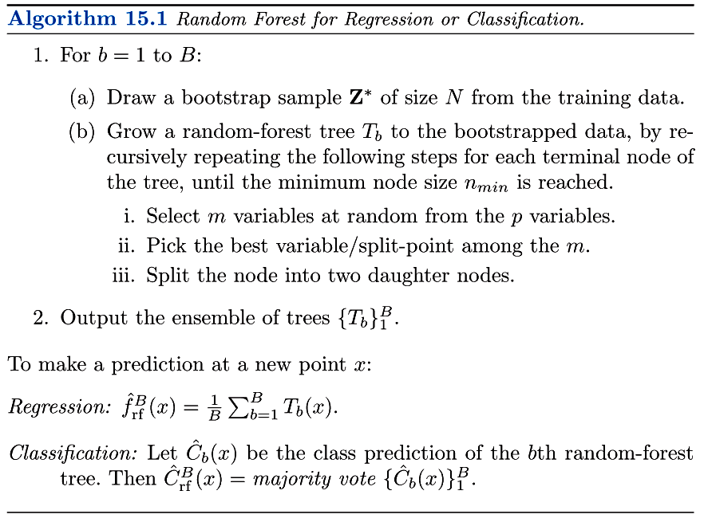
Random Forest
Trevor Hastie et al., "The Elements of Statistical Learning"

Slide 33
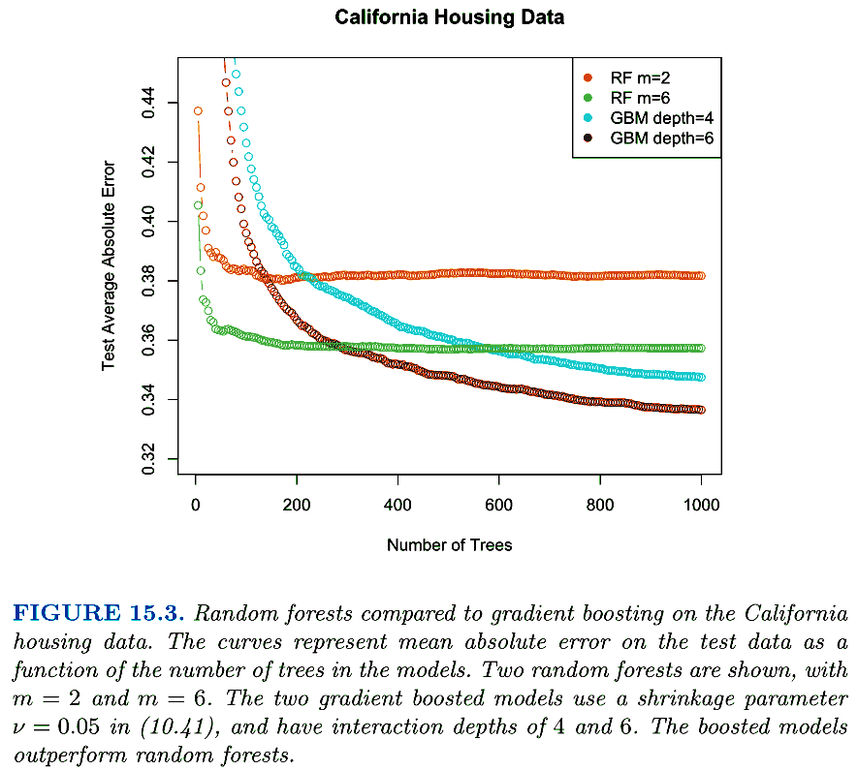
RF: random forest
GBM: gradient boosting model
GBM效能較佳，RF較快收斂
Trevor Hastie et al., "The Elements of Statistical Learning"

Slide 34
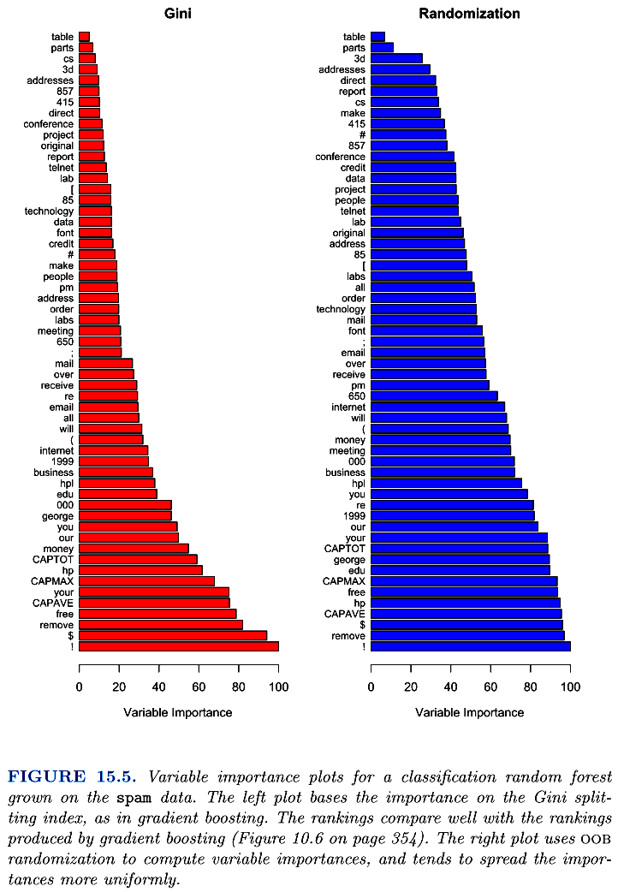
RF: random forest
GBM: gradient boosting model
RF較均勻選擇大部份特徵
Trevor Hastie et al., "The Elements of Statistical Learning"

Slide 35
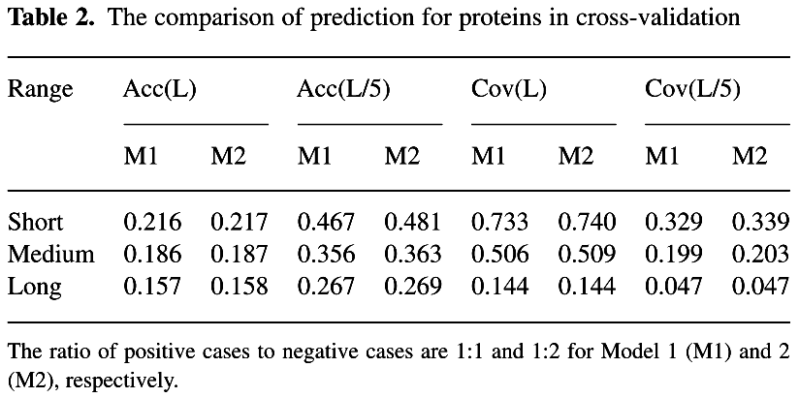
Experiments
Randomly split all proteins in D1490 into three portions and use a standard 3-fold cross-validation to estimate the performance of the models.
  Use all positive samples and randomly select the same or double number of negative samples in the training set to balance the data

Slide 36
Experiments
Classifier ensemble (random forest)
  500 decision trees
  RF algorithm v4.5 in R (Liaw and Wiener, 2002)
After the cross-validation, we build the ﬁnal models of ProC_S3 using all the positive samples and randomly selected double number of negative pairs for short-, medium- and long-range predictions, respectively.

Slide 37
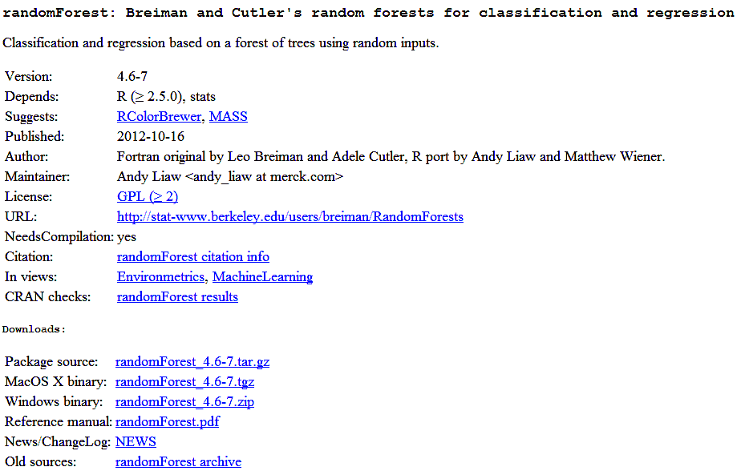
http://cran.r-project.org/web/packages/randomForest/

Slide 38
Performance assessment
Use the accuracy (Acc) and the coverage (Cov) to evaluate the top L/5 and L predicted positives (contact residues)
  Acc: the number of correctly predicted residue pairs divided by the total number of predictions
  Cov: the number of correctly predicted residue pairs divided by the total number of existing contact residue pairs

Slide 39
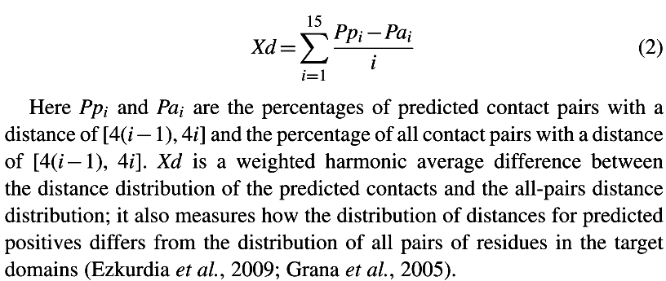
Performance assessment
Xd
The parameter estimates the deviation of the distribution of distances in the list of contacts from
the distribution of distances in all pairs of residues in the protein.
http://predictioncenter.org/casp10/doc/rr_help.html#avg

Slide 40
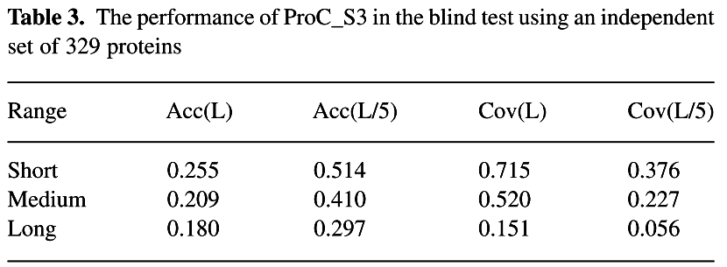
Benchmark tests on dataset D329

Slide 41
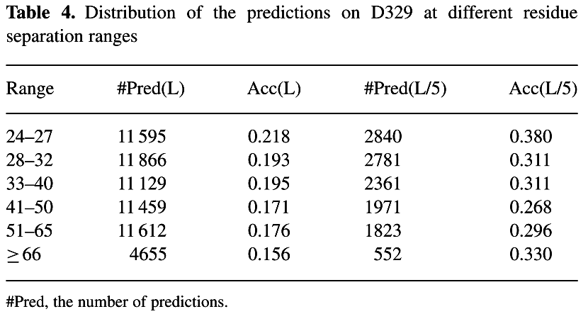
Benchmark tests on dataset D329

Slide 42
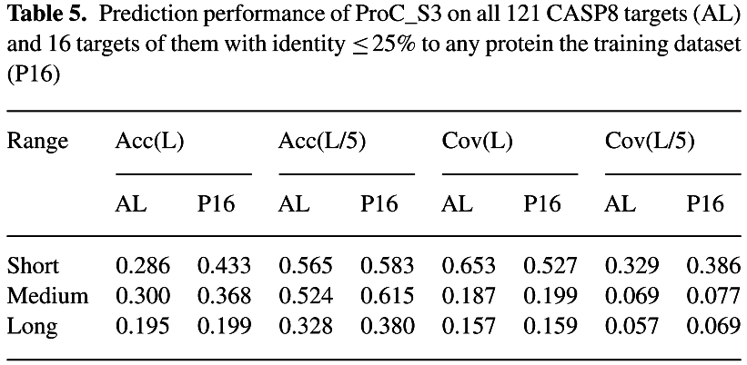
Benchmark tests on CASP8

Slide 43
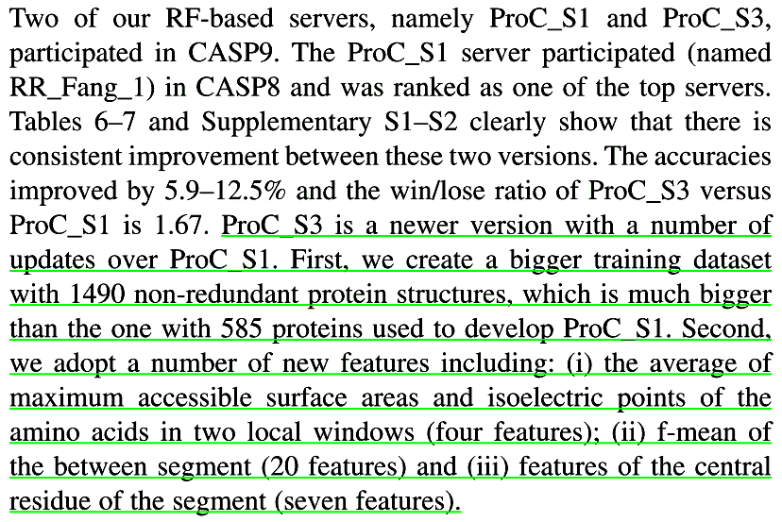
ProC_S1 and ProC_S3

Slide 44
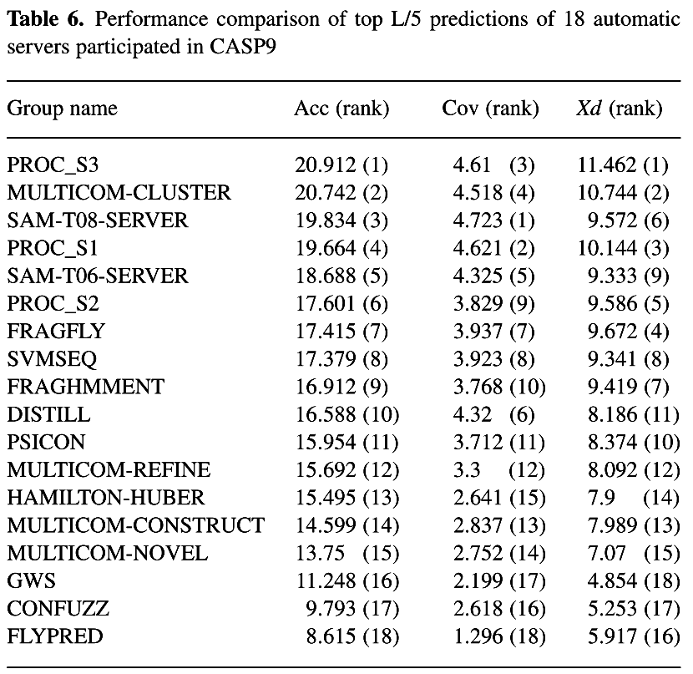
Benchmark tests on CASP9
PROC_S3 & PROC_S1均參加CASP9
PROC_S1參加CASP8 & CASP9

Slide 45
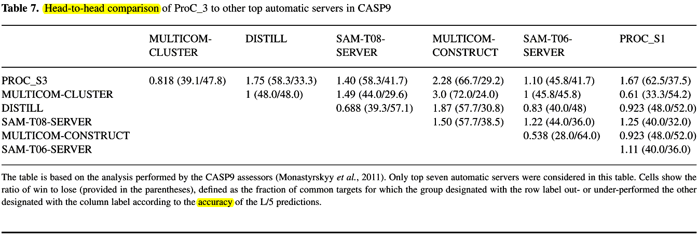
Benchmark tests on CASP9
PROC_S3 & PROC_S1均參加CASP9
PROC_S1參加CASP8 & CASP9

Slide 46
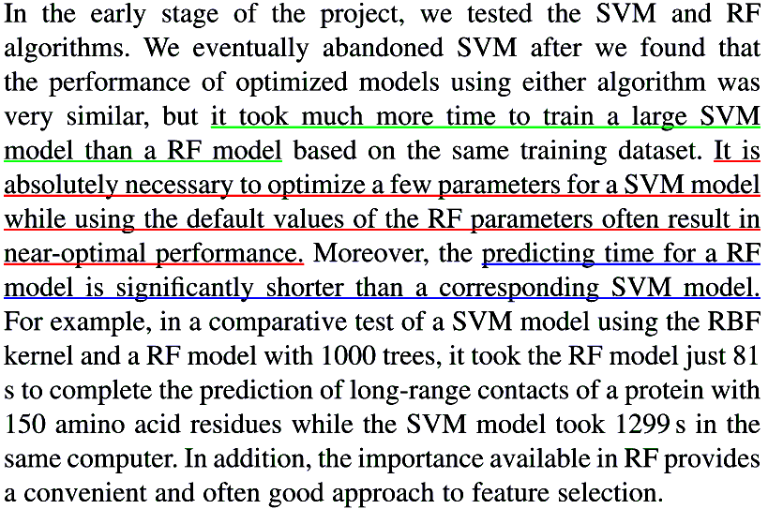
Advantages of RF over SVM

