Slide 1
Fast algorithms to enumerate all common intervals of two permutations.
T. Uno and M. Yagiura
Algorithmica, 26:290-309, 2000.
Presenter: 方鈞毅
Date: Apr. 23, 2013

Slide 2
Abstract
Given two permutations of n elements, a pair of intervals of these permutations consisting of the same set of elements is called a common interval. Some genetic algorithms based on such common intervals have been proposed for sequencing problems and have exhibited good prospects.
In this paper we propose three types of fast algorithms to enumerate all common intervals: (i) a simple O(n²) time algorithm (LHP), whose expected running time becomes O(n) for two randomly generated permutations, (ii) a practically fast O(n²) time algorithm (MNG) using the reverse Monge property, and (iii) an O(n + K ) time algorithm (RC), where K (=< C(^{n}₂)) is the number of common intervals.

Slide 3
Abstract
It will also be shown that the expected number of common intervals for two random permutations is O(1). This result gives a reason for the phenomenon that the expected time complexity O(n) of the algorithm LHP is independent of K. Among the proposed algorithms, RC is most desirable from the theoretical point of view; however, it is quite complicated compared with LHP and MNG. Therefore, it is possible that RC is slower than the other two algorithms in some cases. For this reason, computational experiments for various types of problems with up to n = 10⁶ are conducted. The results indicate that (i) LHP and MNG are much faster than RC for two randomly generated permutations, and (ii) MNG is rather slower than LHP for random inputs; however, there are cases in which LHP requires Ω(n²) time, but MNG runs in o(n²) time and is faster than both LHP and RC.

Slide 4
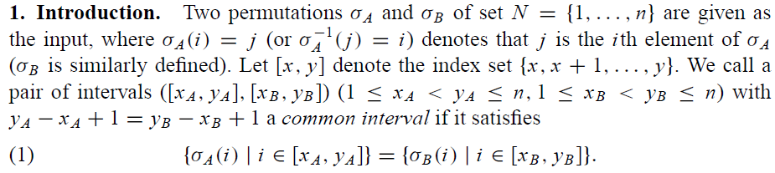
Common Interval

Slide 5
Basic Algorithm(BSC)

Slide 6
Example of BSC

Slide 7
BSC

Slide 8
Improved of BSC
Two improved versions of BSC, called LHP and MNG, both of which detect some redundant inner loop iterations from Line 3 to 8 of BSC They still require O(n²) time in the worst case;

Slide 9
The Algorithm LHP
Here, we only the common intervals of length 2 to n-2 are considered, and Line 3 of BSC is modified as
即不考慮common intervals 長度為 = n-1,n-2

Slide 10
The Algorithm LHP
即，若上式成立代表u-l 已經超過目前最大可能長度 [ x..n ]或長度超過n-2，內無法達成，又因為u-l是非嚴格單調遞增，故在此x層之後的y無須再討論。

Slide 11
The Algorithm LHP
即，若發現上下限中包夾了一個不會出現的數字時，則之後的序列亦不可能為common interval

Slide 12
The Algorithm LHP
正式的HP
x=1 ,HP= π_{AB}(n-1,n)
x=2 ,HP= π_{AB}(1,n-1)
x=3 ,HP= π_{AB}(1,2)
x=4 ,HP= π_{AB}(1,2,3)
x=k ,HP= π_{AB}(1,2,..,k-1)
修改版(亦可取隨機)
x=1 ,HP’= π_{AB}(n-1,n)
x=2 ,HP’= π_{AB}(1,n-1)
x=3 ,HP’= π_{AB}(1,2)
x=4 ,HP’= π_{AB}(2,3)
x=k ,HP’= π_{AB}(k-2,k-1)

Slide 13
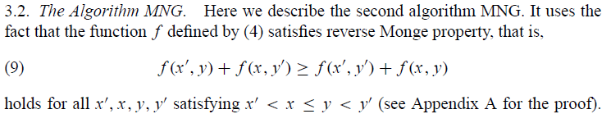
The Algorithm MNG

Slide 14
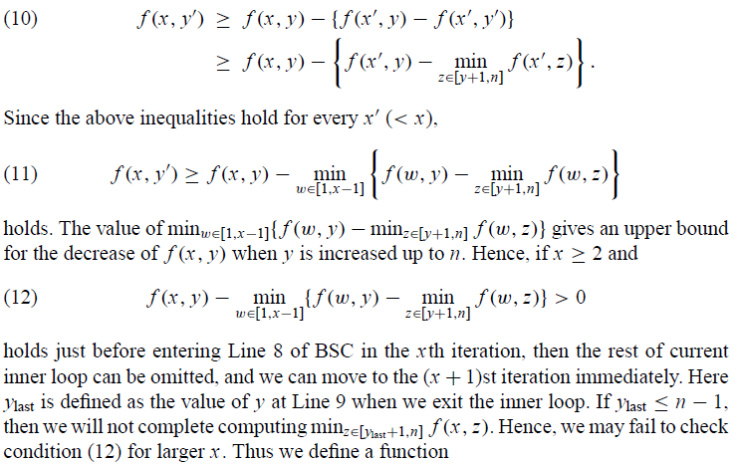
若(12)成立,by(11),則可得到f(x,y+)>0即之後都不match

Slide 15
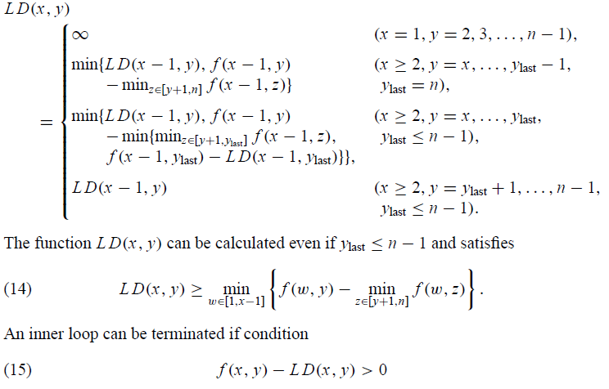
The Algorithm MNG

Slide 16
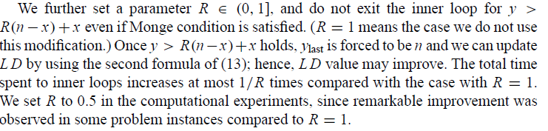
The Algorithm MNG

Slide 17
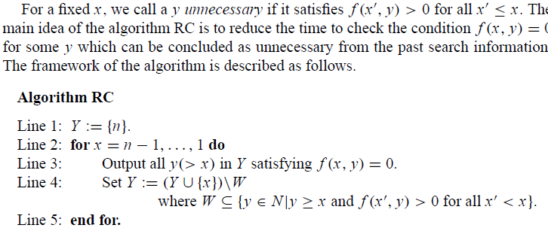
Algorithm RC

Slide 18
Algorithm RC

Slide 19
Algorithm RC

Slide 20
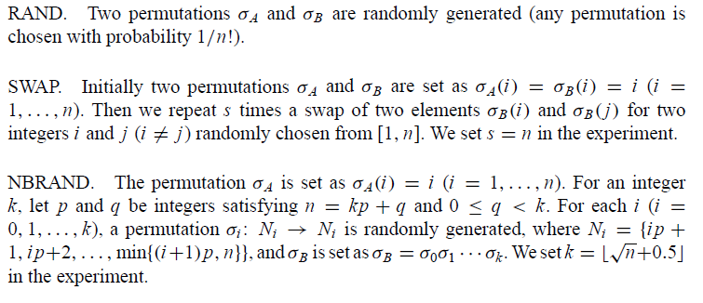
Types of Problem Instances

Slide 21
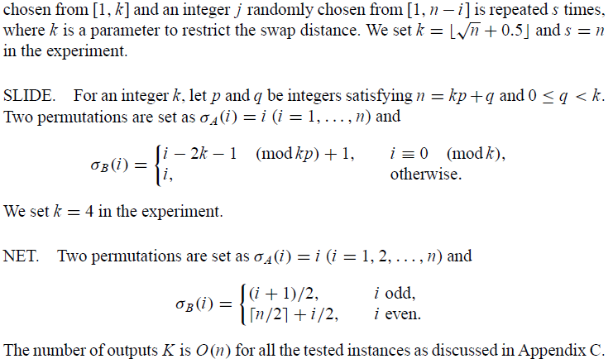

Slide 22
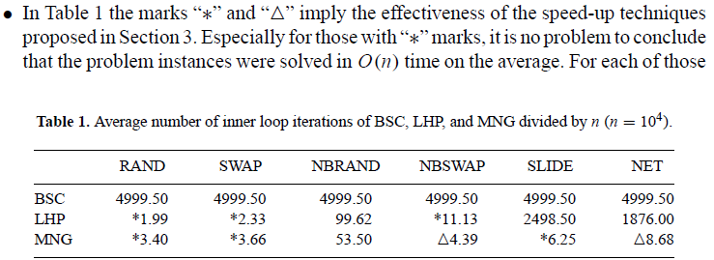
Computational Result

Slide 23
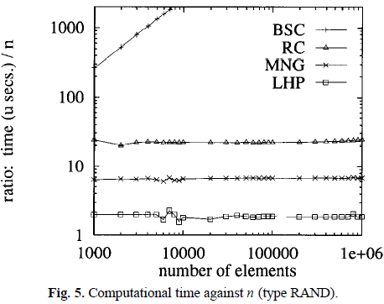

Slide 24
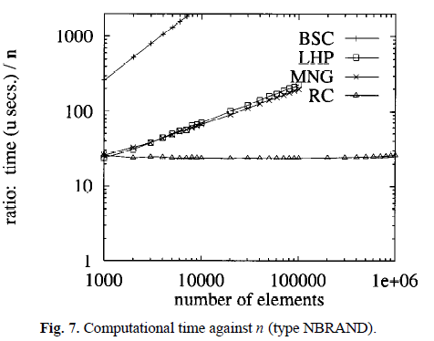

Slide 25
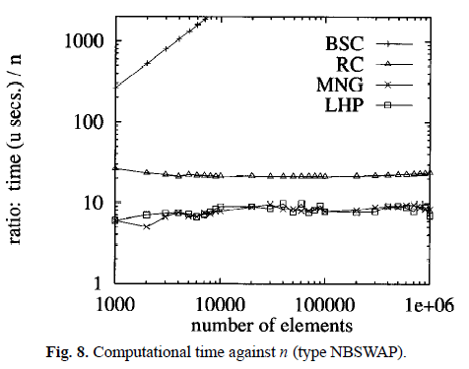

Slide 26
