Slide 1
Score Normalization by Dynamic Time Warping
R. Modugno, G. Pirlo and D. Impedovo
Conference on Computational Intelligence for Measurement Systems and Applications (CIMSA), 2010 IEEE International
Presenter: Che-Jui Hsu(許哲睿)
Date: 2013/4/23

Slide 2
Abstract
Multi-expert approach is a well-known paradigm to support complex decisions and several decision fusion techniques have been considered. In this field score normalization is a fundamental step to allow high performances and hence several techniques have been proposed so far. This paper addresses the problem of score normalization and presents a new technique based on Dynamic Time Warping. The experimental results, carried out in the field of pattern classification, show the superiority of the new technique with respect to other approaches in the literature, based on MIN-MAX, z-score and characteristics functions.

Slide 3
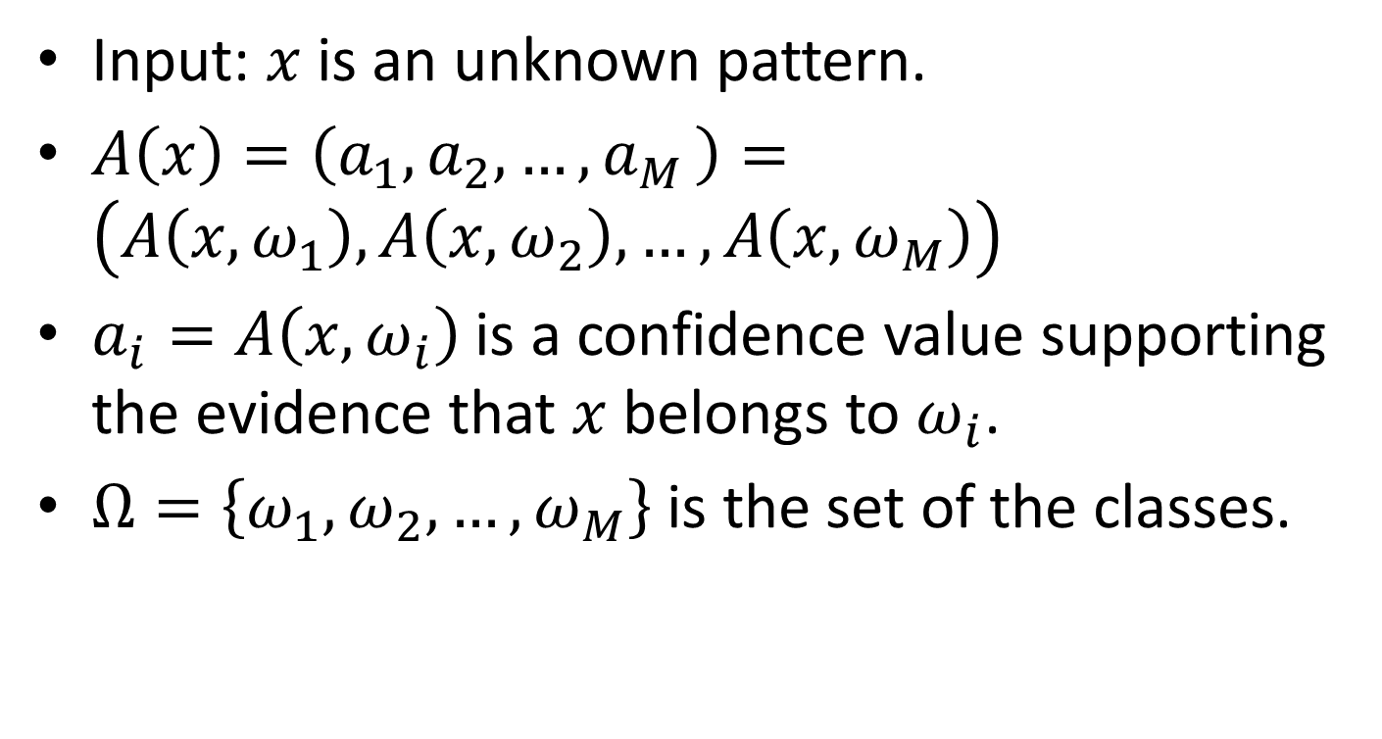
Score Normalization
Input: $x$ is an unknown pattern.
$A\left(x\right)=\left(a_{1},a_{2},{…, a}_{M}\right)=\left(A\left(x, ω_{1}\right),A\left(x, ω_{2}\right), …,A\left(x, ω_{M}\right)\right)$
$a_{i}=A\left(x, ω_{i}\right)$ is a confidence value supporting the evidence that $x$ belongs to $ω_{i}$.
$Ω=\left\{ω_{1},ω_{2}, …,ω_{M}\right\}$ is the set of the classes.

Slide 4
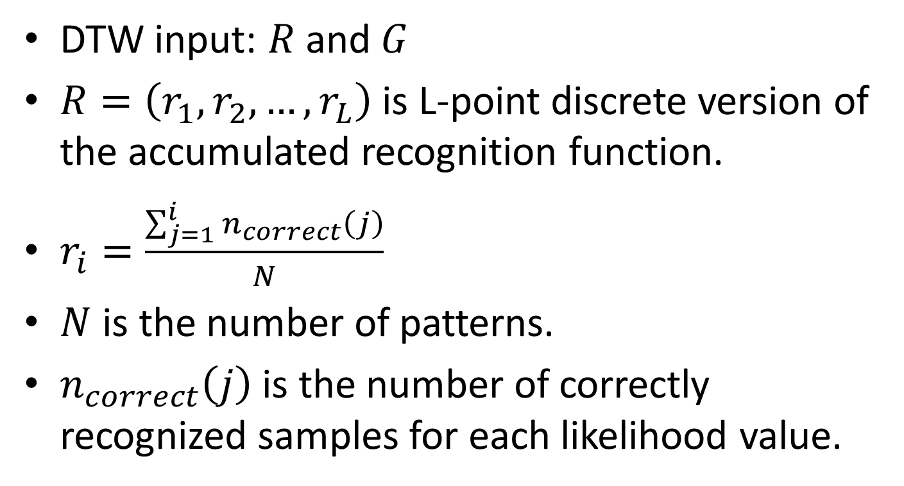
Score Normalization by DTW (1/3)
DTW input: $R$ and $G$
$R=\left(r_{1},r_{2}, …,r_{L}\right)$ is L-point discrete version of the accumulated recognition function.
$r_{i}=\frac{\sum_{j=1}^{i}{n_{correct}\left(j\right)}}{N}$
$N$ is the number of patterns.
$n_{correct}\left(j\right)$ is the number of correctly recognized samples for each likelihood value.

Slide 5
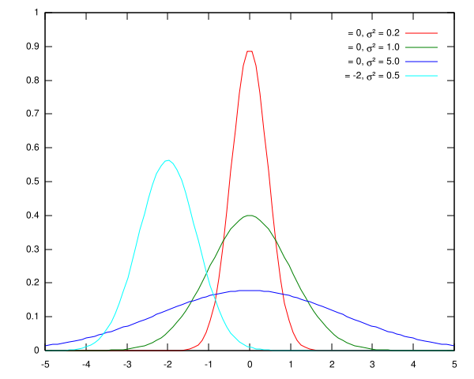
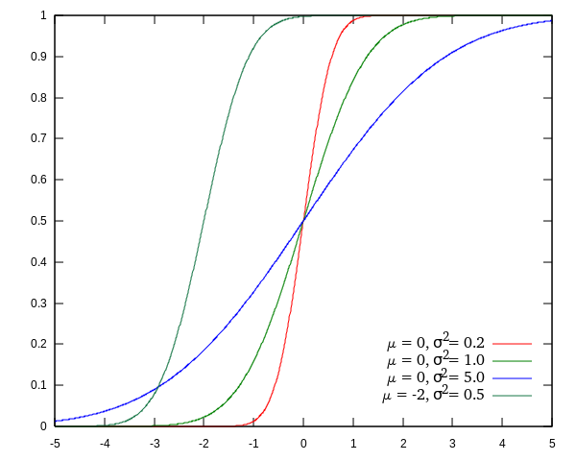

Score Normalization by DTW (2/3)
$G=\left(g_{1},g_{2}, …,g_{L}\right)$ is the L-point discrete version of the accumulated probability function of the standard Gaussian distribution.
Notes:
圖片來源：https://zh.wikipedia.org/wiki/%E6%AD%A3%E6%80%81%E5%88%86%E5%B8%83

Slide 6

Score Normalization by DTW (3/3)
$a_{i}^{′}=\frac{1}{card\left(G_{i}\right)}×\sum_{g_{q}∈G_{i}}{\left(g_{q}\right)}$
$G_{i}=\left\{g_{q} | \left(q, i\right)∈W^{∗}\left(R, G\right)\right\}$

Slide 7
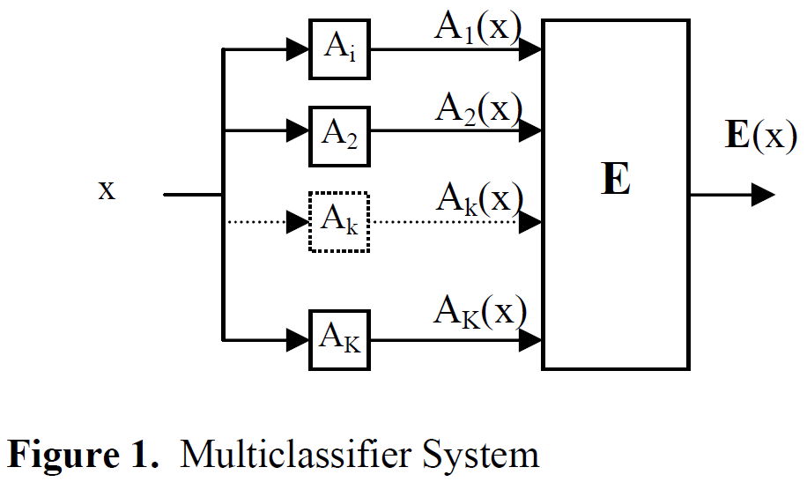
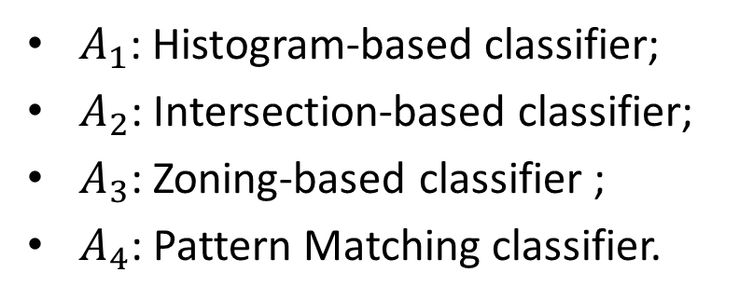
Experiments (1/3)
$A_{1}$: Histogram-based classifier;
$A_{2}$: Intersection-based classifier;
$A_{3}$: Zoning-based classifier ;
$A_{4}$: Pattern Matching classifier.

Slide 8
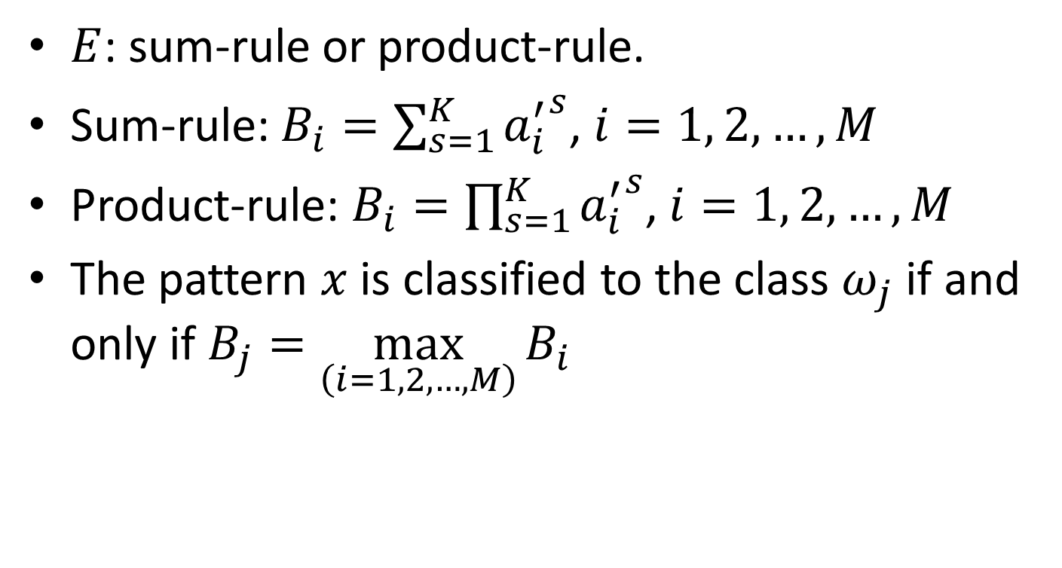
Experiments (2/3)
$E$: sum-rule or product-rule.
Sum-rule: $B_{i}=\sum_{s=1}^{K}{{a_{i}^{′}}^{s}}$, $i=1, 2, …, M$
Product-rule: $B_{i}=\prod_{s=1}^{K}{{a_{i}^{′}}^{s}}$, $i=1, 2, …, M$
The pattern $x$ is classified to the class $ω_{j}$ if and only if $B_{j}=\max_{\left(i=1, 2, …, M\right)}{B_{i}}$

Slide 9
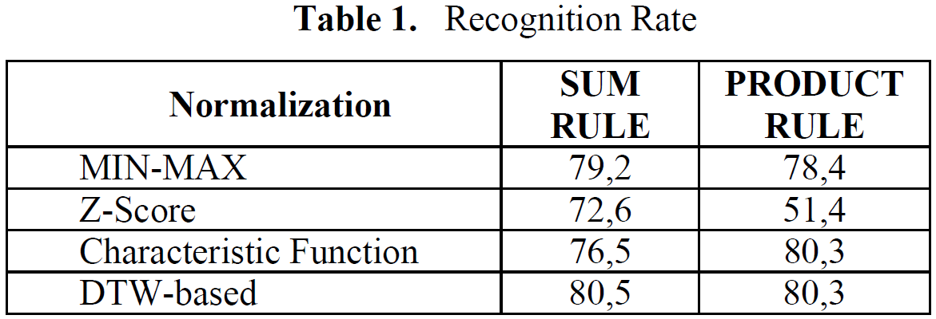
Experiments (3/3)
CEDAR: 18467 patterns for learning and 2189 patterns for the test.

