Slide 1
Towards the identification of essential genes using targeted genome sequencing and comparative analysis
Adam M Gustafson, Evan S Snitkin, Stephen CJ Parker, Charles DeLisi and Simon Kasif
BMC Genomics 2006, 7:265

Slide 2
Abstract
Backgrpund: The identification of genes essential for survival is of theoretical importance in the understanding of the minimal requirements for cellular life, and of practical importance in the identification of potential drug targets in novel pathogens [發病; 疾病學; 病原]. With the great time and expense required for experimental studies aimed at constructing a catalog of essential genes in a given organism, a computational approach which could identify essential genes with high accuracy would be of great value.

Slide 3
Abstract
Results: We gathered numerous features which could be generated automatically from genome sequence data and assessed their relationship to essentiality, and subsequently utilized machine learning to construct an integrated classifier of essential genes in both S. cerevisiae [釀酒酵母] and E. coli [大腸桿菌]. When looking at single features, phyletic[生物種系的] retention[保留], a measure of the number of organisms an ortholog[直接同源] is present in, was the most predictive of essentiality. Furthermore, during construction of our phyletic retention feature we for the first time explored the evolutionary relationship among the set of organisms in which the presence of a gene is most predictive of essentiality.

Slide 4
Abstract
Results (Cont'd): We found that in both E. coli and S. cerevisiae the optimal sets always contain host-associated organisms with small genomes which are closely related to the reference. Using five optimally selected organisms, we were able to improve predictive accuracy as compared to using all available sequenced organisms. We hypothesize the predictive power of these genomes is a consequence of the process of reductive evolution, by which many parasites[寄生蟲] and symbionts[共生有機體] evolved their gene content. In addition, essentiality is measured in rich media, a condition which resembles the environments of these organisms in their hosts where many nutrients are provided. Finally, we demonstrate that integration of our most highly predictive features using a probabilistic classifier resulted in accuracies surpassing any individual feature.

Slide 5
Abstract
Conclusions: Using features obtainable directly from sequence data, we were able to construct a classifier which can predict essential genes with high accuracy. Furthermore, our analysis of the set of genomes in which the presence of a gene is most predictive of essentiality may suggest ways in which targeted sequencing can be used in the identification of essential genes. In summary, the methods presented here can aid in the reduction of time and money invested in essential gene identification by targeting those genes for experimentation which are predicted as being essential with a high probability.

Slide 6
Experimental data
S. cerevisiae
  4,728 yeast genes were used, 966 of which are essential [子杰與Hwang用4815 genes]
  Giaever G et al., Functional profiling of the Saccharomyces cerevisiae genome. Nature 2002, 418:387-391.
E. coli
  3569 genes were used, of which 611 are essential [Hwang用3039 genes]
  Experimental determination and system level analysis of essential genes in Escherichia coli MG1655. J Bacteriol 2003, 185:5673-5684

Slide 7
Features
Experimental
  Protein interaction network degree
  Protein Localization
  Recombination Rate
Genomic
  Gene size
  Regulatory complexity
  Phyletic retention measure
  Number of paralagous genes
  Strand bias
Protein (by CodonW software)
  http://codonw.sourceforge.net/
  Amino acid composition, codon bias, codon adaptation index (CAI), frequency of optimal codons (FOP), isoelectric point (PI), hydropathicity score, and hydrophobicity score

Slide 8
重組速率(Recombination Rate) [子杰沒有]
調控複雜度 (Regulatory Complexity) [子杰沒有]
蛋白質在演化上面被保留程度 (Phyletic Retention Measure)
旁系同源基因的數目 (Number of Paralogous Genes) [子杰沒有]
蛋白質互動網路分支度(Degree)
密碼子使用情形偏移(Codon Bias) [子杰沒有]
蛋白質細胞位置 (Protein Localization) [子杰沒有]
胺基酸組成 (Amino Acid Composition)
密碼子適應指數 (Codon Adaptation Index，CAI) [子杰沒有]
最優化密碼子之頻率 (Frequency of Optimal Codons，FOP) [子杰沒有]
等電點(Isoelectric point ，PI) [子杰沒有]
親水性(Hydropathicity Score) [子杰沒有]
疏水性(Hydrophobicity Score) [子杰沒有?]

Slide 9
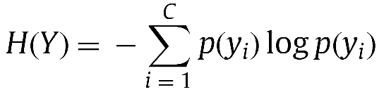
The Shannon Entropy
y: 類別(或特徵)變數
C: 總類別數
p(yi): yi出現機率分佈(probability distribution)
凌亂程度或資訊含量(想像當p(yi)=1時的狀況)

Slide 10

Mutual Information
X: 特徵變數(集合)
y: 類別變數
C: 總類別數
Ω: 總特徵變數集合
p(x,yi): x和yi共同出現機率分佈(joint probability distribution)

Slide 11
Mutual Information (Contd)
The mutual information (MI) is a measure of generalized correlation between two random variables, and can also be interpreted as the amount of information shared by two random variables or the quantity of information one variable can predict about the other one.
如果x代表特徵變數，y代表類別變數，則MI為衡量x可預測y的程度。

Slide 12

Conditional Mutual Information
xi, xj: 特徵變數
y: 類別變數
C: 總類別數
N: the number of samples
p(xi,xj,yk): xi,xj和yk共同出現機率分佈(joint probability distribution)

Slide 13
Conditional Mutual Information (Contd)
Being corresponding to two feature spaces over the same data set, and the relevant variable Y, representing the class labels. In this case, I(Xi; y| Xj) can be interpreted as how much information the feature space Xi can predict about the relevant variable Y that the feature space Xj cannot.
用於衡量Xi比Xj多出來預測y的能力

Slide 14


Metric distance (dissmilarity) between features
用於衡量Xi比Xj多出來預測y的能力
利用Xi比Xj多出來(加上Xj比Xi多出來)預測y的能力來衡量兩個特徵相似(異)程度
正規化版本
Jose Martinez Sotoca et al., Supervised feature selection by clustering using conditional mutual information-based distances

Slide 15
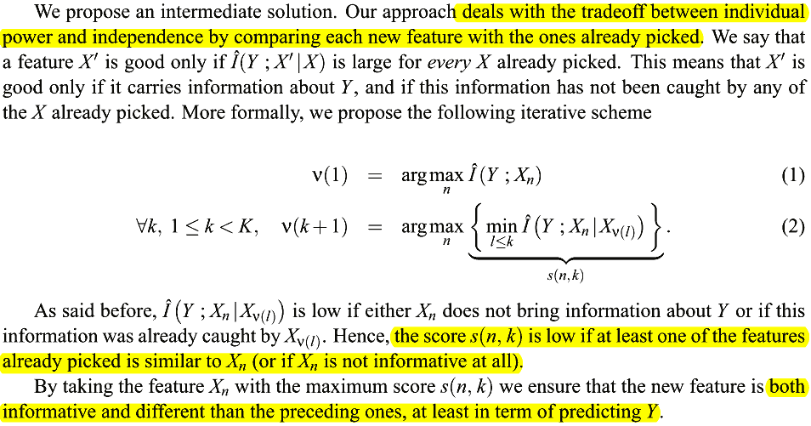
Conditional mutual information maximization criteria (CMIM)
Fleuret F: Fast Binary Feature Selection with Conditional Mutual Information. Journal of Machine Learning Research (JMLR) 2004, 5:1531–1555.

Slide 16


Available CMIM library
FEAST
  A Feature Selection Toolbox for C and Matlab
  http://www.cs.man.ac.uk/~gbrown/fstoolbox/
  Python wrapper
    https://github.com/mutantturkey/PyFeast/blob/master/README.markdown
RDKit (Cheminformatics and Machine Learning Software)
  C++ and Python
  http://www.rdkit.org/
http://downloadsourcecodes.com/matlabfiles/cmim.m
CVRG
  http://wiki.cvrgrid.org/index.php/FeatureSelection
  R

Slide 17
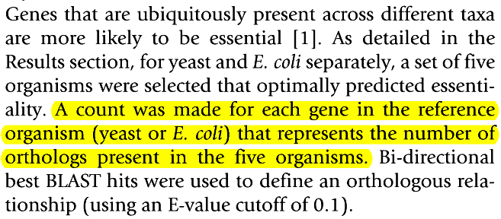
phyletic retention measure

Slide 18
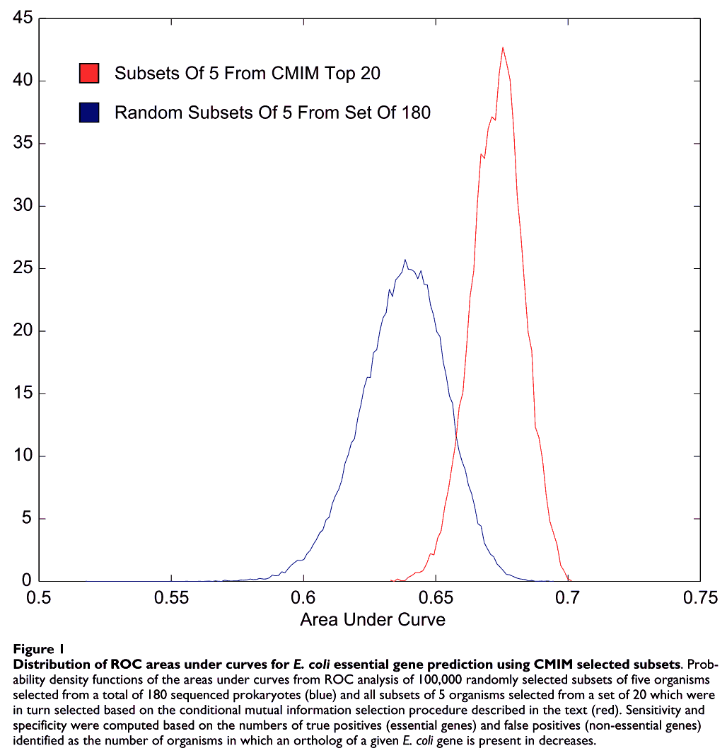

phyletic retention measure

Slide 19
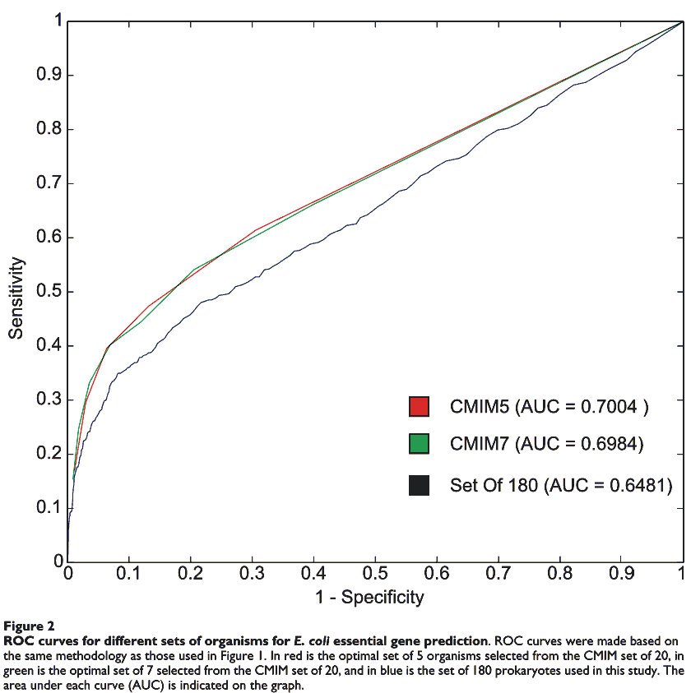
phyletic retention measure

Slide 20
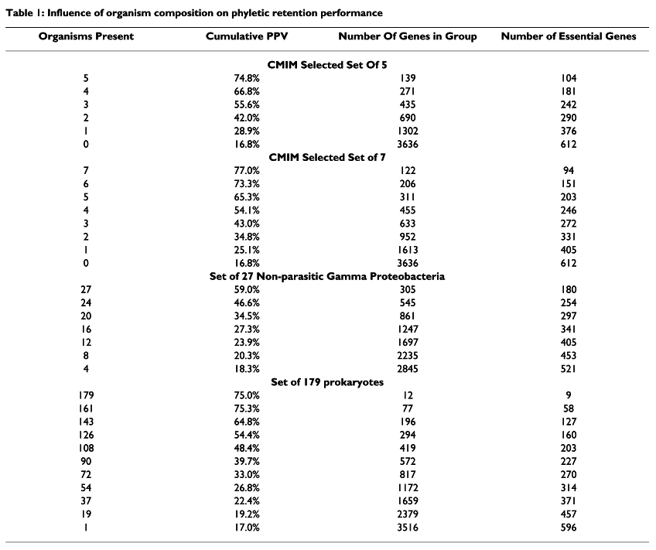
phyletic retention measure

Slide 21

CodonW
http://codonw.sourceforge.net

Slide 22
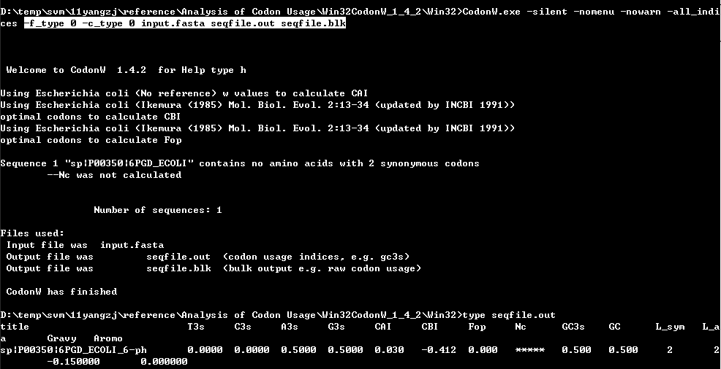
CodonW

Slide 23
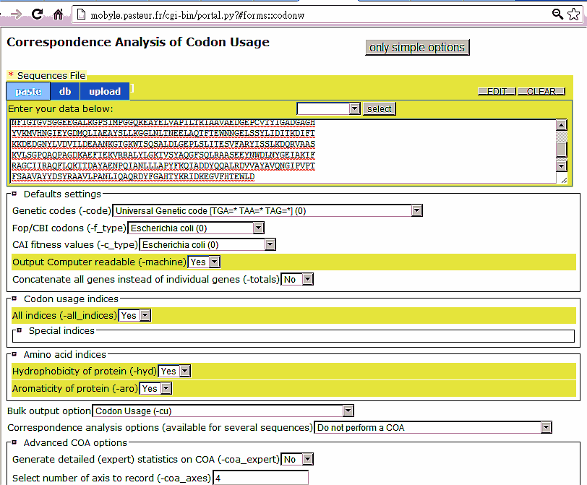
CodonW
http://mobyle.pasteur.fr/cgi-bin/portal.py?#forms::codonw

Slide 24
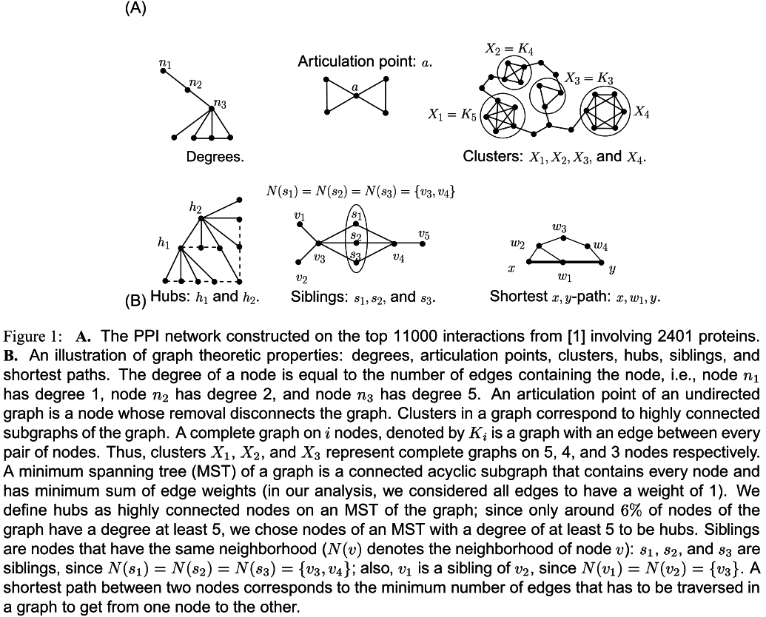
N. Pržulj et al., Functional topology in a network of protein interactions

Slide 25


Node/Graph properties
Degree: the number of edges containing that node
An articulation point: a node whose removal disconnects the graph
Shortest paths: A shortest path between two nodes corresponds to the minimum number of edges that has to be traversed in the graph to get from one node to the other
Notes:
library(igraph)
g0 <- read.graph("http://cneurocvs.rmki.kfki.hu/igraph/karate.net",format="pajek")
#Degree
g = g0
V(g)$label = paste(degree(g))
coords=layout.kamada.kawai(g)
g <- set.graph.attribute(g, "layout", coords)
plot(g,main='degree')#, layout=layout.kamada.kawai)
#articulation point
g = g0
artp = articulation.points(g)
if(length(artp)>0) V(g)[artp]$color = 'red'
x11()
g <- set.graph.attribute(g, "layout", coords)
plot(g,main='articulation point')#, layout=layout.kamada.kawai)
#shortest paths
g = g0
#path = get.shortest.paths(g, from=0, to=length(V(g))-1)[[1]]
mat=shortest.paths(g); colnames(mat) = rownames(mat) = paste(V(g))
wh_max = which(mat == max(mat), arr.ind = TRUE)[1,]
path = get.shortest.paths(g, from=wh_max[1], to=wh_max[2])[[1]]
E(g)$color = 'black'
E(g,path=path)$color = 'red'
x11()
g <- set.graph.attribute(g, "layout", coords)
plot(g,main=paste('one shortest path:',paste(path,collapse=' ')))#, layout=layout.kamada.kawai)
#clique
g = g0
cls = cliques(g)
max_cl = cls[[which.max(sapply(cls,length))[1]]]
E(g)$color = 'black'
E(g)[max_cl %--% max_cl]$color = 'red'
x11()
g <- set.graph.attribute(g, "layout", coords)
plot(g,main='one clique')#, layout=layout.kamada.kawai)

Slide 26
Node/Graph properties
Hub: the high degree nodes (degree ≥ 5) on the MST
Clusters: 應該是clique
Bottleneck: the number of descendents for the node in the tree > N/4
Pathways

Slide 27
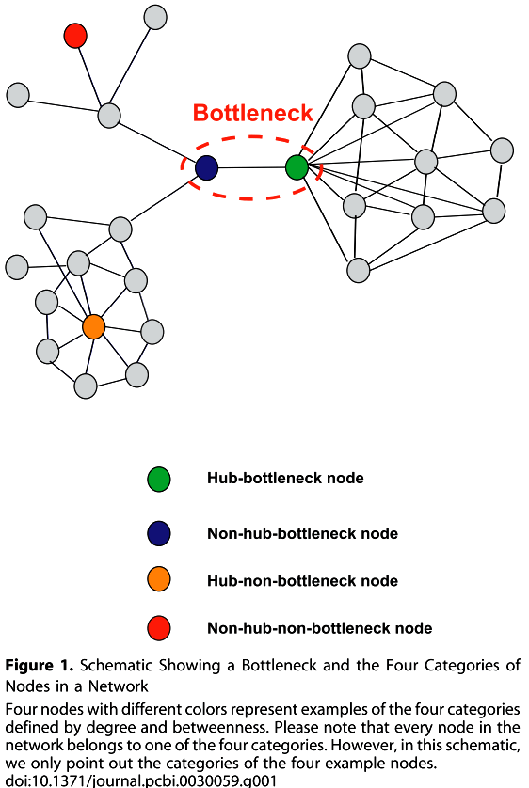
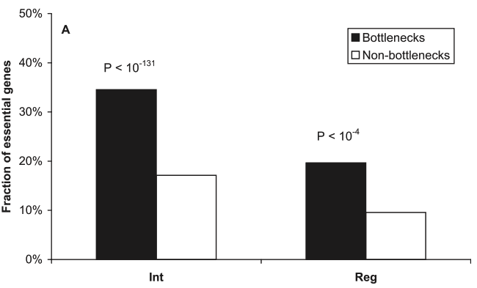
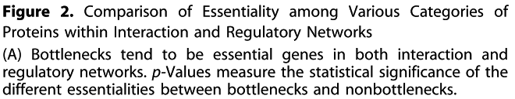
bottlenecks tend to be essential
bottlenecks dictate the essentiality of networks with directed edges
Haiyuan Yu et al., "The Importance of Bottlenecks in Protein Networks: Correlation with Gene Essentiality and Expression Dynamics"

Slide 28
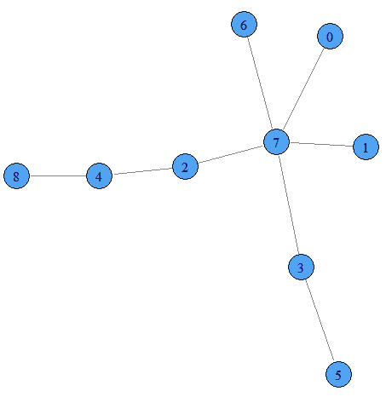

Bottleneck
Check bottleneck score for node 4:
Node 0 as root:
0 7 2 4 8
Node 1 as root:
1 7 2 4 8
Node 2 as root:
2 4 8
Node 3 as root:
3 7 2 4 8
Node 5 as root:
5 3 7 2 4 8
Node 6 as root:
6 7 2 4 8
Node 7 as root:
7 2 4 8
Node 8 as root:
8 4 2 7 0
8 4 2 7 1
8 4 2 7 3 5
8 4 2 7 6
Notes:
library(igraph)
get_tree_descendents <- function(tree,root,node){
leaves = V(tree)[degree(tree)==1]
all_shortest_paths = sapply(leaves,function(leave) get.shortest.paths(tree,root,leave))
descendents = c()
for(path in all_shortest_paths){
whe_in = node %in% path
wh = which(path==node)
if(length(wh)>0){
descendents = c(descendents,path[(wh+1):length(path)])
}
}
descendents
}
fact = 0.25
lists = c(1,8,2,8,3,8,4,8,5,3,7,8,4,6,5,9) - 1
g = graph(lists, directed=F)
plot(g, layout=layout.kamada.kawai)
vs = as.integer(V(g))
N = length(vs)
thr = N * fact
bns0 = rep(0,length(vs)); names(bns0) = paste(vs)
all_shortest_paths_by_nodes = lapply(vs,function(v){
bns = bns0
tr = unfold.tree(g,roots=v)$tree
leaves = V(tr)[degree(tr)==1]
all_shortest_paths = sapply(leaves,function(leave) get.shortest.paths(tr,v,leave))
for(v_ in setdiff(vs,v)){
descendents = get_tree_descendents(tr,v,v_)
all_shortest_paths = sapply(leaves,function(leave) get.shortest.paths(tr,v,leave))
if(length(descendents) >= round(thr+0.5)){
cat('Node',paste(v_),'is a bottleneck (#descendents>',thr,') from root',v,'\n')
bns[paste(v_)] = bns[paste(v_)] + 1
for(path in all_shortest_paths){
whe_in = v_ %in% path
wh = which(path==v_)
if(length(wh)>0){
cat(path,'\n')
}
}
}
}
list(root=v,all_shortest_paths=all_shortest_paths,bottleneck=bns)
})

Slide 29
Important proteins
70% of the top 10 most frequent proteins are in viable and structural proteins. These results suggest that such ‘most frequent’ proteins in the PPI graph create and support structure, rather than transduce cellular signal.

Slide 30
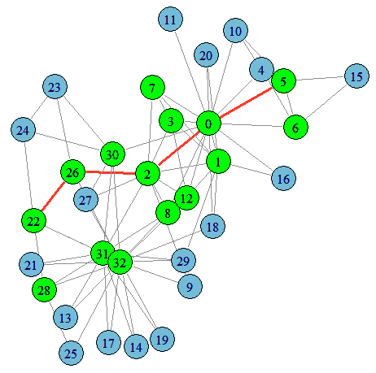
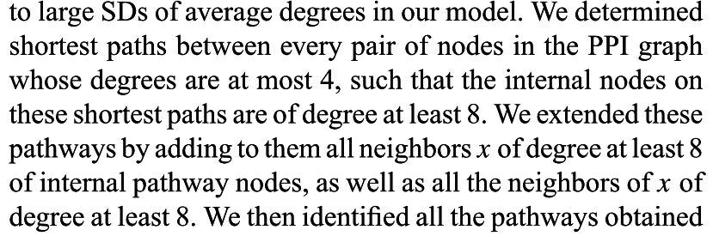

把degree大的nodes連起來
Notes:
library(igraph)
g <- read.graph("http://cneurocvs.rmki.kfki.hu/igraph/karate.net",format="pajek")
g = delete.vertices(g, which(degree(g)==1))
wh = degree(g) > 3
V(g)$color <- ifelse(wh, "green", "lightblue")
#sizes = log(degree(g)) * 10
#V(g)$size <- log(degree(g))*10
wh_nodes = V(g)[wh]
all_shortest_paths_by_nodes = unlist(lapply(wh_nodes,function(v){
get.shortest.paths(g, from=v, to=setdiff(wh_nodes,v))
}),recursive=F)
lens = sapply(all_shortest_paths_by_nodes,length)
max_length = max(lens)
which_max = which(lens==max_length)[1]
#which_max = which(lens==max_length)
E(g)$color <- "grey"
E(g)$width <- 1
for(i in 1:length(which_max)){
path = all_shortest_paths_by_nodes[which_max[i]][[1]]
for(p in 1:(length(path)-1)){
#E(g)[ V(g)[ path[p] ] %--% V(g)[ path[p+1] ] ]$color <- "red"
#E(g)[ V(g)[ path[p] ] %--% V(g)[ path[p+1] ] ]$color <- sample(colors(),1)
E(g,path=path)$color = sample(colors(),1)
E(g,path=path)$width = 3
}
}
plot(g, layout=layout.kamada.kawai)

Slide 31

The MAPK/ERK pathway is a chain of proteins in the cell that communicates a signal from a receptor on the surface of the cell to the DNA in the nucleus of the cell.
The pathway includes many proteins, including MAPK (Mitogen-activated protein kinases, originally called ERK, Extracellular signal-regulated kinases), which communicate by adding phosphate groups to a neighboring protein.
When one of the proteins in the pathway is mutated, it can be stuck in the "on" or "off" position, which is a necessary step in the development of many cancers. Components of the MAPK/ERK pathway were discovered when they were found in cancer cells. Drugs that reverse the "on" or "off" switch are being investigated as cancer treatments.
http://en.wikipedia.org/wiki/MAPK/ERK_pathway

Slide 32


Some library for graph property computation & visualization
igraph
  C, Python, R
  http://igraph.sourceforge.net/index.html
NetworkX
  Python
  http://networkx.github.io/

Slide 33
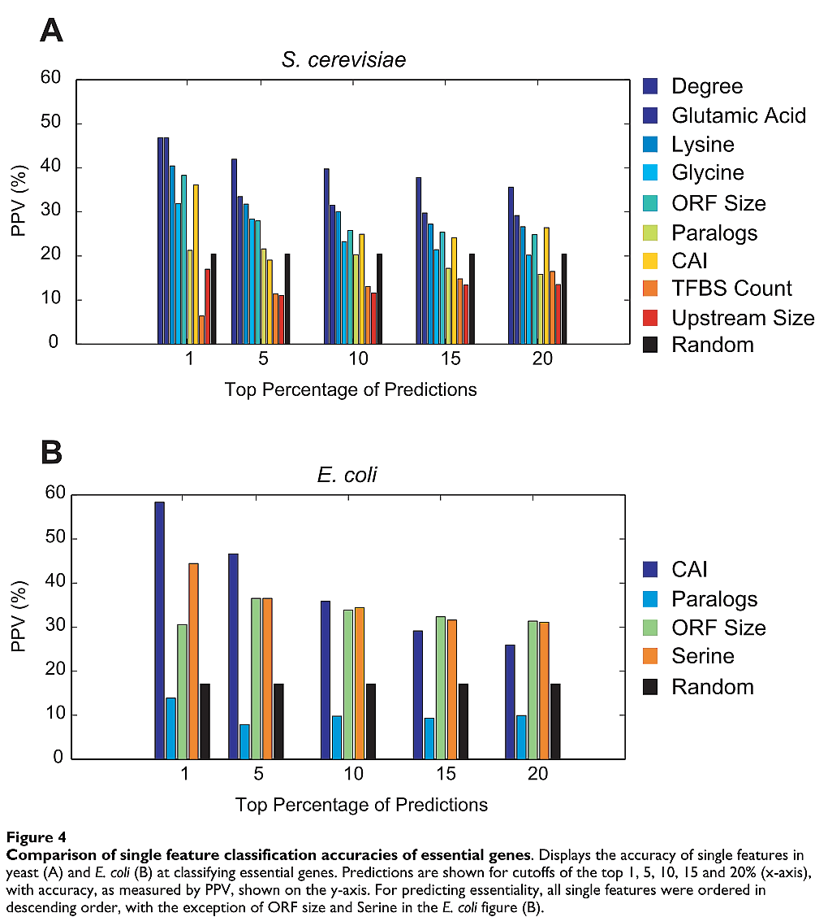
Performance of Single Feature

Slide 34
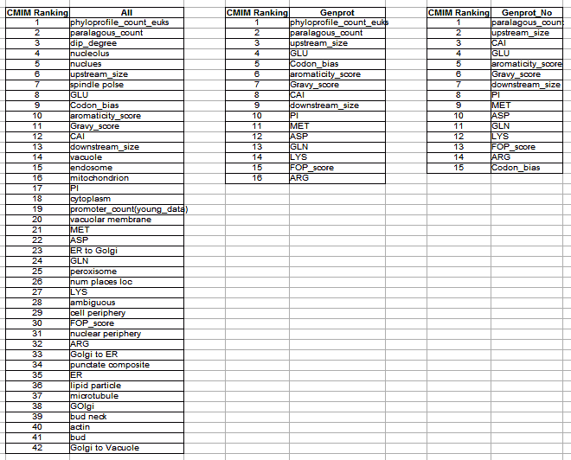
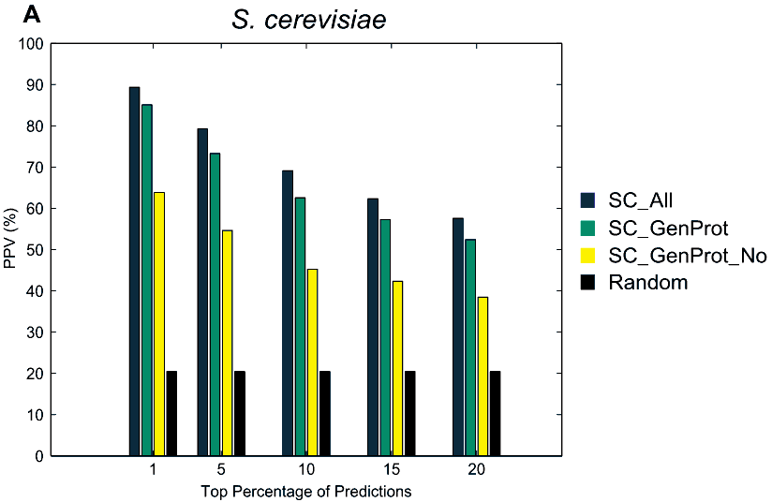
S. cerevisiae
SC_GenProt: all features which can be obtained directly from sequence data
SC_GenProt_No: is identical to SC_GenProt, but lacks the phyletic retention measure.
positive predictive value (PPV)

Slide 35
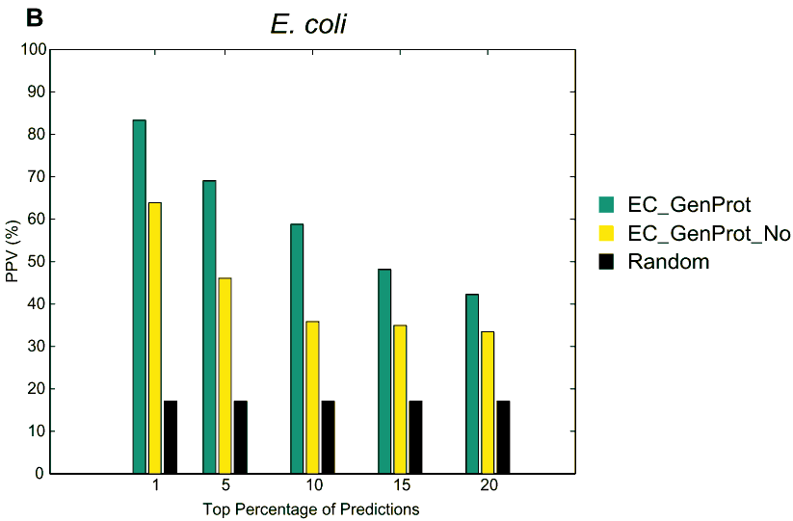
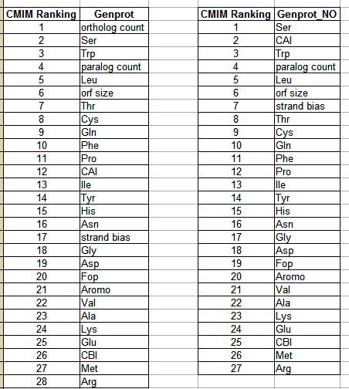
E. coli
positive predictive value (PPV)

Slide 36
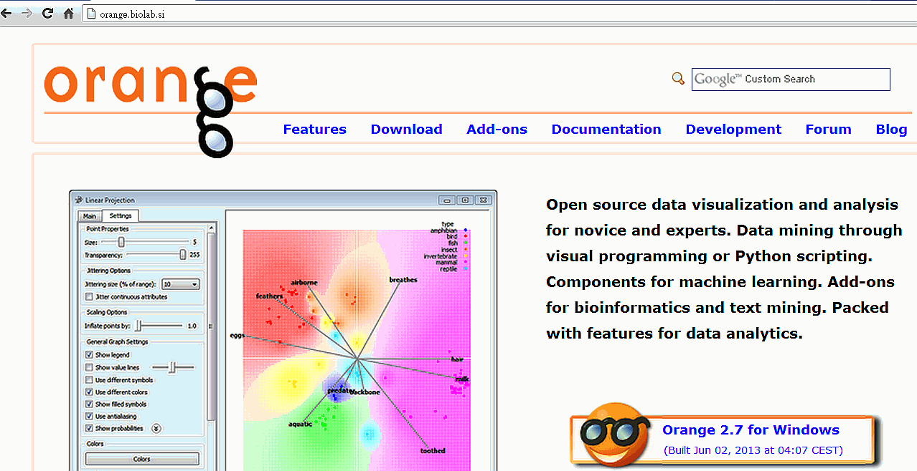


Classifier - Oragne's Navie Bayes
http://orange.biolab.si/

Slide 37
關於投evolutionary bio-informatics
Dataset增加本篇論文大腸桿菌資料，並增加Sequence/Graph特徵。目標是用我們論文的特徵選擇方法打敗本篇論文之CMIM方法，待進行工作
  跑PSSM並取Sequence /Graph特徵
  重跑CMIM/我們論文方法進行10 Fold CV後，進行比較
由於酵母菌與大腸桿菌資料所能用的特徵不一樣，Web版須輸出二種分類器輸出

Slide 38
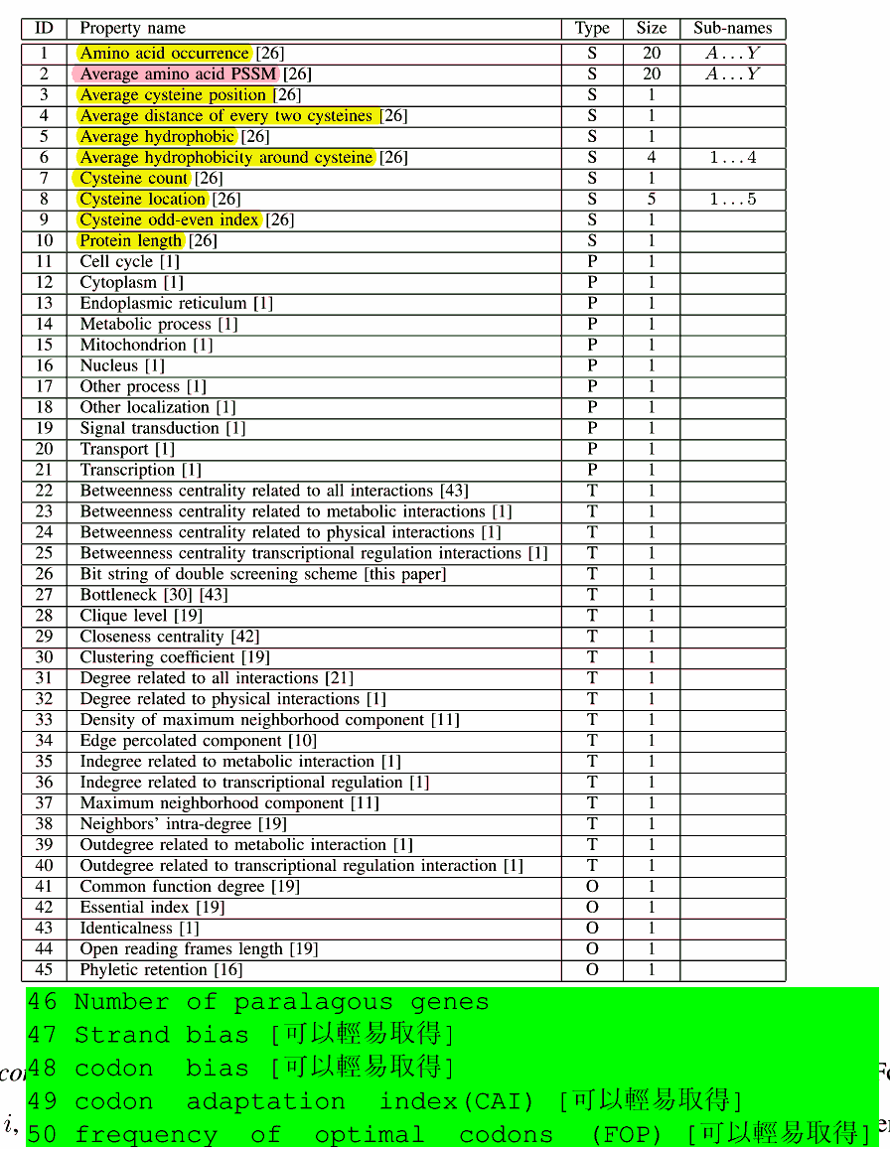

可以擷取特徵(黃色：可以輕易取得，粉紅色：須費不少時間算，其他：無法取得或須使用者輸入)
網路資訊有三種Hu2009：
Integrated PI network data
Integrated functional interaction
Integrated PI and GC network
Notes:
#Hu2009 web site:
http://ecoli.med.utoronto.ca/
User: t16chiouyi
Password: t163566

