Slide 1
A Simple Algorithm for Finding Gene Clusters 2009年資訊科技國際研討會論文集
呂威甫 亞洲大學 資訊工程學系 生物資訊系
陳彥嘉 亞洲大學 生物資訊系
Presentor：Hsin-Chuan Yuan

Slide 2
Abstract
Genomes evolve through large-scale events, known as genome rearrangements, that reorganize the gene order in the chromosome. Usually two closely related prokaryotes share many gene clusters, which are sets of genes in close proximity to each other, but not necessarily contiguous nor in the same order in both genomes. Gene clusters could result from evolution of common ancestors, and could represent phenomenon of co-expression. It plays an important role in the construction of phylogenetic trees and prediction of gene functions.

Slide 3
Abstract
Thus, finding gene clusters is an important problem in comparative genomics. In this paper, we will discuss gene clusters finding problem using model of approximate common intervals, that is, genomes are considered as strings and approximate common intervals are defined as set symmetric difference. We present an O(n³) algorithm to find gene clusters.

Slide 4
Basic Definitions
Approximate common intervals
e.g.
Σ = {a, b, c, d, e, f, g, h}
S1 = c b b e g h h
S2 = b c g f f e h h
CS(S1)={b, c, e, g, h}
CS(S2)={b, c, e, f, g, h}
稱相差1的近似空間或對稱差為1的近似空間

Slide 5
Basic Definitions
Σ = {a, b, c, d, e, f, g, h}
CS(S1)={b, c, e, g, h} 0 1 1 0 1 0 1 1
CS(S2)={b, c, e, f, g, h} 0 1 1 0 1 1 1 1
對稱差(CS(S1), CS(S2))
= Hamming distance(0 1 1 0 1 0 1 1, 0 1 1 0 1 1 1 1)
= 1

Slide 6
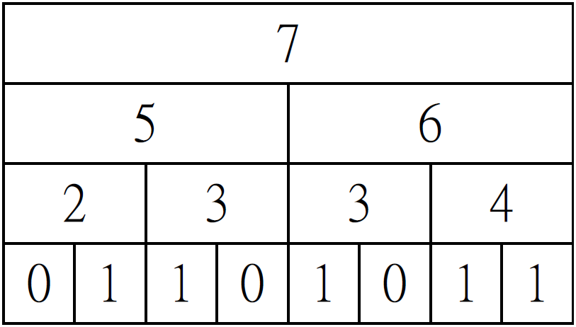
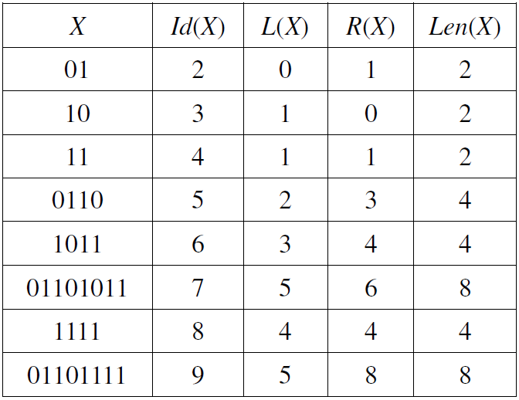
命名法則

Slide 7
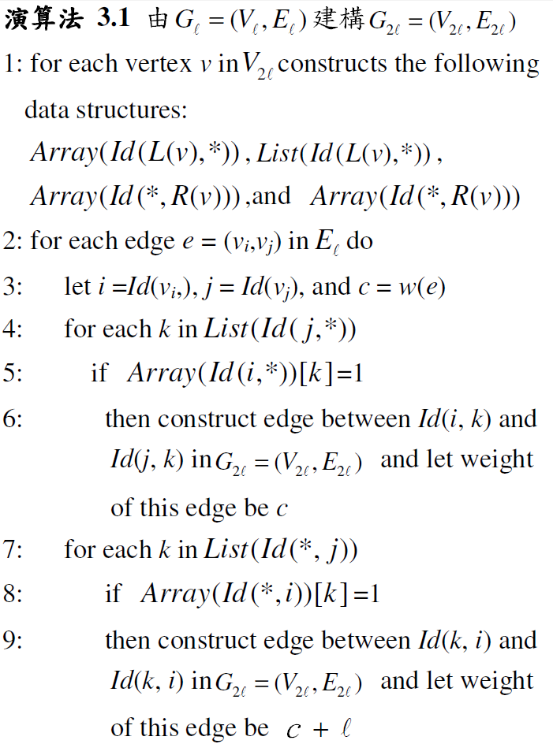

演算法

Slide 8
演算法
7
5 |  |  |  | 6
2 |  | 3 |  | 3 |  | 4
0 | 1 | 1 | 0 | 1 | 0 | 1 | 1
9
5 |  |  |  | 8
2 |  | 3 |  | 4 |  | 4
0 | 1 | 1 | 0 | 1 | 1 | 1 | 1

Slide 9
演算法
7
5 |  |  |  | 6
2 |  | 3 |  | 3 |  | 4
0 | 1 | 1 | 0 | 1 | 0 | 1 | 1
9
5 |  |  |  | 8
2 |  | 3 |  | 4 |  | 4
0 | 1 | 1 | 0 | 1 | 1 | 1 | 1
2 3
4
1
2

Slide 10
演算法
7
5 |  |  |  | 6
2 |  | 3 |  | 3 |  | 4
0 | 1 | 1 | 0 | 1 | 0 | 1 | 1
9
5 |  |  |  | 8
2 |  | 3 |  | 4 |  | 4
0 | 1 | 1 | 0 | 1 | 1 | 1 | 1
2 3
4
5 6
8
1
2
2

Slide 11
演算法
7
5 |  |  |  | 6
2 |  | 3 |  | 3 |  | 4
0 | 1 | 1 | 0 | 1 | 0 | 1 | 1
9
5 |  |  |  | 8
2 |  | 3 |  | 4 |  | 4
0 | 1 | 1 | 0 | 1 | 1 | 1 | 1
2 3
4
5 6
8
1
2
6
2
7 9
Time complexity: O(n³)

Slide 12
演算法(for K>1)
Σ = {a, b, c, d}
S1 = abcc | S2 = acbd
1110 | 1111
1100 | 1110
0110 | 0111
 | 0110
Time complexity: O(n³)

Slide 13
演算法(for K>1)
Σ = {a, b, c, d}
S1 = abcc | S2 = acbd
1110 | 1111
1100 | 1110
0110 | 0111
 | 0110
1
4
2
1
3
5
3
Time complexity: O(n³)

Slide 14
演算法(for K>1)
Σ = {a, b, c, d}
S1 = abcc | S2 = acbd
1110 | 1111
1100 | 1110
0110 | 0111
 | 0110
 | 1010
 | 0101
1
4
2
1
3
5
3
6
7
3
2
6
2
1
1
3
4
4
1
5
Time complexity: O(|En|)
4
3
7

Slide 15
Conclusions
目前演算法的時間分析雖然是O(n³)的時間複雜度，但我們相信經過更嚴格的時間分析，演算法應該可以得O(nlog²n)的時間複雜度。目前正著手進行修改。

