Slide 1
An Efficient Algorithm for The k Maximum Convex Sums
Mohammed Thaher and Tadao Takaoka
University of Canterbury, Christchurch 8140, New Zealand
Procedia Computer Science 1 (2012) 1475–1483
Presenter: 方鈞毅
Date: Oct. 09, 2012

Slide 2
Abstract
This research presents efficient methods for computing the maximum sum in a subarray problem.
Firstly, one of the presented methods uses an efficient algorithm that determines the boundaries of a convex shape to calculate the optimal gain.
The time complexity of this algorithm is the same as that for other existing algorithms, such as Kadane’s algorithm.
Furthermore, even though this algorithm involves complicated operations, the involved processes return the shape of the optimised solution.

Slide 3
Abstract
Secondly, a generalization of the derived efficient algorithm is presented in this paper.
This algorithm finds the first maximum sum, second maximum sum and up to the kth maximum sum.
Finding the kth maximum convex sum can be utilized in many applications, such as accurately and efficiently locating the spreading of cancer.

Slide 4

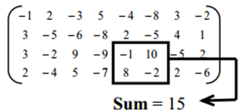

The Maximum Subarray Problem (MSP)
Find the maximum subarray in a given array
1D array
2D array
Find a rectangular regions of a given m × n array of real numbers , which has the maximal sum .

Slide 5
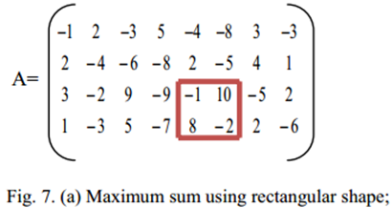
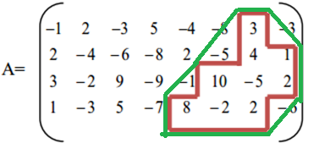
The Maximum Convex Sums

Slide 6
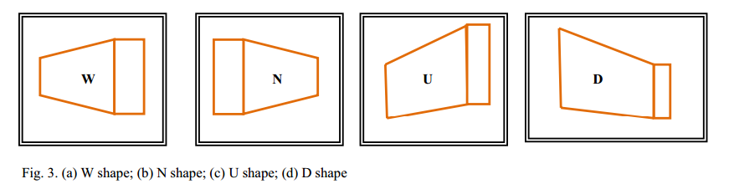
Shapes

Slide 7
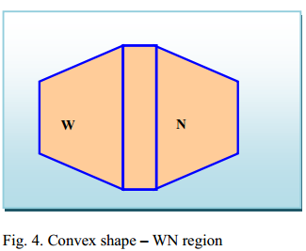
Convex Shape
Definition of Convex Shape : A region is called convex, called rectilinear convex.
Any convex shape can be constructed from (W, U, N) or (W, D, N).
This research focuses on shapes composed of W and N, which we call the WN shape

Slide 8
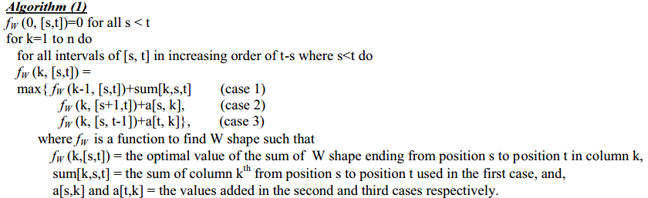
Algorithm(1)
Best W shape
Let array bw store the values of the case number, 1, 2, or 3 to keep track of directions for backtracking

Slide 9
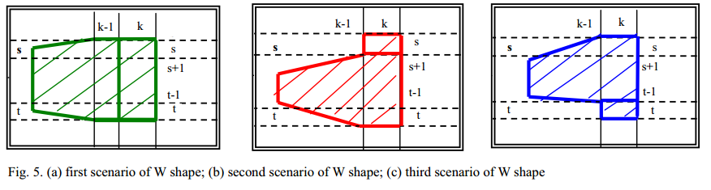
three cases to find the best W shape

Slide 10
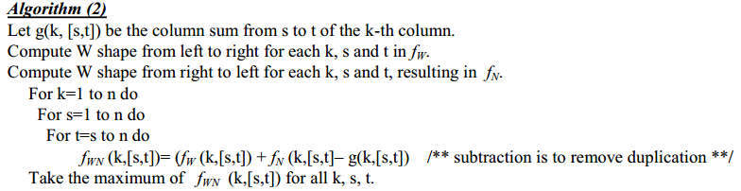
Algorithm(2)

Slide 11
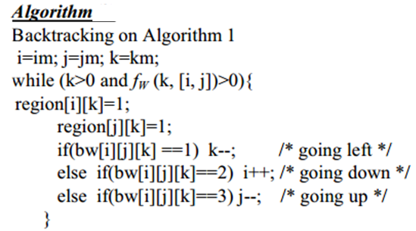
Algorithm(3)
Backtracking its shape

Slide 12
K Convex Sum Problem
overlapping sum
disjoint sum
Steps.
Find the next maximum convex sum
Find numbers in its shape , and replaced with negative numbers
do again until the k-th times

Slide 13
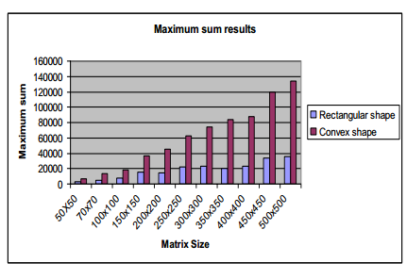
Results

Slide 14
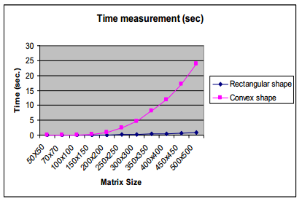
Results

