Slide 1
Weighted dynamic time warping for time series classiFIcation
Young-Seon Jeong, Myong K. Jeong, Olufemi A. Omitaomu
Pattern Recognition, 2011
Presenter : Cheng-Han Lee
Date: 2012/10/9

Slide 2
Abstract
Dynamic time warping (DTW), which finds the minimum path by providing non-linear alignments between two time series, has been widely used as a distance measure for time series classification and clustering. However, DTW does not account for the relative importance regarding the phase difference between a reference point and a testing point. This may lead to misclassification especially in applications where the shape similarity between two sequences is a major consideration for an accurate recognition. Therefore, we propose a novel distance measure, called a weighted DTW (WDTW), which is a penalty- based DTW.

Slide 3
Our approach penalizes points with higher phase difference between a reference point and a testing point in order to prevent minimum distance distortion caused by outliers. The rationale underlying the proposed distance measure is demonstrated with some illustrative examples. A new weight function, called the modified logistic weight function (MLWF), is also proposed to systematically assign weights as a function of the phase difference between a reference point and a testing point. By applying different weights to adjacent points, the proposed algorithm can enhance the detection of similarity between two time series.

Slide 4
We show that some popular distance measures such as DTW and Euclidean distance are special cases of our proposed WDTW measure. We extend the proposed idea to other variants of DTW such as derivative dynamic time warping (DDTW) and propose the weighted version of DDTW. We have compared the performances of our proposed procedures with other popular approaches using public data sets available through the UCR Time Series Data Mining Archive for both time series classification and clustering problems. The experimental results indicate that the proposed approaches can achieve improved accuracy for time series classification and clustering problems.

Slide 5
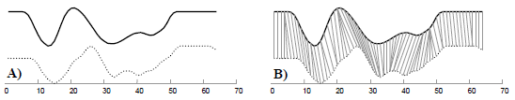

Dynamic time warping (DTW)
${DTW}_{i,j}=d(t_{i},r_{j})+min\left\{\begin{aligned}{DTW}_{i−1,j} \\ {DTW}_{i,j−1} \\ {DTW}_{i−1,j−1}\end{aligned}\right.$
$d is Euclidean distance$

Slide 6
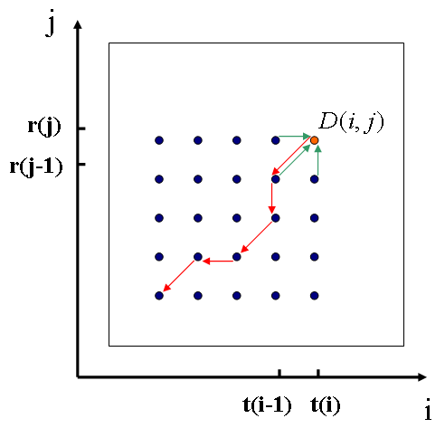
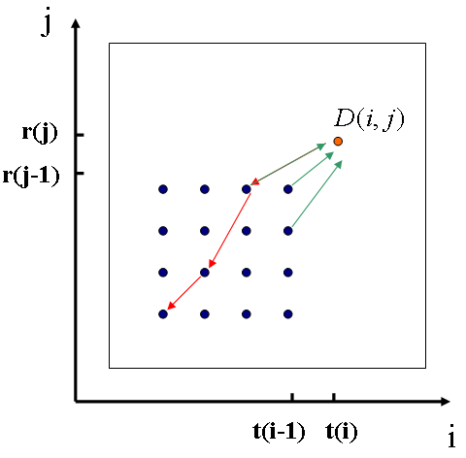

Local Path Constraint
${DTW}_{i,j}=d(t_{i},r_{j})+min\left\{\begin{aligned}{DTW}_{i−2,j−1} \\ {DTW}_{i−1,j−2} \\ {DTW}_{i−1,j−1}\end{aligned}\right.$

Slide 7
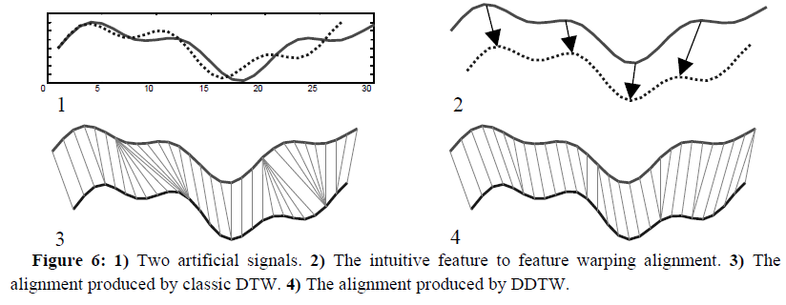

Derivative DTW (DDTW)
$d\left(t_{i},r_{j}\right)⇒d′(D_{x}[t_{i}],D_{x}[r_{j}])$
$d^{′} is square of the difference$
$D_{x}\left[q\right]=\frac{{(q}_{i}−q_{i−1})+({(q}_{i+1}−q_{i−1})/2)}{2}$
($D_{x}$可想成q點附近的平均斜率，以斜率匹配)

Slide 8
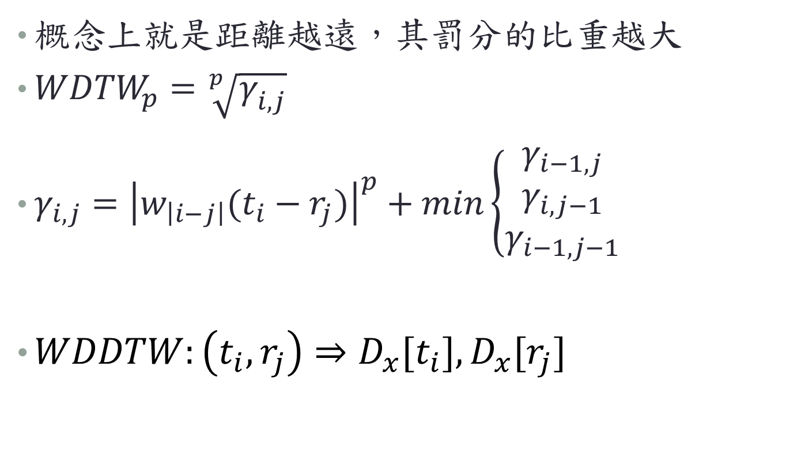
Weighted DTW
概念上就是距離越遠，其罰分的比重越大
${WDTW}_{p}=\sqrt[p]{γ_{i,j}^{}}$
$γ_{i,j}={\left|w_{\left|i−j\right|}(t_{i}−r_{j})\right|}^{p}+min\left\{\begin{aligned}γ_{i−1,j} \\ γ_{i,j−1} \\ γ_{i−1,j−1}\end{aligned}\right.$
${WDDTW:\left(t_{i},r_{j}\right)⇒D}_{x}[t_{i}],D_{x}[r_{j}]$

Slide 9
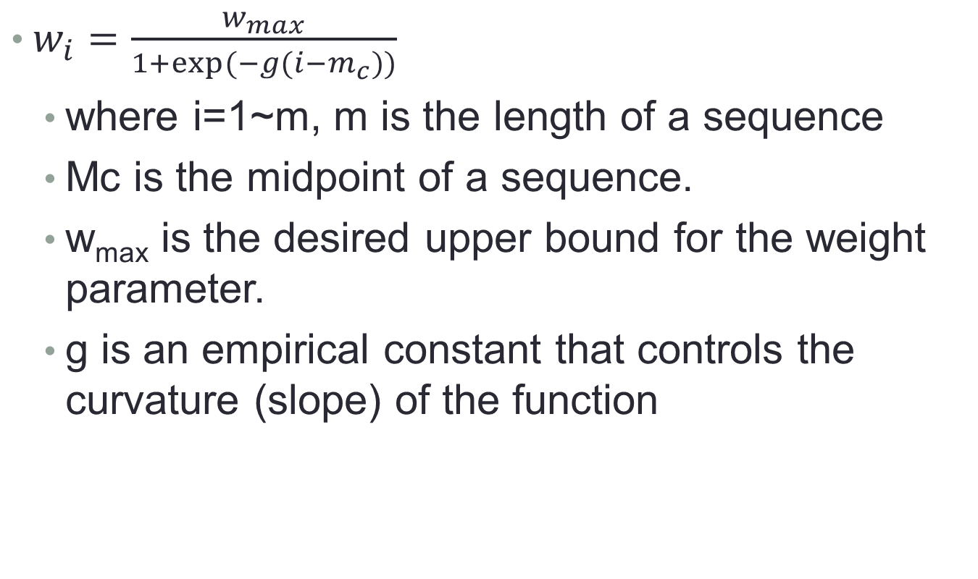
$w_{i}=\frac{w_{max}}{1+exp⁡(−g(i−m_{c}))}$
where i=1~m, m is the length of a sequence
Mc is the midpoint of a sequence.
w_{max} is the desired upper bound for the weight parameter.
g is an empirical constant that controls the curvature (slope) of the function

Slide 10
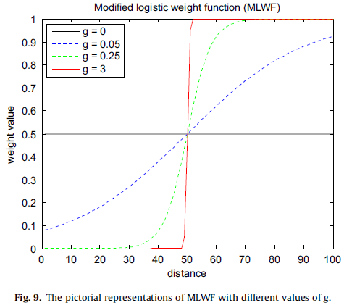

Slide 11
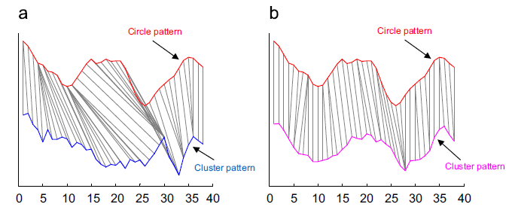
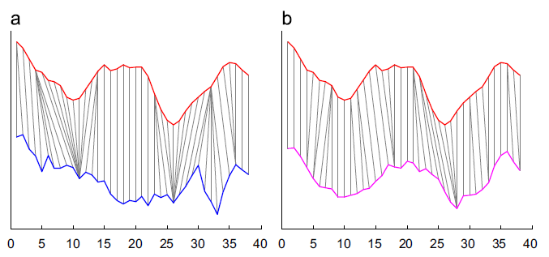
DTW
WDTW

Slide 12
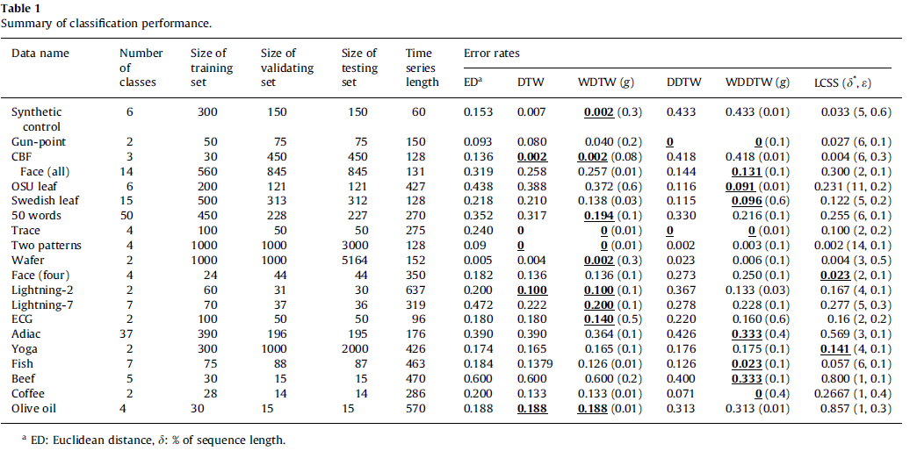
Experimental results

Slide 13
THE END

