Slide 1

Optimal Dynamic Portfolio Selection: Multiperiod Mean-Variance Formulation
Duan Li (李端) and Wan-Lung Ng
Department of Systems Engineering and Engineering Management,
Chinese University of Hong Kong
Mathematical Finance, Vol. 10, No. 3 pp. 387–406, 2000
Presenter: Hung-Hsin Chen (陳紘昕)
Date: Oct. 23, 2012

Slide 2
Abstract
The mean-variance formulation by Markowitz in the 1950s paved a foundation for modern portfolio selection analysis in a single period. This paper considers an analytical optimal solution to the mean-variance formulation in multiperiod portfolio selection. Speciﬁcally, analytical optimal portfolio policy and analytical expression of the mean-variance efﬁcient frontier are derived in this paper for the multiperiod mean-variance formulation. An efﬁcient algorithm is also proposed for ﬁnding an optimal portfolio policy to maximize a utility function of the expected value and the variance of the terminal wealth.

Slide 3
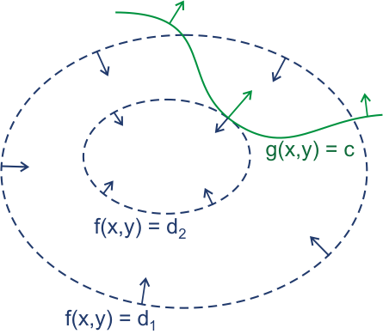
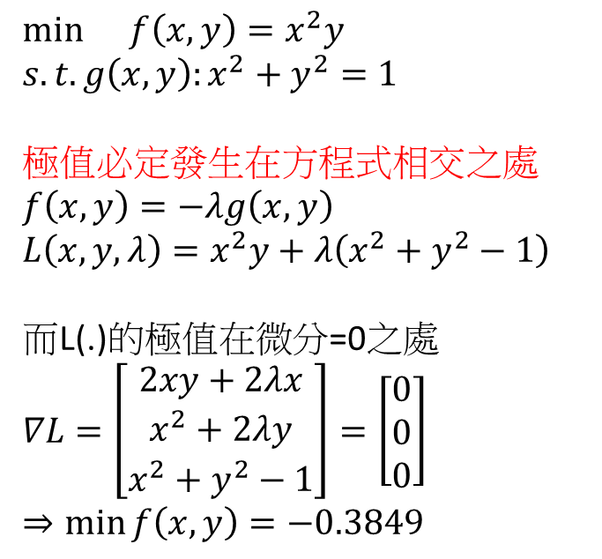
Lagrange multiplier
$$\min{}f\left(x,y\right)=x^{2}y$$
$$s.t. g\left(x,y\right):x^{2}+y^{2}=1$$
極值必定發生在方程式相交之處
$$f\left(x,y\right)=−λg\left(x,y\right)$$
$$L\left(x,y,λ\right)=x^{2}y+λ\left(x^{2}+y^{2}−1\right)$$
而L(.)的極值在微分=0之處
$$∇L=\left[\begin{matrix}2xy+2λx \\ x^{2}+2λy \\ x^{2}+y^{2}−1\end{matrix}\right]=\left[\begin{matrix}0 \\ 0 \\ 0\end{matrix}\right]$$
$$⇒\min{f\left(x,y\right)=−0.3849}$$
圖1：綠線標出的是約束g(x,y) = c的點的軌跡。藍線是f的等高線。箭頭表示斜率，和等高線的法線平行。
From wikipedia

Slide 4
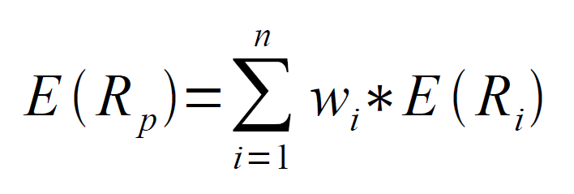
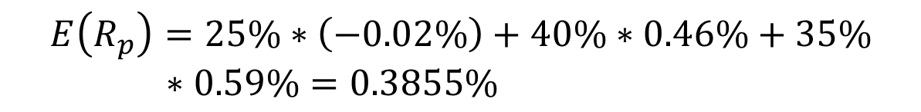
Portfolio return
Stock | Period 1 | 2 | 3 | 4 | 5 | E(.) | W_{i}
Stock1 | 0.3% | 0.2% | 1.0% | -0.7% | -0.9% | -0.02% | 25%
Stock 2 | 0.3% | 2.40% | -1.32% | 0.53% | 0.41% | 0.46% | 40%
Stock 3 | -0.1% | 2.1% | -0.3% | 1.1% | 0.13% | 0.59% | 35%
$$E\left(R_{p}\right)=25\%∗\left(−0.02\%\right)+40\%∗0.46\%+35\%∗0.59\%=0.3855\%$$

Slide 5
Covariance matrix Σ
Covariance of data X, Y:
X=[1, 2 ,3], Y=[4,5,6]
E(x) = 2, E(y)=5, E(xy) = (4+10+18)/3 = 32/3
σ_{xy} = 32/3 – 10 = 2/3

Slide 6
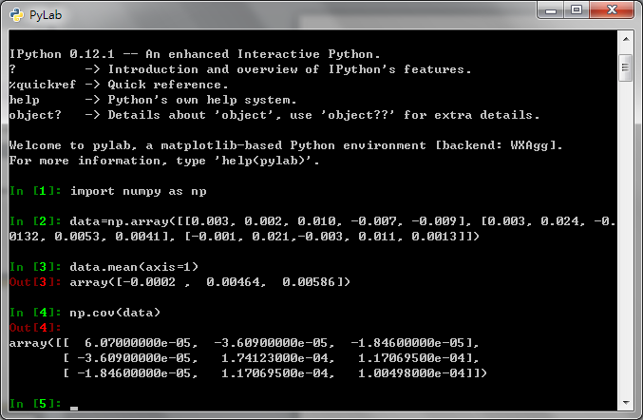

Slide 7
Portfolio risk (standard deviation)
Covariance matrix

Slide 8
Correlation of the assets
Pearson correlation coefficient
γ₁₂ = 1 (完全正相關)
γ ₁₂ = -1(完全負相關)
-1 < γ ₁₂ < 1 (部分相關)
資產間相關性越低，投資組合風險(deviation)越小

Slide 9
A、B、C 證券之報酬率

Slide 12
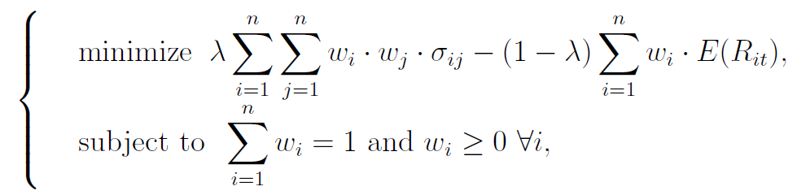
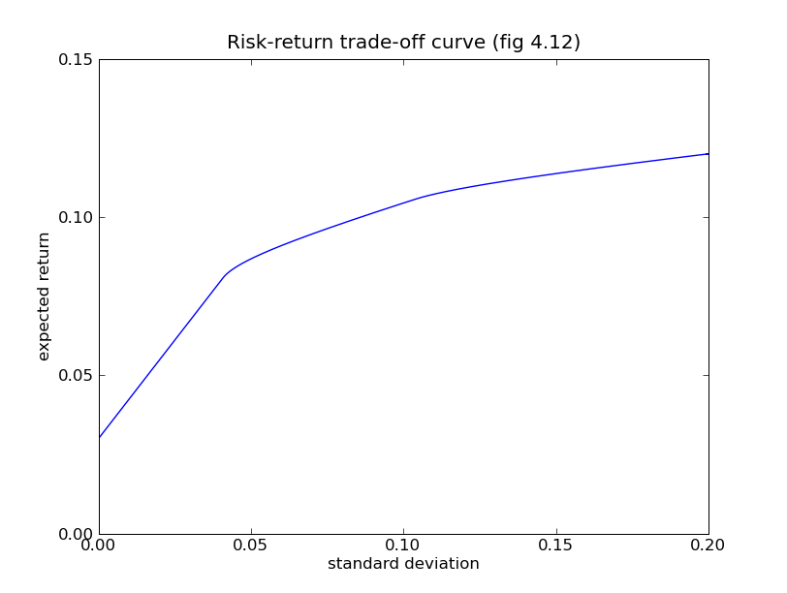
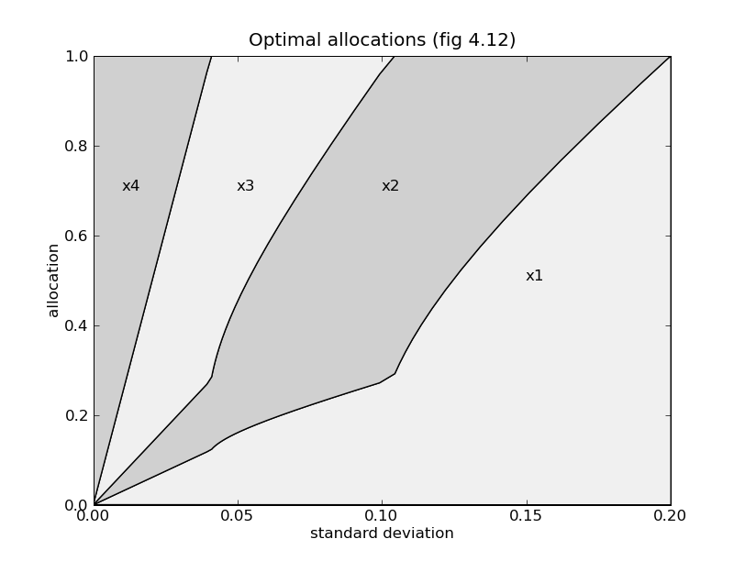
Mean-Variance model (single period)
Inequality constraints, 如果有此類限制式時，必須使用KKT condition求analytic solution，或使用數值分析軟體求解
http://abel.ee.ucla.edu/cvxopt/userguide/coneprog.html

Slide 13
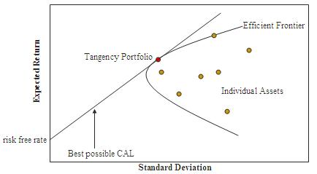
Efficient frontier

Slide 14
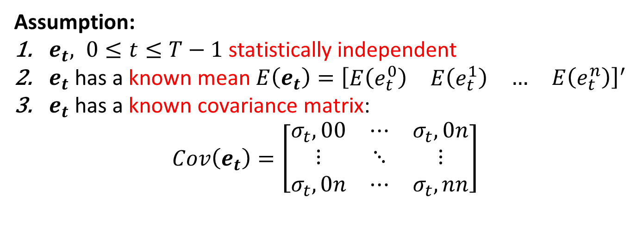
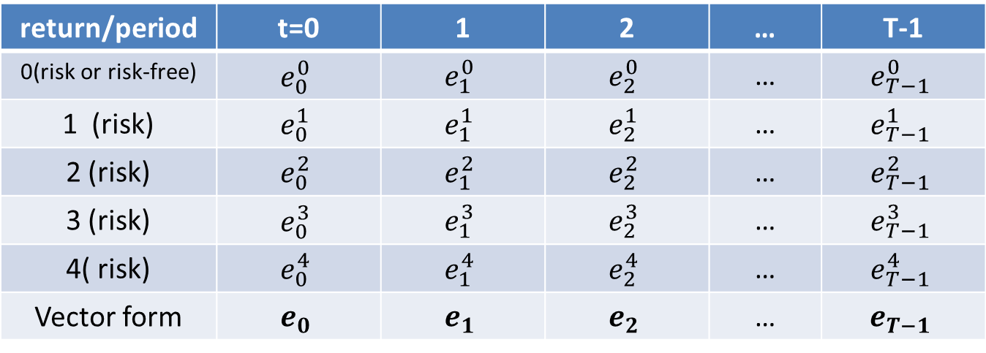
Mean-variance model (multi-period)
return/period | t=0 | 1 | 2 | … | T-1
0(risk or risk-free) | $$e_{0}^{0}$$ | $$e_{1}^{0}$$ | $$e_{2}^{0}$$ | … | $$e_{T−1}^{0}$$
1 (risk) | $$e_{0}^{1}$$ | $$e_{1}^{1}$$ | $$e_{2}^{1}$$ | … | $$e_{T−1}^{1}$$
2 (risk) | $$e_{0}^{2}$$ | $$e_{1}^{2}$$ | $$e_{2}^{2}$$ | … | $$e_{T−1}^{2}$$
3 (risk) | $$e_{0}^{3}$$ | $$e_{1}^{3}$$ | $$e_{2}^{3}$$ | … | $$e_{T−1}^{3}$$
4( risk) | $$e_{0}^{4}$$ | $$e_{1}^{4}$$ | $$e_{2}^{4}$$ | … | $$e_{T−1}^{4}$$
Vector form | $$e_{0}$$ | $$e_{1}$$ | $$e_{2}$$ | … | $$e_{T−1}$$
Assumption:
$e_{t}, 0≤t≤T−1$ statistically independent
$e_{t}$ has a known mean $E\left(e_{t}\right)={\left[\begin{matrix}E\left(e_{t}^{0}\right) & E\left(e_{t}^{1}\right) & \begin{matrix}… & E\left(e_{t}^{n}\right)\end{matrix}\end{matrix}\right]}^{′}$
$e_{t}$ has a known covariance matrix:
$$Cov\left(e_{t}\right)=\left[\begin{matrix}σ_{t},00 & ⋯ & σ_{t},0n \\ ⋮ & ⋱ & ⋮ \\ σ_{t},0n & ⋯ & σ_{t},nn\end{matrix}\right]$$

Slide 15
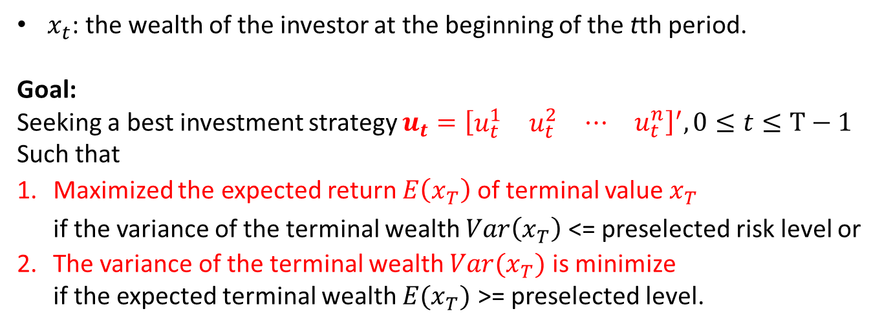
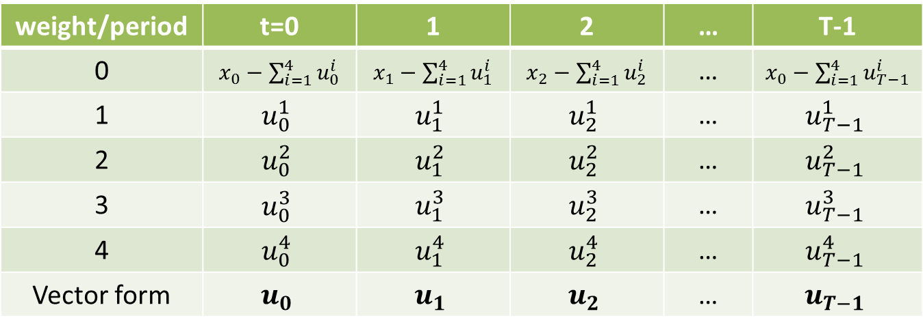
weight/period | t=0 | 1 | 2 | … | T-1
0 | $x_{0}−\sum_{i=1}^{4}{u_{0}^{i}}$ | $x_{1}−\sum_{i=1}^{4}{u_{1}^{i}}$ | $x_{2}−\sum_{i=1}^{4}{u_{2}^{i}}$ | … | $x_{0}−\sum_{i=1}^{4}{u_{T−1}^{i}}$
1 | $$u_{0}^{1}$$ | $$u_{1}^{1}$$ | $$u_{2}^{1}$$ | … | $$u_{T−1}^{1}$$
2 | $$u_{0}^{2}$$ | $$u_{1}^{2}$$ | $$u_{2}^{2}$$ | … | $$u_{T−1}^{2}$$
3 | $$u_{0}^{3}$$ | $$u_{1}^{3}$$ | $$u_{2}^{3}$$ | … | $$u_{T−1}^{3}$$
4 | $$u_{0}^{4}$$ | $$u_{1}^{4}$$ | $$u_{2}^{4}$$ | … | $$u_{T−1}^{4}$$
Vector form | $$u_{0}$$ | $$u_{1}$$ | $$u_{2}$$ | … | $$u_{T−1}$$
$x_{t}$: the wealth of the investor at the beginning of the tth period.
Goal:
Seeking a best investment strategy $u_{t}={\left[\begin{matrix}u_{t}^{1} & u_{t}^{2} & \begin{matrix}⋯ & u_{t}^{n}\end{matrix}\end{matrix}\right]}^{′}, 0≤t≤T−1$
Such that
Maximized the expected return $E\left(x_{T}\right)$of terminal value $x_{T}$ if the variance of the terminal wealth $Var\left(x_{T}\right)$ <= preselected risk level or
The variance of the terminal wealth $Var(x_{T})$ is minimize if the expected terminal wealth $E(x_{T})$ >= preselected level.

Slide 16
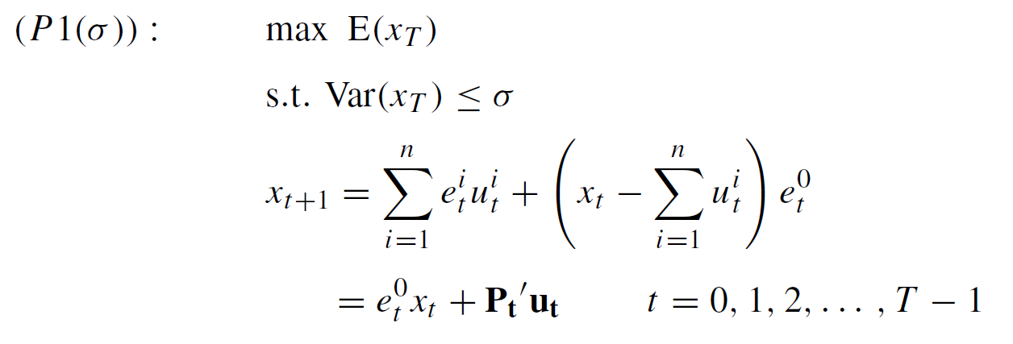
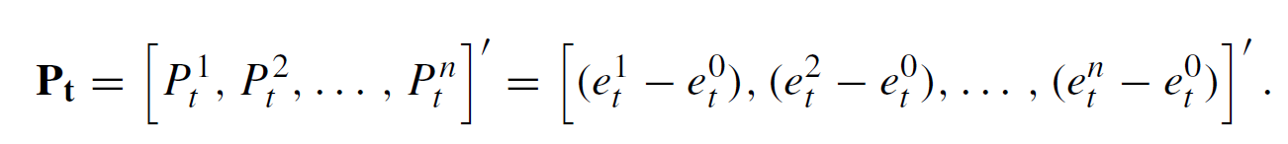
Multi-period MV model (maximize return)

Slide 17
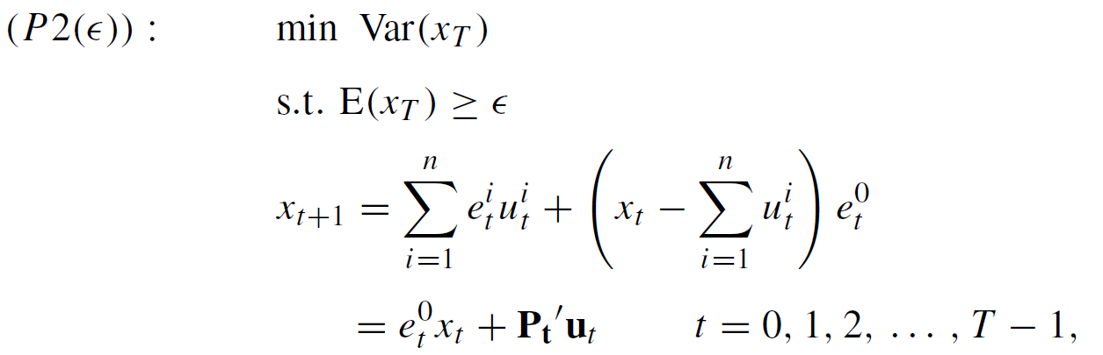
Multi-period MV model (minimize risk)

Slide 18
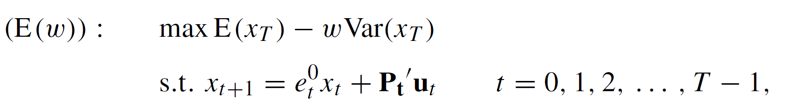

Multi-period MV model (combination)

Slide 19

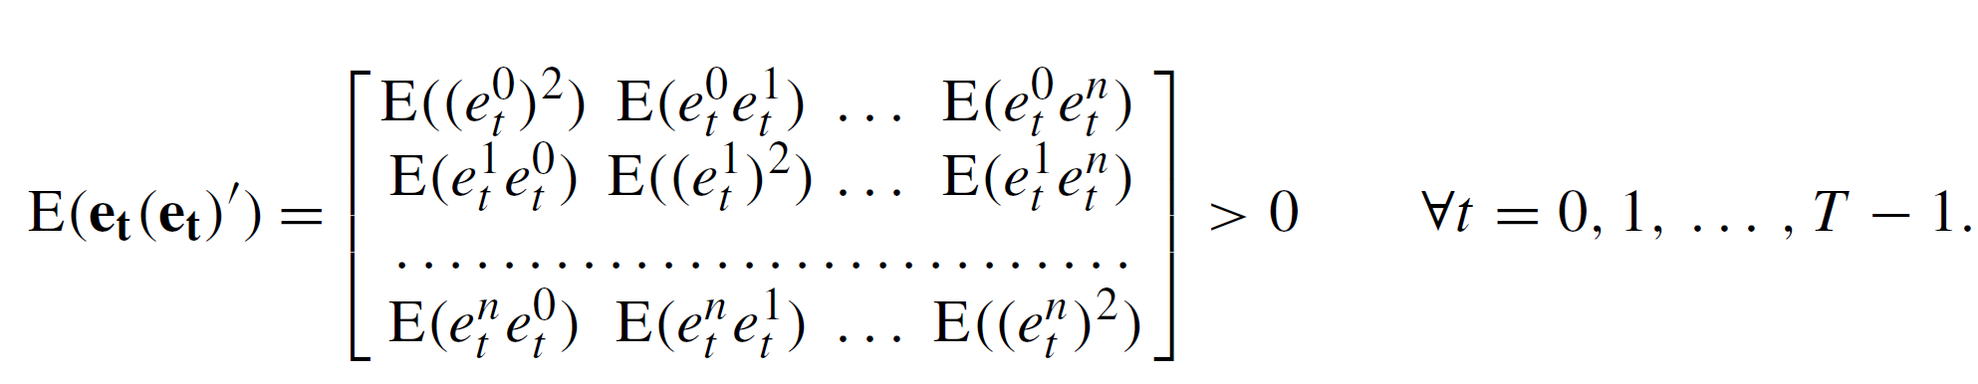
Covariance matrix
($\left(∵Var\left(xx^{′}\right)=Cov(x\right)=E\left(xx′\right)−E\left(x\right)E(x′)$
Assuming $E\left(e_{t}{\left(e_{t}\right)}^{′}\right), ∀t$ is positive definite (P.D.), i.e.

Slide 20
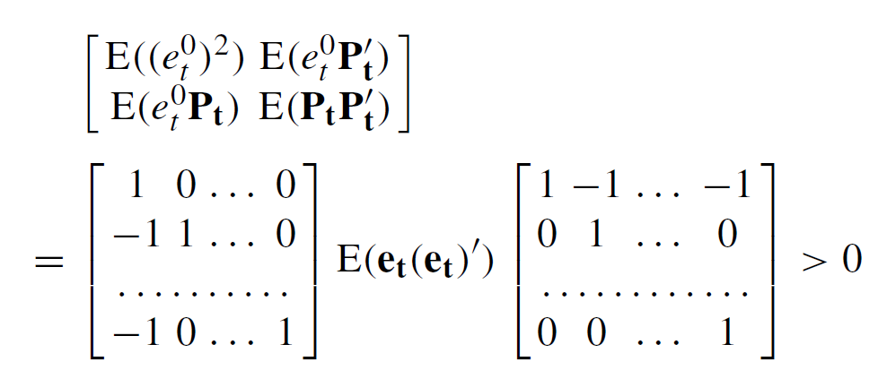

Then we can get=>

Slide 21
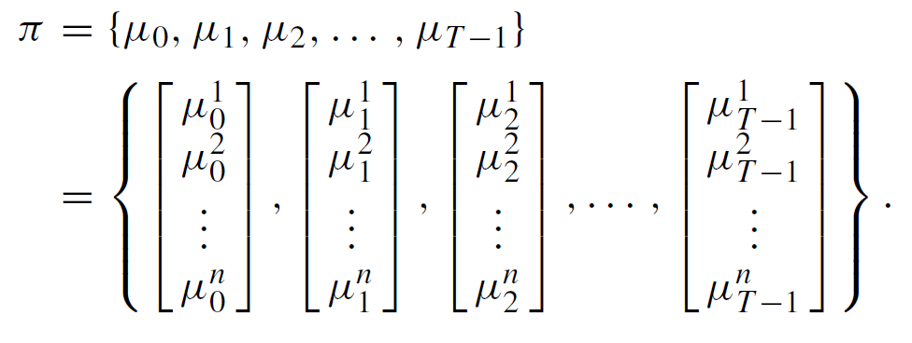
Multi-period portfolio policy

Slide 22
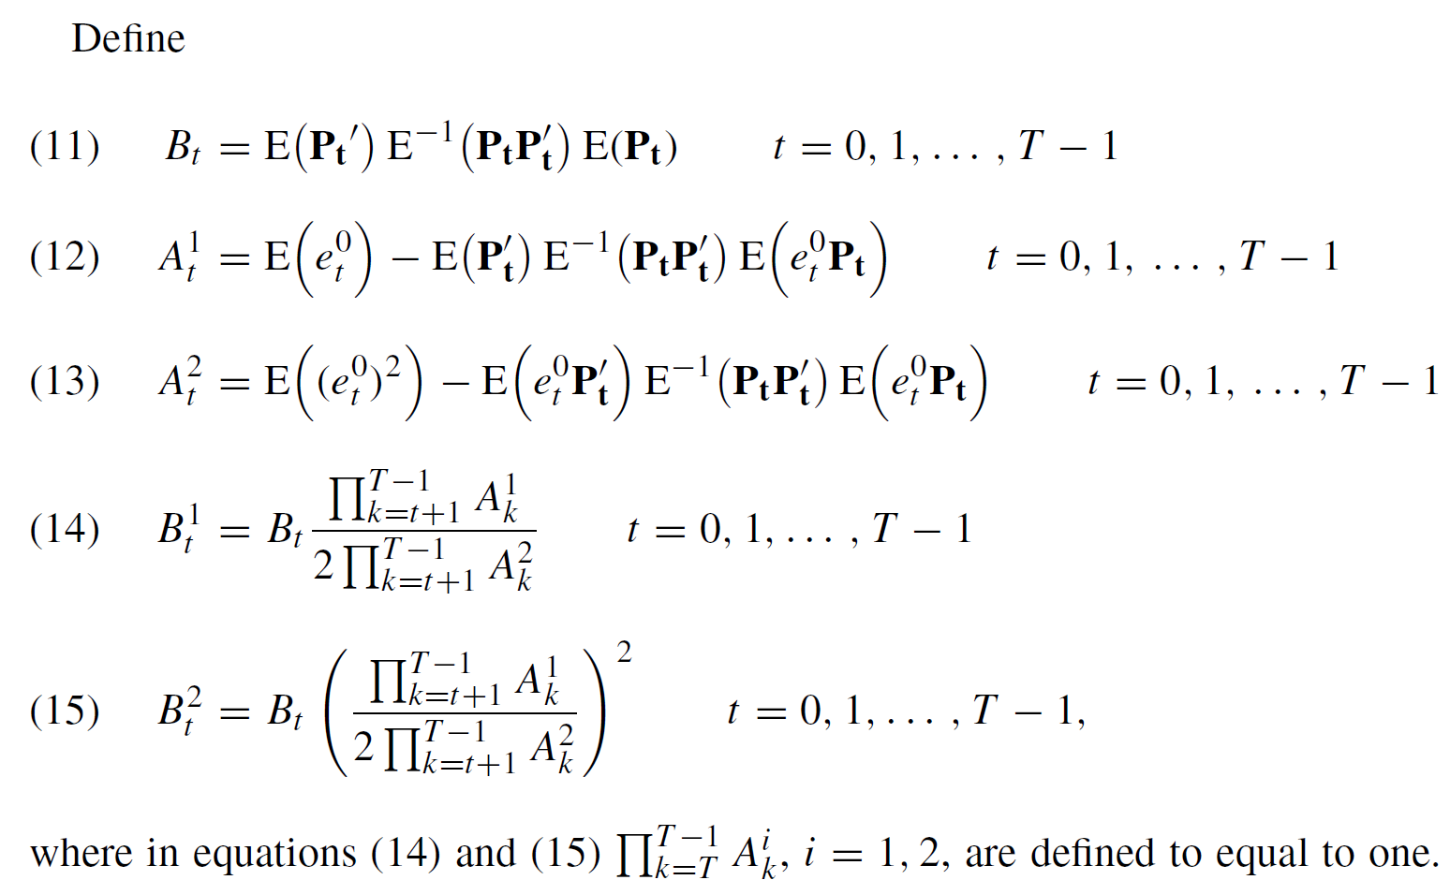
Analytic solution

Slide 23
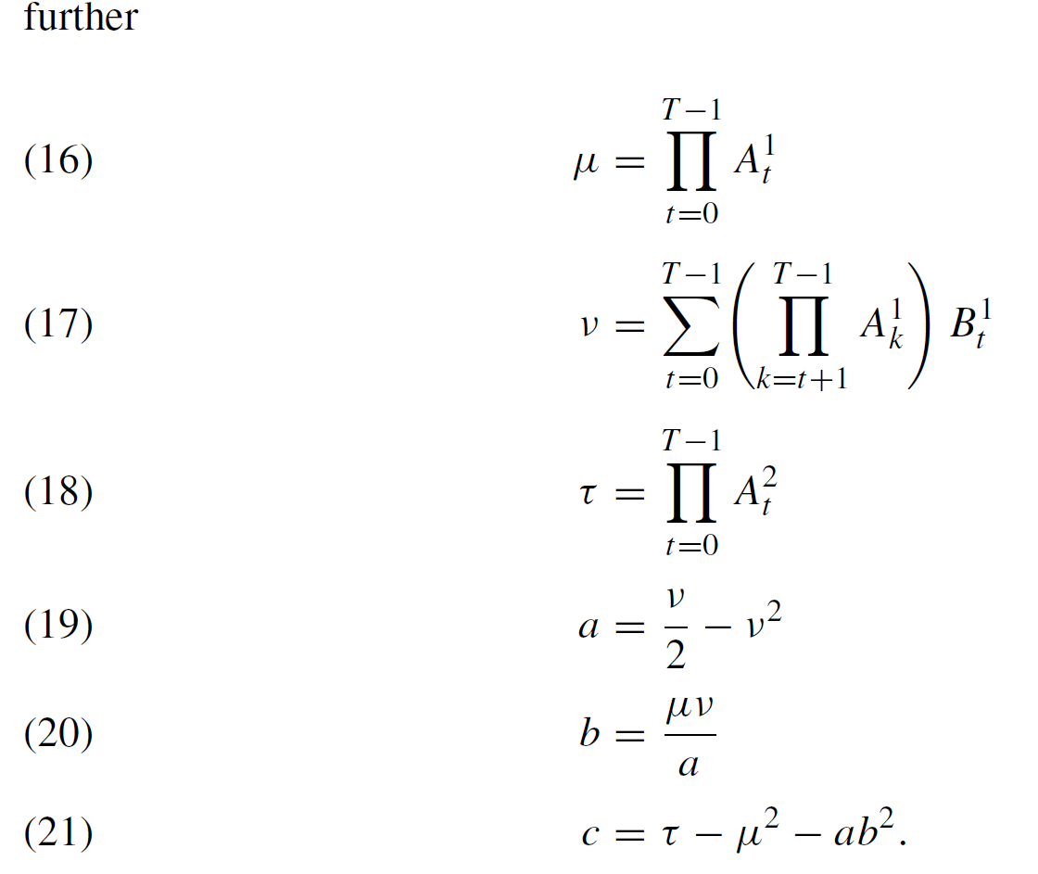

Slide 24
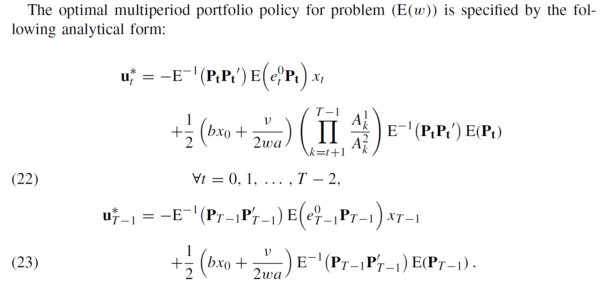

Slide 25
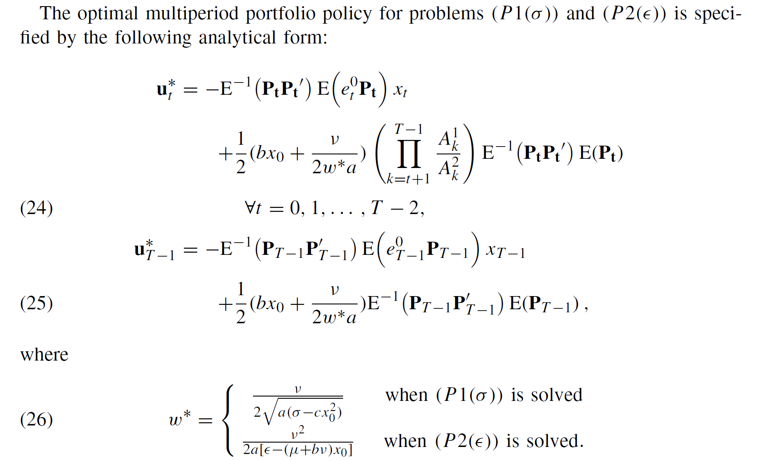

Slide 26
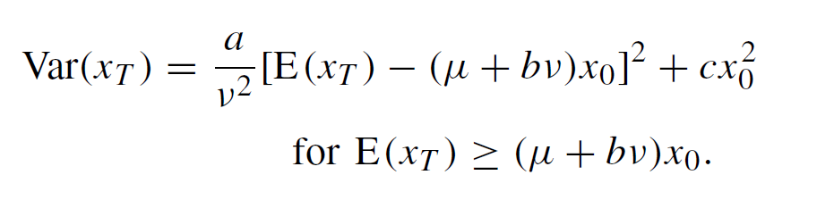
Analytic form of efficient frontier

Slide 27
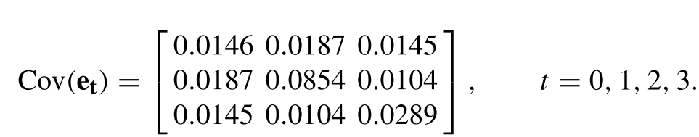
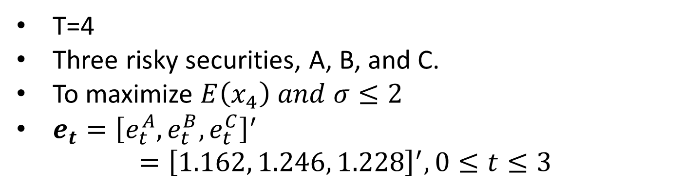
Example
T=4
Three risky securities, A, B, and C.
To maximize $E\left(x_{4}\right) and σ≤2$
$e_{t}={\left[e_{t}^{A}, e_{t}^{B},e_{t}^{C}\right]}^{′}$ $={\left[1.162, 1.246, 1.228\right]}^{′}, 0≤t≤3$
Take A as the reference asset,

Slide 28
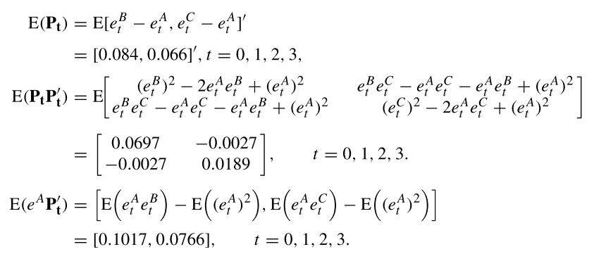
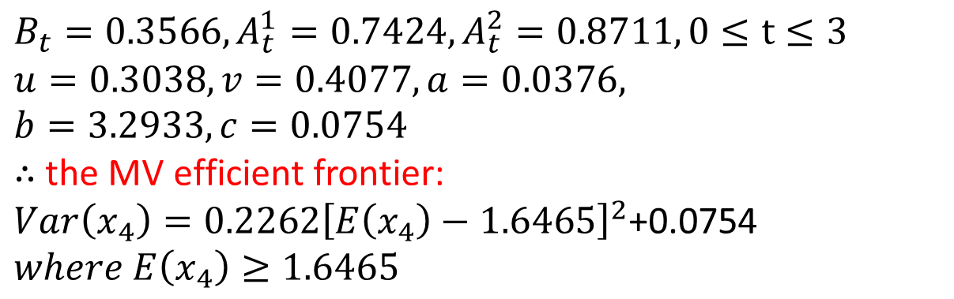
$$B_{t}=0.3566, A_{t}^{1}=0.7424, A_{t}^{2}=0.8711, 0≤t≤3$$
$$u=0.3038, v=0.4077, a=0.0376,$$
$$b=3.2933, c=0.0754$$
$∴$ the MV efficient frontier:
$Var\left(x_{4}\right)=0.2262{\left[E\left(x_{4}\right)−1.6465\right]}^{2}$+0.0754
$$where E\left(x_{4}\right)≥1.6465$$

Slide 29
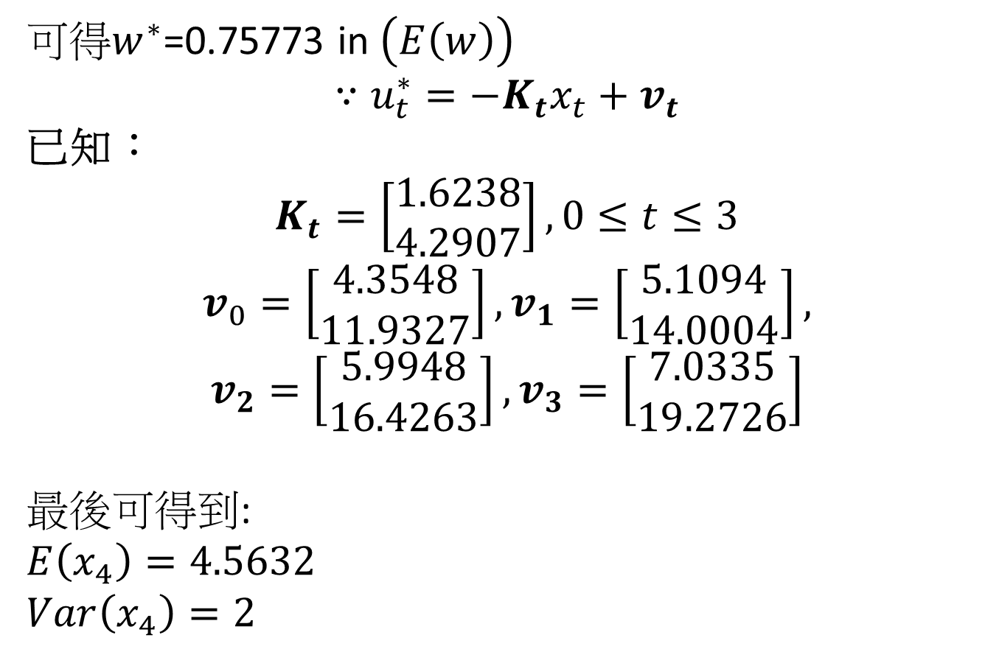
可得$w^{∗}$=0.75773 in $\left(E\left(w\right)\right)$
$$∵u_{t}^{∗}=−K_{t}x_{t}+v_{t}$$
已知：
$$K_{t}=\left[\begin{matrix}1.6238 \\ 4.2907\end{matrix}\right], 0≤t≤3$$
$$v_{0}=\left[\begin{matrix}4.3548 \\ 11.9327\end{matrix}\right], v_{1}=\left[\begin{matrix}5.1094 \\ 14.0004\end{matrix}\right],$$
$$v_{2}=\left[\begin{matrix}5.9948 \\ 16.4263\end{matrix}\right],v_{3}=\left[\begin{matrix}7.0335 \\ 19.2726\end{matrix}\right]$$
最後可得到:
$$E\left(x_{4}\right)=4.5632$$
$$Var\left(x_{4}\right)=2$$

Slide 30
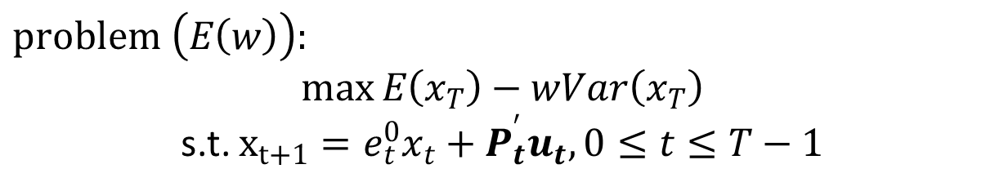
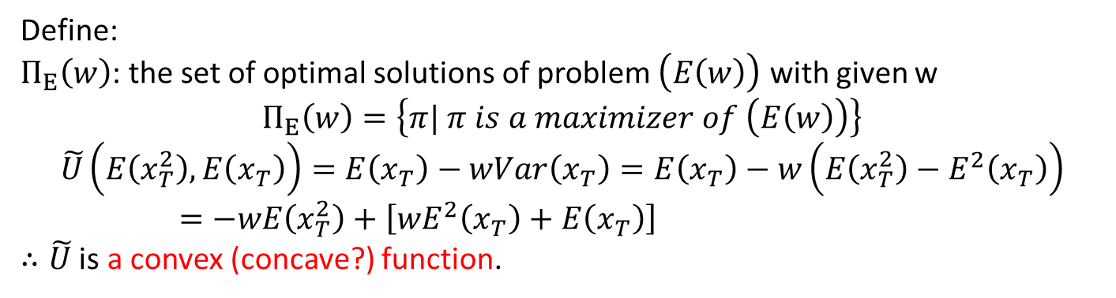
Derivation
$$\left(E\left(w\right)\right)→tractable auxiliary problem, \left(A\left(λ, w\right)\right)→solve \left(A\left(λ, w\right)\right)$$
$$problem \left(E\left(w\right)\right):$$
$$\max{E\left(x_{T}\right)−wVar\left(x_{T}\right)}$$
s.t. $x_{t+1}=e_{t}^{0}x_{t}+P_{t}^{′}u_{t}, 0≤t≤T−1$
Define:
$Π_{E}\left(w\right)$: the set of optimal solutions of problem $\left(E\left(w\right)\right)$ with given w
$$Π_{E}\left(w\right)=\left\{π| π is a maximizer of \left(E\left(w\right)\right)\right\}$$
$$\tilde{U}\left(E\left(x_{T}^{2}\right),E\left(x_{T}\right)\right)=E\left(x_{T}\right)−wVar\left(x_{T}\right)=E\left(x_{T}\right)−w\left(E\left(x_{T}^{2}\right)−E^{2}\left(x_{T}\right)\right)=−wE\left(x_{T}^{2}\right)+\left[wE^{2}\left(x_{T}\right)+E\left(x_{T}\right)\right]$$
$∴\tilde{U}$ is a convex (concave?) function.

Slide 31
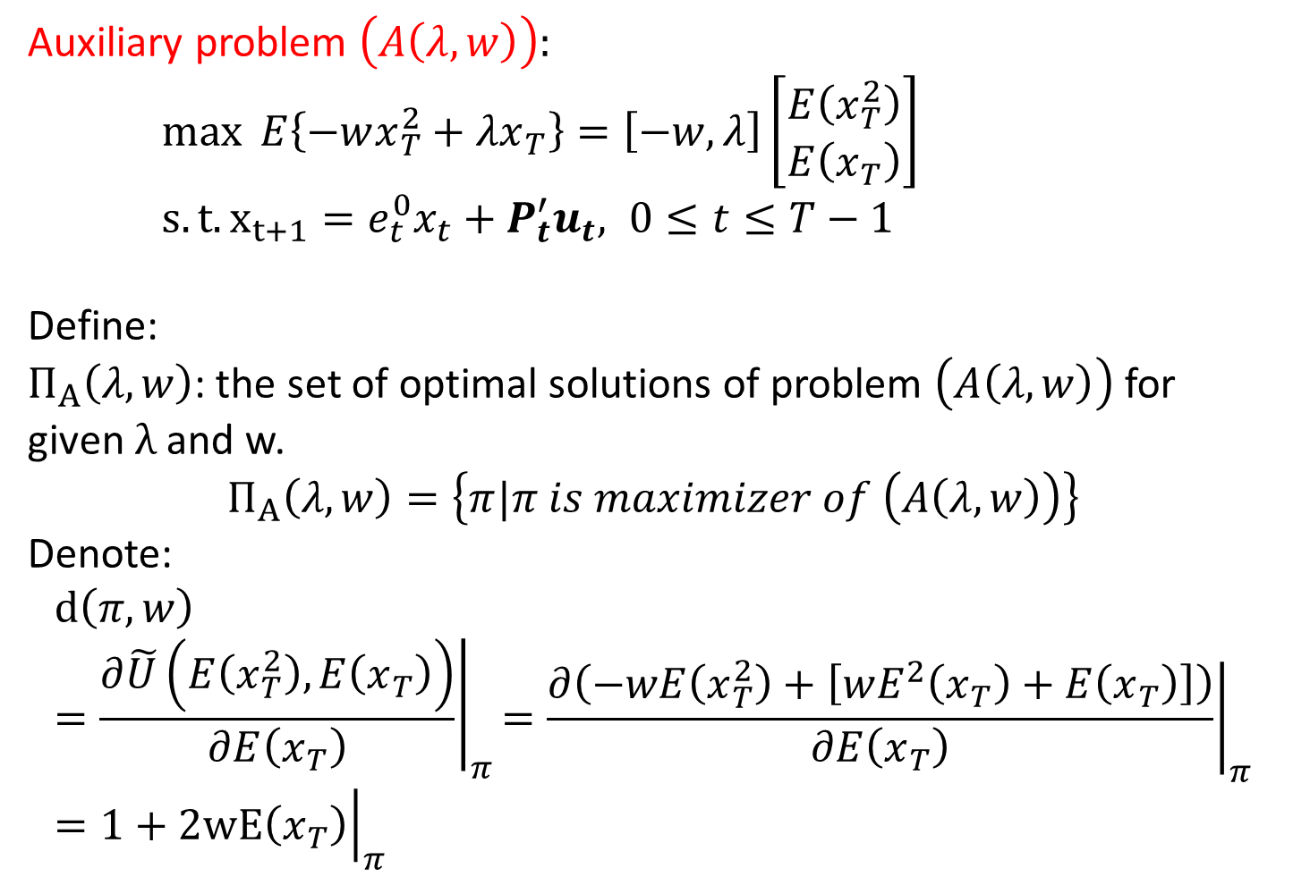
Auxiliary problem $\left(A\left(λ,w\right)\right):$
$\max{ E\left\{−wx_{T}^{2}+λx_{T}\right\}=\left[−w,λ\right]\left[\begin{matrix}E\left(x_{T}^{2}\right) \\ E\left(x_{T}\right)\end{matrix}\right]}$
$s.t. x_{t+1}=e_{t}^{0}x_{t}+P_{t}^{′}u_{t}, 0≤t≤T−1$
Define:
$Π_{A}\left(λ,w\right)$: the set of optimal solutions of problem $\left(A\left(λ,w\right)\right)$ for given $λ$ and w.
$$Π_{A}\left(λ,w\right)=\left\{π|π is maximizer of \left(A\left(λ,w\right)\right)\right\}$$
Denote:
$${\left.d\left(π,w\right)=\frac{∂\tilde{U}\left(E\left(x_{T}^{2}\right),E\left(x_{T}\right)\right)}{∂E\left(x_{T}\right)}\right|}_{π}{\left.=\frac{∂\left(−wE\left(x_{T}^{2}\right)+\left[wE^{2}\left(x_{T}\right)+E\left(x_{T}\right)\right]\right)}{∂E\left(x_{T}\right)}\right|}_{π}={\left.1+2wE\left(x_{T}\right)\right|}_{π}$$

Slide 32
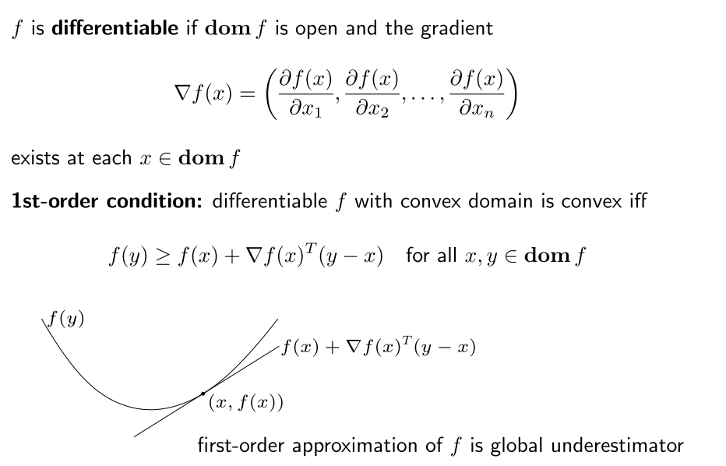
Convex function, 1st condition

Slide 33
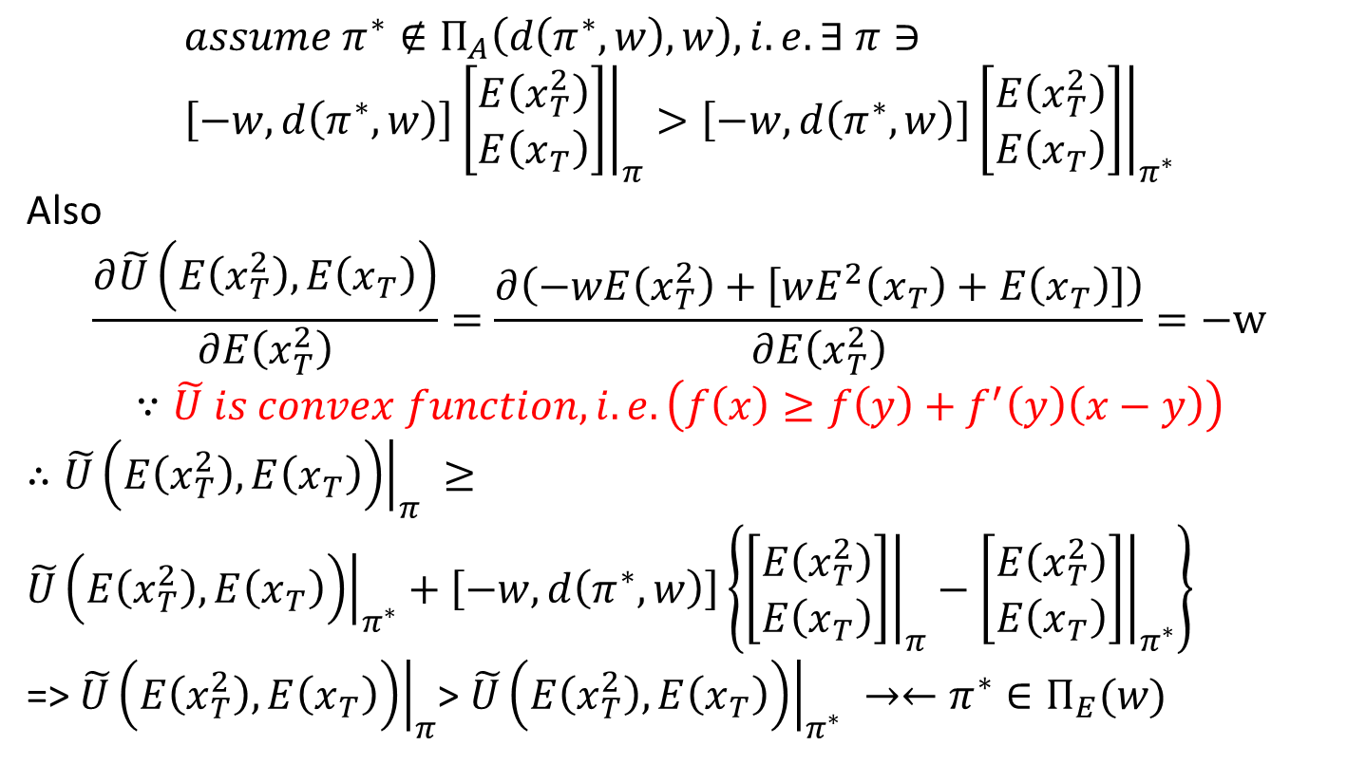

Theorem 1:
$$∀ π^{∗}∈Π_{E}\left(w\right),→π^{∗}∈Π_{A}\left(d\left(π^{∗},w\right),w\right)$$
$$Π_{E}之最佳解，必為Π_{A}之最佳解 (反之不一定成立)$$
$$assume π^{∗}∉Π_{A}\left(d\left(π^{∗},w\right),w\right), i.e. ∃ π∋ \\ {\left.\left[−w, d\left(π^{∗},w\right)\right]\left[\begin{matrix}E\left(x_{T}^{2}\right) \\ E\left(x_{T}\right)\end{matrix}\right]\right|}_{π}>{\left.\left[−w, d\left(π^{∗},w\right)\right]\left[\begin{matrix}E\left(x_{T}^{2}\right) \\ E\left(x_{T}\right)\end{matrix}\right]\right|}_{π^{∗}}$$
Also
$$\frac{∂\tilde{U}\left(E\left(x_{T}^{2}\right),E\left(x_{T}\right)\right)}{∂E\left(x_{T}^{2}\right)}=\frac{∂\left(−wE\left(x_{T}^{2}\right)+\left[wE^{2}\left(x_{T}\right)+E\left(x_{T}\right)\right]\right)}{∂E\left(x_{T}^{2}\right)}=−w$$
$$∵\tilde{U} is convex function, i.e. \left(f\left(x\right)≥f\left(y\right)+f^{′}\left(y\right)\left(x−y\right)\right)$$
$∴{\left.\tilde{U}\left(E\left(x_{T}^{2}\right),E\left(x_{T}\right)\right)\right|}_{π} ≥{\left.\tilde{U}\left(E\left(x_{T}^{2}\right),E\left(x_{T}\right)\right)\right|}_{π^{∗}}+\left[−w, d\left(π^{∗},w\right)\right]\left\{{\left.\left[\begin{matrix}E\left(x_{T}^{2}\right) \\ E\left(x_{T}\right)\end{matrix}\right]\right|}_{π}−{\left.\left[\begin{matrix}E\left(x_{T}^{2}\right) \\ E\left(x_{T}\right)\end{matrix}\right]\right|}_{π^{∗}}\right\}$
=> ${\left.\tilde{U}\left(E\left(x_{T}^{2}\right),E\left(x_{T}\right)\right)\right|}_{π}$> ${\left.\tilde{U}\left(E\left(x_{T}^{2}\right),E\left(x_{T}\right)\right)\right|}_{π^{∗}} →←π^{∗}∈Π_{E}(w)$

Slide 34
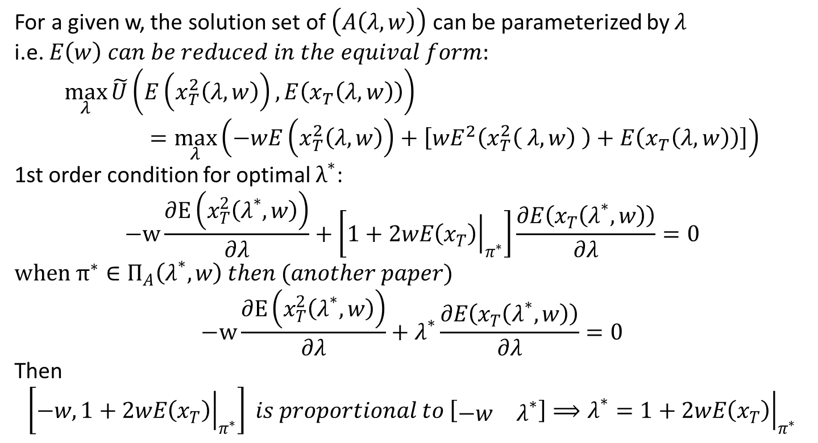
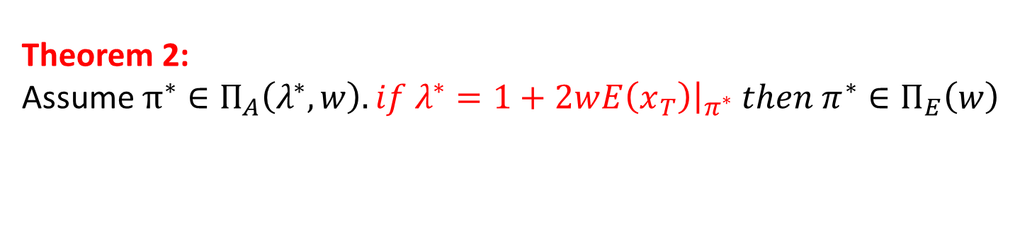
Theorem 2:
Assume $π^{∗}∈Π_{A}\left(λ^{∗},w\right). if λ^{∗}=1+2w{\left.E\left(x_{T}\right)\right|}_{π^{∗}} then π^{∗}∈Π_{E}\left(w\right)$
For a given w, the solution set of $\left(A\left(λ,w\right)\right)$ can be parameterized by $λ$
i.e. $E\left(w\right) can be reduced in the equival form:$
$$\max_{λ}{\tilde{U}\left(E\left(x_{T}^{2}\left(λ,w\right)\right), E\left(x_{T}\left(λ,w\right)\right)\right)}=\max_{λ}\left(−wE\left(x_{T}^{2}\left(λ,w\right)\right)+\left[wE^{2}\left(x_{T}^{2}\left( λ,w\right) \right)+E\left(x_{T}\left(λ, w\right)\right)\right]\right)$$
1st order condition for optimal $λ^{∗}$:
$$−w\frac{∂E\left(x_{T}^{2}\left(λ^{∗},w\right)\right)}{∂λ}+\left[1+{\left.2wE\left(x_{T}\right)\right|}_{π^{∗}}\right]\frac{∂E\left(x_{T}\left(λ^{∗},w\right)\right)}{∂λ}=0$$
$$when π^{∗}∈Π_{A}\left(λ^{∗},w\right) then (another paper)$$
$$−w\frac{∂E\left(x_{T}^{2}\left(λ^{∗},w\right)\right)}{∂λ}+λ^{∗}\frac{∂E\left(x_{T}\left(λ^{∗},w\right)\right)}{∂λ}=0$$
Then
$$\left[−w,1+{\left.2wE\left(x_{T}\right)\right|}_{π^{∗}}\right] is proportional to \left[\begin{matrix}−w & λ^{∗}\end{matrix}\right]⟹λ^{∗}=1+{\left.2wE\left(x_{T}\right)\right|}_{π^{∗}}$$

Slide 35

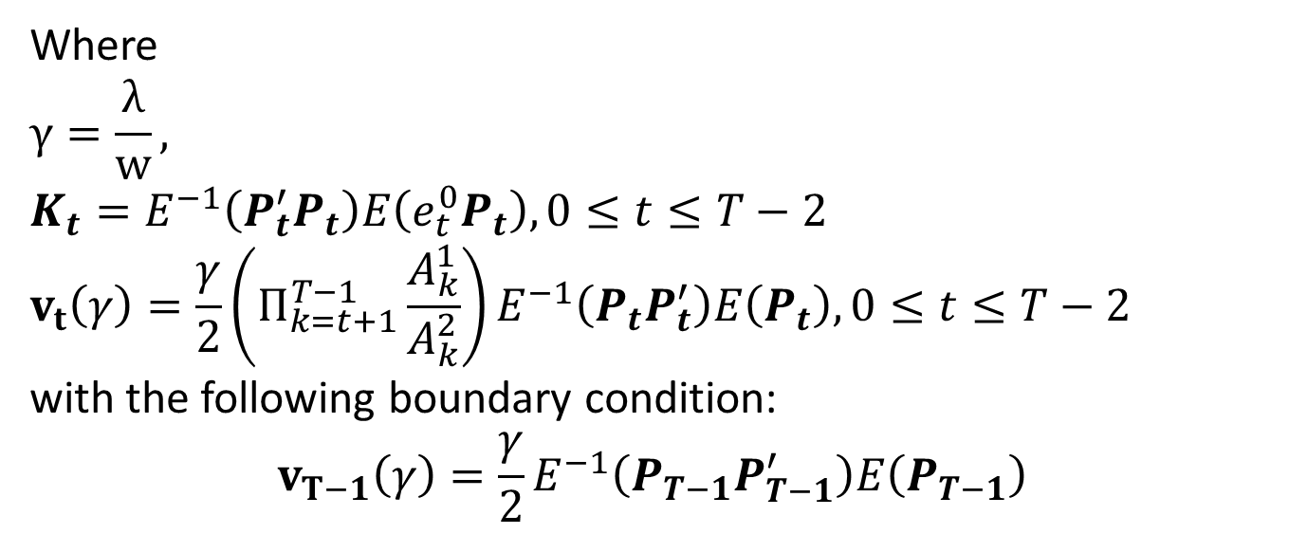
The optimal solution of $\left(A\left(λ, w\right)\right)$ can be get using dynamic programming.
The optimal policy at each time period t is (Li, Chan and Ng (98)):
$$u_{t}^{∗}\left(x_{t};γ\right)=−K_{t}x_{t}+v_{t}\left(γ\right), 0≤t≤T−1,$$
Where
$$γ=\frac{λ}{w},$$
$$K_{t}=E^{−1}\left(P_{t}^{′}P_{t}\right)E\left(e_{t}^{0}P_{t}\right), 0≤t≤T−2$$
$$v_{t}\left(γ\right)=\frac{γ}{2}\left(Π_{k=t+1}^{T−1}\frac{A_{k}^{1}}{A_{k}^{2}}\right)E^{−1}\left(P_{t}P_{t}^{′}\right)E\left(P_{t}\right), 0≤t≤T−2$$
with the following boundary condition:
$$v_{T−1}\left(γ\right)=\frac{γ}{2}E^{−1}\left(P_{T−1}P_{T−1}^{′}\right)E\left(P_{T−1}\right)$$

Slide 36
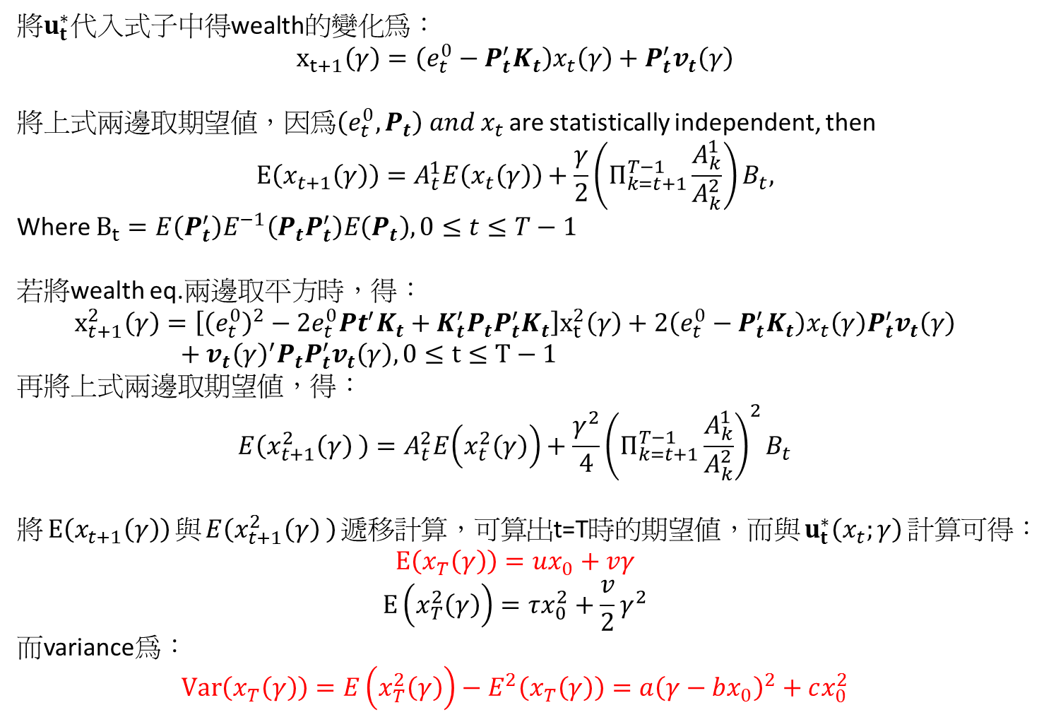
將$u_{t}^{∗}$代入式子中得wealth的變化為：
$$x_{t+1}\left(γ\right)=\left(e_{t}^{0}−P_{t}^{′}K_{t}\right)x_{t}\left(γ\right)+P_{t}^{′}v_{t}\left(γ\right)$$
將上式兩邊取期望值，因為$\left(e_{t}^{0}, P_{t}\right) and x_{t}$ are statistically independent, then
$$E\left(x_{t+1}\left(γ\right)\right)=A_{t}^{1}E\left(x_{t}\left(γ\right)\right)+\frac{γ}{2}\left(Π_{k=t+1}^{T−1}\frac{A_{k}^{1}}{A_{k}^{2}}\right)B_{t},$$
Where $B_{t}=E\left(P_{t}^{′}\right)E^{−1}\left(P_{t}P_{t}^{′}\right)E\left(P_{t}\right), 0≤t≤T−1$
若將wealth eq.兩邊取平方時，得：
$$x_{t+1}^{2}\left(γ\right)=\left[{\left(e_{t}^{0}\right)}^{2}−2e_{t}^{0}Pt^{′}K_{t}+K_{t}^{′}P_{t}P_{t}^{′}K_{t}\right]x_{t}^{2}\left(γ\right)+2\left(e_{t}^{0}−P_{t}^{′}K_{t}\right)x_{t}\left(γ\right)P_{t}^{′}v_{t}\left(γ\right)+v_{t}{\left(γ\right)}^{′}P_{t}P_{t}^{′}v_{t}\left(γ\right), 0≤t≤T−1$$
再將上式兩邊取期望值，得：
$$E\left(x_{t+1}^{2}\left(γ\right) \right)=A_{t}^{2}E\left(x_{t}^{2}\left(γ\right)\right)+\frac{γ^{2}}{4}{\left(Π_{k=t+1}^{T−1}\frac{A_{k}^{1}}{A_{k}^{2}}\right)}^{2}B_{t}$$
將$E\left(x_{t+1}\left(γ\right)\right)$與$E\left(x_{t+1}^{2}\left(γ\right) \right)$遞移計算，可算出t=T時的期望值，而與$u_{t}^{∗}\left(x_{t};γ\right)$計算可得：
$$E\left(x_{T}\left(γ\right)\right)=ux_{0}+vγ$$
$$E\left(x_{T}^{2}\left(γ\right)\right)=τx_{0}^{2}+\frac{v}{2}γ^{2}$$
而variance為：
$$Var\left(x_{T}\left(γ\right)\right)=E\left(x_{T}^{2}\left(γ\right)\right)−E^{2}\left(x_{T}\left(γ\right)\right)=a{\left(γ−bx_{0}\right)}^{2}+cx_{0}^{2}$$

Slide 37
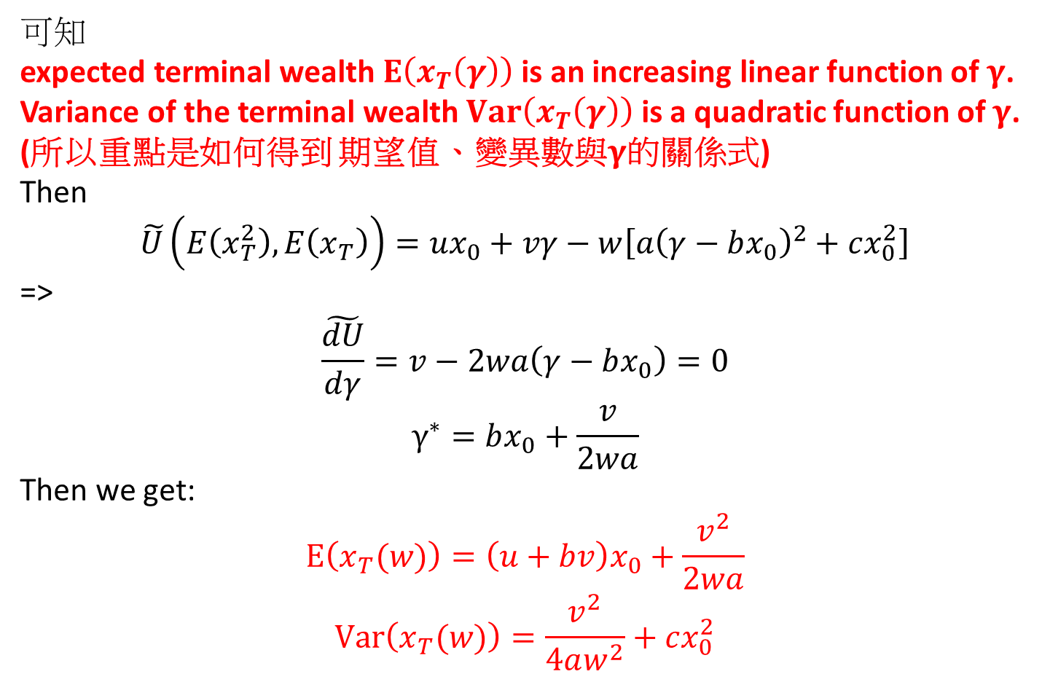
可知
expected terminal wealth $E\left(x_{T}\left(γ\right)\right)$ is an increasing linear function of $γ$.
Variance of the terminal wealth $Var\left(x_{T}\left(γ\right)\right)$ is a quadratic function of $γ$.
(所以重點是如何得到 期望值、變異數與$γ$的關係式)
Then
$$\tilde{U}\left(E\left(x_{T}^{2}\right), E\left(x_{T}\right)\right)=ux_{0}+vγ−w\left[a{\left(γ−bx_{0}\right)}^{2}+cx_{0}^{2}\right]$$
=>
$$\frac{\tilde{dU}}{dγ}=v−2wa\left(γ−bx_{0}\right)=0$$
$$γ^{∗}=bx_{0}+\frac{v}{2wa}$$
Then we get:
$$E\left(x_{T}(w)\right)=\left(u+bv\right)x_{0}+\frac{v^{2}}{2wa}$$
$$Var\left(x_{T}(w)\right)=\frac{v^{2}}{4aw^{2}}+cx_{0}^{2}$$

Slide 38
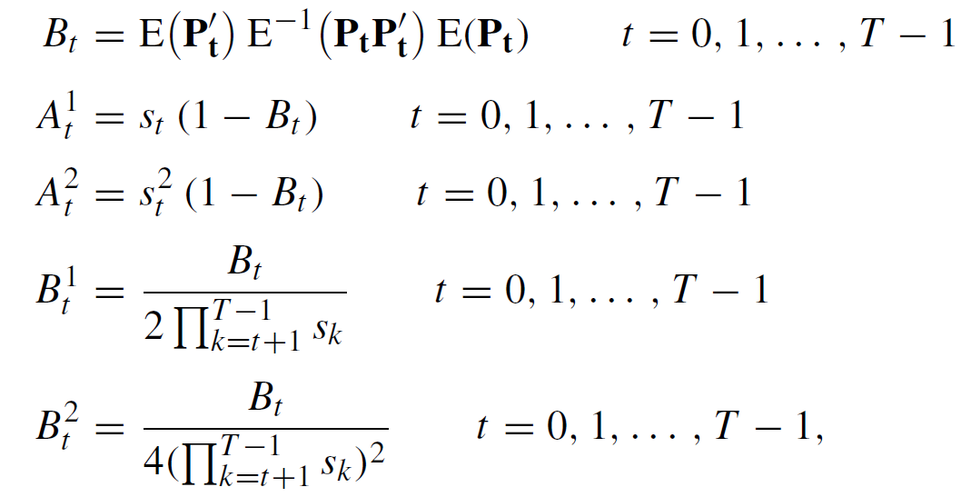
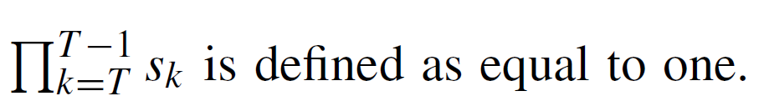
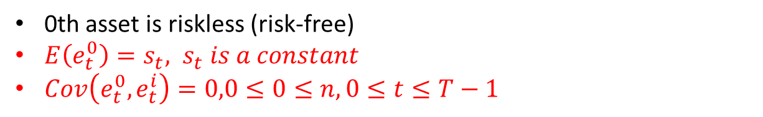
Investment with one riskless asset
0th asset is riskless (risk-free)
$E\left(e_{t}^{0}\right)=s_{t}, s_{t} is a constant$
$Cov\left(e_{t}^{0}, e_{t}^{i}\right)=0,0≤0≤n, 0≤t≤T−1$

Slide 39
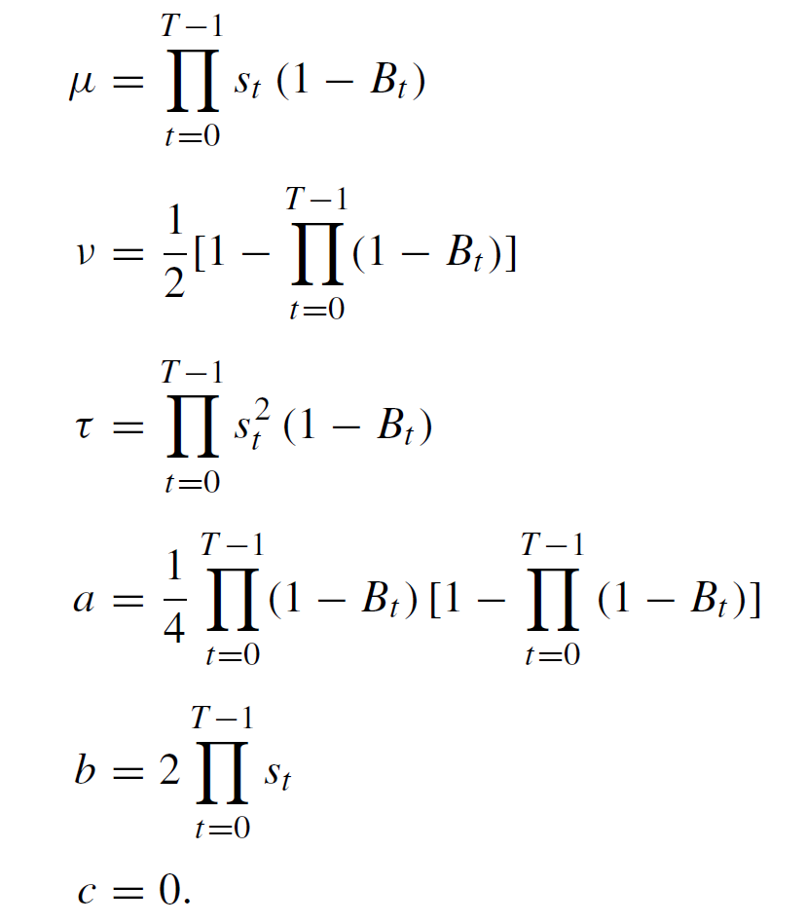

Slide 40
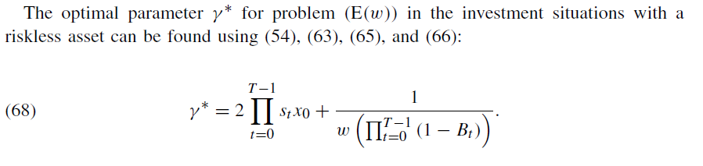
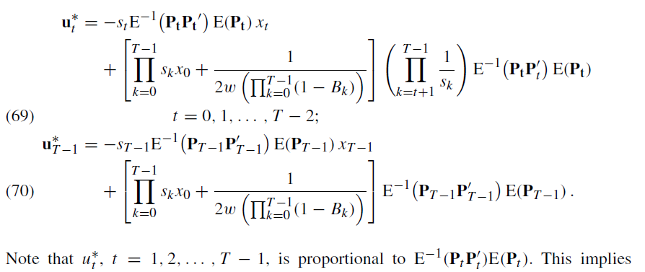

Slide 41
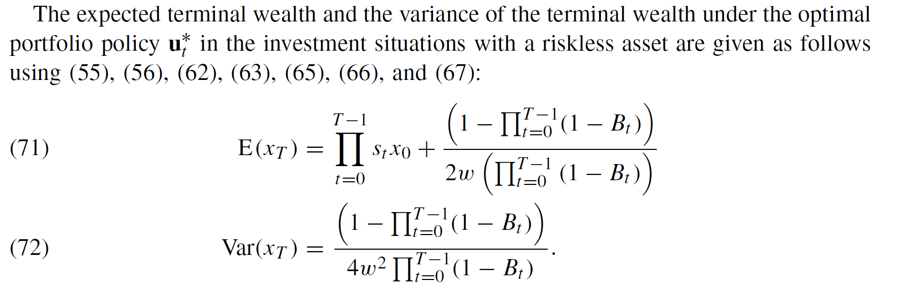

Slide 42
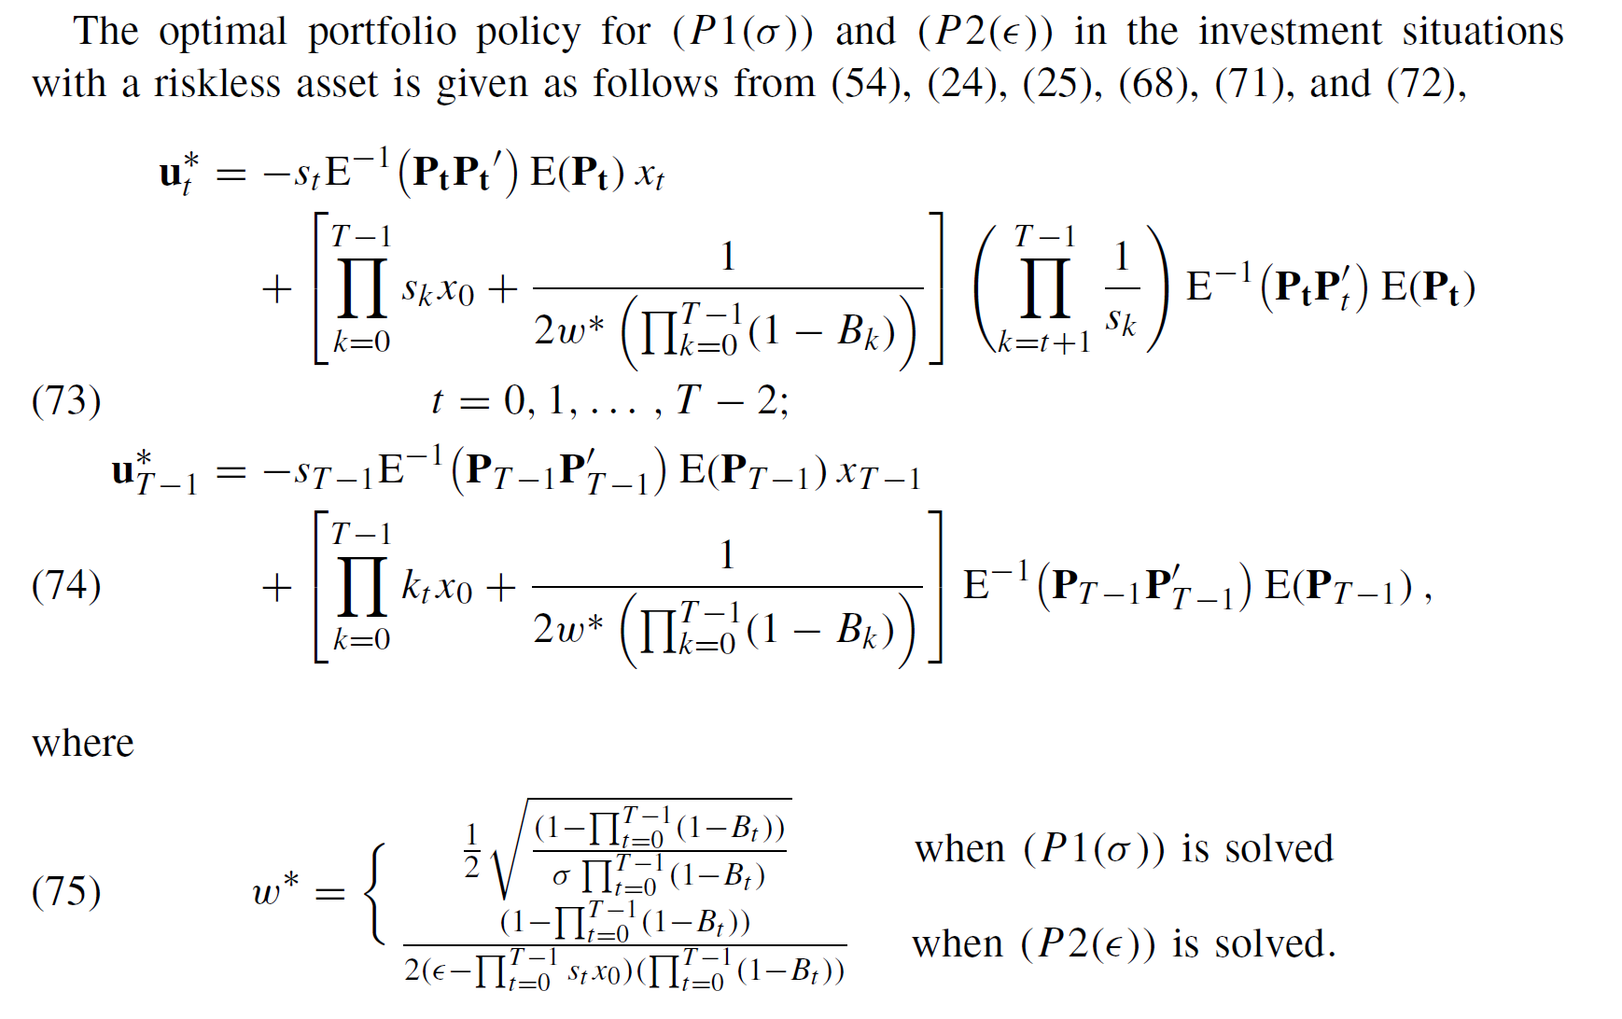

Slide 43
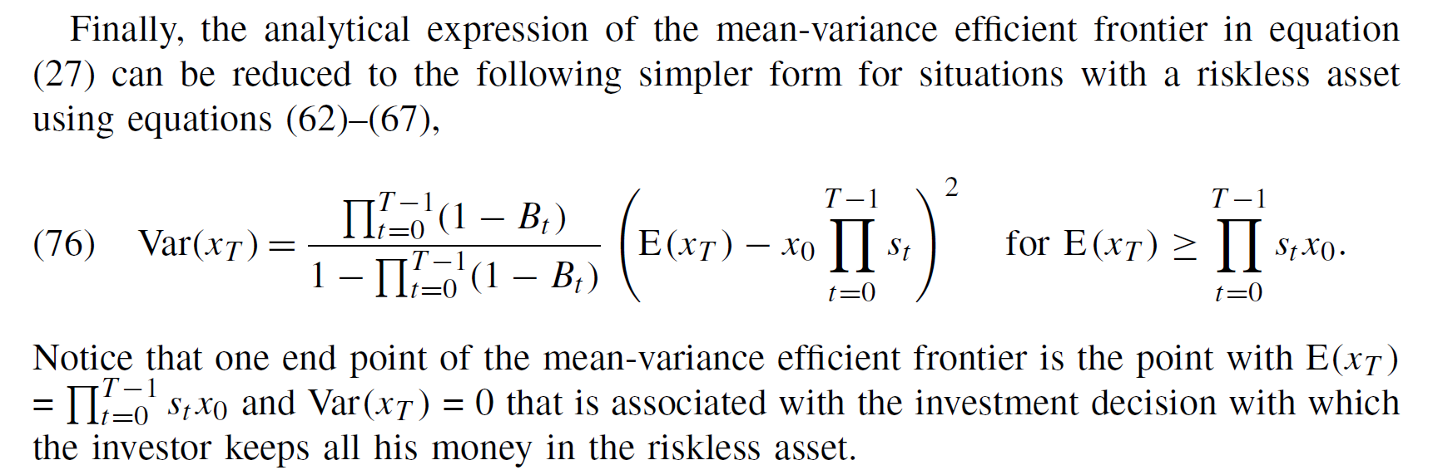

Slide 44
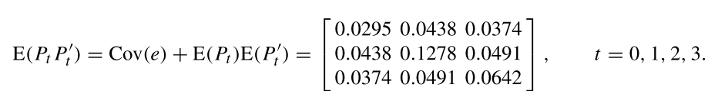


Example
T=4
Tree risky securities, a, B, and C and one riskless asset with return 1.04
To maximize $E\left(x_{4}\right) −2Var\left(x_{4}\right)$
$e_{t}={\left[e_{t}^{A}, e_{t}^{B},e_{t}^{C}\right]}^{′}$ $={\left[1.162, 1.246, 1.228\right]}^{′}, 0≤t≤3$
MV frontier:

Slide 45


Slide 46

Multi-period portfolio selection via maximizing utility function
期望報酬率最大化
變異數(風險)最小化

Slide 47


Generalized multi-period portfolio selection problem

Slide 48

(可從problem (E(w)得到 problem (U) 的最佳解)
U is increasing function of $E\left(x_{T}\right)$ and a decreasing function of $Var\left(x_{T}\right)$
$∴$the optimal solution of (U) must be on MV efficient frontier in the $\left\{E\left(x_{T}\right), Var\left(x_{T}\right)\right\}$ space.
From MV frontier function:
$$Var\left(x_{T}\right)=\frac{a}{v^{2}}{\left[E\left(x_{T}\right)−\left(μ−bv\right)x_{0}\right]}^{2}+cx_{0}^{2}$$
$$for E\left(x_{T}\right)≥\left(μ+bv\right)x_{0}$$
We know that $Var\left(x_{T}\right)$ is a convex function of $E\left(x_{T}\right)$.
$∴$supporting lines exist everywhere on the frontier.
$∴$every efficient solution can be generated by auxiliary problem $\left(E\left(w\right)\right)$.

Slide 49


Pf:
The efﬁcient frontier in the $\left\{E\left(x_{T}\right),Var\left(x_{T}\right)\right\}$ space can be parameterized by the coefﬁcient w.
each point on the efﬁcient frontier can be represented $\left\{E\left(x_{T}(w)\right), Var\left(x_{T}(w)\right)\right\}$
$$∵Π_{U}⊆\bigcup_{w≥0}{Π_{E}\left(w\right)}∴the equivalent form of \left(U\right):$$
$$\max_{w≥0}{U\left(E\left(x_{T}(w)\right), Var\left(x_{T}(w)\right)\right)}$$

Slide 50

1st condition for optimal $w^{∗}>0$:
$$U_{E}\left(π^{∗}\right)\frac{∂E\left(x_{T}\left(w^{∗}\right)\right)}{∂w}+U_{V}\left(π^{∗}\right)\frac{∂Var(x_{T}\left(w^{∗}\right))}{∂w}=0$$
$ifπ^{∗}∈Π_{E}(w)$, from (Reid and Citron (71)):
$$\frac{∂E\left(x_{T}\left(w^{∗}\right)\right)}{∂w}−w^{∗}\frac{∂Var(x_{T}\left(w^{∗}\right))}{∂w}=0$$
$$∴\left[U_{E}\left(π^{∗}\right),U_{V}\left(π^{∗}\right)\right] is proportional to \left[1, −w^{∗}\right]$$
$$⇒w^{∗}=−\left(\frac{U_{V\left(π^{∗}\right)}}{U_{E}\left(π^{∗}\right)}\right)$$

Slide 51



Slide 52


Slide 53



Example
Same conditions as above example

Slide 54


Thank you!!

