Slide 1
GDTW-P-SVMs: Variable-length time series analysis using support vector machines
Arash Jalalian, Stephan K. Chalup Neurocomputing, 2012
Presenter: Cheng-Han Lee
Date: 2012/10/23

Slide 2
Abstract
We describe a new technique for sequential data analysis, called GDTW-P-SVMs. It is a maximum margin method for the construction of classifiers with variable-length input series. It employs potential support vector machines (P-SVMs) and Gaussian Dynamic Time Warping (GDTW) to waive the fixed-length restriction of feature vectors in training and test data. As a result, GDTW-P-SVMs enjoy the P-SVM method's properties such as the ability to: (i) handle data and kernel matrices that are neither positive definite nor square and (ii) minimise a scale-invariant capacity measure.

Slide 3
The new technique elaborates on the P-SVM kernel functions, by utilising the well-known dynamic time warping algorithm to provide an elastic distance measure for the kernel functions. Bench marks for classification are performed with several real-world data sets from the UCR timeseries classification / clustering page, the GeoLife trajectory dataset, and the UCI Machine Learning Repository. The datasets include data with both variable and fixed-length input series. The results show that the new method performs significantly better than the benchmarked standard classification methods.

Slide 4
DTW Matrix
 | X1 | X2 | X3 | X4
X1 | DTW(X1,X1) | DTW(X1,X2) | DTW(X1,X3) | DTW(X1,X4)
X2 | DTW(X2,X1) | DTW(X2,X2) | DTW(X2,X3) | DTW(X1,X4)
X3 | DTW(X3,X1) | DTW(X3,X2) | DTW(X3,X3) | DTW(X3,X4)
X3 | DTW(X4,X1) | DTW(X4,X2) | DTW(X4,X3) | DTW(X4,X4)

Slide 5
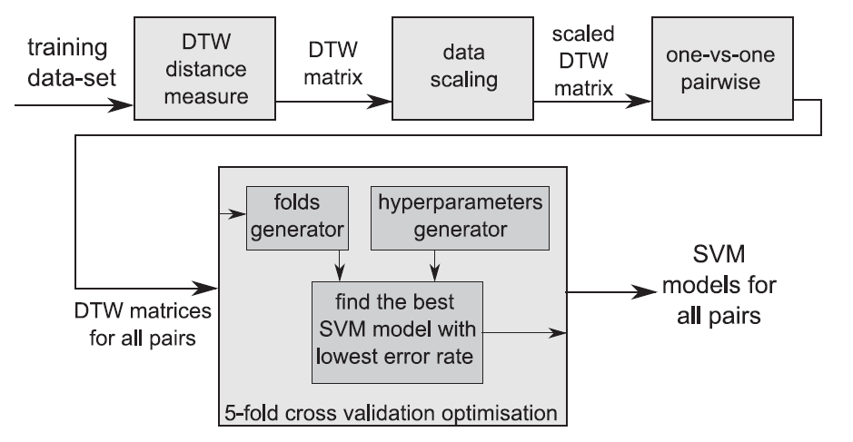
Two-step DTW-SVMs

Slide 6
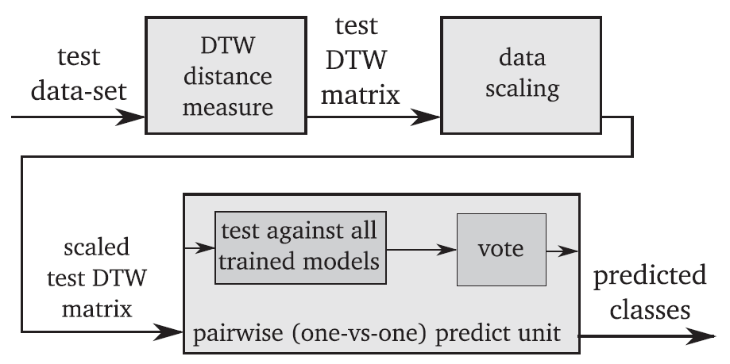

Slide 7
Shortcomings
1) It needs the training datasets as well as the trained model when testing a new sample.
2) while online testing is a common requirement of many time series classification problems, testing against a large training dataset using the two-stepDTW-SVM sclassifier could be a very slow process.

Slide 8
GDTW-P-SVMs
P-SVM (Potential-SVM) (2006)
Accept dyadic pairwise data.
Tool
http://ni.cs.tu-berlin.de/software/psvm/index.html
Better than libsvm. (他說的)

Slide 9
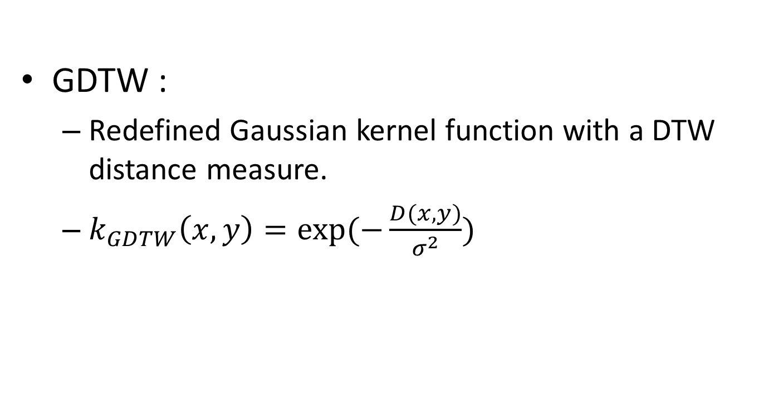
GDTW-P-SVMs
GDTW :
Redefined Gaussian kernel function with a DTW distance measure.
$k_{GDTW}\left(x,y\right)=exp⁡(−\frac{D(x,y)}{σ^{2}})$

Slide 10
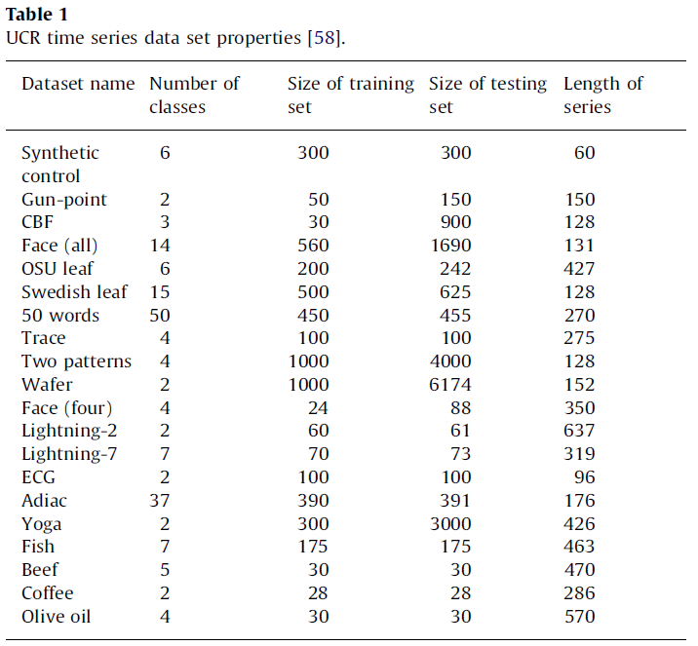
Experiments

Slide 11
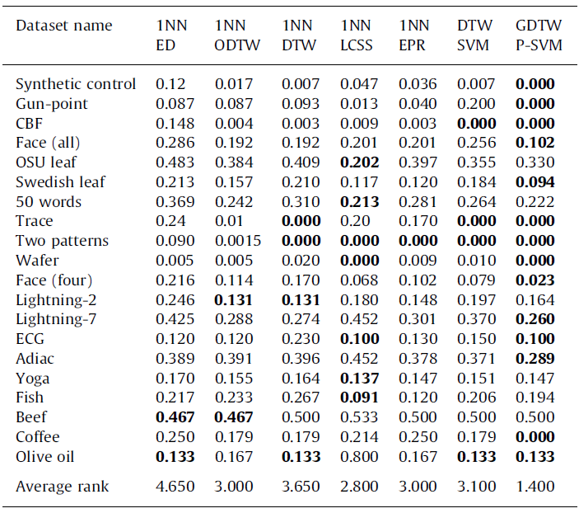

Slide 12
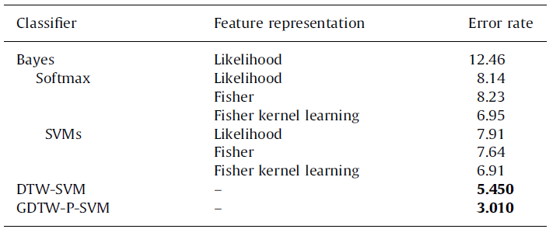
Trajectory data set(筆跡座標及筆壓)

Slide 13
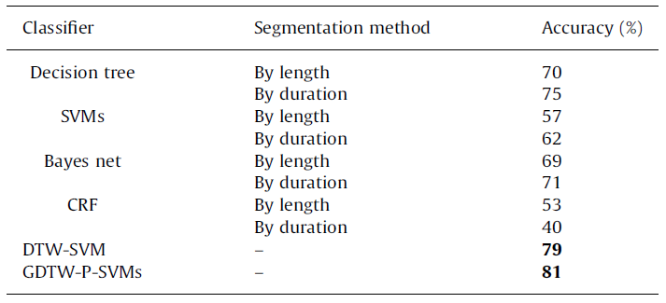
GeoLife GPS Trajectories (經度,緯度,海拔)

Slide 14
THE END

