Slide 1
Algorithms for the Constrained Longest Common Subsequence Problems
Abdullah N. Arslan and Ömer Eğecioğlu
International Journal of Foundations of Computer Science
Vol. 16, No. 6 (2005) 1099-1109
Presenter: Che-Jui Hsu(許哲睿)
Date: 2012/11/6

Slide 2
Abstract
Given strings S1, S2, and P, the constrained longest common subsequence problem for S1 and S2 with respect to P is to find a longest common subsequence lcs of S1 and S2 such that P is a subsequence of this lcs. We present an algorithm which improves the time complexity of the problem from the previously known O(rn²m²) to O(rnm) where r, n, and m are the lengths of P, S1, and S2, respectively. As a generalization of this, we extend the definition of the problem so that the lcs sought contains a subsequence whose edit distance from P is less than a given parameter d. For the latter problem, we propose an algorithm whose time complexity is O(drnm).

Slide 3
Constrained LCS Problem
S1 = bbaba
S2 = abbaa
P = ab
LCS = bbaa
Constrained LCS = aba

Slide 4
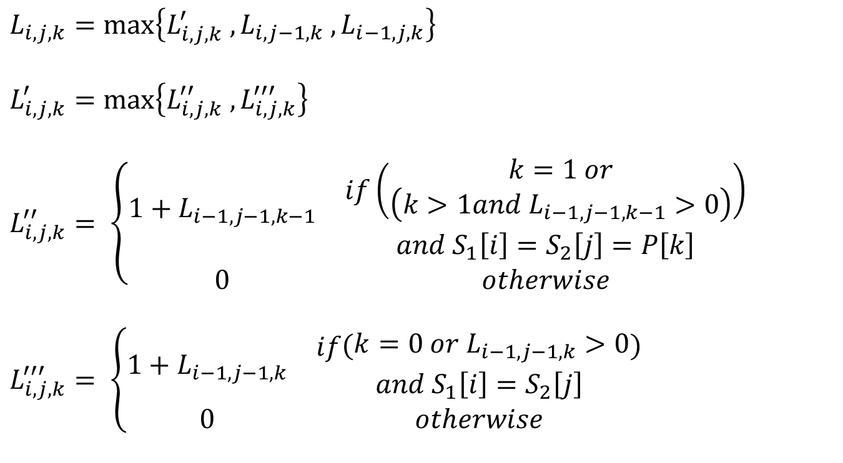
Constrained LCS Algorithm
$$L_{i,j,k}=max⁡\left\{L_{i,j,k}^{′} ,L_{i,j−1,k} ,L_{i−1,j,k}\right\}$$
$$L_{i,j,k}^{′}=max\left\{L_{i,j,k}^{′′} ,L_{i,j,k}^{′′′}\right\}$$
$$L_{i,j,k}^{′′}= \left\{\begin{aligned}\begin{matrix}1+L_{i−1,j−1,k−1} & \begin{aligned}if\left(\begin{aligned}k=1 or \\ \left(k>1and{ L}_{i−1,j−1,k−1}>0\right)\end{aligned}\right) \\ and S_{1}\left[i\right]=S_{2}\left[j\right]=P\left[k\right]\end{aligned} \\ 0 & otherwise\end{matrix}\end{aligned}\right.$$
$$L_{i,j,k}^{′′′}= \left\{\begin{aligned}\begin{matrix}1+L_{i−1,j−1,k} & \begin{aligned}if\left(\begin{aligned}k=0 or{ L}_{i−1,j−1,k}>0\end{aligned}\right) \\ and S_{1}\left[i\right]=S_{2}\left[j\right]\end{aligned} \\ 0 & otherwise\end{matrix}\end{aligned}\right.$$

Slide 5
Example
S1 = abbaa, S2 = bbaba, P = ab
Constrained lcs = aba
 | b | b | a | b | a |  |  | b | b | a | b | a |  |  | b | b | a | b | a
a | 0 | 0 | 1 | 1 | 1 |  | a | 0 | 0 | 1 | 1 | 1 |  | a | 0 | 0 | 0 | 0 | 0
b | 1 | 1 | 1 | 2 | 2 |  | b | 0 | 0 | 1 | 2 | 2 |  | b | 0 | 0 | 0 | 2 | 2
b | 1 | 2 | 2 | 2 | 2 |  | b | 0 | 0 | 1 | 2 | 2 |  | b | 0 | 0 | 0 | 2 | 2
a | 1 | 2 | 3 | 3 | 3 |  | a | 0 | 0 | 3 | 3 | 3 |  | a | 0 | 0 | 0 | 2 | 3
a | 1 | 2 | 3 | 3 | 4 |  | a | 0 | 0 | 3 | 3 | 4 |  | a | 0 | 0 | 0 | 2 | 3
k = 0 |  |  |  |  |  |  | k = 1 |  |  |  |  |  |  | k = 2

Slide 6

Complexity
Time complexity：$O\left(rnm\right)$
Space complexity： $O\left(rm\right)$
Space complexity with LCS information： $O\left(rnm\right)$

Slide 7
Edit Distance Constrained LCS Problem
S1 = bbaba
S2 = abbaa
P = ab
edit distance = 1
(Ex：P’ = a_ or P’ = aa or P’ = bab)
Constrained LCS = aba
Constrained LCS with edit distance = bbaa

Slide 8
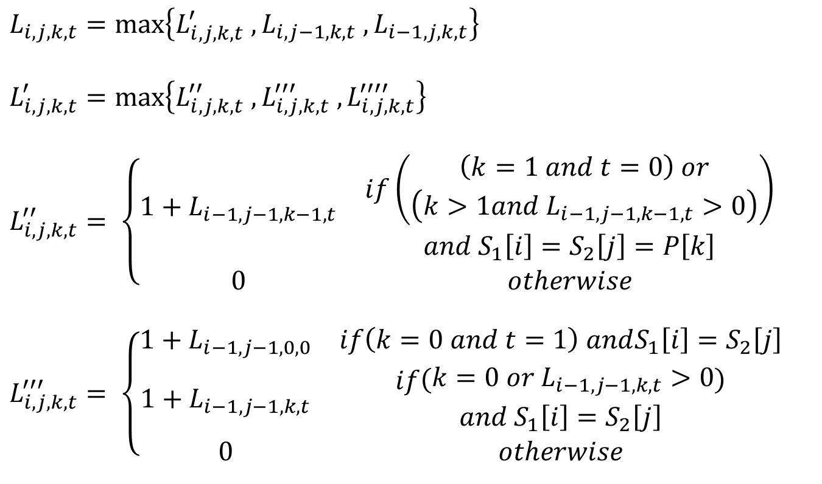
Edit Distance Constrained LCS Algorithm (1/2)
$$L_{i,j,k,t}=max⁡\left\{L_{i,j,k,t}^{′} ,L_{i,j−1,k,t} ,L_{i−1,j,k,t}\right\}$$
$$L_{i,j,k,t}^{′}=max\left\{L_{i,j,k,t}^{′′} ,L_{i,j,k,t}^{′′′} ,L_{i,j,k,t}^{′′′′}\right\}$$
$$L_{i,j,k,t}^{′′}= \left\{\begin{aligned}\begin{matrix}1+L_{i−1,j−1,k−1,t} & \begin{aligned}if\left(\begin{aligned}\left(k=1 and t=0\right) or \\ \left(k>1and{ L}_{i−1,j−1,k−1,t}>0\right)\end{aligned}\right) \\ and S_{1}\left[i\right]=S_{2}\left[j\right]=P\left[k\right]\end{aligned} \\ 0 & otherwise\end{matrix}\end{aligned}\right.$$
$$L_{i,j,k,t}^{′′′}= \left\{\begin{aligned}\begin{matrix}1+L_{i−1,j−1,0,0} & if\left(k=0 and t=1\right) andS_{1}\left[i\right]=S_{2}\left[j\right] \\ 1+L_{i−1,j−1,k,t} & \begin{aligned}if\left(\begin{aligned}k=0 or{ L}_{i−1,j−1,k,t}>0\end{aligned}\right) \\ and S_{1}\left[i\right]=S_{2}\left[j\right]\end{aligned} \\ 0 & otherwise\end{matrix}\end{aligned}\right.$$

Slide 9
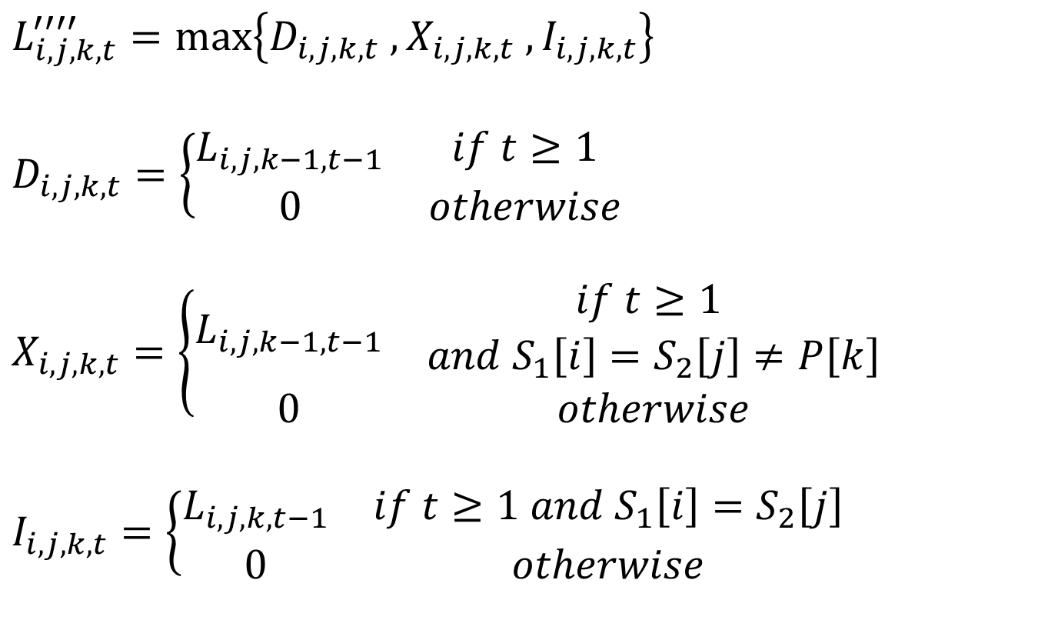
Edit Distance Constrained LCS Algorithm (2/2)
$$L_{i,j,k,t}^{′′′′}=max\left\{D_{i,j,k,t} ,X_{i,j,k,t} ,I_{i,j,k,t}\right\}$$
$$D_{i,j,k,t}=\left\{\begin{aligned}\begin{matrix}L_{i,j,k−1,t−1} & if t≥1 \\ 0 & otherwise\end{matrix}\end{aligned}\right.$$
$$X_{i,j,k,t}=\left\{\begin{aligned}\begin{matrix}L_{i,j,k−1,t−1} & \begin{aligned}if t≥1 \\ and{ S}_{1}\left[i\right]=S_{2}\left[j\right]≠P\left[k\right]\end{aligned} \\ 0 & otherwise\end{matrix}\end{aligned}\right.$$
$$I_{i,j,k,t}=\left\{\begin{aligned}\begin{matrix}L_{i,j,k,t−1} & if t≥1 and{ S}_{1}\left[i\right]=S_{2}\left[j\right] \\ 0 & otherwise\end{matrix}\end{aligned}\right.$$

Slide 10
Example
S1 = abbaa, S2 = bbaba, P = ab, edit distance = 1
Constrained LCS with edit distance = bbaa
 | b | b | a | b | a |  |  | b | b | a | b | a |  |  | b | b | a | b | a
a | 0 | 0 | 1 | 1 | 1 |  | a | 0 | 0 | 1 | 1 | 1 |  | a | 0 | 0 | 0 | 0 | 0
b | 1 | 1 | 1 | 2 | 2 |  | b | 0 | 0 | 1 | 2 | 2 |  | b | 0 | 0 | 0 | 2 | 2
b | 1 | 2 | 2 | 2 | 2 |  | b | 0 | 0 | 1 | 2 | 2 |  | b | 0 | 0 | 0 | 2 | 2
a | 1 | 2 | 3 | 3 | 3 |  | a | 0 | 0 | 3 | 3 | 3 |  | a | 0 | 0 | 0 | 2 | 3
a | 1 | 2 | 3 | 3 | 4 |  | a | 0 | 0 | 3 | 3 | 4 |  | a | 0 | 0 | 0 | 2 | 3
k = 0, t = 0 |  |  |  |  |  |  | k = 1, t = 0 |  |  |  |  |  |  | k = 2, t = 0
 | b | b | a | b | a |  |  | b | b | a | b | a |  |  | b | b | a | b | a
a | 0 | 0 | 1 | 1 | 1 |  | a | 0 | 0 | 1 | 1 | 1 |  | a | 0 | 0 | 1 | 1 | 1
b | 1 | 1 | 1 | 2 | 2 |  | b | 1 | 1 | 1 | 2 | 2 |  | b | 0 | 0 | 1 | 2 | 2
b | 1 | 2 | 2 | 2 | 2 |  | b | 1 | 2 | 2 | 2 | 2 |  | b | 0 | 0 | 1 | 2 | 2
a | 1 | 2 | 3 | 3 | 3 |  | a | 1 | 2 | 3 | 3 | 3 |  | a | 0 | 0 | 3 | 3 | 3
a | 1 | 2 | 3 | 3 | 4 |  | a | 1 | 2 | 3 | 3 | 4 |  | a | 0 | 0 | 3 | 3 | 4
k = 0, t = 1 |  |  |  |  |  |  | k = 1, t = 1 |  |  |  |  |  |  | k = 2, t = 1

Slide 11

Complexity
Time complexity：$O\left(drnm\right)$
Space complexity： $O\left(drm\right)$
Space complexity with LCS information： $O\left(drnm\right)$

