Slide 1
Complex Stock Trading Strategy Based on Particle Swarm Optimization
2012 IEEE Conference on Computational Intelligence for
Financial Engineering & Economics
Fei Wang, Philip L.H. Yu and David W. Cheung
Presenter:Cheng-Han Lee
Date:2012/11/6

Slide 2
Abstract
Trading rules have been utilized in the stock market to make profit for more than a century. However, only using a single trading rule may not be sufficient to predict the stock price trend accurately. Although some complex trading strategies combining various classes of trading rules have been proposed in the literature, they often pick only one rule for each class, which may lose valuable information from other rules in the same class. In this paper, a complex stock trading strategy, namely weight reward strategy (WRS), is proposed. WRS combines the two most popular classes of trading rules-moving average (MA) and trading range break-out (TRB).

Slide 3
For both MA and TRB, WRS includes different combinations of the rule parameters to get a universe of 140 component trading rules in all. Each component rule is assigned a start weight and a reward/penalty mechanism based on profit is proposed to update these rules' weights over time. To determine the best parameter values of WRS, we employ an improved time variant Particle Swarm Optimization (PSO) algorithm with the objective of maximizing the annual net profit generated by WRS. The experiments show that our proposed WRS optimized by PSO outperforms the best moving average and trading range break-out rules.

Slide 4
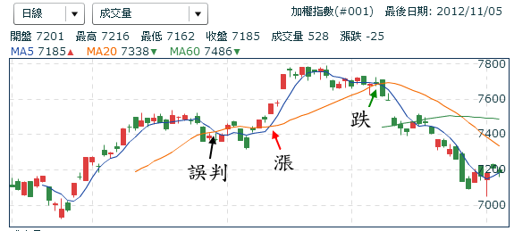
Moving Average(MA)
過去n天的平均價格
通常短的平均線向上突破長的平均線視為漲的趨勢，向下突破則是跌的趨勢
臺灣加權指數

Slide 5
Trading Range Break-out(TRB)
指定過去n天為一個區間
突破區間高點則視為漲的趨勢，突破低點則視為跌的趨勢

Slide 6
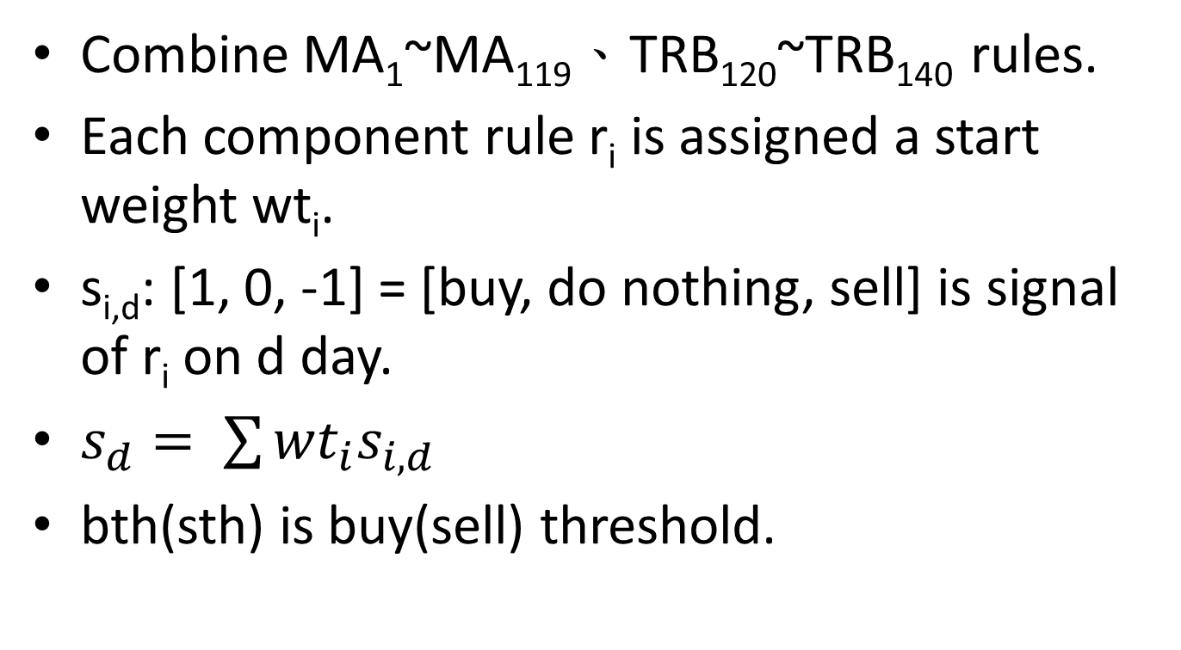
Weight Reward Strategy(WRA)
CombineMA₁~MA₁₁₉、TRB₁₂₀~TRB₁₄₀rules.
Each component rule r_{i} is assigned a start weight wt_{i}.
s_{i,d}:[1, 0, -1] = [buy, do nothing, sell] is signal of r_{i}on d day.
$s_{d}= \sum{{wt}_{i}s_{i,d}}$
bth(sth) is buy(sell) threshold.

Slide 7
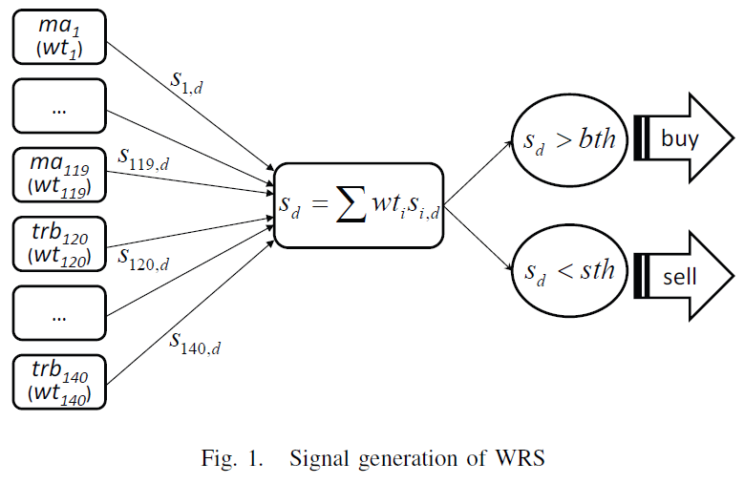

Slide 8
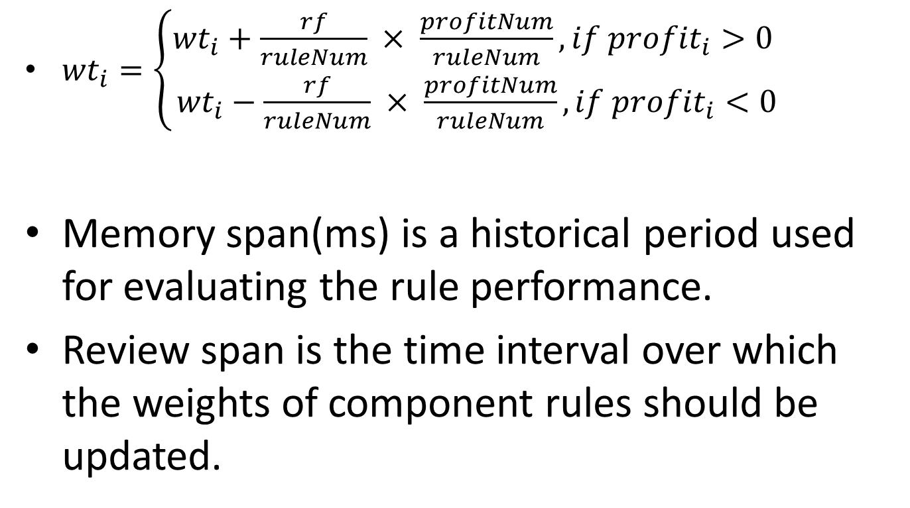
Reward and Penalty of Component Rules
${wt}_{i}=\left\{\begin{aligned}{wt}_{i}+\frac{rf}{ruleNum} × \frac{profitNum}{ruleNum}, if {profit}_{i}>0 \\ {wt}_{i}−\frac{rf}{ruleNum} × \frac{profitNum}{ruleNum}, if {profit}_{i}<0\end{aligned}\right.$
Memory span(ms) is a historical period used for evaluating the rule performance.
Review span is the time interval over which the weights of component rules should be updated.

Slide 9
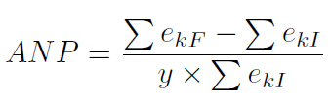
Experimental
Optimize factors with PSO.
Objective function
Traning : 1995~2002
Testing : 2003~2010

Slide 10
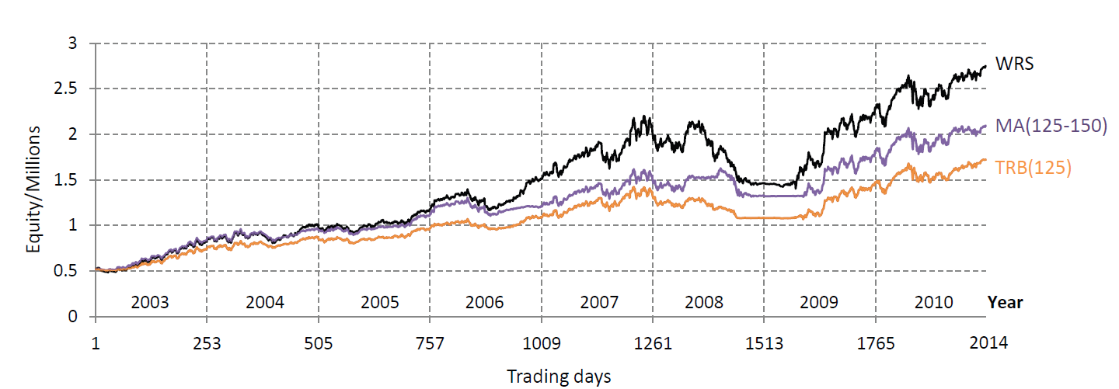

Slide 11
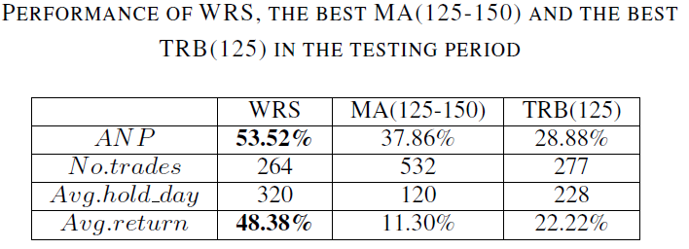

Slide 12
