Slide 1
A Wavelet-Based Anytime Algorithm for K-Means Clustering of Time Series
Michail Vlachos Jessica Lin Eamonn Keogh Dimitrios Gunopulos,
In Proc. Workshop on Clustering High Dimensionality Data and Its Applications, 2003
Date:2012/11/27
Presenter: Cheng-Han Lee

Slide 2
Abstract
The emergence of the field of data mining in the last decade has sparked an increasing interest in clustering of time series. Although there has been much research on clustering in general, most classic machine learning and data mining algorithms do not work well for time series due to their unique structure. In particular, the high dimensionality, very high feature correlation, and the (typically) large amount of noise that characterize time series data present a difficult challenge. In this work we address these challenges by introducing a novel anytime version of k-Means clustering algorithm for time series. The algorithm works by leveraging off the multi-resolution property of wavelets. In particular, an initial clustering is performed with a very coarse resolution representation of the data.

Slide 3
The results obtained from this “quick and dirty” clustering are used to initialize a clustering at a slightly finer level of approximation. This process is repeated until the clustering results stabilize or until the “approximation” is the raw data. In addition to casting k-Means as an anytime algorithm, our approach has two other very unintuitive properties. The quality of the clustering is often better than the batch algorithm, and even if the algorithm is run to completion, the time taken is typically much less than the time taken by the original algorithm. We explain, and empirically demonstrate these surprising and desirable properties with comprehensive experiments on several publicly available real data sets.

Slide 4
Clustering of timeseries data—a survey(2005)

Slide 5
Raw-data-based approaches

Slide 6
Feature-based approaches

Slide 7
Model-based approaches

Slide 8
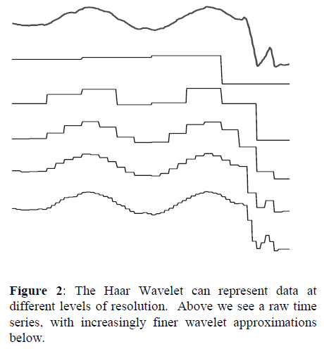
Wavelet

Slide 9
Algorithm I-kMeans
1. Decide on a value for k.
2. Initialize the k cluster centers (randomly, if
necessary).
3. Run the k-Means algorithm on the level_{i} representation of the data
4. Use final centers from leveli as initial centers for level_{i+1}. This is achieved by projecting the k centers returned by k-Means algorithm for the 2i space in the 2i+1 space.
5. If none of the N objects changed membership in the last iteration, exit. Otherwise goto 3.

Slide 10

Experimental
Data set
JPL
This dataset consists of readings from various inertial sensors from Space Shuttle mission STS-57.
Heterogeneous :10 dataset from UCR

Slide 11
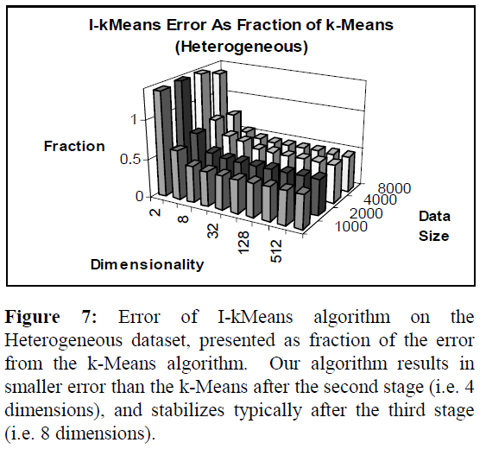
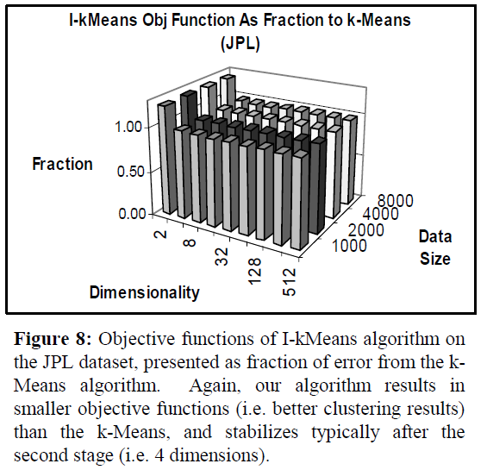

Slide 12
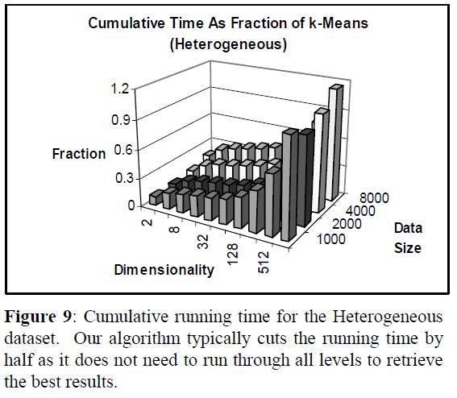
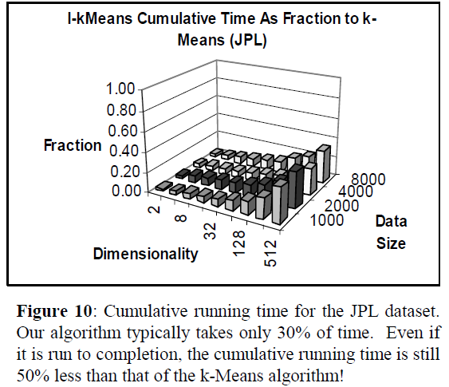

Slide 13
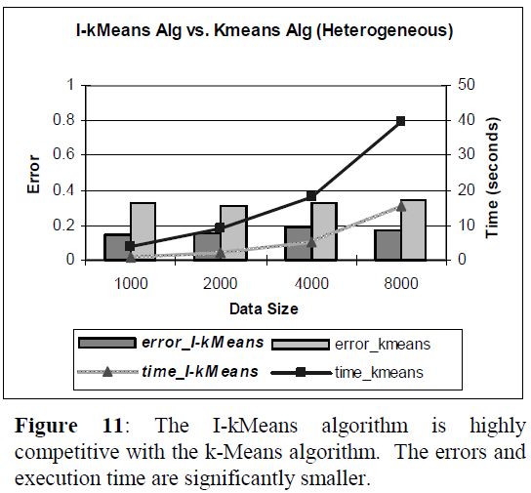
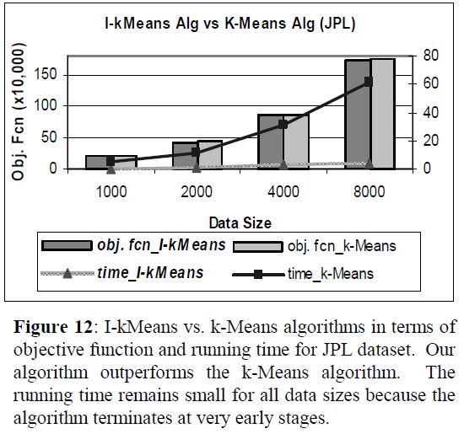

Slide 14
THE END

