Slide 1
Coloring large graphs based on independent set extraction
Qinghua Wu, Jin-Kao Hao
Computers & Operations Research 39 (2012) 283–290
Presenter: 許竣傑
2012/11/27

Slide 2
Abstract
This paper presents an effective approach (EXTRACOL) to coloring large graphs. The proposed approach uses a preprocessing method to extract large independent sets from the graph and a memetic algorithm to color the residual graph. Each preprocessing application identifies, with a dedicated tabu search algorithm, a number of pairwise disjoint independent sets of a given size in order to maximize the vertices removed from the graph. We evaluate EXTRACOL on the 11 largest graphs (with 1000 to 4000 vertices) of the DIMACS challenge benchmarks and show improved results for four very difficult graphs (DSJC1000.9, C2000.5, C2000.9, C4000.5). The behavior of the proposed algorithm is also analyzed.

Slide 3
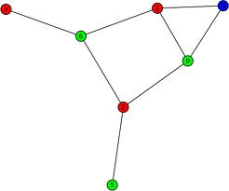
Problem to Solve
Let G=(V,E), a legal k-coloring of G corresponds to a partition of V into k independent sets
V >= 1000
Finding the smallest k for a given graph G

Slide 4
EXTRACOL Algorithm
Two phases:
a preprocessing phase
a coloring phase

Slide 5
Preprocessing Phase
Find independent sets M={ I₁,I₂,….,I_{n} }, I_{i}≠I_{j}
I₁ ={1,5}, I₂={2,3,4}, I₃={4,5}
1
4
2
3
5

Slide 6
ATS for Maximal Independent Set
G=(V,E), Ω={S⊂V: |S|=k}
Let G_{s}={S,E_{s}}, E_{s}={(u,v) ∈E: u,v∈S}
The evaluation function f(S)=| E_{s} |
ATS algorithm is to find a solution S* such that f(S*) reaches its minimum value f(S*)=0.

Slide 7
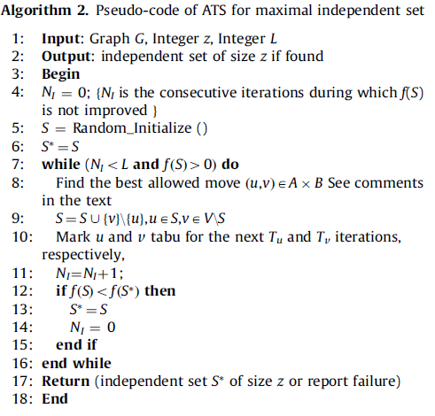
ATS for Maximal Independent Set
Adaptive tabu search
A={u∈S, u∉tabu_list, d(u)=MaxInS}
B={v ∈V\S,v ∉tabu_list, d(v)=MinOutS}
1
5
2
3
6
7
8
4

Slide 8
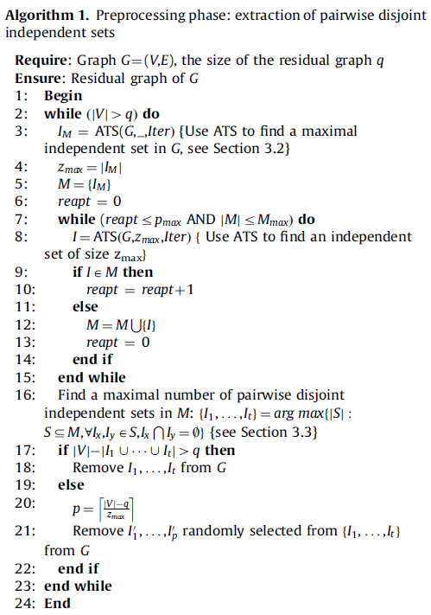
Preprocessing Phase
1
2
3
4
5
1
3
2
4
5

Slide 9
Coloring the Residual Graph
Lu Z, Hao JK. A memetic algorithm for graph coloring. European Journal of Operational Research 2010; 200(1): 235–44.

Slide 10
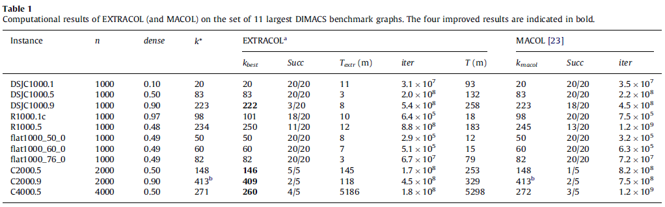
Experimental Results
Three large random graphs (DSJC1000.1, DSJC1000.5, DSJC1000.9).
Three large flat graphs (flat1000_50_0, flat1000_60_0, flat1000_76_0).
Two large random geometric graphs(R1000.1c,R1000.5).
Three very large random graphs(C2000.5,C2000.9,C4000.5).

Slide 11
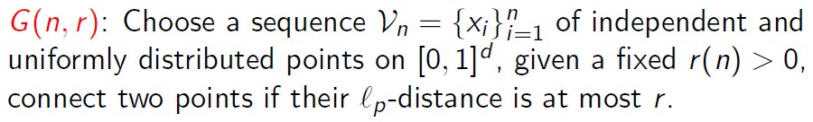
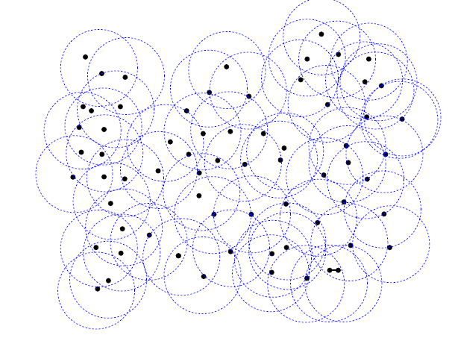
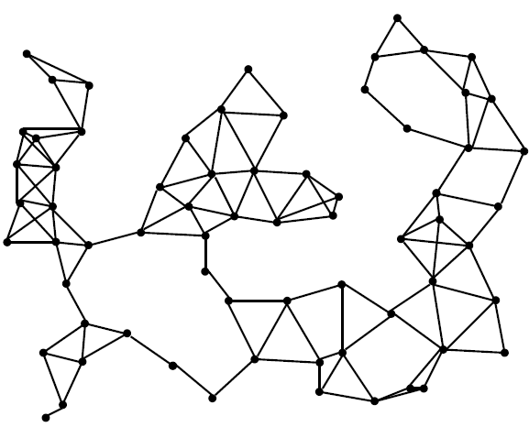
Random Geometric Graphs

Slide 12
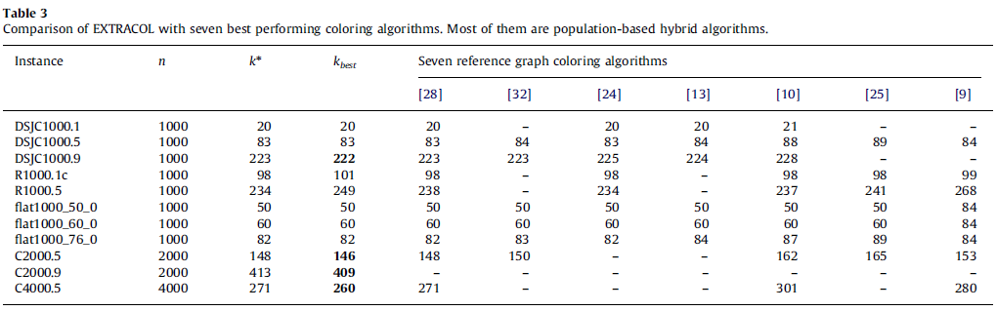
Experimental Results
[28] An evolutionary approach with diversity guarantee and well-informed grouping recombination for graph coloring.
[32] Graph coloring by multiagent fusion search.
[24] A metaheuristic approach for the vertex coloring problem.
[13] An adaptive memory algorithm for the K-colouring problem.
[10] A minimal-state processing search algorithm for graph coloring problems.
[25] Distributed coloration neighborhood search.
[9] Genetic and hybrid algorithms for graph coloring.

