Slide 1
Large margin mixture of AR models for time series classification
B. Venkataramana Kini and C. Chandra Sekhar
Applied Soft Computing, Vol. 13, pp. 361–371, 2013

Slide 2
Abstract
In this paper, we propose the large margin autoregressive (LMAR) model for classification of time series patterns. The parameters of the generative AR models for different classes are estimated using the margin of the boundaries of AR models as the optimization criterion. Models that use a mixture of AR (MAR) models are considered for representing the data that cannot be adequately represented using a single AR model for a class.

Slide 3
Abstract
Based on a mixture model representing each class, we propose the large margin mixture of AR (LMMAR) models. The proposed methods are applied on the simulated time series data, electrocardiogram data, speech data for E-set in English alphabet and electroencephalogram time series data. Performance of the proposed methods is compared with that of support vector machine (SVM) based classifier that uses AR coefficients based features.

Slide 4
Abstract
The proposed methods give a better classification performance compared to the SVM based classifier. Being generative models, the LMAR and LMMAR models provide a generative interpretation that enables utilization of the rejection option in the high risk classification tasks. The proposed methods can also be used for detection of novel time series data.

Slide 5
自我相關函數
林晉勗, "時間序列模型之應用"
Notes:
12.01.2000, EPFL
Goal:
Overview on some tools used in the analysis of macroeconomic issues in the context of energy policy definition and sustainable development.
Not same as macroeconomic tools …

Slide 6
自我共變異數函數
在一穩定隨機過程中，任取第 i 期及第 i+j 期之隨機變數 y_{i} 與 y_{i+j} ，自我共變數為
γ_{j} = Cov(y_{i}，y_{i+j})
任一期之變異數 γ₀ = Cov(y_{i}，y_{i}) = Var(y_{i})。
γ_{j} 對稱於0，亦即γ_{j} = γ_{-j} ，因為
γ_{-j} = Cov(y_{i}，y_{i-j}) = Cov(y_{i-j}，y_{i}) = γ_{j}
{γ_{j}}_{j=0,1,2, …, ∞} 稱為自我共變異數函數。
林晉勗, "時間序列模型之應用"

Slide 7
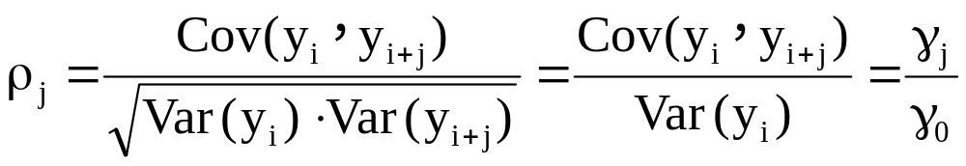
自我相關函數
由自我相關係數可觀察第 i 期與第 i+j 期的相關性強弱，及其方向。
令ρ_{j} 為第 i 期與第 i+j 期的相關係數，則
{ρ_{j}}_{j=1,2,…,∞} 稱為自我相關函數(Autocorrelation Function)，簡稱ACF。
林晉勗, "時間序列模型之應用"

Slide 8
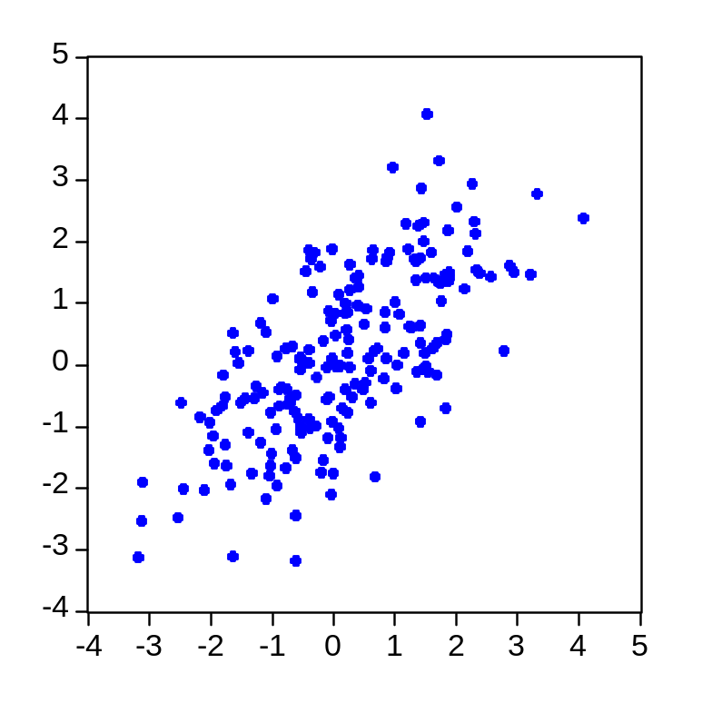
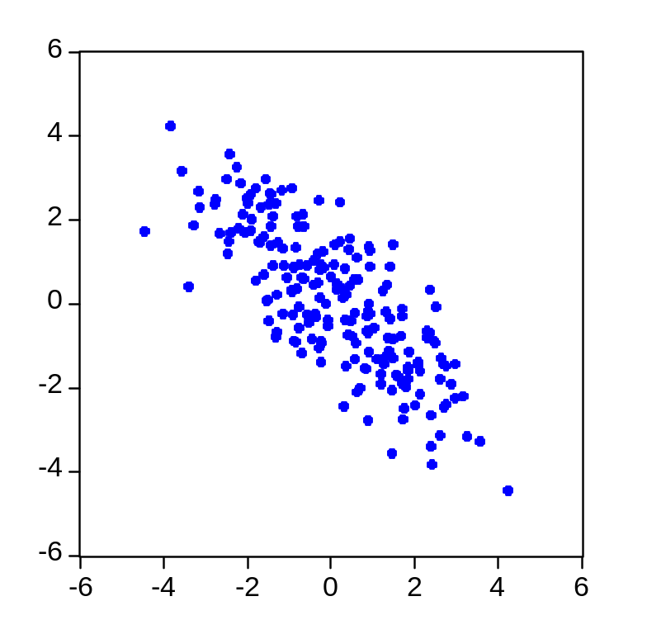
自我相關之正負相關
y_{t-1}
y_{t-1}
y
Y_{t}
y_{t}
正相關 (ρ₁>0)
負相關 (ρ₁<0)
林晉勗, "時間序列模型之應用"

Slide 9
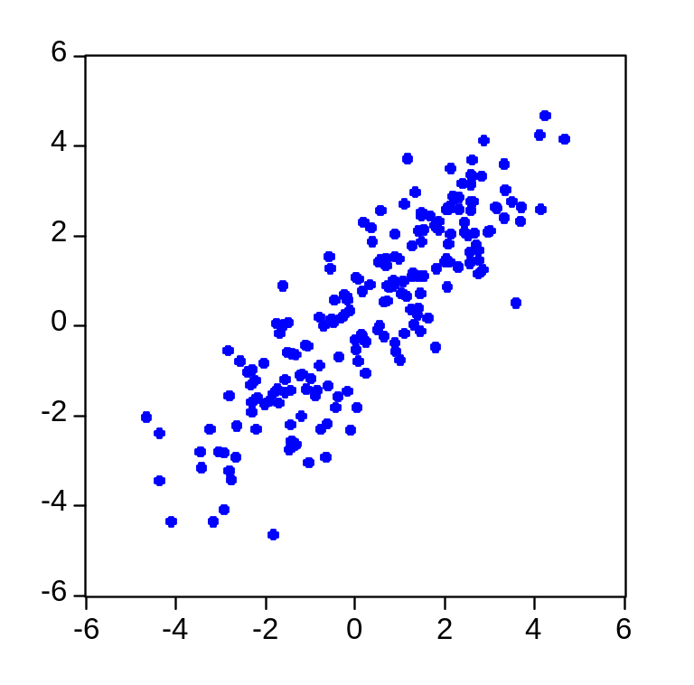
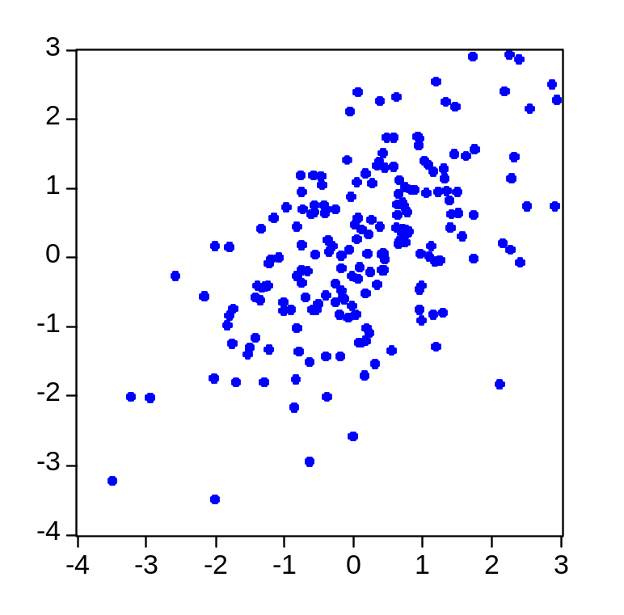
自我相關之強弱
y_{t-1}
y_{t-1}
y_{t}
y_{t}
相關性強 ( |ρ₁|較大)
相關性弱 ( |ρ₁|較小)
林晉勗, "時間序列模型之應用"

Slide 10
穩定數列之移動平均模型
Moving Average (MA)
林晉勗, "時間序列模型之應用"
Notes:
12.01.2000, EPFL
Goal:
Overview on some tools used in the analysis of macroeconomic issues in the context of energy policy definition and sustainable development.
Not same as macroeconomic tools …

Slide 11
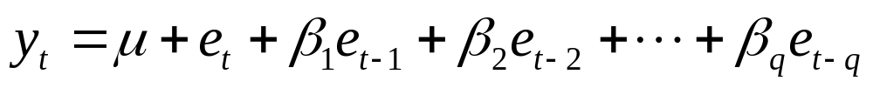
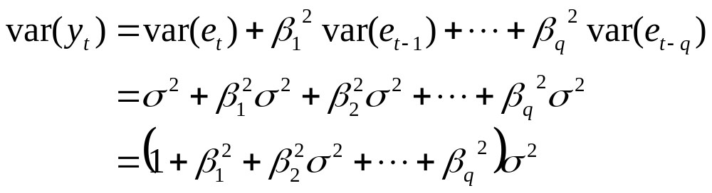
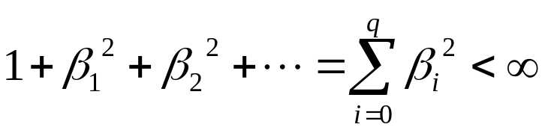
移動平均(Moving Average; MA)模型之定義
在q階的MA模型中，每個觀察值y_{t} 是由過去q個隨機干擾項的加權平均而產生，可將MA(q)表示為
其中，β可正可負，且e_{t}~N(0,σ²)。
y的變異數
若 ，則 y_{t} 為一平穩的時間序列模型。
林晉勗, "時間序列模型之應用"

Slide 12

MA(1) 模型—基本性質
期望值 E(y_{t}) = μ
變異數 γ₀ = Var(y_{t}) = σ² ( 1+β₁²)
自我共變異數
γ₁ = E[ y_{t} , y_{t-1}]
= E[ μ+ e_{t} + β₁e_{t-1}， μ+ e_{t-1} + β₁e_{t-2}]
= β₁ σ²
γ₂ = E[ y_{t} , y_{t-2}]
= E[ μ+ e_{t} + β₁e_{t-1}， μ+ e_{t-2} + β₁e_{t-3}] = 0
γ_{k} = 0，k ≧ 2
林晉勗, "時間序列模型之應用"

Slide 13
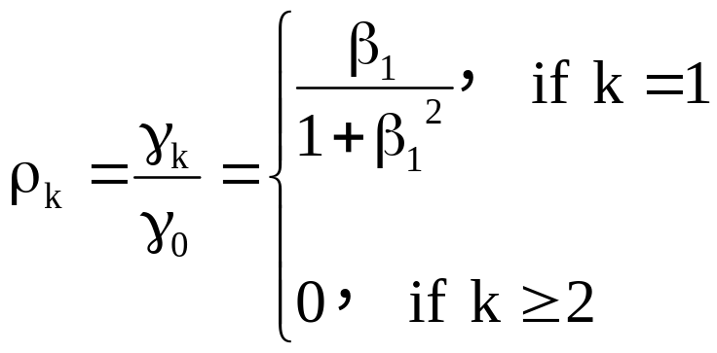
MA(1) 模型—自我相關函數 (ACF)
自我相關函數
ρ_{k}
ρ_{k}
0
1
1
2
3
4
5
k
0
2
3
4
5
k
ρ₁ > 0
ρ₁ < 0
林晉勗, "時間序列模型之應用"

Slide 14
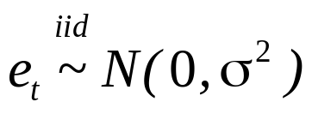

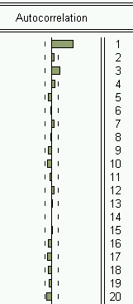
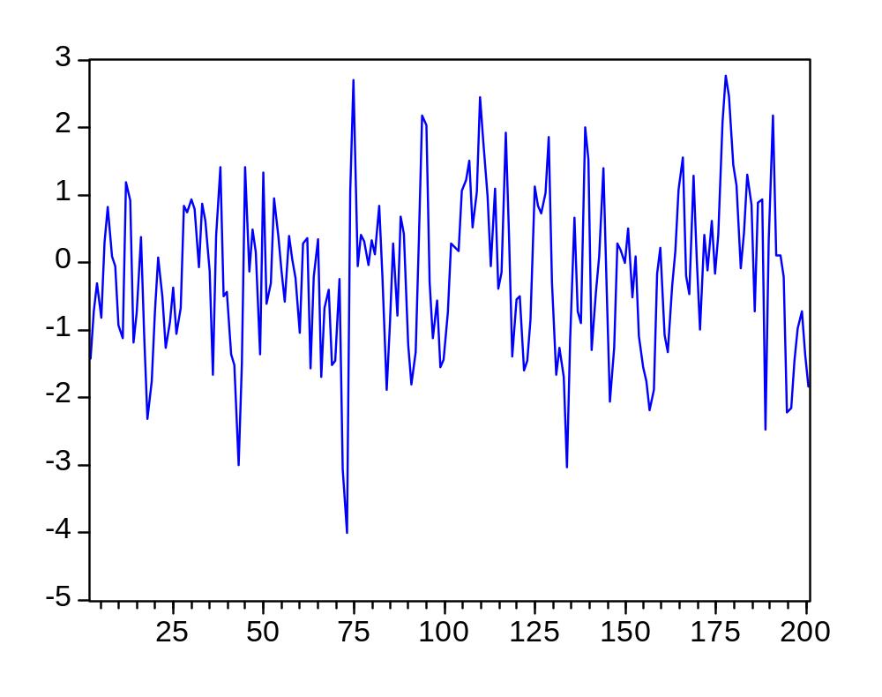
MA(1) 模型—範例
林晉勗, "時間序列模型之應用"

Slide 15

MA(2) 模型—基本性質
平均數 E(y_{t}) = μ
變異數 γ₀ = Var(y_{t}) = σ² ( 1+β₁²+ β₂²)
自我共變異數
γ₁ = E[ y_{t} , y_{t-1}]
= E[ μ+ e_{t} + β₁e_{t-1} + β₂e_{t-2} ， μ+ e_{t-1} + β₁e_{t-2} + β₂e_{t-3}]
= β₁ σ² + β₁ β₂ σ²
γ₂ = E[ y_{t} , y_{t-2}]
= E[ μ+ e_{t} + β₁e_{t-1} + β₂e_{t-2} ， μ+ e_{t-2} + β₁e_{t-3} + β₂e_{t-4}]
= β₂ σ²
γ_{k} = 0，k ≧ 3
林晉勗, "時間序列模型之應用"

Slide 16
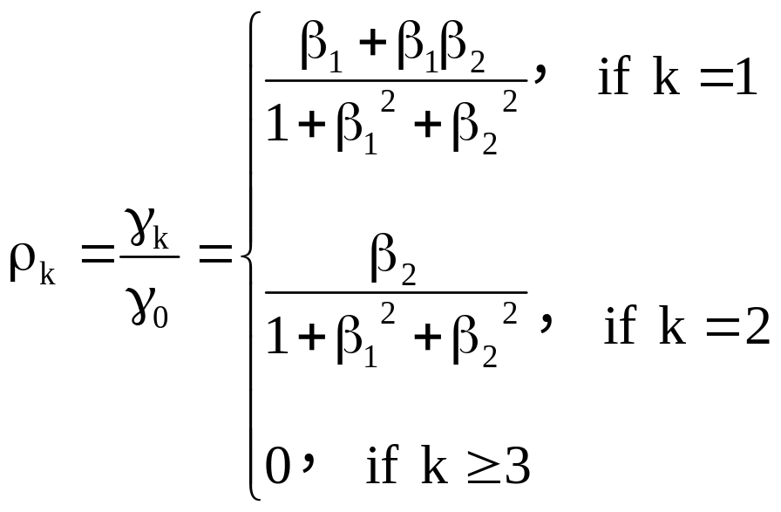
MA(2) 模型—自我相關函數 (ACF)
自我相關函數(ACF)
ρ_{k}
0
1
2
3
4
5
k
林晉勗, "時間序列模型之應用"

Slide 17
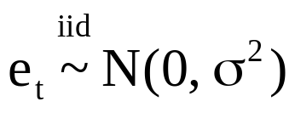

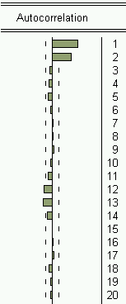
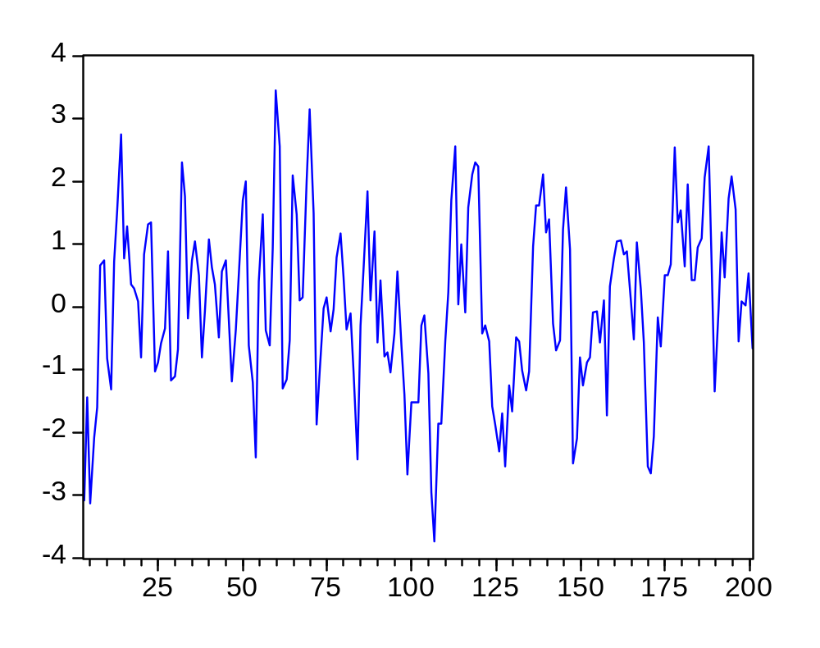
MA(2) 模型—範例
林晉勗, "時間序列模型之應用"

Slide 18
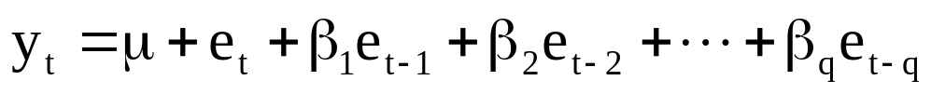
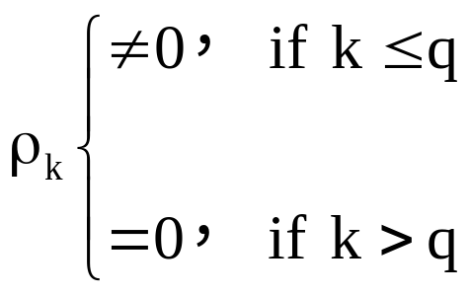
MA(q) 之基本性質
平均數 E(y_{t}) = μ
變異數 γ₀ = Var(y_{t}) = σ² ( 1+β₁²+ … +β_{q}²)＜∞ (穩定)
自我相關函數
MA(q)之ACF在落後期數q之後截斷 (cut off after lag q)，因此可藉由ACF判斷MA之落後期數。
林晉勗, "時間序列模型之應用"

Slide 19
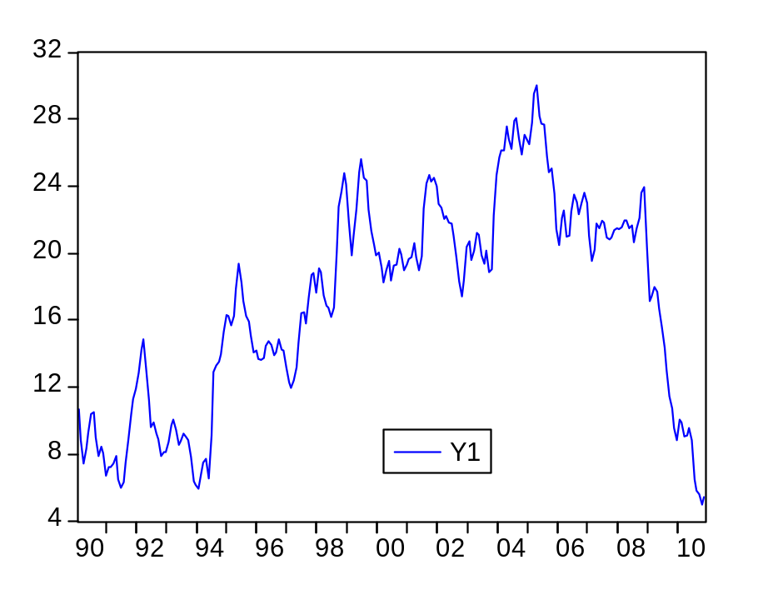
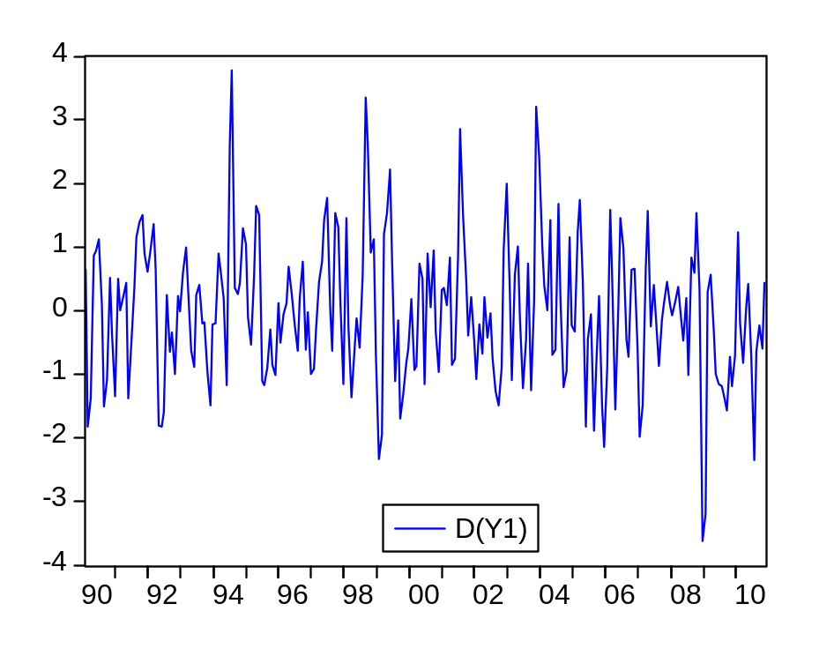
MA模型範例
Y₁為不平穩數列，建立模型之前必須先平穩化。
將Y₁差分後，即為一平穩數列。
林晉勗, "時間序列模型之應用"

Slide 20
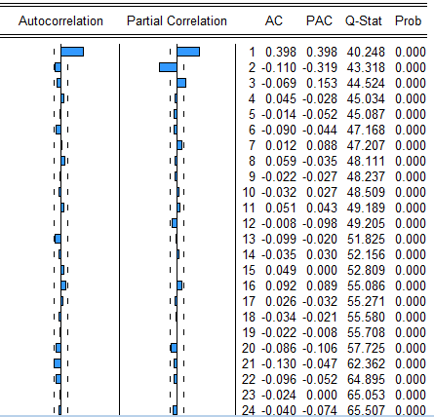
MA模型 Eviews 操作步驟
correlogram of d(Y₁)
在Eviews指令列中輸入
ident d(y1)
即可出現autocorrelation
ACF中，落後1期的部份有凸出，且落後2期的部份即收斂，因此可以MA(1) 來建立模型
指令說明
ident 指 identification
d(。) 將括號中的變數做一階 差分
林晉勗, "時間序列模型之應用"

Slide 21
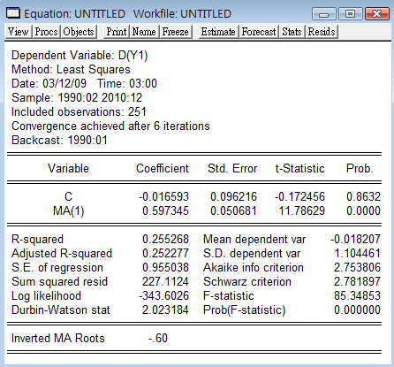
MA模型 Eviews 操作步驟
在Eviews指令列中輸入
ls d(y1) c ma(1)
即可出現MA(1)模型
指令說明
ls 指 least square，亦即最小平方法
d(。) 將括號中的變數做一階差分
c 代表常數項
ma(q) 表示落後第q期的殘差項
註：LS 之後緊接著的第1個變數為因變數，而後的所有變數皆為自變數，變數與變數之間以空格為隔開即可。
林晉勗, "時間序列模型之應用"

Slide 22
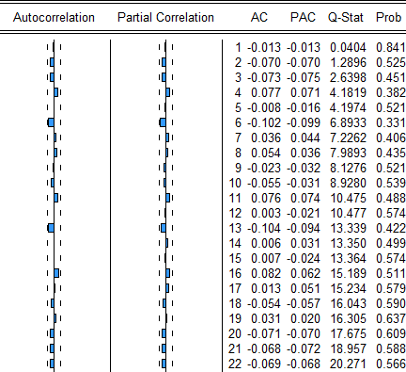
MA模型 Eviews 操作步驟
建立MA(1)模型之後，必須確認MA(1)模型是否足以解釋Y₁的變異。若MA(1)仍不足以解釋Y₁的異，則未解釋的部份會表現在殘差項，所以可藉由殘差的檢定來判斷模型配適是否合適。
在Eviews指令列中輸入
ident resid
即可出現殘差的相關係數圖
指令說明
resid 代表殘差
correlogram of resid
殘差的ACF已不存在自我相關，代表 Y₁的序列相關由MA(1) 來補捉就已足夠
林晉勗, "時間序列模型之應用"

Slide 23
穩定數列之自我迴歸模型
Autoregressive (AR)
林晉勗, "時間序列模型之應用"
Notes:
12.01.2000, EPFL
Goal:
Overview on some tools used in the analysis of macroeconomic issues in the context of energy policy definition and sustainable development.
Not same as macroeconomic tools …

Slide 24
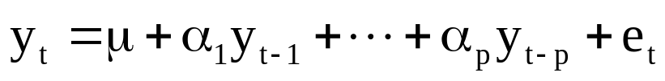
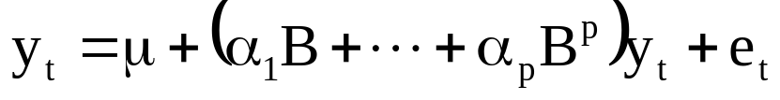

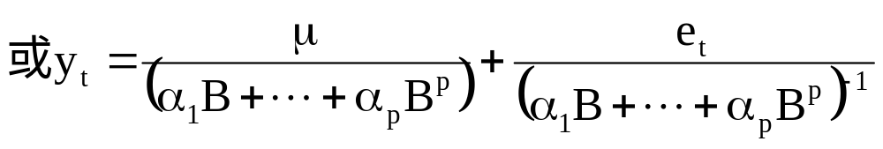
定義AR(p) 模型
在p階的AR模型中，每個觀察值y_{t} 是由過去p期的線性組合，再加上一個隨機干擾項，可將AR(p)表示為
其中，α_{i} 可為正，亦可為負。
定義B為落遲因子(Lag operator)，亦即y_{t-1} = B y_{t}，
y_{t-2} = B y_{t-1} = B (B y_{t} ) = B²y_{t}。則 AR(p)可以表示為
林晉勗, "時間序列模型之應用"

Slide 25


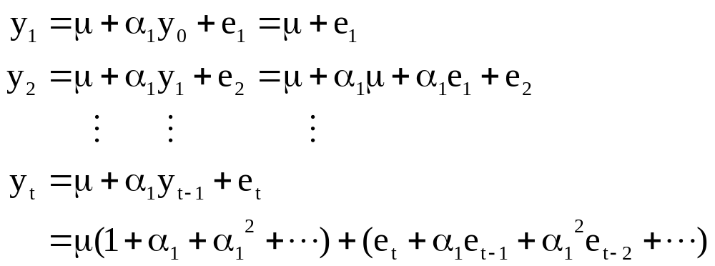
AR(1) 模型—基本性質
林晉勗, "時間序列模型之應用"

Slide 26
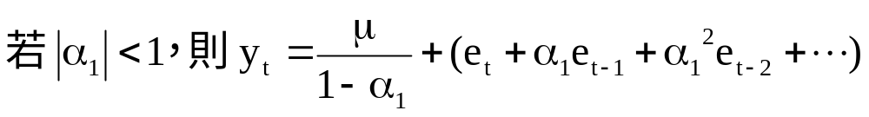
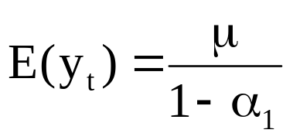
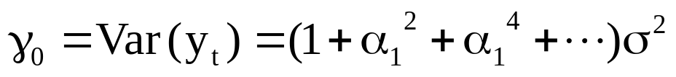
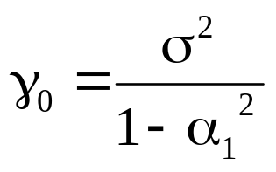
AR(1) 模型—基本性質
平均數
變異數
➔安定條件為 |α₁| <1，則變異數收斂至
林晉勗, "時間序列模型之應用"

Slide 27
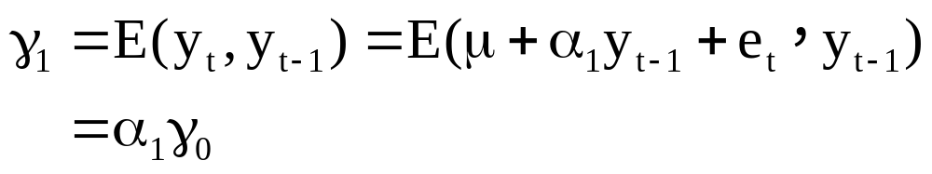
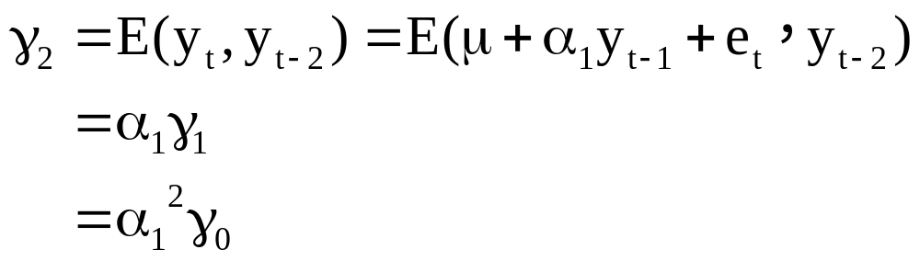
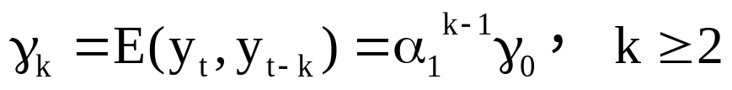
AR(1) 模型—基本性質
自我共變異數
林晉勗, "時間序列模型之應用"

Slide 28
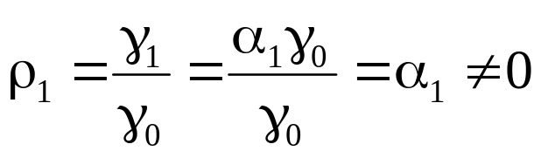
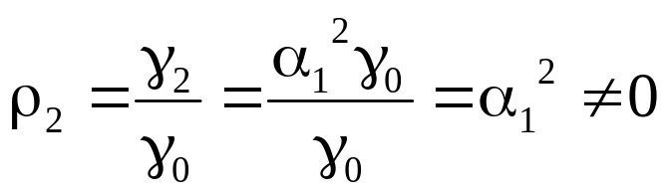
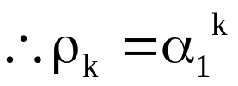
AR(1) 模型—自我相關函數 (ACF)
ρ_{k}
0 <α₁< 1
0
1
2
3
4
5
k
ACF沒有截斷的現象
若 0 <α₁< 1，則AR(1)之ACF呈現一遞減的狀態。
若 -1 <α₁< 0，則AR(1)之ACF呈現一擺盪遞減的狀態。
ρ_{k}
1
3
5
0
2
4
k
-1 <α₁< 0
林晉勗, "時間序列模型之應用"

Slide 29
AR(1) 模型—偏自我相關函數 (PACF)
AR 之ACF呈現遞減的狀態，並無截斷，因此不易判斷AR之落後期數，此時必須引入Partial Autocorrelation Function (PACF)藉以判斷AR之落後期數。
林晉勗, "時間序列模型之應用"

Slide 30






AR(1) 模型—偏自我相關函數 (PACF)
做法：For AR(1)
step 1:估計
則一階偏相關係數
step 2:估計
則二階偏相關係數
若為AR(1)模型，則
ρ_{k}
0
0
1
2
3
4
5
k
1
2
3
4
5
k
ACF
PACF
林晉勗, "時間序列模型之應用"

Slide 31

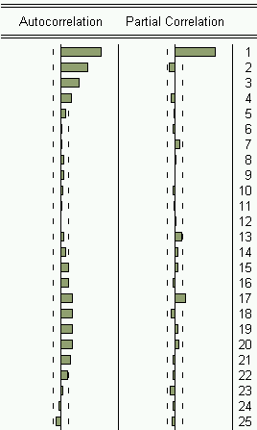
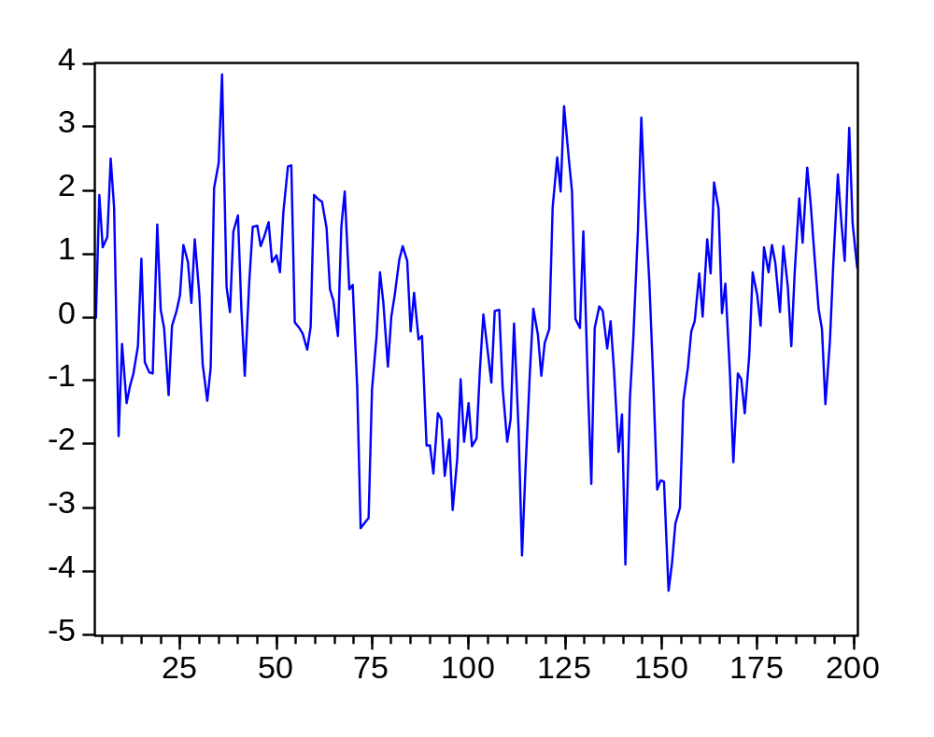
AR(1) 模型—範例
林晉勗, "時間序列模型之應用"

Slide 32

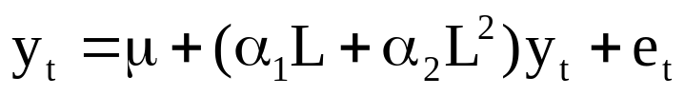
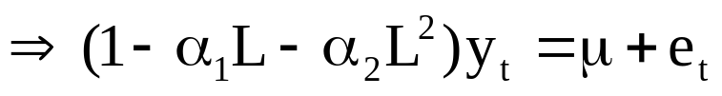
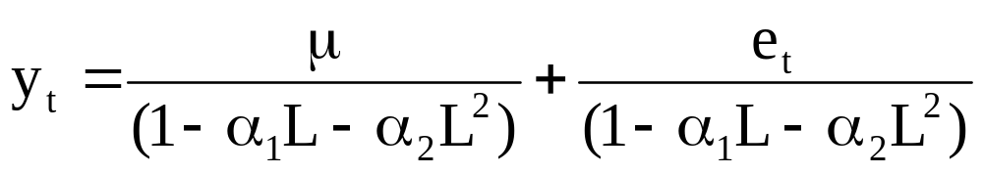



AR(2) 模型—基本性質
若令L為落遲因子(Lag operator)，即y_{t-1} = L．y_{t}，且y_{t-2} = L．y_{t-1}=L（L．y_{t}）= L² y_{t}
則AR(2)可以表示為
林晉勗, "時間序列模型之應用"

Slide 33
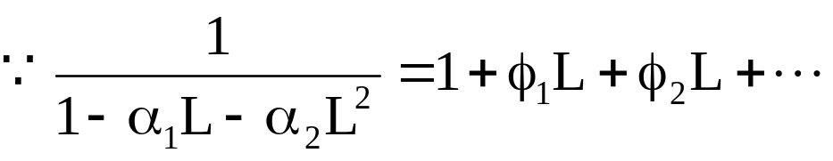

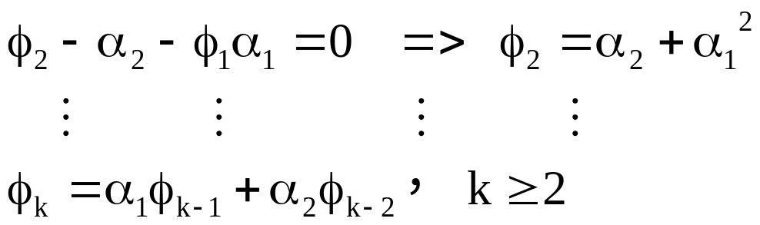
AR(2) 模型—基本性質
林晉勗, "時間序列模型之應用"

Slide 34

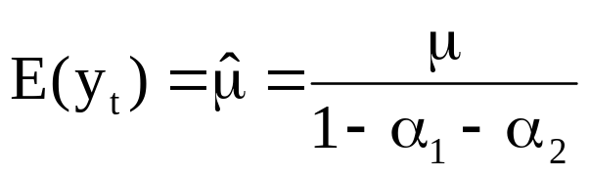
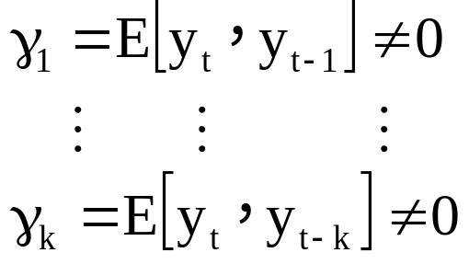
AR(2) 模型—基本性質
平均數
自我共變異數
林晉勗, "時間序列模型之應用"

Slide 35

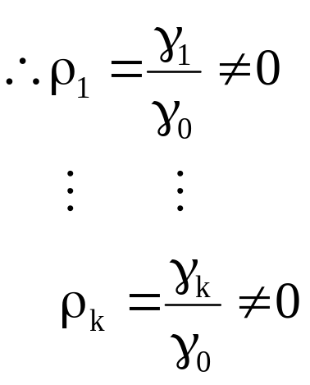
AR(2) 模型—自我相關函數 (ACF)
ρ_{k}
1
3
5
0
2
4
k
ACF沒有截斷的現象
林晉勗, "時間序列模型之應用"

Slide 36
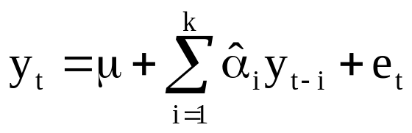



AR(2) 模型—偏自我相關函數 (PACF)
做法：估計
k階偏自我相關係數
若為AR(2)模型，則
且
ρ_{k}
0
0
1
2
3
4
5
k
1
2
3
4
5
k
ACF
PACF
林晉勗, "時間序列模型之應用"

Slide 37

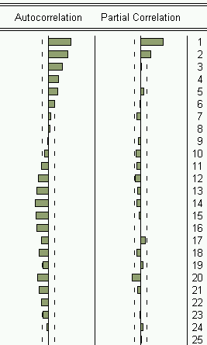
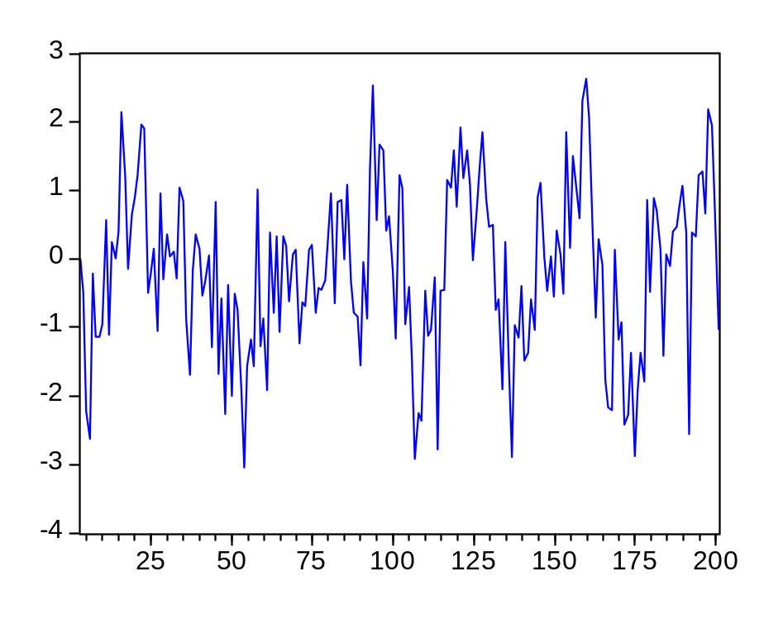
AR(2) 模型—偏自我相關函數 (PACF)
林晉勗, "時間序列模型之應用"

Slide 38


AR 模型實例
Y₂為不平穩數列，建立模型之前必須先平穩化。
將Y₂差分後，即為一平穩數列。
林晉勗, "時間序列模型之應用"

Slide 39

AR 模型 Eviews 操作步驟
在Eviews指令列中輸入
ident d(y2)
即可出現ACF與PACF
ACF中，從落後1期開始持續遞減，但PACF中僅第1期有很高的相關係數，第2期後即截斷，因此可以 AR(1) 來建立模型
指令說明
ident 指 identification
d(。) 將括號中的變數做一階差分
correlogram of d(Y₂)
林晉勗, "時間序列模型之應用"

Slide 40

AR 模型 Eviews 操作步驟
在Eviews指令列中輸入
ls d(y2) c d(y2(-1))
即可出現AR(1)模型
指令說明
ls 指 least square，亦即最小平方法
d(。) 將括號中的變數做一階差分
c 代表常數項
y(-k) 代表y的落後k期
林晉勗, "時間序列模型之應用"

Slide 41

AR 模型 Eviews 操作步驟
correlogram of resid
建立AR(1)模型之後，必須確認AR(1)模型是否足以解釋Y₁的變異。若AR(1)仍不足以解釋Y₁的異，則未解釋的部份會表現在殘差項，所以可藉由殘差的檢定來判斷模型配適是否合適。
在Eviews指令列中輸入
ident resid
即可出現殘差的相關係數圖
指令說明
resid 代表殘差
殘差的ACF與PACF 皆不存在自我相關，代表 Y₂的序列相關由AR(1) 來補捉就已足夠
林晉勗, "時間序列模型之應用"

Slide 42


AR coefficients and ACF

Slide 43

AR coefficients and ACF

Slide 44

AR coefficients
ACF
Walter Enders, "Applied Econometric Time Series", 3rd

Slide 45

Walter Enders, "Applied Econometric Time Series", 3rd

Slide 46



Mahalanobis distance
Introduced by P. C. Mahalanobis in 1936
It differs from Euclidean distance in that it takes into account the correlations of the data set and is scale-invariant.
http://en.wikipedia.org/wiki/Mahalanobis_distance
http://www.aiaccess.net/English/Glossaries/GlosMod/e_gm_mahalanobis.htm#Animation Mahalanobis
http://people.revoledu.com/kardi/tutorial/Similarity/MahalanobisDistance.html

Slide 47

For multivariate normal data with mean μ and covariance matrix Σ, you can decorrelate the variables and standardize the distribution by applying the Cholesky transformation z = L⁻¹(x - μ), where L is the Cholesky factor of Σ, Σ=LL^{T}
The squared distance Mahal²(x,μ) is
= z^{T} z
= (L⁻¹(x - μ))^{T} (L⁻¹(x - μ))
= (x - μ)^{T} (LL^{T})⁻¹ (x - μ)
= (x - μ)^{T} Σ ⁻¹ (x - μ)
http://blogs.sas.com/content/iml/2012/02/15/what-is-mahalanobis-distance/

Slide 48

The first observation is at the coordinates (4,0), whereas the second is at (0,2). The question is: which marker is closer to the origin?
The answer is, "It depends how you measure distance." The Euclidean distances are 4 and 2, respectively, so you might conclude that the point at (0,2) is closer to the origin. However, for this distribution, the variance in the Y direction is less than the variance in the X direction, so in some sense the point (0,2) is "more standard deviations" away from the origin than (4,0) is.
Notice the position of the two observations relative to the ellipses. The point (0,2) is located at the 90% prediction ellipse, whereas the point at (4,0) is located at about the 75% prediction ellipse. What does this mean? It means that the point at (4,0) is "closer" to the origin in the sense that you are more likely to observe an observation near (4,0) than to observe one near (0,2). The probability density is higher near (4,0) than it is near (0,2).
In this sense, prediction ellipses are a multivariate generalization of "units of standard deviation."
http://blogs.sas.com/content/iml/2012/02/15/what-is-mahalanobis-distance/

Slide 49

AR-based time series classification

Slide 50

AR-based time series classification
r
c∈{1,2,3}

Slide 51
Mixture of AR (MAR)
α₁₁ P₁₁
α₁₂ P₁₂
α₂₁ P₂₁
α₃₁ P₃₁
α₃₂ P₃₂
α₂₂ P₂₂
y=argmax(Σ_{k} α_{ck} P_{ck})
c∈{1,2,3}

Slide 52

Properties of covariance matrix
σ₂
σ₁
http://www.ece.unm.edu/faculty/bsanthan/EECE-340/covar.pdf

Slide 53
Margin of AR
small margin
small Σ_{k}trace(1/σ_{k})
large margin
large Σ_{k}trace(1/σ_{k})

Slide 54

Margin of AR
Φ_{yn}=Σ⁻¹_{yn}
r_{n}
Φ_{c}=Σ⁻¹_{c}

Slide 55


Large margin AR (LMAR)

Slide 56
Margin of MAR

Slide 57


Large margin mixture of AR (LMMAR)

Slide 58
Study on electrocardiogram [心電圖; 心動電流圖] (ECG) data
Obtained from The MIT-BIH ECG database
The categories of ECG signals in these databases are: normal sinus rhythm (NSR), atrial[房的, 前房的] premature[早熟的] contraction[收縮] (APC), premature ventricular[室的; 腦室的] contraction (PVC), supra[在上; 在前] ventricular contraction (SVT), ventricular tachycardia[心跳過速] (VT), and ventricular fibrillation[原纖維形成過程; 纖維性顫動] (VF).
300 sample length time series
number: NSR(10,000), SVT (6121), APC (2505), PVC (6183), VT (470), VF (484)
5 fold CV

Slide 59

Study on electrocardiogram [心電圖; 心動電流圖] (ECG) data

Slide 60

Study on electrocardiogram [心電圖; 心動電流圖] (ECG) data

Slide 61

Study on electrocardiogram [心電圖; 心動電流圖] (ECG) data

Slide 62

Study on electrocardiogram [心電圖; 心動電流圖] (ECG) data

Slide 63
Study on E-set speech data
The E-set recognition task involves recognition of spoken utterances of nine letters in English alphabet: {b, c, d, e, g, p, t, v, z}. The Oregon Graduate Institute (OGI) spoken letter database is used inthis study. The data set consists of 300 utterances from 150 speakers (75 male and 75 female) for each letter. From each of the speech time series, the consonant part is extracted by retaining the rest 40% of the time series and discarding the rest.

Slide 64

Study on E-set speech data

Slide 65


Study on E-set speech data

Slide 66
Study on EEG[腦電圖; 腦動電流圖] data
Obtained from the UCI KDD archive for our experiments [http://kdd.ics.uci.edu]
Two kinds of subjects in the data: control subjects and alcoholic subjects
Each measurement is sampled at 256 Hz for 1 second.
The whole dataset includes 122 subjects, with each subject performed 120 trials where different stimuli were shown.

Slide 67

Study on EEG data

Slide 68

Study on EEG data

Slide 69


Study on EEG data

Slide 70

Performance comparison

