Slide 1
A Neural Model for Automatic Bidding of Contract Bridge
Xiaoyu Zhang, Wei Liu, and Fangchun Yang
IEEE 22nd International Conference on High Performance Computing and Communications, 2020
Presenter: Yu-Yen Chu
Date: Jan. 31, 2023

Slide 2
Abstract
Contract bridge is a typical representative of imperfect information game, which consists of two phases: bidding and playing. One of the most challenging tasks in the contract bridge is bidding. Prior studies mainly focus on bidding without competition. However, it is not the case in reality, which inevitably leads to information loss. This work introduces hand understanding to model the real bidding process and restore the multi-task nature of the work. Therefore, Automatic Bidding Model(ABM), a novel neural architecture, is designed to solve this multi-task learning problem. A layered LSTM is provided to players to model real data, as well as an understanding and a bidding component. ABM proves its advantage through comprehensive experiments on real data set. Lastly, this study summarizes the advantage of ABM.

Slide 3
Problem Setup
Train an automatic bidding model (with competition).
Use LSTM(Long Short-Term Memory), a special case of RNN.
Not only predict the next bid, but also predict the hand distribution.

Slide 4
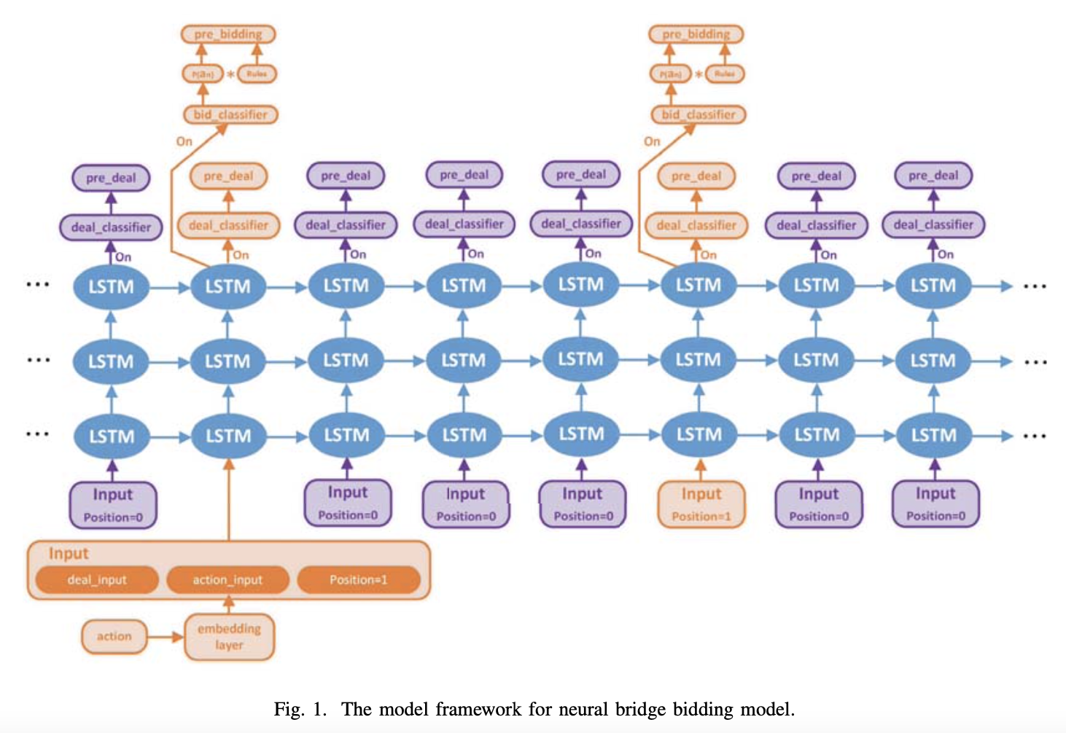
RNN and LSTM
input
hidden layer
output
memory
Recurrent Neural Network (RNN)
The hidden layer’s output can be
stored in memory, which can be
used as one of the inputs of the
hidden layer in next step.
Long Short-Term Memory (LSTM)
input gate
output gate
forget gate

Slide 5
Experiment
data
Snyrey Platform
Convention: 2 over 1 (CCBA version).
Each datum has bidding sequence and double dummy result.
Nearly 700,000 data, 70% training, 20% validation, 10% testing.
model’s input
Own hand, previous bidding action, check rule, vulnerability, and position.
model’s output
prediction of hand distribution of all players
bidding action

Slide 6
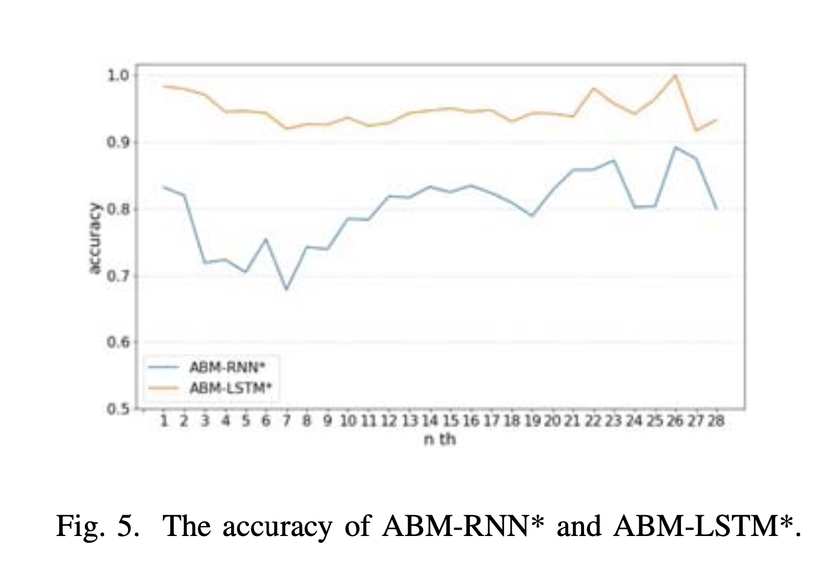
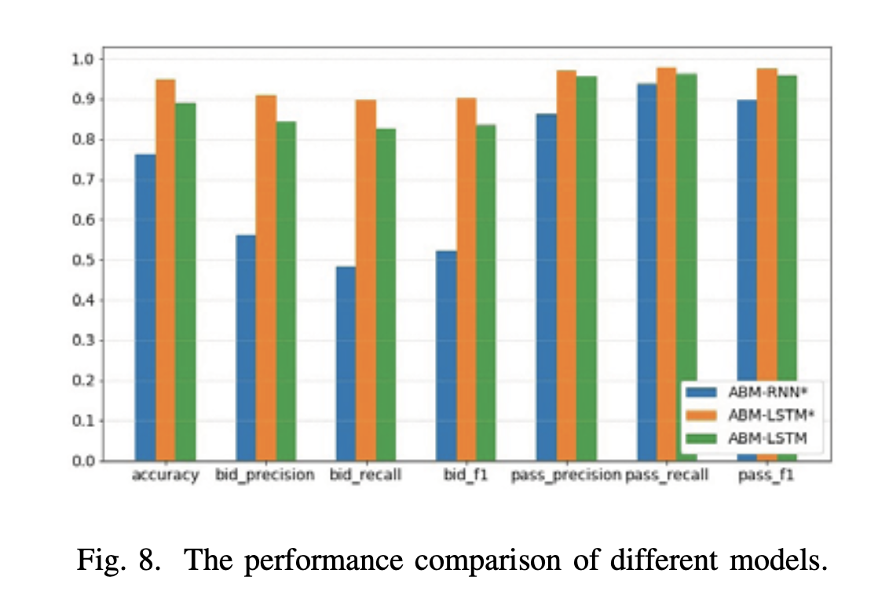
Result

Slide 7
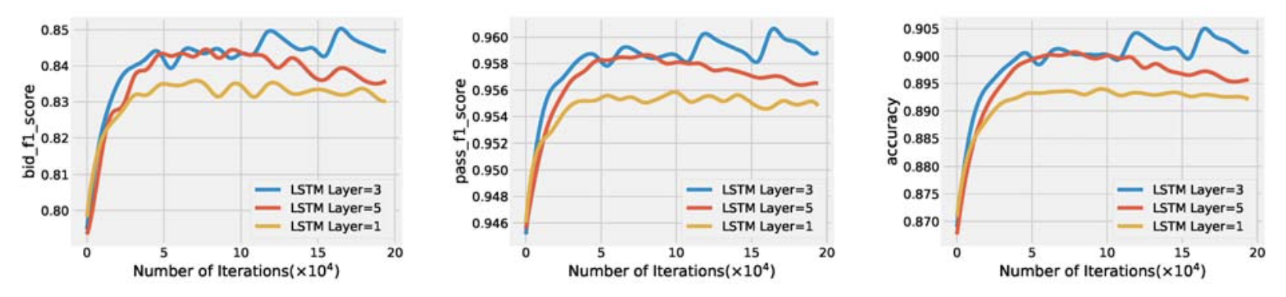
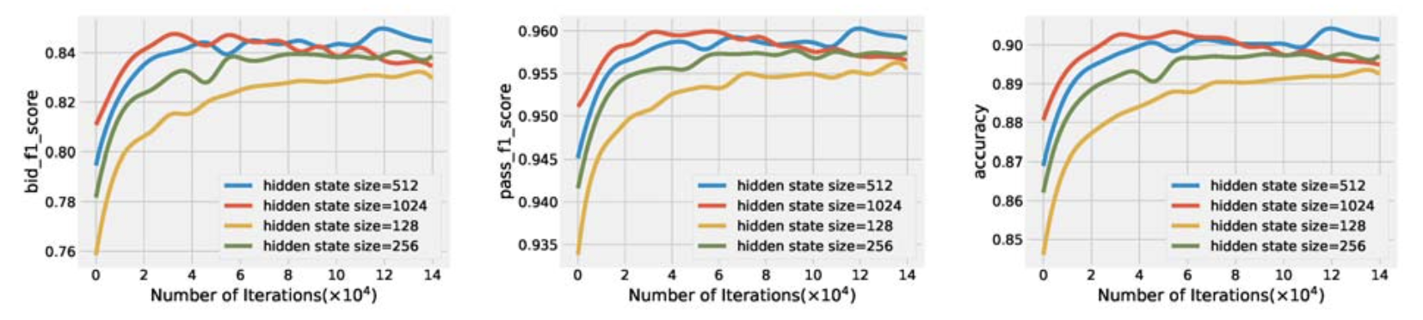
Result

Slide 8
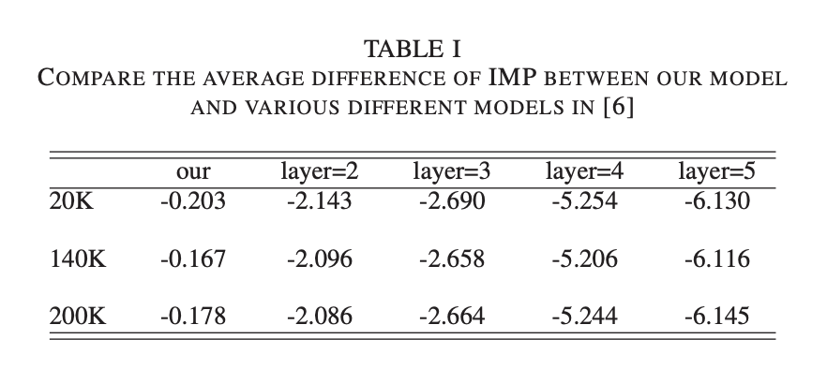
Result
Compare with the result in “Automatic Bridge Bidding Using Deep Reinforcement Learning, Yeh, Hsieh, and Lin, 2018”.

