Slide 1
A Fast and Memory Efficient MLCS Algorithm by Character Merging for DNA Sequences Alignment
Sen Liu, Yuping Wang, Wuning Tong and Shiwei Wei
Bioinformatics
Volume 36, Issue 4, February 2020, Pages 1066–1073
Presenter: Chien-Ting Lee
Date: Jan. 31, 2023
Notes:
劉森 王宇平 童武寧 衛世偉

Slide 2
Abstract
Motivation: Multiple Longest Common Subsequence (MLCS) problem is searching all longest common subsequences of multiple character sequences. It appears in many fields such as data mining, DNA alignment, bioinformatics, text editing and so on. With the increasing of sequence length and number of sequences, the existing dynamic programming algorithms and the dominant point based algorithms become ineffective and inefficient, especially for large-scale MLCS problems.

Slide 3
Abstract
Results: In this paper, by considering the characteristics of DNA sequences with many consecutively repeated characters, we first design a character merging scheme which merges the consecutively repeated characters in the sequences. As a result, it shortens the length of sequences considered and saves the space of storing all sequences. To further reduce the space and time costs, we construct a Weighted Directed Acyclic Graph (WDAG) which is much smaller than widely used DAG for MLCS problems.

Slide 4
Abstract
Based on these techniques, we propose a fast and memory efficient algorithm for MLCS problems. Finally, the experiments are conducted and the proposed algorithm is compared with several state-of-the art algorithms. The experimental results show that the proposed algorithm performs better than the compared state-of-the art algorithms in both time and space costs.

Slide 5
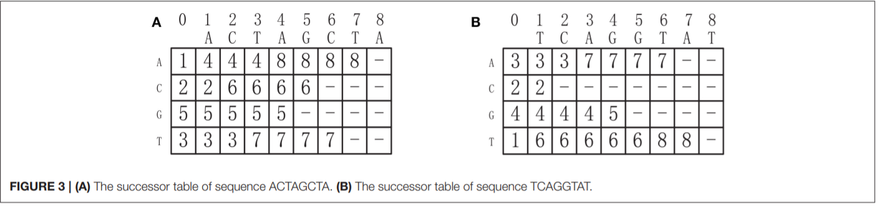
Successor Table
Notes:
下一個字母出現的位置

Slide 6
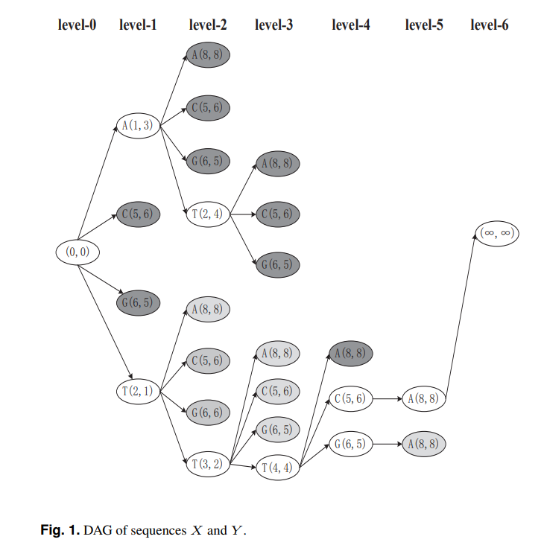
Notes:
枚舉所有點可能的 共同子序列 再利用dominant point的方法

Slide 7
S1=ATTTCGGA => S’1= ATCGA
S2=TTATGCCA => S’2= TATGCA
 | 1 | 2 | 3 | 4 | 5 | 6
S’1 | 1(A) | 3(T) | 1(C) | 2(G) | 1(A)
S’2 | 2(T) | 1(A) | 1(T) | 1(G) | 2(C) | 1(A)

Slide 8

A(5,6)
A(1,2)
T(2,3)
T($∞$,$∞$)
C(3,5)
0,0
G(4,4)
A(5,2)
T(2,1)

Slide 9
5,4
A(5,6)
1,1
6,1
A(1,2)
T(2,3)
T($∞$,$∞$)
2,4
C(3,5)
0,0
3,4
G(4,4)
7,1
A(5,2)
4,1
T(2,1)

Slide 10
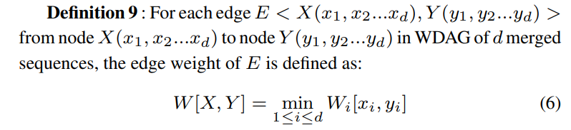
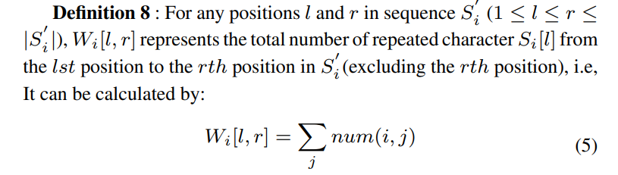

Slide 11
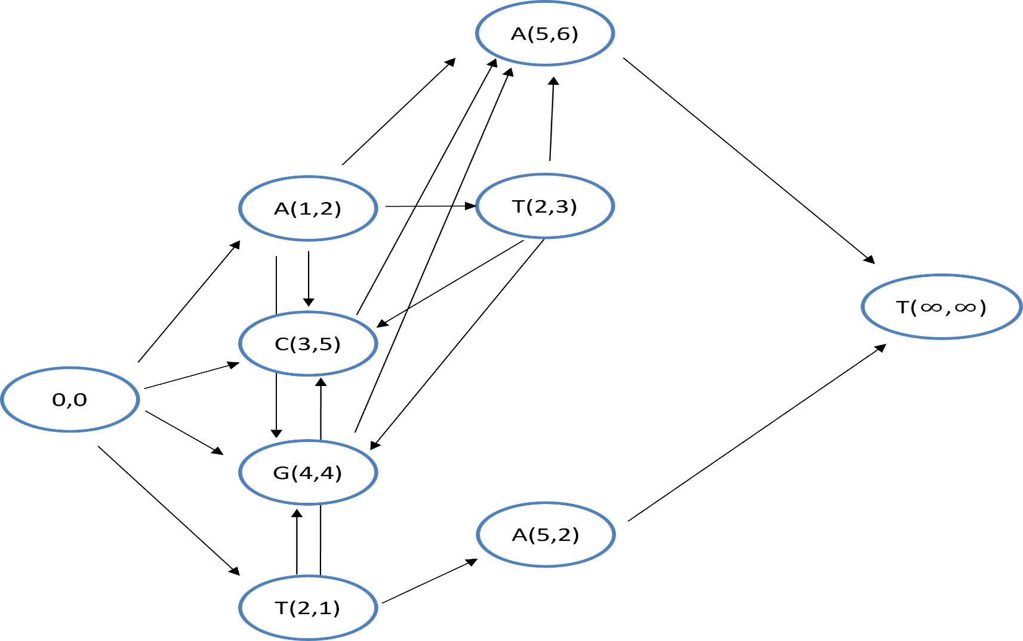
S1=ATTTCGGA => S’1= ATCGA
S2=TTATGCCA => S’2= TATGCA
 | 1 | 2 | 3 | 4 | 5 | 6
S’1 | 1(A) | 3(T) | 1(C) | 2(G) | 1(A)
S’2 | 2(T) | 1(A) | 1(T) | 1(G) | 2(C) | 1(A)
2

Slide 12

A(5,6)
C(3,5)
G(4,4)
A(1,2)
A(5,6)
T(2,3)
C(3,5)
A(5,6)
C(3,5)
G(4,4)
A(5,6)
0,0
T($∞$,$∞$)
G(4,4)
A(5,2)
T(2,1)
C(3,5)
G(4,4)

Slide 13
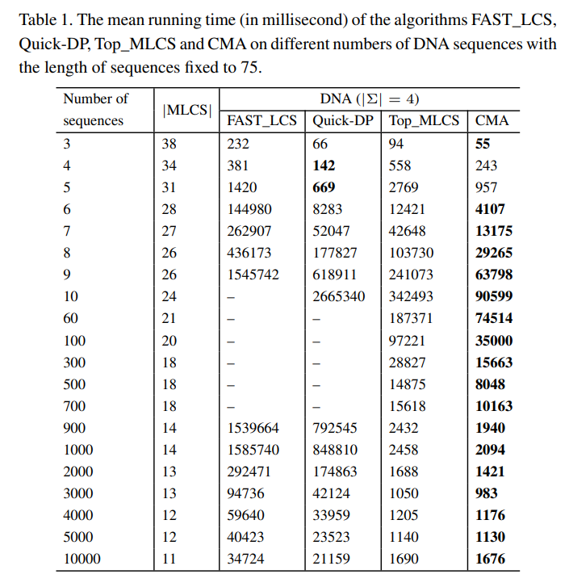
Experimental Results
Notes:
-表示超過一小時
單位是ms
Fast_LCS, Quick-DP 無法在給定時間內完成
Top_MLCS花的時間比CMA多
都是先增加後減少
這是因為對於固定長度的序列，序列數量的增加，搜索所有MLCS的代價會增加，但是當序列的數量增加到一定數量時，MLCS 的數量和長度都會減少。 這導致降低搜索 MLCS 的成本。

Slide 14
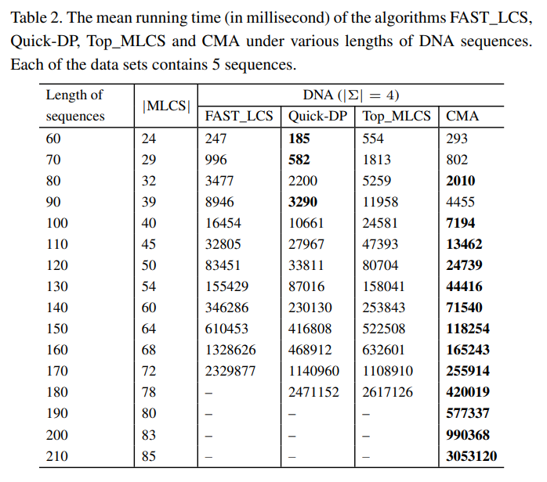
Experimental Results
Notes:
-表示超過一小時
sequence數量為5
sequence長度變更

Slide 15
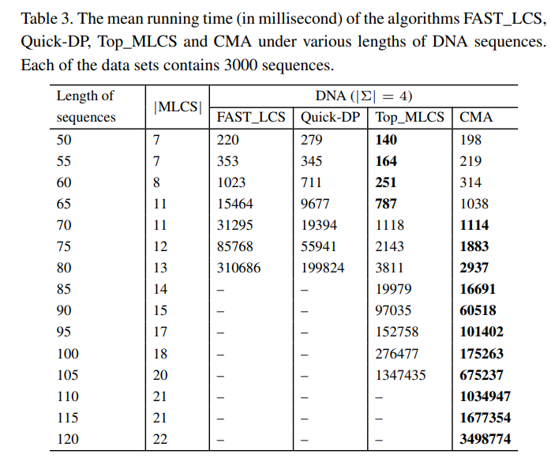
Experimental Results
Notes:
-表示超過一小時
sequence數量為3000
sequence長度變更

Slide 16
Conclusion
作者提出CMA(character merging algorithm)，
縮短序列長度，來提高效率。
序列長度大約縮短25%
實驗結果優於另外三個比較的演算法
Notes:
注意NDA 序列只有四個字符。 重複的概率當前角色和後一個也是 25%

