Slide 1
Fair budget constrained workflow scheduling approach for heterogeneous clouds
Naela Rizvi & Dharavath Ramesh
Cluster Computing, Vol. 23, pp. 3185– 3201, 2020
Presenter: Chih-Hsuan Chien​
Date: Feb. 07, 2023

Slide 2
Abstract (1/2)
The phenomenal advancement of technology paved the way for the execution of complex scientific applications. The emergence of the cloud provides a distributed heterogeneous environment for the execution of large and complex workflows. Due to the dynamic and heterogeneous nature of the cloud, scheduling workflows become a challenging problem. Mapping and assignment of heterogeneous instances for each task while minimizing execution time and cost is a NP-complete problem. For efficient scheduling, it is required to consider various QoS parameters such as time, cost, security, and reliability. Among these, computation time and cost are the two notable parameters. In order to preserve the functionalities of these two parameters in heterogeneous cloud environments, in this paper, a fair budget-constrained workflow scheduling algorithm (FBCWS) is proposed.

Slide 3
Abstract (2/2)
The novelty of the proposed algorithm is to minimize the makespan while satisfying budget constraints and a fair means of schedule for every task. FBCWS also provides a mechanism to save budget by adjusting the cost-time efficient factor of the minimization problem. The inclusion of a cost-time efficient factor in the algorithm provides flexibility to minimize the makespan or save budget. In order to validate the effectiveness of the proposed approach, several real scientific workflows are simulated, and experimental results are compared with other existing approaches, namely; Heterogeneous Budget Constrained Scheduling (HBCS), Minimizing Schedule Length using Budget Level (MSBL) and Pareto Optimal Scheduling Heuristic (POSH) algorithms.

Slide 4
Abstract (2/2)
Experimental results prove that the proposed algorithm behaves outstandingly for compute-intensive workflows such as Epigenomic and Sipht. Also, FBCWS outperforms the existing HBCS in most of the cases. Moreover, FBCWS proves to be more time-efficient than POSH and more cost-efficient than MSBL. The effectiveness of the proposed algorithm is illustrated through the popular ANOVA test.

Slide 5
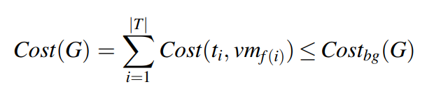
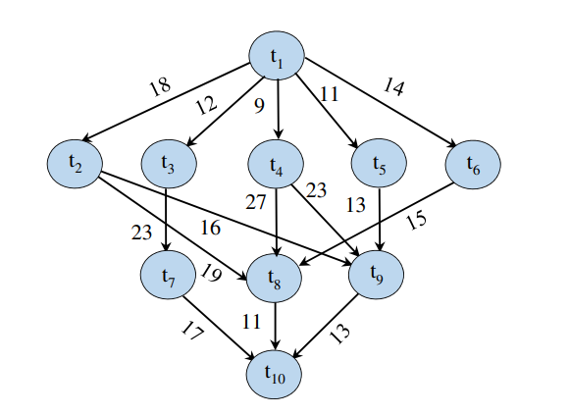

Problem definition

Slide 6
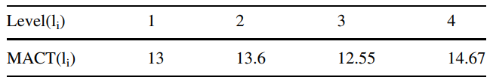
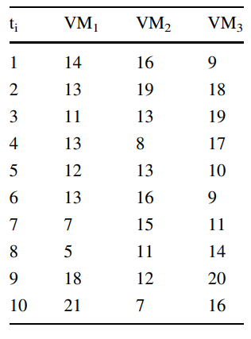

1 | 2 | 3 | 4 | 5 | 6 | 7 | 8 | 9 | 10
13 | 16.6 | 14.3 | 12.6 | 11.6 | 12.6 | 11 | 10 | 16.6 | 14.67
Notes:
之前的演算法遺漏這點

Slide 7
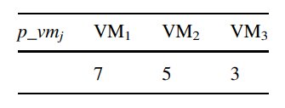
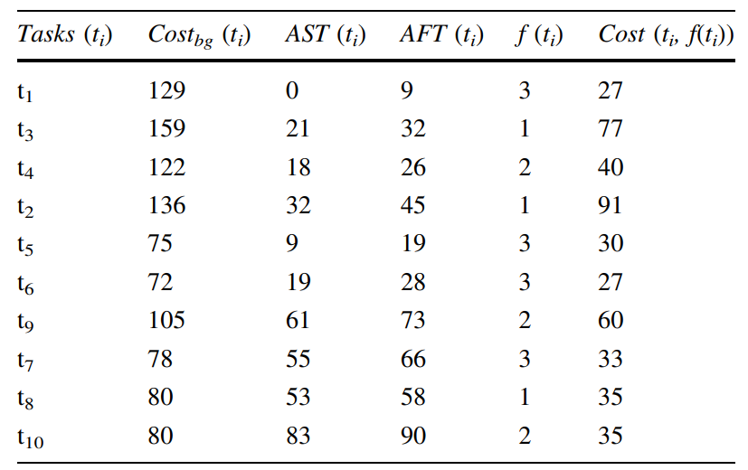


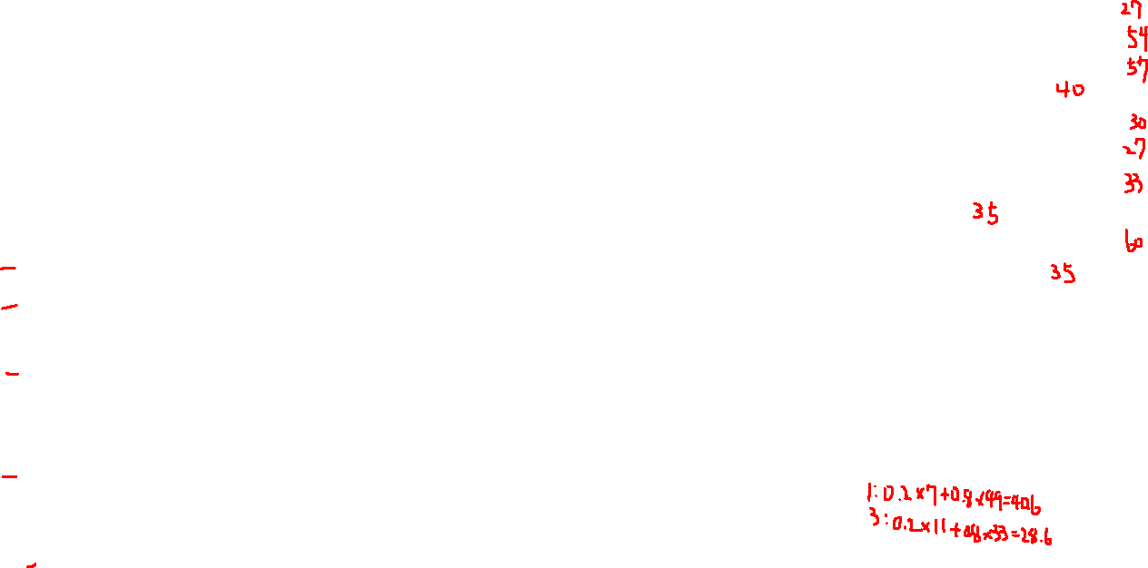






RB=500 RCB=398 B=0.2
RB | RCB | RB
500 | 371 | 473
473 | 314 | 396
396 | 274 | 356
356 | 220 | 265
265 | 190 | 235
235 | 163 | 208
208 | 103 | 148
148 | 70 | 115
115 | 35 | 80
80 | 0 | 45
Makespan=90 Cost=455
Notes:
Rcb 其他剩下的task最少要多少
Rb 剩下的錢
公式隨時可動
做完由下往上發現哪個任務需要較多錢

Slide 8

Performance evaluation

Slide 9
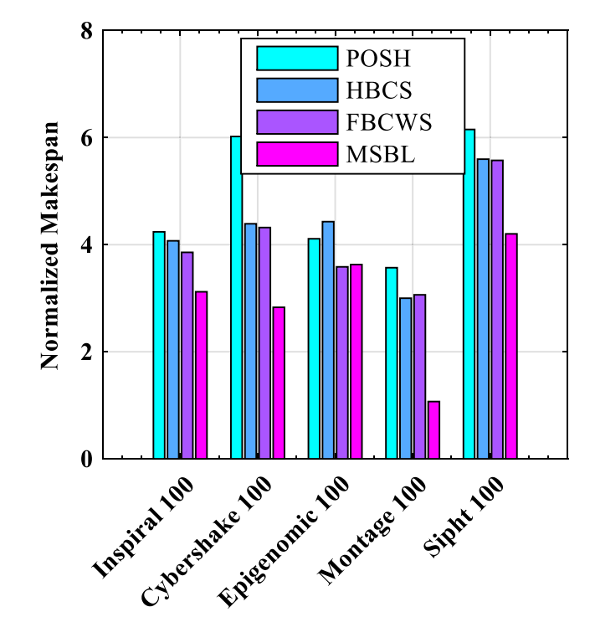
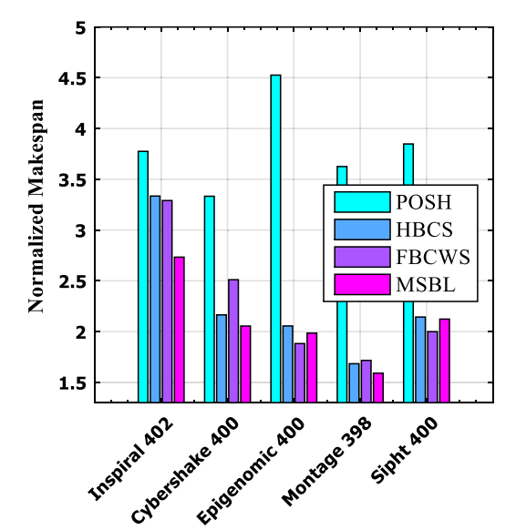
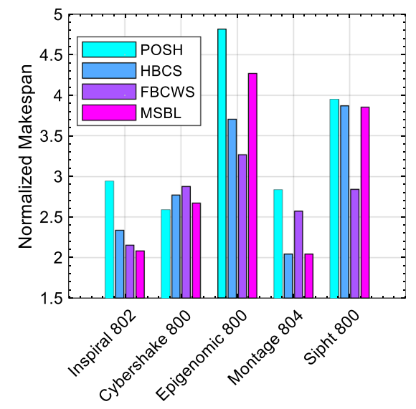
Experiment
Notes:
Compute intensive : epigenomic,sipht
Data intensive:montage,cybershake

