Slide 1
Maximal common subsequence algorithms
Yoshifumi Sakai
Theoretical Computer Science, Volume 793, November 2019, pp. 132-139
Presenter: Wen-Wen Liao
Date: Feb. 7, 2023

Slide 2
Abstract
A common subsequence of two strings is maximal if inserting any character into it no longer yields a common subsequence. The present article proposes a (sub)linearithmic-time, linear-space algorithm for finding a maximal common subsequence of two strings and a linear-time algorithm for determining if a common subsequence of two strings is maximal.

Slide 3
MCS (Maximal common subsequence)
X = aadbcbbda
Y = addababc
MCS = {adbc, adda, adbb, aa, …}
add, ad is not MCS

Slide 4
Algorithm for finding an MCS
X = eeeaeecebebcd
Y = fafffaffbddcfa
W = ε (empty sequence)

Slide 5
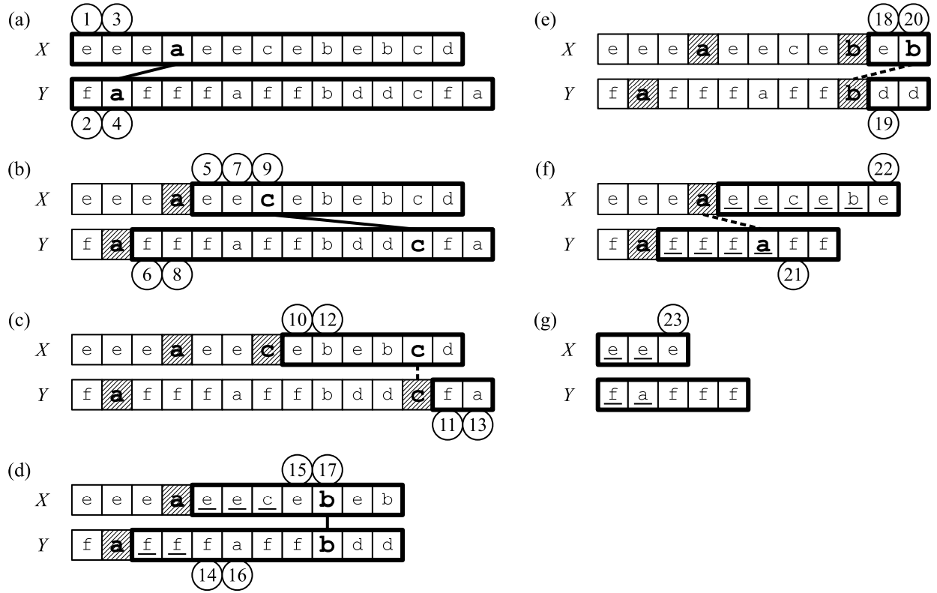
Algorithm for finding an MCS
W = ε
a = X[4] = Y[2] =>W = a
W = a
c = X[7] = Y[12] =>W = ac

Slide 6
Algorithm for finding an MCS
W = ac
X[8, 13] and Y[13, 14] are disjoint
c is the last element of the output
|X| = 11, |Y| = 11, W = a
b = X[9] = Y[9] =>W = ab
check in stage(b)

Slide 7
Algorithm for finding an MCS
W = a
X[10, 11] and Y[10, 11] are disjoint
b is the second last element of the output
|X| = 10, |Y| = 8, W = a
X[5, 10] and Y[3, 8] are disjoint
a is the third last element of the output
|X| = 3, |Y| = 4, W = ε
X[1, 3] and Y[1, 5] are disjoint
obtain output =>MCS = abc

Slide 8
Algorithm for finding a constrained MCS
initializes W to an arbitrary common subsequence, instead of ε
X = eeeaeecebebcd
Y = fafffaffbddcfa
W = ab

Slide 9

Algorithm for determining if a common subsequence is maximal
${next}_{X}\left(g, c\right)$
字母c在X中第g個index之後出現的第1個位置

Slide 10
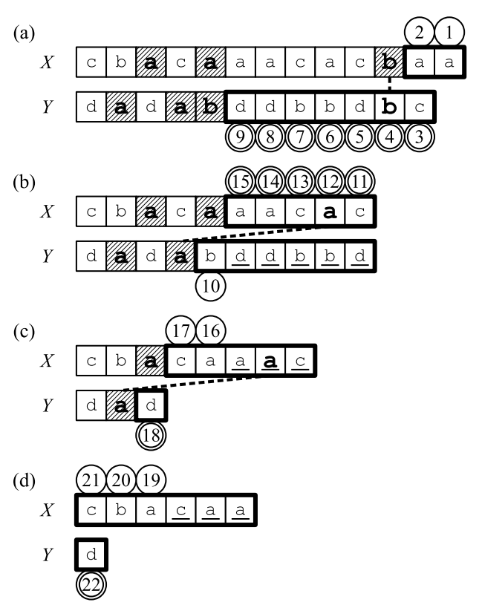
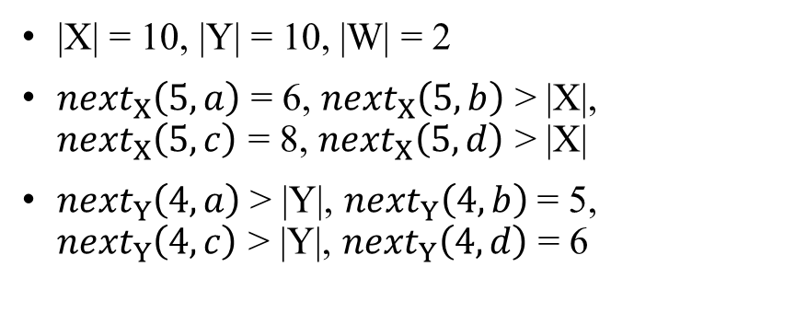
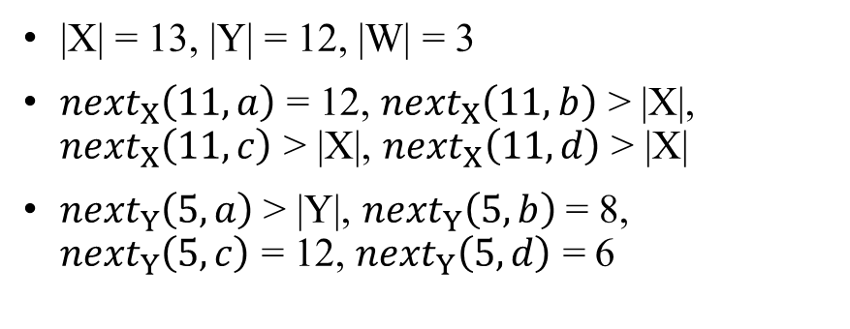
Algorithm for determining if a common subsequence is maximal
|X| = 13, |Y| = 12, |W| = 3
${next}_{X}\left(11, a\right)$ = 12, ${next}_{X}\left(11, b\right)$ > |X|, ${next}_{X}\left(11, c\right)$ > |X|, ${next}_{X}\left(11, d\right)$ > |X|
${next}_{Y}\left(5, a\right)$> |Y|, ${next}_{Y}\left(5, b\right)$ = 8, ${next}_{Y}\left(5, c\right)$ = 12, ${next}_{Y}\left(5, d\right)$ = 6
|X| = 10, |Y| = 10, |W| = 2
${next}_{X}\left(5, a\right)$ = 6, ${next}_{X}\left(5, b\right)$ > |X|, ${next}_{X}\left(5, c\right)$ = 8, ${next}_{X}\left(5, d\right)$ > |X|
${next}_{Y}\left(4, a\right)$> |Y|, ${next}_{Y}\left(4, b\right)$ = 5, ${next}_{Y}\left(4, c\right)$ > |Y|, ${next}_{Y}\left(4, d\right)$ = 6

Slide 11
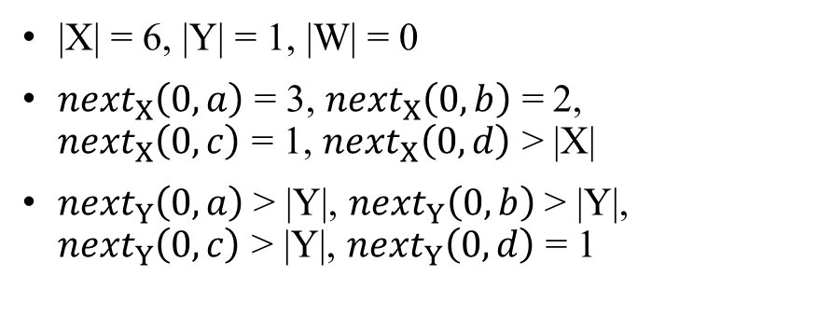
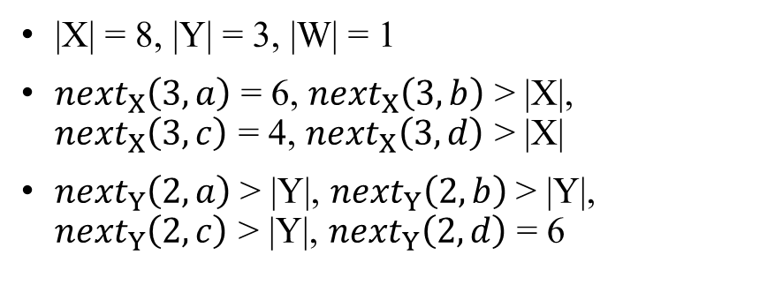
Algorithm for determining if a common subsequence is maximal
|X| = 8, |Y| = 3, |W| = 1
${next}_{X}\left(3, a\right)$ = 6, ${next}_{X}\left(3, b\right)$ > |X|, ${next}_{X}\left(3, c\right)$ = 4, ${next}_{X}\left(3, d\right)$ > |X|
${next}_{Y}\left(2, a\right)$> |Y|, ${next}_{Y}\left(2, b\right)$ > |Y|, ${next}_{Y}\left(2, c\right)$ > |Y|, ${next}_{Y}\left(2, d\right)$ = 6
|X| = 6, |Y| = 1, |W| = 0
${next}_{X}\left(0, a\right)$ = 3, ${next}_{X}\left(0, b\right)$ = 2, ${next}_{X}\left(0, c\right)$ = 1, ${next}_{X}\left(0, d\right)$ > |X|
${next}_{Y}\left(0, a\right)$> |Y|, ${next}_{Y}\left(0, b\right)$ > |Y|, ${next}_{Y}\left(0, c\right)$ > |Y|, ${next}_{Y}\left(0, d\right)$ = 1

Slide 12
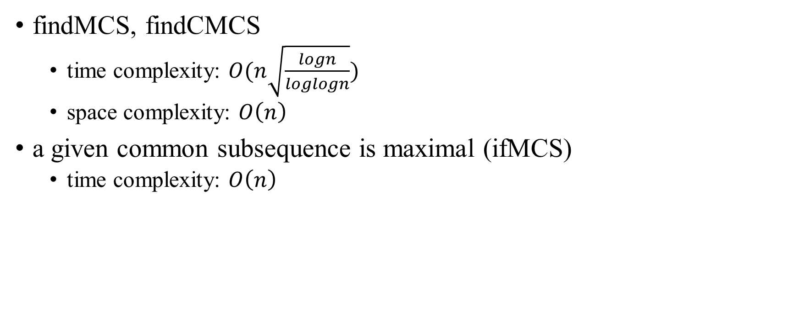
Conclusion
findMCS, findCMCS
time complexity: $O(n\sqrt{\frac{logn}{loglogn}})$
space complexity: $O\left(n\right)$
a given common subsequence is maximal (ifMCS)
time complexity: $O\left(n\right)$

