Slide 1
A scheduling algorithm using sub-deadline for workflow applications under budget and deadline constrained
Ting Sun, Chuangbai Xiao and Xiujie Xu
Cluster Computing, Vol. 22, pp. 5987–5996, 2019
Presenter: Chih-Hsuan Chien​
Date: Mar. 20, 2023

Slide 2
Abstract (1/2)
With the development of the cloud and grid computing, the cloud infrastructures and grids provide a platform for workflow applications. It is very essential to meet the requirements of users and to complete workflow scheduling efficiently. The scheduling of the workflow is limited by quality of service (QoS) parameters. Many scheduling algorithms have been proposed for the execution of workflow applications using QoS parameters. In this study, we improved a scheduling algorithm that considers workflow applications under budget and deadline constraints. This algorithm provided a simple way to deal with the deadline and budget constraints. The algorithm was named BDSD and used to find a scheduling that satisfies of deadline and budget constraints required by a user.

Slide 3
Abstract (2/2)
The planning success rate (PSR) was utilized to show the effectiveness of the proposed algorithm. For the simulation experiment, random and real workflow applications were exploited. Experimental results showed that compared with other algorithms the algorithm had a higher PSR.

Slide 4
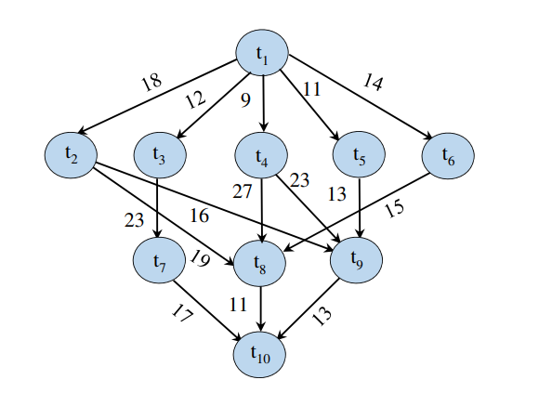
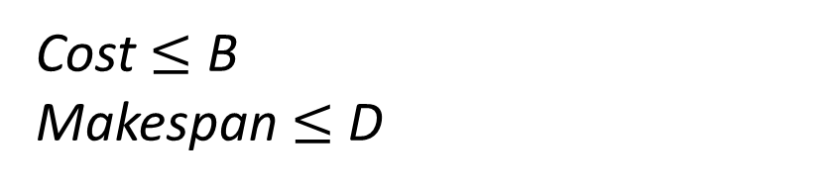
Problem definition
Cost $≤$ B
Makespan $≤$ D

Slide 5
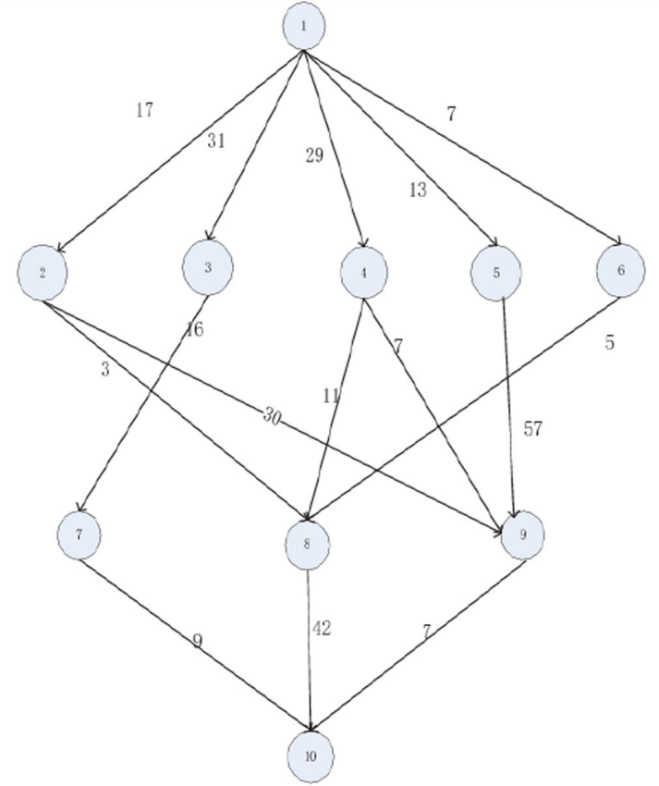
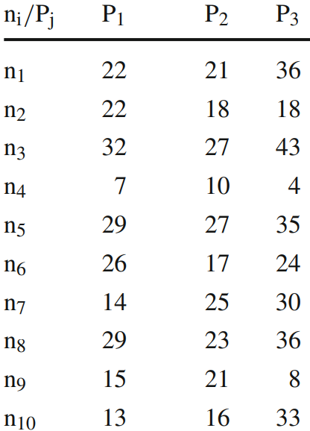
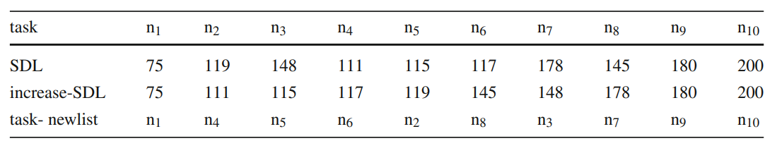
Task sorting

Slide 6
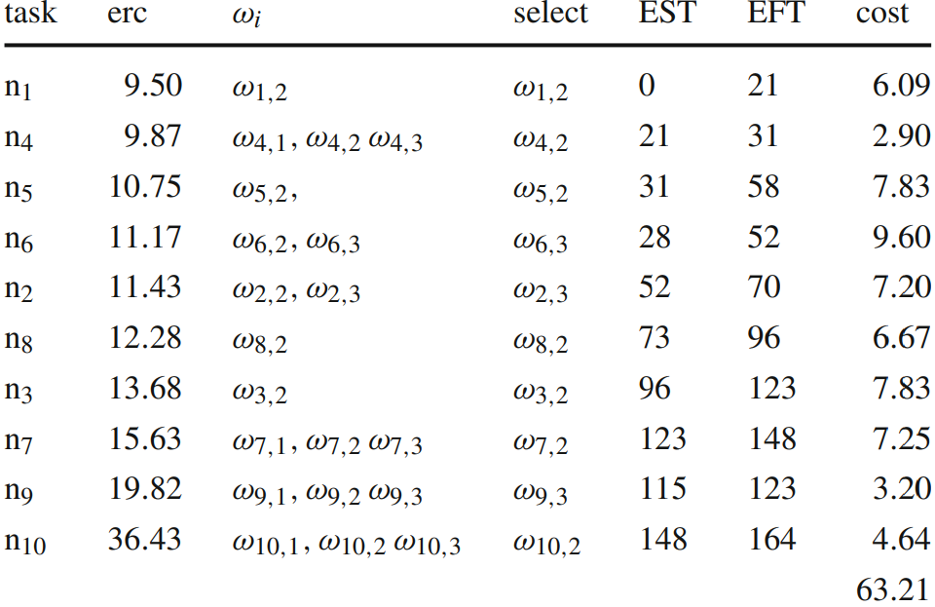
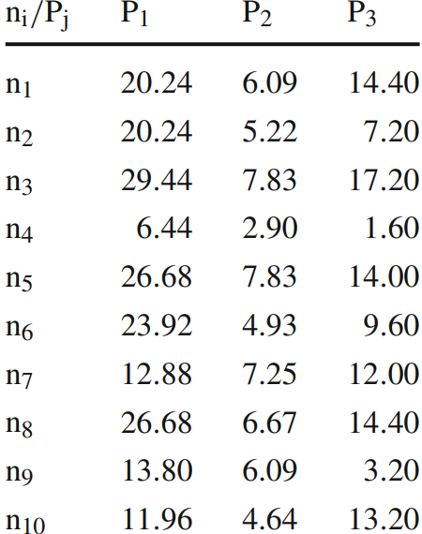
B=95
D=200

Slide 7



Experiment

Slide 8
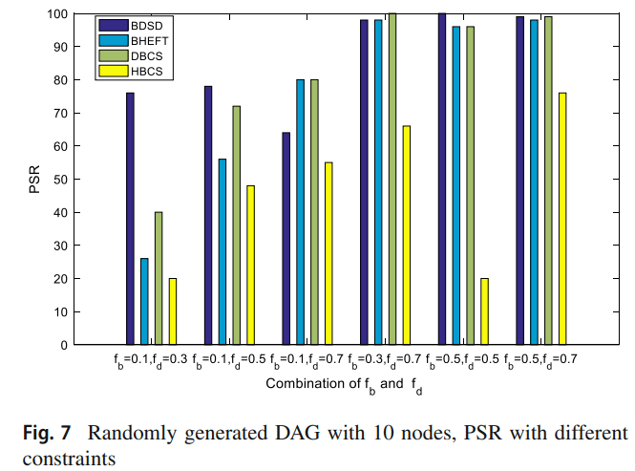
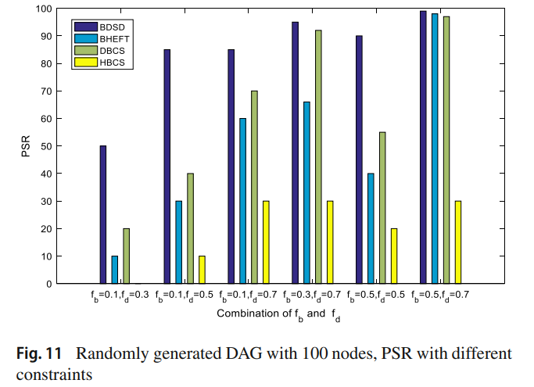
Experiment

