Slide 1
Competitive Bridge Bidding with Deep Neural Networks
Jiang Rong, Tao Qin, Bo An, arXiv, 2019
Presenter: Yu-Yen Chu
Date: Mar. 20, 2023

Slide 2
Abstract
The game of bridge consists of two stages: bidding and playing. While playing is proved to be relatively easy for computer programs, bidding is very challenging. During the bidding stage, each player knowing only his/her own cards needs to exchange information with his/her partner and interfere with opponents at the same time. Existing methods for solving perfect-information games cannot be directly applied to bidding. Most bridge programs are based on human-designed rules, which, however, cannot cover all situations and are usually ambiguous and even conflicting with each other.

Slide 3
Abstract (Cont.)
In this paper, we, for the first time, propose a competitive bidding system based on deep learning techniques, which exhibits two novelties. First, we design a compact representation to encode the private and public information available to a player for bidding. Second, based on the analysis of the impact of other players’ unknown cards on one’s final rewards, we design two neural networks to deal with imperfect information, the first one inferring the cards of the partner and the second one taking the outputs of the first one as part of its input to select a bid. Experimental results show that our bidding system outperforms the top rule-based program.

Slide 4
Problem Setup
Train a bridge bidding model (with competition).
Supervised Learning
ENN(estimation neural network): estimating partner’s hand.
Output: all cards’ probability distribution.
PNN(policy neural network): choosing an auction to bid.
Both take own hand and historical bidding sequence as input.
PNN takes ENN’s output as input.
Reinforcement Learning
Using the score of Double Dummy Analysis as reward.

Slide 5
Experiment
dataset
1,000,000 data with bidding sequence and double dummy result played by expert, noted as expert data.
12,000,000 instances (generated from expert data) to train ENN & PNN.
70% training, 10% validation, 20% testing.
ENN
8 layers, each hidden layer has 1500 neurons.
accuracy: 13 cards with highest probability compared with real partner’s hand.
PNN
10 layers, each hidden layer has 1200 neurons.
accuracy: all auctions compared with real bidding sequence.

Slide 6
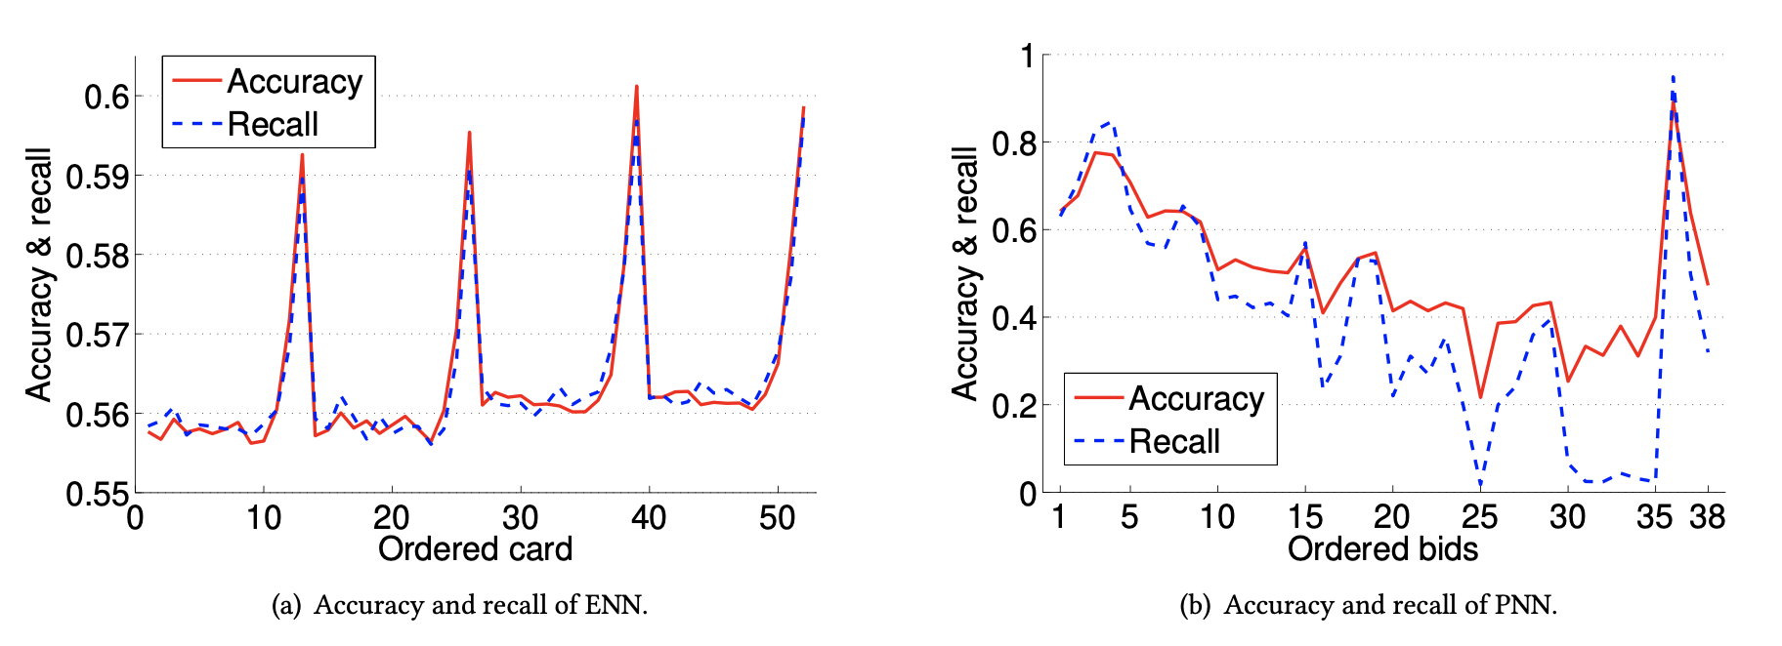

Slide 7
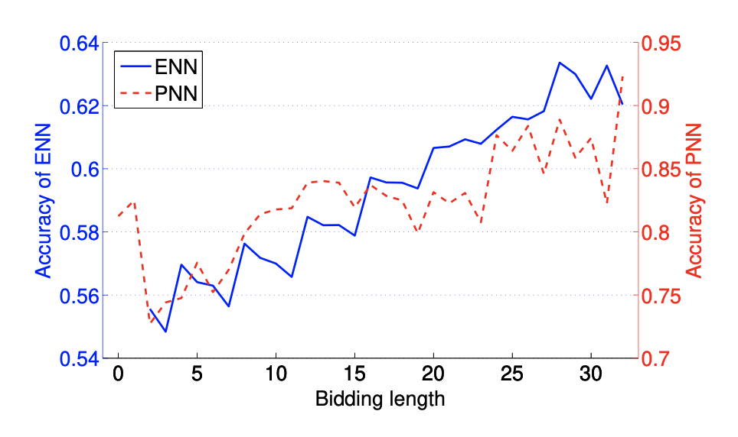
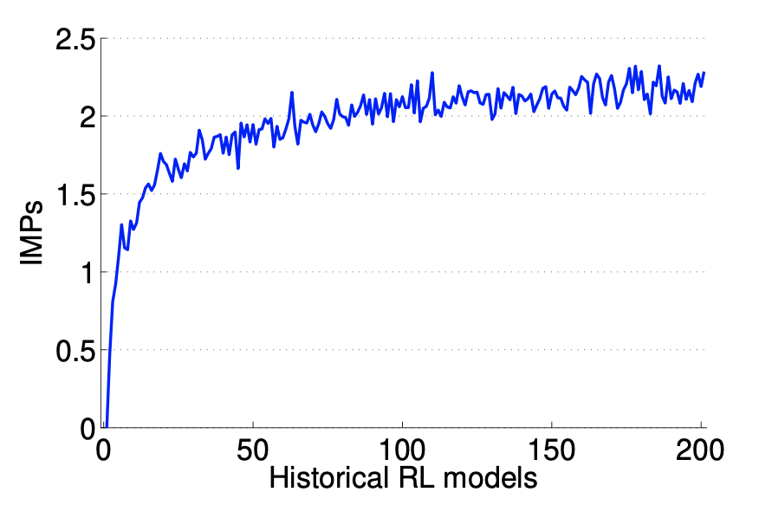

Slide 8
