Slide 1
Shape-Preserving Pattern Matching
Domenico Cantone, Simone Faro and M.Oguzhan Külekci, 21st Italian Conference on Theoretical Computer Science, 14-16 September 2020, Ischia, Italy
Presenter: Wen-Wen Liao
Date: May. 2, 2023

Slide 2
Abstract
Two sequences of integers x and z of the same length m ≥ 2 are shape-isomorphic if, up to a positive proportional factor, the sequences of the distances between consecutive elements of x and z are the same, i.e., if for some ρ > 0 one has x[i + 1] − x[i] = ρ(z[i + 1] − z[i]), for each 1 ≤ i ≤ m − 1. In this paper we present two linear-time algorithms which, given a text y and a pattern x over an integer alphabet, finds all the factors of y that are shape-isomorphic to x. Our first solution is a two steps algorithm based on a reduction to the standard exact string matching problem, while our second solution is an online algorithm based on the well-known Knuth-Morris-Pratt string matching algorithm. We call this problem shape-preserving pattern-matching problem.

Slide 3
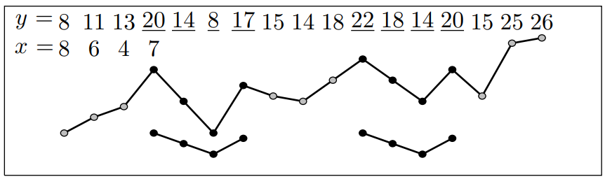
Shape-Preserving Pattern Matching
Finer than order-isomorphism.
Proportionality factors is 3 and 2, respectively.
6 6 9
4 4 6
2 2 3

Slide 4

Reducing SPPM to Exact Pattern Matching
y = 14 18 15 18 12 21 15 25 26
x = 6 8 4 10 6
find k to separate $x_{1}$ and $x_{2}$, $k=max⁡(\left\{j: j>0 and x\left[j\right]≠x\left[j+1\right]\right\}∪\left\{0\right\})$
k = 4
$x_{1}$ = 6 8 4 10 => prefix
$x_{2}$ = 10 6 => suffix

Slide 5

Reducing SPPM to Exact Pattern Matching
Delta function: for $1≤i≤m−1, δ\left(x\right)\left[i\right]≔x\left[i+1\right]−x\left[i\right]$
Last Non-Zero Function: for $1≤i≤m−1, γ\left(x\right)\left[i\right]≔x\left[j\right] where j=max⁡(\{1≤h<i+1:x[h]≠0\}∪\{0\})$
Ratios Function: for $1≤i≤m−1, ψ\left(x\right)\left[i\right]≔\frac{x[i+1]}{γ\left(x\right)[i]}$

Slide 6

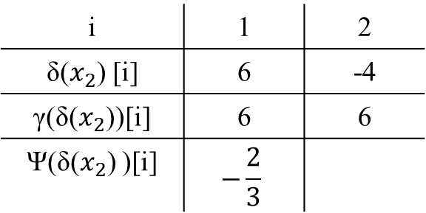
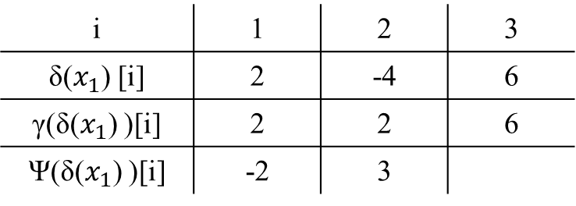
Reducing SPPM to Exact Pattern Matching
y = 14 18 15 18 12 21 15 25 26
x = 6 8 4 10 6
$x_{1}$ = 6 8 4 10
$x_{2}$ = 10 6
i | 1 | 2 | 3
δ($x_{1}$) [i] | 2 | -4 | 6
γ(δ($x_{1}$) )[i] | 2 | 2 | 6
Ψ(δ($x_{1}$) )[i] | -2 | 3
i | 1 | 2
δ($x_{2}$) [i] | 6 | -4
γ(δ($x_{2}$))[i] | 6 | 6
Ψ(δ($x_{2}$) )[i] | $$−\frac{2}{3}$$

Slide 7

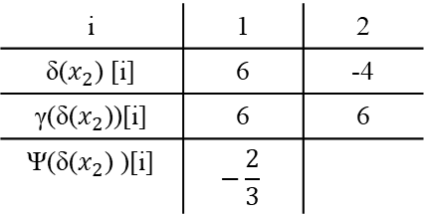
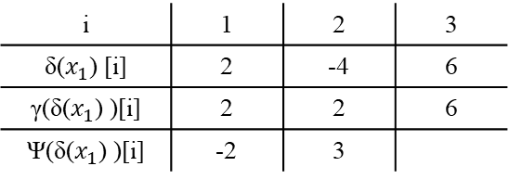
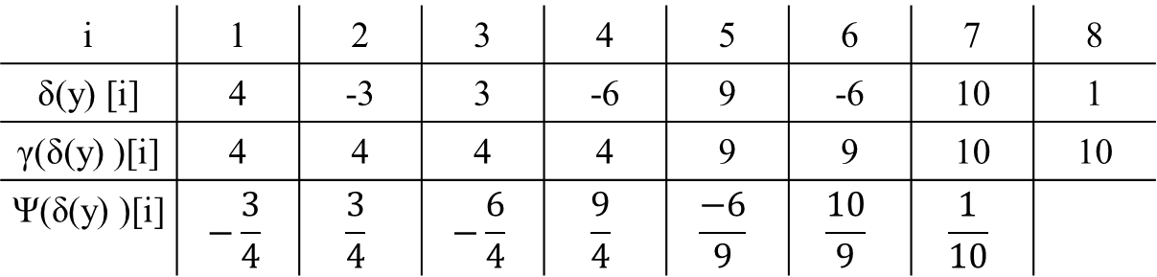
Reducing SPPM to Exact Pattern Matching
y = 14 18 15 18 12 21 15 25 26
x = 6 8 4 10 6
$Г_{1}$ = occurrences of δ($x_{1}$) in δ($y$)
$Г_{2}$ = occurrences of ψδ(($x_{2}$)) in δ($y$)
i | 1 | 2 | 3
δ($x_{1}$) [i] | 2 | -4 | 6
γ(δ($x_{1}$) )[i] | 2 | 2 | 6
Ψ(δ($x_{1}$) )[i] | -2 | 3
i | 1 | 2
δ($x_{2}$) [i] | 6 | -4
γ(δ($x_{2}$))[i] | 6 | 6
Ψ(δ($x_{2}$) )[i] | $$−\frac{2}{3}$$
i | 1 | 2 | 3 | 4 | 5 | 6 | 7 | 8
δ(y) [i] | 4 | -3 | 3 | -6 | 9 | -6 | 10 | 1
γ(δ(y) )[i] | 4 | 4 | 4 | 4 | 9 | 9 | 10 | 10
Ψ(δ(y) )[i] | $$−\frac{3}{4}$$ | $$\frac{3}{4}$$ | $$−\frac{6}{4}$$ | $$\frac{9}{4}$$ | $$\frac{−6}{9}$$ | $$\frac{10}{9}$$ | $$\frac{1}{10}$$

Slide 8

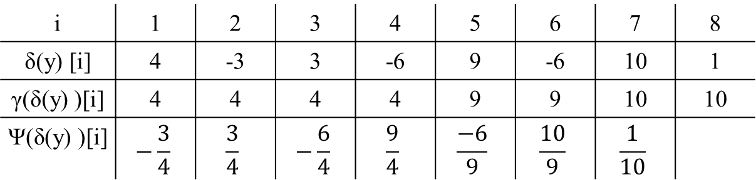
Reducing SPPM to Exact Pattern Matching
y = 14 18 15 18 12 21 15 25 26
x = 6 8 4 10 6
$Г$ = {$i−k+2:i∈Г_{2} and \left(i−k+2\right)∈Г_{1}and δ\left(x\right)\left[1\right]×δ\left(y\left[i\right]\right)>0$}
=> i = 3
i | 1 | 2 | 3 | 4 | 5 | 6 | 7 | 8
δ(y) [i] | 4 | -3 | 3 | -6 | 9 | -6 | 10 | 1
γ(δ(y) )[i] | 4 | 4 | 4 | 4 | 9 | 9 | 10 | 10
Ψ(δ(y) )[i] | $$−\frac{3}{4}$$ | $$\frac{3}{4}$$ | $$−\frac{6}{4}$$ | $$\frac{9}{4}$$ | $$\frac{−6}{9}$$ | $$\frac{10}{9}$$ | $$\frac{1}{10}$$

Slide 9
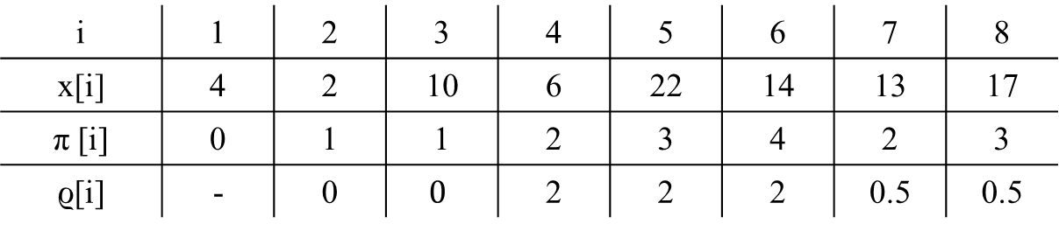
A KMP based Algorithm for the SPPM Problem
x = 4 2 10 6 22 14 13 17
shape-border table
i | 1 | 2 | 3 | 4 | 5 | 6 | 7 | 8
x[i] | 4 | 2 | 10 | 6 | 22 | 14 | 13 | 17
π [i] | 0 | 1 | 1 | 2 | 3 | 4 | 2 | 3
ϱ[i] | - | 0 | $$0$$ | 2 | 2 | 2 | 0.5 | 0.5
-2 -4

Slide 10
A KMP based Algorithm for the SPPM Problem
x = 4 2 10 6 22 14 13 17
shape-border table
i | 1 | 2 | 3 | 4 | 5 | 6 | 7 | 8
x[i] | 4 | 2 | 10 | 6 | 22 | 14 | 13 | 17
π [i] | 0 | 1 | 1 | 2 | 3 | 4 | 2 | 3
ϱ[i] | - | 0 | $$0$$ | 2 | 2 | 2 | 0.5 | 0.5
8 16

Slide 11
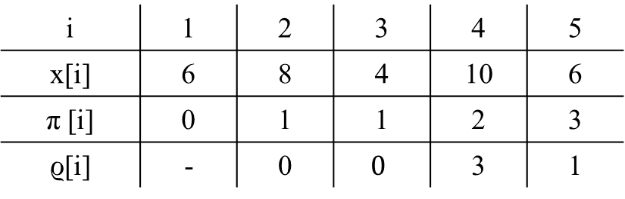
A KMP based Algorithm for the SPPM Problem
y = 14 18 15 18 12 21 15 25 26
x = 6 8 4 10 6
i | 1 | 2 | 3 | 4 | 5
x[i] | 6 | 8 | 4 | 10 | 6
π [i] | 0 | 1 | 1 | 2 | 3
ϱ[i] | - | 0 | $$0$$ | 3 | 1

Slide 12
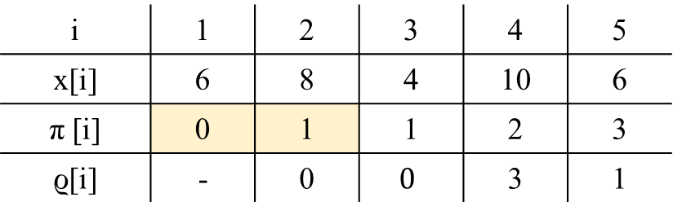
A KMP based Algorithm for the SPPM Problem
i | 1 | 2 | 3 | 4 | 5
x[i] | 6 | 8 | 4 | 10 | 6
π [i] | 0 | 1 | 1 | 2 | 3
ϱ[i] | - | 0 | $$0$$ | 3 | 1
y = 14 18 15 18 12 21 15 25 26
x = 6 8 4 10 6
14 | 18 | 15 | 18 | 12 | 21 | 15 | 25 | 26
6 | 8 | 4 | 10 | 6
重複1個
匹配上2個 π[2] = 1
表示重複1個 跳過2-1=1步
6 | 8 | 4 | 10 | 6
跳過1步
重複0個
匹配上1個 π[1] = 0
表示重複0個 跳過1-0=1步
6 | 8 | 4 | 10 | 6
跳過1步

Slide 13

Conclusion
Reducing SPPM to Exact Pattern Matching
Time complexity: $O(n + m)$
A KMP based Algorithm for the SPPM Problem
Time complexity: $O(n)$

