Slide 1
Algorithms for the Constrained Longest Common Subsequence Problems
Abduliah N. Arslan and Omer Egecioglu
International Journal of Foundations of Computer Science
Vol. 16, No. 6, 2005, 1099-1109
Presenter：Siang-Huai Hung
Date：2016/09/13

Slide 2
Abstract
Given string S₁, S₂, and P, the constrained longest common subsequence problem for S₁ and S₂ with respect to P is to find a longest common subsequence lcs of S₁ and S₂ which contains P as a subsequence. We present an algorithm which improves the time complexity of the problems from the previously known
O(rn²m²) to O(rnm) where r, n, and m are the lengths of P, S₁, and S₂, respectively. As a generalization of this, we extend the definition of the problem so that the lcs sought contains a subsequence whose edit distance from P is less than a given parameter d. For the latter problem, we propose an algorithm whose time complexity is O(drnm).

Slide 3
Constrained LCS
S₁ = bbaba
S₂ = abbaa
P = ab
LCS = bbaa
CLCS = aba

Slide 4
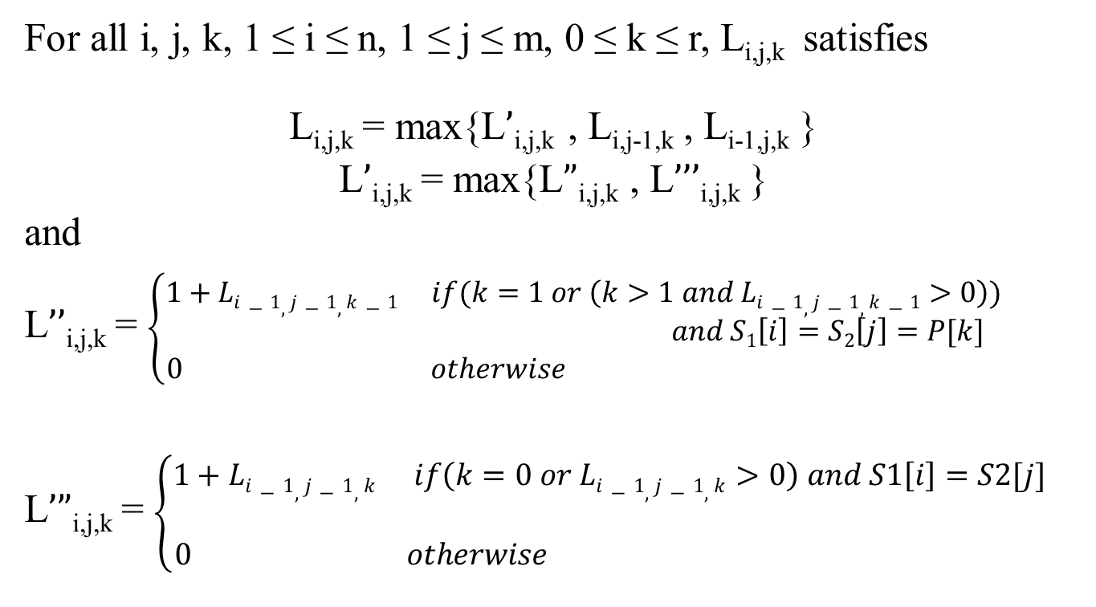
CLCS Algorithm
For all i, j, k, 1 ≤ i ≤ n, 1 ≤ j ≤ m, 0 ≤ k ≤ r, L_{i,j,k} satisfies
L_{i,j,k} = max{L’_{i,j,k} , L_{i,j-1,k} , L_{i-1,j,k} }
L’_{i,j,k} = max{L”_{i,j,k} , L’’’_{i,j,k} }
and
L’’_{i,j,k} = $\left\{\begin{aligned}1+Li−1,j−1,k−1 if(k=1 or \left(k>1 and Li−1,j−1,k−1>0\right)) \\ and S1\left[i\right]=S2\left[j\right]=P[k] \\ 0 otherwise \end{aligned}\right.$
L’”_{i,j,k} = $\left\{\begin{aligned}1+Li−1,j−1,k if\left(k=0 or Li−1,j−1,k>0\right) and S1\left[i\right]=S2[j] \\ \\ 0 otherwise \end{aligned}\right.$

Slide 5
Example
S₁ = abbaa, S₂ = bbaba, P = ab
k = 0 k = 1 k = 2
CLCS = aba
 | b | b | a | b | a
a | 0 | 0 | 1 | 1 | 1
b | 1 | 1 | 1 | 2 | 2
b | 1 | 2 | 2 | 2 | 2
a | 1 | 2 | 3 | 3 | 3
a | 1 | 2 | 3 | 3 | 4
 | b | b | a | b | a
a | 0 | 0 | 1 | 1 | 1
b | 0 | 0 | 1 | 2 | 2
b | 0 | 0 | 1 | 2 | 2
a | 0 | 0 | 3 | 3 | 3
a | 0 | 0 | 3 | 3 | 4
 | b | b | a | b | a
a | 0 | 0 | 0 | 0 | 0
b | 0 | 0 | 0 | 2 | 2
b | 0 | 0 | 0 | 2 | 2
a | 0 | 0 | 0 | 2 | 3
a | 0 | 0 | 0 | 2 | 3

Slide 6
Complexity
Time complexity: O(rnm)
Space complexity: O(rm)
Space complexity with LCS result: O(r²m)

Slide 7
Edit Distance CLCS
S₁ = bbaba
S₂ = abbaa
P = ab
edit distance = 1 (Ex. P’ = _b or P’ = aa or P’ = bab)
LCS = bbaa
CLCS = aba
CLCS with edit distance = bbaa

Slide 8
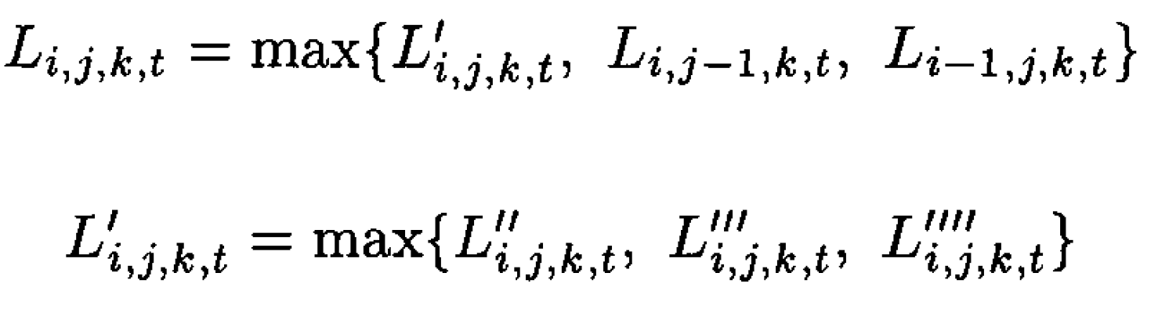
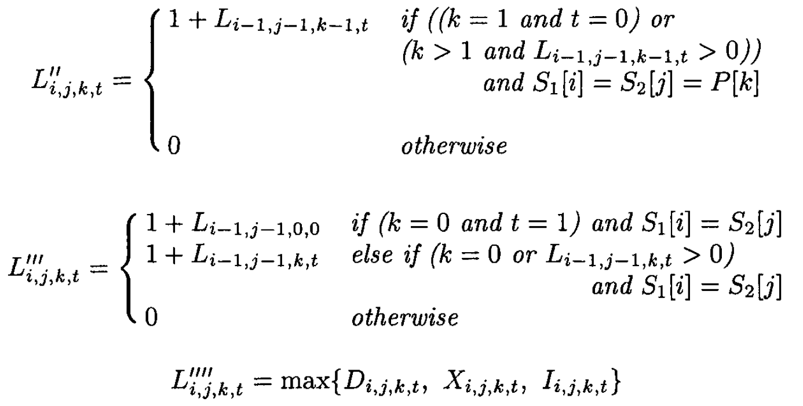
Edit Distance CLCS Algorithm(1/2)

Slide 9
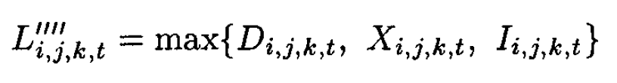
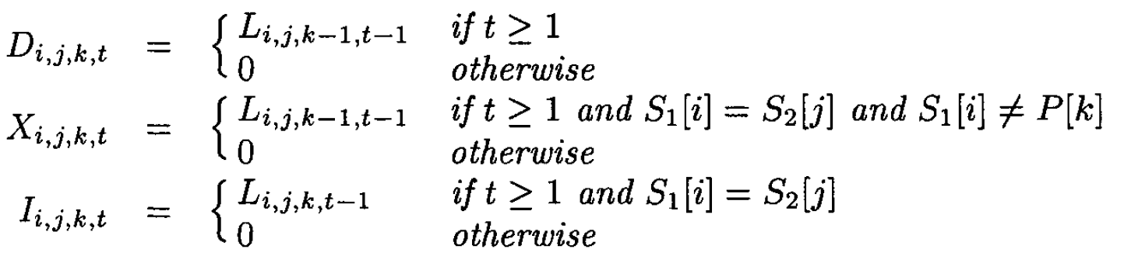
Edit Distance CLCS Algorithm(2/2)

Slide 10
Example
S₁ = abbaa, S₂ = bbaba, P = ab
k = 0, t = 0 k = 1, t = 0 k = 2, t = 0
k = 0, t = 1 k = 1, t = 1 k = 2, t = 1
 | b | b | a | B | a
a | 0 | 0 | 1 | 1 | 1
b | 1 | 1 | 1 | 2 | 2
b | 1 | 2 | 2 | 2 | 2
a | 1 | 2 | 3 | 3 | 3
a | 1 | 2 | 3 | 3 | 4
 | b | b | a | b | a
a | 0 | 0 | 1 | 1 | 1
b | 0 | 0 | 1 | 2 | 2
b | 0 | 0 | 1 | 2 | 2
a | 0 | 0 | 3 | 3 | 3
a | 0 | 0 | 3 | 3 | 4
 | b | b | a | b | a
a | 0 | 0 | 0 | 0 | 0
b | 0 | 0 | 0 | 2 | 2
b | 0 | 0 | 0 | 2 | 2
a | 0 | 0 | 0 | 2 | 3
a | 0 | 0 | 0 | 2 | 3
 | b | b | a | B | a
a | 0 | 0 | 1 | 1 | 1
b | 1 | 1 | 1 | 2 | 2
b | 1 | 2 | 2 | 2 | 2
a | 1 | 2 | 3 | 3 | 3
a | 1 | 2 | 3 | 3 | 4
 | b | b | a | b | a
a | 0 | 0 | 1 | 1 | 1
b | 1 | 1 | 1 | 2 | 2
b | 1 | 2 | 2 | 2 | 2
a | 1 | 2 | 3 | 3 | 3
a | 1 | 2 | 3 | 3 | 4
 | b | b | a | b | a
a | 0 | 0 | 1 | 1 | 1
b | 0 | 0 | 1 | 2 | 2
b | 0 | 0 | 1 | 2 | 2
a | 0 | 0 | 3 | 3 | 3
a | 0 | 0 | 3 | 3 | 4

Slide 11
Complexity
Time complexity: O(drnm)
Space complexity: O(drm)
Space complexity with LCS result: O(drnm)

Slide 12
Thanks for listening

