Slide 1
Semi-local longest common subsequences in subquadratic time
Alexander Tiskin
Journal of Discrete Algorithms, Volume 6, Issue 4, December 2008, Pages 570–581
Presenter: Bi-Shiang Lin
Date:2016/9/13

Slide 2
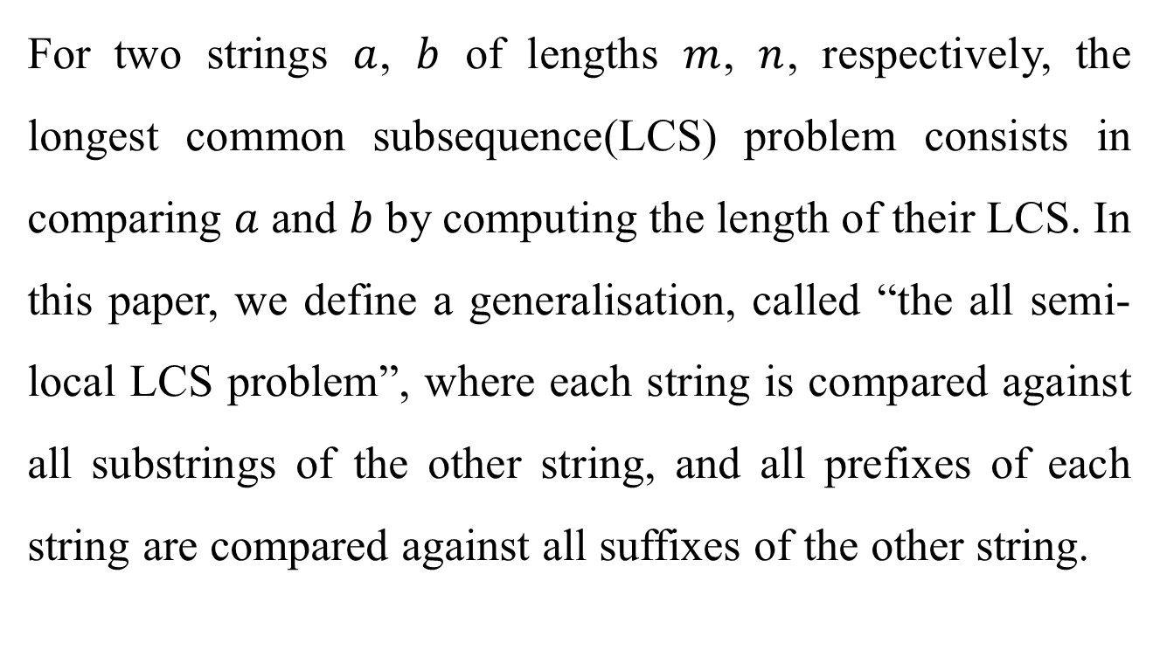
Abstract(1/3)
For two strings $a$, $b$ of lengths $m$, $n$, respectively, the longest common subsequence(LCS) problem consists in comparing $a$ and $b$ by computing the length of their LCS. In this paper, we define a generalisation, called “the all semi-local LCS problem”, where each string is compared against all substrings of the other string, and all prefixes of each string are compared against all suffixes of the other string.

Slide 3
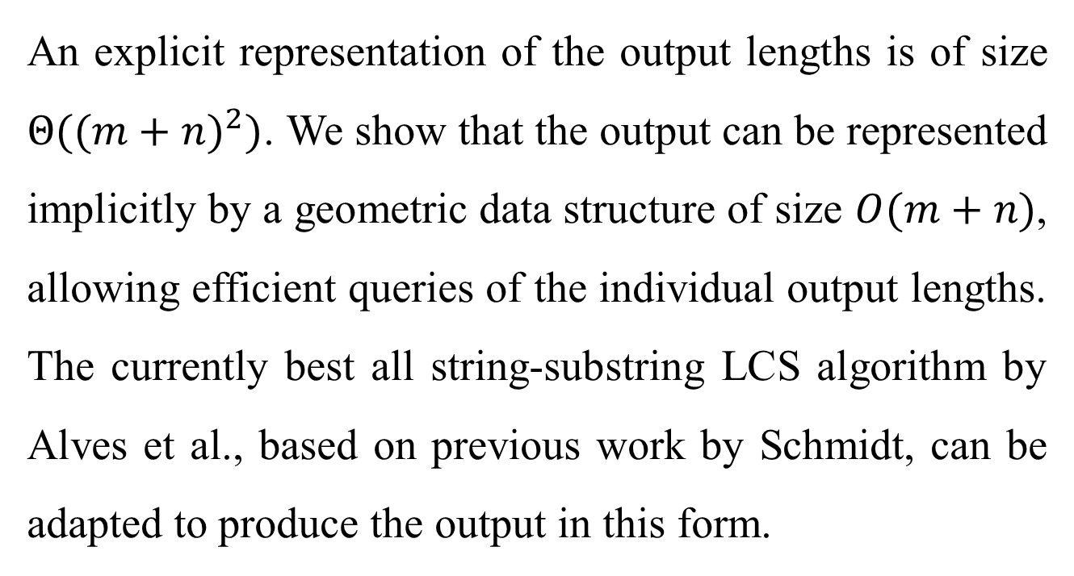
Abstract(2/3)
An explicit representation of the output lengths is of size $Θ({(m+n)}^{2})$. We show that the output can be represented implicitly by a geometric data structure of size $O(m+n)$, allowing efficient queries of the individual output lengths. The currently best all string-substring LCS algorithm by Alves et al., based on previous work by Schmidt, can be adapted to produce the output in this form.

Slide 4
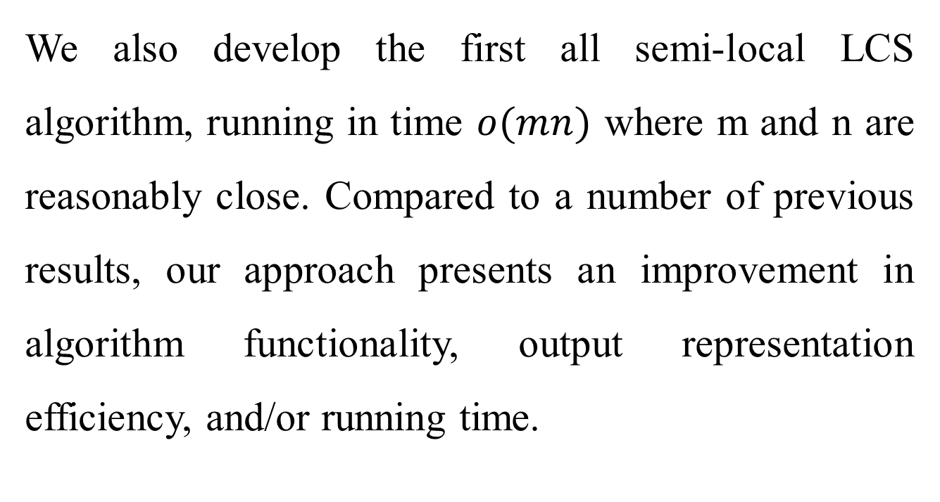
Abstract(3/3)
We also develop the first all semi-local LCS algorithm, running in time $o(mn)$ where m and n are reasonably close. Compared to a number of previous results, our approach presents an improvement in algorithm functionality, output representation efficiency, and/or running time.

Slide 5
Semi-local LCS problem
All string-substring LCS problem
A against every substring of B
B against every substring of A
All prefix-suffix LCS problem
every prefix of A against every suffix of B
every prefix of B against every suffix of A

Slide 6
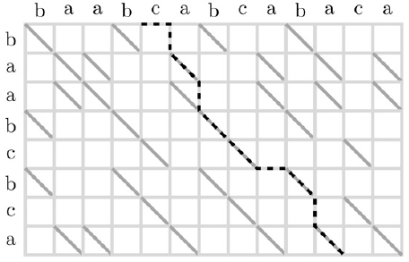

Alignment Directed Acyclic Graph(DAG)
semi-local problems can transfer to find four kinds of paths in alignment dag.
length of string ($A$,$B$) is ($m$,$n$).

Slide 7

Alignment DAG
With the highest-score matrix, all problems can be solved.
$$example :maxscore = A(−i,j’)−i$$
(i,0)
(m,j’)

Slide 8
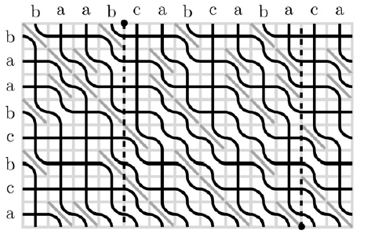
A-critical point

Slide 9
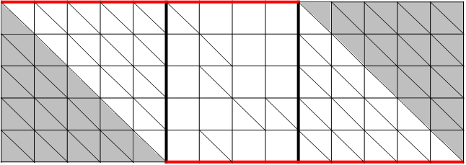

A-critical point
index $i$ will be critical for $j$ iff index $j$ is critical for $i$.
There are exactly $m+n$ non-trivial A-critical points.

Slide 10

A-critical point
$$A\left(i,j\right)=j−i−d_{A}\left(i,j\right)$$
$$5=11−4−2, LCS=abcba$$

Slide 11
A-critical point
0 | 1 | 2 | 3 | 4
0 | 0 | 1 | 2 | 3
0 | 0 | 1 | 1 | 2
0 | 0 | 1 | 1 | 1
0 | 0 | 0 | 0 | 0
1
 |  | 1
 |  |  | 1
 | 1

Slide 12
Algorithm
Divide and conquer
Divide : cut the origin block into subblocks.
Merge : after calculating the A-critical points of subblocks, merge them and get the implicit A-critical points of origin block.
Final : get the A-critical Points of the block.

Slide 13
Merge step
0 | 1 | 2 | 3 | 4
0 | 1 | 1 | 2 | 3
0 | 1 | 1 | 2 | 2
0 | 1 | 1 | 1 | 1
0 | 0 | 0 | 0 | 0
1
 |  | 1
 |  |  | 1
 | 1
0 | 1 | 2 | 3 | 4
0 | 1 | 1 | 2 | 3
0 | 0 | 0 | 1 | 2
0 | 0 | 0 | 1 | 1
0 | 0 | 0 | 0 | 0
 | 1
1
 |  |  | 1
 |  | 1
0 | 1 | 2 | 3 | 4
0 | 1 | 1 | 2 | 3
0 | 1 | 1 | 2 | 2
0 | 1 | 1 | 1 | 1
0 | 0 | 0 | 0 | 0
1
 |  | 1
 |  |  | 1
 | 1

Slide 14

Merge step
$4−2−2+1=1$
Cut recursively until Find the ‘1’.
Merge step time $O\left(M+n^{1.5}\right)$ memory $O(M+n)$
0 | 1 | 2 | 3 | 4
0 | 1 | 1 | 2 | 3
0 | 1 | 1 | 2 | 2
0 | 1 | 1 | 1 | 1
0 | 0 | 0 | 0 | 0
1
 |  | 1
 |  |  | 1
 | 1

Slide 15
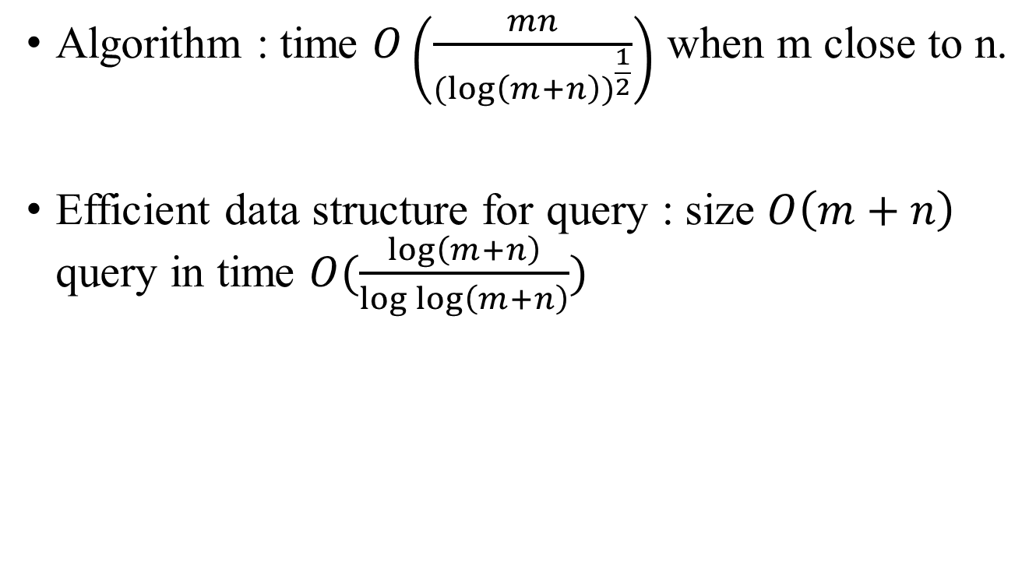
Conclusions
Algorithm : time $O\left(\frac{mn}{{(log\left(m+n\right))}^{\frac{1}{2}}}\right)$ when m close to n.
Efficient data structure for query : size $O\left(m+n\right)$ query in time $O(\frac{\log\left(m+n\right)}{\log{\log\left(m+n\right)}})$

