Slide 1
Planar 3DM Is NP-Complete
M.E. Dyer
A.M. Frieze
Journal of Algorithms, Vol.7, pp.174-184 (1986)
Presenter: Shiou-Zong Chiou
Date:2016/09/21

Slide 2
Abstract
A restriction of the three-dimensional matching problem 3DM, in which the associated bipartite graph is planar, is shown to remain NP-complete. The restriction is inspired by that of Lichtenstein’s planar 3SAT. Planar 3DM is principally a tool for use in NP-completeness proofs for planar restrictions of other problems.

Slide 3

Planar 1-3SAT
$C_{1}=\left\{x_{1}, x_{2},x_{3} \right\}$
$C_{2}=\left\{x_{1}, \overline{x_{2}},x_{3} \right\}$
$C_{3}=\left\{x_{1}, x_{2},\overline{x_{3}} \right\}$

Slide 4


Planar 3SAT $∝$ Planar 1-3SAT
$C_{5}=\{x_{1},x_{2},x_{3}\}$
$C_{5_{1}}=\{x_{1},a_{5},b_{5}\}$
$C_{5_{2}}=\{\overline{x_{2}},a_{5},c_{5}\}$
$C_{5_{3}}=\{\overline{x_{3}},b_{5},d_{5}\}$

Slide 5
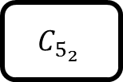
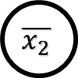
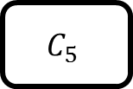
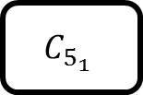
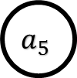
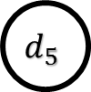
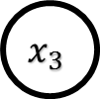
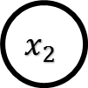
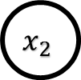
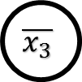
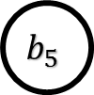
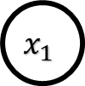

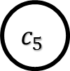
Planar 3SAT $∝$ Planar 1-3SAT
$$x_{2}$$
$$x_{1}$$
$$C_{5_{1}}$$
$$C_{5}$$
$$a_{5}$$
$$b_{5}$$
$$x_{2}$$
$$x_{3}$$
$$C_{5_{2}}$$
$$C_{5_{3}}$$
$$\overline{x_{2}}$$
$$c_{5}$$
$$d_{5}$$
$$\overline{x_{3}}$$

Slide 6
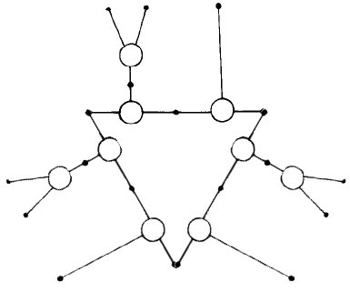

Planar 1-3SAT $∝$ Planar X3C

Slide 7
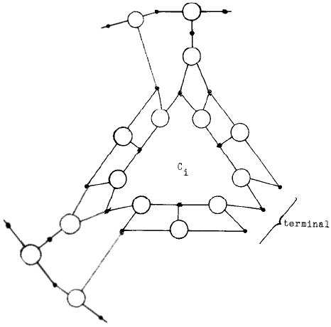
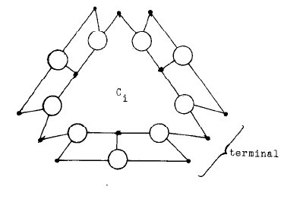
Planar 1-3SAT $∝$ Planar X3C

Slide 8

Planar X3C $∝$ Planar 3DM

Slide 9
Planar X3C $∝$ Planar 3DM

Slide 10
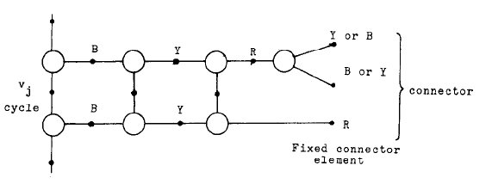
Planar X3C $∝$ Planar 3DM

