Slide 1
Partial correlation analysis : application for financial markets
DROR Y. KENETT†, XUQING HUANG†, IRENA VODENSKA†‡,
SHLOMO HAVLIN†§ and H. EUGENE STANLEY†
†Center for Polymer Studies and Department of Physics, Boston University, Boston, USA
‡Administrative Sciences Department, Metropolitan College, Boston University, Boston, USA
§Department of Physics, Bar-Ilan University, Ramat-Gan 52900, Israel
Quantitative Finance, 2015
Vol. 15, No. 4, pp. 569-578
Presenter : Shih-jhan Huang
Date : 2016/9/21

Slide 2
Review of partial correlation
淨相關，亦有譯為偏相關，是指在控制第三個變項(z變項)的情況下，用來分析兩個變項(x變項和y變項)之間關係的方法。也就是兩個變項(x變項和y變項)同時去除z變項的影響後，所得的相關程度稱為淨相關。
當研究者想知道二個連續變項在第三個變項出現時，會對原先的二個變項產生什麼樣的變化，即可用淨相關分析。

Slide 3
Data of experiment
Use daily adjusted closing stock price time series from four different markets. (US, the UK, Japan and India)
We only consider stocks that are active from January 2000 until December 2010.

Slide 4
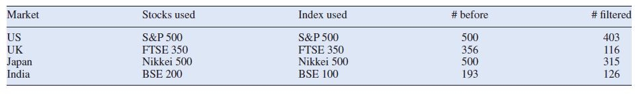
拿掉價格漲跌沒有超過6%的股票(交易日:2700)
標準普爾500
富時350
日經500
孟買100
Table 1. Present the number of stocks remaining after filtering out the stocks that had no price movement for more than 6% of the 2700 trading days.

Slide 5
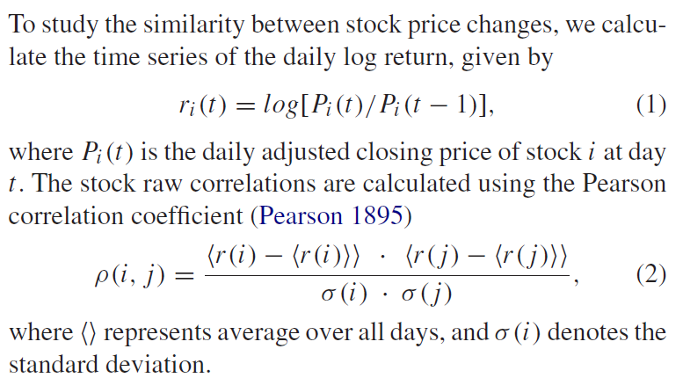
D days’ pearson correlation

Slide 6
In some cases, a strong correlation not necessarily means strong direct relation between two variables.
For example, two stocks in the same market can be influenced by common macroeconomic factors or investor psychological factors.
(Pearson correlation高，並不代表兩者之間直接的相關性高，非僅自身相互影響，可能存在其它共同影響因子)
To study the direct correlation of the performance of these two stocks, we need to remove the common driving factors, which are represented by the market index.
Use partial correlation

Slide 7

Partial correlation
(X與Y排除M之影響的相關係數)
Let X, Y be two stock return time series and M be the index. The partial correlation, ρ(X, Y : M), between variables X and Y conditioned on variable M is the Pearson correlation coefficient between the residuals of X and Y that are uncorrelated with M.

Slide 8
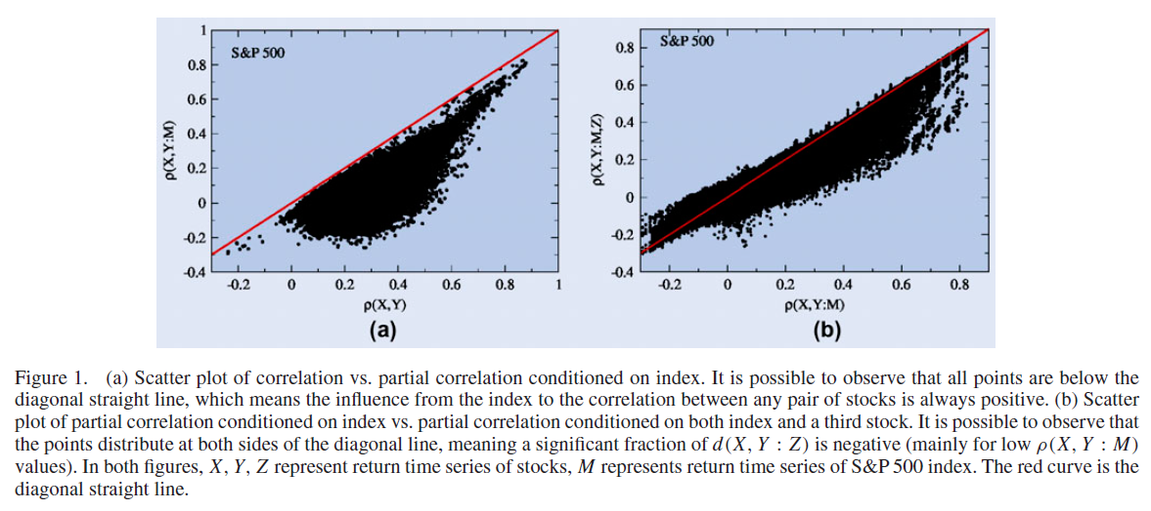
美國標準普爾500
(S&P 500 index)
In figure 1(a), all points are below the diagonal straight line, which means the influence from the index to the correlation between any pair of stocks is always positive.
（X、Y與M(共同影響因子Index)為正相關，所以點分佈偏向對角線下方）
換句話說：不論X、Y間相關性為正或負，M對X與Y之影響皆為正相關，也就是X、Y及M會同漲或同跌。

Slide 9
When two stocks X and Y both have business relation with a third common stock Z, their prices can be both affected by the performance of the third stock, thus showing similar price movements even after removing the effect of the index.
(去除index的影響之後，X、Y之間可能還有第三支股票Z對其產生影響。)

Slide 10
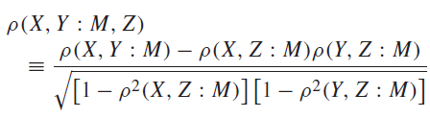
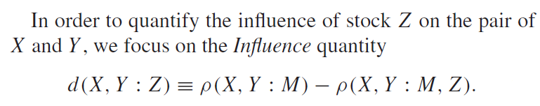
此式是將前述已去除M之影響的相關係數，再拿來去除Z之影響所得結果。
∴此為去除M、Z這兩個影響因子所得X、Y之間的相關性。
(將影響X、Y的第三支股票Z之影響程度做量化)
含Z、不含M
不含Z、不含M
Z對於X、Y的影響程度(相關性)
建議先去除市場共同影響因子(ex:index)，然後再去除其餘股票(ex:Z股票)的影響會比較好，因為通常市場共同影響因子比較強勢(dominant)，整體趨勢容易受其影響。
(Z股票可能同時也含有index的影響，所以此舉也可避免計算Z之影響程度時的誤差。)
(想法源自Kenett et al. 2010)

Slide 11
美國標準普爾500
(S&P 500 index)
In figure 1(b), the points distribute at both sides of the diagonal line
By removing the influence from the third company, we can see the importance of the role that the third stock acts in the correlation of two stocks.
(可找尋出除了Index之外的influence factor對原本兩者之間的相關性意義)
當X、Y相關係數>0，d(X, Y : Z)為正，代表Z對X、Y之影響為正相關(同漲同跌)；
當X、Y相關係數<0，d(X, Y : Z)為負，代表Z對X、Y之影響為負相關(Z漲或跌，X、Y一漲一跌) 。

Slide 12
Stable v.s Volatile
If the companies tend to keep their past strategies, then the level of partial correlation between two companies’ stocks tends to be stable.
(公司經營策略保持穩定，貫如以往，那麼公司與公司間的相關性會相對地穩定)
Companies switch their strategies more quickly, two companies which had similar behaviour in the previous year might have quite different behaviour in the next year.
(公司經營策略飄移不定、常更換，今年兩公司之間可能有高度相關性，明年相關性或許會有很大的變化(↓?) )
In such markets, partial correlation between stocks should be more volatile.
穩定性的意義：
市場如果穩定，那麼股票之間的相關性才不會反覆無常、高低不定，這樣才能持續準確的利用相關性來找出股票市場中同漲跌的股票群體。

Slide 13
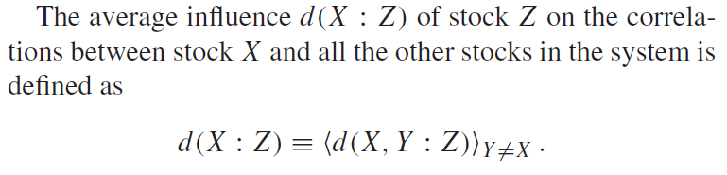
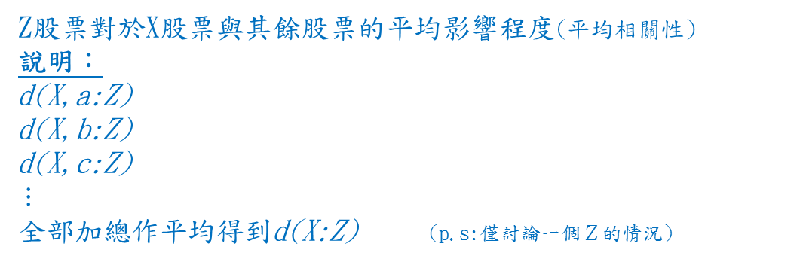
Z股票對於X股票與其餘股票的平均影響程度(平均相關性)
說明：
d(X,a:Z)
d(X,b:Z)
d(X,c:Z)
$$⋮$$
全部加總作平均得到d(X:Z) (p.s:僅討論一個Ｚ的情況)

Slide 14
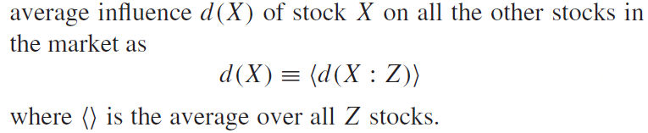
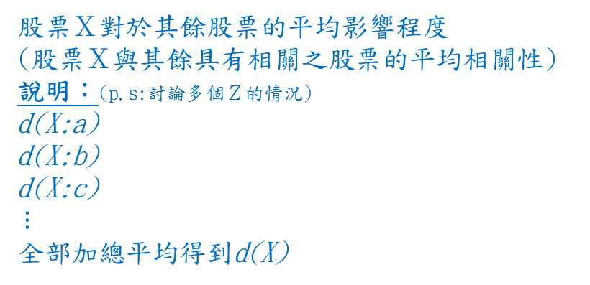
股票Ｘ對於其餘股票的平均影響程度
(股票Ｘ與其餘具有相關之股票的平均相關性)
說明：(p.s:討論多個Ｚ的情況)
d(X:a)
d(X:b)
d(X:c)
$$⋮$$
全部加總平均得到d(X)
We rank the stocks by their d(X) values, which we consider as a representation of the structure of the market. By dividing the 11-year period into 44 quarterly periods, we can compare similarity of the market structures (ranking of stocks) in different years.
利用〝各股票對其餘股票之平均影響力〞 來作排序，然後可利用此結果來比較不同年份市場結構的相似性
接下來利用Kendall τ 來計算經rank過的兩條序列相似性(市場結構相似性)
y\stocks | A | B | C | D
第1年 | 5 | 3 | 2 | 1
第2年 | 2 | 7 | 5 | 3
造成兩序列同質性降低
(第2年A股票與其餘股票的平均影響程度)

Slide 15
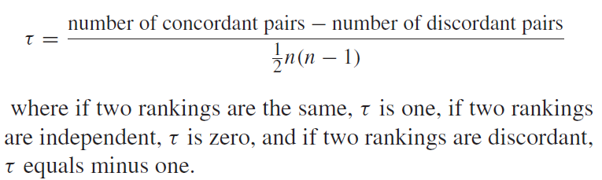



１：the same
0：independent
-1：two rankings are discordant.
The Kendall τ coefficient is defined as
同為遞增或遞減
一者為遞增，則另為遞減。反之亦然
計算Kendall τ的所有次數
範例
Kendall τ：
1：-1-1+1+1 = 0
2：-1+1+1 = 1
3：+1-1 = 0
4：+1 = 1
5：0
季\股票 | A | B | C | D | E
第一季 | 6 | 9 | 4 | 3 | 5
第二季 | 6 | 5 | 10 | 2 | 3
$$\frac{0+1+0+1+0}{\frac{1}{2}∗5(5−1)}$$
$$=$$
$$\frac{2}{10}$$
(註：格子內數字代表某股票於某季的平均影響程度)

Slide 16
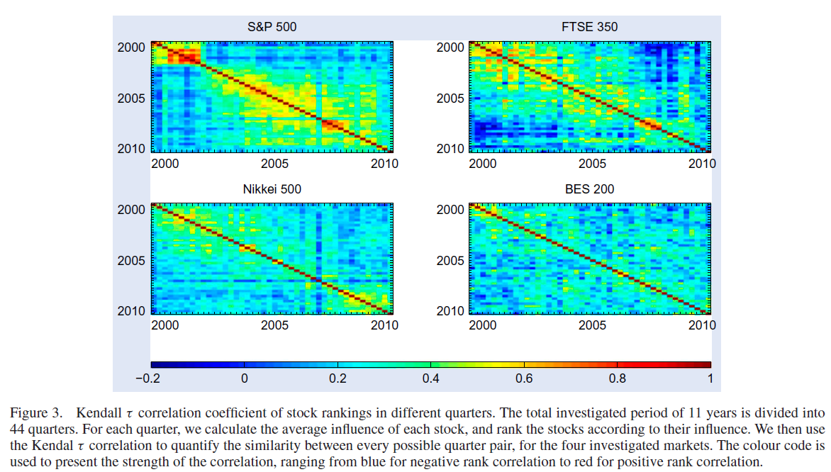
兩季之間的Kendall τ係數 (兩季中全部股票依d(X)值rank後，然後計算Kendall τ)
１：the same
0：independent
-1：two rankings are discordant.
We find that S&P 500, FTSE 350 and Nikkei 500 stocks show strong market stability patterns, while Indian BES 200 stocks almost do not demonstrate any stable patterns.
‘dot com’ crisis of 2000 (Q4 of 2000 till Q4 of 2001) (網際網路泡沫化) S&P 500
‘’ crisis of 2008 (Q4 of 2007 till Q4 of 2008) (全球金融危機) S&P 500、FTSE350
Red rectangles present a strong similarity in the structure during the two crises, followed by consecutive quarters with low values of three rank correlations, representing the change in structure.
(紅色區塊代表發生突發危機時，兩季之間Kendall τ飆高，各股票對其餘股票之影響程度近乎不變，此後接續下去的兩季之間Kendall τ陡降，代表市場結構已改變，各股票對其餘股票之影響程度已完全改變，不同以往。)

Slide 17
Discussion of stability
Developed markets tend to keep their market structure longer than fast developing markets.
(已開發國家 相對 開發中國家 穩定)
市場穩定的話，利用相關性來作漲跌預測才有意義

Slide 18
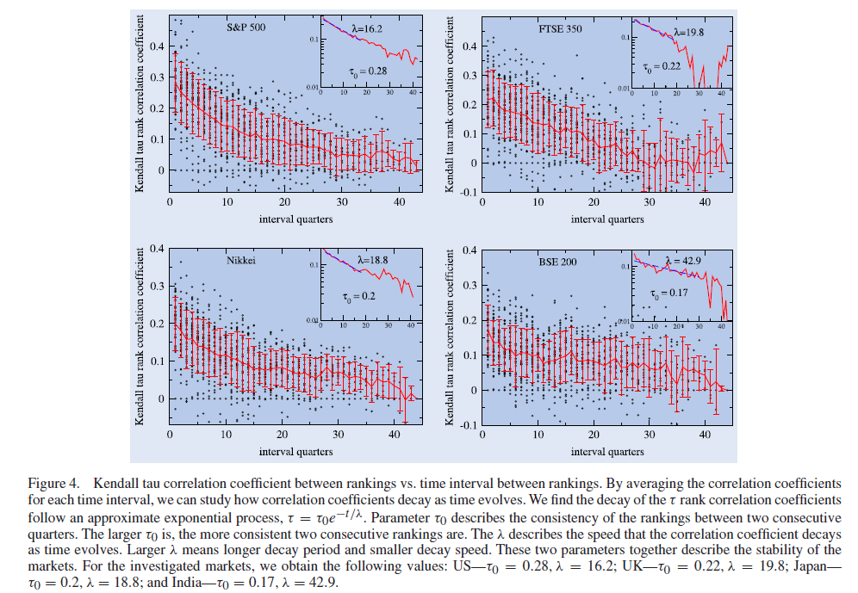
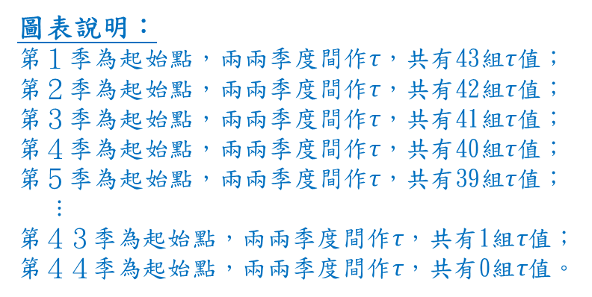
τ₀最大 λ最小
圖表說明：
第１季為起始點，兩兩季度間作τ，共有43組τ值；
第２季為起始點，兩兩季度間作τ，共有42組τ值；
第３季為起始點，兩兩季度間作τ，共有41組τ值；
第４季為起始點，兩兩季度間作τ，共有40組τ值；
第５季為起始點，兩兩季度間作τ，共有39組τ值；
$$⋮$$
第４３季為起始點，兩兩季度間作τ，共有1組τ值；
第４４季為起始點，兩兩季度間作τ，共有0組τ值。
小圖說明：(小圖的紅色曲線為每一季全部τ值取平均所得)
We find the decay of the τ rank correlation coefficients follow an approximate exponential process, τ = τ₀e^{−t/λ}, as shown in the insets in figure 4.
Larger τ₀ is, the more consistent two consecutive ranking are. (τ₀大，同質性高，不同兩季間影響程度變動不大)
Larger λ values mean longer persistence period, and thus, describe the change in influence ranking across time. (λ大，市場狀態持續時間越久，市場結構的變動時間緩慢)
Using the τ₀ and λ parameters can help in monitoring structural changes in the market, and their persistence. (觀測市場的穩定性)
τ₀最小 λ最大

Slide 19
只將某股票歸類到單一sector，無法反映它的整體表現及相關風險。
有些公司屬於集團，旗下子公司散佈各sector，所以會受到多個sector影響。
就算某一公司生產服務皆屬同sector，但有可能因為分工，也會受到其它sector的影響。
所以接下來要討論關於多個sector同時對股票的影響。

Slide 20



The partial correlation methodology to study the multiple-sector influence on stocks
where X represents the investigated stock, S represents a given sector, N_{S} is the number of stocks in sector S and Z_{S} represents the stocks in sector S.
The average influence $d_{x}^{s}$ reflects the level of influence that stock X receives from sector S. (Sector S對股票X的影響程度)
$$\frac{某sector對X的影響程度}{各sector對X之影響程度的總和}$$
we can attribute stock X’s performance to sectors’ performances with coefficients

Slide 21
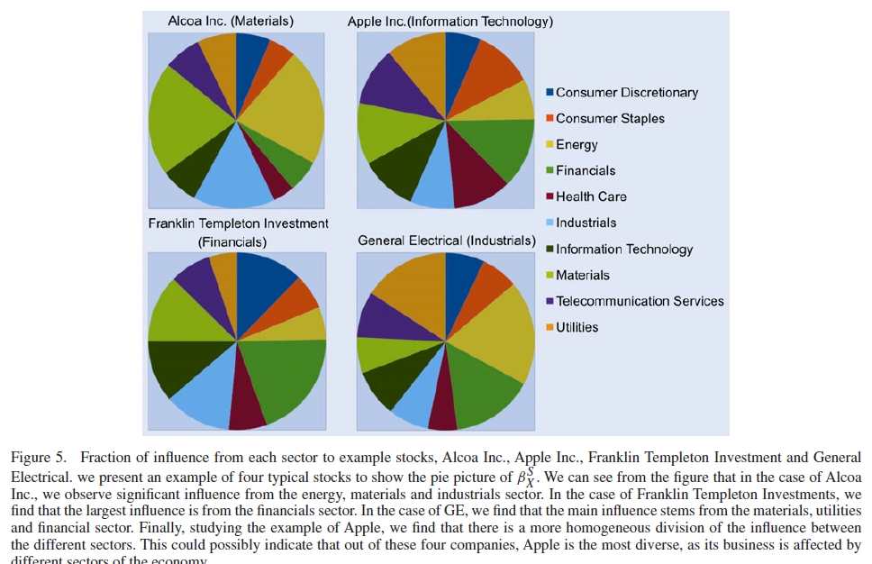

The pie picture of $β_{X}^{S}$
(生活非必需品)
Alcoa Inc. ：
energy, industrials and materials sector.
Franklin Templeton Investments ：
financials sector.
GE：
energy, financial and utilities sector
Apple ：
we find that there is a more homogeneous division of the influence between the different sectors. (均勻分布)
(生活必需品)
(健康照護)
(公用事業)

Slide 22
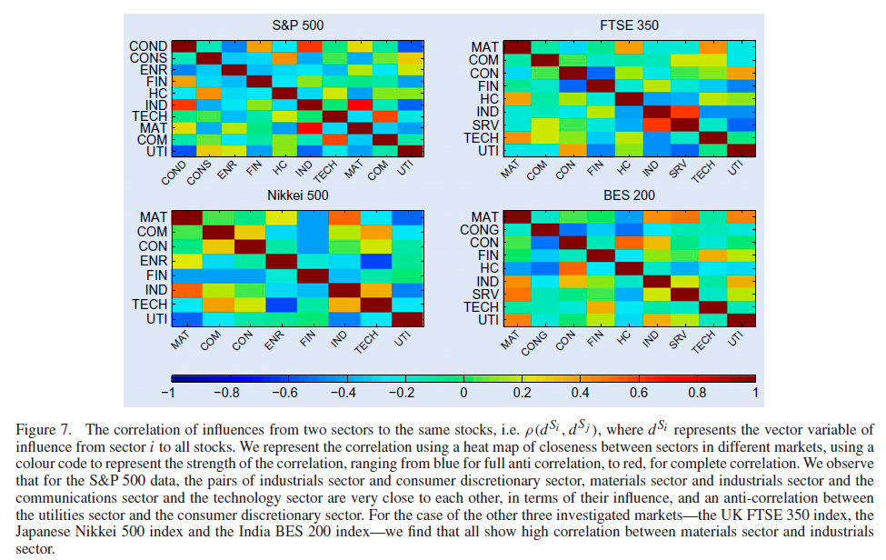
Some sectors tend to influence the same stocks concurrently.
Calculate the Pearson correlation of influences from two sectors to the same stocks.
i.e. ρ(d^{Si} , d^{Sj} ), where d^{Si} represents the vector variable of influence from sector i to all stocks.
兩sector influence相關性高，代表它們同時對某些相同的股票影響程度大。
正相關(S&P500)：
industrials sector、consumer discretionary sector
materials sector、industrials sector
communications sector、technology sector
正相關(Nikkei 500、BES 200)：
materials sector、industrials sector
Their influence are very close to each other.
負相關(S&P500)：
utilities sector and consumer discretionary sector
One is highly influence,the other is little influence.

Slide 23
Conclusion
使用partial correlation分析不同股票間(可能不只兩個)的相關性。（相依?or獨立?）
此篇所提的方法，可用來排除其餘會影響相關性結果的對象。
已開發國家(US,UK,and Japan)相對開發中國家(India)來說，市場結構穩定性較高。
股票可能會受到除了本身所屬類股之外的其它類股所影響。

