Slide 1
M. Calonder, V. Lepetit, C. Strecha, and P. Fua. Computer Vision - ECCV 2010, 11th European Conference on Computer Vision, Heraklion, Crete, Greece, September 5-11, 2010, Proceedings, Part IV.
BRIEF: Binary Robust Independent Elementary Features
Presenter：Wei-Hao Fu
Date：2016/ 10/ 05
Notes:
1

Slide 2
Abstract
We propose to use binary strings as an efficient feature point descriptor, which we call BRIEF. We show that it is highly discriminative even when using relatively few bits and can be computed using simple intensity difference tests. Furthermore, the descriptor similarity can be evaluated using the Hamming distance, which is very efficient to compute, instead of the L2 norm as is usually done. As a result, BRIEF is very fast both to build and to match. We compare it against SURF and U-SURF on standard benchmarks and show that it yields a similar or better recognition performance, while running in a fraction of the time required by either.

Slide 3

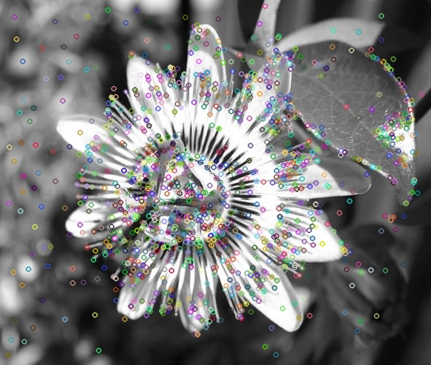
Key point
What are key points?
Key points are the same with interest points. They are some special points that can show the image’s feature.

Slide 4
Descriptor
How to descript a key point?
Use a descriptor to descript a key point.
This paper use a method-”Binary Robust Independent Elementary Feature”.

Slide 5
BRIEF(1/3)
First, find the key points. In this paper, they use CenSurE.
Second, they use a S*S patch surrounding with the key points, and generate some pairs of points.
S
S

Slide 6
BRIEF(2/3)
Use the patch and pairs of points to scan key points, if p(x)>p(y) then records 1, else records 0.
y
x
0
0
0
0

Slide 7
BRIEF(3/3)
When every key points have a bit string, then they can use XOR to match each others.
A =10010
B =11101
XOR(A, B) =01111
Hamming Distance=4, if the larger the number, they are more and more different.

Slide 8
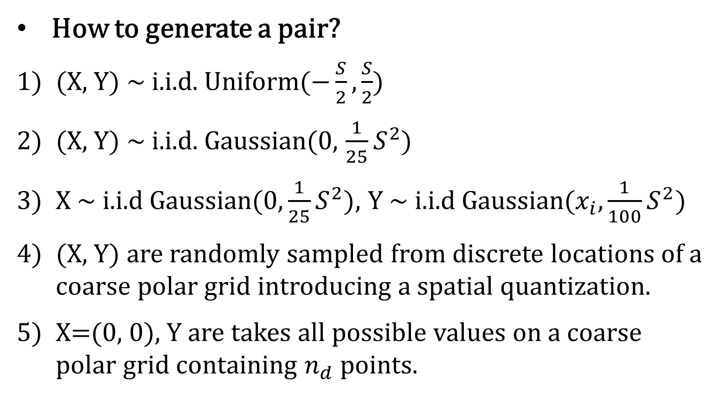
Pairs of points(1/2)
How to generate a pair?
(X, Y) ~ i.i.d. Uniform($−\frac{S}{2}, \frac{S}{2}$)
(X, Y) ~ i.i.d. Gaussian(0, $\frac{1}{25}S^{2}$)
X ~ i.i.d Gaussian($0, \frac{1}{25}S^{2})$, Y ~ i.i.d Gaussian($x_{i}, \frac{1}{100}S^{2})$
(X, Y) are randomly sampled from discrete locations of a coarse polar grid introducing a spatial quantization.
X=(0, 0), Y are takes all possible values on a coarse polar grid containing $n_{d}$points.

Slide 9
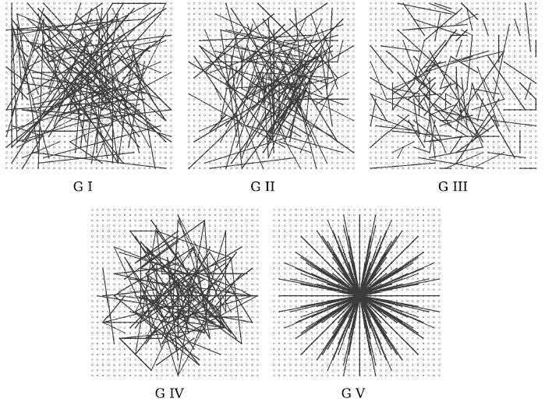
Pairs of points(2/2)

Slide 10
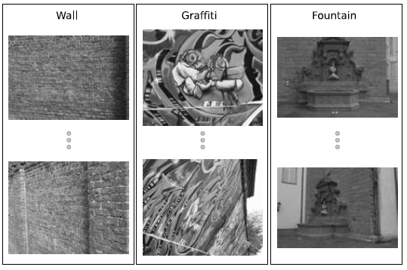
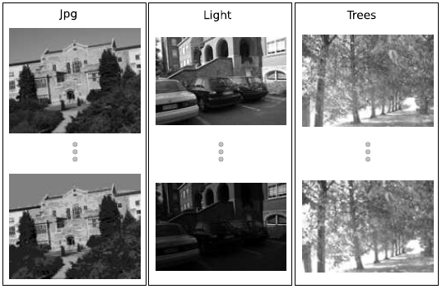
Experiment Result(1/5)
Dataset

Slide 11
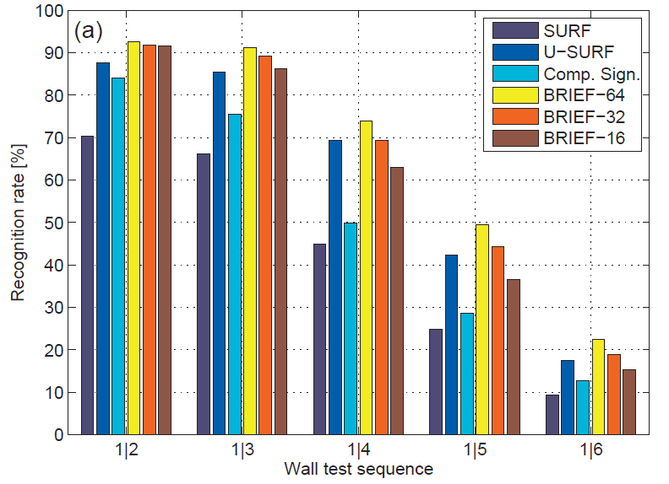
Experiment Result(2/5)

Slide 12
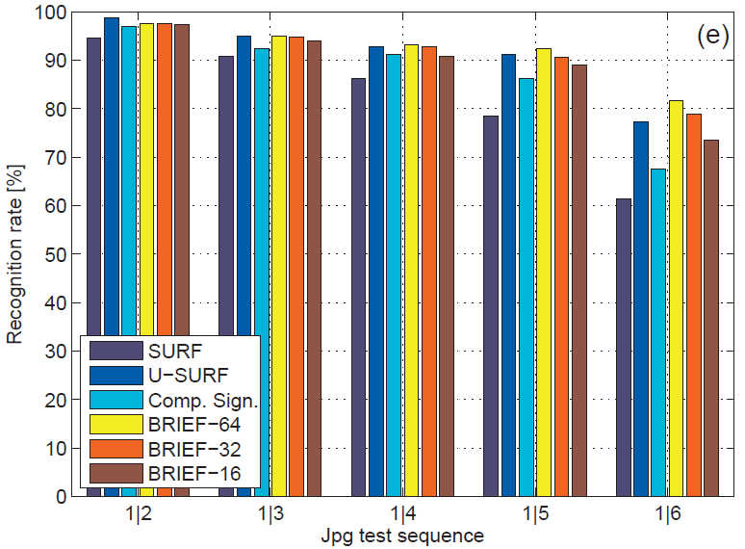
Experiment Result(3/5)

Slide 13
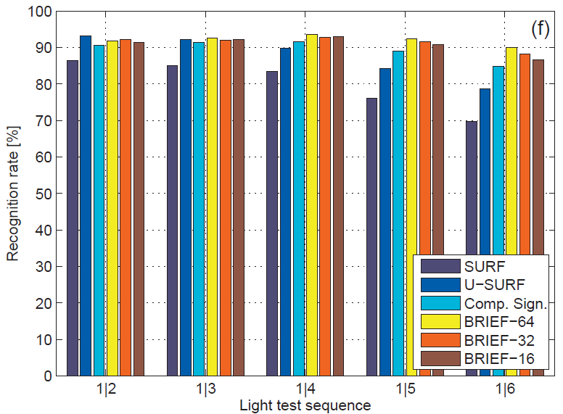
Experiment Result(4/5)

Slide 14
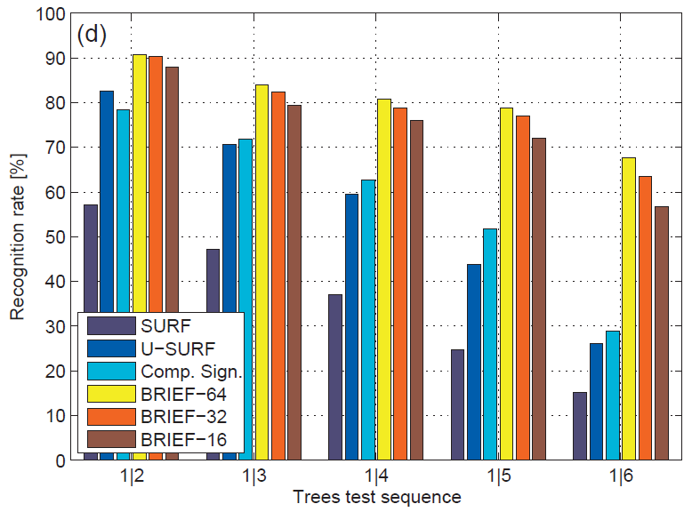
Experiment Result(5/5)

