Slide 1
Making Time-series Classification more accurate Using Learned Constraints
Chotirat Ann Ratanamahatana
Eamonn Keogh
Society for Industry and Applied Mathematics(SIAM) International Conference On Data Mining, 2004
Presenter : Shu-Kai, Hung
Date : 2016/10/5
Notes:
http://alumni.cs.ucr.edu/~ratana/
被引用267次

Slide 2
Abstract
It has long been known that Dynamic Time Warping (DTW) is superior to Euclidean distance for classification and clustering of time series. However, until lately, most research has utilized Euclidean distance because it is more efficiently calculated. A recently introduced technique that greatly mitigates DTWs demanding CPU time has sparked a flurry of research activity. However, the technique and its many extensions still only allow DTW to be applied to moderately large datasets. In addition, almost all of the research on DTW has focused exclusively on speeding up its calculation. there has been little work done on improving its accuracy. In this work, we target the accuracy aspect of DTW performance and introduce a new framework that learns arbitrary constraints on the warping path of the DTW calculation. Apart from improving the accuracy of classification, our technique as a side effect speeds up DTW by a wide margin as well. We show the utility of our approach on datasets from diverse domains and demonstrate significant gains in accuracy and efficiency.

Slide 3
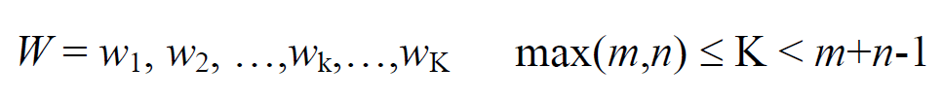
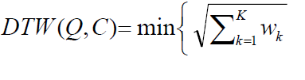


Dynamic Time Warping
Q =$q_{1}q_{2}…q_{i}…q_{n}$ ex : Q = 1 3 2 4 5 0
C = $c_{1}c_{2}…c_{j}…q_{m}$ ex : C = 1 2 2 3 4
$d\left(q_{i},c_{j}\right)= {(q_{i}−c_{j})}^{2}$
The $k^{th} of W \text{is} \text{defined} \text{as} W_{k}={(i,j)}_{k}$
=>
 | 1 | 2 | 2 | 3 | 4
1 | 0 | 1 | 1 | 4 | 9
3 | 4 | 1 | 1 | 0 | 1
2 | 1 | 0 | 0 | 1 | 4
4 | 9 | 4 | 4 | 1 | 0
5 | 16 | 9 | 1 | 4 | 1
0 | 4 | 1 | 1 | 0 | 1

Slide 4
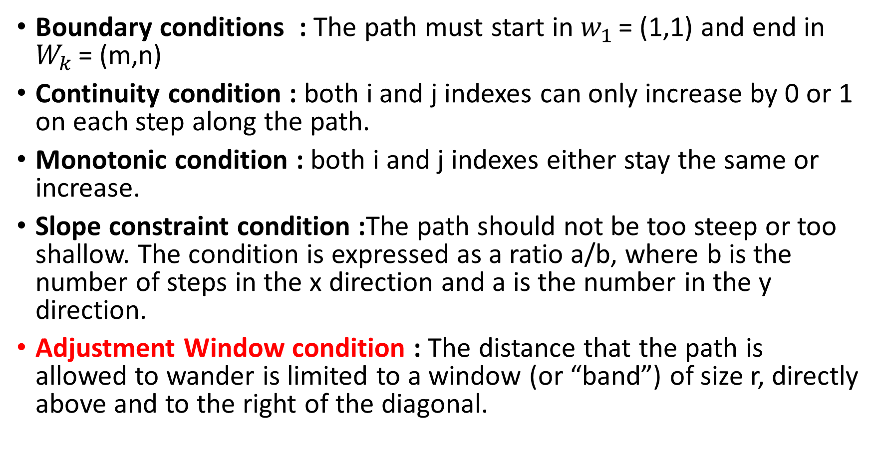
DTW condition
Boundary conditions : The path must start in $w_{1}$ = (1,1) and end in $W_{k}$ = (m,n)
Continuity condition : both i and j indexes can only increase by 0 or 1 on each step along the path.
Monotonic condition : both i and j indexes either stay the same or increase.
Slope constraint condition :The path should not be too steep or too shallow. The condition is expressed as a ratio a/b, where b is the number of steps in the x direction and a is the number in the y direction.
Adjustment Window condition : The distance that the path is allowed to wander is limited to a window (or “band”) of size r, directly above and to the right of the diagonal.

Slide 5
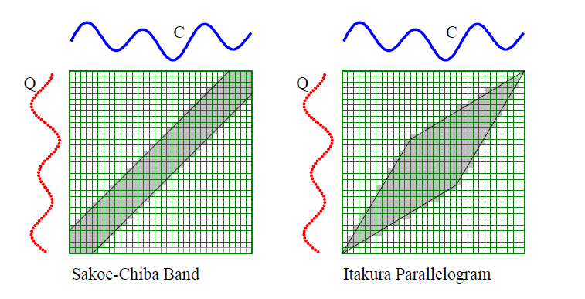

General model of global constraints.
global constraint as constraining the indices of the warping path $W_{k}$= ${(i,j)}_{k} ,\text{such} \text{that} \text{j}\text{−}R_{i}\text{≤ }\text{i}\text{ ≤ }\text{j}\text{+}R_{i}\text{, }\text{where}{ R}_{i} \text{is} \text{a} \text{term} \text{defining} \text{the} \text{allowed} \text{range} \text{of} \text{warping}\text{, }\text{for} \text{a} \text{given} \text{point} \text{in} \text{a} \text{sequence}$
where $R_{i}$ is the height above the diagonal in the y direction, as well as the width to the right of the diagonal in the x direction.

Slide 6
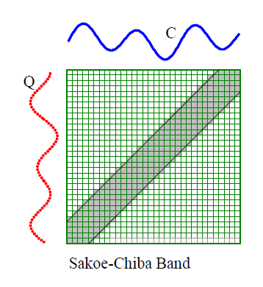
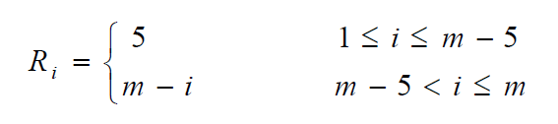
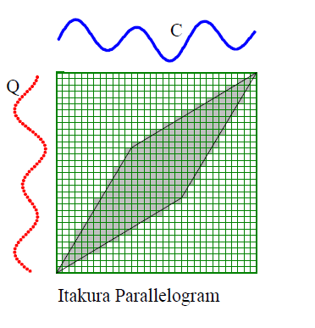
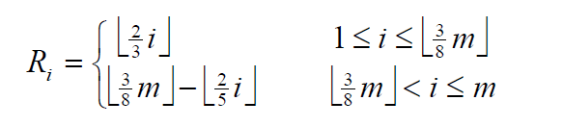
Sakoe-Chiba Band
Itakura Parallelogram

Slide 7
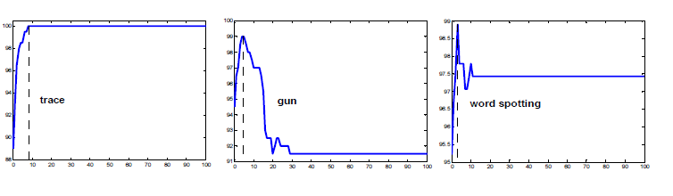

Ratanamahatana-Keogh Band (R-K Band).
define any arbitrary global constraint with the vector R.
Euclidean distance can be defined in terms of $R_{i}$ = 0; 1 ≤ i ≤ m
Are we better off with wider band? (Sakoe-Chiba Band)
Need to learn its wider(learn its function)

Slide 8
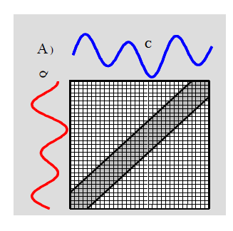
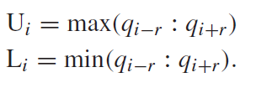
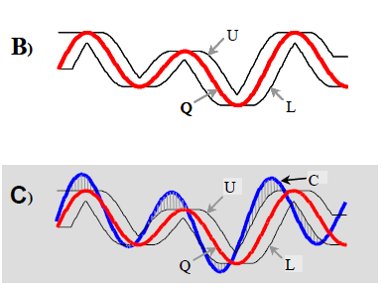
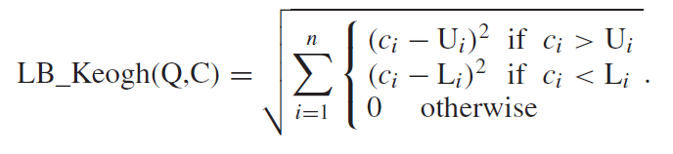
lower bounding distance measure
LB_Keogh(Under Sakoe-Chiba Band)
LB_Keogh(Q,C) ≤ DTW(Q,C)

Slide 9
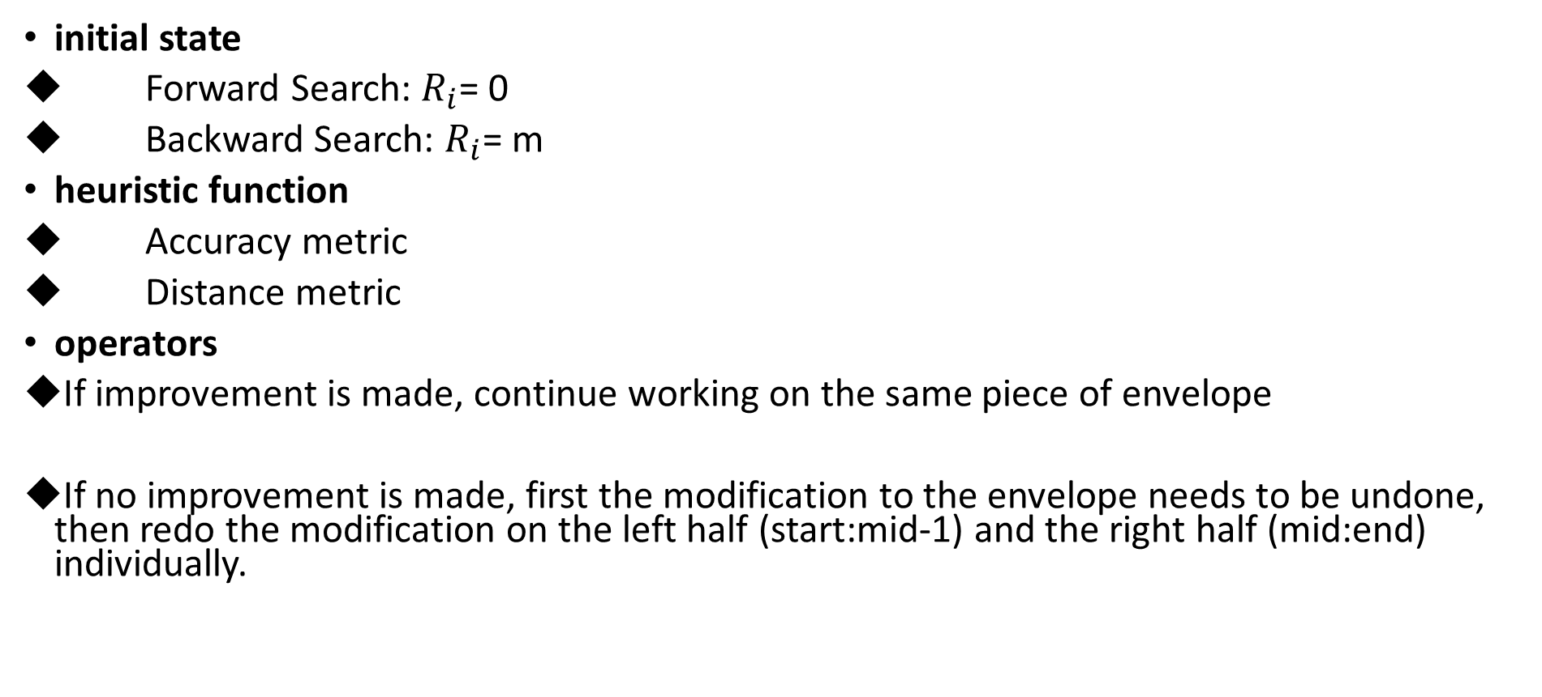
Learning multiple Ratanamahatana-Keogh bands for classification
initial state
Forward Search: $R_{i}$= 0
Backward Search: $R_{i}$= m
heuristic function
Accuracy metric
Distance metric
operators
If improvement is made, continue working on the same piece of envelope
If no improvement is made, first the modification to the envelope needs to be undone, then redo the modification on the left half (start:mid-1) and the right half (mid:end) individually.

Slide 10
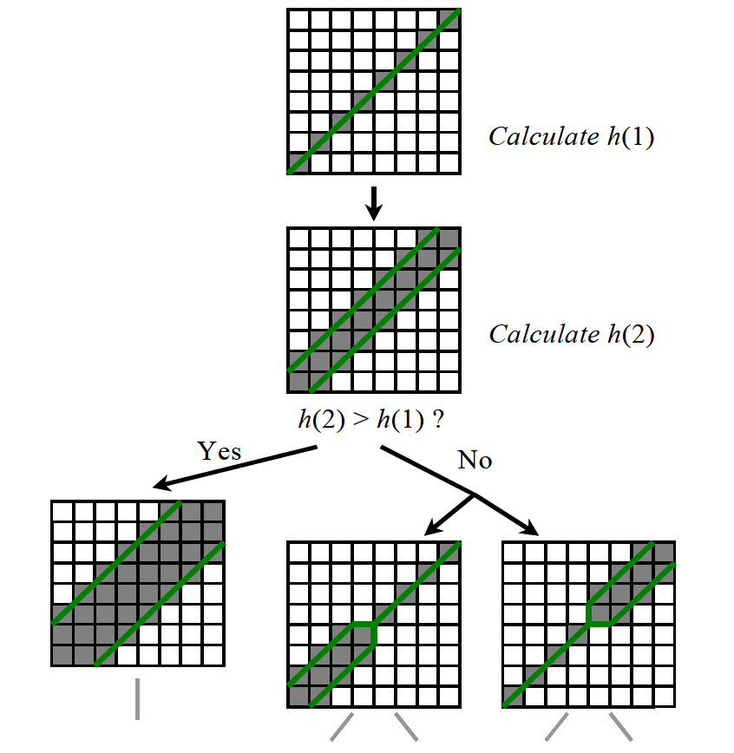
Forward Search
terminal test:
Forward Search: The search is complete when one of the following is true:
No improvement can be made.
The envelope’s width reaches m
When a condition end-start+1 ≤ threshold is met for all the pieces of the envelope
Left half modification
Right half modification

Slide 11
Local maximum
Forward search with Accuracy metric.
Forward search with Distance metric.
Backward search with Accuracy metric.
Backward search with Distance metric.

Slide 12
