Slide 1
Time-shift asymmetric correlation analysis of global stock markets
Sergey K. Aityanª ,Alexey K. Ivanov-Schitz^{b} ,Sergey S. Izotov^{b}
ª Department of Business and Economics, Lincoln University, 401 15th Street, Oakland, CA 94612, USA
^{b} School of International Economic Relations, MGIMO University, 76 Prospekt Vernadskogo, 119454 Moscow, Russia
Journal of International Financial Markets, Institutions & Money 20, pp. 590–605 (2010)
Presenter：Shih-jhan Huang

Slide 2
Abstract
The time-shift asymmetric correlation analysis method is introduced for stock exchanges with different but non-overlapping trading hours to analyze the degree of global integration between stock markets of different countries and their influence on each other. Next-day correlation (NDC) and same-day correlation (SDC) coefficients are introduced. Correlations between major U.S. and Asia-Pacific stock market indices are analyzed. Most NDCs are statistically significant while most SDCs are insignificant. NDCs grow over time and the U.S. stock market plays a pacemaking role for the Asia-Pacific region. The correlation coefficients can be used as a measure of the degree of globalization for the corresponding countries.

Slide 3
Discussion(1/2)
This paper proposed a time-shift asymmetric correlation analysis for studying correlations and the interdependency of international stock markets that have no overlap of trading hours.
About shifts：
Time-lags不是明確固定
股票兩兩之間cross-autocorrelations也不是明確的
可能因為遇上週末、國家節慶假日…等，平移時間而有所不同。
傳統的相關性分析無法辨別出股市之間的因果關係；
此篇利用time-shift asymmetric correlation這個方法，可找出於不同國家之間具有引領效用的國家股市(or股票)。 (交易時間不重疊)

Slide 4
Discussion(2/2)
此篇論文為了辨別出具引領作用的股市，使用各地區股市交易時間的不同，來找出之間互相影響的因果關係。
（例如：美國NYSE、NASDAQ(9:30AM~4:00PM EST)指數與日本Tokyo and Osaka stock exchange(8:00PM~10:00PM and 11:30PM~2:00AM EST)營業時間的不同）

Slide 5
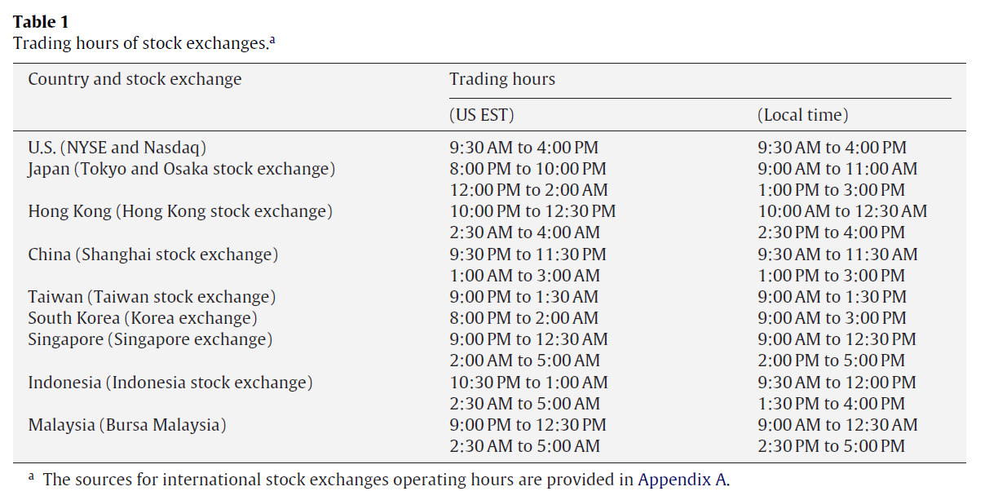
以美國與其他國家營業時間不重疊為主，
因為之後是以美國為先導來判斷是否具有引領作用。

Slide 6
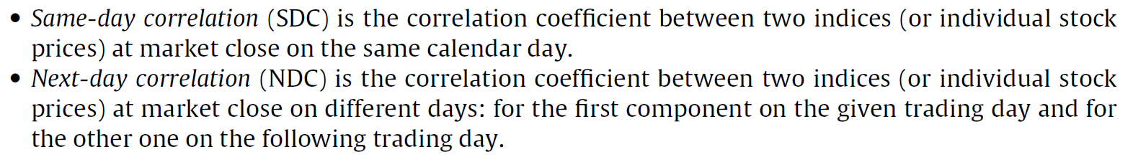
On any given trading day the U.S. stock exchanges operate with known
results of Japanese stock exchanges for the same calendar trading day.
On the other hand, on the next trading day, Japanese stock exchanges operate with information available about the results of U.S. stock exchanges from the previous trading day.
SDC and NDC correlation coefficients differ from each other only by values associated with stock index B, which are shifted by one trading day ahead in the NDC relative to one in the SDC.

Slide 7
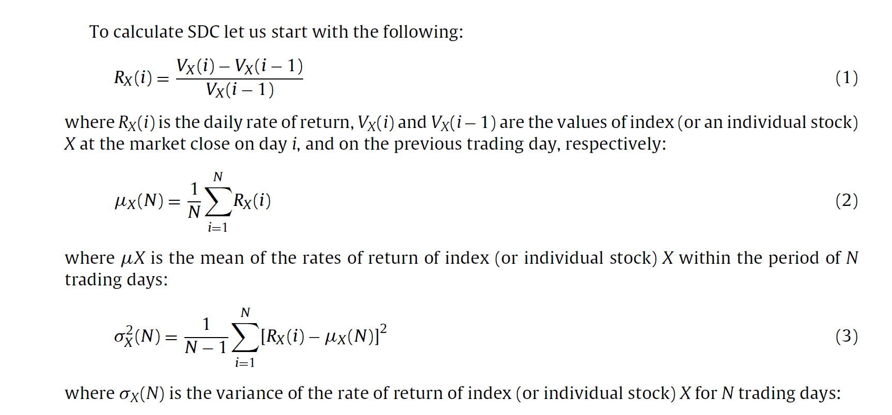

Slide 8
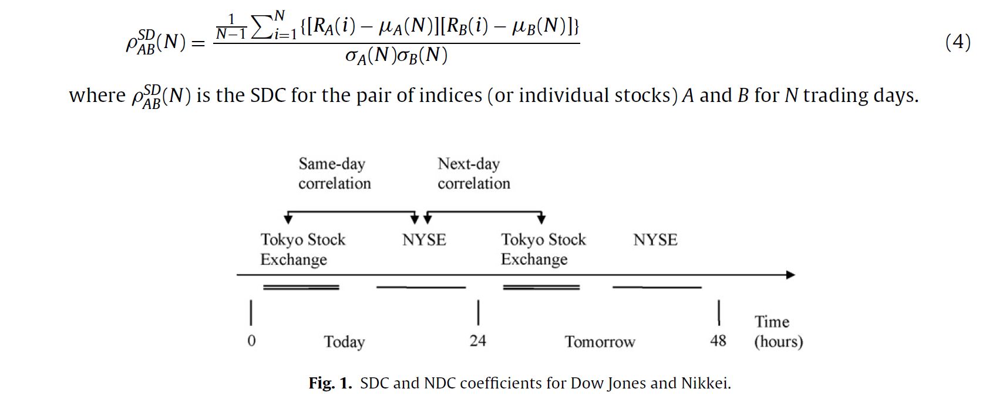

Slide 9
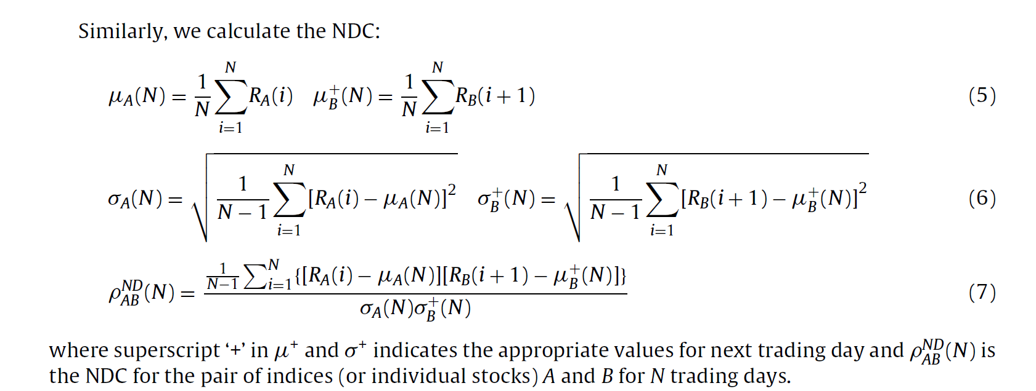

Slide 10
藉由比較SDC與NDC可以得到股市之間的關係，可看出何者為leading role
To make a decision on whether the calculated SDC or NDC coefficients are statistically significant, one has to conduct a test for acceptance or rejection of the null-hypothesis that states “no correlation.”
(檢測假設結果是否可被接受)
相關係數為一不知名機率分佈的random numbers，使得它不清楚如何做上述測試。
為了做測試所以需要將相關係數轉換為知名的機率分佈或者至少接近知名分佈（例：高斯分佈）
使用 Fisher’s z-transformation

Slide 11
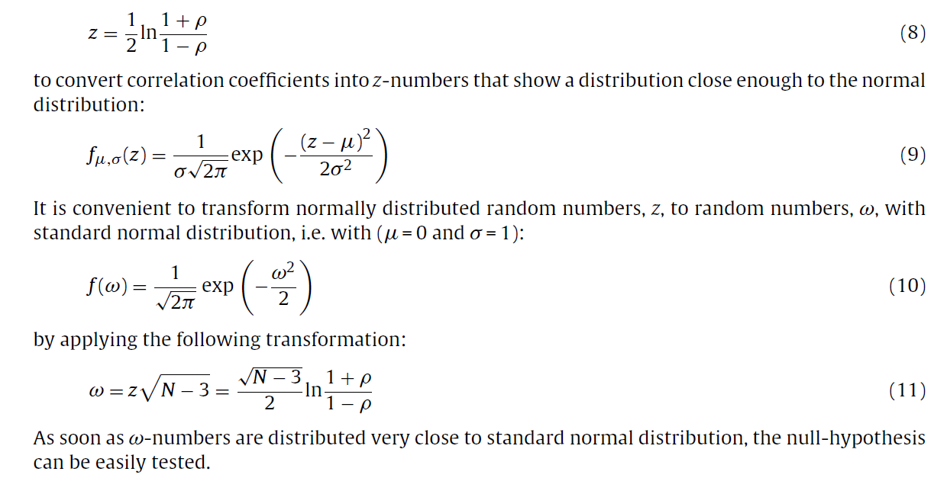

近似常態分佈
μ：機率密度函數的均值
$σ$：標準差

Slide 12
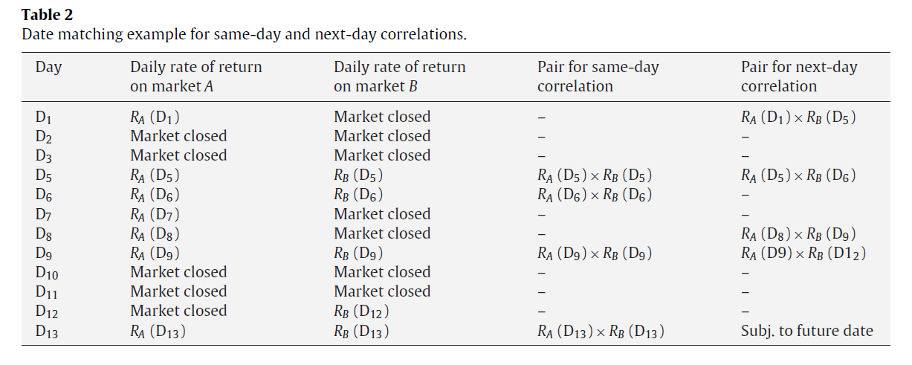
Data processing
Next day：在此被訂為下一個交易日

Slide 13
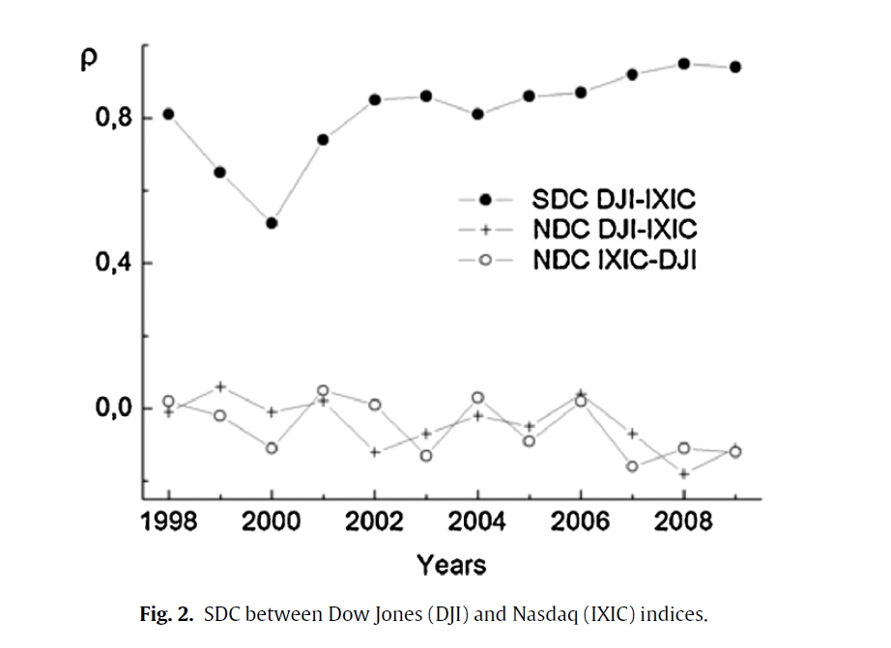
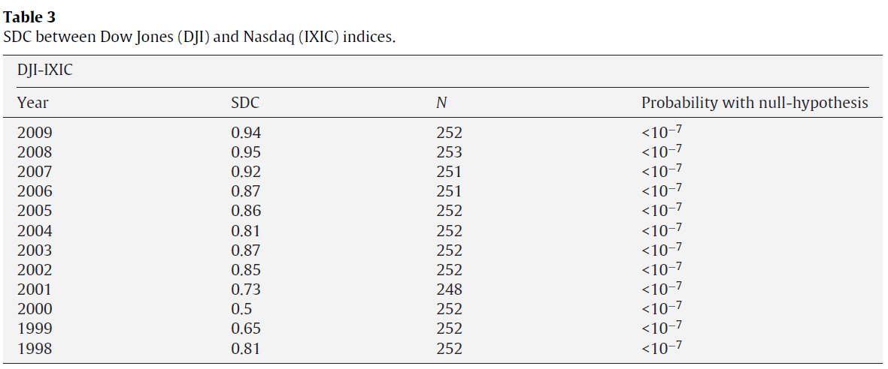
Correlations between Dow Jones and Nasdaq indices
the correlation coefficients between Dow Jones Industrial Average (DJI) and Nasdaq Composite (IXIC) from 1998 through 2009. (道瓊指數) (那斯達克綜合指數)
Internet bubble影響
These results were expected because both indices, Dow Jones Industrial Average (DJI) and Nasdaq Composite (IXIC), are related to the U.S. stock market which is quite mature and for this reason highly correlated.

Slide 14
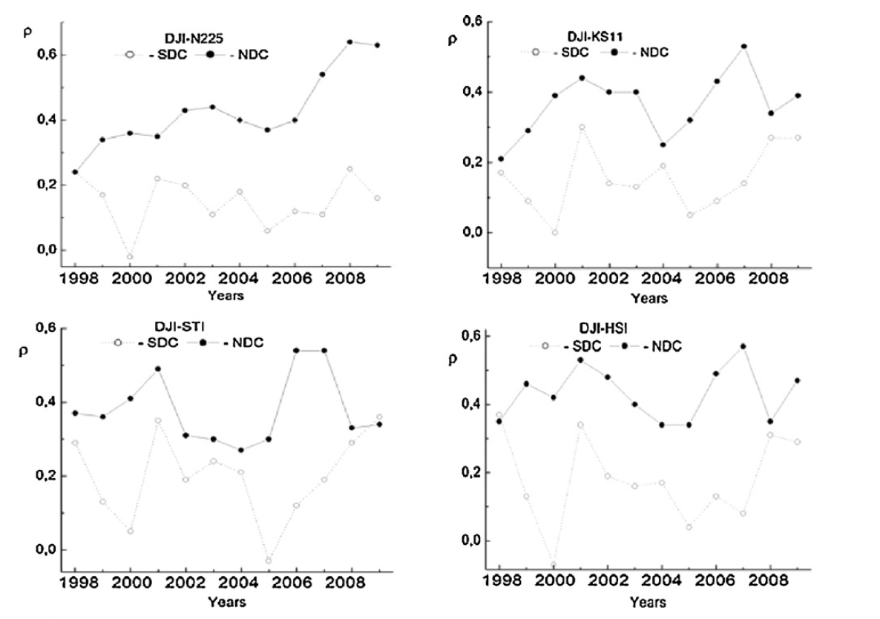
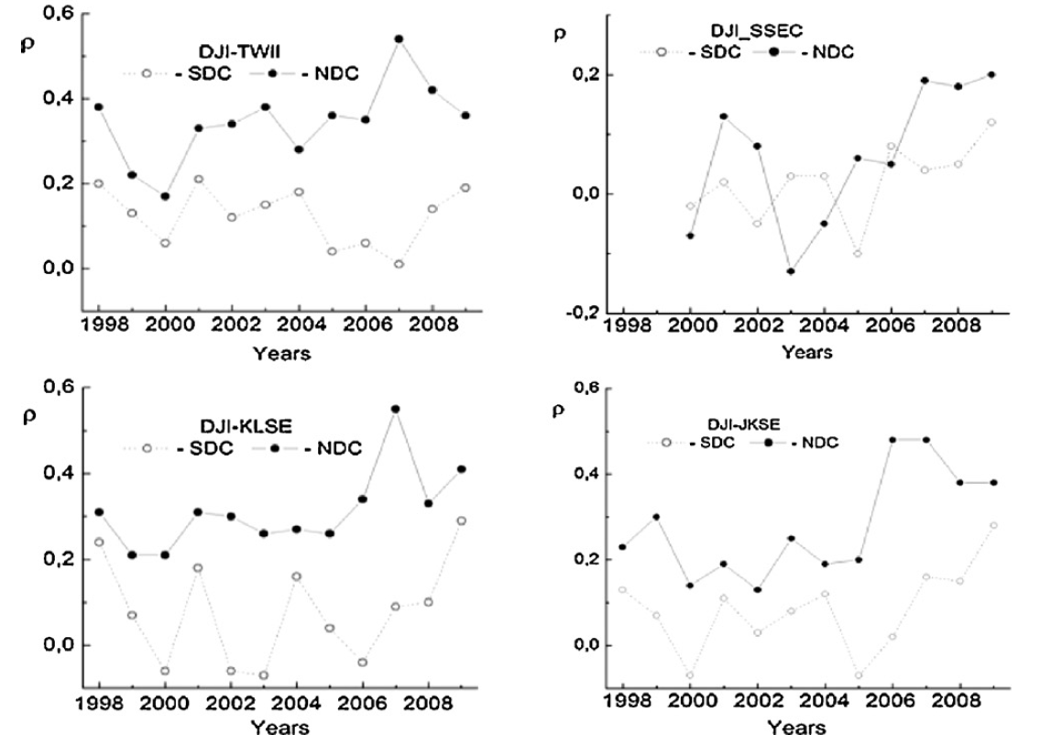
Correlations between Dow Jones and Nasdaq indices
世界各地有許多的國家，他們股市交易的時間是不重疊的。
舉例來說： Americas vs. Asia-Pacific、 America vs. Oceania、 America vs. Eastern Europe、
Western Europe vs. Asia-Pacific
此篇論文是使用 Americas vs. Asia-Pacific 組合做實驗
道瓊 vs. 亞太地區 股市
日經
南韓綜合指數
台灣加權指數
上海證券綜指
新加坡海峽時報指數
香港恆生
馬來西亞
印尼雅加達綜合指數

Slide 15
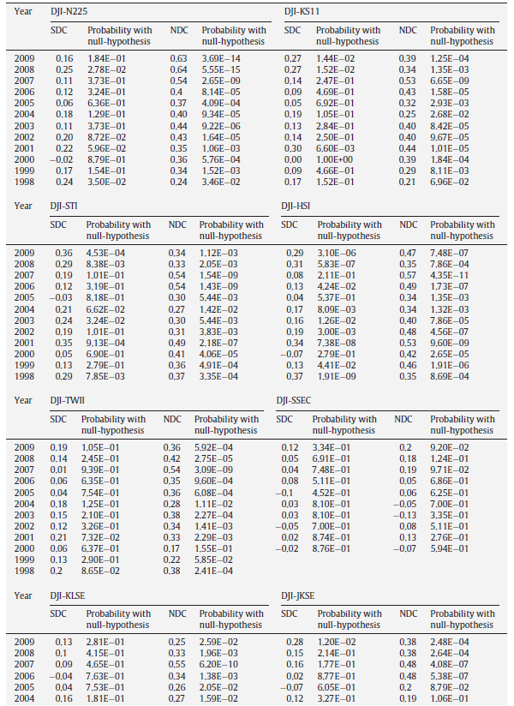
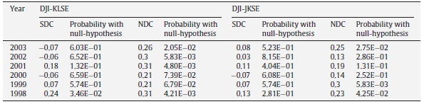
道瓊 vs. 亞太地區 股市
詳細實驗數據

Slide 16
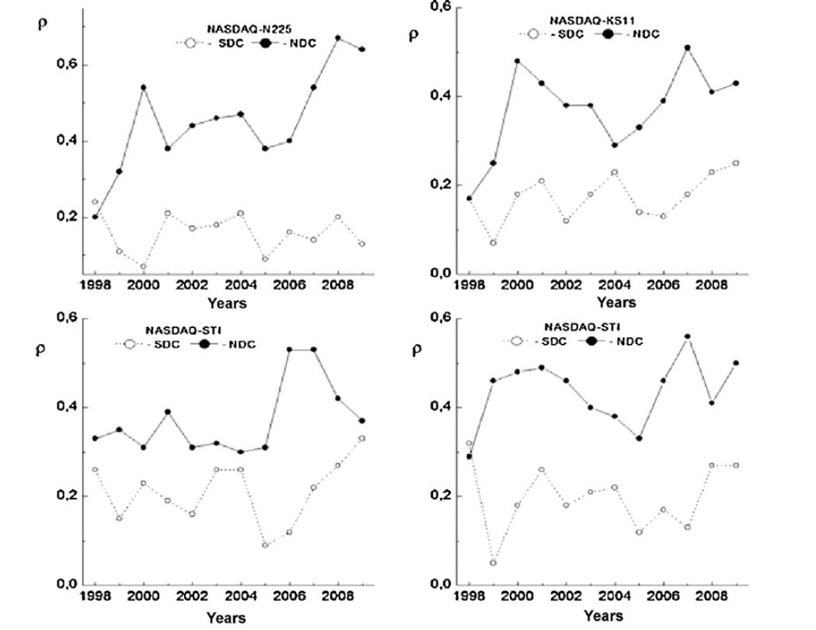
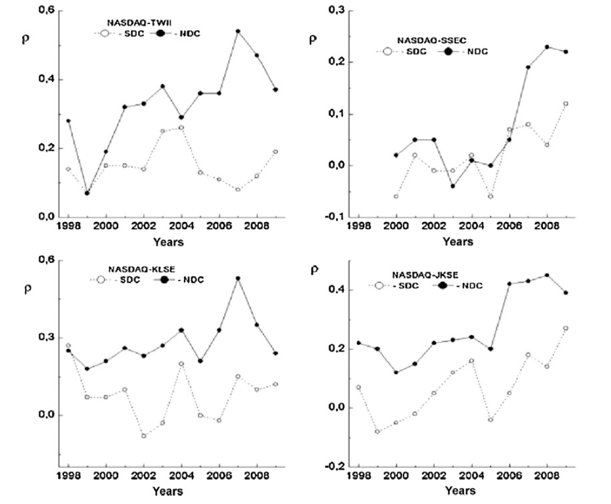
Nasdaq vs. 亞太地區 股市

Slide 17
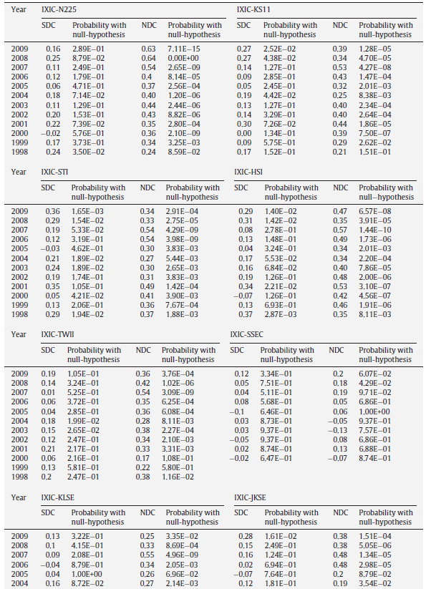
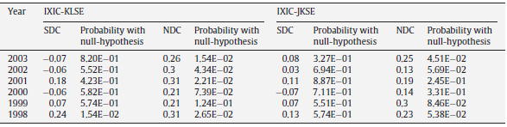
Nasdaq vs. 亞太地區 股市
詳細實驗數據

Slide 18
Discussion
U.S.對於亞太地區股市指數之SDC值在統計上為不明顯的（相關低），除了DJI-STI和DJI-HSI兩者在某幾年全球經濟金融不穩定時，較明顯一些以外。
U.S.對於亞太地區股市指數之NDC值在統計上為明顯的（相關高），除了DJI-SSEC（上海綜指）不明顯之外。
通常SDC值小於NDC值，NDC依此篇實驗來說是能找出股市之間的因果關係。
中國上海綜指與美國兩指數皆呈現低相關，雖然中國為股市引領指標之一，但他有巨大的內部市場，可完全抵銷全球化。
已開發先進國家相對開發中國家來說，NDC值是比較顯著的。

Slide 19
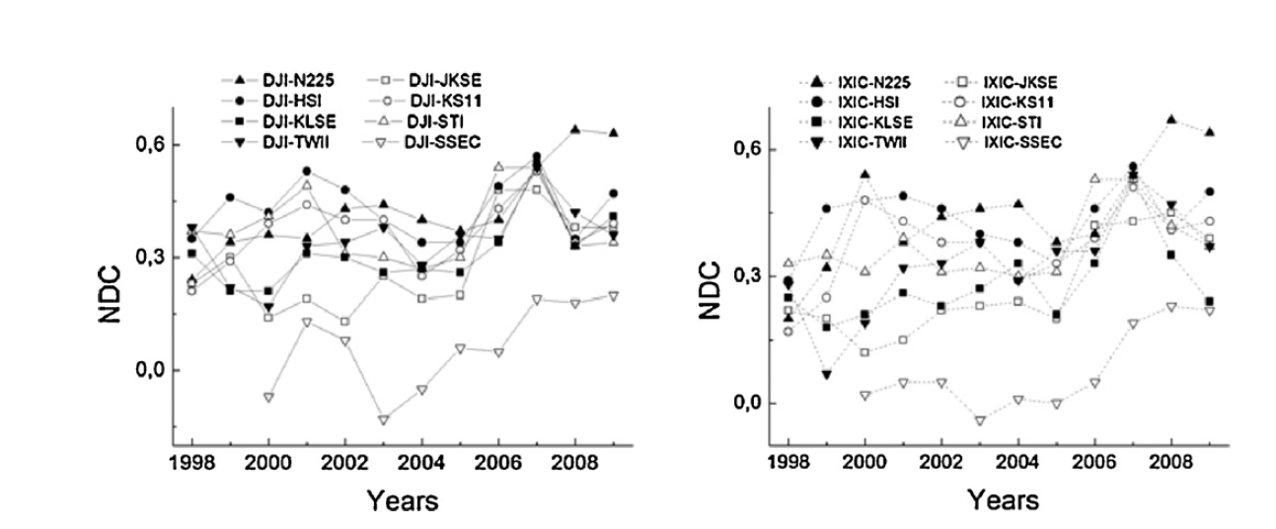

Slide 20
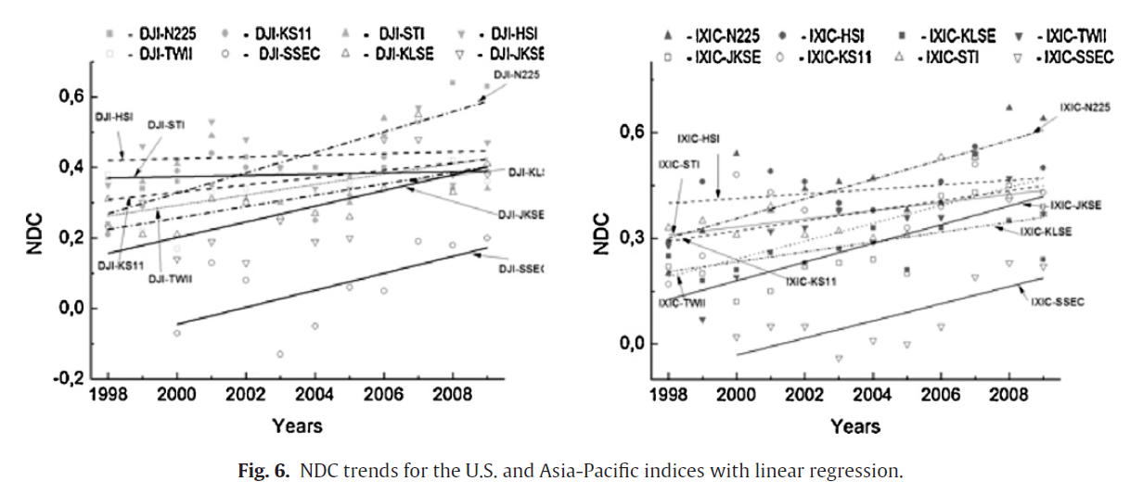

Slide 21
Conclusion

