Slide 1
A Linear Space Algorithm for Computing Maximal Common Subsequences
Communications of the ACM
Volume 18 Number 6 pp. 341-343 June 1975
D.S. Hirschberg
Princeton University
Presenter : Bo-Xian Chen
Date : 2016/10/18

Slide 2
Outline
Abstract
LCS
How to work?
Algorithm & Time and Space Analysis
A
B
C

Slide 3
Abstract
The problem of finding a longest common subsequences of two strings has been solved in quadratic time and space. An algorithm is presented which will solve this problem in quadratic time and in linear space.

Slide 4
Longest Common Subsequence(LCS)
Suppose two string A, B
A = “abyxabx” B = “bbyax”
We can find common subsequences in two strings A, B :
common subsequences : b, by ,ax …
but there will be a longest common subsequence in both of them .
longest common subsequences : byax

Slide 5
LCS – How to work?
Suppose two strings A_{1m} , B_{1n} , and a Largest common subsequence C(i, j)
Let A_{1m} = a₁ a₂ ... a_{m} , B_{1n} = b₁ b₂ ... b_{n} , C(i, j)=c₁c₂c_{3…}c_{p}
If a_{i} = b_{j} and taking c_{p} = a_{i} → (A_{1,i-1}, B_{1,j-1}) + 1
If a_{i} ≠ b_{j} and taking c_{p} = a_{i} → (A_{1,i}, B_{1,j-1}) (∵ B_{j} is not used
If a_{i} ≠ b_{j} and taking c_{p} = b_{j} → (A_{1,i-1}, B_{1,j}) (∵ A_{i} is not used

Slide 6
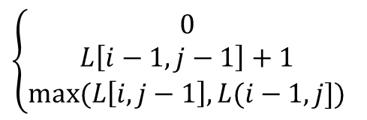
Algorithm A
ALG A(m, n, A, B, L)
Initialization:
L(i,0) ←0 [i=0…m]
L(0,j) ←0 [j=0…n]
for i ← 1 to m do
begin
for j ← 1 to n do
If A(i) = B(j) then L(i , j) ← L(i-1 , j-1) + 1
else L(i , j) ←max{L(i , j-1) , L(i-1 , j)}
end
Suppose two strings A, B A : abyx
B : bby
B A | Ø | b | b | y
Ø | 0 | 0 | 0 | 0
a | 0 | 0 | 0 | 0
b | 0 | 0 | 0 | 0
y | 0 | 0 | 0 | 0
x | 0 | 0 | 0 | 0
B A | Ø | b | b | y
Ø | 0 | 0 | 0 | 0
a | 0 | 0 | 0 | 0
b | 0 | 1 | 1 | 1
y | 0 | 1 | 1 | 2
x | 0 | 1 | 1 | 2
Let matrix L be notation of maximum length of A and B
$$\left\{\begin{aligned}0 \\ L\left[i−1, j−1\right]+1 \\ max⁡(L\left[i, j−1\right], L(i−1, j])\end{aligned}\right.$$
if i=0 or j=0
Execution : mn times
Input and output arrays : m+n+(m+1)(n+1)
Time complexity : O(mn) Space complexity : O(mn)
L[i, j] =
if i, j >0 and a_{i} = b_{i}
if i, j >0 and a_{i} ≠ b_{i}

Slide 7
Algorithm B
ALG B(m, n, A, B, LL)
Initialization:
K(1, j) ←0 [j=0…n]
for i ← 1 to m do
Begin
K(0, j) ← K(1, j) [j=0…n]
for j ← 1 to n do
if A(i) = B(j) then K(1 , j) ← K(0 , j-1) + 1
else K(1 , j) ←max{K(1, j-1), K(0, j)}
end
LL(j) ←K(1, j) [j=0…n]
[Induction]
For i =1 , L(i-1, j)=L(0, j) = 0 (statement 1 of ALG A )
∵K(1, j) ←0 [j=0…n] , K(0, j) ← K(1, j) [j=0…n]
L(i-1, j) = K(0, j)
Assume K(0, j) =L(i-1, j) , then K(1, j) =L(i, j) since the statements within the inner loops of ALG A and ALG B are equivalent .
K(0, j)=L(i, j)
inner loops of ALG A and ALG B are equivalent .
K(1, j)=L(i+1, j)
L(i,1) L(i,2) … L(i,n) requires only row i-1 of matrix L .
B A | Ø | b | b | y
Ø | 0 | 0 | 0 | 0
a | 0 | 0 | 0 | 0
b | 0 | 1 | 1 | 1
y | 0 | 1 | 1 | 2
x | 0 | 1 | 1 | 2
j | 0 | 1 | … | n-1 | n
0 | 0 | 0 | … | 0 | 0
1 | 0 | 0 | … | 0 | 0
K(0, j)
i
K(1, j)

Slide 8
Algorithm B (Cont'd)
j | 0 | 1 | 2 | 3
0 | 0 | 0 | 0 | 0
1 | 0 | 0 | 0 | 0
ALG B(m, n, A, B, LL)
Initialization:
K(1, j) ←0 [j=0…n]
for i ← 1 to m do
Begin
K(0, j) ← K(1, j) [j=0…n]
for j ← 1 to n do
if A(i) = B(j) then K(1 , j) ← K(0 , j-1) + 1
else K(1 , j) ←max{K(1, j-1), K(0, j)}
end
LL(j) ←K(1, j) [j=0…n]
Suppose two strings A, B A : abyx
B : bby
j | 0 | 1 | 2 | 3
0 | 0 | 0 | 0 | 0
1 | 0 | 0 | 0 | 0
j | 0 | 1 | 2 | 3
0 | 0 | 0 | 0 | 0
1 | 0 | 1 | 1 | 1
K(0, j)
K(0, j)
K(1, j)
K(1, j)
j | 0 | 1 | 2 | 3
0 | 0 | 1 | 1 | 1
1 | 0 | 1 | 1 | 2
j | 0 | 1 | 2 | 3
0 | 0 | 1 | 1 | 2
1 | 0 | 1 | 1 | 2
K(0, j)
K(0, j)
K(1, j)
K(1, j)
Execution : mn times
Input and output arrays : m+n+(n+1)*2
Time complexity : O(mn) Space complexity : O(m+n)

Slide 9
Algorithm C
Using Algorithm B for appropriate substrings of A and B will enable us to recover a maximal common subsequence of A and B in linear space .
Let i to be m/2 : A_{1i} 、A_{i+1,m} ,
Find j (0≦ j≦n) to determine a prefix B₁ of B which can be matched with the first half A₁ of A , and suffix B₂ of B matched with the last half A₂ of A = LCS(A, B)
i
m-i
i | 1 | 2 | 3 | … | i-1 | i | i+1 | … | m-3 | m-2 | m-1 | m

Slide 10
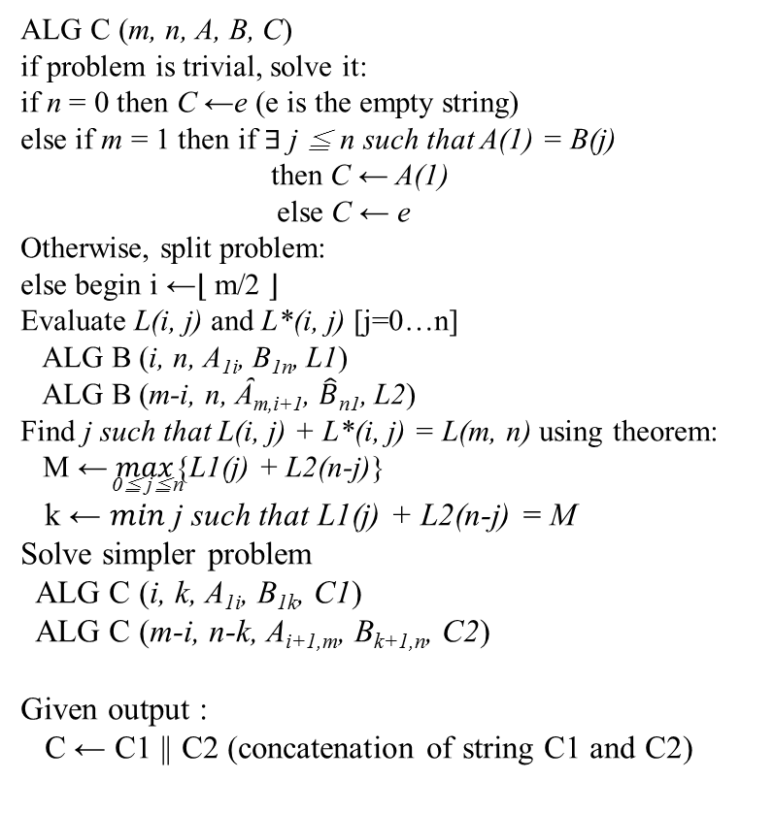
Algorithm C (Cont'd)
ALG C (m, n, A, B, C)
if problem is trivial, solve it:
if n = 0 then C ←e (e is the empty string) else if m = 1 then if ∃ j ≦ n such that A(1) = B(j)
then C ← A(1)
else C ← e
Otherwise, split problem:
else begin i ←⌊ m/2 ⌋
Evaluate L(i, j) and L*(i, j) [j=0…n]
ALG B (i, n, A_{1i}, B_{1n}, L1)
ALG B (m-i, n, Ȃ_{m,i+1}, $\hat{B}$_{n1}, L2)
Find j such that L(i, j) + L*(i, j) = L(m, n) using theorem: M ← $max${L1(j) + L2(n-j)}
0≦ j≦n
k ← $min$ j such that L1(j) + L2(n-j) = M
Solve simpler problem
ALG C (i, k, A_{1i}, B_{1k}, C1)
ALG C (m-i, n-k, A_{i+1,m}, B_{k+1,n}, C2)
Given output :
C ← C1 || C2 (concatenation of string C1 and C2)
Suppose two strings A, B A : abyx
B : bby
A_{1,i} : ab
A : abyx
Ȃ_{m,i+1} : xy
ALG B (2, 3, “ab”, “bby”,L1)
ALG B (2, 3, “xy”, “ybb”,L2)
j | 0 | b | b | y
0 | 0 | 0 | 0 | 0
a | 0 | 0 | 0 | 0
j | 0 | y | b | b
0 | 0 | 0 | 0 | 0
x | 0 | 0 | 0 | 0
j | 0 | b | b | y
0 | 0 | 0 | 0 | 0
b | 0 | 1 | 1 | 1
j | 0 | y | b | b
0 | 0 | 0 | 0 | 0
y | 0 | 1 | 1 | 1
L1
L2

Slide 11
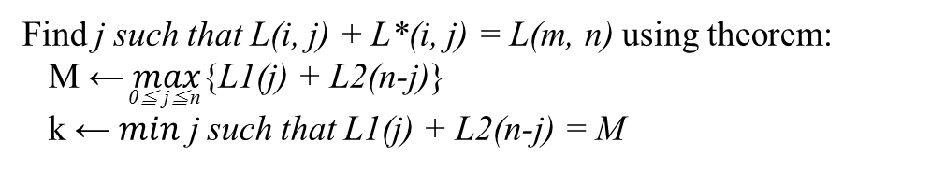
Algorithm C (Cont'd)
Find j such that L(i, j) + L*(i, j) = L(m, n) using theorem: M ← $max${L1(j) + L2(n-j)}
0≦ j≦n
k ← $min$ j such that L1(j) + L2(n-j) = M
j | 0 | b | b | y
0 | 0 | 0 | 0 | 0
b | 0 | 1 | 1 | 1
j | 0 | y | b | b
0 | 0 | 0 | 0 | 0
y | 0 | 1 | 1 | 1
L1
L2
For j = 0 , L1(0) + L2(3) = 1
For j = 1 , L1(1) + L2(2) = 2 ← Max ； j = 1 → k = 1
For j = 2 , L1(2) + L2(1) = 2
For j = 3 , L1(3) + L2(0) = 1
Solve simpler problem
ALG C (i, k, A_{1i}, B_{1k}, C1)
ALG C (m-i, n-k, A_{i+1,m}, B_{k+1,n}, C2)
ALG C (2, 1, A₁₂, B₁₁ , C1)
ALG C (2, 2, A₃₄, B₂₃ , C2)

Slide 12
Algorithm C (Cont'd)
ALG B (1, 1, A₁₁, “b”, C1)
ALG B (1, 1, “a”, “b”, C1)
ALG C (2, 1, A₁₂, B₁₁ , C1)
ALG C (2, 2, A₃₄, B₂₃ , C2)
ALG B (1, 1, A₂₂, “b” , C1)
ALG B (1, 1, “b”, “b”, C1)
ALG B (1, 2, A₃₃, B₂₃, C2)
ALG B (1, 2, “y”, “by”, C2)
ALG B (1, 2, A₄₄, B₂₃, C2)
ALG B (1, 2, “x”, “by”, C2)

Slide 13
Algorithm C (Cont'd)
concatenation of string C1 and C2
ALG B (1, 1, “a”, “b”, C2)
e
ALG B (1, 1, “b”, “b”, C2)
b
“by”
LCS(abyx, bby)
ALG B (1, 2, “y”, “by”, C2)
y
ALG B (1, 2, “x”, “by”, C2)
e

Slide 14
Algorithm C (Cont'd)
ALG C (m, n, A, B, C)
if problem is trivial, solve it:
if n = 0 then C ←e (e is the empty string) else if m = 1 then if ∃ j ≦ n such that A(1) = B(j)
then C ← A(1)
else C ← e
Otherwise, split problem:
else begin i ←⌊ m/2 ⌋
Evaluate L(i, j) and L*(i, j) [j=0…n]
ALG B (i, n, A_{1i}, B_{1n}, L1)
ALG B (m-i, n, Ȃ_{m,i+1}, $\hat{B}$_{n1}, L2)
Find j such that L(i, j) + L*(i, j) = L(m, n) using theorem: M ← $max${L1(j) + L2(n-j)}
0≦ j≦n
k ← $min$ j such that L1(j) + L2(n-j) = M
Solve simpler problem
ALG C (i, k, A_{1i}, B_{1k}, C1)
ALG C (m-i, n-k, A_{i+1,m}, B_{k+1,n}, C2)
Given output :
C ← C1 || C2 (concatenation of string C1 and C2)
Time complexity : O(mn)
Space complexity : O(m+n)

