Slide 1
Flower Image Retrieval with Category Attributes
Lin Li, Yu Qiao
2014 4th IEEE International Conference on Information Science and Technology (ICIST)
Presenter: Tsai-Ming Sun
Date:2015/3/31

Slide 2
abstract
In this paper, we recommend a mid-level representation, category attributes, for content based flower image retrieval. Low-level features have been utilized in images for retrieval. However, even though these features are efficient, the similarity between low-level features may differ from high level human perception, known as semantic gap. In real life, it is very usual to use attributes, a domain specific terminology, to describe the visual appearance of objects. Inspired by this, we utilize category attributes, i.e. daisy, buttercup or iris to construct semantic representation of flower images. For each category attribute, we train a linear SVM based on low level visual features, containing the appearance of color, texture and shape. Outputs of these classifiers are regarded as attribute features. Then we use distances between attribute features for flower retrieval. This method was evaluated on 17 Category Flower Dataset. Experimental results show that attribute based representation outperforms low-level features in terms of mean-average precision.

Slide 3
Low-level image feature
HSV
SIFT
Local Binary Pattern(LBP)

Slide 4
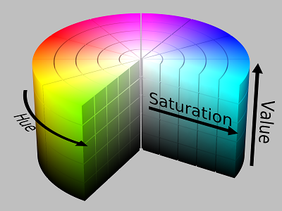
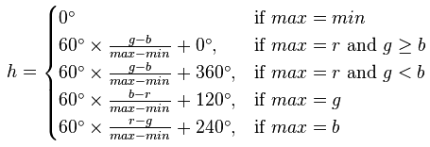

HSV
一種將RGB色彩模型中的點在圓柱坐標系中的表示法。
H(色相,Hue)
S(飽和度,Saturation)
V(明度,value)
max: max(r,g,b)
min: min(r,g,b)

Slide 5
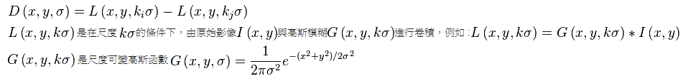
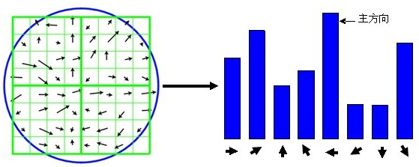
SIFT(Scale-invariant feature transform)
一種圖像匹配演算法，同時能處理亮度、平移、旋轉、尺度的變化，利用特徵點的配對來尋找圖像之間的對應關係。
DoG(Difference of Gaussians)

Slide 6
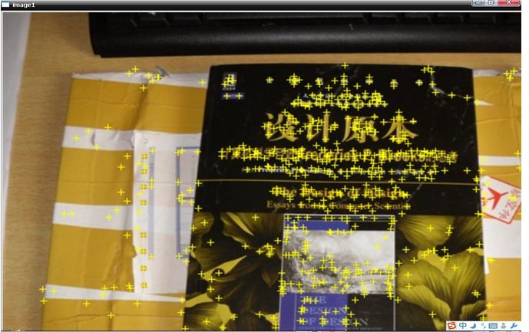
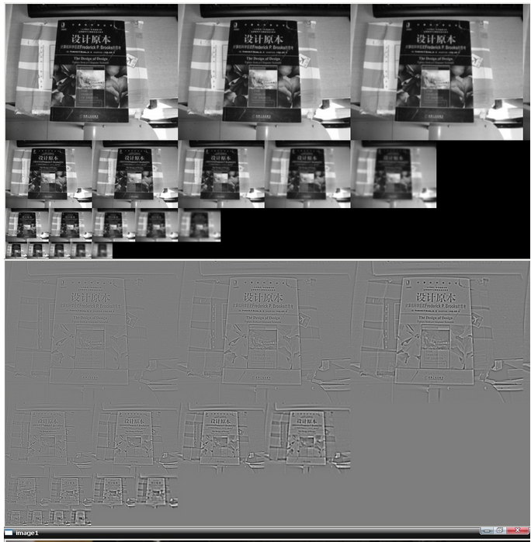
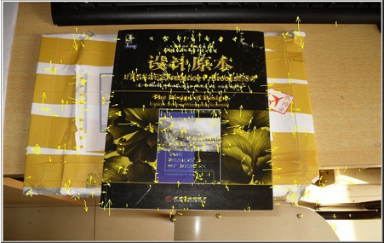
SIFT

Slide 7
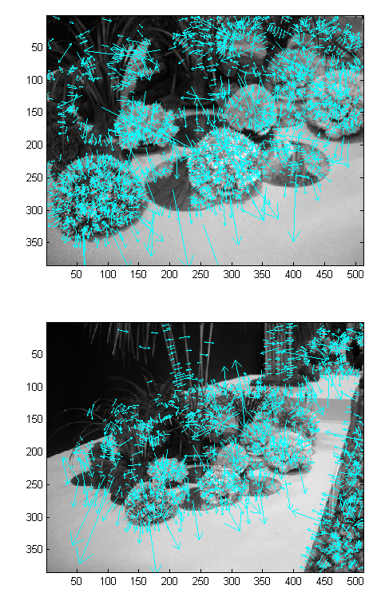
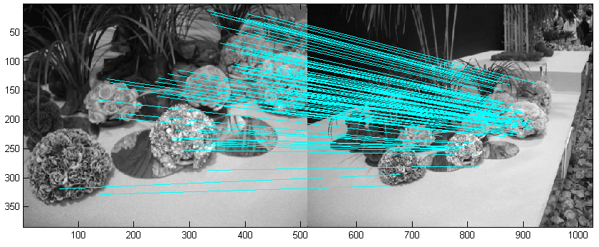
SIFT

Slide 8
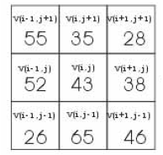
LBP
LBP是一種用來描述區域紋理變化的特徵計算方式。其計算速度非常的快，相當適合使用在真實的即時系統之中。而缺點則是在平滑影像上的效果差強人意(例如:天空or海洋)，因為平滑影像的灰階值太過相近。
先將周圍的灰階與中心點相減之後做二值化(Threholding)。像這樣： 55-43=＋12>0 則二值化後，其值=1 35-43=－08<0 則二值化後，其值=0 28-43=－15<0 則二值化後，其值=0 52-43=＋09>0 則二值化後，其值=1

Slide 9
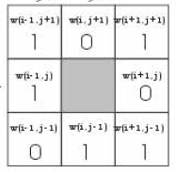
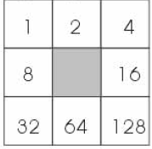
依照2的次方排列相關位置的權重。由左到右，由上到下分別是 2的0次方=1、2的1次方=2、2的2次方=4、2的3次方=8，以此類推。因此會形成下面的權重方塊。
將權重方塊在第一步得到的結果相乘以後再相加 1X1+0X2+1X4+1X8+0X16+0X32+1X64+1X128=205 就是這3X3區塊的LBP值。

Slide 10

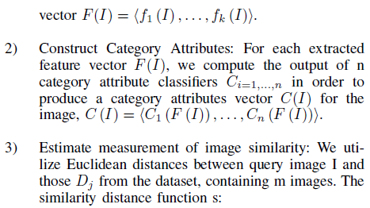

Estimate measurement of image similarity
we compute the Euclidean distances between the query and images from the dataset

Slide 11
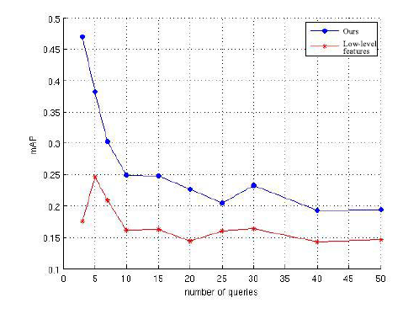





EXPERIMENTS AND RESULTS

Slide 12
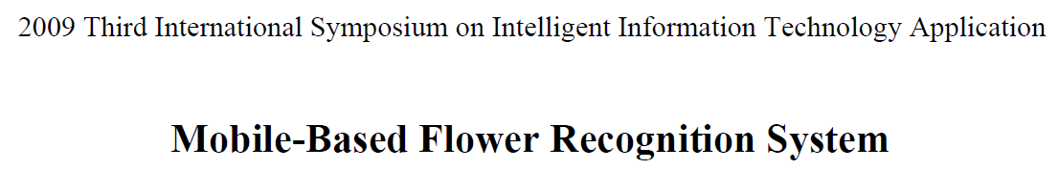
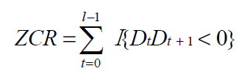
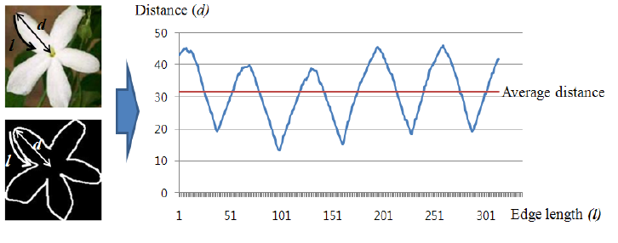
ZCR(zero-crossing rate)
where D is a value of d -average_d and the indicator function I{A} is 1, if its argument A is true and 0 otherwise.

