Slide 1
Computational Methods for Protein Structure Prediction
Student: Hsin-Chuan Yuan (袁信全)
Advisor: Prof. Chang-Biau Yang (楊昌彪)
Date: Mar. 31, 2015
Notes:
利用工具偏好分類與特徵選取之蛋白質骨幹重建

Slide 2
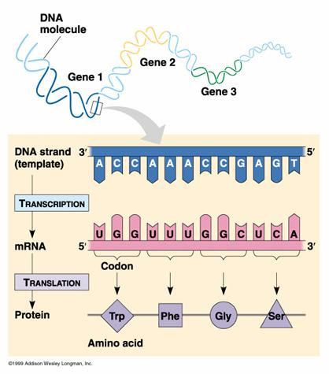
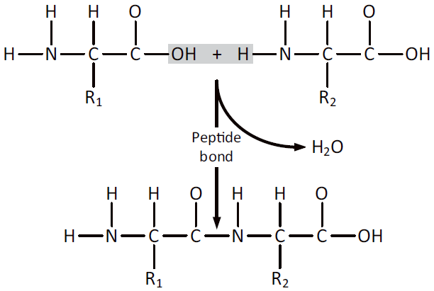
Introduction
蛋白質由DNA轉錄成mRNA，再經過轉譯和一連串脫水反應，連結成串而得。
Peptide bond and backbone

Slide 3
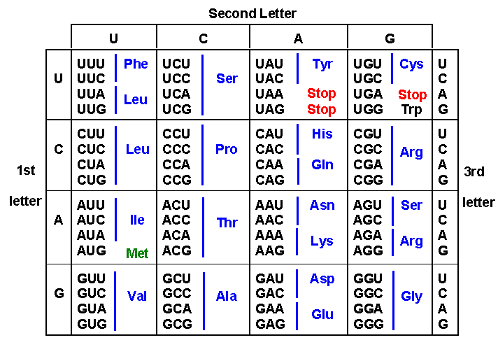
Introduction
Proteins通常指以折疊型態呈現的較大多肽分子(約包含50個以上胺基酸殘基)，Peptides則指較小的多肽分子(約包含50個以下胺基酸殘基)。
生物細胞中用來合 成蛋白質的胺基酸 共有20種。

Slide 4
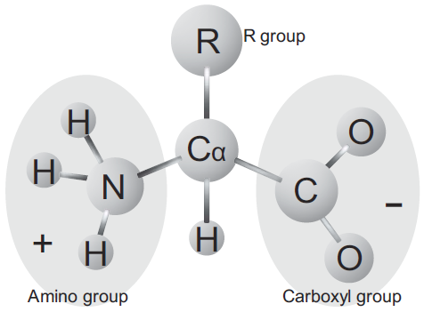
Introduction
 | Amino Acid | Three-letter Abbreviation | One-letter Abbreviation
1 | Alanine | Ala | A
2 | Arginine | Arg | R
3 | Asparagine | Asn | N
4 | Aspartic Acid | Asp | D
5 | Cysteine | Cys | C
6 | Glutamic Acid | Glu | E
7 | Glutamine | Gln | Q
8 | Glycine | Gly | G
9 | Histidine | His | H
10 | Isoleucine | Ile | I
11 | Leucine | Leu | L
12 | Lysine | Lys | K
13 | Methionine | Met | M
14 | Phenylalanine | Phe | F
15 | Proline | Pro | P
16 | Serine | Ser | S
17 | Threonine | Thr | T
18 | Tryptophan | Trp | W
19 | Tyrosine | Tyr | Y
20 | Valine | Val | V
A protein is a consecutive chain of amino acids. Each amino acid possesses a variety of properties.
The fundamental structure of Alanine.

Slide 5
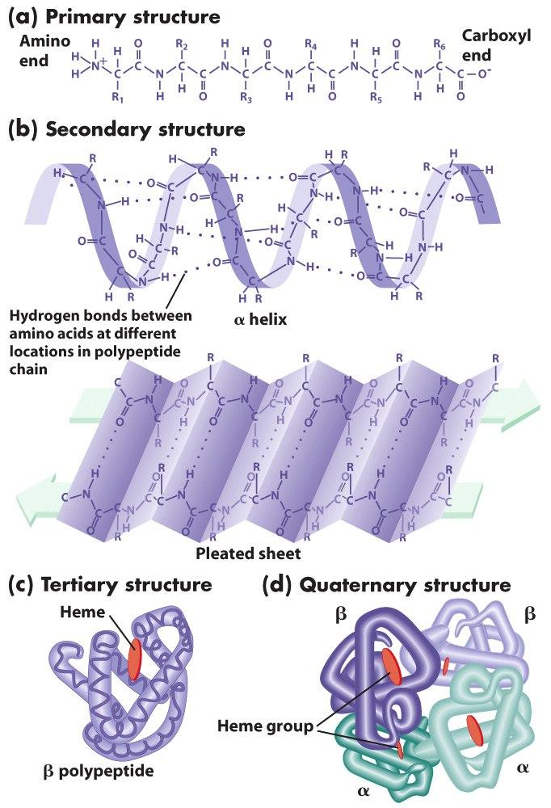
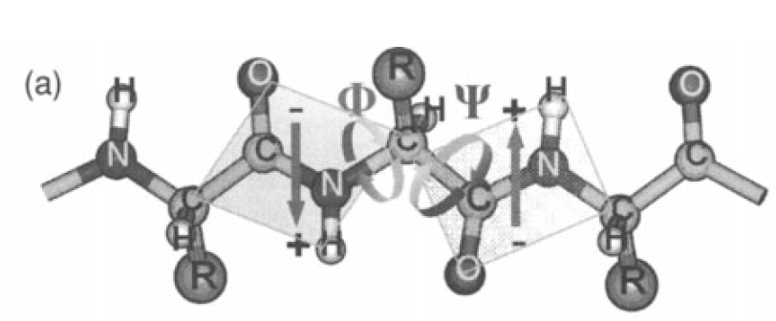
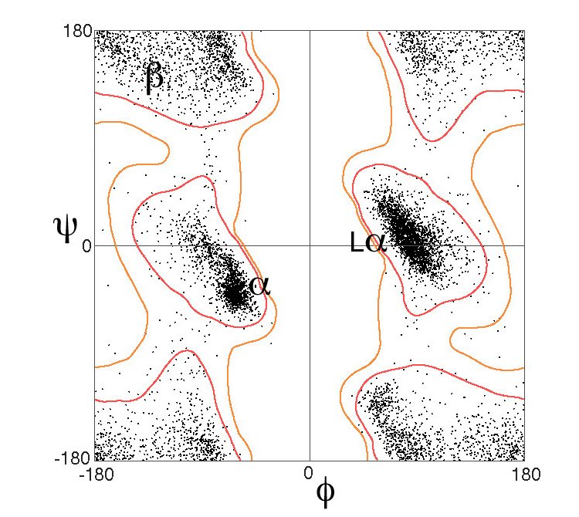
Introduction
Ramachandran plot

Slide 6
Introduction
1955年英國生化學家 Frederick sanger 由實驗辨識出胰島素的序列，1958年獲得諾貝爾化學獎。
1954年美國生化學家 Christian Anfinsen 發現牛胰核糖核酸酶會自然地摺疊成固定立體結構，後稱 native conformation。以及發現蛋白質暴露在極端環境後會展開，在回到育設環境後很快的又折疊回來。1972年獲得諾貝爾化學獎。
根據 Anfinsen 的實驗得知，蛋白質的胺基酸序列包含了其建立三級結構所需的資訊。此外蛋白質的功能取決於其立體結構，若直接從基因推測其編碼蛋白質，即可推導出對應的生物學功能。因此，研究蛋白質摺疊的過程，可以說是破譯「第二遺傳密碼」—摺疊密碼（folding code）的過程。

Slide 7
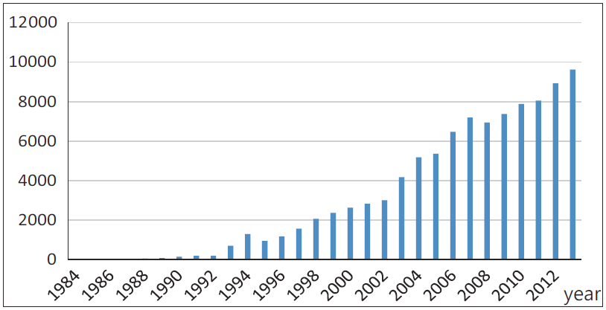
Introduction
Critical assessment of protein structure prediction (CASP) is a world-wide experiments and contest for protein structure prediction.
Protein data bank (PDB) archive contains information about the 3D structures of proteins and nucleic acids.
The numbers of the protein structures deposited to PDB per year.

Slide 8
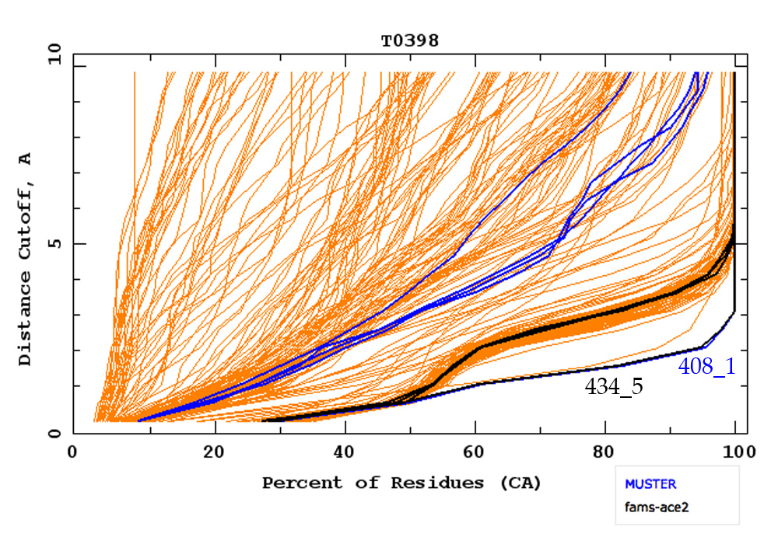
Evaluation- Cumulative plot of α-carbon accuracy
Cumulative plot of α-carbon accuracy, of all predicted models for target T0398 in CASP8, with the two best models labeled. Created on the CASP Prediction Center site.

Slide 9
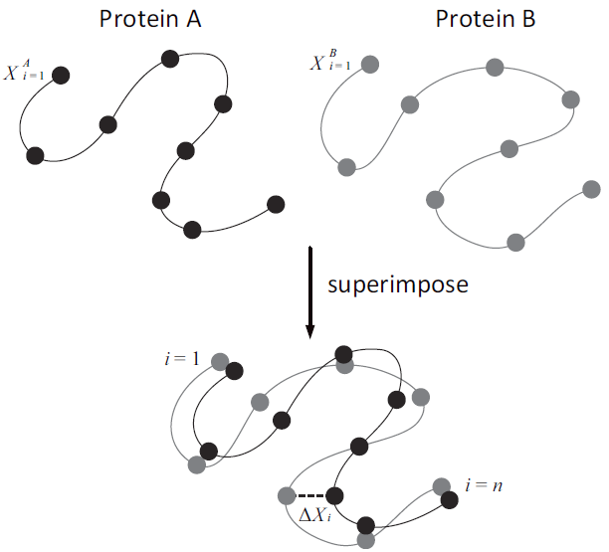
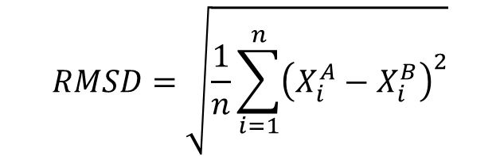
Evaluation- Root Mean Square Deviation (RMSD)
The RMSD is a measure of similarity between a predicted structure and a real one.
RMSD formula:
$$RMSD=\sqrt{\frac{1}{n}\sum_{i=1}^{n}{{\left(X_{i}^{A}−X_{i}^{B}\right)}^{2}}}$$

Slide 10
Evaluation- TM-score
TM-score is a recently proposed scale for measuring the structural similarity between two structures. The purpose of proposing TM-score is to solve the problem of RMSD which is sensitive to the local error. Because RMSD is an average distance of all residue pairs in two structures, a local error (e.g. a misorientation of the tail) will arise a big RMSD value although the global topology is correct. In TM-score, however, the small distance is weighted stronger than the big distance which makes the score insensitive to the local modeling error. A TM-score >0.5 indicates a model of correct topology and a TM-score<0.17 means a random similarity. These cutoff does not depends on the protein length.

Slide 11

Evaluation- TM-score
Where and are the lengths of the target protein and the aligned region respectively. is the distance between the th pair of residues and
is a distance scale that normalizes distances.

Slide 12
Evaluation- Global Distance Test
GDT-TS measure performs sequence-independent superposition of the model and the native structure and calculates the number of structurally equivalent pairs of Cα atoms that are within specified distance d. The GDT-TS score is the average of four scores obtained with d = 1, 2, 4 and 8 Å divided by the number of residues of the target. Despite being slow, GDT-TS is the standard measure used in CASP.
GDT-TS = 100 * (n1 + n2 + n4 + n8) / (4 * a), where n1, n2, n4, n8 is the number of aligned residues within 1, 2, 4, 8 angstroms, respectively, and a is the aligned-length. Note that GDT-TS is a percentage.

Slide 13
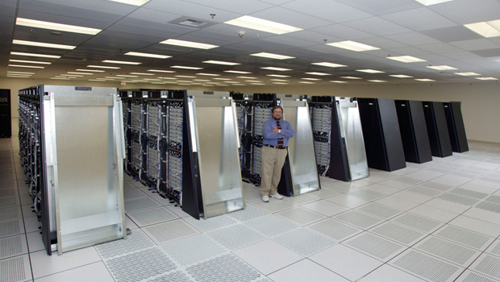
Ab Initio Protein Structure Prediction
早期使用熱力學，試圖找到最小能量的結構。然而根據利文索爾佯謬，假定一個由100個胺基酸殘基組成的蛋白質，其每個胺基酸殘基有2種構象，那麼該蛋白質的總構象數目即2¹⁰⁰ ，再假定此蛋白質在尋找總能量最低的構象狀態時每嘗試一次構象耗時10⁻¹³ s，則將所有構象都嘗試過試遍的所需時間將是4 X 10⁹年。
分子力學方法 (模擬蛋白質的運動)
牛頓運動定律, 共價鍵, 凡德瓦力, 氫鍵, 疏水反應…
IBM’s Blue Gene project
布朗運動方法
蒙地卡羅隨機模擬方法
目前廣泛使用在優化低 清晰度的model。

Slide 14
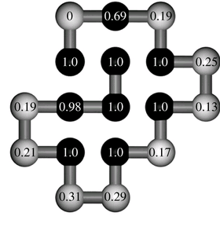
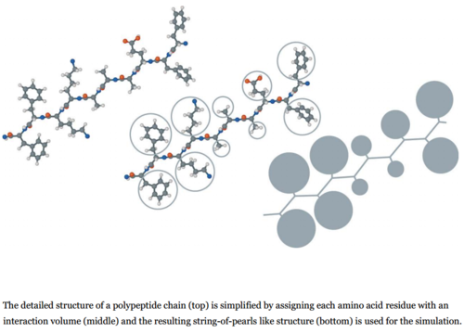
Ab Initio Protein Structure Prediction
Reduced Model
Lattice models (1989)
The HP model, proposed by Lau and Dill.
Levitt and Warshel model (1975)
Representing the residues as two center(Cα, centroid of the side chain)
Resulting the backbone RMSD in the range of 6.5Å.
The Nobel Prize in Chemistry 2013 was awarded jointly to Martin Karplus, Michael Levitt and Arieh Warshel "for the development of multiscale models for complex chemical systems".

Slide 15
Homology modeling
Browne(1969) 溶菌酶 → α-乳清蛋白
Proteins that have similar sequences usually have similar structures.
Protein structures are more conserved than their sequences.
Steps:
Detection of a suitable template.
An alignment is produced.
Insertions, deletions and residue replacements are performed.
The model is optimized using energy minimization.

Slide 16
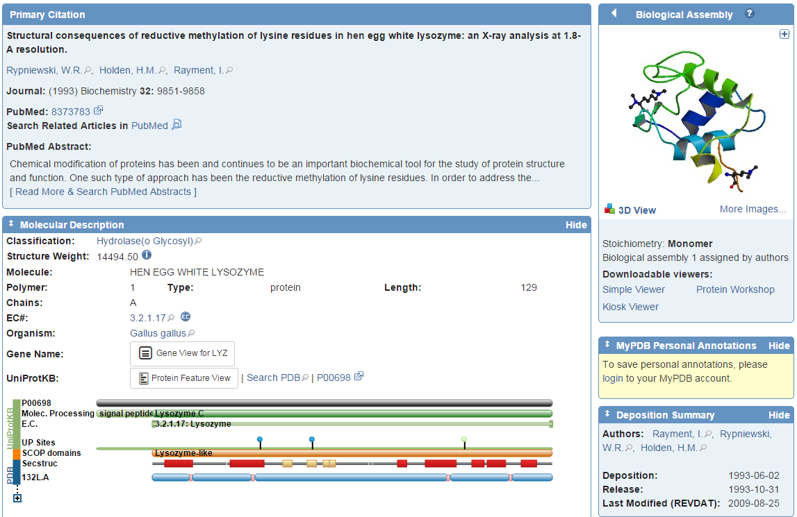

Slide 17
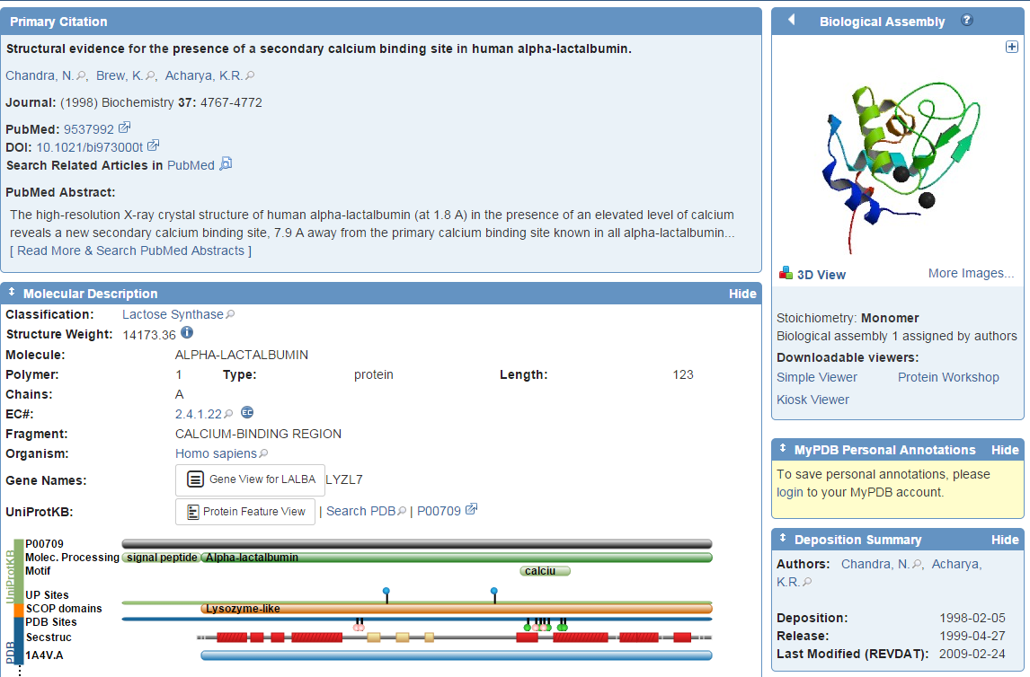

Slide 18
>132L:A|PDBID|CHAIN|SEQUENCE
KVFGRCELAAAMKRHGLDNYRGYSLGNWVCAAKFESNFNTQATNRNTDGSTDYGILQINSRWWCNDGRTPGSRNLCNIPC
SALLSSDITASVNCAKKIVSDGNGMNAWVAWRNRCKGTDVQAWIRGCRL
>1A4V:A|PDBID|CHAIN|SEQUENCE
KQFTKCELSQLLKDIDGYGGIALPELICTMFHTSGYDTQAIVENNESTEYGLFQISNKLWCKSSQVPQSRNICDISCDKF
LDDDITDDIMCAKKILDIKGIDYWLAHKALCTEKLEQWLCEKL

Slide 19
Protein Threading / fold recognition
Protein Threading is a method of protein modeling which is used to model those proteins which have the same fold as proteins of known structures, but migh not have homologous proteins with known structure.
Threading problem: identifying appropriate templates.
Structure-sequence alignment 將胺基酸序列表示為一系列的 environmental feature (二級結構, 可溶性, 疏水性)，已統計其環境相容性。
Statistical potential 觀察蛋白質內一對胺基酸彼此在空間上的距離。
Sequence-profile alignments PSI-BLAST PSSM

Slide 20
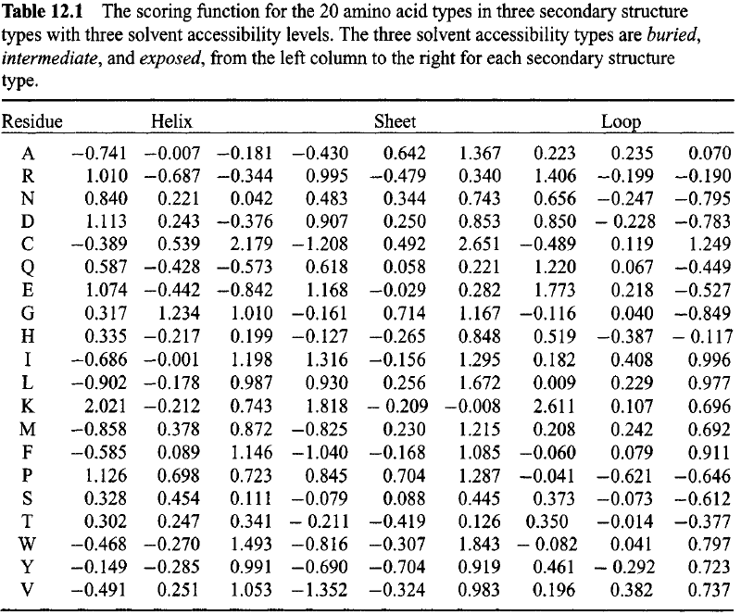
Protein Threading / fold recognition
Protein Threading is a method of protein modeling which is used to model those proteins which have the same fold as proteins of known structures, but do not have homologous proteins with known structure.
Threading problem: identifying appropriate templates.
Structure-sequence alignment 將胺基酸序列表示為一系列的 environmental feature (二級結構, 可溶性, 疏水性)
Statistical potential

Slide 21
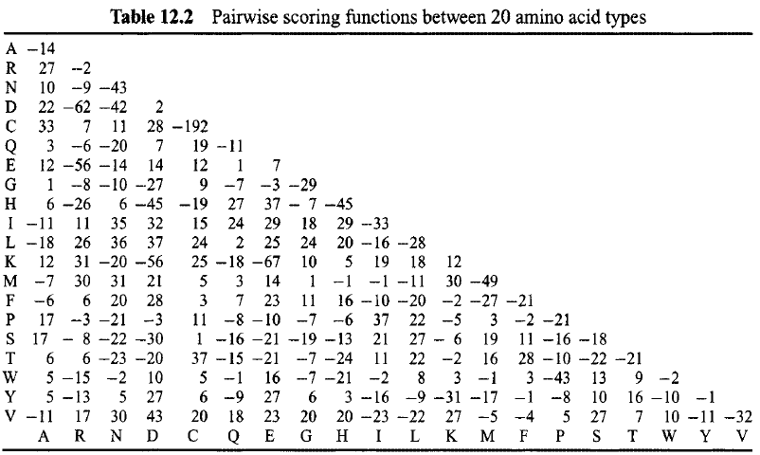
Protein Threading / fold recognition

Slide 22
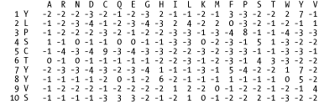
position-specific scoring matrix (PSSM)
A PSSM is a type of scoring matrix used in protein BLAST searches in which amino acid substitution scores are given separately for each position in a protein multiple sequence alignment.

Slide 23
Conclusions and Future Work

