Slide 1
A Fast Algorithm for Computing Longest Common Subsequences
Communications of the ACM
Volume 20 pp.350-353 May 1977
James W. Hunt
Stanford University
Thomas G. Szymanski
Princeton University
Presentor:Shih-Jhan Huang
Date:2015/10/13

Slide 2
Abstract
Previously published algorithms for finding the longest common subsequence of two sequences of length n have had a best-case running time of O(n²). An algorithm for this problem is presented which has a running time of O((r+n)logn), where r is the total number of ordered pairs of positions at which the two sequences match.
Thus in the worst case the algorithm has a running time of O(n²logn). However, for those applications where most positions of one sequence match relatively few positions in the other sequence, a running time of O(nlogn) can be expected.

Slide 3
The LCS Problem
Sequence X: TAGTCACG
Sequence Y: AGACTGTC
Common subsequences:GG, AGC, AGACG
Longest Common Subsequences: AGACG

Slide 4
The Longest Increasing Subsequence (LIS) Problem
Definition:
  Input: One numeric sequence S
  Output: The longest increasing subsequence in S
Example: Given S = 35274816, the LIS in S is 3578.
By applying the LCS algorithm, this problem can be
solved in O(n²) time.
Robinson-Schensted-Knuth Algorithm can solve the
LIS problem in O(nlogn) time.

Slide 5
Robinson-Schensted-Knuth Algorithm for LIS
Input
3
5
2
7
4
8
1
6
1
3
3
2
2
2
2
1
1
L
2
5
5
5
4
4
4
4
3
7
7
7
7
6
4
8
8
8
LIS: 3578
time complexity: O(nlogn)
  n numbers are inserted and each insertion takes O(logn) time for binary search.
5

Slide 6
Hunt-Szymanski LCS Algorithm
By extending the idea in RSK algorithm, the LCS problem
can be solved in O((r + n) log n) time, where r denotes the
number of matches.
This algorithm is faster than traditional dynamic
programming if r is small (in the worst case r = n²).
Time complexity:O((r + n) log n)
Worst case:O(n² log n)
6

Slide 7
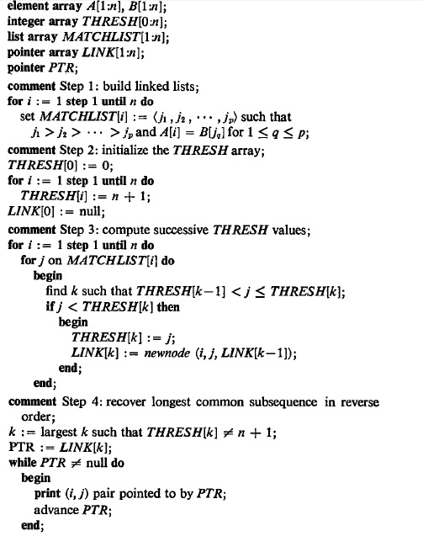
O(nlogn)
O(n)
O(n + rlogn)
O(n)

Slide 8
The Pairs of Matching
Input sequences: S_{X}=abcbdda and S_{Y}=badbabd
Pairs of matching:
MATCHLIST[1] = (5, 2)
MATCHLIST[2] = (6, 4, 1)
MATCHLIST[3] = ( )
MATCHLIST[4] = MATCHLIST[2]
MATCHLIST[5] = (7, 3)
MATCHLIST[6] = MATCHLIST[5]
MATCHLIST[7] = MATCHLIST[I]
 | b | a | d | b | a | b | d
a
b
c
b
d
d
a

Slide 9
Example for Hunt-Szymanski Algorithm
The insertion order is row major and column backward.
r
 | (1,5) | (1,2) | (2,6) | (2,4) | (2,1) | (4,6) | (4,4) | (4,1) | (5,7) | (5,3) | (6,7) | (6,3) | (7,5) | (7,2)
1 | (1,5) | (1,2) | (1,2) | (1,2) | (2,1) | (2,1) | (2,1) | (2,1) | (2,1) | (2,1) | (2,1) | (2,1) | (2,1) | (2,1)
2 |  |  | (2,6) | (2,4) | (2,4) | (2,4) | (2,4) | (2,4) | (2,4) | (5,3) | (5,3) | (5,3) | (5,3) | (7,2)
3 |  |  |  |  |  | (4,6) | (4,6) | (4,6) | (4,6) | (4,6) | (4,6) | (4,6) | (7,5) | (7,5)
4 |  |  |  |  |  |  |  |  | (5,7) | (5,7) | (5,7) | (5,7) | (5,7) | (5,7)
L
Time Complexity: O(r log n), r: # of matches
Each match needs O(log n) time for binary search.

Slide 10
Example for Hunt-Szymanski Algorithm
The insertion order is row major and column backward.
r
 | (1,5) | (1,2) | (2,6) | (2,4) | (2,1) | (4,6) | (4,4) | (4,1) | (5,7) | (5,3) | (6,7) | (6,3) | (7,5) | (7,2)
1 | (1,5) | (1,2) | (1,2) | (1,2) | (2,1) | (2,1) | (2,1) | (2,1) | (2,1) | (2,1) | (2,1) | (2,1) | (2,1) | (2,1)
2 |  |  | (2,6) | (2,4) | (2,4) | (2,4) | (2,4) | (2,4) | (2,4) | (5,3) | (5,3) | (5,3) | (5,3) | (7,2)
3 |  |  |  |  |  | (4,6) | (4,6) | (4,6) | (4,6) | (4,6) | (4,6) | (4,6) | (7,5) | (7,5)
4 |  |  |  |  |  |  |  |  | (5,7) | (5,7) | (5,7) | (5,7) | (5,7) | (5,7)
L
LCS:(1,2)←(2,4)←(4,6)←(5,7)
Time Complexity: O(r log n), r: # of matches
Each match needs O(log n) time for binary search.

Slide 11
The Pairs of Matching
Input sequences: S_{X}=abcbdda and S_{Y}=badbabd
Pairs of matching:
MATCHLIST[1] = (5, 2)
MATCHLIST[2] = (6, 4, 1)
MATCHLIST[3] = ( )
MATCHLIST[4] = MATCHLIST[2]
MATCHLIST[5] = (7, 3)
MATCHLIST[6] = MATCHLIST[5]
MATCHLIST[7] = MATCHLIST[I]
 | b | a | d | b | a | b | d
a |  | X
b |  |  |  | X
c
b |  |  |  |  |  | X
d |  |  |  |  |  |  | X
d
a
(1,2)←(2,4)←(4,6)←(5,7)
LCS = abbd

Slide 12
Conclusion
Hunt-Szymanski Algorithm:
Time complexity:O((r + n) log n)
Worst case:O(n² log n)
This algorithm is faster than traditional dynamic
programming if r is small (in the worst case r = n²).

Slide 13
The End
Thanks for listening!

