Slide 1
A data envelopment analysis approach to measure the mutual fund performance
Antonella Basso, Stefania Funari
University of Trieste
European Journal of Operational Research, 2000
pp. 477 - 492
Presenter : Tsai Yao-Chou
2015/10/27

Slide 2
Abstract(1/2)
In this paper we present a model which can be used to evaluate the performance of mutual funds. This model applies an operational research methodology, called data envelopment analysis DEA), which allows to measure the relative efficiency of decision making units. This approach allows to define mutual fund performance indexes that can take into account several inputs and thus consider different risk measures and, above all, the investment costs subscription costs and redemption fees). Moreover, the DEA approach can naturally envisage other output indicators, in addition to the mean return considered by the traditional indexes. Therefore, a generalized version of the DEA mutual fund performance indexes is defined, too, which includes among the outputs a stochastic dominance indicator that reflects both the investors' preference structure and the time occurrence of the returns.

Slide 3
Abstract(2/2)
In addition, the procedure allows to identify, for each mutual fund, a composite portfolio which can be considered as a particular benchmark. The performance indexes proposed are tested on empirical data.

Slide 4

Data Envelopment Analysis
1. 中文: 資料包絡分析
2. 目的: 以效率最大化目標
3. 提出: Charnes et al., 1978
4. 公式:
$$E=\frac{\sum_{j∈0}{u_{j}Y_{j}}}{\sum_{i∈l}{v_{i}X_{i}}}$$
Y: Output, 越大越好
X: Input, 越小越好
u and v: 權重(weight)

Slide 5
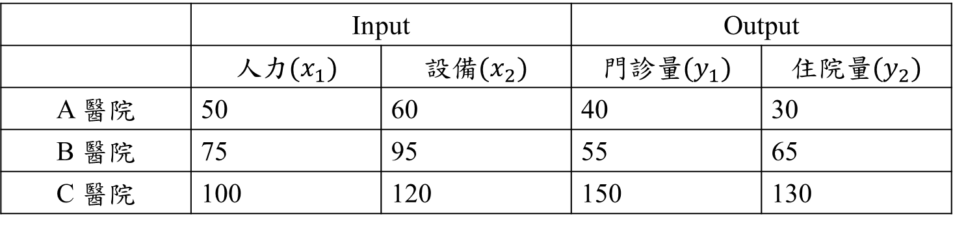
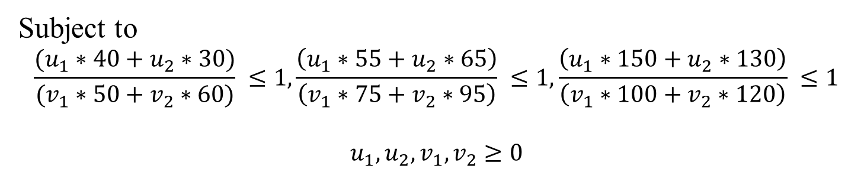
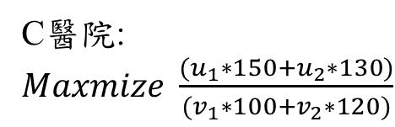
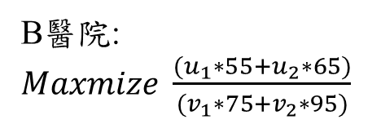
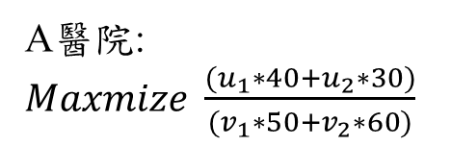
Data Envelopment Analysis(1/2)
 | Input |  | Output
 | 人力$(x_{1})$ | 設備$(x_{2})$ | 門診量$(y_{1})$ | 住院量$(y_{2})$
A 醫院 | 50 | 60 | 40 | 30
B 醫院 | 75 | 95 | 55 | 65
C 醫院 | 100 | 120 | 150 | 130
A醫院:
$Maxmize \frac{(u_{1}∗40+u_{2}∗30)}{(v_{1}∗50+v_{2}∗60)}$
B醫院:
$Maxmize \frac{(u_{1}∗55+u_{2}∗65)}{(v_{1}∗75+v_{2}∗95)}$
C醫院:
$Maxmize \frac{(u_{1}∗150+u_{2}∗130)}{(v_{1}∗100+v_{2}∗120)}$
Subject to
$$\frac{(u_{1}∗40+u_{2}∗30)}{(v_{1}∗50+v_{2}∗60)} ≤1,\frac{\left(u_{1}∗55+u_{2}∗65\right)}{\left(v_{1}∗75+v_{2}∗95\right)} ≤1,\frac{\left(u_{1}∗150+u_{2}∗130\right)}{\left(v_{1}∗100+v_{2}∗120\right)} ≤1$$
$$u_{1},u_{2},v_{1},v_{2}≥0$$

Slide 6
Data Envelopment Analysis(2/2)
Conclusion:
選擇決策單位(醫院)
選擇Input(人力、設備)
設計Model
分析結果

Slide 7

#1 DEA Model(1/4)
$$max\frac{u{∗o}_{j_{0}}}{\sum_{i=1}^{h}{v_{i}∗q_{ij_{0}}}+\sum_{i=1}^{k}{w_{i}∗c_{ij_{0}}}}$$
Subject to
$$\frac{u{∗o}_{j_{0}}}{\sum_{i=1}^{h}{v_{i}∗q_{ij_{0}}}+\sum_{i=1}^{k}{w_{i}∗c_{ij_{0}}}}≤1, j=1,…,n$$
$$u≥ε$$
$$v_{i}≥ε, i=1,…,h$$
$$w_{i}≥ε, i=1,…,k$$
$ε$: Small positive number, prevent the weight from vanish.

Slide 8
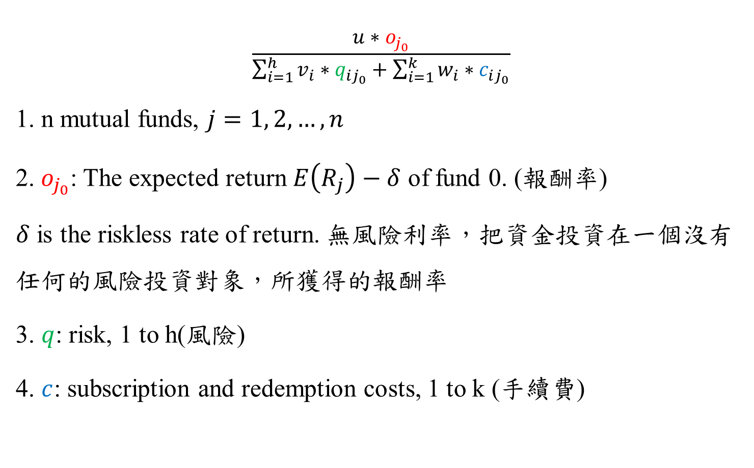
#1 DEA Model(2/4)
$$\frac{u{∗o}_{j_{0}}}{\sum_{i=1}^{h}{v_{i}∗q_{ij_{0}}}+\sum_{i=1}^{k}{w_{i}∗c_{ij_{0}}}}$$
1. n mutual funds, $j=1, 2,…,n$
2. $o_{j_{0}}$: The expected return $E\left(R_{j}\right)−δ$ of fund 0. (報酬率)
$δ$ is the riskless rate of return. 無風險利率，把資金投資在一個沒有任何的風險投資對象，所獲得的報酬率
3. $q$: risk, 1 to h(風險)
4. $c$: subscription and redemption costs, 1 to k (手續費)

Slide 9

#1 DEA Model(3/4)
Definitions:
$E(R_{j})$: Expected return(期望報酬率), 在一定風險下的平均報酬率.
$$\left(\overline{R}\right)=\sum_{i=1}^{n}{(P_{i}K_{i})}$$
A: $\left(\overline{R}\right)=0.3∗90\%+0.4∗15\%+0.3∗\left(−60\%\right)=15\%$
B: $\left(\overline{R}\right)=0.3∗20\%+0.4∗15\%+0.3∗10\%=15\%$
經濟狀況 | 發生概率 | A預期報酬率 | B預期報酬率
繁榮 | 0.3 | 90% | 20%
正常 | 0.4 | 15% | 15%
衰退 | 0.3 | -60% | 10%

Slide 10
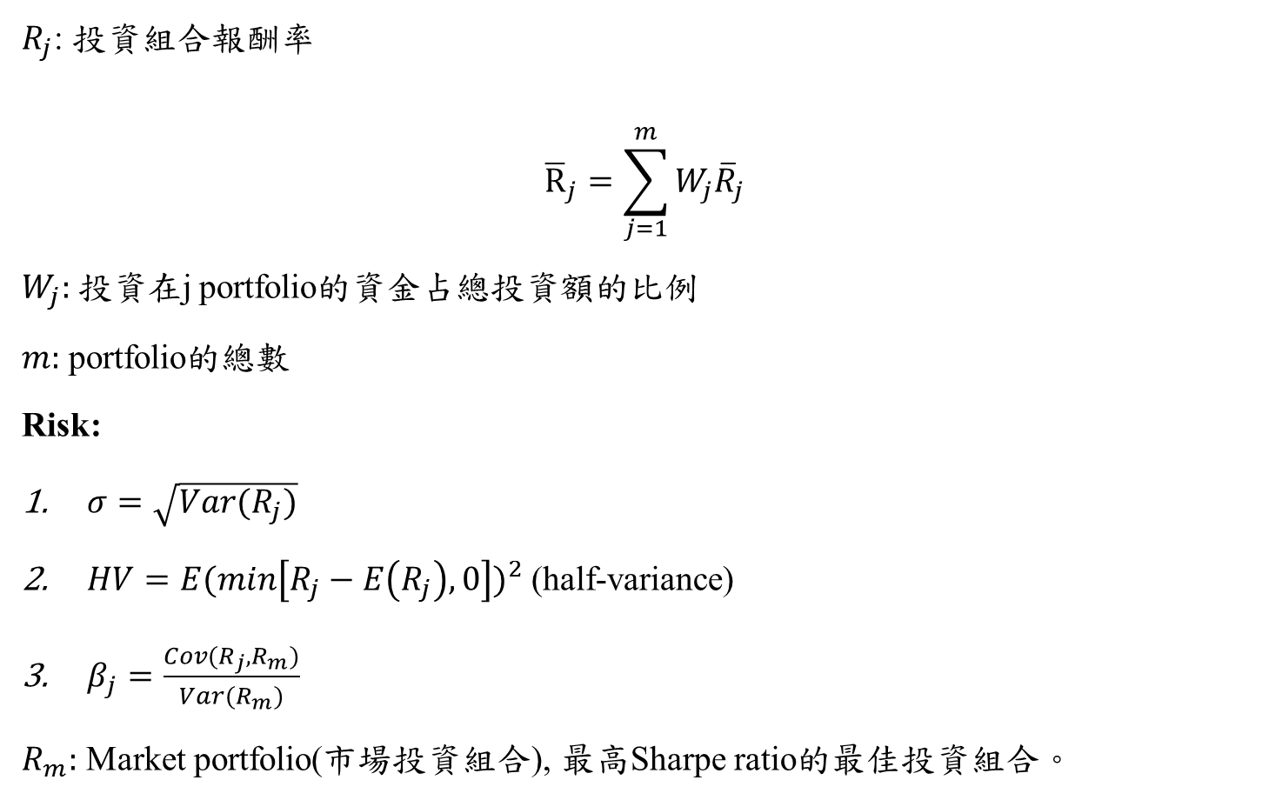
#1 DEA Model(4/4)
$R_{j}$: 投資組合報酬率
$${\overline{R}}_{j}=\sum_{j=1}^{m}{W_{j}{\overline{R}}_{j}}$$
$W_{j}:$ 投資在j portfolio的資金占總投資額的比例
$m:$ portfolio的總數
Risk:
$σ=\sqrt{Var(R_{j})}$
$HV={E(min\left[R_{j}−E\left(R_{j}\right), 0\right])}^{2}$ (half-variance)
$β_{j}=\frac{Cov(R_{j},R_{m})}{Var(R_{m})}$
$R_{m}:$ Market portfolio(市場投資組合), 最高Sharpe ratio的最佳投資組合。

Slide 11

Stochastic dominance(1/2)
Make an order of portfolios.
Two Gambles A & B, outcome x, $P\left[A≥x\right]≥P\left[B≥x\right]$.
Example:
Utility function:
效用 與 投資組合 之間的關係函數 (自行定義)
Trivial Example:
2 products tea & coffee.
$$u\left(c, t\right)=c+t$$
Buy 1 tea and 0 coffee: $u\left(c, t\right)=0+1=1$
Gamble/State | 1 | 2 | 3 | 4 | 5 | 6
Gamble A wins | 1 | 1 | 2 | 2 | 2 | 2
Gamble B wins | 1 | 1 | 1 | 2 | 2 | 2
Gamble C wins | 3 | 3 | 3 | 1 | 1 | 1

Slide 12

Stochastic dominance(2/2)
Two portfolios, X and. Y
A utility function set: $μ_{n}=\left\{Uεμ_{n−1}:{\left(−1\right)}^{n}U^{\left(n\right)}≤0\right\}$
$$E\left(U\left(X\right)\right)≥E\left(U\left(Y\right)\right) ∀U∈μ_{n}$$

Slide 13
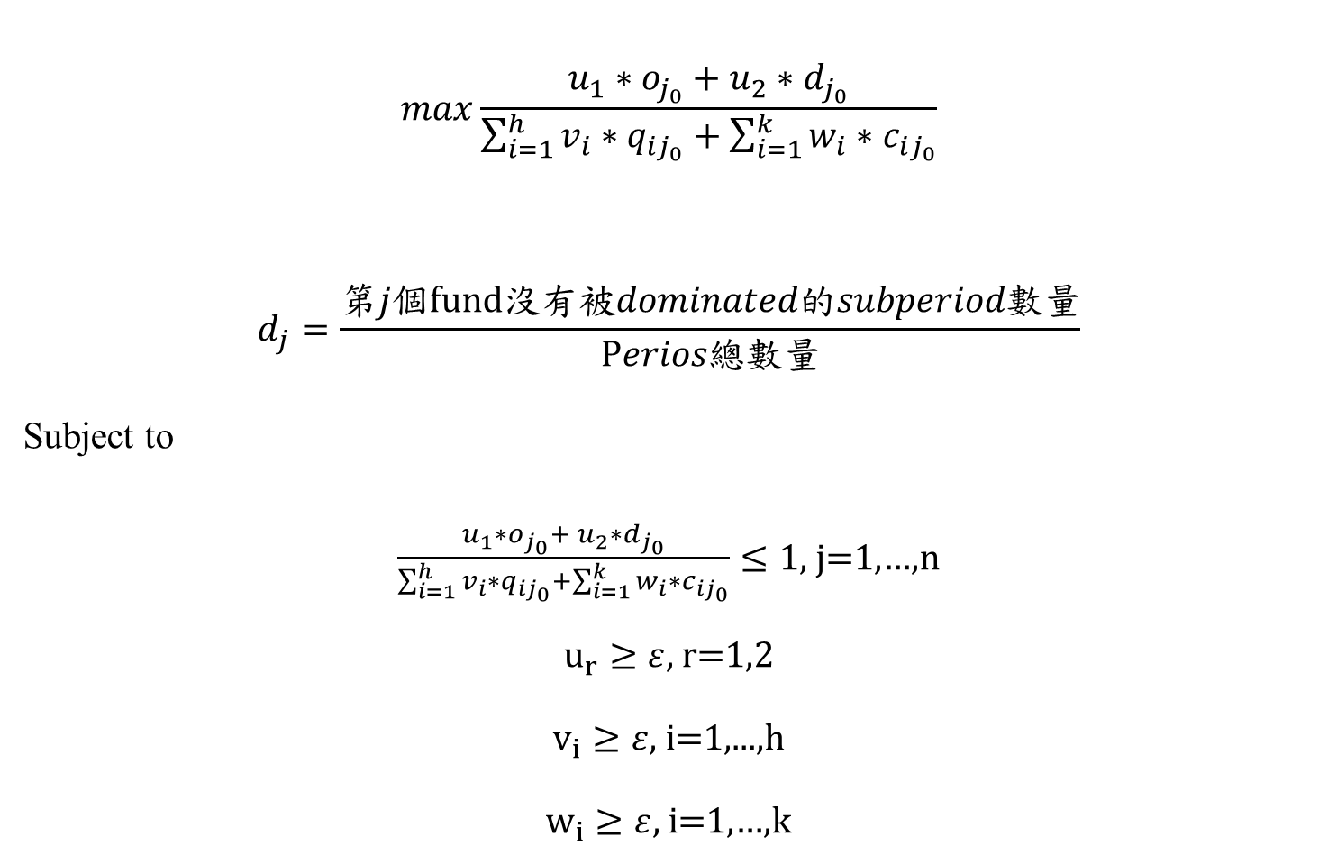
#2 DEA Model
$$max\frac{u_{1}{∗o}_{j_{0}}+ u_{2}∗d_{j_{0}}}{\sum_{i=1}^{h}{v_{i}∗q_{ij_{0}}}+\sum_{i=1}^{k}{w_{i}∗c_{ij_{0}}}}$$
$$d_{j}=\frac{第j個fund沒有被dominated的subperiod數量}{Perios總數量}$$
Subject to
$\frac{u_{1}{∗o}_{j_{0}}+ u_{2}∗d_{j_{0}}}{\sum_{i=1}^{h}{v_{i}∗q_{ij_{0}}}+\sum_{i=1}^{k}{w_{i}∗c_{ij_{0}}}}≤1$, j=1,…,n
$u_{r}≥ε,$ $r$=1,2
$v_{i}≥ε,$ $i$=1,...,h
$w_{i}≥ε,$ $i$=1,…,k

Slide 14
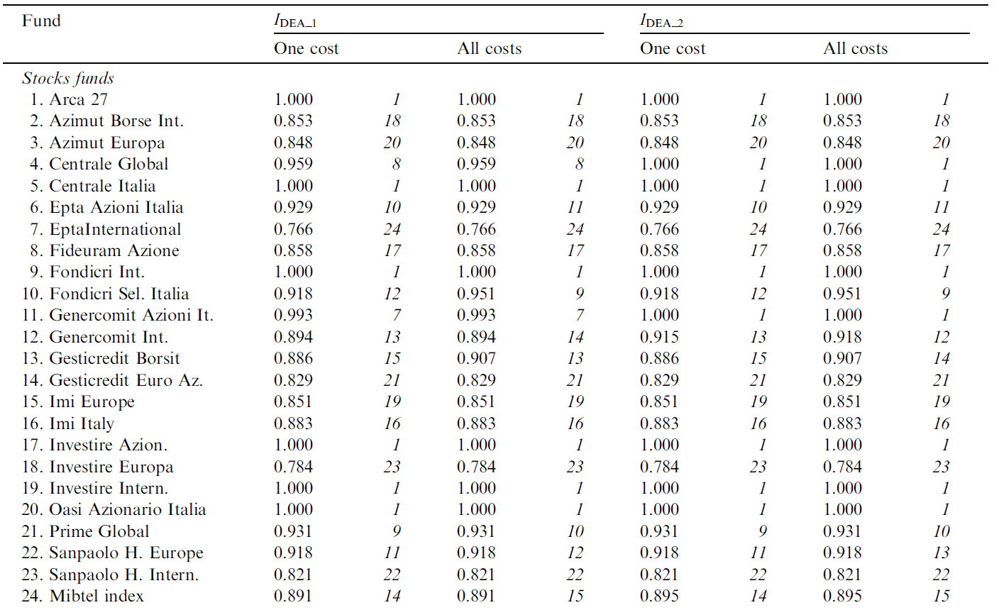
Empirical Result

