Slide 1
Algorithms for Computing the Longest Parameterized Common Subsequence
Costas S. Iliopoulos, Marcin Kubica, M. Sohel Rahman, Tomasz Waleń
Combinatorial Pattern Matching
Volume 4580 of the series Lecture Notes in Computer Science 2007 pp 265-273
Presenter: Huang-Ting Chan
Date:2015/11/24

Slide 2
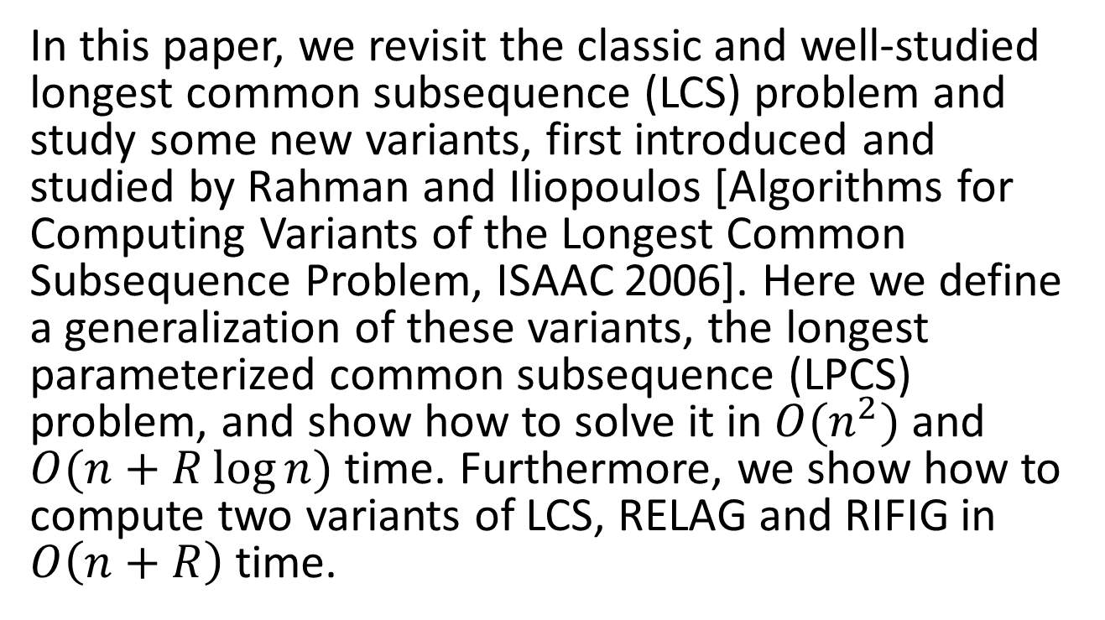
Abstract
In this paper, we revisit the classic and well-studied longest common subsequence (LCS) problem and study some new variants, first introduced and studied by Rahman and Iliopoulos [Algorithms for Computing Variants of the Longest Common Subsequence Problem, ISAAC 2006]. Here we define a generalization of these variants, the longest parameterized common subsequence (LPCS) problem, and show how to solve it in $O(n^{2})$and $O(n+R\log{n})$ time. Furthermore, we show how to compute two variants of LCS, RELAG and RIFIG in $O\left(n+R\right)$ time.

Slide 3

The problem
$$PCS(X,Y,K_{1},K_{2},D)$$
X =
Y =
A | C | B | A | C | C | A | B | C | A
B | B | A | A | C | B | C | B | B | C

Slide 4






The problem
$$PCS(X,Y,K_{1},K_{2},D)$$
X =
Y =
1 | 2 | 3 | 4 | 5 | 6 | 7 | 8 | 9 | 10
A | C | B | A | C | C | A | B | C | A
B | B | A | A | C | B | C | B | B | C
$$K_{1}=2 K_{2}=4$$
$$K_{1}≤3−1≤K_{2}$$
$$K_{1}≤6−3≤K_{2}$$
$$K_{1}≤6−3≤K_{2}$$
$$K_{1}≤7−6≤K_{2}$$

Slide 5



The problem
$$PCS(X,Y,K_{1},K_{2},D)$$
X =
Y =
1 | 2 | 3 | 4 | 5 | 6 | 7 | 8 | 9 | 10
A | C | B | A | C | C | A | B | C | A
B | B | A | A | C | B | C | B | B | C
$$D=2$$
$$\left|\left(3−1\right)−\left(6−3\right)\right|≤D$$
$$\left|\left(5−3\right)−\left(7−6\right)\right|≤D$$

Slide 6
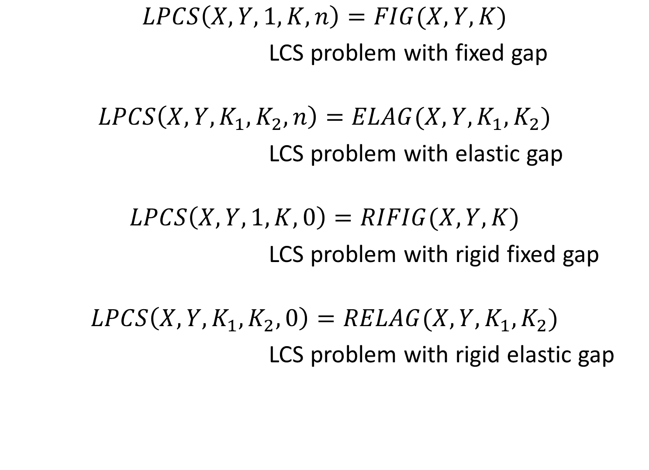
$$LPCS\left(X,Y,1,K,n\right)=FIG(X,Y,K)$$
LCS problem with fixed gap
$$LPCS\left(X,Y,K_{1},K_{2},n\right)=ELAG(X,Y,K_{1},K_{2})$$
LCS problem with elastic gap
$$LPCS\left(X,Y,1,K,0\right)=RIFIG(X,Y,K)$$
LCS problem with rigid fixed gap
$$LPCS\left(X,Y,K_{1},K_{2},0\right)=RELAG(X,Y,K_{1},K_{2})$$
LCS problem with rigid elastic gap

Slide 7


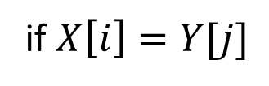
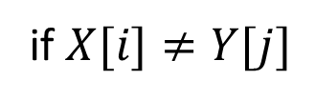
An $O(n^{2})$ Algorithm for LPCS
if $X[i]≠Y[j]$
$$T\left[i,j\right]=\left\{\begin{aligned}0 \\ 1+max⁡(\{0\}∪\{T\left[x,y\right]:(x,y)∈Z_{i−K_{1},j−K_{1}}\})\end{aligned}\right.$$
$Z_{i,j}=\{\left(x,y\right):0≤i−x,j−y≤K_{2}−K_{1},|\left(i−x\right)−(j−y)|≤D\}$
if $X\left[i\right]=Y[j]$

Slide 8

$$K_{1}=3 K_{2}=8 D=2$$
 | 1 | 2 | 3 | 4 | 5 | 6 | 7 | 8 | 9 | 10 | 11
1
2
3
4
5
6
7
8
9
10 |  |  |  |  |  |  |  |  |  |  | X

Slide 9
$$K_{1}=3 K_{2}=8 D=2$$
 | 1 | 2 | 3 | 4 | 5 | 6 | 7 | 8 | 9 | 10 | 11
1
2
3
4
5
6
7
8
9
10 |  |  |  |  |  |  |  |  |  |  | X
B
C
$$B=\min\left(K_{2}−K_{1},D\right)+1 C= K_{2}−K_{1}−B+2$$

Slide 10
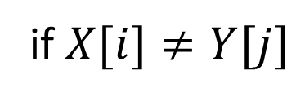

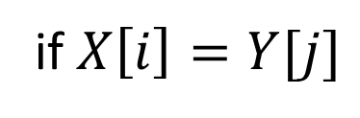
$$R\left[i,j\right]=\max_{k=0,…,B−1}T\left[i−k,j\right]$$
$$S\left[i,j\right]=\max_{k=0,…,B−1}R\left[i,j−k\right]$$
$=\max_{(x,y)∈S_{i,j}}T[x,y]$
$$P\left[i,j\right]=\max_{k=0,…,C−1}S\left[i−k,j−k\right]$$
$=\max_{(x,y)∈Z_{i,j}}T[x,y]$
$$T\left[i,j\right]=\left\{\begin{aligned}0 \\ 1+P[i−K_{1},j−K_{1}]\end{aligned}\right.$$
if $X[i]≠Y[j]$
if $X\left[i\right]=Y[j]$

Slide 11
$$K_{1}=3 K_{2}=8 D=2$$
 | 1 | 2 | 3 | 4 | 5 | 6 | 7 | 8 | 9 | 10 | 11
1
2
3
4
5
6
7
8
9
10 |  |  |  |  |  |  |  |  |  |  | X

Slide 12
$$K_{1}=3 K_{2}=8 D=2$$
 | 1 | 2 | 3 | 4 | 5 | 6 | 7 | 8 | 9 | 10 | 11
1
2
3
4
5
6
7
8
9
10 |  |  |  |  |  |  |  |  |  |  | X

Slide 13
$$K_{1}=3 K_{2}=8 D=2$$
 | 1 | 2 | 3 | 4 | 5 | 6 | 7 | 8 | 9 | 10 | 11
1
2
3
4
5
6
7
8
9
10 |  |  |  |  |  |  |  |  |  |  | X

Slide 14
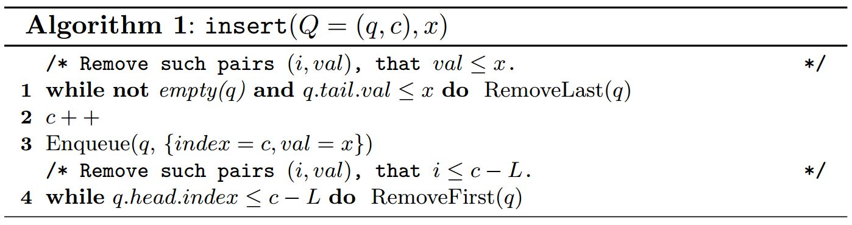
Max-Queue
1 | 5 | 4 | 2 | 3 | 4 | 7 | 5 | 8 | 9
1
5
5 4
5 4 2
5 4 3
5 4
7
75
8
9
Amortized running time of insert is O(1)

Slide 15
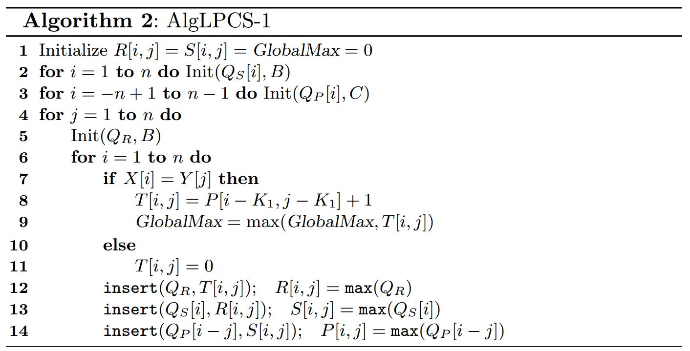

Time complexity
$$O(n^{2})$$

Slide 16
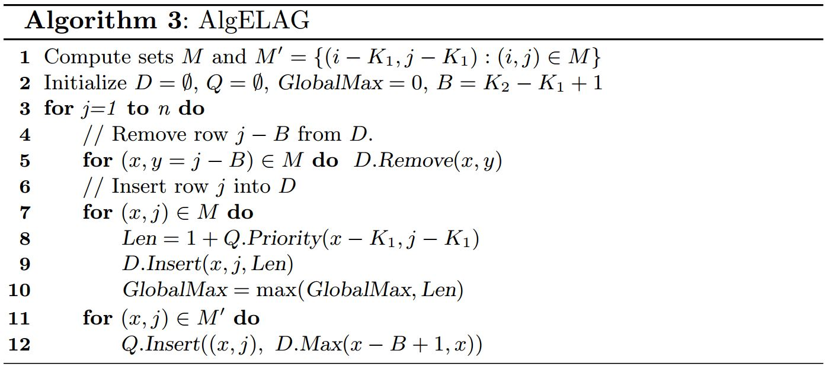
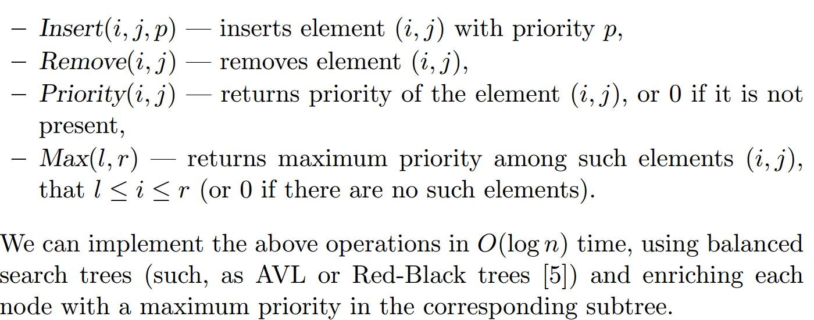
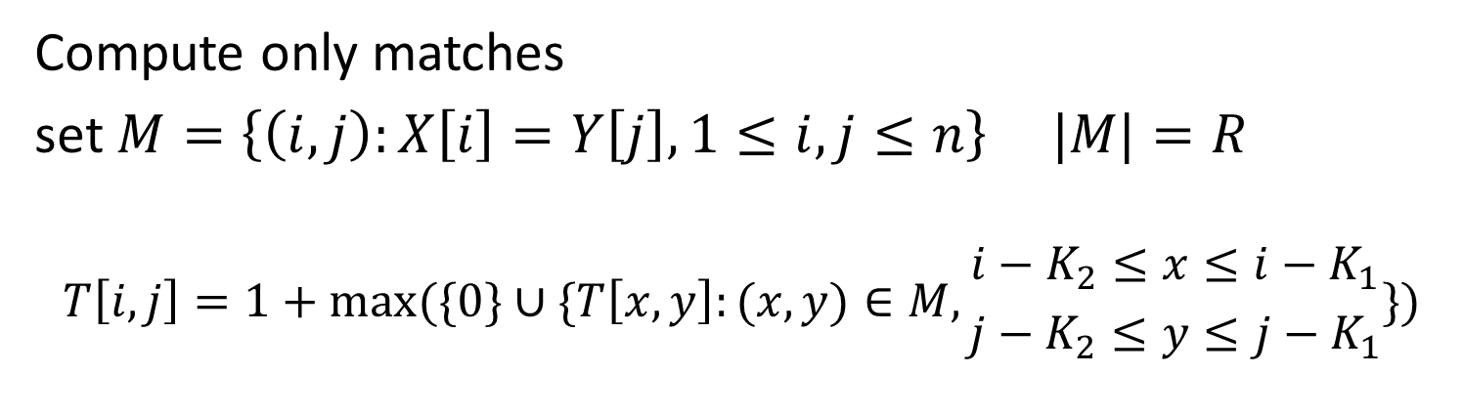
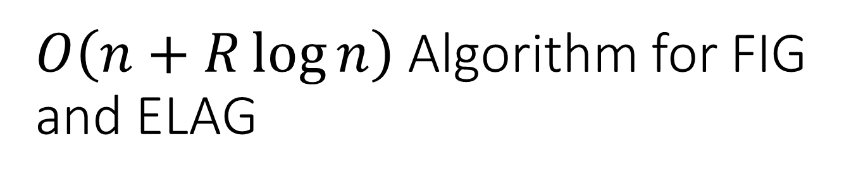
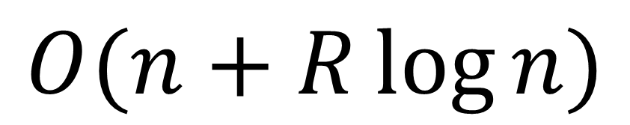
$O\left(n+R\log{n}\right)$ Algorithm for FIG and ELAG
Compute only matches
set $M=\left\{\left(i,j\right):X\left[i\right]=Y\left[j\right],1≤i,j≤n\right\} |M|=R$
$$T\left[i,j\right]=1+max⁡(\{0\}∪\{T\left[x,y\right]:(x,y)∈M,{i−K_{2}≤x≤i−K_{1} \atop j−K_{2}≤y≤j−K_{1}}\})$$
$$O(n+R\log{n})$$

Slide 17
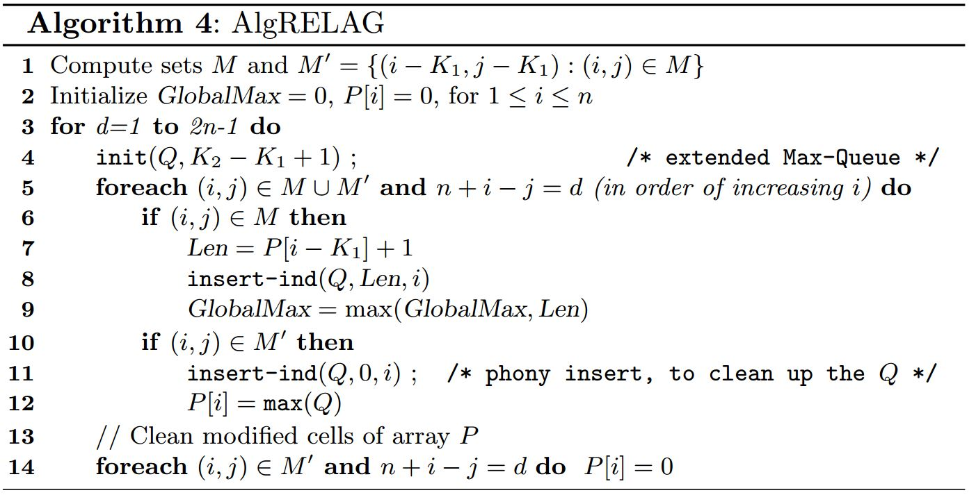
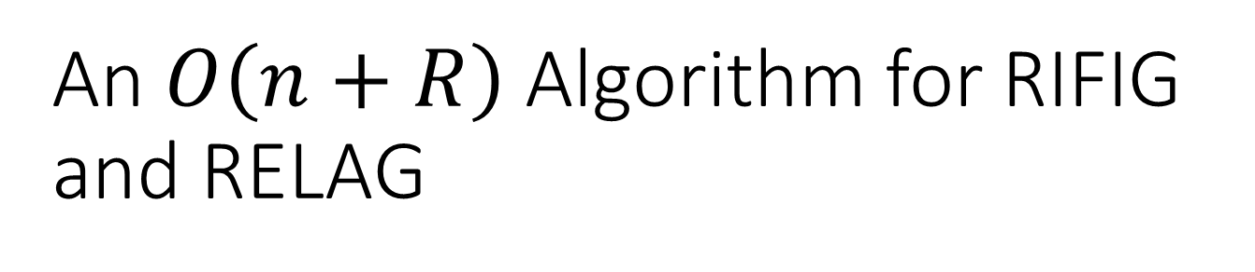
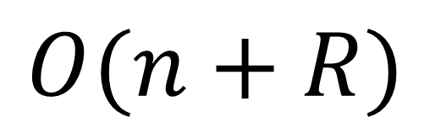
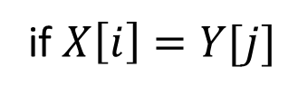
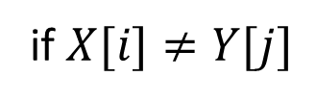

An $O\left(n+R\right)$ Algorithm for RIFIG and RELAG
if $X[i]≠Y[j]$
$$T\left[i,j\right]=\left\{\begin{aligned}0 \\ 1+max⁡\{T\left[i−p,j−p\right]:K_{1}≤p≤K_{2}\}\end{aligned}\right.$$
if $X\left[i\right]=Y[j]$
$$O(n+R)$$

