Slide 1
Esko Ukkonen Algorithmica, Vol. 14, No. 3, pp. 249-260, (1995)
On-line construction of suffix trees
Presenter：Jyun-Hao Lai
Date：104 / 12 / 23
Notes:
1

Slide 2
Abstract
An on–line algorithm is presented for constructing the suffix tree for a given string in time linear in the length of the string. The new algorithm has the desirable property of processing the string symbol by symbol from left to right. It has always the suffix tree for the scanned part of the string ready. The method is developed as a linear–time version of a very simple algorithm for (quadratic size) suffix tries. Regardless of its quadratic worst-case this latter algorithm can be a good practical method when the string is not too long. Another variation of this method is shown to give in a natural way the well–known algorithms for constructing suffix automata (DAWGs).

Slide 3
Suffix Tree
S = xabxa$
xabxa$ | S1
abxa$ | S2
bxa$ | S3
xa$ | S4
a$ | S5
$ | S6
xa
bxa$
a
bxa$
1
$
$
3
bxa$
4
$
6
2
5

Slide 4
Suffix Tree
Properties of a Suffix Tree
Each tree edge is labeled by a substring of S.
Each internal node has at least 2 children.
There are n leaves.
Sibling edges begin with different characters
xa
bxa$
a
bxa$
1
$
$
3
bxa$
4
$
6
2
5

Slide 5
Implicit suffix tree and Explicit Suffix Tree
xa
xabxa
bxa$
a
bxa$
1
bxa
$
$
abxa
3
bxa$
1
4
$
3
2
6
2
5
Implicit
Explicit

Slide 6

Ukkonen's algorithm
In computer science, Ukkonen's algorithm is a linear-time, online algorithm for constructing suffix trees, proposed by Esko Ukkonen in 1995.
The algorithm begins with an implicit suffix tree containing the first character of the string.

Slide 7
Ukkonen's algorithm
首先，我們從一個簡單的字串開始建立suffix tree，步驟是由左到右，逐一走訪每個字母。並且我們使用一對指標來代表該字串在本文中的位置。(#指向當前的下一個字母)
S = xab
S = xab
S = xab
xab
xa
x
ab
b
a
[0, #]
[0, #]
[0, #]
[1, #]
[1, #]
[2, #]

Slide 8
Ukkonen's algorithm
We observe two things:
The edge representation for ab is the same as it used to be in the initial tree: [0,#]. Its meaning has automatically changed because we updated the current position # from 1 to 2.
Each edge consumes O(1) space, because it consists of only two pointers into the text, regardless of how many characters it represents.

Slide 9
Ukkonen's algorithm
現在我們來看更複雜一點的字串：S = xabxawxabc
前面三個字母與上例相同，因此我們省略先前的步驟，進而得到下面這顆樹。
xabx
abx
bx

Slide 10
Ukkonen's algorithm
The active point (活動點)：(active_node,active_edge,active_length)
The remainder ： which is an integer indicating how many new suffixes we need to insert
S = xabxawxabc
xabx
active point： (root,’x’,1)
abx
bx
remainder：2

Slide 11
Ukkonen's algorithm
We update the current position # to 5. This automatically updates the tree to this ：
S = xabxawxabc
The a suffix from the previous step has never been properly inserted. So it has remained, and since we have progressed one step, it has now grown from x to xa.
And we need to insert the new final edge a.
xabxa
active point： (root,’x’,2)
abxa
remainder：3
bxa

Slide 12
Ukkonen's algorithm
We proceed to step 6 by incrementing #. The tree is automatically updated to ：
bxaw
S = xabxawxabc
w
active point： (root,’x’,2)
xa
remainder：2 (“aw” , “w”)
remainder：3 (“xaw”, “aw” , “w”)
abxaw
bxaw

Slide 13
Ukkonen's algorithm
Rule1：當活動點為root時遵守
active_node ：保持為root.
active_edge ： 改成下一個suffix的第一個字母
active_length ：減 1
active point： (root,’x’,2)
active point： (root,’a’,1)
remainder：3 (“xaw”, “aw” , “w”)
remainder：2 (“aw” , “w”)

Slide 14
Ukkonen's algorithm
S = xabxawxabc
active point： (root,’a’,1)
bxaw
remainder：2 (“aw” , “w”)
w
xa
bxaw
a
w
active point： (root,’w’,0)
bxaw
remainder：1 ( “w”)

Slide 15
Ukkonen's algorithm
Rule2：
如果我們插入一個新的內部結點，則把先前插入的內部結點與現在的內部結點，用一個指標連接，該指標稱為Suffix Link
bxaw
w
xa
bxaw
a
w
bxaw

Slide 16
Ukkonen's algorithm
S = xabxawxabc
bxaw
w
xa
active point： (root,’w’,0)
bxaw
a
remainder：1 ( “w”)
w
bxaw
w

Slide 17
Ukkonen's algorithm
S = xabxawxabc
S = xabxawxabc
S = xabxawxabc
active point： (root,’x’,1)
active point： (root,’x’,2)
active point： (node1,’b’,1)
S = xabxawxabc
remainder：2
remainder：3
remainder：4
“xabc”, ”abc”, ”bc”, “c”
bxaw
bxawxabc
xa
w
xa
wxabc
bxaw
bxawxabc
a
a
w
wxabc
bxaw
bxawxabc
w
wxabc

Slide 18
Ukkonen's algorithm
active point： (node2,’b’,1)
S = xabxawxabc
active point： (node1,’b’,1)
remainder：4 (“xabc”, ”abc”, ”bc”, “c”)
remainder：3 ( ”abc”, ”bc”, “c”)
xawxabc
b
c
bxawxabc
xa
wxabc
xa
wxabc
bxawxabc
a
bxawxabc
a
wxabc
wxabc
bxawxabc
bxawxabc
wxabc
wxabc

Slide 19
active point： (root,’b’,1)
S = xabxawxabc
active point： (node2,’b’,1)
remainder：3 (”abc”, ”bc”, “c”)
remainder：2 (”bc”, “c”)
xawxabc
xawxabc
b
c
b
wxabc
c
xa
xawxabc
xa
wxabc
b
bxawxabc
a
a
c
wxabc
wxabc
bxawxabc
bxawxabc
wxabc
wxabc

Slide 20
S = xabxawxabc
active point： (root,’b’,1)
remainder：2 (”bc”, “c”)
active point： (root,’c’,0)
remainder：1 (“c”)
xawxabc
xawxabc
b
c
b
wxabc
c
xa
wxabc
xawxabc
xa
xawxabc
b
b
a
c
a
wxabc
c
wxabc
c
b
bxawxabc
xawxabc
wxabc
wxabc

Slide 21
S = xabxawxabc
active point： (root,’c’,0)
remainder：1 (“c”)
xawxabc
b
c
xa
wxabc
xawxabc
b
a
c
wxabc
c
b
xawxabc
c
wxabc

Slide 22
複雜度分析
如果Text的長度為n，則有n步需要執行。在每一個步驟當中要麼甚麼也不做，只更新活動點以及remainder 加一，要麼則remainder執行插入操作，每次插入操作消耗O(1)。
當走訪完整個Text，則suffix也建立完畢，因此總體的複雜度為O(n)。

Slide 23
History
[Weiner, IEEE FOCS 1973]
Linear time but expensive in space.
D. E. Knuth: “the algorithm of 1973”.
[McCreight, J. ACM 1976]
Linear time and quadratic space.
[Ukkonen, Algorithmica 1995]
Linear time and linear space.
Much better readability.

Slide 24
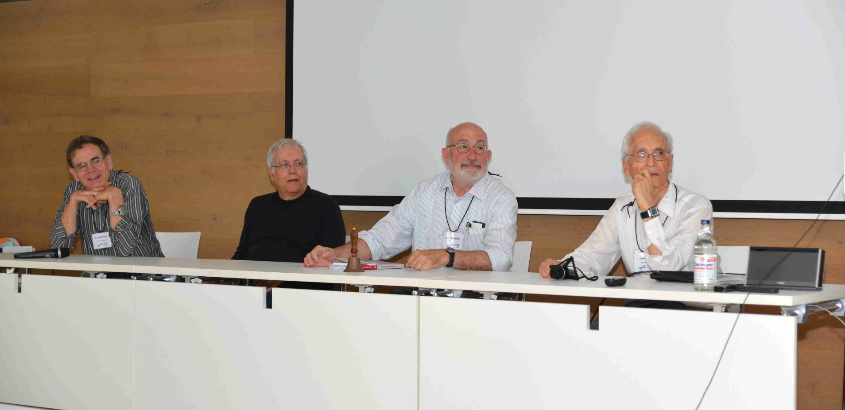

40th Anniversary of the Suffix Tree
2013 marks the 40th anniversary of P. Weiner's foundational paper on suffix trees. CPM 2013 celebrates this event with a special session, organized by Martin Farach-Colton and S. Muthukrishnan. It includes talks by the following speakers:
Edward M. McCreight
Vaughan R. Pratt
Peter Weiner
Jacob Ziv
Peter Weiner
left to right: Vaughan Pratt, Peter Weiner, Ed McCreight, Jacob Ziv.

