Slide 1
Sequential and Parallel Algorithms for the All-Substrings Longest Common Subsequence Problem
C. E. R. Alves, E. N. C´aceres, S. W. Song
Technical Report RT-MAC-2003-03, Department of Computer Science, Institute of Mathematics and Statistics, University of São Paulo (2003)
Presenter: Bi-Shiang Lin
Date:2015/12/23

Slide 2
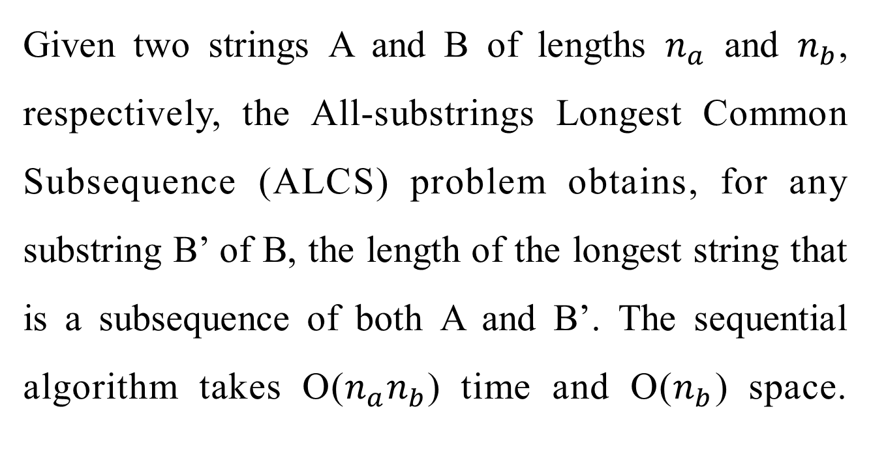
Abstract(1/2)
Given two strings A and B of lengths $n_{a}$ and $n_{b}$, respectively, the All-substrings Longest Common Subsequence (ALCS) problem obtains, for any substring B’ of B, the length of the longest string that is a subsequence of both A and B’. The sequential algorithm takes O($n_{a}n_{b}$) time and O($n_{b}$) space.

Slide 3
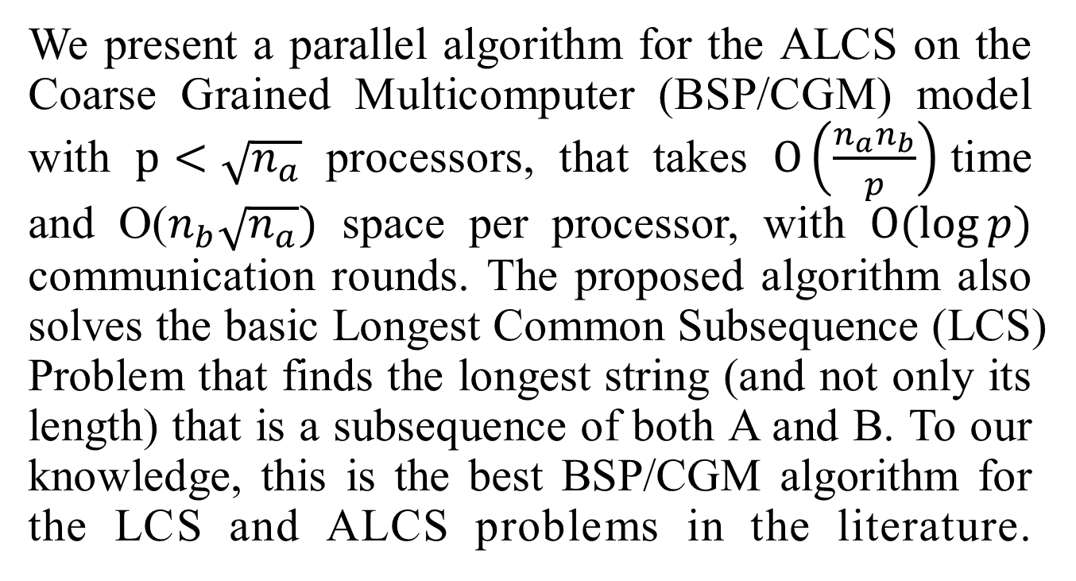
Abstract(2/2)
We present a parallel algorithm for the ALCS on the Coarse Grained Multicomputer (BSP/CGM) model with $p<\sqrt{n_{a}}$ processors, that takes $O\left(\frac{n_{a}n_{b}}{p}\right)$time and O($n_{b}\sqrt{n_{a}})$ space per processor, with $O(\log{p})$ communication rounds. The proposed algorithm also solves the basic Longest Common Subsequence (LCS) Problem that finds the longest string (and not only its length) that is a subsequence of both A and B. To our knowledge, this is the best BSP/CGM algorithm for the LCS and ALCS problems in the literature.

Slide 4

The LCS Problem
Sequence $A$: actat
Sequence $B$: tacat
Common Subsequence : at、cat…
Longest Common Subsequence : acat

Slide 5
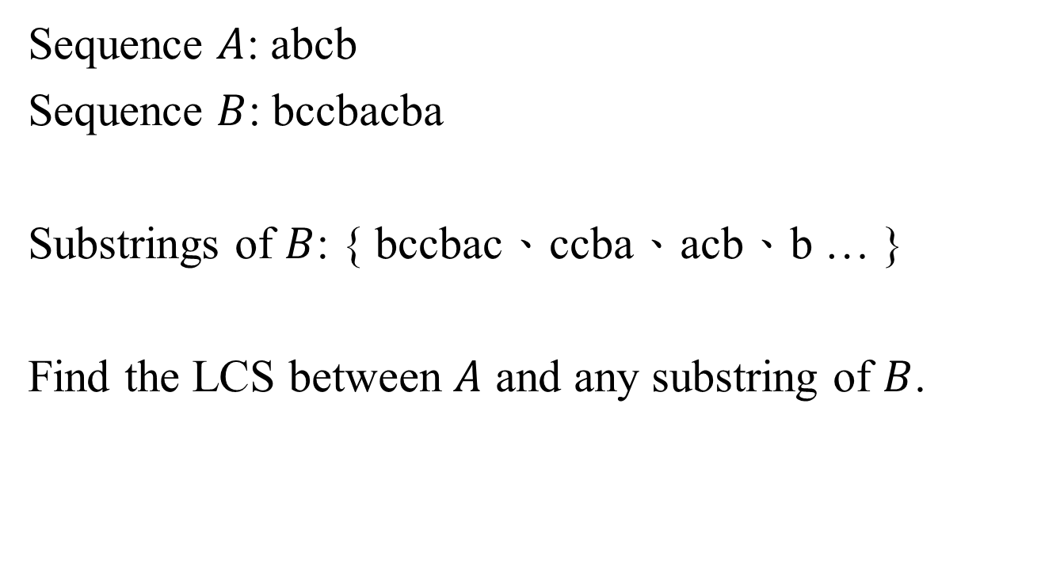
The ALCS Problem
Sequence $A$: abcb
Sequence $B$: bccbacba
Substrings of $B$: { bccbac、ccba、acb、b … }
Find the LCS between $A$ and any substring of $B$.

Slide 6
GDAG for the ALCS problem
(0,0)
A
B
B
A
A
C
B
C
A
B
C
B
(4,8)

Slide 7

Table $C_{G}$
 | 0 | 1 | 2 | 3 | 4 | 5 | 6 | 7 | 8
0 | 0 | 1 | 2 | 3 | 3 | 3 | 3 | 4 | 4
1 | 0 | 0 | 1 | 2 | 2 | 2 | 2 | 3 | 3
2 | 0 | 0 | 0 | 1 | 1 | 1 | 2 | 3 | 3
3 | 0 | 0 | 0 | 0 | 1 | 1 | 2 | 3 | 3
4 | 0 | 0 | 0 | 0 | 0 | 1 | 2 | 3 | 3
5 | 0 | 0 | 0 | 0 | 0 | 0 | 1 | 2 | 2
6 | 0 | 0 | 0 | 0 | 0 | 0 | 0 | 1 | 2
7 | 0 | 0 | 0 | 0 | 0 | 0 | 0 | 0 | 1
8 | 0 | 0 | 0 | 0 | 0 | 0 | 0 | 0 | 0

Slide 8
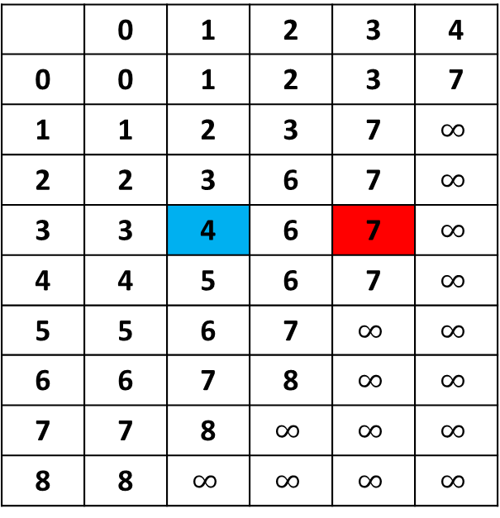

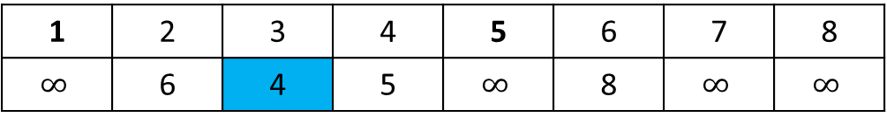
Table $D_{G}$、Vector $V_{G}$
 | 0 | 1 | 2 | 3 | 4
0 | 0 | 1 | 2 | 3 | 7
1 | 1 | 2 | 3 | 7 | $$∞$$
2 | 2 | 3 | 6 | 7 | $$∞$$
3 | 3 | 4 | 6 | 7 | $$∞$$
4 | 4 | 5 | 6 | 7 | $$∞$$
5 | 5 | 6 | 7 | $$∞$$ | $$∞$$
6 | 6 | 7 | 8 | $$∞$$ | $$∞$$
7 | 7 | 8 | $$∞$$ | $$∞$$ | $$∞$$
8 | 8 | $$∞$$ | $$∞$$ | $$∞$$ | $$∞$$
1 | 2 | 3 | 4 | 5 | 6 | 7 | 8
$$∞$$ | 6 | 4 | 5 | $$∞$$ | 8 | $$∞$$ | $$∞$$

Slide 9

The Sequential Algorithm
$i_{h}(l,j)$、 $i_{v}(l,j)$
$i_{h}\left(3,3\right)=0$、 $i_{v}\left(3,3\right)=3$
i
j
A
B
A
C
B
0
B
C
A
A
B
l
C

Slide 10
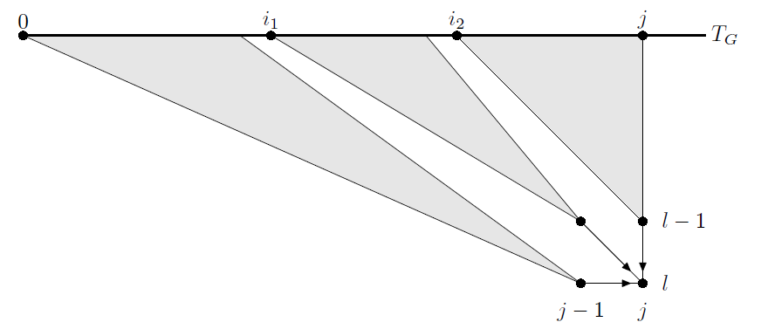
The Sequential Algorithm

Slide 11
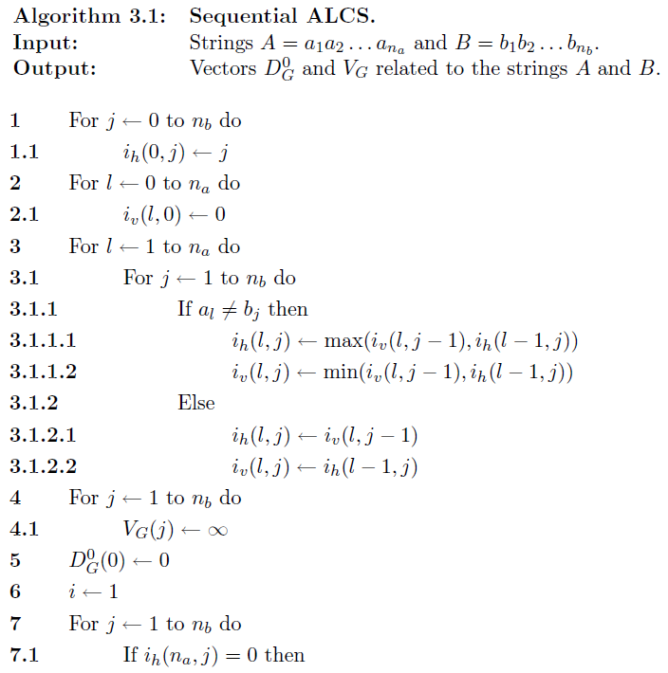
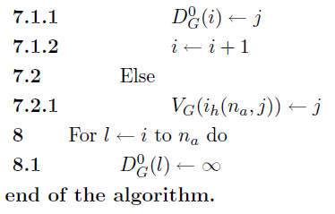

Slide 12
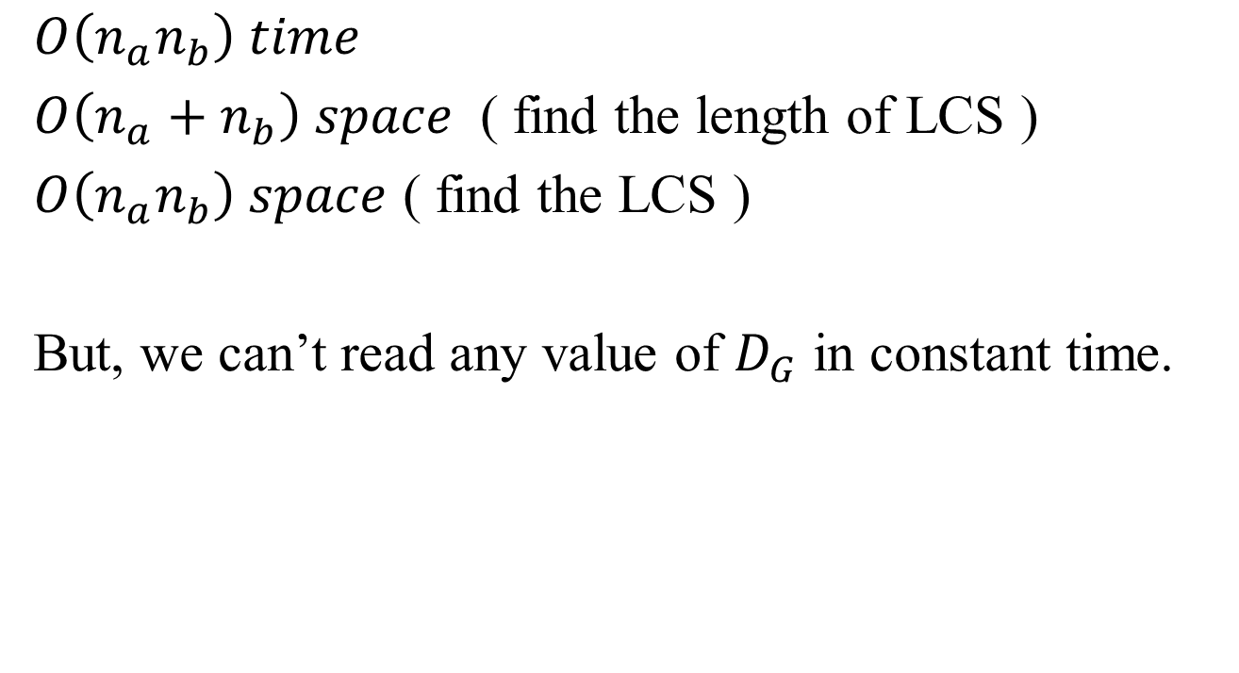
The Sequential Algorithm
$$O\left(n_{a}n_{b}\right) time$$
$O\left(n_{a}+n_{b}\right) space$ ( find the length of LCS )
$O\left(n_{a}n_{b}\right) space$ ( find the LCS )
But, we can’t read any value of $D_{G}$ in constant time.

Slide 13
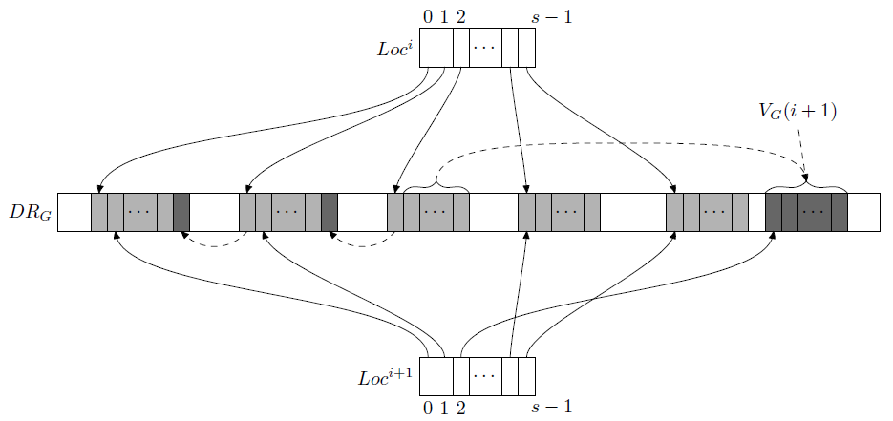

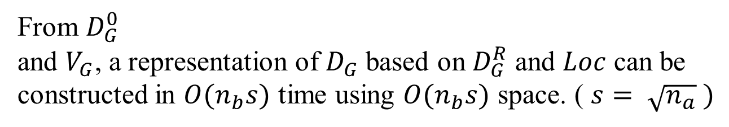
Compact Structure for $D_{G}$
From $D_{G}^{0}$
and $V_{G}$, a representation of $D_{G}$ based on $D_{G}^{R}$ and $Loc$ can be
constructed in $O(n_{b}s)$ time using $O(n_{b}s)$ space. ( $s= \sqrt{n_{a}} )$

Slide 14
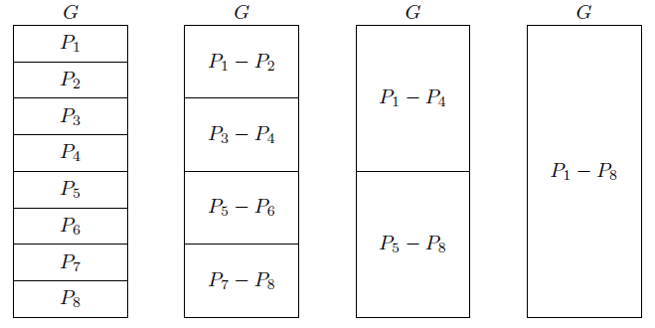
The CGM Algorithm for the ALCS

Slide 15
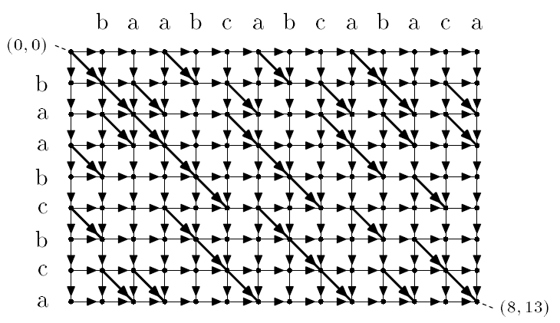
The CGM Algorithm for the ALCS

Slide 16
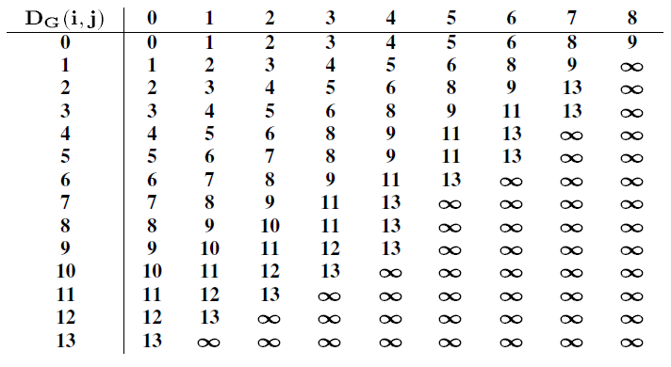
The CGM Algorithm for the ALCS

Slide 17
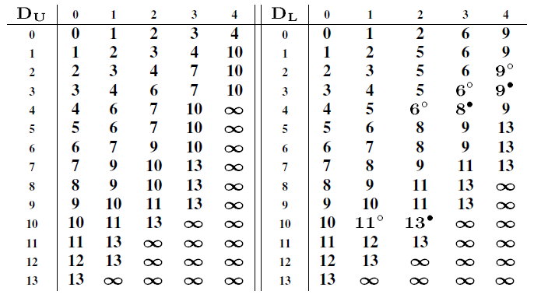
The CGM Algorithm for the ALCS

Slide 18
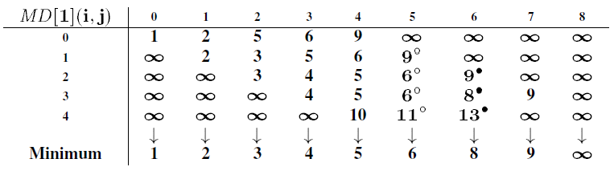
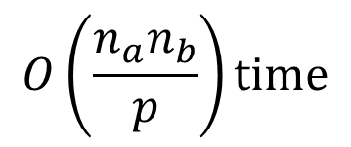
The CGM Algorithm for the ALCS
$$O\left(\frac{n_{a}n_{b}}{p}\right)time$$

Slide 19
Contract the blocks

Slide 20

Conclusion
With p processors $\left( p<\sqrt{n_{a}} \right), need$
$O\left(\frac{n_{a}n_{b}}{p}\right)$time
$O(n_{b}\sqrt{n_{a}})$space

