Slide 1
Algorithms for Approximate String Matching
Esko Ukkonen
Information and Control,
Vol. 64, pp. 100-118, 1985.
Date: Jan. 6, 2009
Introducer: Hsing-Yen Ann

Slide 2
Abstract (1/2)
The edit distance between strings a₁…a_{n} and b₁…b_{m} is the minimum cost s of a sequence of editing steps (insertions, deletions, changes) that convert one string into the other. A well-known tabulating method computes s as well as the corresponding editing sequence in time and space O(mn) (in space O(min(m,n)) if the editing sequence is not required). Starting from this method, we develop an improved algorithm that works in time and in space O(s·min(m,n)). Another improvement with time O(s·min(m,n)) and space O(s·min(s,m,n)) is given for the special case where all editing steps have the same cost independently of the characters involved.

Slide 3
Abstract (2/2)
If the editing sequence that gives cost s is not required, our algorithms can be implemented in space O(min(s,m,n)). Since s = O(max(m,n)), the new methods are always asymptotically as god as the original tabulating method. As a by-product, algorithms are obtained that, given a threshold value t, test in time O(t·min(m,n)) and in space O(min(t,m,n)) where s≦t. Finally, different generalized edit distances are analyzed and conditions are given under which our algorithms can be used in conjunction with extended edit operation sets, including, for example, transposition of adjacent characters.

Slide 4
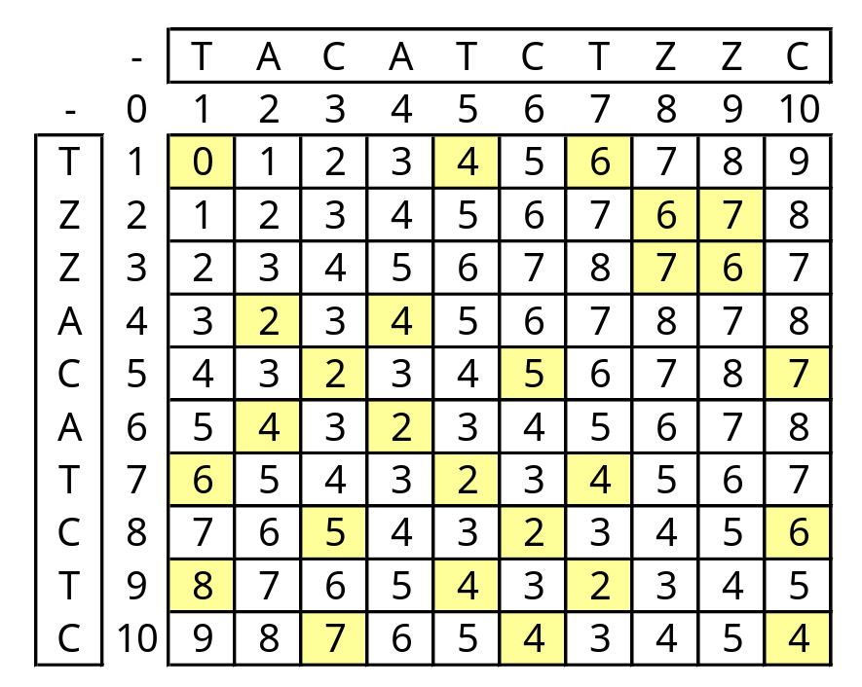
The Edit Distance
Can be computed in O(nm) time

Slide 5

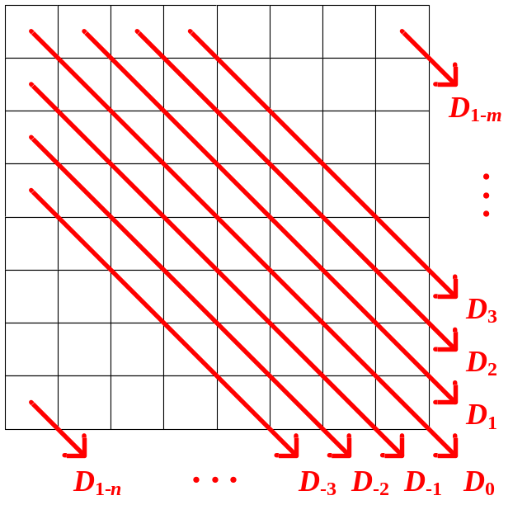
The Main Idea
Only consider the diagonals close to D₀
Bandwidth DP

Slide 6

Bandwidth DP
Let , only the diagonals from D_{-s} to D_{s} are considered.
How to get s ?
Try the bandwidths
{1,2,4,8,16,…,t}
until t ≧ s

Slide 7
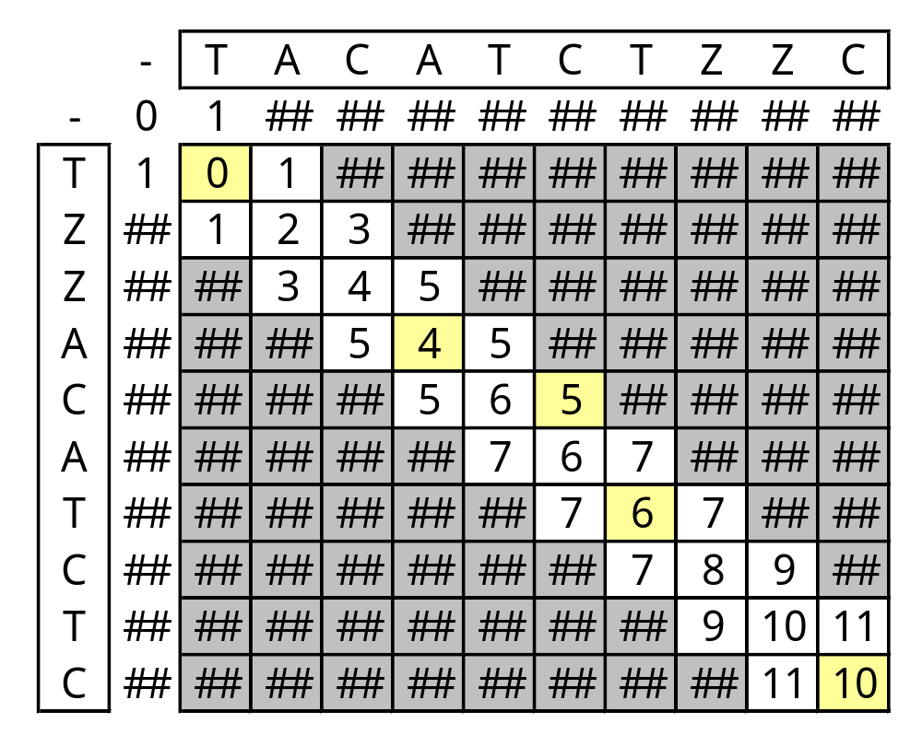
Example (t=1)

Slide 8
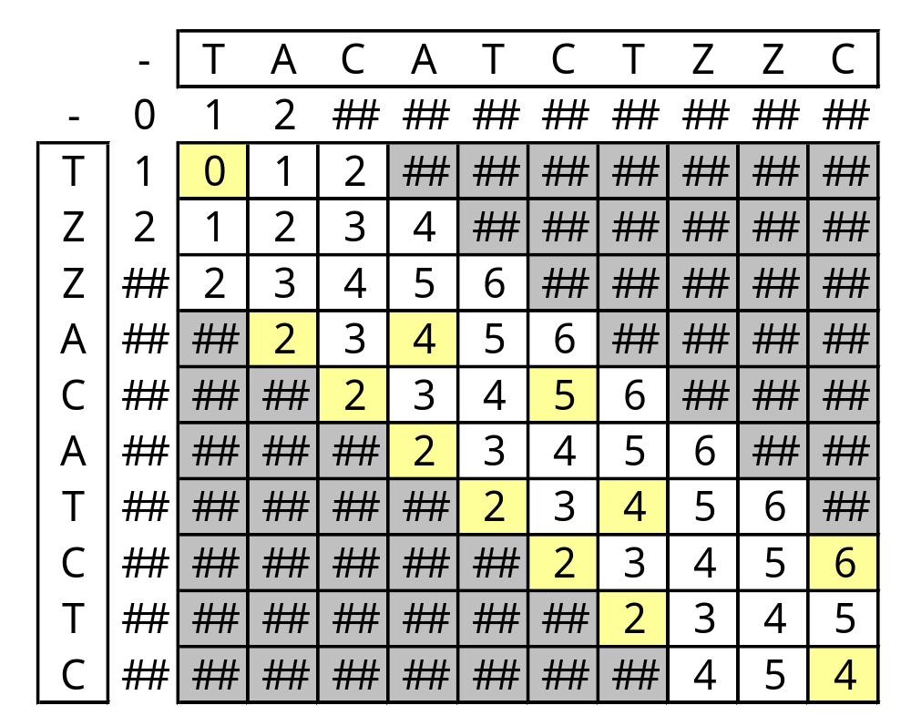
Example (t=2)

Slide 9
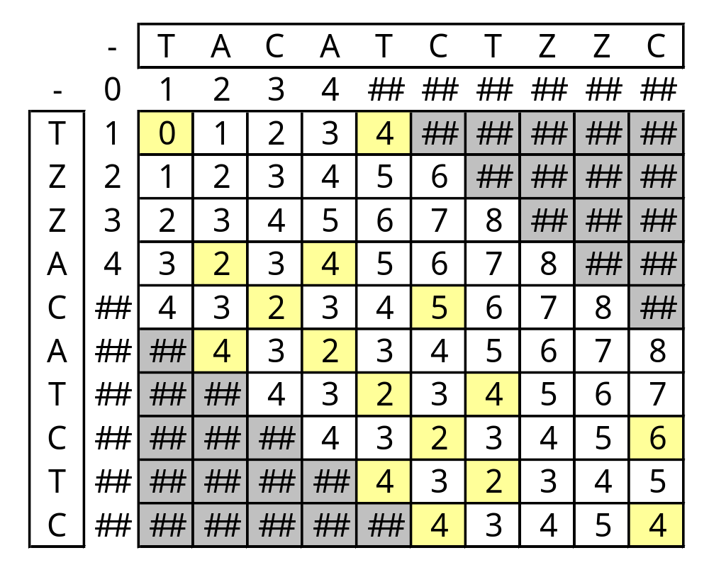
Example (t=4)

Slide 10
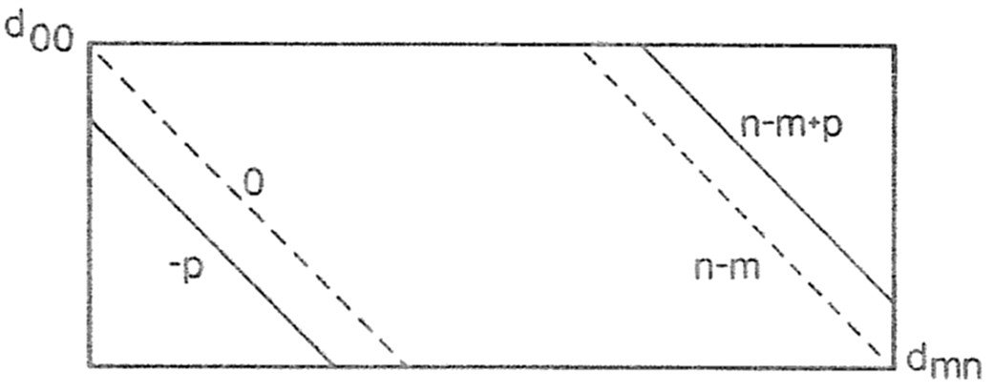

Analysis of Bandwidth DP
Time: O(s·min(m,n))
This is because

