Slide 1
Measures of Diversity in Classifier Ensembles and Their Relationship with the Ensemble Accuracy
Ludmila I. Kuncheva and Christopher J. Whitaker
Machine Learning,
VOL. 51, pp. 181-207, 2003

Slide 2
Abstract
Diversity among the members of a team of classiﬁers is deemed to be a key issue in classiﬁer combination. However, measuring diversity is not straightforward because there is no generally accepted formal deﬁnition. We have found and studied ten statistics which can measure diversity among binary classiﬁer outputs (correct or incorrect vote for the class label):

Slide 3
Abstract
four averaged pairwise measures (the Q statistic, the correlation, the disagreement and the double fault) and six non-pairwise measures (the entropy of the votes, the difﬁculty index, the Kohavi-Wolpert variance, the interrater agreement, the generalized diversity, and the coincident failure diversity). Four experiments have been designed to examine the relationship between the accuracy of the team and the measures of diversity, and among the measures themselves.

Slide 4
Abstract
Although there are proven connections between diversity and accuracy in some special cases, our results raise some doubts about the usefulness of diversity measures in building classiﬁer ensembles in real-life pattern recognition problems.

Slide 5
Why combine models?
Diversity in Decision Making
  Utility of combining diverse, independent outcomes in human decision-making
    Expert panels
    Protective Mechanism (e.g. stock portfolio diversity)
  Suppose we have 5 completely independent decision makers…
    If accuracy is 70% for each
      10 (.7^3)(.3^2)+5(.7^4)(.3)+(.7^5)
      83.7% majority vote accuracy
    101 such classifiers
      99.9% majority vote accuracy
Todd Holloway ETech 2008, "Ensemble Learning"
Notes:
So there is support for using ensembles. What is the intuition behind the success. On major aspect of concern is diversity. That is to say there are meaningful differences between the classifications of each classifier in the ensemble. Add picture.

Slide 6
A Reflection
Combining models adds complexity
  More difficult to characterize, anticipate predictions, explain predictions, etc.
  But accuracy may increase
Violation of Ockham’s Razor
  “simplicity leads to greater accuracy”
  Identifying the best model requires identifying the proper "model complexity"
See Domingos, P. Occam’s two razors: the sharp and the blunt. KDD. 1998.
Todd Holloway ETech 2008, "Ensemble Learning"

Slide 7
Achieving Diversity
Diversity from different algorithms, or algorithm parameters
(as we’ve seen with the Netflix Prize leaders)
Examples
  5 neighbor-based models with different relatedness measures
  1 neighbor model + 1 Bayesian model
Todd Holloway ETech 2008, "Ensemble Learning"
Notes:
Add images, examples. Have users seen the terminology in past slides? Voting?

Slide 8
Two Particular Strategies
Bagging
  Use different subsets of the training data for each model
Boosting
  With each additional model, make misclassified examples more important (or less, in some cases)
Todd Holloway ETech 2008, "Ensemble Learning"
Notes:
The two most common strategies. Bagging—diversity comes focusing on different subsets of data. Boosting is incremental, and gets diversity by having each additional classifier a bit more focused than the last. Add pics. (Bootstrap Aggregating)

Slide 9
Bagging Diversity
Requirement: Need unstable classifier types
  Unstable means a small change to the training data may lead to major decision changes.
  Is the neighbor approach unstable? No, but many other types are.
Todd Holloway ETech 2008, "Ensemble Learning"
Notes:
Originally rejected (journal of statistics). Can also create multiple NN using different random initial weights for diversity. Another bagging technique?

Slide 10
Bagging Algorithm
For 1 to k,
Take a bootstrap sample of the training examples
Build a model using sample
Add model to ensemble
To make a prediction, run each model in the ensemble, and use the majority prediction.
Todd Holloway ETech 2008, "Ensemble Learning"
Notes:
Originally rejected (journal of statistics). Can also create multiple NN using different random initial weights for diversity. Another bagging technique?

Slide 11
Boosting
Incrementally create models using selectively using training examples based on some distribution.
Todd Holloway ETech 2008, "Ensemble Learning"

Slide 12
AdaBoost (Adaptive Boosting) Algorithm
Initialize Weights
Construct a model. Compute the error.
Update the weights to reflect misclassified examples, and repeat step 2.
Finally, sum hypotheses…
Todd Holloway ETech 2008, "Ensemble Learning"
Notes:
Note: if weights can’t be used directly, they can be used to make examples currently misclassified more important (or less, if lots of noise).
generate a weighted sample of the example. Point is that the construction of a classifier

Slide 13
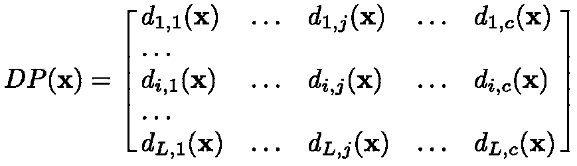

Decision profile
Classifiers
Classes
where d_{ij}(x) is the degree of support given by classifier i to the hypothesis that comes from class j

Slide 14
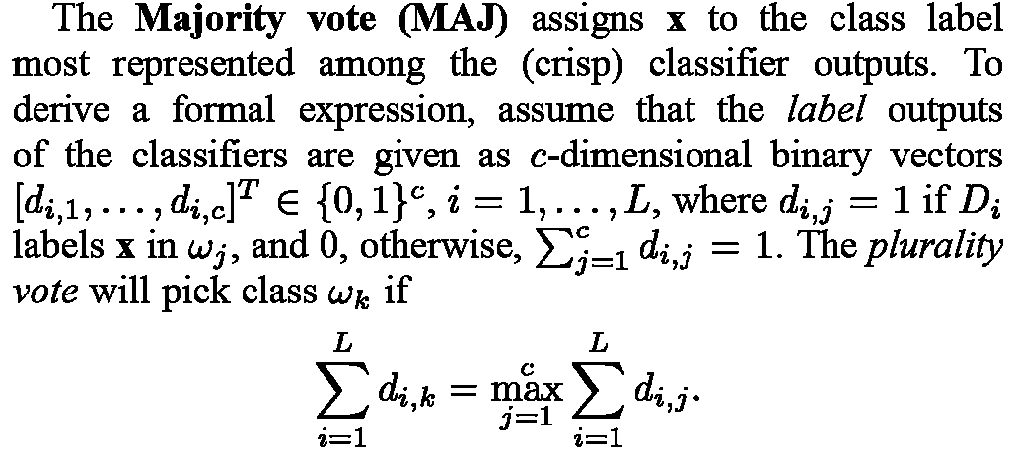
Majority vote
Ludmila I. Kuncheva, "Combining Pattern Classifiers"

Slide 15
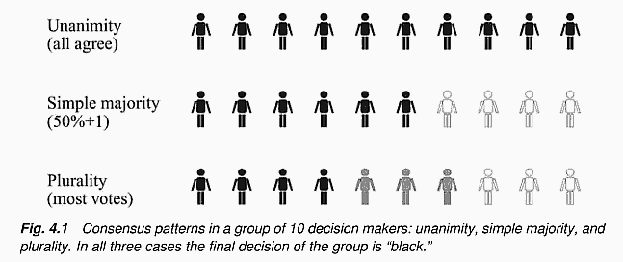
Majority vote
Ludmila I. Kuncheva, "Combining Pattern Classifiers"

Slide 16
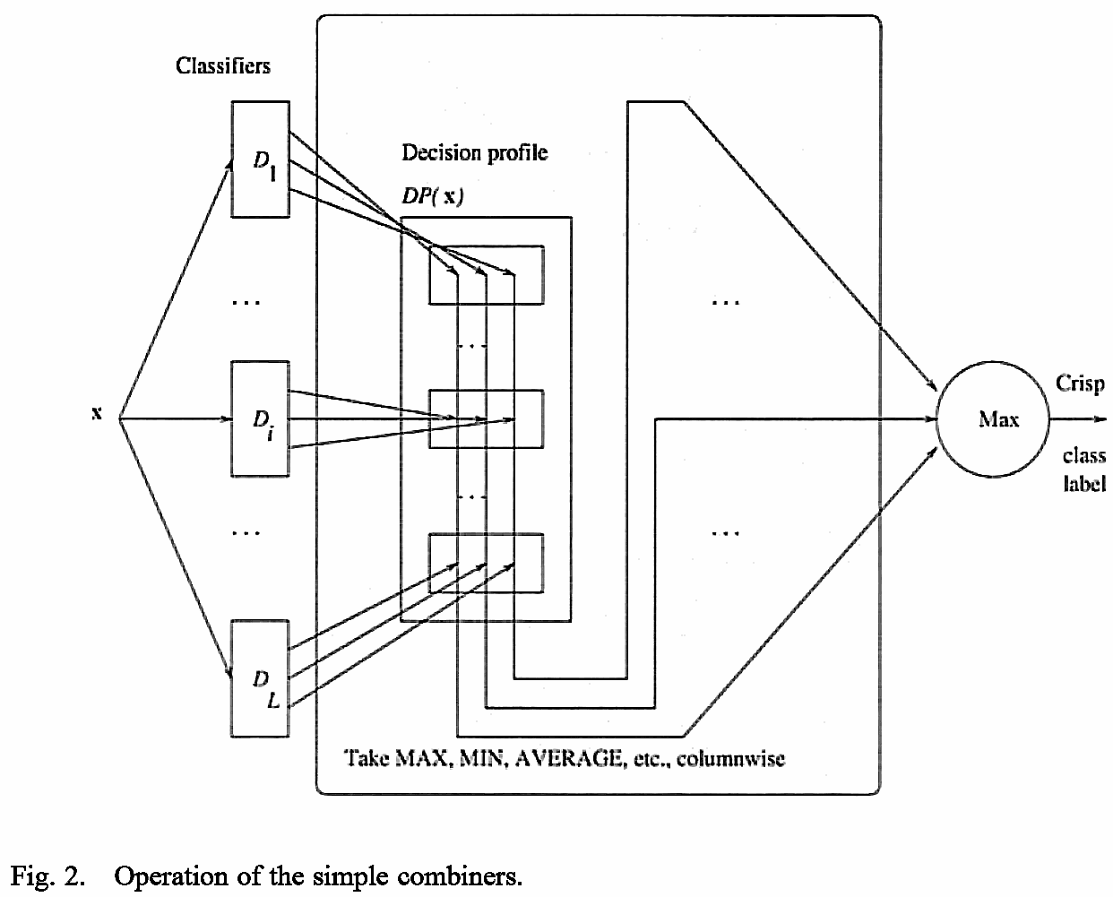
Simple combiners
The class support is calculated from the decision profile taking Maximum, Average and Product separately for each column.

Slide 17
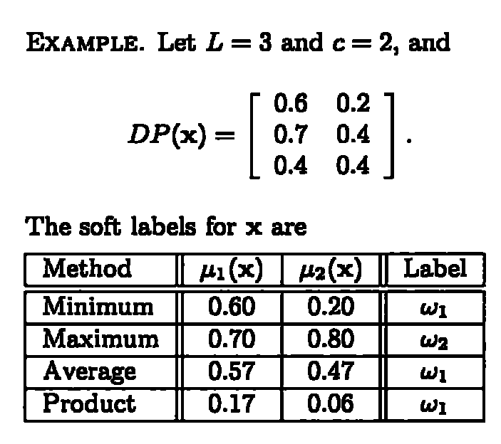
Example of Simple combiners
0.8

Slide 18
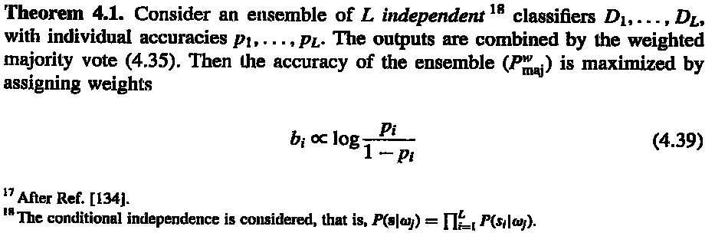
Weighted majority vote αm = log((1-e)/e)
Ludmila I. Kuncheva, "Combining Pattern Classifiers"
Notes:
x <- cbind(rep(seq(0,10,.2),each=51),rep(seq(0,10,.2),51))
cl <- apply(x,1,function(x) if((x[1]-x[2])>=0) "C1" else "C2")
col <- rep("blue",dim(x)[1])
col[which(cl=="C1")] <- "red"
plot(x,type='p',xlab="x1",ylab="x2",col=col,main="Original data")
x<-data.frame(x1=x[,1],x2=x[,2],class=cl)
ad <- adaboost.M1(class~.,x,mfinal=10)
for(i in 1:length(ad$trees)){
pred <- predict(ad$trees[[i]],x,type="class")
col <- rep("blue",dim(x)[1])
col[which(pred=="C1")] <- "red"
str <- sprintf("Classifier %i output, error: %f, weight: %f",
i,sum(pred!=x[,3])/dim(x)[1],ad$weights[i])
print(str)
x11()
plot(x[,1:2],type='p',xlab="x1",ylab="x2",col=col,main=str)
}
pred <- predict(ad,x)$class
col <- rep("blue",dim(x)[1])
col[which(pred=="C1")] <- "red"
str <- sprintf("Classifier 1~%i output, error: %f",
length(ad$trees),sum(pred!=x[,3])/dim(x)[1])
print(str)
x11()
plot(x[,1:2],type='p',xlab="x1",ylab="x2",col=col,main=str)

Slide 19
Example
125特徵(CSHVPZ)，訓練資料311筆分四類，CSHVPZ各用訓練25隱藏神經元神經網路，驗證正確率分別為：0.84、0.87、0.61、0.58、0.59及0.59。，因此，分類器權重為：1.65、1.93、0.45、0.30、0.34及0.34。
測試資料383筆，正確率分別為：0.68、0.77、0.66、0.63、0.62及0.62。
合併後測試正確率為0.81。
http://ranger.uta.edu/~chqding/protein/

Slide 20
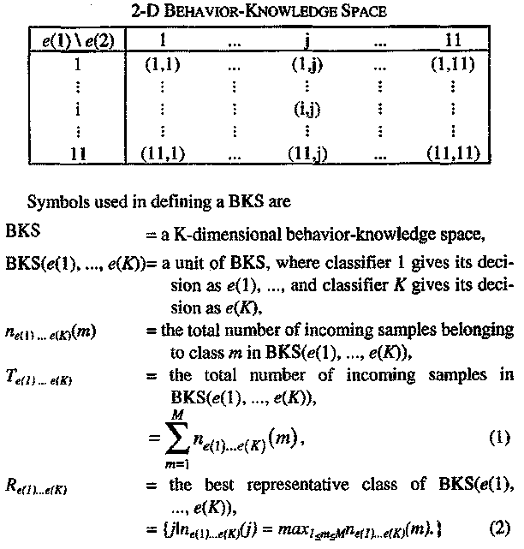
Behavior knowledge space (BKS)
IEEE TRANSACTIONS ON PATERN ANALYSIS AND MACHINE INTELLIGENCE, VOL. 17, NO. 1, JANUARY 1995

Slide 21
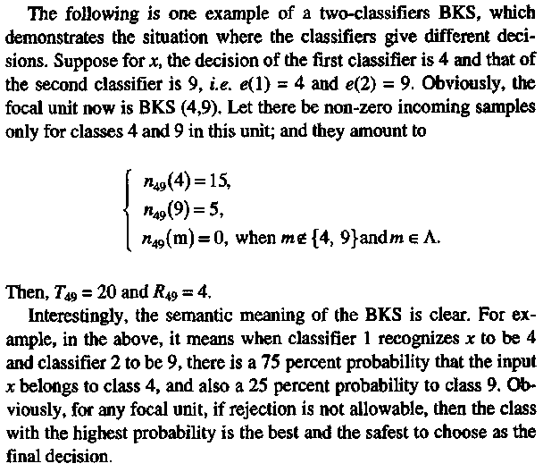
Behavior knowledge space (BKS)
IEEE TRANSACTIONS ON PATERN ANALYSIS AND MACHINE INTELLIGENCE, VOL. 17, NO. 1, JANUARY 1995

Slide 22
Decision templates (DT)
The idea of the decision templates (DTs) model is to "remember" the most typical decision profile for each class, called the decision template, , for that class, and then compare it with the current decision profile . The closest match will label x.把DP當成一向量，與類別之DT比較(計算similarity)。
Decision profile

Slide 23
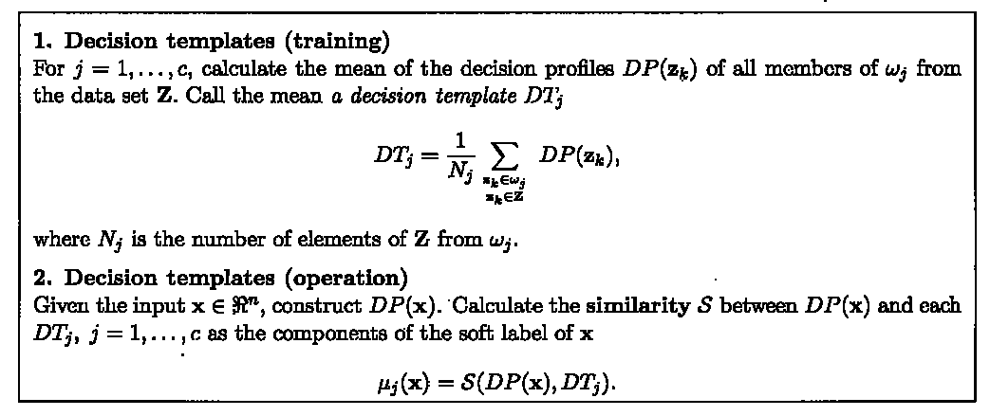
Fusion with DT & DP
Notes:
(dt1=matrix(c(.6,.8,.5,.4,.2,.5),nrow=3))
(dp=matrix(c(.3,.6,.5,.7,.4,.5),nrow=3))
(dt_e=1-sum((dt1-dp)^2)/length(dt1))
(dt_s1 = sum(c(.3,.6,.5,.4,.2,.5))/sum(c(.6,.8,.5,.7,.4,.5)))
(dt_s2=1-sum(abs(dt1-dp))/length(dt1))

Slide 24
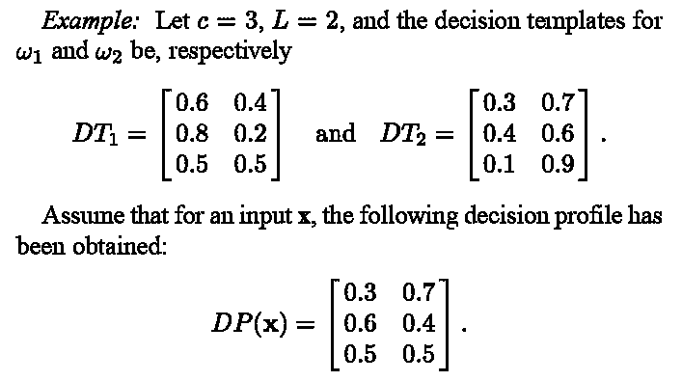
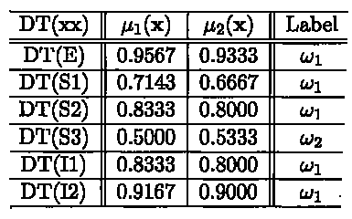
Fusion with DT & DP example
Notes:
(dt1=matrix(c(.6,.8,.5,.4,.2,.5),nrow=3))
(dp=matrix(c(.3,.6,.5,.7,.4,.5),nrow=3))
(dt_e=1-sum((dt1-dp)^2)/length(dt1))
(dt_s1 = sum(c(.3,.6,.5,.4,.2,.5))/sum(c(.6,.8,.5,.7,.4,.5)))
(dt_s2=1-sum(abs(dt1-dp))/length(dt1))

Slide 25
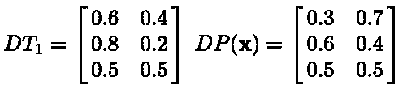
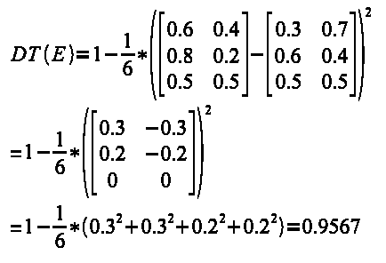
Similarity between DT & DP
- Euclidean distance (E)
Notes:
DT(E)={1-{1 over 6}* left(left [ matrix{0.6 # 0.4 ## 0.8 # 0.2 ## 0.5 # 0.5} right ] -left [ matrix{0.3 # 0.7 ## 0.6 # 0.4 ## 0.5 # 0.5} right ]right)^2}
newline
"="1-{1 over 6}*left(left [ matrix{0.3 # -0.3 ## 0.2 # -0.2 ## 0 # 0} right ]right)^2
newline
"="1-{1 over 6}*(0.3^2+0.3^2+0.2^2+0.2^2)=0.9567

Slide 26

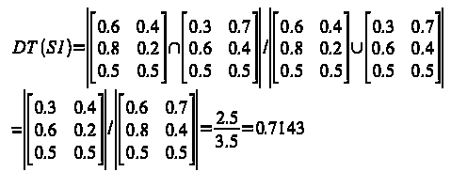
Similarity between DT & DP
- fuzzy similarity (S1)
Notes:
DT(S1)={left lline left [ matrix{0.6 # 0.4 ## 0.8 # 0.2 ## 0.5 # 0.5} right ] intersection left [ matrix{0.3 # 0.7 ## 0.6 # 0.4 ## 0.5 # 0.5} right ]right rline } /
{left lline left [ matrix{0.6 # 0.4 ## 0.8 # 0.2 ## 0.5 # 0.5} right ] union left [ matrix{0.3 # 0.7 ## 0.6 # 0.4 ## 0.5 # 0.5} right ]right rline}
newline
"=" left lline left [ matrix{0.3 # 0.4 ## 0.6 # 0.2 ## 0.5 # 0.5} right ] right rline /
left lline left [ matrix{0.6 # 0.7 ## 0.8 # 0.4 ## 0.5 # 0.5} right ] right rline
={2.5} over {3.5} =0.7143

Slide 27

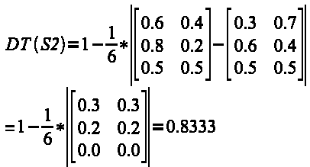
Similarity between DT & DP
- fuzzy similarity (S2)
Notes:
DT(S2)=1-{1 over 6}* left lline left [ matrix{0.6 # 0.4 ## 0.8 # 0.2 ## 0.5 # 0.5} right ] -left [ matrix{0.3 # 0.7 ## 0.6 # 0.4 ## 0.5 # 0.5} right ] right rline
newline
"=" 1-{1 over 6}* left lline left [ matrix{0.3 # 0.3 ## 0.2 # 0.2 ## 0.0 # 0.0} right ] right rline
=0.8333

Slide 28

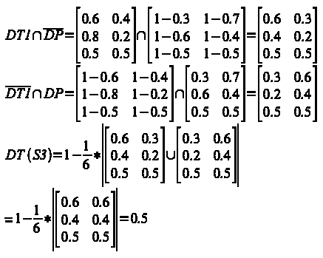
Similarity between DT & DP
- fuzzy similarity (S3)
Notes:
DT1 intersection overline {DP} = left [matrix{0.6 # 0.4 ## 0.8 # 0.2 ## 0.5 # 0.5} right] intersection
{left [ matrix{1-0.3 # 1-0.7 ## 1-0.6 # 1-0.4 ## 1-0.5 # 1-0.5} right ]}
=left [ matrix{0.6 # 0.3 ## 0.4 # 0.2 ## 0.5 # 0.5} right ]
newline
overline DT1 intersection DP = left [matrix{1-0.6 # 1-0.4 ## 1-0.8 # 1-0.2 ## 1-0.5 # 1-0.5} right] intersection
{left [ matrix{0.3 # 0.7 ## 0.6 # 0.4 ## 0.5 # 0.5} right ]}
=left [ matrix{0.3 # 0.6 ## 0.2 # 0.4 ## 0.5 # 0.5} right ]
newline
DT(S3)=1-{1 over 6}* left lline
left [ matrix{0.6 # 0.3 ## 0.4 # 0.2 ## 0.5 # 0.5} right ] union
left [ matrix{0.3 # 0.6 ## 0.2 # 0.4 ## 0.5 # 0.5} right ]
right rline
newline
"="1-{1 over 6}* left lline
left [ matrix{0.6 # 0.6 ## 0.4 # 0.4 ## 0.5 # 0.5} right ]
right rline=0.5

Slide 29

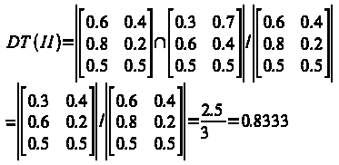
Similarity between DT & DP
- fuzzy similarity (I1)
Notes:
DT(I1)= left lline
left [ matrix{0.6 # 0.4 ## 0.8 # 0.2 ## 0.5 # 0.5} right ] intersection
left [ matrix{0.3 # 0.7 ## 0.6 # 0.4 ## 0.5 # 0.5} right ]
right rline /
left lline
left [ matrix{0.6 # 0.4 ## 0.8 # 0.2 ## 0.5 # 0.5} right ]
right rline
newline
"="left lline
left [ matrix{0.3 # 0.4 ## 0.6 # 0.2 ## 0.5 # 0.5} right ]
right rline /
left lline
left [ matrix{0.6 # 0.4 ## 0.8 # 0.2 ## 0.5 # 0.5} right ]
right rline=2.5 over 3.0=0.8333

Slide 30

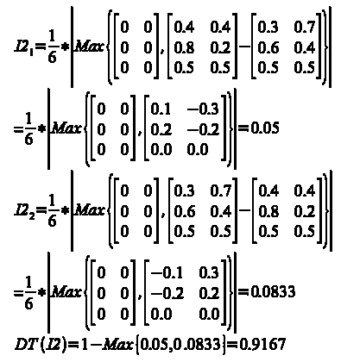
Similarity between DT & DP
- fuzzy similarity (I2)
Notes:
I2_1= {1 over 6} *left lline Max left lbrace
left [ matrix{0 # 0 ## 0 # 0 ## 0 # 0} right ] ,
left [ matrix{0.4 # 0.4 ## 0.8 # 0.2 ## 0.5 # 0.5} right ]-
left [ matrix{0.3 # 0.7 ## 0.6 # 0.4 ## 0.5 # 0.5} right ]
right rbrace right rline
NEWLINE
"="
{1 over 6} *left lline Max left lbrace
left [ matrix{0 # 0 ## 0 # 0 ## 0 # 0} right ] ,
left [ matrix{0.1 # -0.3 ## 0.2 # -0.2 ## 0.0 # 0.0} right ]
right rbrace right rline
=0.05
newline
I2_2= {1 over 6} *left lline Max left lbrace
left [ matrix{0 # 0 ## 0 # 0 ## 0 # 0} right ] ,
left [ matrix{0.3 # 0.7 ## 0.6 # 0.4 ## 0.5 # 0.5} right ]-
left [ matrix{0.4 # 0.4 ## 0.8 # 0.2 ## 0.5 # 0.5} right ]
right rbrace right rline
NEWLINE
"="{1 over 6} *left lline Max left lbrace
left [ matrix{0 # 0 ## 0 # 0 ## 0 # 0} right ] ,
left [ matrix{-0.1 # 0.3 ## -0.2 # 0.2 ## 0.0 # 0.0} right ]
right rbrace right rline=0.0833
newline
DT(I2)=1-Max left lbrace 0.05,0.0833 right rbrace=0.9167

Slide 31
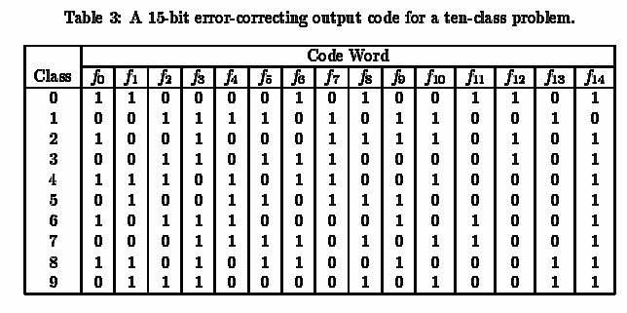
Error correct output coding
Each of the learned hypotheses makes classi_x000c_cation errors independently, then individual errors can be corrected because the codewords are "far apart" in the output space.

Slide 32
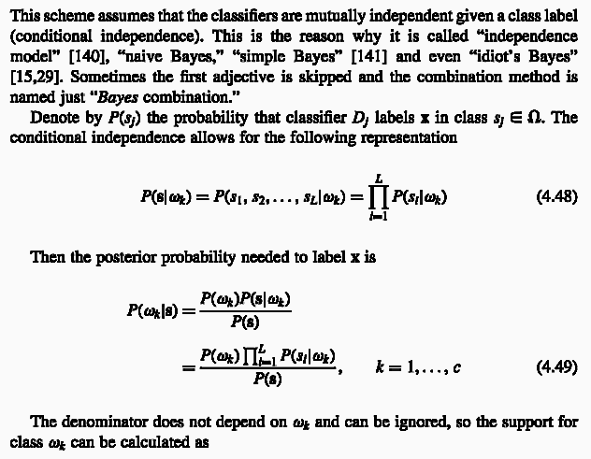
Navie Bayes combination
Ludmila I. Kuncheva, "Combining Pattern Classifiers"

Slide 33
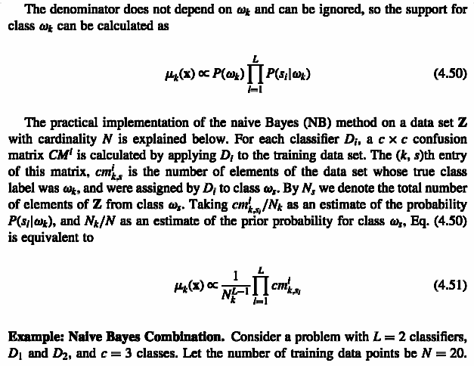
Navie Bayes combination
Ludmila I. Kuncheva, "Combining Pattern Classifiers"

Slide 34
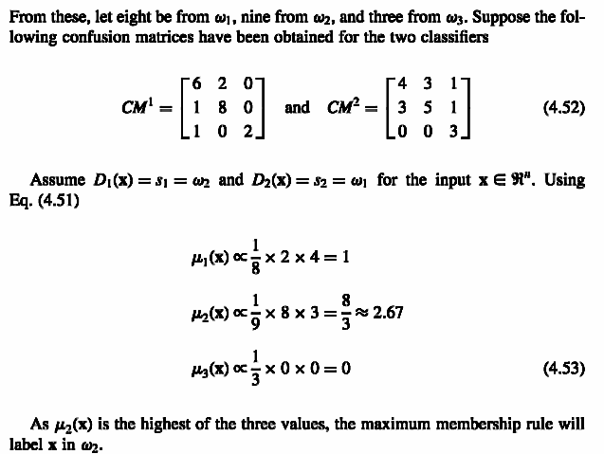
Navie Bayes combination
Ludmila I. Kuncheva, "Combining Pattern Classifiers"

Slide 35
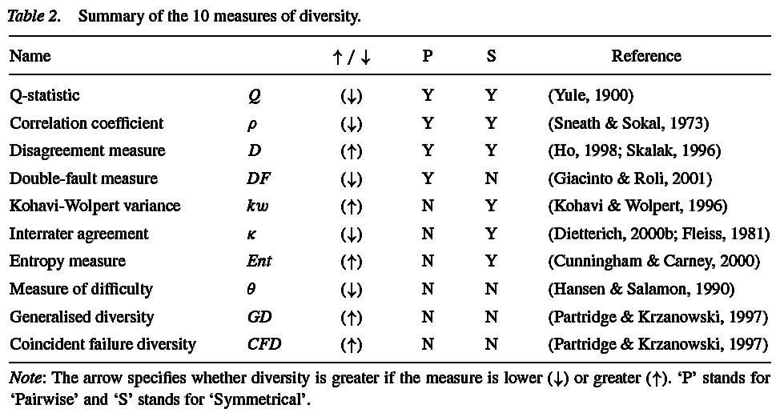
Summary of diversity
The measures of diversity is symmetrical(nonaffected) with respect to swapping the 0 and the 1.

Slide 36
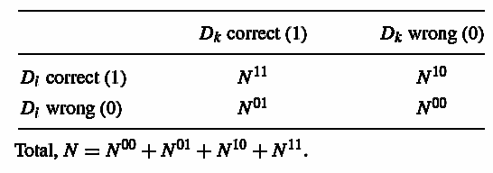


The Q statistics
The similarity of outputs between two classifier Di and Dk, i or k=1~L (classifiers#). For statistically independent classifiers, the expectation of Qi,k is 0.

Slide 37
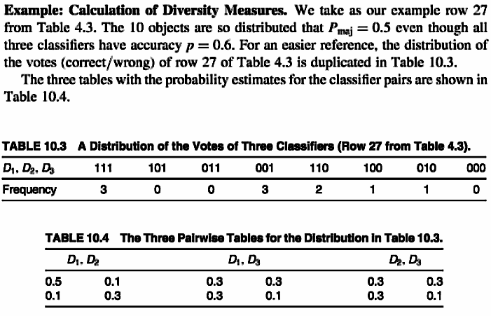
The Q statistics

Slide 38

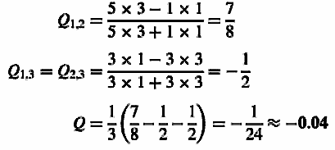
The Q statistics

Slide 39

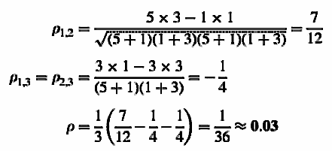
The correlation coefficient

Slide 40

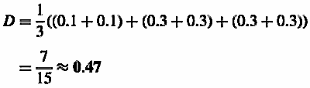
The disagreement measure
It is the ratio between the number of observations on which one classifier (classifier i) is correct and the other (classifier j) is incorrect to the total number of observations.

Slide 41


The double fault measure
It is defined as the proportion of the cases that have been misclassified by both classifiers.

Slide 42
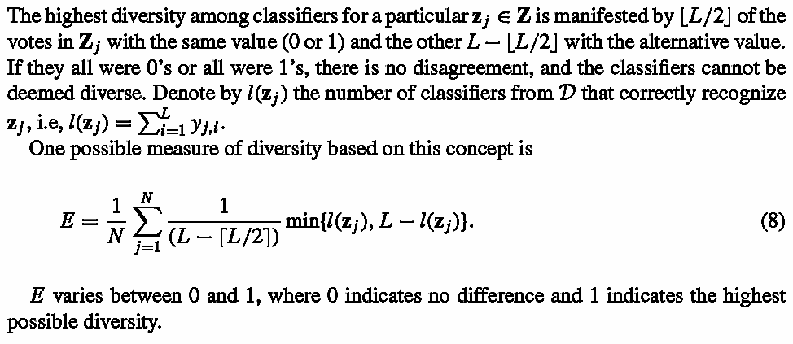
The entropy measure

Slide 43

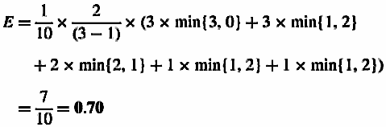
The entropy measure

Slide 44

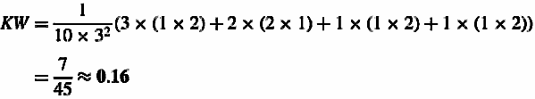
Kohavi-Wolpert variance
A expression of the variability of the predicted class label y for x, across training sets, for a specific classifier model.

Slide 45
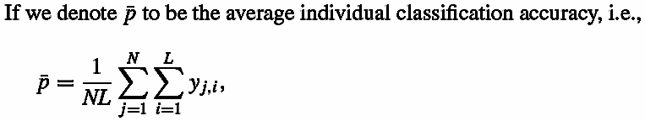

Interrater agreement
Rater: classifier

Slide 46
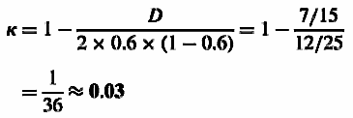
Interrater agreement

Slide 47
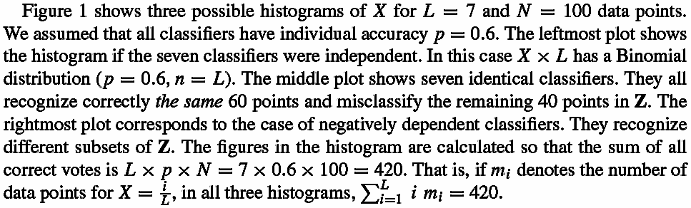
The measure of difficulty

Slide 48
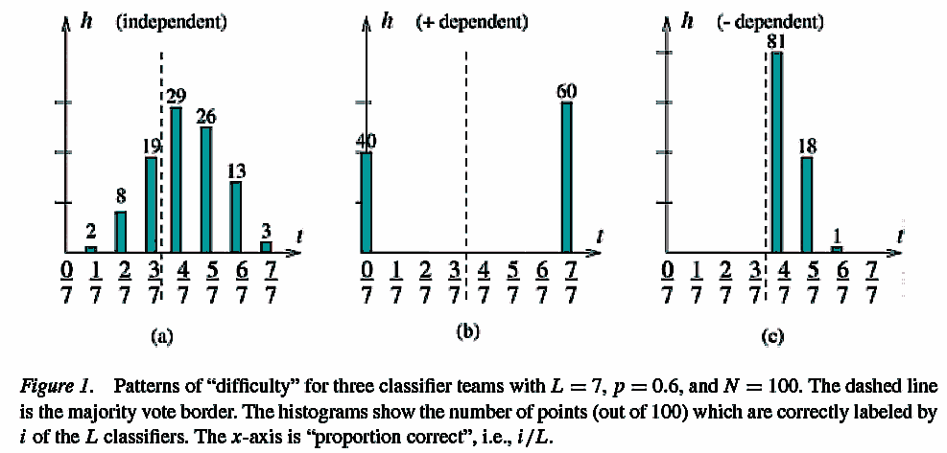
The measure of difficulty
Notes:
Hansen and Salamon (1990) talk about a pattern of “difficulty” of the points in the feature
space, which in our case is represented by the histogram over Z. If the same points have been
difficult for all classifiers, and the other points have been easy for all classifiers, we obtain
a plot similar to the middle one (no diversity in the team). If the points that were difficult
for some classifiers were easy for other classifiers, the distribution of X is as the one on the
right. Finally, if each point is equally difficult for all classifiers, the distribution on the left
is the most likely one.
The target is a measure of diversity based on the distribution of difficulty.We can capture
the distribution shape by using the variance of X.Diverse teamsDwill have smaller variance
of X (right plot). Teams of similar classifiers will have high variance, as the pattern in the
middle plot. Let the three variables X in figure 1(a), 1(b) and 1(c) be Xa, Xb, and Xc,
Respectively.
Based on this, we define the difficulty θ to be Var(X). For convenience we can scale θ
linearly into [0, 1], taking p(1− p) as the highest possible value. The higher the value of θ,
the worse the classifier team. Ideally, θ = 0, but this is an unrealistic scenario. More often,
real classifiers are positively dependent and will exhibit patterns similar to figure 1(b).

Slide 49
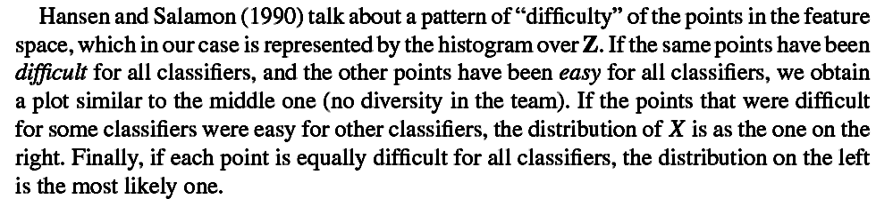
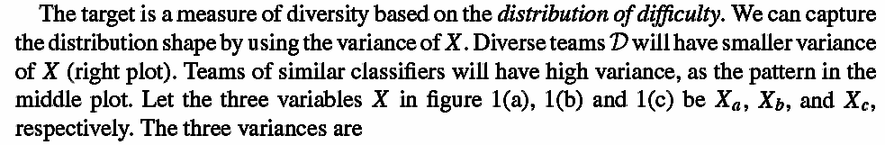
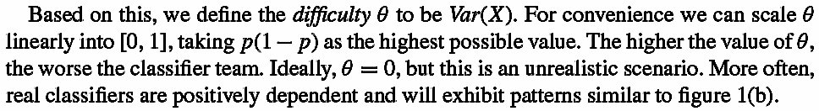
The measure of difficulty

Slide 50
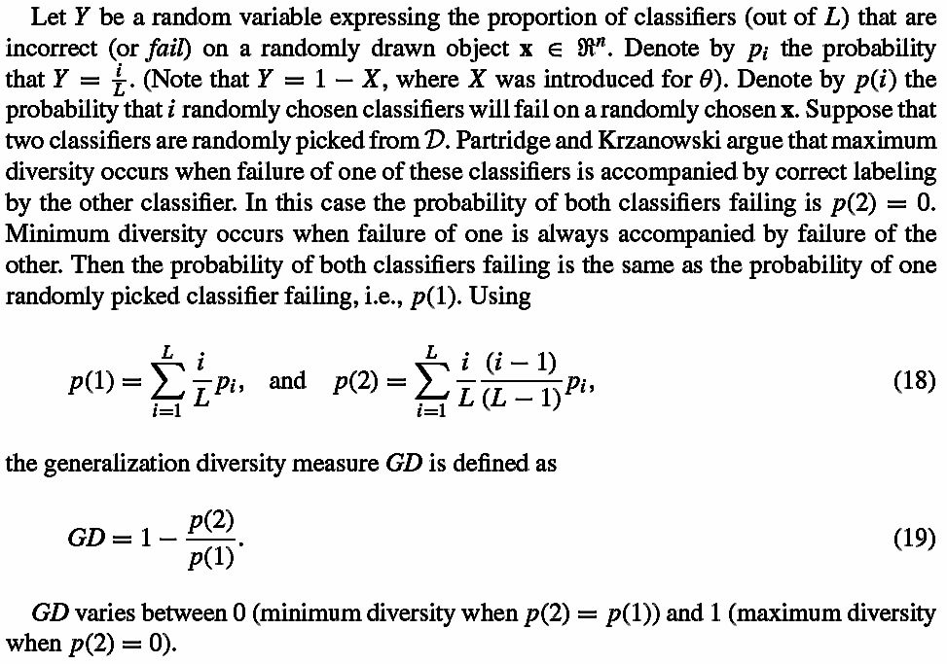
The generalized diversity

Slide 51
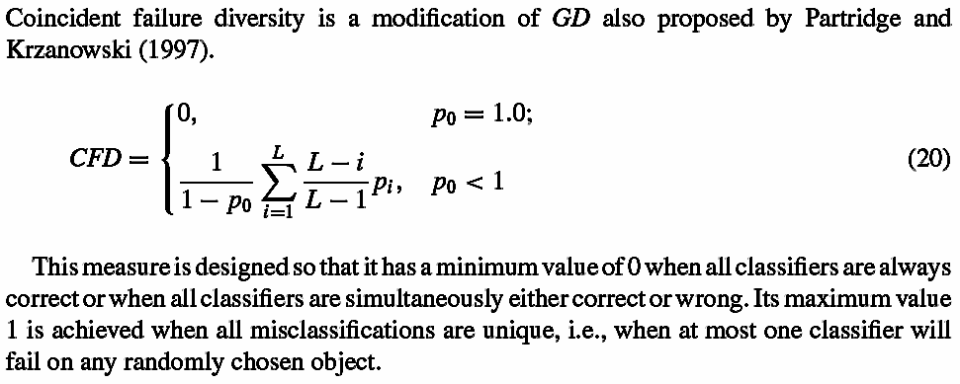
The coincident failure diversity

Slide 52
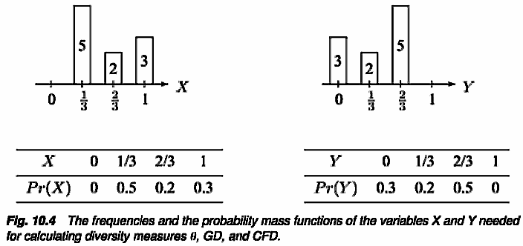
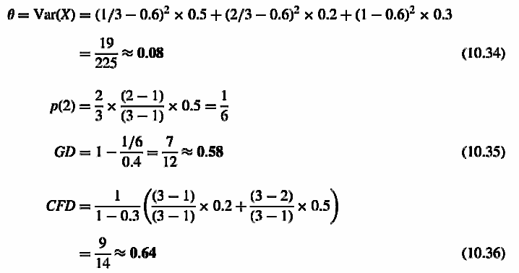
The θ, GD, CFD example

Slide 53
Experiment 1
A Matlab programwas designed to randomly generate L binary classifier outputs for N objects, so that the individual accuracy is approximately p and with a (symmetric) matrix of dependencies Q=[Q_{ik}], where i,k=1~L.
Six sets of experiments were carried out with the individual accuracy p ∈ {0.6, 0.7} and the number of classifiers L ∈ {3, 5, 9}. In all experiments N = 1000.
15 classifier teams D were generated for each of the 21 values of the averaged pairwise dependency Q_{av} ∈ {−1.0,−0.9, . . . ,0.9, 1.0}, giving a total of 315 classifier teams.

Slide 54
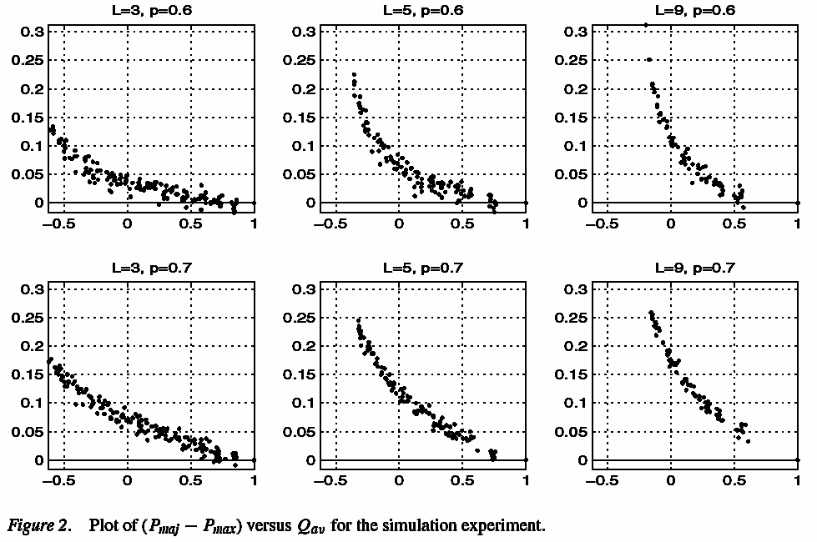
Experiment 1

Slide 55
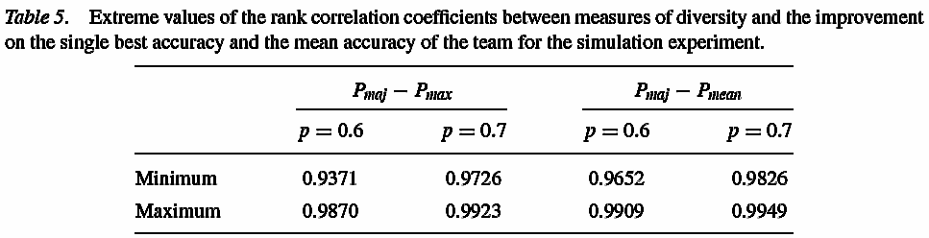
Experiment 1
Smaller Q (more diverse classifiers) leads to higher improvement over the single best classifier. Negative Q (negative dependency) is better than independence (Q = 0) as it leads to an even bigger improvement.
Total positive dependency (identical classifiers, Q =1) is not the worst case. The worst case is obtained for positively dependent but not identical classifiers.
請注意，此為模擬數據

Slide 56
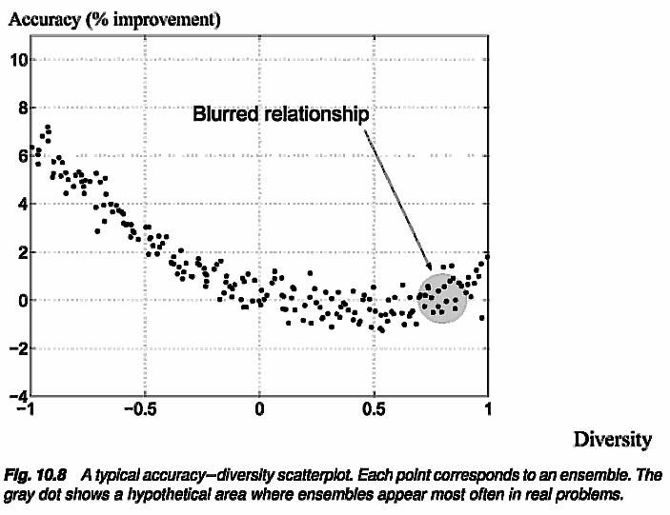
Experiment 1
一般來說，訓練出的分類器相異性均不至太大，因此整合後之進步有限

Slide 57
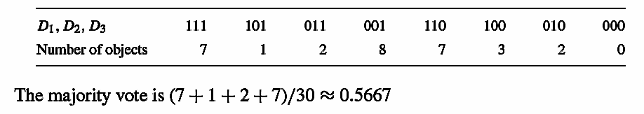
Experiment 2
1. All three individual classifier have exactly the same accuracy, p = 0.6.
2. The pairwise dependency is not restricted. As the example shows, classifiers of very different pairwise Q are generated too.
3. All possible classifier outputs with L = 3, p = 0.6 and N =30 were generated (no special arrangements for uniform distribution of Q or any other measures have been made). The total number of possible classifier ensembles is 563.
For example, one possible partition is shown below

Slide 58
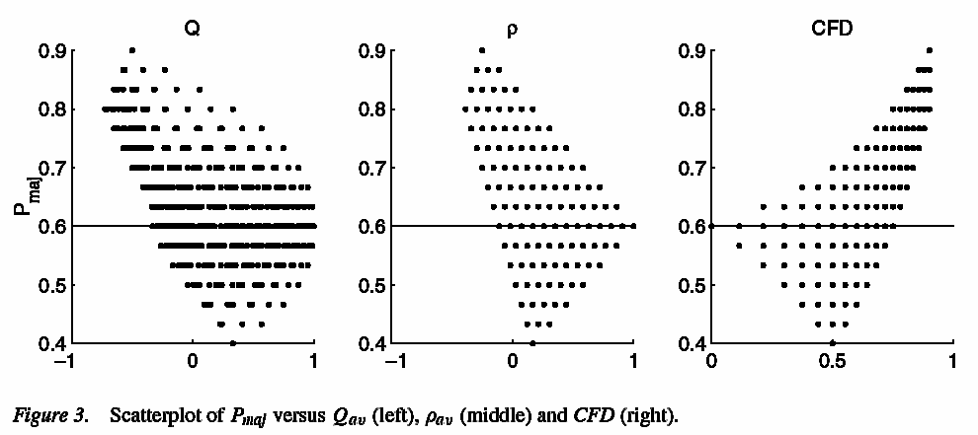
Experiment 2
1.紅色區域表無論如何合併，整體正確率均可提升
2.藍色區域提升則需靠運氣
3.請注意，此為模擬數據

Slide 59
Experiment 3
1. Wisconsin Diagnostic Breast Cancer database is taken from the UCI Repository of Machine Learning Database.
2. There are total 569 data, each of which has 30 features. Only 10 relevant feature are adopted.
3. We considered L = 3 classifiers. All partitions of the 10-element feature set into _x0015_(4, 4, 2) (3150 partitions) and (_x0015_4, 3, 3) (4200 partitions) were generated.
4.Linear and quadratic classifier are used.
5.Applying other combination methods besides the majority vote (MAJ). These were Naive Bayes (NB), the Behavior Knowledge Space method (BKS), maximum (MAX), minimum, average (AVR) and product (PRO) from the simple methods, and the decision templates (DT) method.

Slide 60
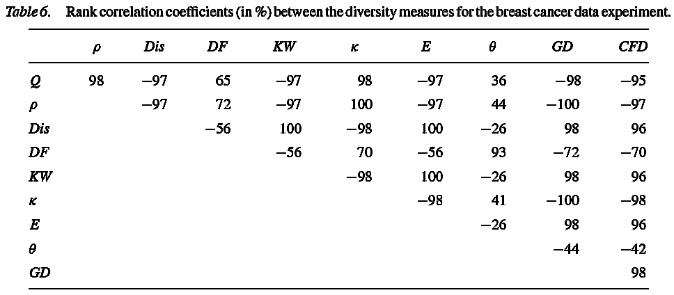
Experiment 3
Diversity的相關係數大部份很高，最低的為θ，其與DF相關係數也很高。這表示不同Diversity其實是差不多的。

Slide 61
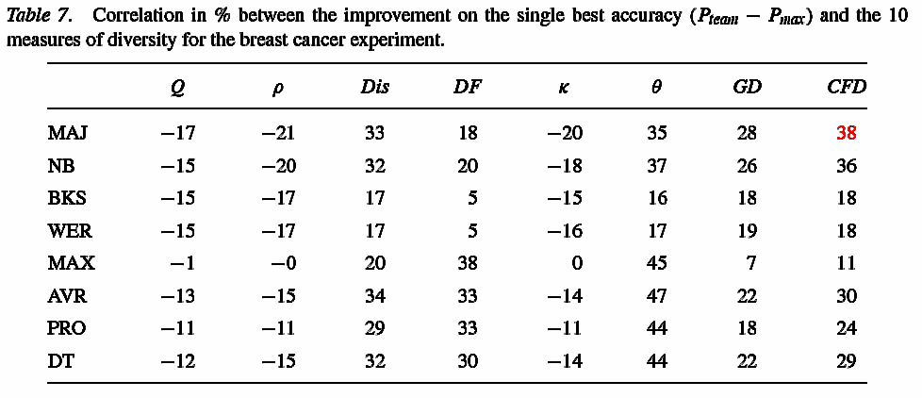
Experiment 3
合併分類器的改進與Diversity的相關係數最高僅達+0.47，其餘均很低，看不出此二者相關性。►這表示這些Diversity並無法保證合併後結果的提升

Slide 62
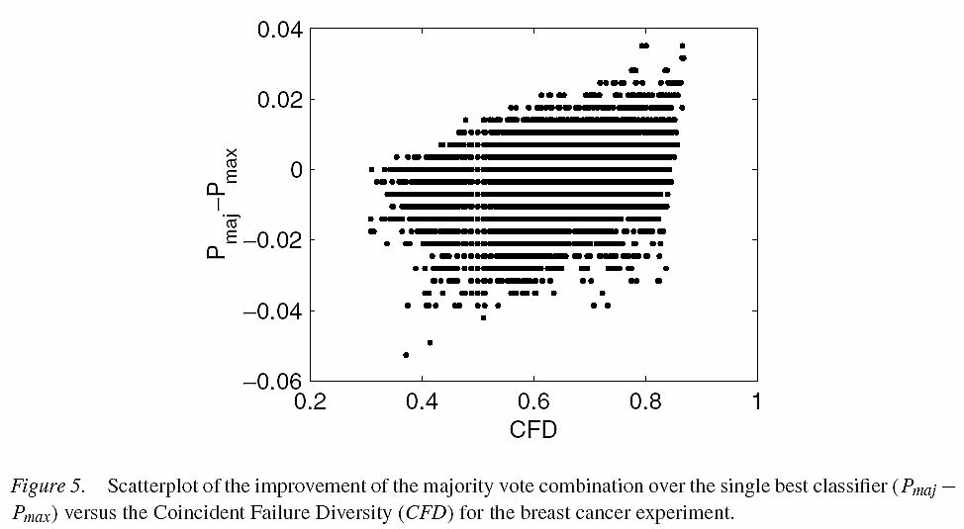
Experiment 3
MAJ合併分類器的改進與CFD Diversity的相關係數最高(+0.38)，但看不出此二者相關性

Slide 63
Experiment 4
1. Phoneme data: Five-dimensional data characterizing two classes of phonemes: nasals (70.65%) and orals (29.35%).
2.Cone-torus data: A three-class dataset with 400 2-d points generated from three differently shaped distributions: a cone, half a torus, and a normal distribution with prior probabilities 0.25, 0.25, and 0.5,
3.Linear and 15-hidden-node neural network classifier are used.
4. Considering L = 9 classifiers. 500 random partitions of the training and testing are 1000/4404 and 400/400. Two ensemble configurations: bagging and weak classifiers.

Slide 64


Experiment 4
For the random weak-classifiers method, 9 weak classifiers were generated by randomly assigning the coefficients of the linear discriminant functions. A classifier was accepted for the team if the training accuracy was greater than the highest prior probability (estimated from the training set).
Cone and torus graphs are from:
http://f-lohmueller.de/pov_tut/basic/povtuto5.htm)

Slide 65

Experiment 4
500次實驗統計，Diversity間相關係數大致高於Diversity與正確率提高之相關係數

Slide 66

Experiment 4
合併分類器的正確率與Q Diversity的相關係數看不出二者相關性

Slide 67

Experiment 4
合併分類器的正確率與Q Diversity的相關係數看不出二者相關性

Slide 68

Experiment 4
合併分類器的正確率與Q Diversity的相關係數看不出二者相關性

Slide 69
Conclusion
The mutual relationships between the diversity measures were found to be strong. (每一種diversity都有高的相互關係)
There is no clear relationship between diversity and the averaged individual accuracy, which is counterintuitive, much as most of the other findings in our study. (到底用那一種似乎不大有關係)
The relationship between Q and the limits of Pmaj has been formally derived Q is easy to calculate. For these reasons we recommend the use of Q.
The general motivation for designing diverse classifiers is correct but the problem of measuring this diversity and so using it effectively for building better classifier teams is still to be solved.

