Slide 1
A Time-Series-Based Feature Extraction Approach for Prediction of Protein Structural Class
Ravi Gupta, Ankush Mittal, and Kuldip Singh
EURASIP Journal on Bioinformatics and Systems Biology,
VOL. 2008

Slide 2
Abstract
This paper presents a novel feature vector based on physicochemical property of amino acids for prediction protein structural classes. The proposed method is divided into three different stages. First, a discrete time series representation to protein sequences using physicochemical scale is provided. Later on, a wavelet-based time-series technique is proposed for extracting features from mapped amino acid sequence and a fixed length feature vector for classification is constructed.

Slide 3
Abstract
The proposed feature space summarizes the variance information of ten different biological properties of amino acids. Finally, an optimized support vector machine model is constructed for prediction of each protein structural class. The proposed approach is evaluated using leave-one out cross-validation tests on two standard datasets. Comparison of our result with existing approaches shows that overall accuracy achieved by our approach is better than exiting methods.

Slide 4
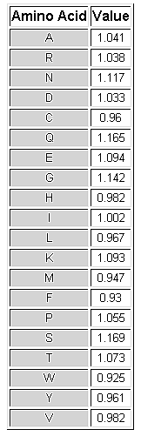
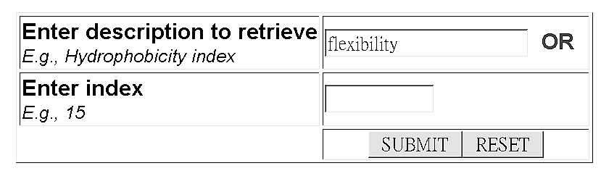
Amino acid Physical-chemical properties
Example:
http://www.rfdn.org/bioinfo/APDbase/APDbase.php

Slide 5
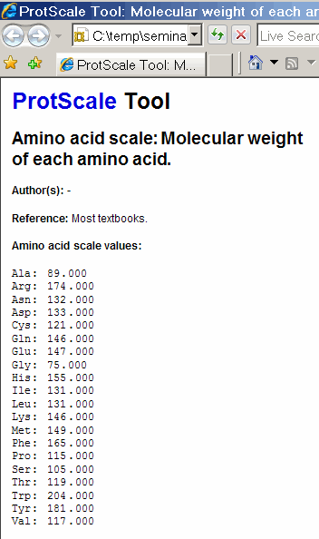
Amino acid Physical-chemical properties
Example:
http://au.expasy.org/tools/protscale.html

Slide 6
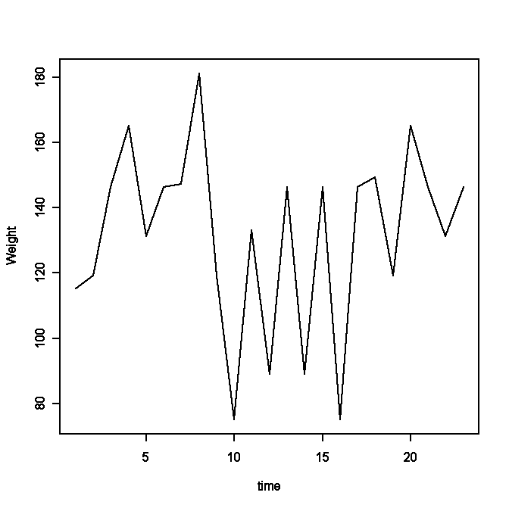
Amino acid Physical-chemical properties  Time series
Molecular weight
Amino Acid
A
R
N
D
C
Q
E
G
H
I
L
K
M
F
P
S
T
W
Y
V
Value
089.089996
174.199997
132.119995
133.100006
121.150002
146.149994
147.130005
075.070000
155.160004
131.169998
131.169998
146.190002
149.210007
165.190002
115.129997
105.089996
119.120003
204.240005
181.190002
117.150002
PTKFLKEYTGDAKAKGKMTFKLK
(115.129997,119.120003,146.190002,
165.190002,131.169998,146.190002,
147.130005,181.190002,119.120003,
75.07,133.100006,89.089996,
146.190002,89.089996,146.190002,
75.07,146.190002,149.210007,
119.120003,165.190002,146.190002,
131.169998,146.190002)

Slide 7
1-5 Features
The average flexibility indices
The normalized hydrophobicity scales
The transfer free energy
The residue accessible surface area in folded protein
The relative mutability
  multiplying the number of observed mutations by the frequency of occurrence of the individual amino acids

Slide 8
6-10 Features
The isoelectric point
The polarity of amino acids
The volume of amino acid
The composition of the amino acids
The molecular weight of the amino acids

Slide 9

Fourier Transforms
傅立葉轉換是一種線性的積分轉換，其主要基本思想由法國學者傅立葉提出
Translating a function in the time domain into a function in the frequency domain
From wikipedia
sines and cosines

Slide 10
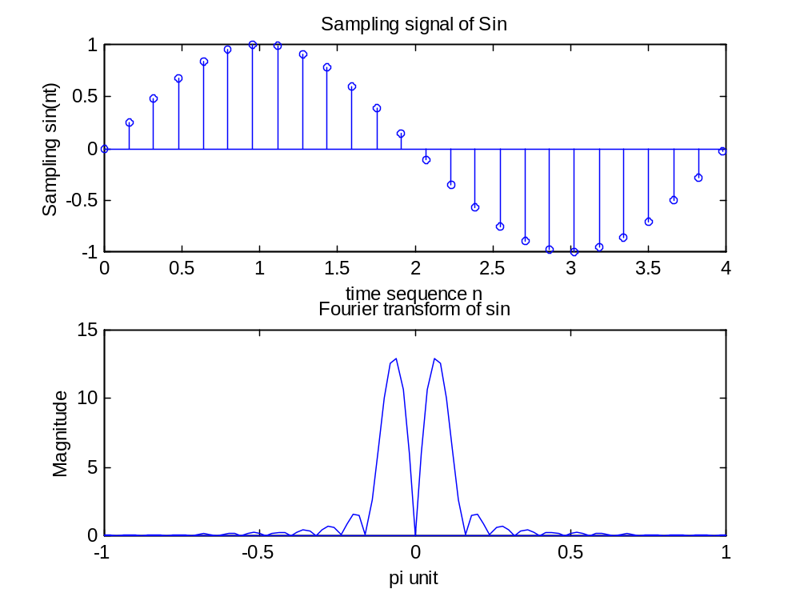
Fourier Transforms

Slide 11
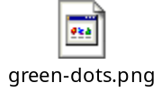
FFT 於影像處理
原始影像
FFT
頻域處理
IFFT
Notes:
Matlab code:
im=imread('c:\green-dots.png');
imshow(im)
x=[1:640];
y=[1:482]';
figure
x=(repmat(x,482,1));
y=(repmat(y,1,640));
im2=(sin((x+y)/2)+1)/2*255;
imshow(uint8(im2))
figure
im_fft=fft2(im);
im2_fft=fft2(im2);
imagesc(log(abs(fftshift(im2_fft))))
im3=(double(im)+im2)/2;
imshow(uint8(im3))
im3_fft=fft2(im3);
figure
imshow(uint8(real(ifft2(im3_fft))))
im4_fft=im3_fft;
im4_fft(:,589:591)=0;
im4_fft(:,51:53)=0;
im4_fft(39:41,:)=0;
im4_fft(439:441,:)=0;
figure
imagesc((real(ifft2(im4_fft))))
figure
imagesc((real(ifft2(im4_fft))))
figure
im5_fft=fftshift(im4_fft);
imagesc((real(ifft2(im5_fft))))

Slide 12
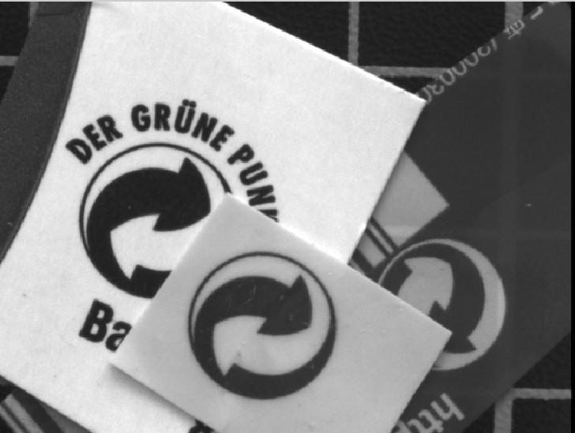


影像還原(Restoration)範例
假設原始影像受到一已知弦波干擾而失真，目標為將影像還原至可辨識程度
原始影像
失真影像

Slide 13
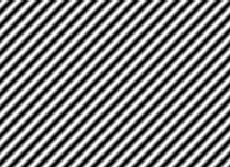
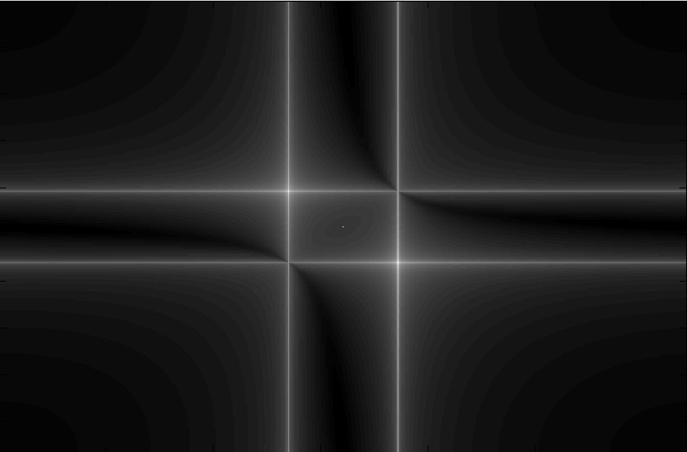
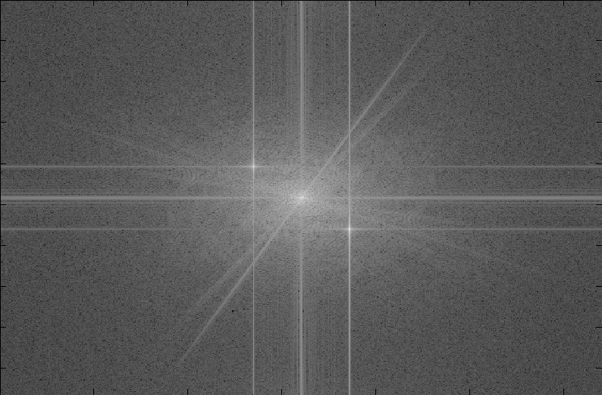
空間及頻域分析
空間域
頻域
雜訊

Slide 14
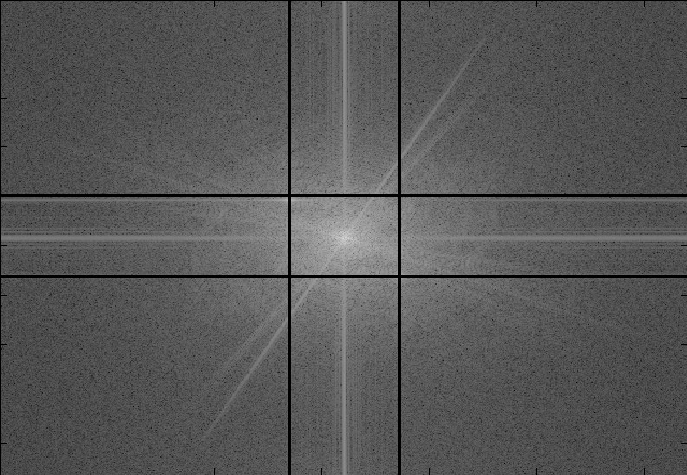

在頻域中去除雜訊
去除雜訊頻率
反傅利葉轉換

Slide 15
Wavelet transform
小波轉換是指用有限長或快速衰減的、稱為母小波的振盪波形來表示訊號。該波形被縮放和平移以匹配輸入的訊號(見以下範例)
From wikipedia

Slide 16
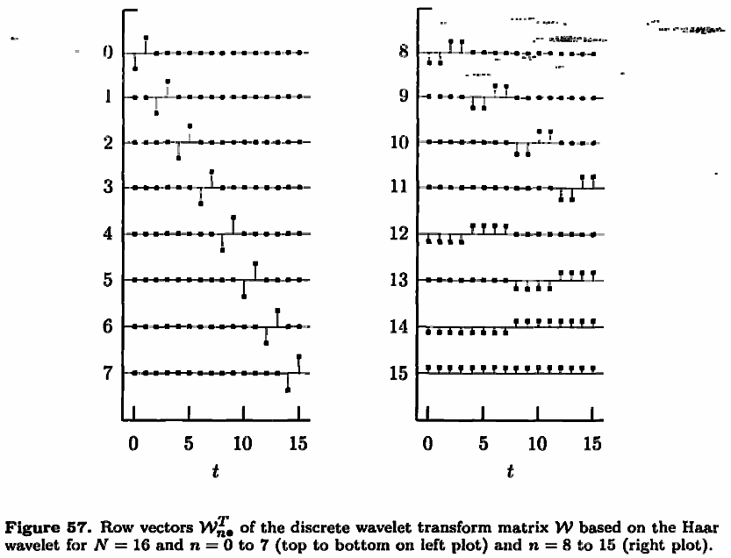
Haar Wavelet
平移
縮放
Percival, D. B. and A. T. Walden (2000) Wavelet Methods for Time Series Analysis, Cambridge University Press.

Slide 17
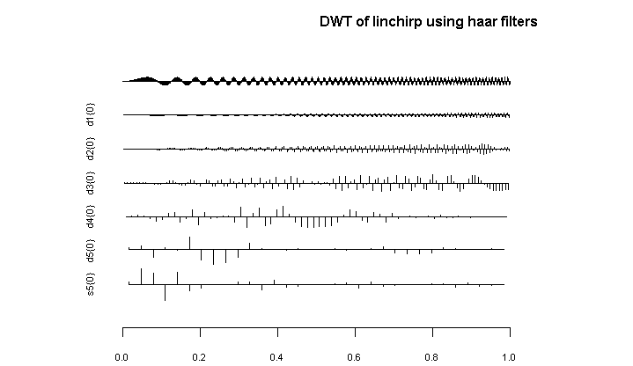
Wavelet transform
Min 1Q Median 3Q Max Mean SD Var MAD Energy %
d1 -0.513 -0.145 0.001 0.143 0.510 0.000 0.223 0.050 0.215 5.079
d2 -1.245 -0.371 0.010 0.377 1.227 -0.001 0.554 0.307 0.561 15.615
d3 -2.041 -0.989 -0.018 0.748 2.066 -0.075 1.133 1.284 1.271 32.711
d4 -2.715 -1.080 0.000 0.431 2.719 -0.188 1.310 1.716 1.044 22.049
d5 -3.811 -0.883 -0.042 0.164 3.081 -0.341 1.343 1.804 0.495 11.909
s5 -4.037 -0.395 0.027 0.545 4.171 0.170 1.418 2.011 0.692 12.637

Slide 18
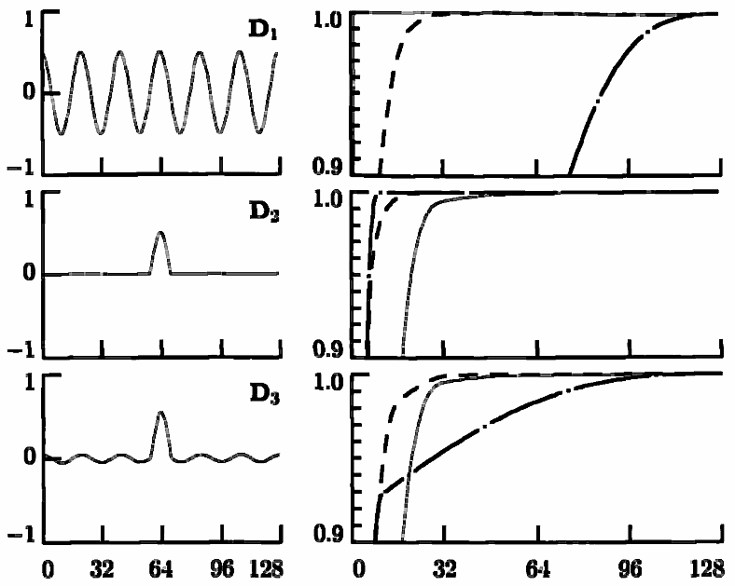
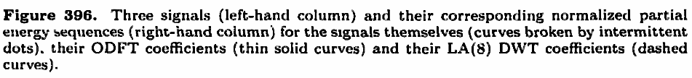
Wavelet transform
小波
原始
傅立葉
Percival, D. B. and A. T. Walden (2000) Wavelet Methods for Time Series Analysis, Cambridge University Press.

Slide 19
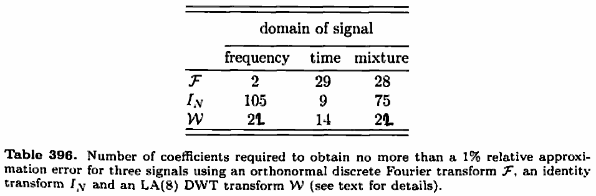
Wavelet transform
Percival, D. B. and A. T. Walden (2000) Wavelet Methods for Time Series Analysis, Cambridge University Press.

Slide 20
Wavelet vs Fourier Transforms
Both transforms can be viewed as a rotation in function space to a different domain
  FFT: basis functions are sines and cosines
  WAV: basis functions are wavelets
Wavelet functions are localized in space (see haar wavelet for example). Fourier sine and cosine functions (maintain themselves for the entire space) are not.
Amara Graps, "An Introduction to Wavelets"

Slide 21
Wavelet vs Fourier Transforms
Wavelet transforms do not have a single set of basis functions like the Fourier transform, which utilizes just the sine and cosine functions. Instead, wavelet transforms have an infinite set of possible basis functions. Thus wavelet analysis provides immediate access to information that can be obscured by other time-frequency methods such as Fourier analysis.
Amara Graps, "An Introduction to Wavelets"

Slide 22
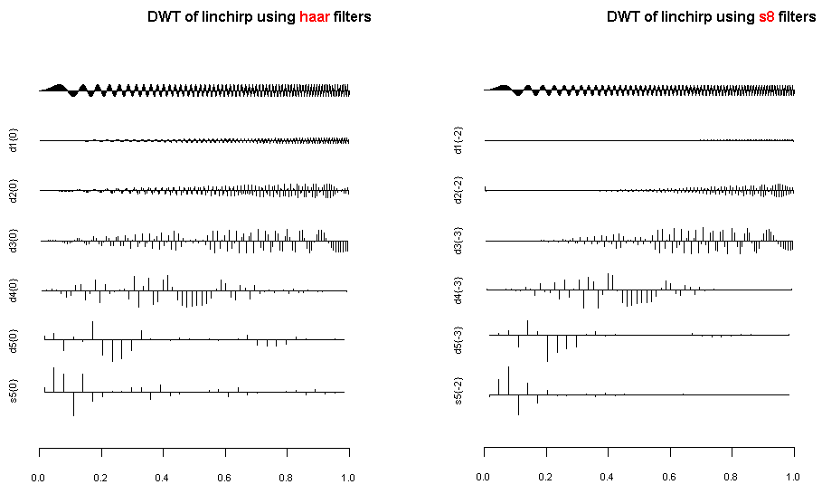
Transforms for different wavelets

Slide 23
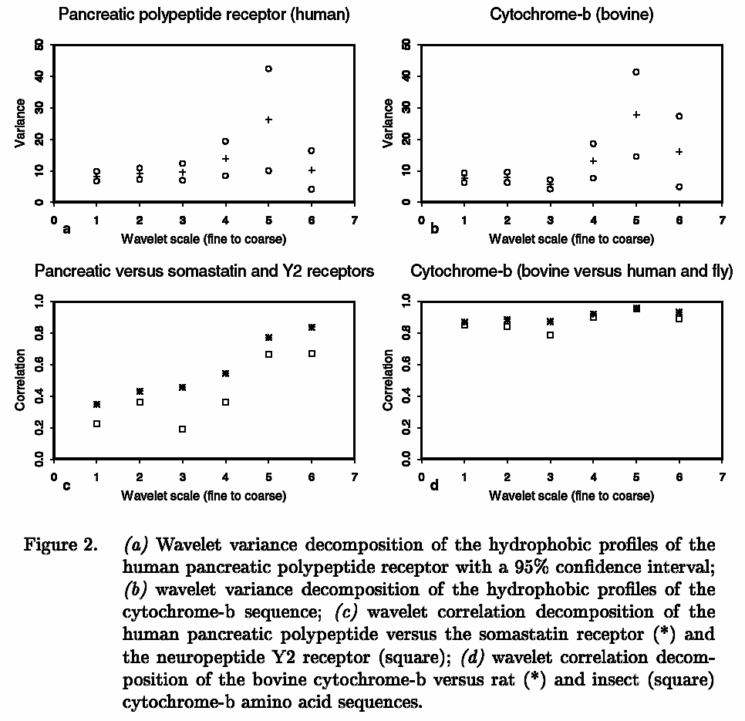
Wavelet variance for pattern recognition
Vannucci M, Lio P. , ‘Non-decimated wavelet analysis of biological sequences: applications to protein structure and genomics’

Slide 24
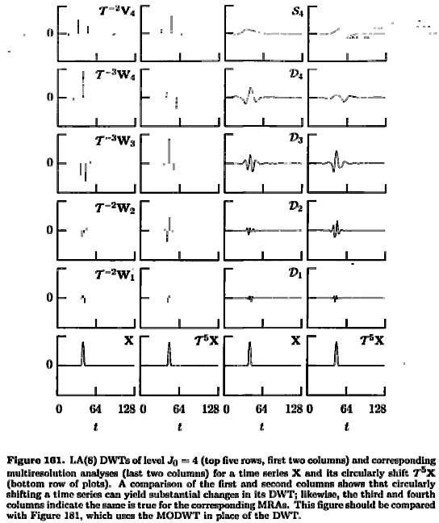
DWT (Discrete wavelet transform)
1.Computerized wavelet implementation
2.Data number is limited to power of 2
3.Not shift invariant so not suitable to circular or periodical data analysis
Percival, D. B. and A. T. Walden (2000) Wavelet Methods for Time Series Analysis, Cambridge University Press.

Slide 25
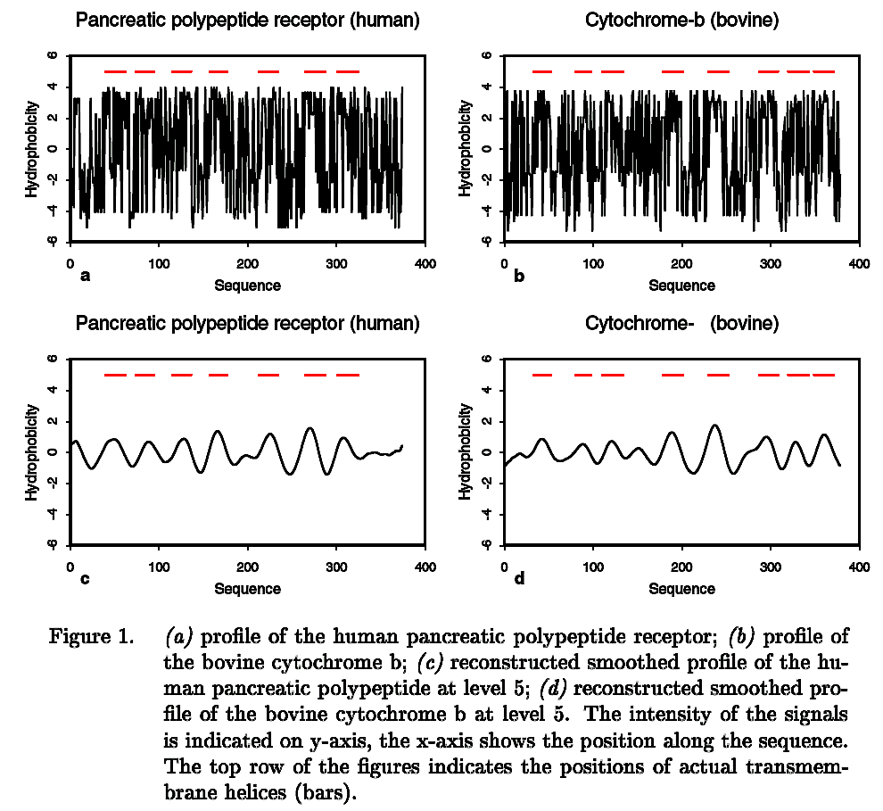
MODWT
(Maximal overlapped DWT)
Vannucci M, Lio P. , ‘Non-decimated wavelet analysis of biological sequences: applications to protein structure and genomics’
Notes:
library(wmtsa)
linchirp <- make.signal("linchirp", n=1024)
result <- wavMODWT(linchirp, wavelet="d8", n.levels=5, keep.series=TRUE)
## plot the transform shifted for approximate zero
## phase alignment
plot(result)
summary(result)
x11()
result <- wavMODWT(linchirp, wavelet="d8", n.levels=4, keep.series=TRUE)
## plot the transform shifted for approximate zero
## phase alignment
plot(result)
summary(result)
sum(attr(linchirp,'data')^2)
sum(unlist(result$data)^2)

Slide 26


MODWT
(Maximal overlapped DWT)
Releasing the restrictions of DWT
轉換方法
P為原始序列，Ｗ為小波轉換所需矩陣，可因不同小波而有所不同，本文選用Daubechies小波，Q為轉換後之係數矩陣
這裡的J表示要分解信號的次數

Slide 27
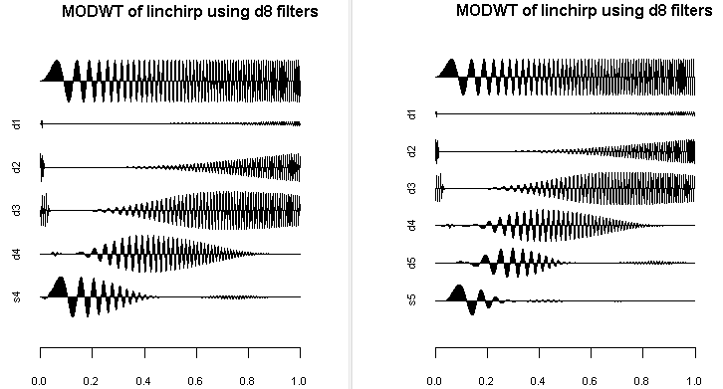
MODWT
(Maximal overlapped DWT)
J=4
Min 1Q Median 3Q Max Mean SD Var MAD Energy %
d1 -0.194 -0.004 0 0.004 0.126 0.00 0.027 0.001 0.006 0.154
d2 -0.679 -0.047 0 0.047 0.687 0.00 0.212 0.045 0.070 9.165
d3 -0.925 -0.270 0 0.245 0.923 0.00 0.453 0.205 0.391 41.957
d4 -0.900 -0.121 0 0.111 0.902 0.00 0.353 0.124 0.175 25.412
s4 -0.979 -0.028 0 0.046 0.991 0.03 0.336 0.113 0.055 23.313
J=5
Min 1Q Median 3Q Max Mean SD Var MAD Energy %
d1 -0.194 -0.004 0 0.004 0.126 0.00 0.027 0.001 0.006 0.154
d2 -0.679 -0.047 0 0.047 0.687 0.00 0.212 0.045 0.070 9.165
d3 -0.925 -0.270 0 0.245 0.923 0.00 0.453 0.205 0.391 41.957
d4 -0.900 -0.121 0 0.111 0.902 0.00 0.353 0.124 0.175 25.412
d5 -0.824 -0.028 0 0.032 0.834 0.00 0.250 0.063 0.044 12.786
s5 -0.793 -0.009 0 0.013 0.925 0.03 0.225 0.051 0.017 10.527
Notes:
library(wmtsa)
linchirp <- make.signal("linchirp", n=1024)
result <- wavMODWT(linchirp, wavelet="d8", n.levels=5, keep.series=TRUE)
## plot the transform shifted for approximate zero
## phase alignment
plot(result)
summary(result)
x11()
result <- wavMODWT(linchirp, wavelet="d8", n.levels=4, keep.series=TRUE)
## plot the transform shifted for approximate zero
## phase alignment
plot(result)
summary(result)
sum(attr(linchirp,'data')^2)
sum(unlist(result$data)^2)

Slide 28
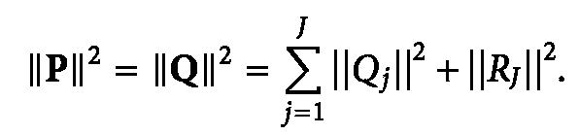
MOWDT能量守恆
轉換前後的能量不變，其中Qj對應至前圖dj，R_{J}對應至前圖s_{J}
在前述例子中，原始訊號能量為
P₁²+...+P₁₀₂₄²=500.6865
在J=4情況下，轉換後能量為
||Q₁||²+...+||Q₄||²+||R₄||²=500.6865

Slide 29
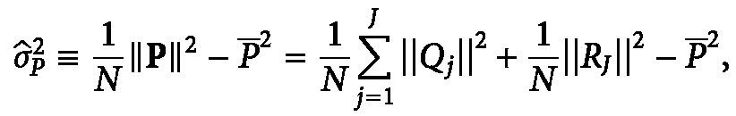
MODWT decomposed variances ►Features
轉換前後的能量不變，其中Qj對應至前圖dj，R_{J}對應至前圖s_{J}
Sample variance 定義
features

Slide 30
MODWT decomposed variances ►Features
Sample variance 定義
以前一例子J=5
Min 1Q Median 3Q Max Mean SD Var MAD Energy %
d1 -0.194 -0.004 0 0.004 0.126 0.00 0.027 0.001 0.006 0.154
d2 -0.679 -0.047 0 0.047 0.687 0.00 0.212 0.045 0.070 9.165
d3 -0.925 -0.270 0 0.245 0.923 0.00 0.453 0.205 0.391 41.957
d4 -0.900 -0.121 0 0.111 0.902 0.00 0.353 0.124 0.175 25.412
d5 -0.824 -0.028 0 0.032 0.834 0.00 0.250 0.063 0.044 12.786
s5 -0.793 -0.009 0 0.013 0.925 0.03 0.225 0.051 0.017 10.527

Slide 31
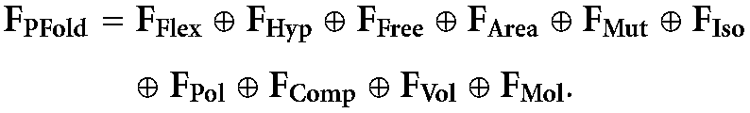
MODWT decomposed variances ►Features
50 Features for 10 feature sets
average flexibility indices (Flex), hydrophobicity (Hyp), transfer free energy (Free), residue accessible surface area (Area), relative mutability (Mut), isoelectric point (Iso), polarity (Pol), volume (Vol), composition (Comp), and molecular weight (Mol)

Slide 32
Data
From Guo-Ping Zhou, 'AN INTRIGUING CONTROVERSY OVER PROTEIN STRUCTURAL CLASS PREDICTION'
Two datasets
  277 data
  497 data

Slide 33
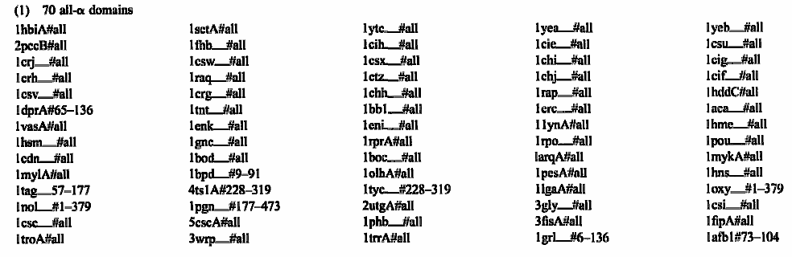
Dataset 1

Slide 34
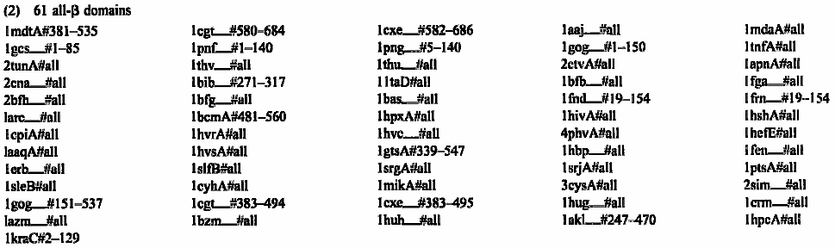
Dataset 1

Slide 35
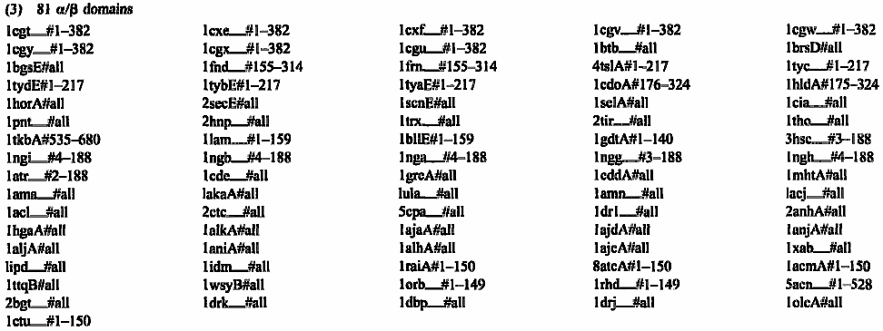
Dataset 1

Slide 36
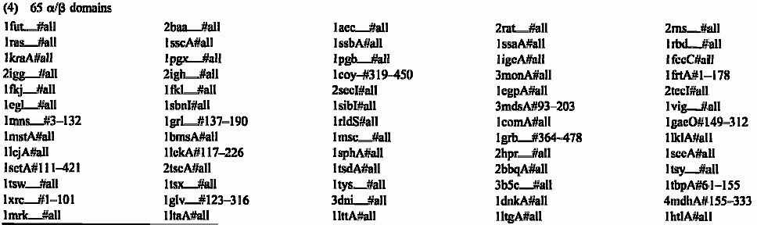
Dataset 1

Slide 37
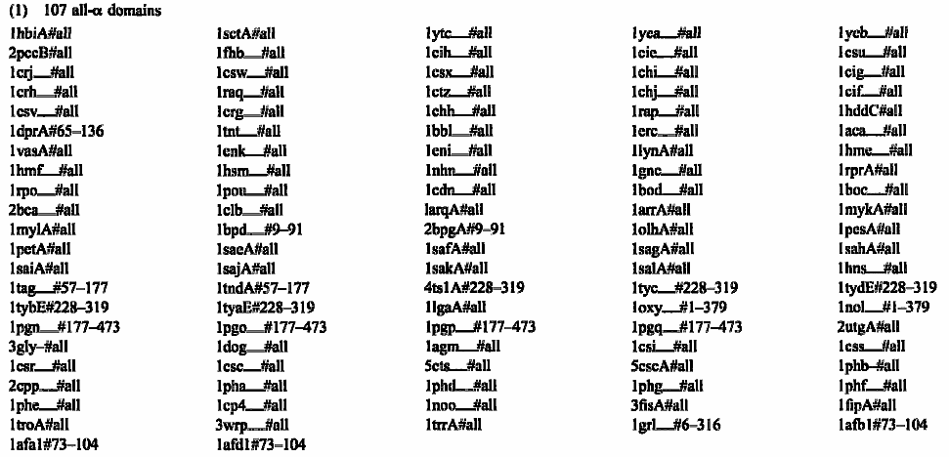
Dataset 2

Slide 38
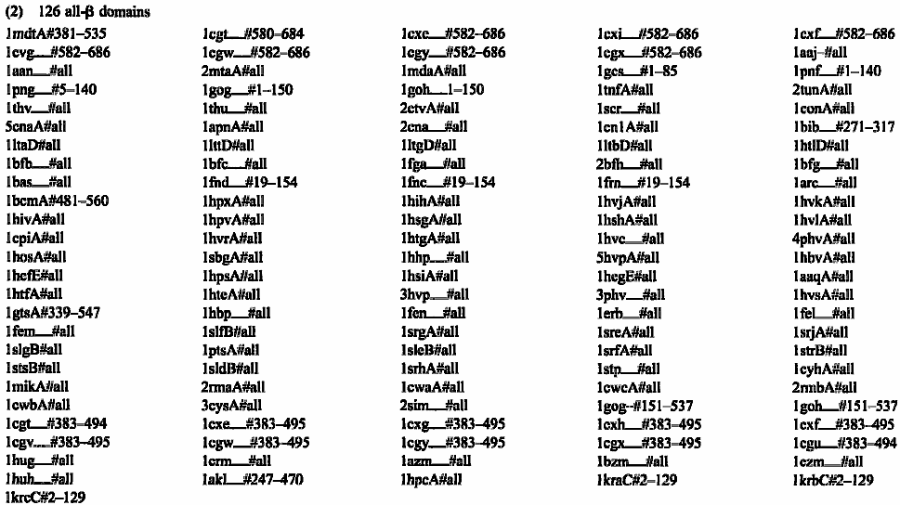
Dataset 2

Slide 39
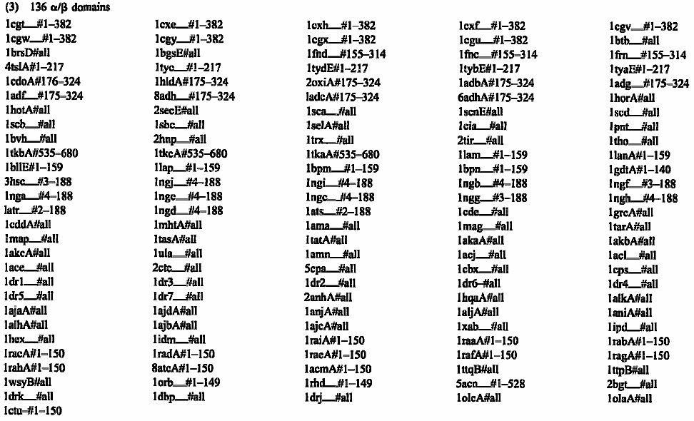
Dataset 2

Slide 40
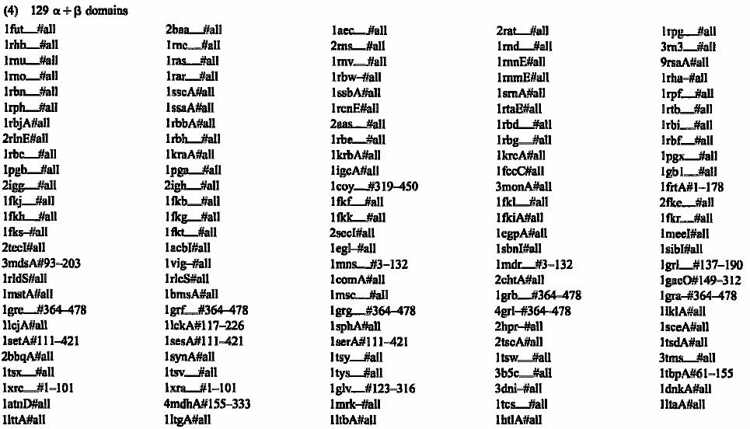
Dataset 2

Slide 41
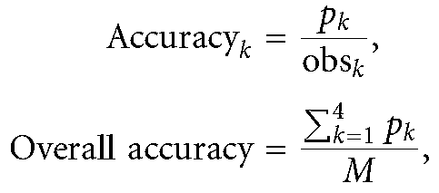
Training & Classification
Trainig LibSVM in an one-versus-others manner
The performance of the SVM classifier is measured using leave-one-out cross-validation (LOOCV) technique. (k: # of classes, M:# of data, p: # of correctly classified data, obs: # of data for one class)

Slide 42
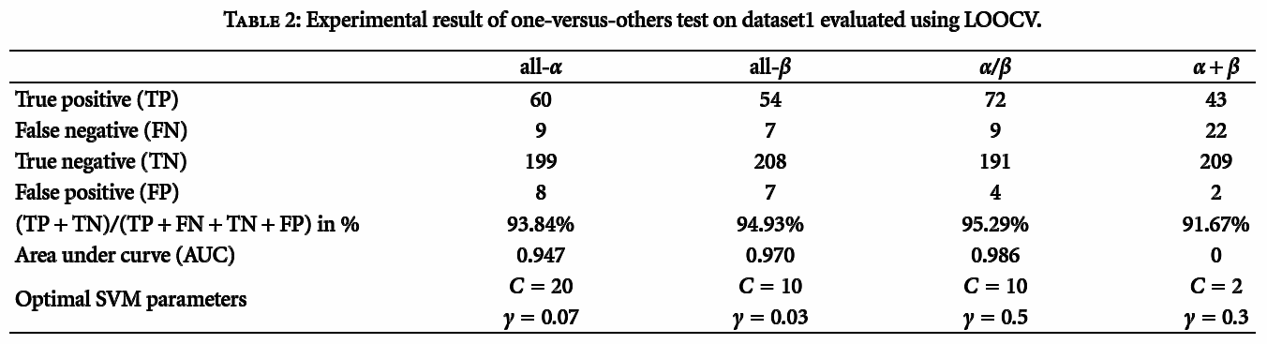
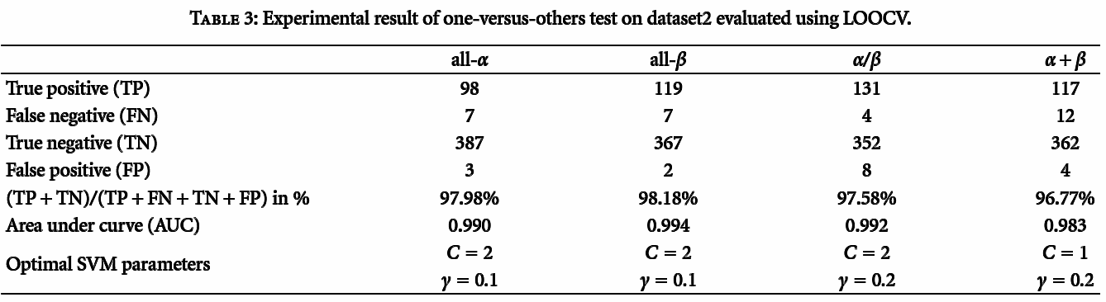
Results

Slide 43
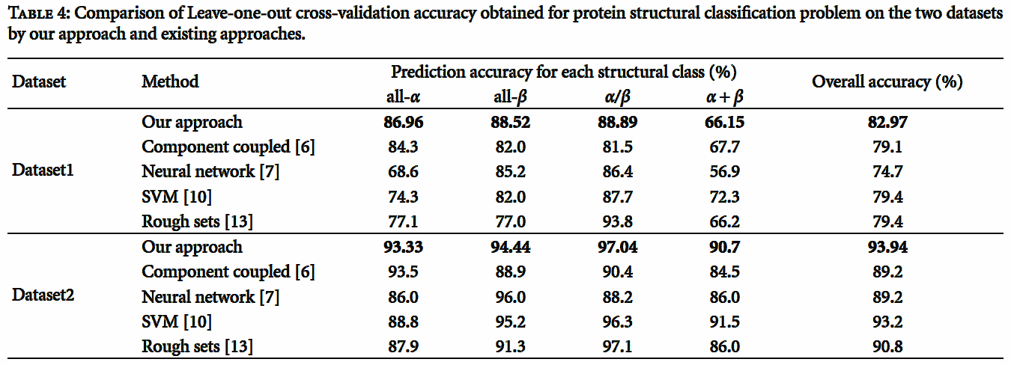
Comparison

