Slide 1
Finding the longest common nonsuperstring in linear time
Joong Chae Na, Dong Kyue Kim and Jeong Seop Sim
Information Processing Letters, Vol. 109, pp. 1066-1070, 2009
Presenter: Dong-Jian Lin
Date: Nov. 3, 2009

Slide 2
Abstract
String inclusion and non-inclusion problems have been vigorously studied in such diverse fields as molecular biology, data compression, and computer security. Among the well-known string inclusion or noninclusion notions, we are interested in the longest common nonsuperstring. Given a set of strings, the longest common nonsuperstring problem is finding the longest string that is not a superstring of any string in the given set. It is known that the longest common nonsuperstring problem is solvable in polynomial time. In this paper, we propose an efficient algorithm for the longest common nonsuperstring problem. The running time of our algorithm is linear with respect to the sum of the lengths of the strings in the given set, using generalized suffix trees.

Slide 3
Outline
Introduction
Preliminaries
Graph model for the LCNSS problem
Algorithm
Conclusion

Slide 4
Introduction
String inclusion problem
Finding a longest string included in every string of a given finite
language, or finding a shortest string including every string of a
given finite language.
The well-known related problems are:
the longest common substring (or subsequence) problem
the shortest common superstring (or supersequence) problem

Slide 5
String non-inclusion problem
Finding a shortest string included in no string of a given finite
language, or finding a longest string including no string of a
given finite language.
The well-known related problem are:
the longest common nonsubstring (or nonsubsequence) problem
the shortest common nonsuperstring (or nonsupersequence) problem

Slide 6
A set of strings F = {f1, . . . , fm} and a string t over a constant
size alphabet. If t is not a superstring of any f_{i} for all
1 ≦ i ≦m, t is called a common nonsuperstring of F. If t is the
longest among all common nonsuperstrings of F , t is called the
longest common nonsuperstring of F.
The common nonsuperstring and the longest common
nonsuperstring are denoted as the CNSS and the LCNSS,
respectively.

Slide 7
Let S denote the set of all the proper suffixes of strings in F. n
distinct strings in S, i.e., S = {s₁, . . . , s_{n}}.
A directed graph Γ_{S} = (V , E) for S whose path corresponds to a
CNSS of F.
When there is a cycle in Γ_{S} , the LCNSS of F does not exist.
A.R. Rubinov, V.G. Timkovsky, String noninclusion optimization problems,
SIAM J. Discrete Mathematics 11 (3) (1998) 456–457.

Slide 8
When Γ_{S} is a directed acyclic graph, the longest path in Γ_{S}
represents the LCNSS of F. Which can be found in O(|V | + |E|)
time.
The remaining part of the solution to the LCNSS problem is how
to construct Γ_{S} efficiently.
But, no efficient algorithm to construct Γ_{S} has been proposed.

Slide 9
In this paper we propose a linear-time algorithm for
finding the LCNSS of F.
For this, we propose an Optimal algorithm for
constructing Γ_{S}.
Γ_{S} can be constructed in time that is linear with respect
to the total sum of the lengths of the strings in F for a
constant size alphabet.
Let ||F|| denote the sum of the lengths of the strings in F.

Slide 10
Preliminaries
Let α be a string over a constant size alphabet Σ.
|α| = length of string α
α[i] = the ith character of string α
We denote β by α[i.. j] and call β a substring of α.
Conversely, α is called a superstring of β.

Slide 11
Define the LCNSS problem
Input: A set of forbidden strings F = {f₁, f₂, . . . , f_{m}} over a constant size alphabet Σ.
Output: If no CNSS exists or an arbitrarily long CNSS of F can be made, the output is ‘NO’. Otherwise, the
output is one of the LCNSSs of F.

Slide 12
Three conditions
No f_{i} is a substring of f _{j} for j ≠ i. If f_{i} is a substring of f _{j} for some j ≠ i, any nonsuperstring of f_{i} is a nonsuperstring of f _{j}.
No σ (∈ Σ) is an element of F. If any σ (∈ Σ) is in F, no CNSS of F can contain σ.
For all σ (∈ Σ), σ ^{k} is in F for some k ≧2. Otherwise, we can make an arbitrarily long CNSS of F in the form of σ ^{n}.

Slide 13
For each string f_{i} ∈ F, we define the extended string f_{i}' as the
concatenation of f_{i} and a special symbol $ ∉ Σ , i.e., f_{i}' = f_{i} $.
Then, the generalized suffix tree GST_{F} of F is a compacted trie
that represents all suffixes of strings in F.
label(u, v) denotes the string represented by the edge from node u
to node v.
For example, label(u₂, l₄) = a$
L(u) denotes the string obtained by concatenating the labels on
the path from the root to node u.
For example, L(u₄) = ab

Slide 14
Each leaf l has a list of pairs of integers, (i, j), such that
f_{i} [ j..| f_{i} |]$ = L(l). These lists are called suffix lists and sl(l)
denotes the suffix list of a leaf l.
For example, sl(l₅) is ( 3, 2) and ( 4, 2) because
f₃[2..3]$ = f₄[2..3]$ =bb$ (= L(l₅)).

Slide 15
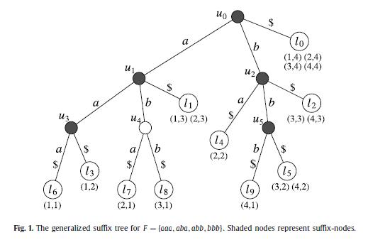

Slide 16
Graph model for the LCNSS problem
A directed graph Γ_{S} = (V , E) is defined over S as follows:
the set of vertices V :
For each s_{i} ∈ S (1 ≦ i ≦ n), a new vertex v_{i} is defined and no
other vertices exist in V . Then, there is a one-to-one
correspondence between vertices in V and strings in S.

Slide 17
the set of edges E:
For s_{i} ∈ S and σ ∈ Σ, we define a set P_{i}^{σ} as follows:
P_{i}^{σ} = {y | y ∈ S ∪ F and y is a prefix of σs_{i}}.
Assume that s _{j} (∈ S) is an element of P_{i}^{σ}. Then, a directed
edge from v _{j} to v_{i} is defined if and only if s _{j} is the longest string
in P_{i}^{σ} . This implies that no incoming edge is defined in v_{i} for
σ if the longest string in P_{i}^{σ} is in F . Therefore, for each string
s_{i} ∈ S and character σ ∈ Σ, at most one edge is defined, and
at most |Σ| incoming edges are defined for each vertex.

Slide 18
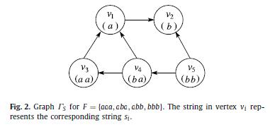
Example. Let F = {aaa, aba, abb, bbb}. Then, S = {a, b, aa, ba, bb} and Γ_{S}
is shown in Fig. 2. Consider a string s₃ (= aa). For character b, an edge from
v₄ to v₃ is defined since ba (= s₄) is the longest string in P₃^{b} = {b, ba}. For
character a, however, no edge is defined since aaa (= f₁) is the longest string
in P₃^{b} = {a,aa,aaa}.

Slide 19
Show the relationship between a path in Γ_{S} and a CNSS of F.
Lemma. If ΓS is a directed acyclic graph (DAG), the longest
path of ΓS corresponds to the LCNSS of F . When the longest
path has been found, the LCNSS can be obtained as follows:
(i) Concatenate the first character of the corresponding
string of each vertex in the longest path before the final vertex.
(ii) Concatenate the complete string corresponding to the
final vertex of the path.
Example. Consider set F and Γ_{S} in Figure 1. The longest path in
Γ_{S} is v₅, v₄, v₃, v₁, v₂ and thus, the LCNSS for F = {aaa, aba, abb,
bbb} is bbaab.

Slide 20
Algorithm
The proposed algorithm for the LCNSS problem consists of three
phases:
Make the generalized suffix tree GST_{F} for F
Make Γ_{S} using GST_{F} (main contribution)
We first find the longest path (if it exists) in Γ_{S} in O(|V| + |E|) time. Then, we construct the LCNSS by traversing each vertex in the longest path.

Slide 21
Make the generalized suffix tree GST_{F} for F
Recall that F = {f₁, . . . , f_{m}} and S = {s₁, . . . , s_{n}}. Then, GST_{F} has
m+n+1 leaves. (Note that m leaves correspond to m strings in F,
n leaves correspond to n strings in S, and one leaf represents the
Empty string ε.)
l_{i} (0 ≦ i ≦ m+n) denote the leaf node of GST_{F.}
str(l_{i}) denote the string obtained by removing $ at the end of L(l_{i}).
L(l₀) = $. Then str(l₀) represents ε.
Also, we assume that |str(l_{i})| ≦ |str(l _{j})| for 0 ≦ i ≦ j ≦ m +n.

Slide 23
GST_{F} can be constructed in O(||F||) time, the first phase runs in
O(||F||) time.

Slide 24
Make Γ_{S} using GST_{F}
The second phase consists of three stages.
1. Compute nsa(x) for every node x.
2. Compute link(l_{i} ,σ) for every leaf l_{i} and character σ .
3. Construct Γ_{S} using the link function.

Slide 25
A node x is called a suffix-node if L(x) ∈ S ∪ F .
In GST_{F} , x is a suffix-node if it has a child (leaf) y such
that label(x, y) = $. The leaf y is called the suffix-leaf of x.
The nearest suffix-ancestor of a node x (denoted by nsa(x)) is
defined as the nearest ancestor z of x such that z is a suffix-node.
(Note that z can equal x.)

Slide 26
Lemma. Let l be a leaf in GST_{F} and w be the nearest suffix-
ancestor of l such that L(w) ≠ str(l). Then, L(w) is the longest
proper prefix of str(l) in S ∪ F .
Proof. It is clear that L(w) is a proper prefix of str(l) in S ∪ F .
Then, we show by contradiction that L(w) is the longest one.
Suppose that there is a prefix δ of str(l) such that δ ∈ S ∪ F
and |L(w)| < |δ| < |str(l)|. Since GSTF represents all strings in
S ∪ F, there exists a leaf l’ such that L(l) = δ$. Also, there
exists a common ancestor w’ of l and l’ such that L(w’) = δ and
label(w’, l) = $, which implies that w is a suffix-node. Then, w’
must exist between w and l, which contradicts the definition of w.

Slide 27
For a leaf l_{i} and a character σ, we define the link function
link(l_{i} ,σ) as follows: Let α be the longest prefix of σstr(l_{i})
such that α ∈ S ∪ F . Since leaves of GST_{F} represent
strings in S ∪ F, there exists a leaf l_{j} such that str(l _{j}) = α.
Then, link(l_{i} ,σ) is defined as leaf l_{j} .
link(l₈, a)
str(l₈) = abb
astr(l₈) = aabb
α = aa ∈ S ∪ F =str(l₃)
link(l₈, a) = l₃

Slide 28
Stage 1. Compute nsa(x) for every node x
For each node x in the preorder traversal, we compute
nsa(x). If x is a suffix node, we set nsa(x) = x; otherwise,
we set nsa(x) = nsa(parent(x)). Note that the root is a suffix
node. Since it takes constant time to check whether x is a
suffix node or not, we can compute nsa(x) for every
node x in O(||F||) time.

Slide 29
Stage 2. Compute link(l_{i} ,σ)
Initially we compute link(l₀,σ) for each character σ.
Part 1.
Compute link(l_{i} ,σ) for characters σ such that
σstr(l_{i}) ∈ S ∪ F. For this, we use the suffix list sl(i). For each
element (p, q) ∈ sl(i) such that q ≠ 1, let l j be the leaf such that
str(l _{j}) = f _{p}[q −1..| f _{p}|]. Given p and q −1, l _{j} can be found in
constant time. Then we set link(l_{i} , f _{p}[q −1]) =l _{j} .

Slide 30
Part 2.
Compute link(l_{i} ,σ) for characters σ such that σstr(l_{i}) ∉
S ∪ F. For this, we use the link function of another leaf. Let
α be the longest proper prefix of str(l_{i}) in S ∪ F. We first
find the suffix-node w such that L(w) = α. By Lemma 2, w is the
nearest suffix-ancestor of li such that L(w) = str(l_{i}). Let x be the
parent node of l_{i} . Then, w = nsa(x) if label(x, l_{i}) ≠ $, otherwise
w = nsa(parent(x)). (See Fig. 3.) Let l_{k} be the suffix-leaf of w.
Then, link(l_{i} ,σ) = link(l_{k},σ), which is proven in Lemma 3.

Slide 31
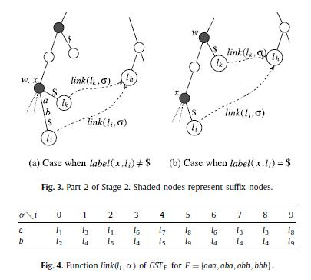

Slide 32
Example. Consider leaf l₅ in Fig. 1. This example shows the
case when σstr(l_{i}) ∈ S ∪ F for every character σ (Part 1).
There are two elements (3, 2) and (4, 2) in the suffix list sl(5).
Since pair (3, 1) is an element of sl(8) and f₃[1] = a, we obtain
link(l₅,a) = l₈. Similarly, for pair (4, 2), we obtain link(l₅, b) =l₉.
Example. Consider leaf l₂ in Fig. 1. First, we process elements
(3, 3) and (4, 3) in sl(2). From these elements, we obtain
link(l₂, b) = l₅. Because Part 1 cannot compute link(l₂,a), this is
computed in Part 2. Since label(u₂, l₂) = $, we check suffix-leaf
l₀ of nsa(parent(u₂)) (= u₀) and get link(l₂,a) = link(l₀,a) =l₁.

Slide 33
Example. Consider leaf l₉ in Fig. 1. There is no pair in sl(9) for
which the second element is not 1. Thus, no link function of l₉
can be computed in Part 1. Sincelabel(u₅, l₉) = $, we check
suffix-leaf l₅ of nsa(u₅) (= u₅) and obtain link(l₉,σ) = link(l₅,σ)
for every σ , that is, link(l₉,a) =l₈ and link(l₉, b) =l₉.

Slide 34
Lemma 3. Stage 2 computes the link function correctly in
O(||F|| ) time.
Proof. We first consider the correctness of Stage 2. It is clear that
the link function of l₀ is computed correctly. For i 1, there are
two cases for a character σ ∈ Σ.
1. Case that σstr(l_{i}) ∈ S ∪ F .
2. Case that σstr(l_{i}) ∉ S ∪ F .
The first and second cases are handled in Parts 1 and 2,
respectively. First, consider the first case, where σstr(l_{i}) is
a string (f _{p}[q − 1..| f _{p}|]) in S ∪ F . Then, pair p, q ∈ sl(i)
since f _{p} [q..| f _{p}|] = str(l_{i}). Thus, by the definition, link(l_{i} ,σ)
is the leaf l _{j} such that str(l _{j}) = f _{p} [q − 1..| f _{p}|]. Note that q
cannot be 1. Moreover, it is clear that Part 1 handles only
the first case.

Slide 35
Next, consider the second case. Let β = str(l_{i}). Recall that α is
the longest proper prefix of β in S ∪ F and α = L(w) = str(l_{k}).
Let l_{h} = link(l_{k},σ) and σδ = str(l_{h}). By the definition of the
link function, σδ is the longest prefix of σα in S ∪ F . Now
we show by contradiction that σδ is also the longest prefix of
σβ in S ∪ F , i.e., link(l_{i} ,σ) = l_{h}. Suppose that there exists a
prefix σδ of σβ in S ∪ F such that |δ| > |δ|. If |δ| |α|,
σδ is a prefix of σα and this contradicts the fact that σδ is
the longest prefix of σα in S ∪ F. If |δ| > |α|, this contradicts
the fact that α is the longest prefix of β in S ∪ F . Thus, such
δ does not exist.

Slide 36
Now we consider the time complexity. Part 1 can be done in
constant time for each element of a suffix list. Since the total
number of elements in all suffix lists is at most ||F|| , Part 1 can
Be done in O(||F|| ) time for all leaves. In Part 2, l_{k} can be found
In constant time and the link function of l_{k} has already been
computed, because k < i. Thus, Part 2 also can be done in
constant time for each leaf l_{i} .
Therefore, Stage 2 can be done in O(||F|| ) time overall.

Slide 37
Stage 3. Construct Γ_{S} using the link function
Create vertices of Γ_{S} using leaves of GST_{F}:
For each leaf l_{b} of GST_{F} (b ≧ 1), the following is done: If str(l_{b})
is a string (s _{j}) in S, a vertex labeled with v _{j} is created (we do not
need to know index j); otherwise, nothing is done. Note that
str(l_{b}) is in either S or F , which can be checked in constant time
because str(l_{b}) is in F if and only if sl(b) has only one pair (p, q)
and q = 1.

Slide 38
The edges of Γ_{S} are created using the link function:
Consider a leaf l_{b} of GSTF such that str(l_{b}) is a string(s _{j}) in S.
For each character σ, set l_{a} = link(l_{b},σ). Recall that str(l_{a}) is
the longest prefix of σ s _{j} in S ∪ F by the definition of the link
function. According to the definition of Γ_{S}, if str(l_{a}) is a string
(s_{i}) in S, an edge from v_{i} to v _{j} is created; otherwise, i.e., str(l_{a}) is
a string in F , nothing is done.

Slide 39
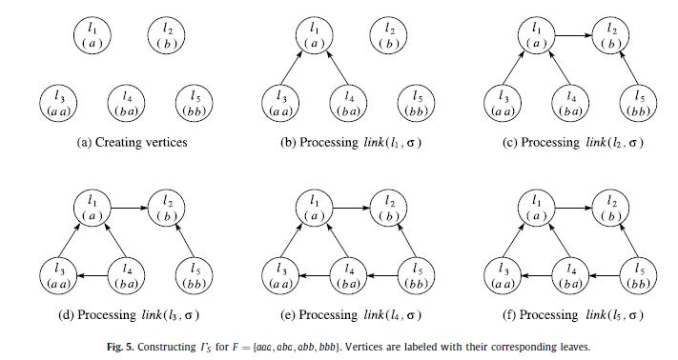

Slide 42
Example. Consider GST_{F} in Fig. 1 and its link function in Fig. 4.
We first create vertices of Γ_{S} as in Fig. 5(a). Only for
1 ≦ b ≦ 5, we create a vertex representing str(l_{b}) because
str(l_{b}) ∈ S. Next, we create edges using the link function.
Figs. 5(b)–5(f) show the graphs after processing the link
function for each leaf from l₁ to l₅. Consider leaf l₃. Because
link(l₃, b) = l₄ and str(l₄) ∈ S, we create an edge from the vertex
representing str(l₄) to the vertex representing str(l₃). However,
we create no edge for link(l₃,a) because link(l₃,a) =l₇ and str(l₇)
∈ F .

Slide 43
Lemma 4. Stage 3 constructs ΓS correctly in O(||F||) time.
Proof. It is clear that Stage 3 constructs a subgraph of Γ_{S} .
We show that all vertices and edges of Γ_{S} are created by Stage 3.
For every vertex v _{j} of ΓS , its corresponding string s _{j} is an
element in S. Since leaves of GSTF represent all strings in S ∪ F,
there must be a leaf l_{b} of GST_{F} such that str(l_{b}) = s _{j} . Therefore,
vertex v _{j} is created by Stage 3.

Slide 44
For every edge (v_{i} , v_{j}) of ΓS, let l_{a} and l_{b} be the leaves of GST_{F}
such that str(l_{a}) = s_{i} and str(l_{b}) = s _{j} , respectively. Consider
link(l_{b},σ), where σ is the first character of str(l_{a}). By the
definition of the link function, str(l_{a}) is the longest prefix of
σstr(l_{b}) in S ∪ F. Since str(l_{a}) = s_{i} is a string in S, edge (v_{i} , v _{j})
is created by Stage 3. It is clear that Stage 3 can be done in
constant time for each leaf of GST_{F} . Thus, Stage 3 can be done
in O(||F||) time overall.

Slide 45
we first find the longest path (if it exists) in Γ_{S} in O(|V | + |E|)
time. Then, we construct the LCNSS by traversing each vertex in
the longest path, in the manner explained in the previous section.
Since Γ_{S} has n (∈ O(||F|| )) vertices and at most n|Σ| edges, the
final phase also runs in O(||F||) time for a constant size alphabet.

Slide 46
Conclusion
Theorem 1. The LCNSS problem is solvable in linear time, i.e.,
O(||F||) time.

