Slide 1
An algorithm for computing the restriction scaffold assignment problem in computational biology
Information Processing Letters 95 (2005) 466–471
Justin Colannino, Godfried Toussaint
Presenter: Jen-Hui Wang
Date: May 4, 2006

Slide 2
Abstract
Let S and T be two finite sets of points on the real line with |S| + |T | = n and |S| > |T |.
The restriction scaffold assignment problem in computational biology assigns each point of S to a point of T such that the sum of all the assignment costs is minimized, with the constraint that every element of T must be assigned at least one element of S.
The cost of assigning an element s_{i} of S to an element t_{j} of T is | s_{i} −t_{j} |, i.e., the distance between s_{i} and t_{j} .
In 2003 Ben-Dor, Karp, Schwikowski and Shamir [J.Comput. Biol. 10 (2) (2003) 385] published an O(nlogn) time algorithm for this problem.
Here we provide a counterexample to their algorithm and present a new algorithm that runs in O(n²) time, improving the best previous complexity of O(n³).

Slide 3
Directed swap distance
Toussaint proposed the directed swap distance, which was first applied to the phylogenetic analysis of Flamenco rhythms by Dìaz-Báñez et al. [4].
Definition:
the minimum number of swaps required to move every element of S to the index of an element of T , with the restriction that every element of T must have at least one element of S moved to its index.
S, T: binary string ,|S| |T |.

Slide 4

Directed swap distance (cont.)
An alternate way of viewing the directed swap distance is as a surjection, ψ, between two sets of elements S (the source) and T (the target) on the interval (0,X) where |S| |T |. (T must have at least one element of S mapped to it)
The surjection distance between two sets S and T :
where δ is a distance metric on the space, and ψ is
a surjection between S and T

Slide 5
Restriction scaffold assignment problem
In 2003, Ben-Dor et al. [2], in the context of the shotgun sequencing problem in computational biology, introduced a modified assignment problem similar to the directed swap problem where the points are real numbers on the line rather than bits in a binary string: the restriction scaffold assignment problem.
They also presented an O(n log n) algorithm to compute this assignment problem, but the problem may be solved in O(n²) time.

Slide 6
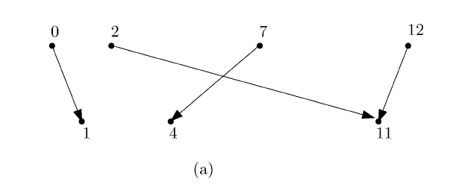

Example
cost = |0-1| + |2-11| + |7-4| + |12-11| = 14

Slide 7
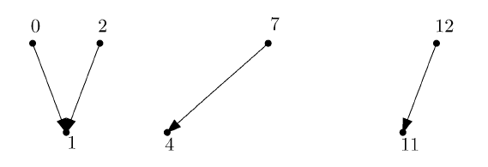

Example
cost = |0-1| + |2-1| + |7-4| + |12-11| = 6

Slide 8
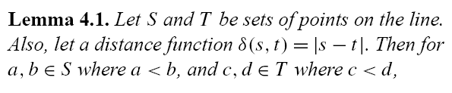

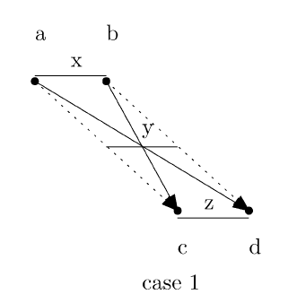
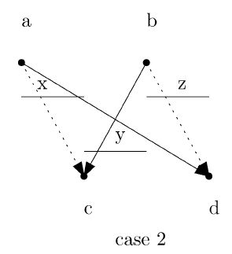
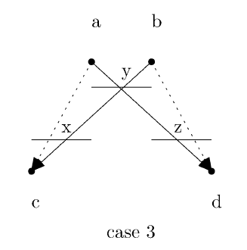
The new O(n²) algorithm

Slide 9
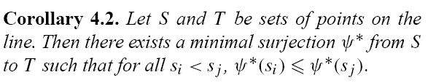


The new O(n²) algorithm (cont.)
Corollary 4.2 implies that no crossings can occur in an optimal assignment. Therefore, we know that the first element of S must be mapped to the first element of T

Slide 10
The new O(n²) algorithm (cont.)
s_{i+1}
s_{i}
s_{i+2}
s_{i}
s_{i+1}
t_{j}
t_{j+1}
t_{j+2}

Slide 11
The new O(n²) algorithm (cont.)
The algorithm is based on a reduction to the problem of computing the single source shortest path problem in a weighted directed acyclic graph.

Slide 12
The new O(n²) algorithm (cont.)
S₁(0)
S₂(2)
S₃(7)
S₄(12)
Start
1
v_{1,1}
1
v_{1,2}
6
v_{1,3}
t₁(1)
3
2
v_{2,2}
v_{2,3}
8
v_{2,4}
t₂(4)
1
v_{3,4}
t₃(11)
Cost = 1 + 1 + 3 + 1 = 6

Slide 13
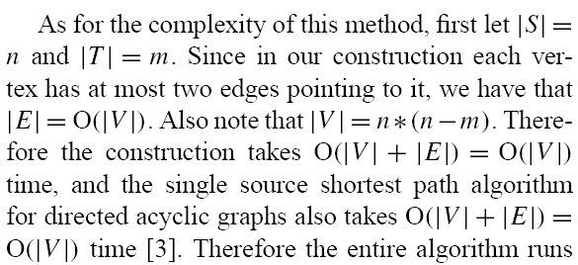
Time complexity

