Slide 1
The Greedy Algorithm for Edit Distance with Moves
Haim Kaplan, Nira Shafrir
Information Processing Letters, Vol. 97, pp. 23–27, 2006
Date: June 22, 2006
Introducer: Hsing-Yen Ann

Slide 2
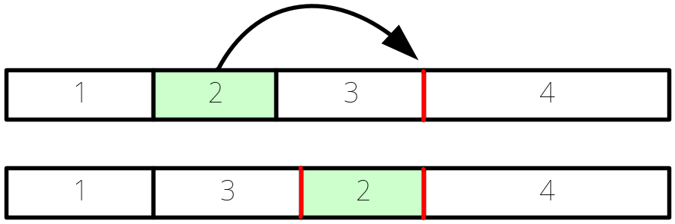
Problem Definition
Edit distance with moves:
-- character insert, character delete
-- block move (in working string, non-overlap)
-- to find the minimum number of operations
Is known to be NP-hard
Can be reduced to block permutation problem

Slide 3
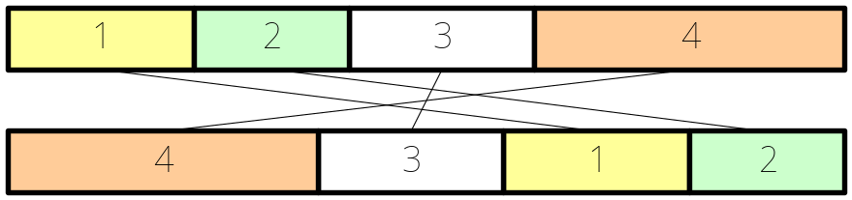


Block Permutation Problem
Definition:
-- to find the partition with minimum number of blocks
Shapira[7] show OPT_{E} ≦ c OPT_{B} for some constant c
OPT_{E} : optimal solution of edit distance with moves
OPT_{B} : optimal solution of block permutation
Shapira[7] claimed their GREEDY algorithm is a log n–approximation to block permutation problem.
Chrobak[5] proved that
In this paper, a tighter lower bound is given.

Slide 4
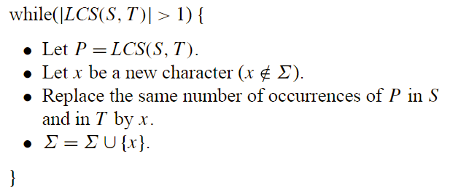
The GREEDY Algorithm
S=DABABC
T=ABCABD
DABABC
ABCABD
DAB①①①
①①①ABD
DAB①①①
①①①ABD
D②②①①①
①①①②②D
D②②①①①
①①①②②D
③②②①①①
①①①②②③
LCS(S,T): longest common sub-string.

Slide 5
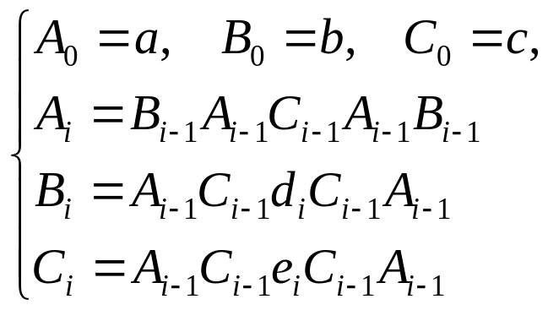
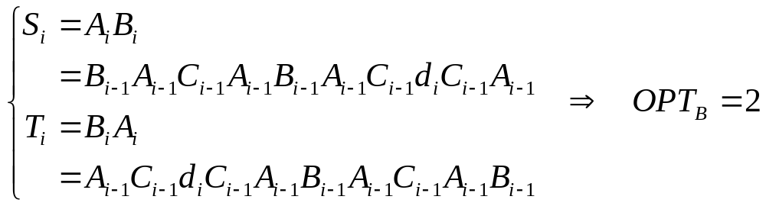
A Generated Bad Example for GREEDY (1)

Slide 6
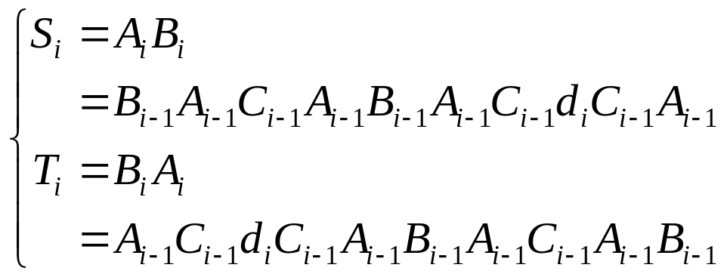
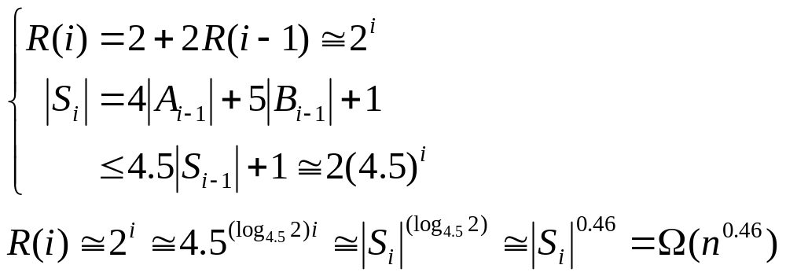
A Generated Bad Example for GREEDY (2)
R(i): number of blocks that GREEDY finds on S_{i}, T_{i}

