Slide 1
Support Vector Machines for Predicting Membrane Protein Types by Using Functional Domain Composition
Biophysical Journal Volume 84 May 2003 3257–3263
Yu-Dong Cai, Guo-Ping Zhou, Kuo-Chen Chou
Presenter: Jen-Hui Wang
Date: July 13, 2006

Slide 2
Abstract
Membrane proteins are generally classified into the following five types: 1), type I membrane protein; 2), type II membrane protein; 3), multipass transmembrane proteins; 4), lipid chain-anchored membrane proteins; and 5), GPI-anchored membrane proteins. In this article, based on the concept of using the functional domain composition to define a protein, the Support Vector Machine algorithm is developed for predicting the membrane protein type. High success rates are obtained by both the self-consistency and jackknife tests. The current approach, complemented with the powerful covariant discriminant algorithm based on the pseudo-amino acid composition that has incorporated quasi-sequence-order effect as recently proposed by K. C. Chou (2001), may become a very useful high-throughput tool in the area of bioinformatics and proteomics.

Slide 3
Membrane protein
Integral protein
  Transmembrane protein
    Type I membrane protein
    Type II membrane protein
    Multipass transmembrane protein
Peripheral protein
Lipid-anchored protein
    Lipid chain-anchored membrane protein
    GPI-anchored membrane protein

Slide 4
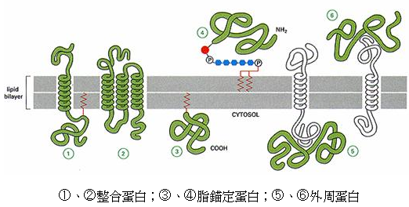
Membrane protein

Slide 5
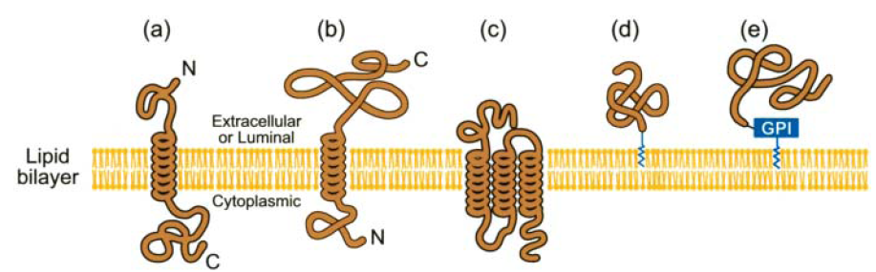
Membrane protein

Slide 6
Conventional amino acid composition
The amino acid composition of a protein consists of 20 components, representing the occurrence frequency of each of its 20 native amino acid (Chou, 1989; Nakashima et al., 1986)

Slide 7
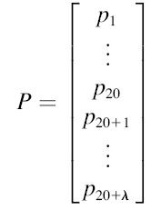
Pseudo-amino acid composition
Instead of 20 discrete numbers as defined in the conventional amino acid composition, the pseudo-amino acid composition consists of 20 + λ discrete numbers (Chou, 2001)

Slide 8
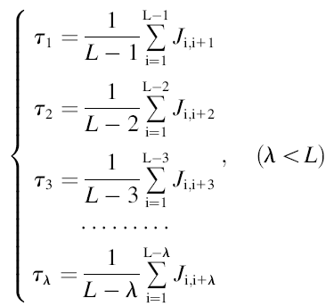
Pseudo-amino acid composition
L: the chain length of the protein concerned
τ_{i}: ith-rank coupling factor that harbors the sequence-order correlation between all the ith most contiguous residues
J_{i,j}: a function of amino acid R_{i} and R_{j}, such as the physicochemical distance from R_{i} to R_{j}, or some combination of several biochemical quantities related to R_{i} and R_{j}(Chou, 2001, 2002)

Slide 9
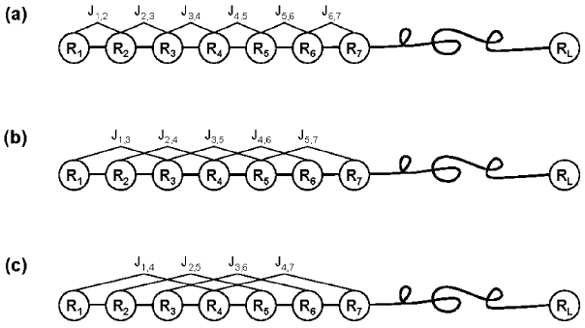
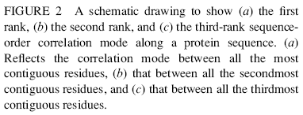
Pseudo-amino acid composition

Slide 10
Functional Domain composition
Murvai and co-workers (Murvai et al., 2001) have constructed a database called SBASE-A that contains 2005 sequences with well-known structural and functional domain types

Slide 11
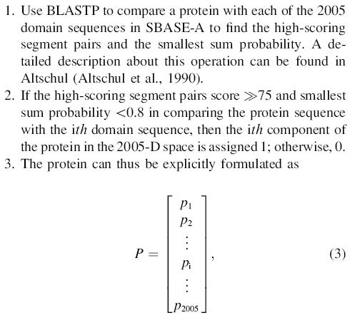
Functional Domain composition

Slide 12
Searching Sequence Database Using BLAST (Altschul et al. 1991)
The single most influential bioinformatics tool
Score (substitution) matrices
  PAMs
    Dayhoff et al. 1978
  BLOSUM family
    Henikoff & Henikoff (1992)
    Practical experience suggests that the BLOSUM62 matrix is quite useful for general use
IBMS, NSYSU
Shirley©

Slide 13
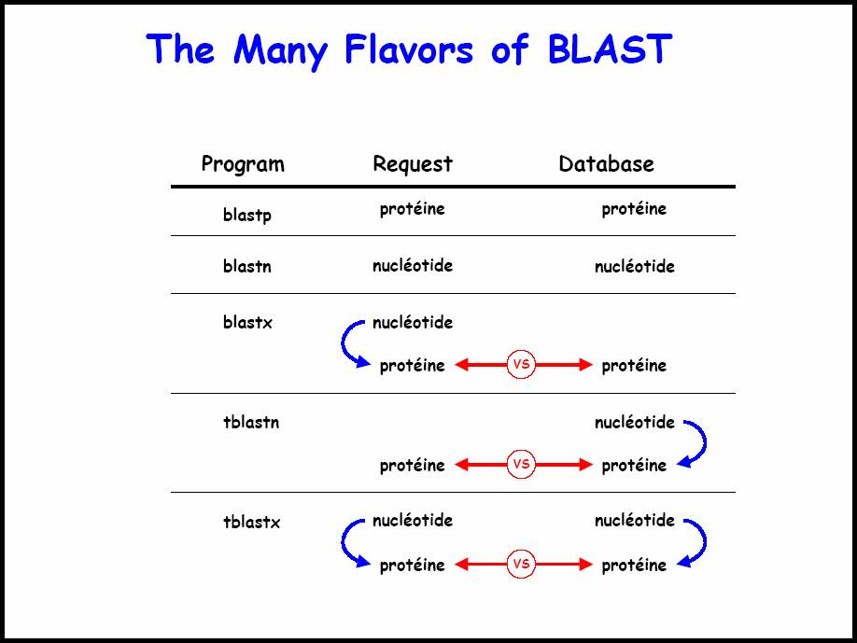

Slide 14
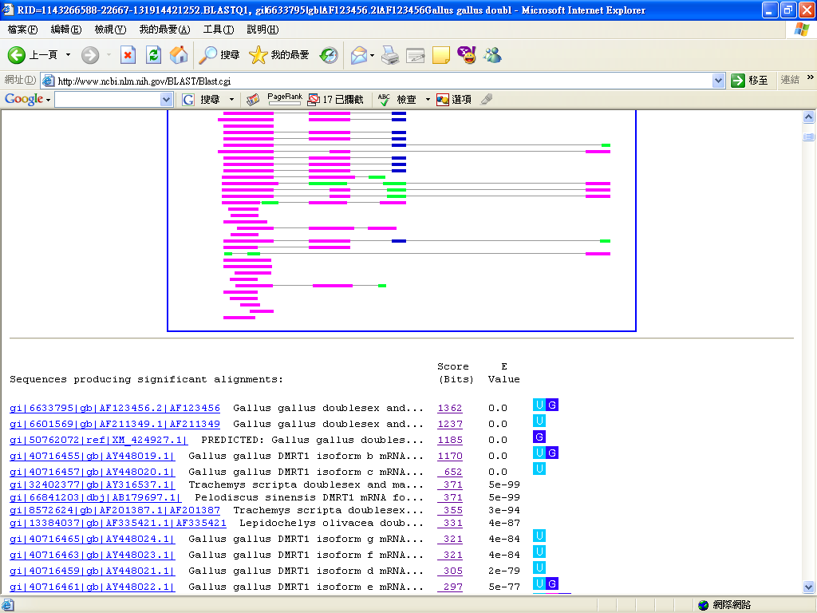
Notes:
MSDDLTDAQTAAIPEGFSQLNWSRGFGRQIGPLFEHREGPGQARLAFRVEEHHTNGLGNCHGGMLMSFADMAWGRIISLQKSYSWVTVRLMCDFLSGAKLGDWVEGEGELISEEDMLFTVRGRIWAGERTLITGTGVFKALSARKPRPGELAYKEEA

Slide 15



Support vector machines
The linear separable case

Slide 16



Support vector machines
The linear nonseparable case
  Soft margin
    minimizing
  Kernel substitution

Slide 17
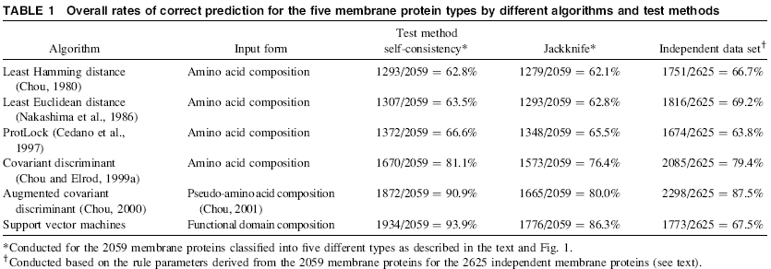
Results

Slide 18
Resubstitution test (self-consistency)

Slide 19
Jackknife test

