Slide 1
Extracting Protein-Protein Interaction Sentences by Applying Rough Set Data Analysis
Filip Ginter, Tapio Pahikkala, Sampo Pyysalo, Jorma Boberg,
Jouni Jarvinen, and Tapio Salakoski
Rough Sets and Current Trends in Computing
4th International Conference
Lecture Notes in Computer Science, 2004, pages 780-785
Presenter:Zih-Jie Yang
Date: February 22,2011
115/11/08

Slide 2
Abstract
In this paper, we introduce a way to apply rough set data analysis to the problem of extracting protein-protein interaction sentences in biomedical literature. Our approach builds on decision rules of protein names, interaction words, and their mutual positions in sentences. In order to broaden the set of potential interaction words, we develop a morphological model which generates spelling and inflection variants of the interaction words. We evaluate the performance of the proposed method on a hand-tagged dataset of 1894 sentences and show a precision-recall break-even performance of 79.8% by using leave-one-out crossvalidation.
115/11/08

Slide 3
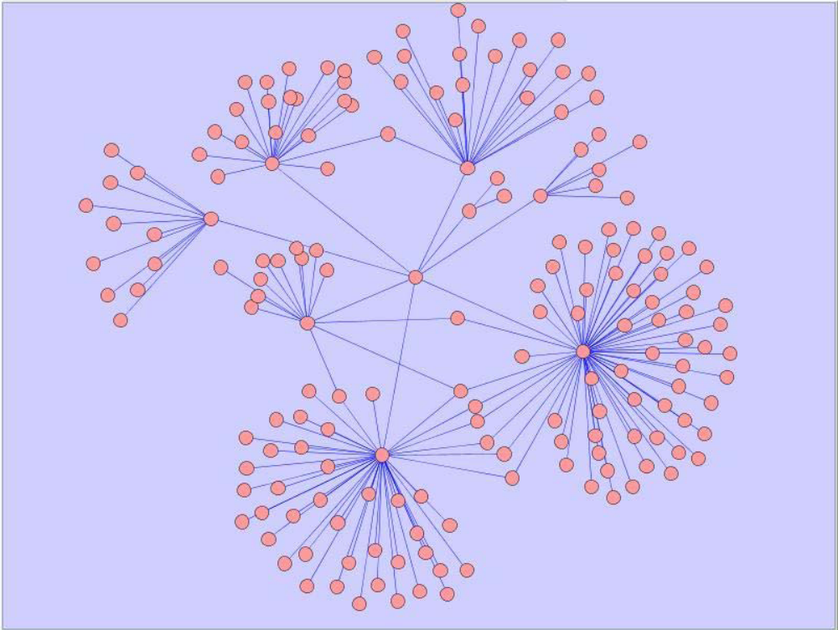
蛋 白 質 交 互 作 用 (Protein-protein interaction)
每一個點為一個蛋白質，每一個邊所連結的兩的點則代表這兩個蛋白質之間有交互作用。
115/11/08

Slide 4
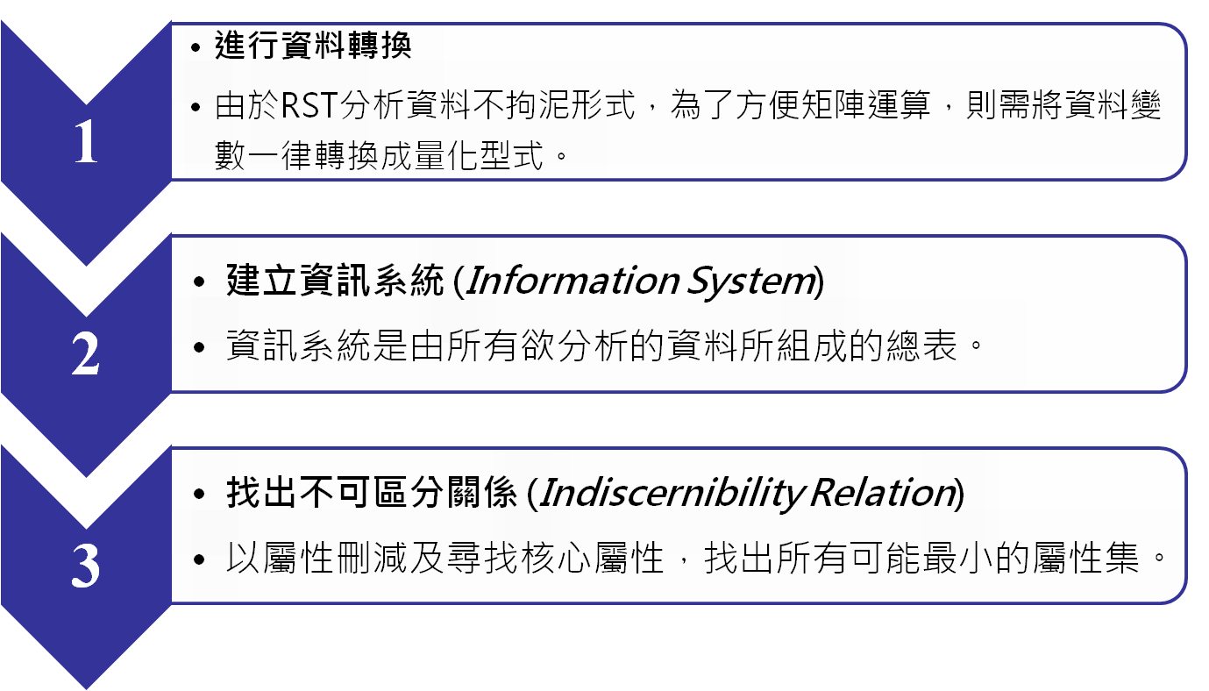
RST concept (1/2)

Slide 5
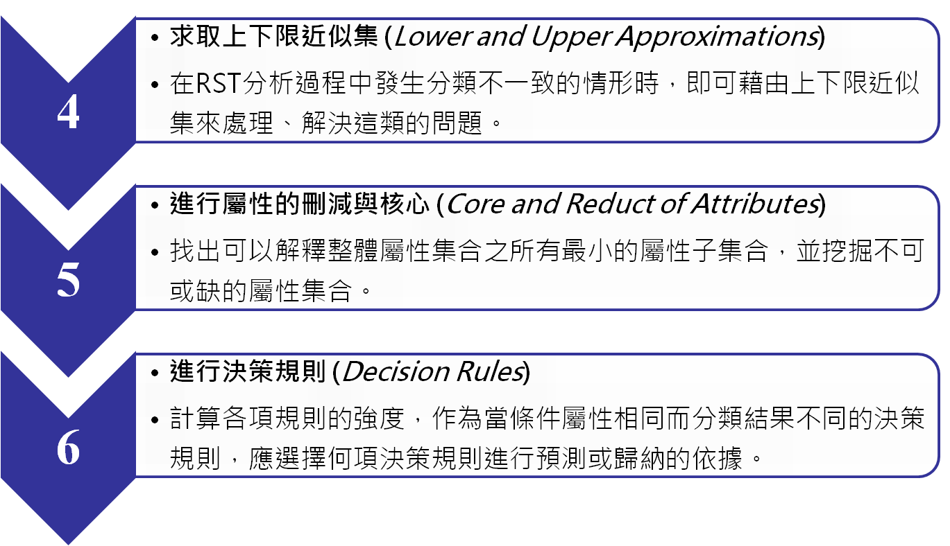
RST concept(2/2)

Slide 6
Information system (IS)
IS = (U, A)
  U = {x₁, x₂,…, x_{m}} (instances)
  A ={a₁, a₂,…,a_{n}} (attributes)
  Va: range of attribute a
U | a₁ | a₂ | a₃
x₁ | 2 | 1 | 3
x₂ | 3 | 2 | 1
x₃ | 2 | 1 | 3
x₄ | 2 | 2 | 3
x₅ | 1 | 1 | 4
x₆ | 1 | 1 | 2
x₇ | 3 | 2 | 1
x₈ | 1 | 1 | 4
x₉ | 2 | 1 | 3
x₁₀ | 3 | 2 | 1
Example:
U = {x₁, x₂,…, x₁₀}
A ={a₁, a₂, a₃}
V₁= {1, 2, 3}
V₂={1, 2}
V₃={1, 2, 3, 4}

Slide 7
Decision table
Any supervised classification problem can be considered as the decision table analysis
U | a₁ | a₂ | a₃ | d
x₁ | 2 | 1 | 3 | 1
x₂ | 3 | 2 | 1 | 2
x₃ | 2 | 1 | 3 | 1
x₄ | 2 | 2 | 3 | 2
x₅ | 1 | 1 | 4 | 3
x₆ | 1 | 1 | 2 | 3
x₇ | 3 | 2 | 1 | 2
x₈ | 1 | 1 | 4 | 3
x₉ | 2 | 1 | 3 | 1
x₁₀ | 3 | 2 | 1 | 2

Slide 8
Discernibility matrix:
須使用何種attributes來區分不同的sets
 | 1 | 2 | 3 | 4 | 5 | 6 | 7 | 8 | 9 | 10
1 | -
2 | a₁,a₂,a₃ | -
3 | - | a₁,a₂,a₃ | -
4 | a₂ | - | a₂ | -
5 | a₁,a₃ | a₁,a₂,a₃ | a₁,a₃ | a₁,a₂,a₃ | -
6 | a₁,a₃ | a₁,a₂,a₃ | a₁,a₃ | a₁,a₂,a₃ | - | -
7 | a₁,a₂,a₃ | - | a₁,a₂,a₃ | - | a₁,a₂,a₃ | a₁,a₂,a₃ | -
8 | a₁,a₃ | a₁,a₂,a₃ | a₁,a₃ | a₁,a₂,a₃ | - | - | a₁,a₂,a₃ | -
9 | - | a₁,a₂,a₃ | - | a₂ | a₁,a₃ | a₁,a₃ | a₁,a₂,a₃ | a₁,a₃ | -
10 | a₁,a₂,a₃ | - | a₁,a₂,a₃ | - | a₁,a₂,a₃ | a₁,a₂,a₃ | - | a₁,a₂,a₃ | a₁,a₂,a₃ | -

Slide 9
f_{A}(D)=(a₁+a₂+a₃)a₂(a₁+a₃) (a₁+a₃) (a₁+a₂+a₃) (a₁+a₃) (a₁+a₂+a₃) (a₁+a₂+a₃) (a₁+a₂+a₃) (a₁+a₂+a₃)a₂(a₁+a₃) (a₁+a₃) (a₁+a₂+a₃) (a₁+a₃) (a₁+a₂+a₃) (a₁+a₂+a₃) (a₁+a₂+a₃) (a₁+a₂+a₃) a₂(a₁+a₃) (a₁+a₂+a₃) (a₁+a₃) (a₁+a₂+a₃) (a₁+a₂+a₃) (a₁+a₃) (a₁+a₂+a₃) (a₁+a₂+a₃) (a₁+a₂+a₃) (a₁+a₃) (a₁+a₂+a₃) (a₁+a₂+a₃) = a₂(a₁+a₃) = a₁a₂ + a₂a₃
D-reducts = {a₁, a₂} and {a₂, a₃}
D-core = {a₂}
U | a₁ | a₂ | d
x₁ | 2 | 1 | 1
x₂ | 3 | 2 | 2
x₃ | 2 | 1 | 1
x₄ | 2 | 2 | 2
x₅ | 1 | 1 | 3
x₆ | 1 | 1 | 3
x₇ | 3 | 2 | 2
x₈ | 1 | 1 | 3
x₉ | 2 | 1 | 1
x₁₀ | 3 | 2 | 2
U | a₂ | a₃ | d
x₁ | 1 | 3 | 1
x₂ | 2 | 1 | 2
x₃ | 1 | 3 | 1
x₄ | 2 | 3 | 2
x₅ | 1 | 4 | 3
x₆ | 1 | 2 | 3
x₇ | 2 | 1 | 2
x₈ | 1 | 4 | 3
x₉ | 1 | 3 | 1
x₁₀ | 2 | 1 | 2

Slide 10
Decision Rules Based on InteractionWords
Condition attributes={Word, Position}
Decision arttributes={Interaction}
Word={activity, link, repair, required, actin,
integrins, and talin}
Position={before, middle, and after}
Interaction={yes, no}
115/11/08

Slide 11

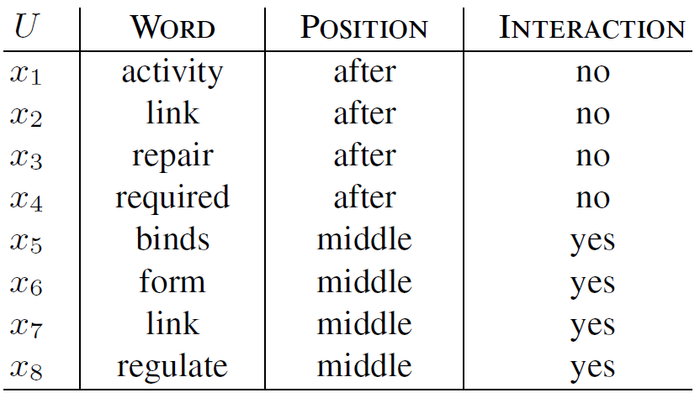
Decision table
115/11/08

Slide 12
Data set
1894 sentences manually annotated as containing an interaction (1114 sentences) or not containing an interaction (780 sentences).
We used the leave-one-out crossvalidation to evaluate the proposed method
115/11/08

Slide 13
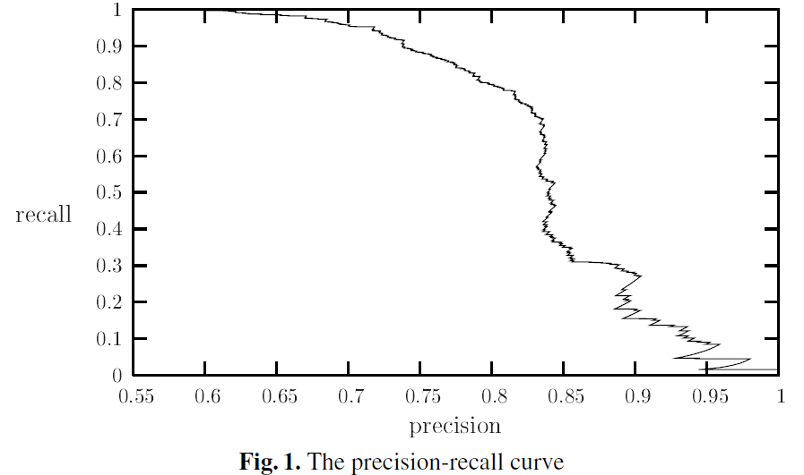
Results
The value of the precision-recall breakeven point, the point at which precision and recall values are equal, is 79.8%.
115/11/08

