Slide 1
pSLIP: SVM based protein subcellular localization prediction using multiple physicochemical properties
BMC Bioinformatics 2005, 6:152
Deepak Sarda, Gek Huey Chua, Kuo-Bin Li and Arun Krishnan

Slide 2
Abstract
Background: Protein subcellular localization is an important determinant of protein function and hence, reliable methods for prediction of localization are needed. A number of prediction algorithms have been developed based on amino acid compositions or on the N-terminal characteristics (signal peptides) of proteins. However, such approaches lead to a loss of contextual information. Moreover, where information about the physicochemical properties of amino acids has been used, the methods employed to exploit that information are less than optimal and could use the information more effectively.

Slide 3
Abstract
Results: In this paper, we propose a new algorithm called pSLIP which uses Support Vector Machines (SVMs) in conjunction with multiple physicochemical properties of amino acids to predict protein subcellular localization in eukaryotes[真核生物] across six different locations, namely, chloroplast[葉綠體], cytoplasmic[細胞質], extracellular, mitochondrial[線粒體], nuclear and plasma membrane[原漿膜 ]. The algorithm was applied to the dataset provided by Park and Kanehisa and we obtained prediction accuracies for the different classes ranging from 87.7% – 97.0% with an overall accuracy of 93.1%.

Slide 4
Abstract
Conclusion: This study presents a physicochemical property based protein localization prediction algorithm. Unlike other algorithms, contextual information is preserved by dividing the protein sequences into clusters. The prediction accuracy shows an improvement over other algorithms based on various types of amino acid composition (single, pair and gapped pair). We have also implemented a web server to predict protein localization across the six classes (available at http://pslip.bii.a-star.edu.sg/).

Slide 5
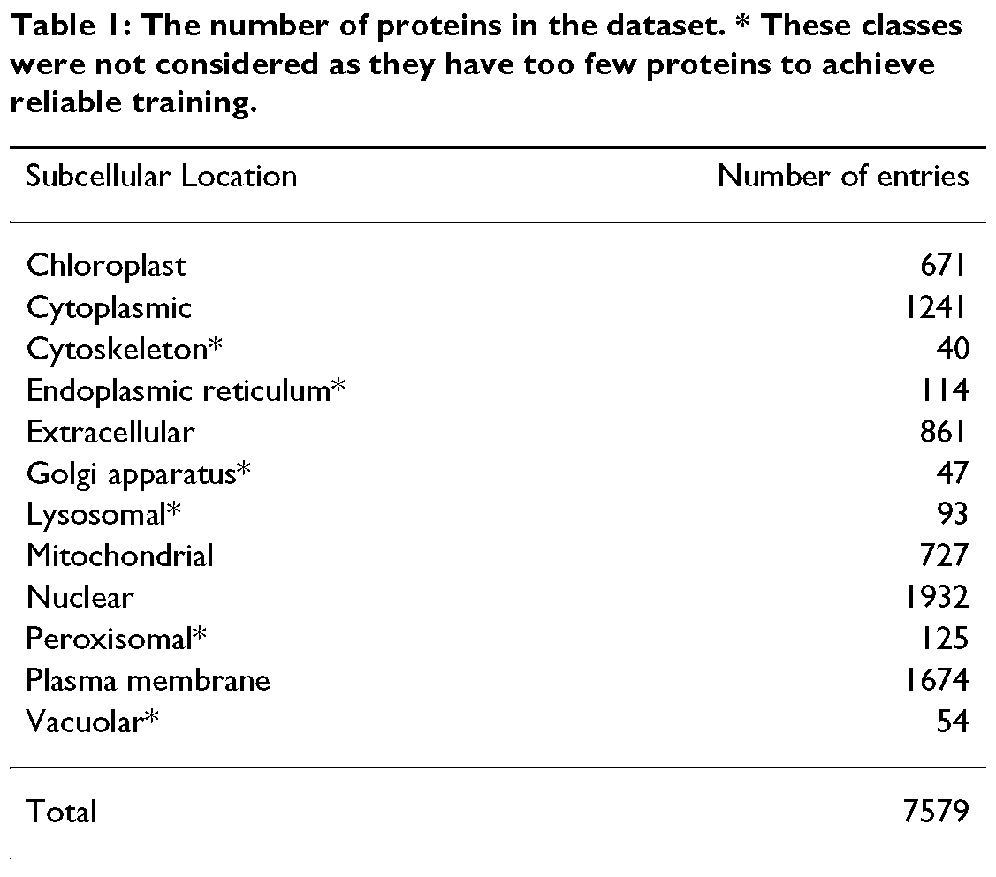
葉綠體
細胞質的
細胞支架
內質網 [細胞]
細胞外的
高爾基氏器官
溶酶體
線粒體
細胞核的
過氧物酶體
原漿膜
空泡的

Slide 6
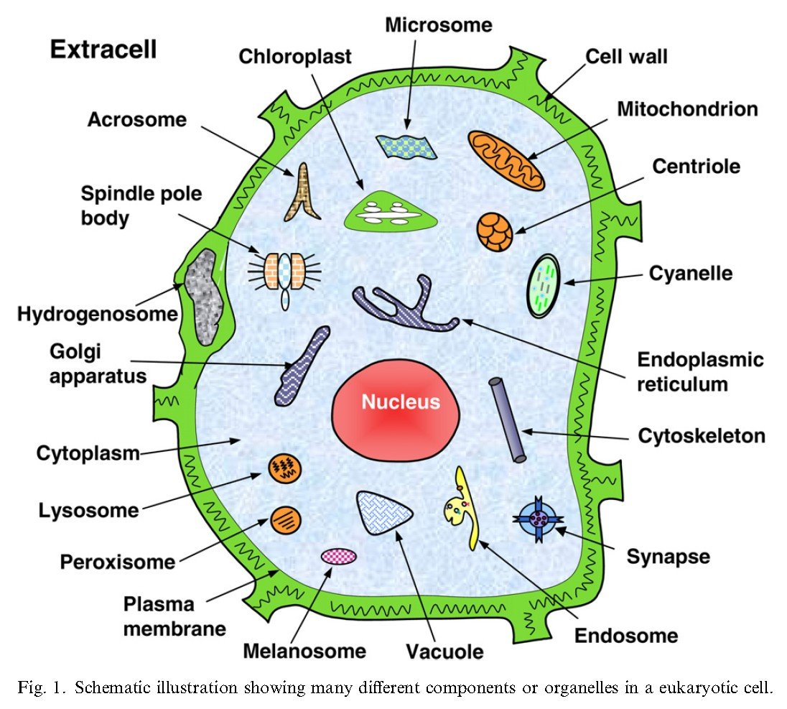
Kuo-Chen Chou et al. “Recent progress in protein subcellular location prediction”

Slide 7
Multi-class SVM
A binary classifier (1-vs-1 method) is constructed for each pair of classes.
A c-class classification problem is transformed into c*(c-1)/2 two-class problems.
The binary decision problems not only contain fewer training examples (because all examples that do not belong to the pair of classes are ignored), but that the decision boundaries of each binary problem may also be considerably simpler

Slide 8
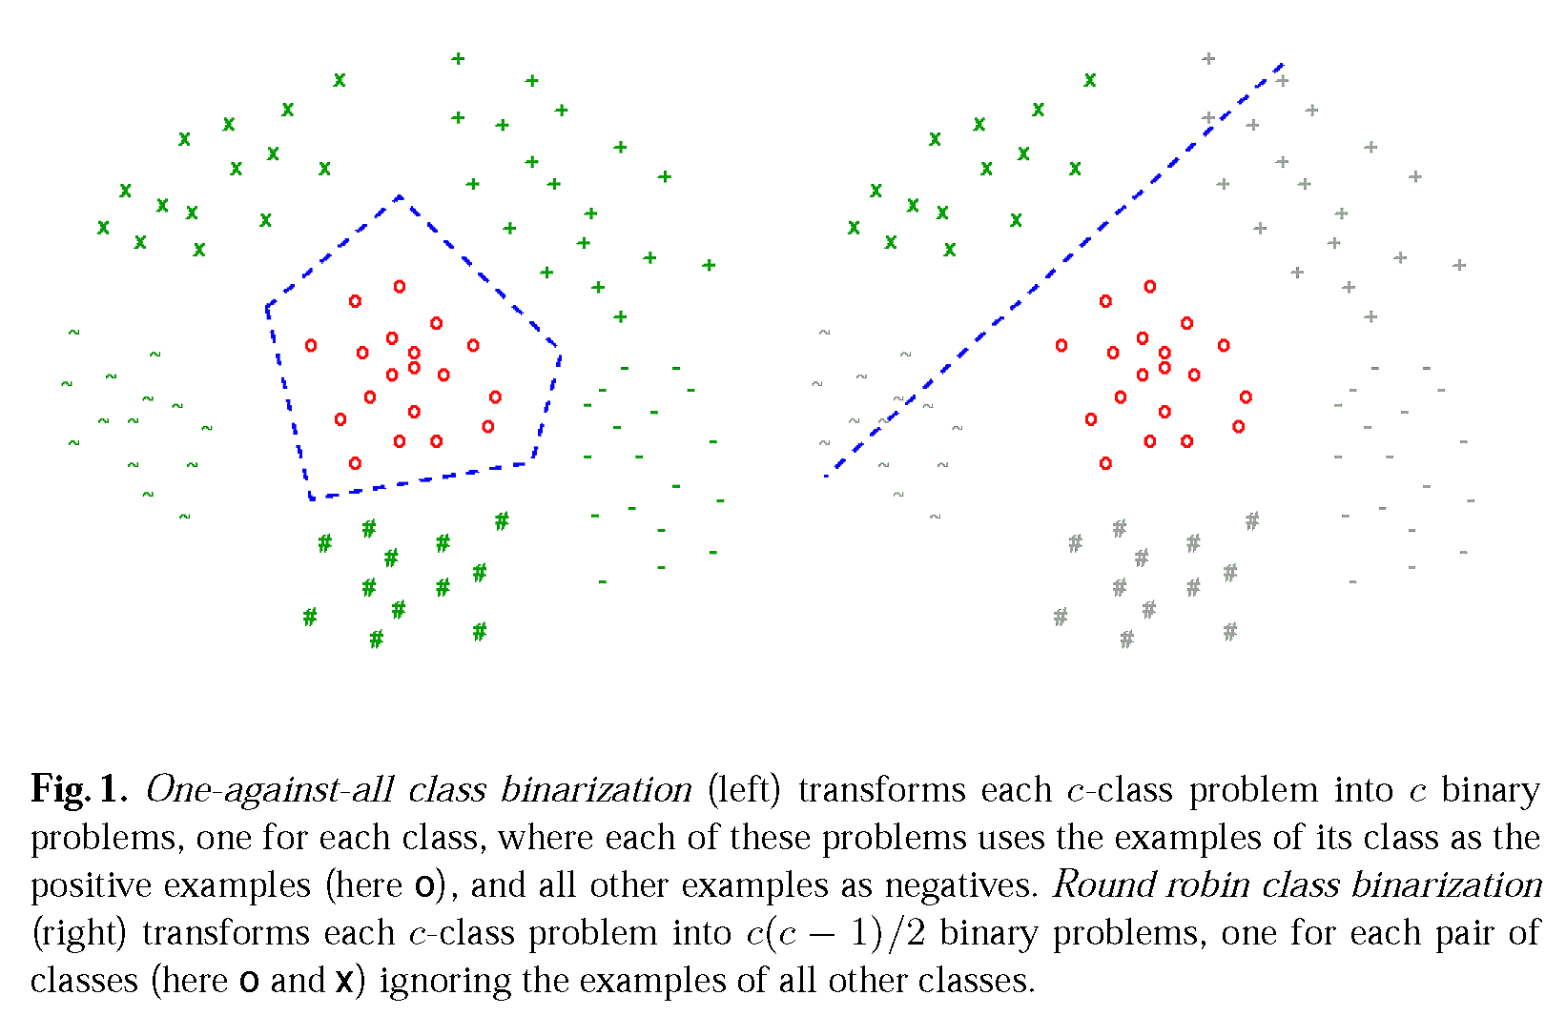
Savicky P, Fuernkranz J, “Combining Pairwise Classifiers with Stacking”

Slide 9
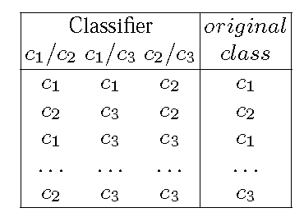
Stacking
Classifier1
Meta-data
Classifier2
Classifier
Output
Meta-
Classifier
Features
…
Classifier
Output
Labels
Output
Classifierk

Slide 10
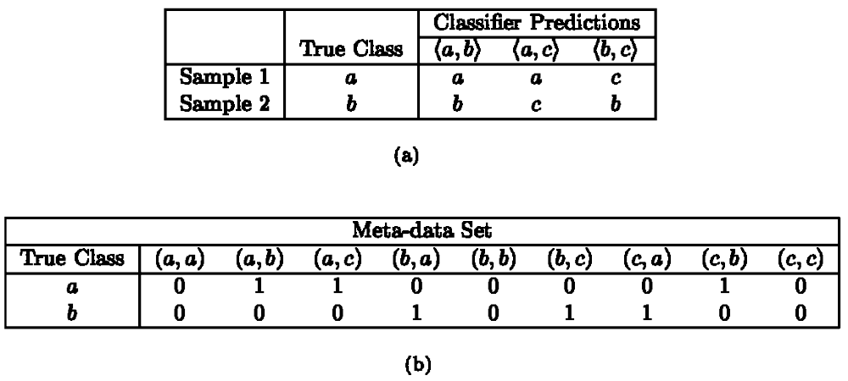
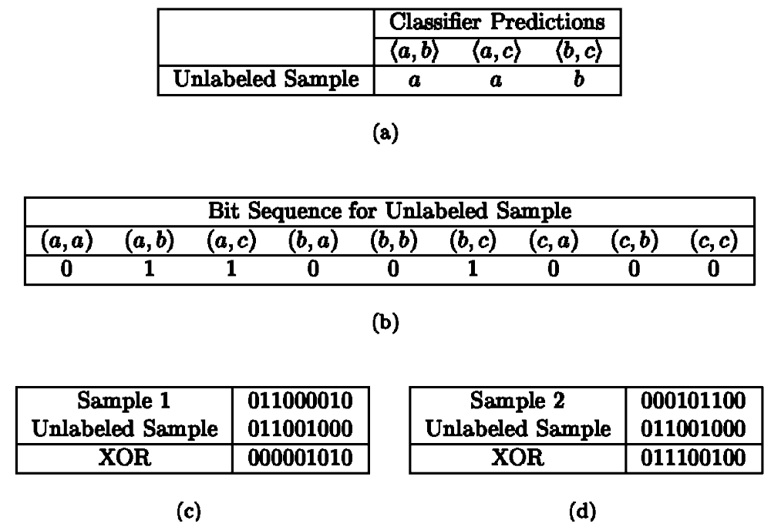
建立meta-classifier
用meta-classifier 預測

Slide 11
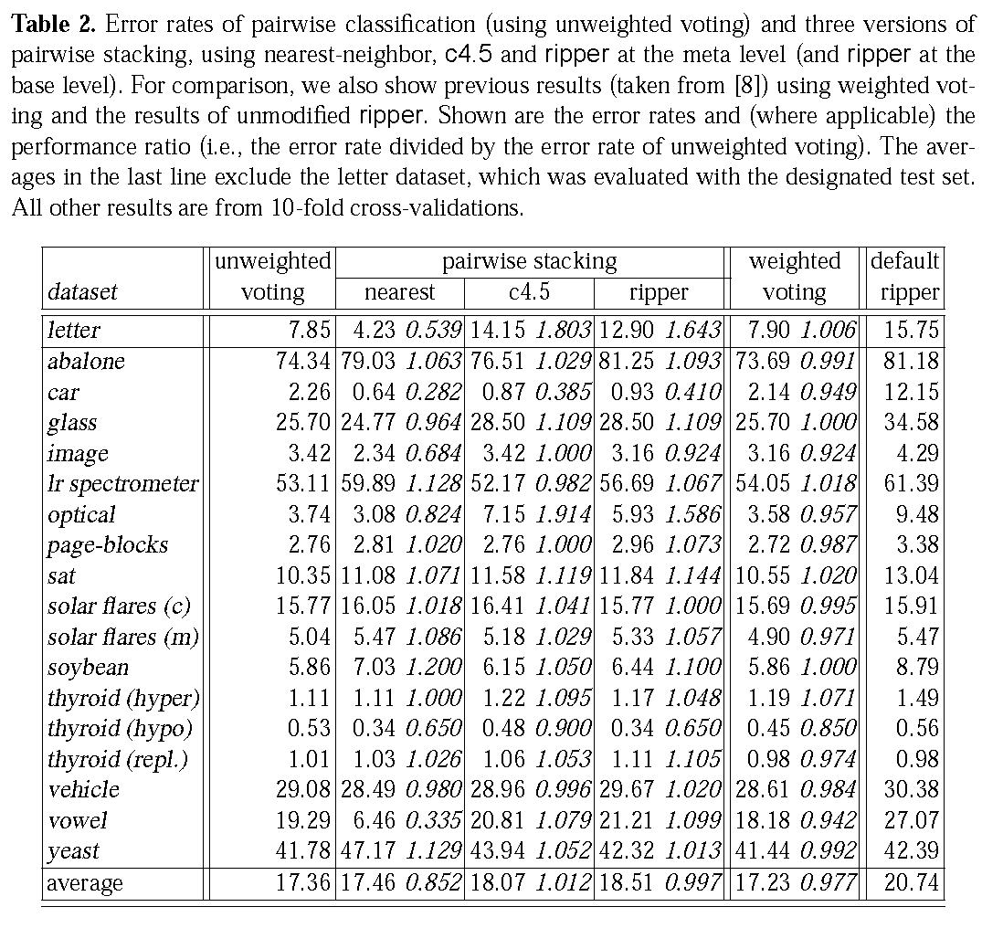
合併方法
整體而言，nearest neighbor合併方法最佳
Savicky P, Fuernkranz J, “Combining Pairwise Classifiers with Stacking”

Slide 12
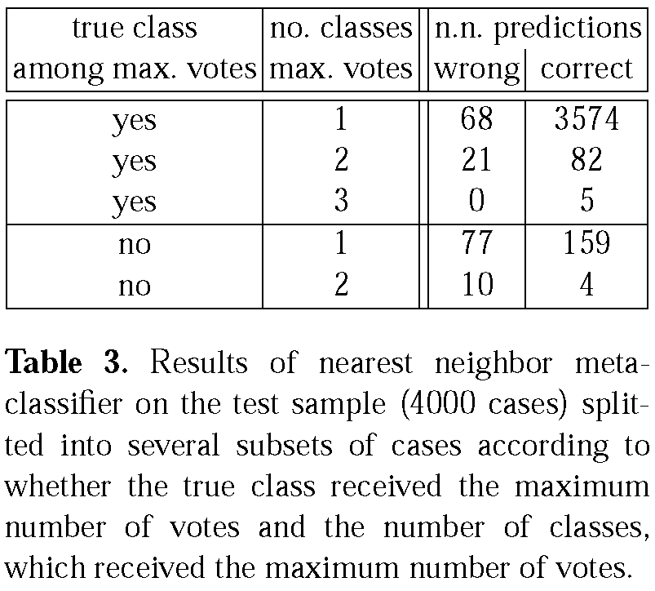
Where NN stacking outperforms simple voting
The last two lines of the table show that nearest neighbor remains relatively succesfull even on cases, where the true class received strictly smaller number of votes than some other classes. Simple voting, of course, cannot predict the correct class for any of these cases.
Savicky P, Fuernkranz J, “Combining Pairwise Classifiers with Stacking”

Slide 13
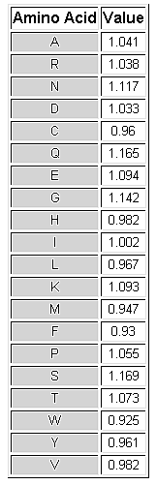
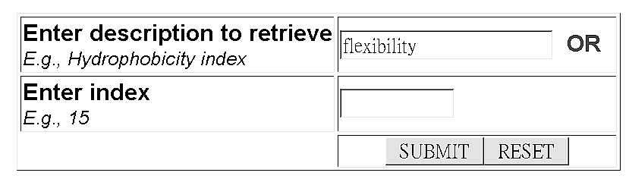
Amino acid physical-chemical properties
Example:
http://www.rfdn.org/bioinfo/APDbase/APDbase.php

Slide 14
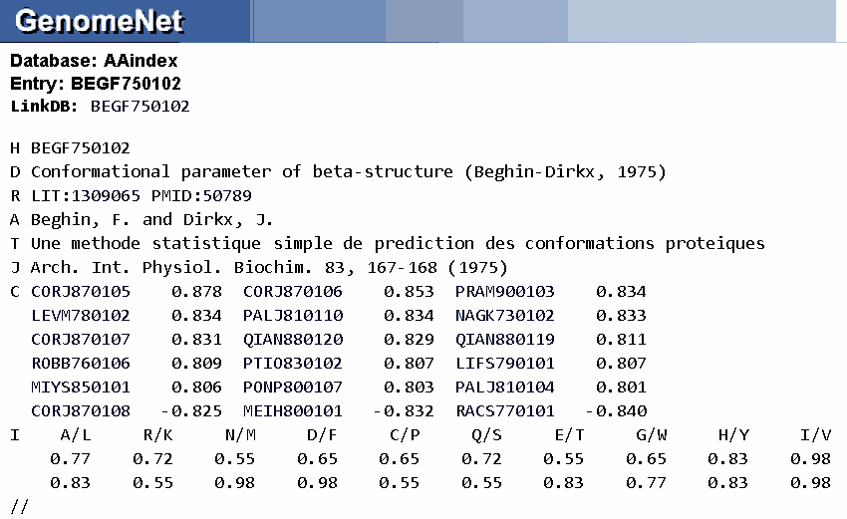
Amino acid physical-chemical properties
Example:
http://www.genome.jp/dbget/aaindex.html

Slide 15
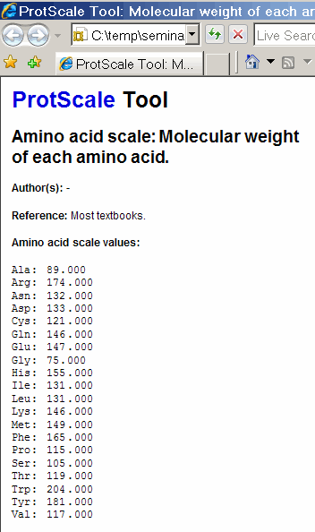
Amino acid Physical-chemical properties
Example:
http://au.expasy.org/tools/protscale.html

Slide 16
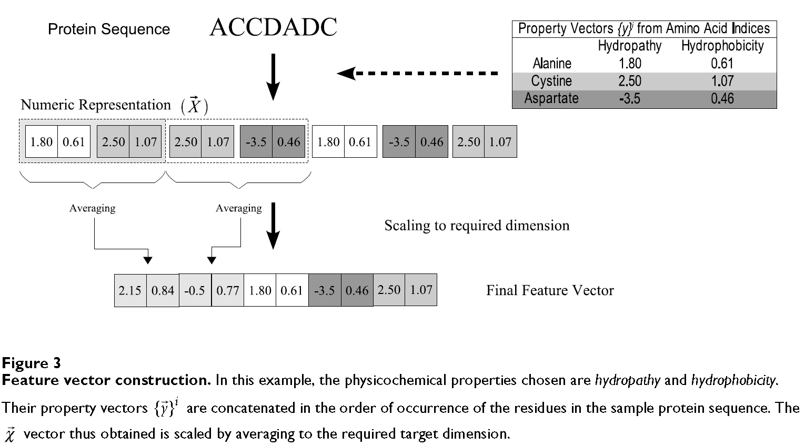
Feature scaling for each series
本文採用
http://www.genome.jp/dbget/aaindex.html 上的484個physicochemical properties

Slide 17
Clustering sequences by length
<=50
Select top 5
p-c properties
Optimize SVM
Cost & gamma
Pick one SVM
Cost & gamma
51~150
Select top 5
p-c properties
Optimize SVM
Cost & gamma
Sequences
151~300
Select top 5
p-c properties
Optimize SVM
Cost & gamma
301~450
Select top 5
p-c properties
Optimize SVM
Cost & gamma
451<=
Select top 5
p-c properties
Optimize SVM
Cost & gamma
Down-sampling the size of the larger class to that of the smaller class

Slide 18
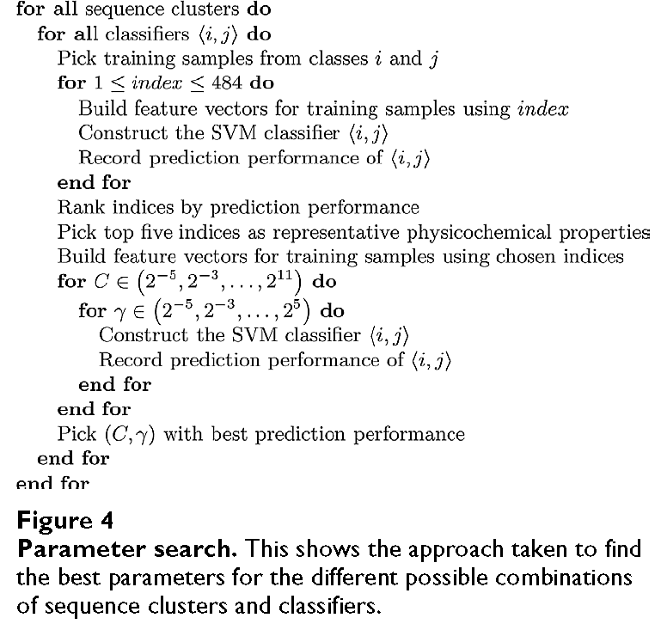

Slide 19
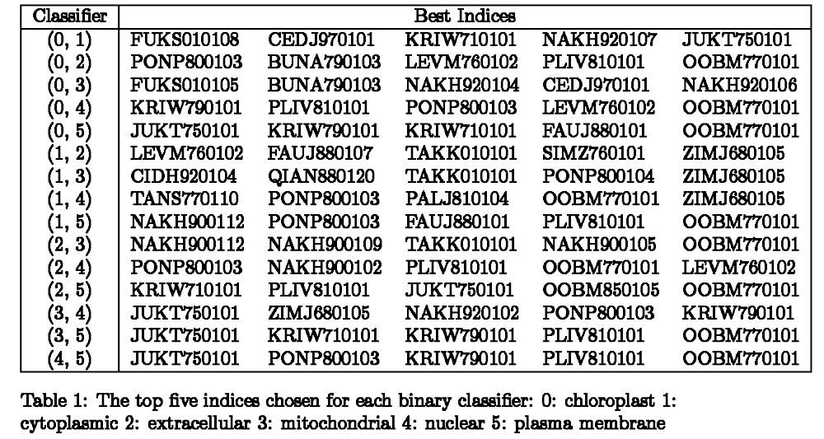
Selected physical-chemical properties
本文採用 http://www.genome.jp/dbget/aaindex.html 上的484個physicochemical properties

Slide 20
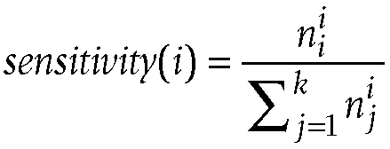
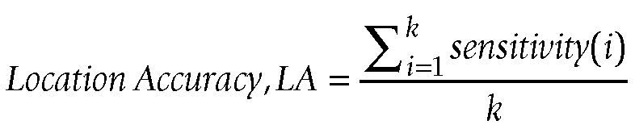
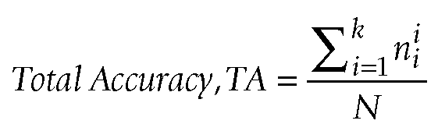
Performance evaluation
N: the total number of proteins in the testing dataset
k: the number of subcellular locations
n^{i}_{j}: the number of proteins of class i classified by the algorithm as belonging to class j

Slide 21
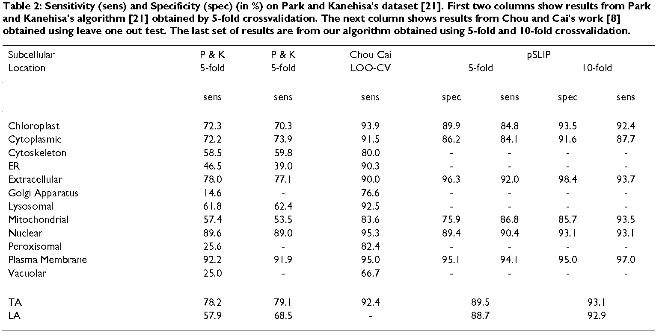
Performance comparison

Slide 22
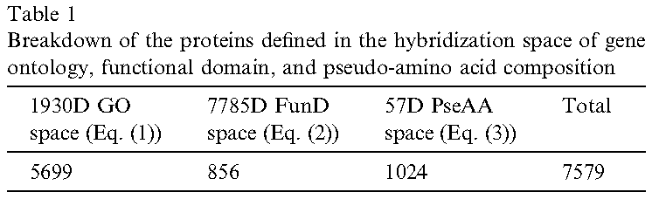
GO–FunD–PseAA predictor
GO?
Sequence
Y
Classify
N
FunD?
Y
Classify
N
PseAA?
Y
Classify

